Slide 1

Summary of the ILC Cryomodule Working Group Meeting Held at CERN
H. Carter
Fermilab
Technical Division

Slide 2
OUTLINE
Some general meeting information
Format of meeting
Meeting goals and details:
  Organizational
  Technical
Interactions
Conclusions

Slide 3
General
Meeting Agenda:
  Monday, January 16
    Introduction and meeting overview H. Carter
    Organizational issues H. Carter
    Institutional Participation Inst. Representatives
    Lunch
    Technical Discussions D. Mitchell, T. Peterson
  Tuesday, January 17
    Technical Discussions T. Peterson
    Lunch
    Continuation of Technical Discussions T. Peterson
    Summary Review H. Carter
    Next meeting
    Adjourn

Slide 4
General
Presentations, task lists, and reference information for the working group discussions can be found at the following URL:
http://indico.cern.ch/conferenceDisplay.py?confId=671

Slide 5
Meeting Format
What the meeting was:
  A working group meeting to discuss the next generation cryomodule (Type IV or T4CM)
What the meeting was not:
  A workshop---there were very few formal presentations and no invited talks

Slide 6
General: Meeting Attendees (25 persons; 9 Institutions)
Name Institution E-mail Comments
Bob Kephart FERMILAB kephart@fnal.gov
Shekhar Mishra FERMILAB mishra@fnal.gov
Harry Carter FERMILAB hfcarter@fnal.gov
Tom Peterson FERMILAB tommy@fnal.gov
Don Mitchell FERMILAB dmitchel@fnal.gov
Rao Ganni JLAB ganni@jlab.org
Joe Preble JLAB preble@jlab.org
Mark Wiseman JLAB wiseman@jlab.org
Rolf Lange DESY rolf.lange@desy.de
Kay Jensch DESY kay.jensch@desy.de
Chris Adolphsen SLAC star@slac.standard.edu
John Weisend SLAC weisend@slac.stanford.edu
Norihito Ohuchi KEK norihito.ohuchi@kek.jp
Carlo Pagani INFN Milano carlo.pagani@mi.infn.it
Paolo Pierini INFN Milano paolo.pierini@mi.infn.it
Nicola Panzeri INFN Milano nicola.panzeri@mi.infn.it
Franco Bedeschi INFN Pisa franco.bedeschi@pi.infn.it
Fabrizio Raffaelli INFN Pisa fabrizio.raffaelli@pi.infn.it
Andrea Basti INFN Pisa andrea.basti@pi.infn.it
Bernard Rousselet CEA Grenoble brousset@cea.fr day 2 only
Laurent Tavian CERN laurent.tavian@cern.ch part of time
Vittorio Parma CERN vittorio.parma@cern.ch
Cedric Garion CERN cedric.garion@cern.ch part of time
Stefano Sgobba CERN stefano.sgobba@cern.ch part of time
Gilles Favre CERN gilles.favre@cern.ch part of time

Slide 7
The path to this point
1st Cryomodule meeting at SLAC (Oct. 2004)
  working group formed to begin identifying the “next generation” cryomodule design issues
2nd Cryomodule meeting at the SMTF Collaboration meeting at Fermilab (Oct. 2005)
  continued working group discussion of features to be incorporated in T4CM
  created rough estimate of the time required to complete the T4CM design
Other relevant meetings----Snowmass 2005 and the recent Frascati meeting

Slide 8
Goals for the meeting were:
Formation of an international T4CM design team
  This did not mean a “design by committee”
Definition of what a T4CM is
  What items are incorporated from the possibilities
Identification of a comprehensive list of tasks to be accomplished
Creation of work packages to address tasks
Assignment of work packages to T4CM design team members
Establish a timeline for T4CM design completion

Slide 9
Organizational Issues
Design team formation
  Regional structure and leadership
    Sort of a “mini-GDE” structure
    Need to identify regional leader(s)
Design tools, standards, and data exchange
  Should design tools be common or regional in nature?
  What design standard(s) should be used?
    Example: Type III+ cryomodule vs. FNAL design requirements
  What format should be used for data exchange?
Integration issues
  to be coordinated by regional leadership
  information exchange

Slide 10
International Design Team Formation (Proposal)
T4CM Design Team
T4CM Americas
T4CM Europe
T4CM Asia
FNAL
KEK
CERN
DESY
JLab
Others?
Milan
SLAC
INFN
Pisa

Slide 11
Institutional Participation in T4CM
At this point representatives from each institution (listed below) were invited to give brief presentations: the order was be alphabetical, except I presented Fermilab’s plan last:
  CERN V. Parma
  DESY R. Lange
  INFN Milan C. Pagani
  INFN Pisa F. Bedeschi
  JLAB J. Preble
  KEK N. Ohuchi
  SLAC J. Weisend
  FNAL H. Carter
Speakers were asked to address:
institutional resources
resource availability
tasks which they are interested
in working on

Slide 12
Institutional Participation in T4CM
CERN: V. Parma stated that the majority of the CERN ILC effort would remain concentrated on the cryogenic systems design effort. He did volunteer some of his time to look at the cryomodule interconnection area, based on his experience with LHC interconnects.
DESY: R. Lange stated that as the SRF cryomodule seat of knowledge for 1.3GHz cryomodules, DESY’s future role in ILC cryomodule development will be one of consultation and knowledge transfer to those directly working on the new generation designs. Of course, the primary role of DESY in the future will be the XFEL project. Claudia Engling is developing a full 3-D model of the Type III+ cryomodule, which will be available shortly. A portion of TTF operations (up to 30%) may be devoted to ILC studies.

Slide 13
Institutional Participation in T4CM
INFN-Milan: C. Pagani
  He and his team have already begun a T4CM solid model based on their experience with the Type III and III+ designs (see next slide)
  He expects that he can have documentation and fabrication drawings by end 2006

Slide 14
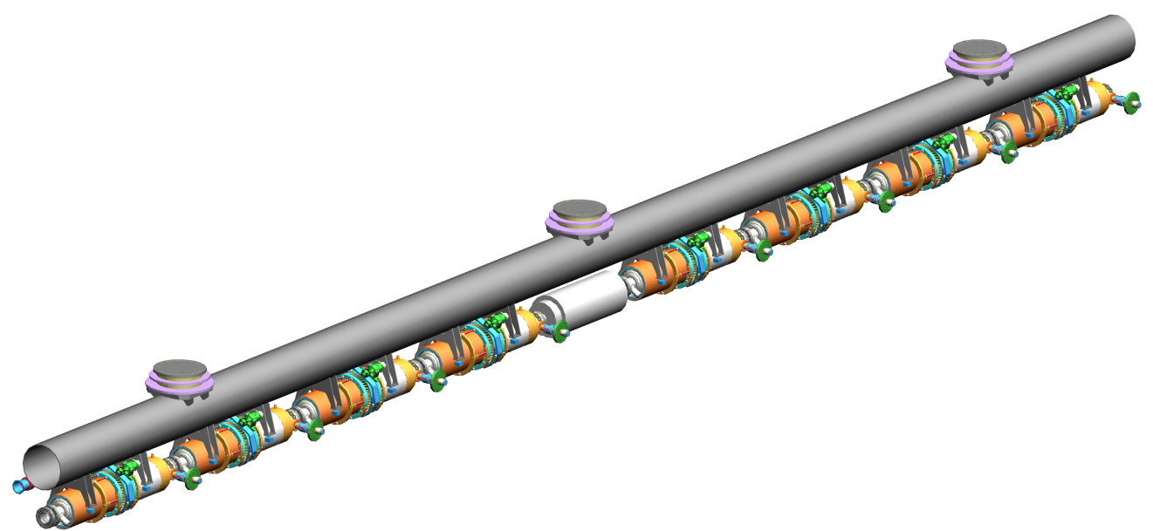
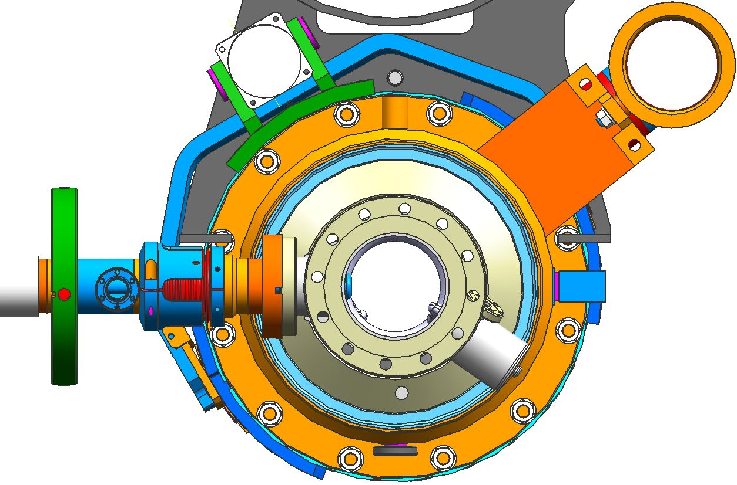
3D Parametric Model well advanced
Starting from “original” INFN CRY3 AutoCAD DWGs used for all modules fabrication
Rebuilding a CRY3 with “symmetric” quasi TESLA TDR string (8)
Using Unigraphics NX3
8 cavities per cryomodule
Verified construction drawings from the 3D model
CRY3 fabrication experience included
QA/QC implemented from ZANON construction
from C. Pagani’s talk

Slide 15
Institutional Participation in T4CM
INFN-Pisa: F. Bedeschi
  As the CMS work they are presently engaged in starts to wind down in approximately four months, INFN-Pisa is very interested beginning SRF cryomodule work.
See next 3 slides

Slide 16
INFN-Pisa: General goals (1)
Long term goals:
  Major participation in the design and construction of the ILC cryomodules and their control systems (WPM, Piezo control, LLRF)
  Establish R&D program with Italian industries to prepare for future participation in mass production of mechanical and electronic parts
  Contribute to commissioning of cryomodule test facilities

Slide 17
INFN-Pisa: General goals (2)
Short term goals (mechanics only)
  Improve current existing cryomodule design in close cooperation with the INFN-Milan group
    Imported parametric 3-D model with central quadrupole package from Milan
    Started calculations on various aspects of this design
    Aim to have updated design by end of 2006
  Cryomodule mockup construction in Pisa
  Participate in monitoring of cryomodule construction at Zanon this spring

Slide 18
Manpower at INFN-Pisa
Situation for mechanical work on cryomodules
  3 Physicists
  2 staff engineers
  2 young engineers
  1 designer
Current involvement ~ 20% for most people
  Growing during 2006 as other activities ramp down
Good support from INFN
  Expect manpower to grow if needed

Slide 19
Institutional Participation in T4CM
JLAB: J. Preble
  Emphasized cryomodule experience on
    SNS – five year project
    CEBAF, including three upgrade cryomodules
  Expressed Further Areas of ILC interest
    Cavity development, design, and optimization
    Cavity manufacturing and processing
    Tuners, slow and fast
    Manufacturing and assembly, industrialization
    System integration
      Cryogenic, RF and controls, interlocks…

Slide 20
Institutional Participation in T4CM
KEK: N. Ohuchi stated that they will continue their plans for their four-cavity cryomodule development for Phases I and II for the STF. This cryomodule is meant to be a cavity test vessel rather than an ILC cryomodule. As they begin Phase II, they will be more interested in the T4CM design effort, but in the interim, they will collaborate on areas of common interest including couplers, tuners, and cavity processing.

Slide 21
Institutional Participation in T4CM
SLAC: J. Weisend
  Staff resources
    1 – 2 cryogenic engineers
    0.5 designers
    Technicians for construction and operation of cryogenic experiments
    Physicists and technicians for designing and conducting precise magnetic measurements
    Physicists, engineers & technicians for designing and testing prototype beam line components

Slide 22
Institutional Participation in T4CM
SLAC: J. Weisend
  Facilities
    Precision magnetic measurements lab
    Currently being upgraded to allow testing of superconducting magnets
    Cryogenics lab for small scale tests of components (current leads, supports, small magnets etc)
    Up to 1 kW of 4.5 K refrigeration available
    Some He II capacity. Much more could be provided via a straightforward upgrade
    End Station A allows beam tests of prototype ILC components.
    Testing at 4.2 K possible now.
    Testing at He II temperatures is possible if additional upgrades are made.
    Strong capabilities in research support (safety, rigging, instrumentation, DAQ, alignment etc)

Slide 23
ILC Americas T4CM Design Team
Task Manager: T. Peterson
  Task Engineering: D. Mitchell: Mechanical design
T. Nicol: Cryostat & supports
  M. McGee: Vibration measurement & analysis S. Tariq: FEA analysis of mechanical components (tuners,cavities, etc.)
  J. Tompkins: SC quadrupole & correctors
  V. Kashikin: SC quadrupole & correctors
  J. Weisend: Cryostat & cryogenics
  K. Jobe: Cryostat & cryogenics
  Task Designer(s): Contract Designers
  Task Scientific Input: H. Edwards / S. Mishra/ K. Ranjan/ N. Solyak/ Paul Lebrun / H. Padamsee
Deliverable: Complete T4CM drawing package ready for procurement by end of CY07

Slide 24
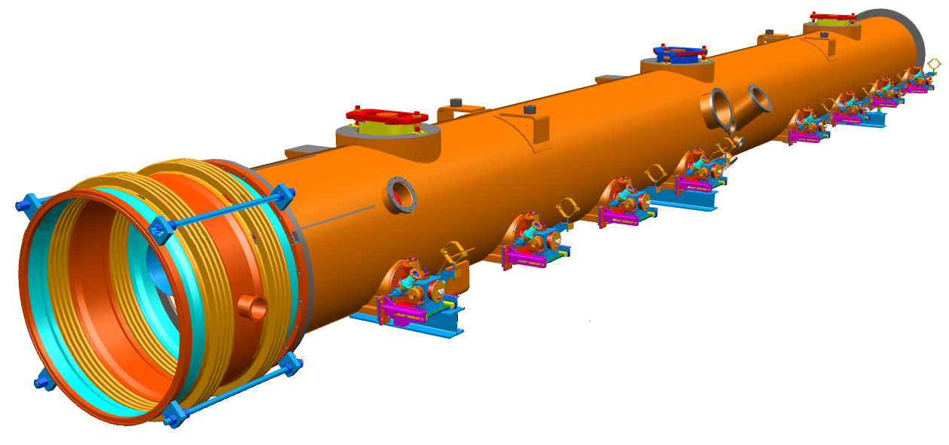
Technical Details
Don Mitchell Presented a Conceptual T4CM 3-D Model

Slide 25
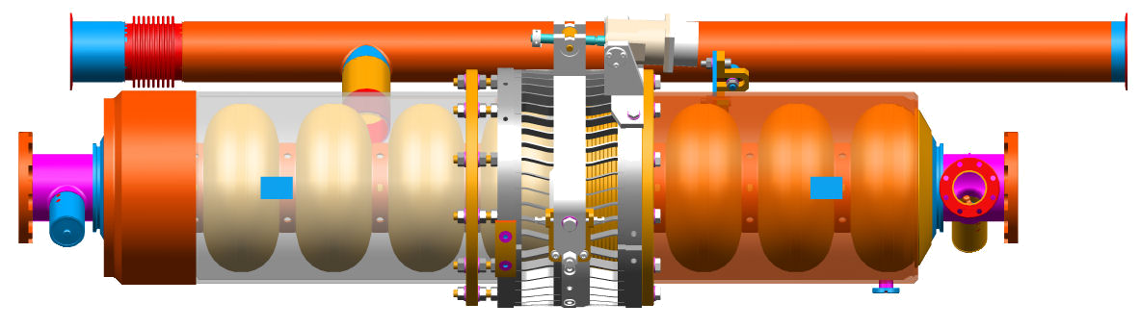
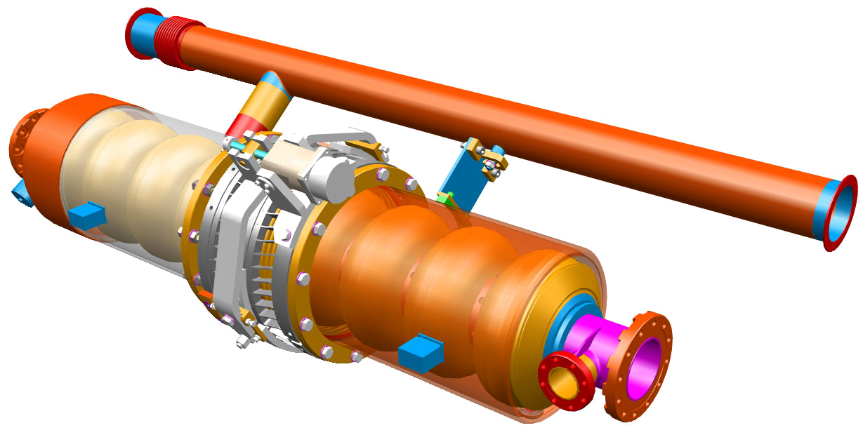
T4CM Proposed Cavity w/ Bladetuner
from D. Mitchell
presentation

Slide 26
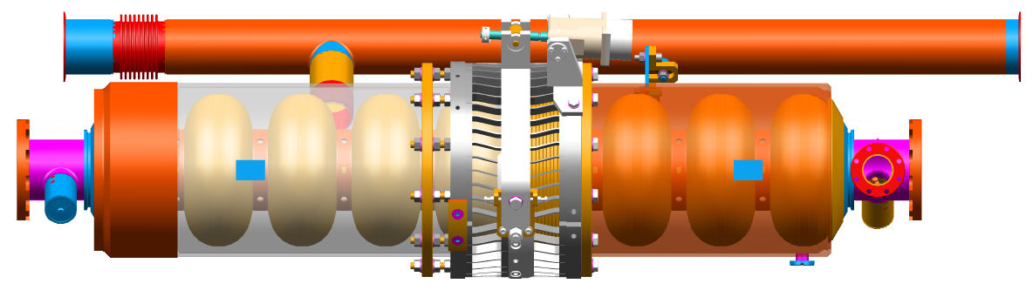
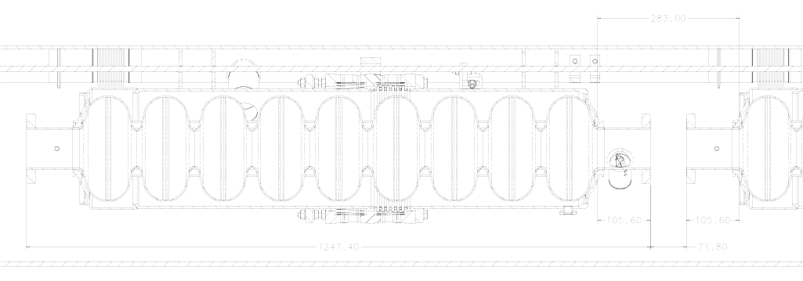
Cavity Dimensions

Slide 27
Technical Details
Tom Peterson led the T4CM Task List Discussion supplemented by a comprehensive 100-slide presentation
The task list is presented in the next few slides

Slide 28
T4CM Task List
Begin a type IV 3-D model and drawing set by importing those features that will remain the same as type III+. Type IV cryomodule will include the following features from Type III+ :
  Same vacuum vessel diameter and cavity centerline location
  Same support posts
  Same cavity support detail (with roller bearings and invar rods)
  Same input coupler (Type III/XFEL) at least in terms of mounting and interface to vacuum vessel, cavity, and thermal shields
  Who: KEK, DESY, Fermilab, INFN. Parallel efforts to obtain consistent model
Decide on pressure drop criteria and pipe sizes for the modules. Thermal shield pipe sizes increase to accommodate high flows and long spacing. Evaluate in conjunction with the development of a cryogenic system layout.
  Who: CERN, Fermilab, DESY
Design of a segmentation “spool” piece. Segmentation of the cryomodule strings, or some other means by which to enable warming up of relatively short sections of the linac.
  Who: SLAC, Weisend; Fermilab, Klebaner

Slide 29
T4CM Task List
Design the intercavity connecting flange and bolting arrangement, detail the new spacing. Cavity iris-to-iris spacing reduced to 283 mm. This is ongoing work but has been moving slowly due to limited resources. Salman Tariq has some confidence that modifying the existing design will work, but it would also be worthwhile to begin exploring quick disconnect options. By late summer next year, we hope to have the modified design analyzed and a prototype built & tested. Getting another engineer involved to look at quick disconnect options might be worthwhile.
  Who: KEK, (Jlab), CERN, INFN, Fermilab
Modify the slow tuner design to allow closer cavity-to-cavity spacing, integrate with fast tuner effort Could mean switching to blade tuner design. Could have a few parallel tuner efforts with a later selection of the tuner. Tuner motor reliability, replacement, repair or location (warm, cold intermediate, accessible, etc.) is an issue for review. Salman Tariq: “We have been conducting an extensive R&D effort on slow/fast tuning utilizing Capture Cavity 2 and Saclay lateral tuner, hoping to understand as much as we can about the system. Several individuals have been involved from both TD & AD.”
  Who: INFN, Fermilab, KEKType IV coaxial tuner

Slide 30
T4CM Task List
Modify the fast tuner design for proper piezo functionAlso consider modifications to the design for magnetostrictive fast tuner. Salman Tariq: “We have made decent headway and are working towards studies incorporating magnetostrictive actuators.”
  Who: INFN, KEK
Design the support details for locating quad/corrector/BPM package under center post, but still hung from 300 mm tubeThe quad/corrector/BPM package is a major unknown right now, we need information. Could have some parallel quad support concepts under development by different groups for later selection. Also consider external support location impact on quad/BPM alignment.
  Who: INFN, Fermilab, KEKPart of the parallel modeling efforts
Select some possible quadrupole current leads and work out configurations for integration into module. The quad current leads may be new and different from TTF type III, with local impact on thermal shields and vacuum vessel ports, and we need provisions for quad power lead connection.
  Who: CERN, Fermilab, KEK
Vibrational analysis of the quad and cavity support structure. Analyses should be compared to measurements for verification of the model for future design work.
  Who: INFN, Fermilab

Slide 31
T4CM Task List
Design for stability with shipping, analysis of shipping restraints and loads. Need to define shipping methods and requirements.
  Who: DESY, Fermilab
Active mover design. The task could start with an attempt to determine the need (or not) and specification for active movers. However, I (Peterson) do not believe we will incorporate active movers in Type IV.
  Yes, longer-term parallel effort
Conceptual design of separate quad cryostat. An alternative, not part of the baseline type IV configuration, but it offers some advantages for standardizing modules and flexibility with respect to quad package variations and quad alignment.
  Who: Fermilab Nicol; Longer-term
Design module end to accommodate the input coupler at the far end of the cryostat. All modules through type III+ included a quadrupole on the input coupler end of the last module. Without the quad, the last input coupler interferes with the vacuum flange. Some extra module length may be necessary.
  Who: INFN, Fermilab. Parallel efforts, part of modeling effort.

Slide 32
T4CM Task List
Module-to-module interconnect design. The interconnect must include the 2-phase pipe to 300 mm pipe cross-connect and an HOM absorber on the beam pipe. We want minimum length in order to maximize linac packing factor.
  Who: CERN, INFN, Fermilab, Part of modeling effort with input from CERN,
Module slot lengthsNeed to define a set of module slot lengths (with and without quad as a minimum) for the GDE RDR effort. This is a “bottom line” based on preliminary estimates for many of the above numbers.
  Who: INFN, Fermilab. Outcome of modeling effort.
Develop module test plans and module component test plans. Consider not only what must be done on a module test stand, but also what earlier tests of the module and module components should be done for QA, QC, and understanding module performance.
  Who: DESY (XFEL), and all

Slide 33
T4CM Task List
Design of instrumentation for installation into the module. Wire position monitor details or another system to verify cavity positional stability with thermal cycles, thermometry, etc.
  Who: DESY (XFEL), and all
Magnetic shielding. Review present practices, make changes to incorporate blade tuner design. Explore alternate concepts such as internal helium vessel shield proposed by KEK.
  Who: KEK, DESY, and all

Slide 34
Arriving at a T4CM Design
1st Qtr
2nd Qtr
3rd Qtr
4th Qtr
1st Qtr
2nd Qtr
3rd Qtr
4th Qtr
1st Qtr
2006
2007
2008
Define design features
Perform engineering analyses
Complete drawing packages
Procure components
All Components in house and ready for assembly

Slide 35
Who will build the T4CM?
FNAL plans:
  The third cryomodule to be assembled at Fermilab will be a T4CM design, incorporating a quadrupole/BPM package if one is available at the start of construction, otherwise a predetermined space will be left for this package and an instrumented mockup (correct size and weight) will be installed.

Slide 36
Schedule for CM Assembly at FNAL
1st Qtr
2nd Qtr
3rd Qtr
4th Qtr
1st Qtr
2nd Qtr
3rd Qtr
4th Qtr
1st Qtr
2006
2007
2008
1st T3CM from
DESY kit
3.9GHz CM for
DESY TTF
2nd T3CM from
FNAL components

Slide 37
Who will build the T4CM?
DESY plans:
  The next cryomodule to be assembled at DESY will be a Type III+ design, designated Cryomodule #6, and will contain 8 cavities with accelerating gradients of > 35MV/m.
  After Cryomodule 6, a spare Type II cryo-module for TTF, designated Cryomodule #7, will be assembled, then the “kit” for the first FNAL cryomodule will be assembled

Slide 38
Who will build the T4CM?
KEK plans:
  Phase 1: KEK is currently working on a cryomodule design that they plan to assemble at KEK in 2006. This cryomodule will contain 4 cavities of the low loss design with accelerating gradients of > 35MV/m.
  Phase 2: Two such cryomodules are planned to be built, joined together, and tested.

Slide 39
BCD Cryomodule:
The T4CM rather than the Type III+ cryo-module has become the design adopted in the BCD:
  283 mm cavity-to-cavity spacing
  coaxial slow tuner design
  quadrupole in center of an 8-cavity cryomodule
Main linac quadrupole spacing
  32 cavities per quadrupole (24 recommended by WG1)

Slide 40
BCD: Cryomodule configuration
Baseline
10MW klystron drives 24 TESLA cavities.
considering 7% WG loss and 11% overhead for 35MV/m operation
Cavities divided into three cryomodules,
Quad package in every 4th cryomodule,
Cos(2φ)type Quad + corrector windings+BPM,
supported from GRP at center post,
<10µm bunch-to-bunch resolution BPM
Cavity spacing 283mm
Contradiction with GG2-BCD!
this slide taken from H. Hayano’s talk
“BCD Input from WG2”

Slide 41
ACD: Cryomodule configuration
Alternatives
12 cavities in one cryomodule,
Cavity spacing 250mm~180mm,
HOM readout,
Quad-BPM in separate cryostat,
Putting movers on center support post
and cryomodule support,
Reduce Quad aperture to ~35mm,
1µm resolution BPM
this slide taken from H. Hayano’s talk
“BCD Input from WG2”

Slide 42
General Interactions
Critical items for other linac work to proceed
  cavity length
  cavity-to-cavity spacing
  Quadrupole/corrector/BPM package design
  overall cryomodule length:
    required in order to define main linac layout for lattice considerations
    required to define civil construction and cryogenic system requirements

Slide 43
Interactions: ILC Linac Layout
Per request from Chris Adolphsen:
  One of the goals of the GDE meeting at KEK on Jan 19-20 is to better define the ILC linac layout. To this end, we have been asked to provide working assumptions as to:
    1) the length of cryomodules with and without quads
    2) the external support of cryomodules (e.g. from the floor or ceiling)
    3) beamline and insulating vacuum segmentation
    4) cryogenic maintenance length and the additional space
    required between segments
    5) the space required to convert from cold to warm sections
    6) the refrigerator spacing, capacities and space requirements
We answered most of these items at this
meeting but not all could be answered at that time

Slide 44
Interactions: Additional goals from Chris Adolphsen---RDR module and cryosystem definition
Length of cryomodules with and without quads
  Answer: 12565 mm with a quad and 11271 without a quad
External support of cryomodules (e.g. from the floor or ceiling)
  Answer: from the floor until forced otherwise
Beamline and insulating vacuum segmentation
  Answer: segmentation box every 500 meters
Cryogenic maintenance length and the additional space required between segments
  Asnwer: segmentation box of one module slot length every 500 m
Space required to convert from cold to warm sections
  Answer: 1.5 meter transition
Refrigerator spacing, capacities and space requirements
  Results to come from cryogenic system effort
from Tom Peterson’s
presentation

Slide 45
Interactions in support of RDR effort
RTML: P. Tenebaum has requested coordination of our efforts with the Ring-To-Main-Linac efforts. He states that the
  RTML includes 4 cryomodules in its first-stage bunch compressor (BC1) and 57 cryomodules in its second-stage compressor (BC2), for a total of 61 modules per side (e⁻ side and e⁺ side)
  RTML cryomodules do not need to be operated at 31.5 MV/m, but will be standard main linac cryomodules that are always run at lower gradients
  Possibility of one or two crab cavity cryomodules per side for beam diagnostics and other longitudinal diagnostics

Slide 46
Interactions in support of RDR effort
BDS: A. Seryi has requested information in support of the crab cavity for the Beam Delivery System
  The crab-cavity is the only SCRF cryomodule in the BDS
  Basic parameters of the crab-cavity are given in BCD. We believe that the crab-cavity will be based on Fermilab CKM 3.9GHz deflecting cavity, however, design may be reoptimized.
Work needed to be done includes:
  Defining specifications for the crab-cavity
  Developing the design for the RDR
  Producing the cost estimates.
Crab cavities are not a topic of discussion for this meeting
however I include this request in case someone here is
interested on working on this problem.

Slide 47
Arriving at a T4CM Design (Revised)
1st Qtr
2nd Qtr
3rd Qtr
4th Qtr
1st Qtr
2nd Qtr
3rd Qtr
4th Qtr
1st Qtr
2006
2007
2008
Define design features
Perform engineering analyses
Complete drawing packages
Procure components
All Components in house and ready for assembly

Slide 48
Conclusions: Did We Achieve the Goals for this Meeting?
Formation of an international T4CM design team
  Not exactly---
    But we have identified broad institutional interest in participation
    Is an international team approach the right organizational model for this effort?
    Do we need to establish regional coordinators ?
    Should we only have discrete work packages with one coordinator/integrator?
Definition of what a T4CM is
  Yes, we agreed that at the very least, the T4CM should include the following features:
    283mm cavity iris-to-iris spacing
    quadrupole in the center of the cryomodule beneath the center support post
    the space alloted for the quad/corrector/bpm package is 1200mm
    coaxial tuner

Slide 49
Conclusions: Did We Achieve the Goals for this Meeting?
Identification of a comprehensive list of tasks to be accomplished
  Yes
Creation of work packages to address tasks
  Need to define scope of work for each task in order to create work packages
Assignment of work packages to T4CM design team members
  Not assignment at this time, but rather expressions of interest by institutions
Establish a timeline for T4CM design completion
  Not a firm timeline---a range of 12-24 months is still anticipated

Slide 50
Conclusions:
Future Meetings
  We agreed that we need to establish video conferencing as soon as possible in order to coordinate efforts on tasks
  The next face-to-face meeting will be after the Bangalore GDE meeting
Summary
  In all, this was a very useful meeting
  We still have a lot of work to do, but we have a plan for accomplishing this work
  We need to follow up quickly to establish the work packages in order to capitalize on the forward momentum this meeting generated

