Slide 1
Active Vibration Compensated Stabilized (AVCS)
Interferometry
John Hayes, Ph.D.

Slide 2
Outline
The problem…
  Vibration is a problem when testing large mirrors
  Can we build an interferometer that cancels vibration?
Review the concept…
  Jim Burge and his students showed it is possible
  Review how it works
Status of the AVCS prototype project...
  Show some results
  Discuss performance & limitations

Slide 3
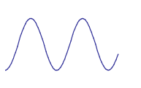
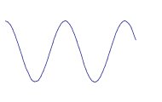
Vibration Compensation Concept
Example: Twyman-Green configuration
  Sense optical phase
  Feedback out-of-phase signal to phase shifter
Jim Burge’s System
  Point sensor
  High speed temporal modulation to sense phase
Problems
  Lower contrast signal
  “Slow”
(Limited bandwidth)
PZT
DRIVER
PZT
Reference
Mirror
Vibration
Single Mode Laser
BS
Lens
Pupil Image Plane
Controller
“Point” Phase Sensor
Anti-Vibration Signal
Vibration Signal

Slide 4
High Speed Phase Modulation
Use polarization Twyman-Green configuration
EOM changes relative phase between ‘S’ & ‘P’ components
  Fast: 200 kHz - 1 GHz response
  Conoptics model 370 with model 302 driver gives 200 kHz
Reference
Mirror
EO
Modulator
S
QWP
P
Single Mode Laser
HWP
PBS
Diverger
Optics
Pol
Pupil Image Plane
Test
Mirror
Controller
& Driver
Point Phase Sensor

Slide 5
High Speed Phase Sensor
Use polarization optics to create four phase shifted fringe patterns
  We will look at how this works shortly
Use four single point detectors
  Align detectors to the same image point
  Compute phase in “real time” with controller
Proportional control loop to drive the phase modulator
  100 MHz 80486 computer running DOS (!)
  Achieves 10-12 kHz control loop speed

Slide 6
Piston Correction Control Loop
EO Modulator
A
Phase
Sensor
B
Test Beam
C
D
CCD
Standard WYKO
PC, Interface Boards,
and Vision Software
…should work with
“any” package
H/S 4 ch A/D
Framegrabber
EOPM Driver
100 MHz
80486
Computer
Pentium PC
COMPUTER
Set Point
Signal

Slide 7
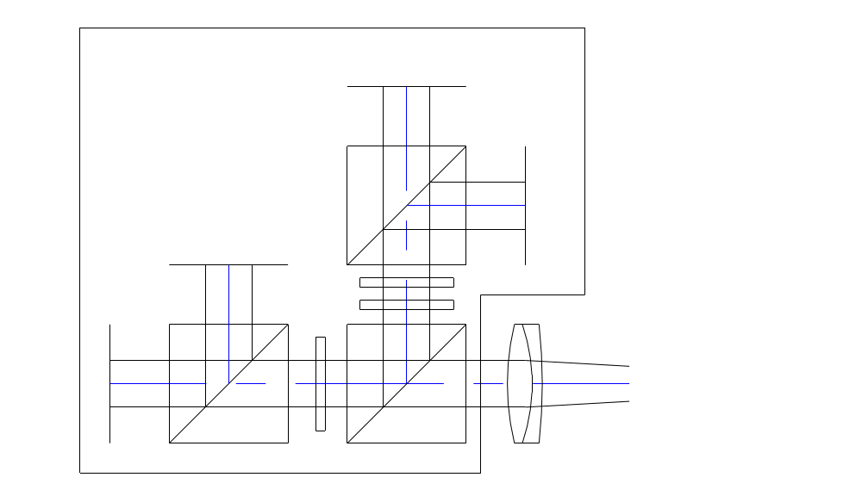
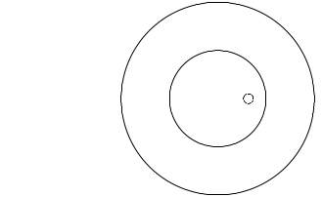
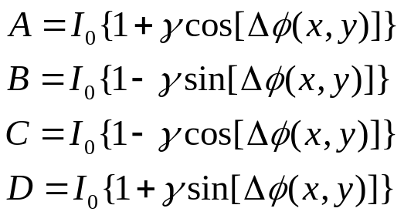
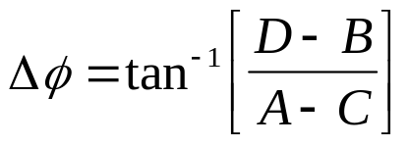
Phase Sensor Optical Layout
UDT, PIN-0202A (4X)
Mounted on linear stage
to allow detectors
to be positioned
along pupil radius
Mounting Plate
90°
Pupil Image plane
PBS
Pupil Image plane
180°
270°
5 mm
Diameter
(1/2 pupil)
HWP @ 22.5 deg
PBS
BS
QWP @ 0 deg
0°
10 mm
Diameter
(Full pupil)
0.51 mm
Diameter
Detector
HWP @ 22.5 deg
Requires fringe density to be
less than 10 fringes/radius at
the detector

Slide 8
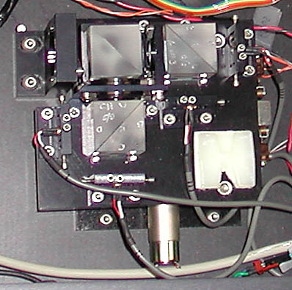
AVCS Point Phase Sensor
HWP
PBS
0 DEG
270 DEG
QWP
HWP
PBS
90 DEG
180 DEG

Slide 9
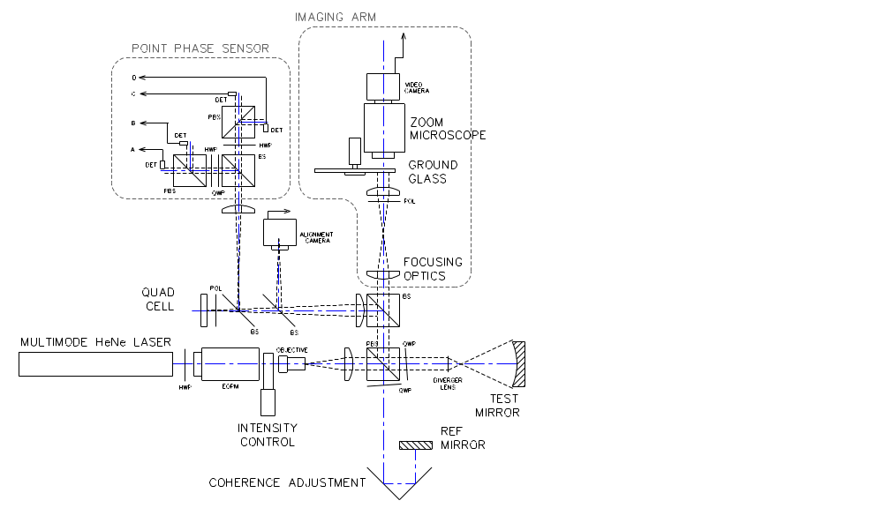
Optical Schematic

Slide 10
Key Features of Layout
Max tilt = 100 fringes/radius without vingetting
Telecentric pupil imaging
  Constant pupil magnification
  < 0.10 λ OPD between on-axis and 100 fr/rad tilt
  3.25” focus range
Phase sensor in telecentric image space
  Fixed pupil magnification equal at all image planes
  Sensor can be positioned along pupil diameter
  Sensor path separate from rotating ground glass
    High speed detectors will not sense moving speckle pattern
Integral 50 mm beam expander

Slide 11
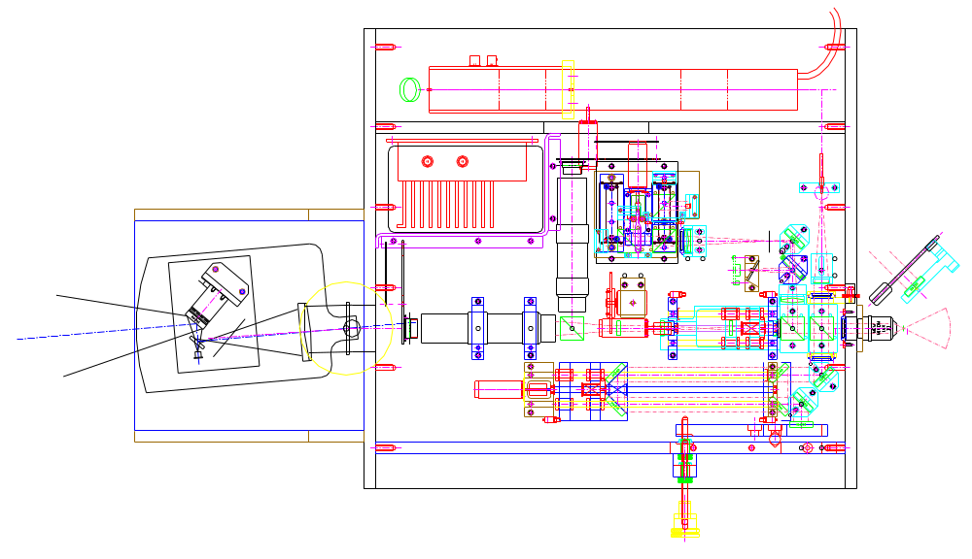
Mechanical Layout - Top View
EOM
LASER
Space for BS, 2nd
zoom and camera
19.750”
R.T. Phase Sensor
Tilt Corrector
CCD Sensor + A/D
Quad
Cell
Tilt
Sensor
10mmOutput Port
Hologram/Diverger
Platform
21.125”

Slide 12
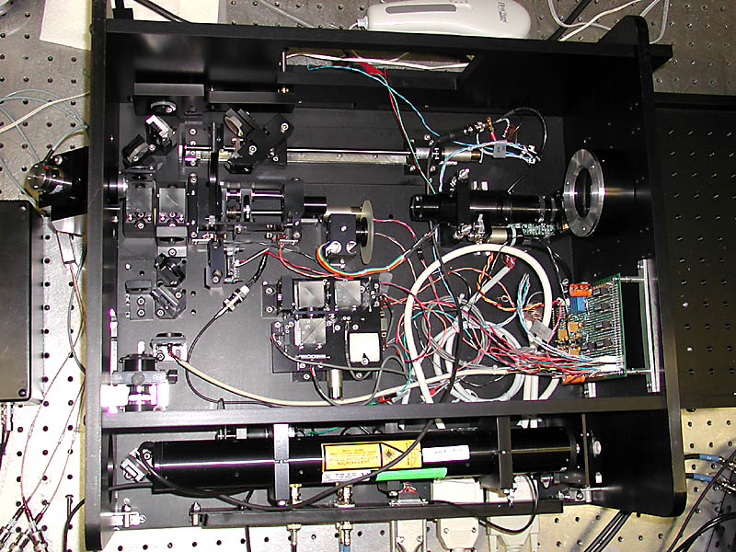
AVCS Top View
(Wires going crazy!)

Slide 13
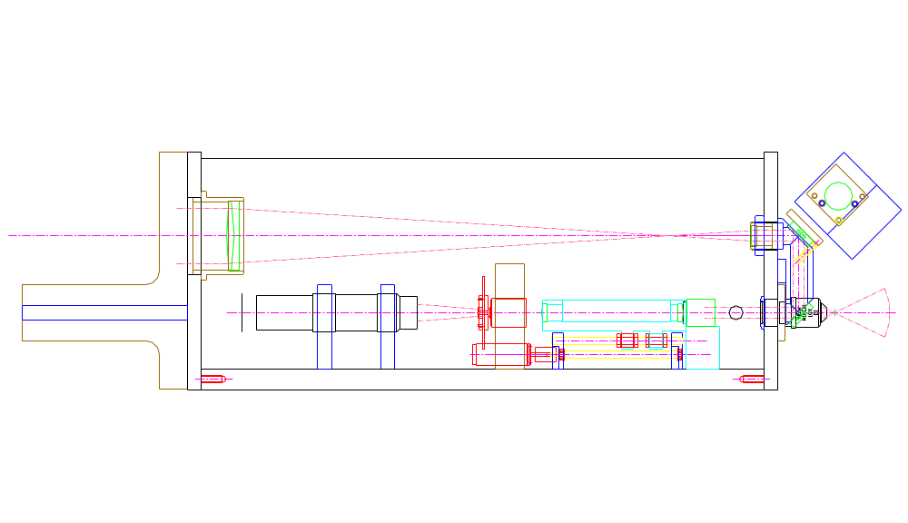
Mechanical Layout - Side View
Internal 5x Beam Expander
Fold output beam into internal beam expander
10 mm
Output
Precision mounting fixture on each port
Design goal: λ/20 P-V max wavefront error

Slide 14
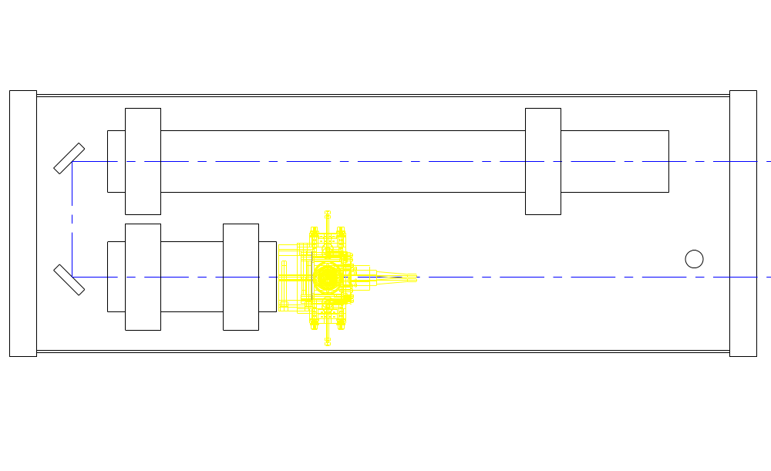
Source Optics, Side View
7 mW HeNe Laser
7.5”
Conoptics Model 307 EOM
Motorized attenuator &
spatial filter assembly (WYKO)
(THIS DIDN’T WORK OUT)

Slide 15
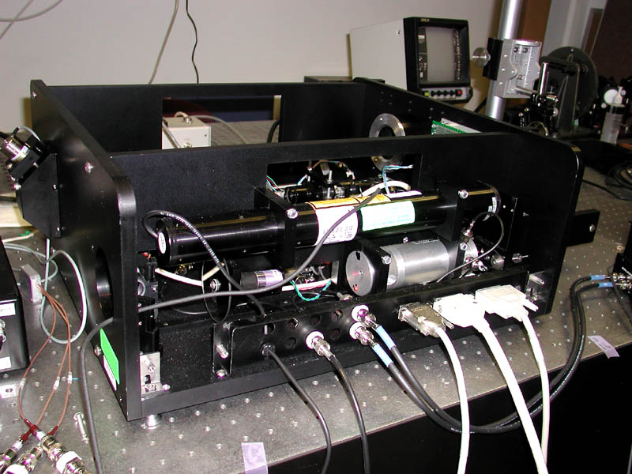
AVCS Source Optics

Slide 16
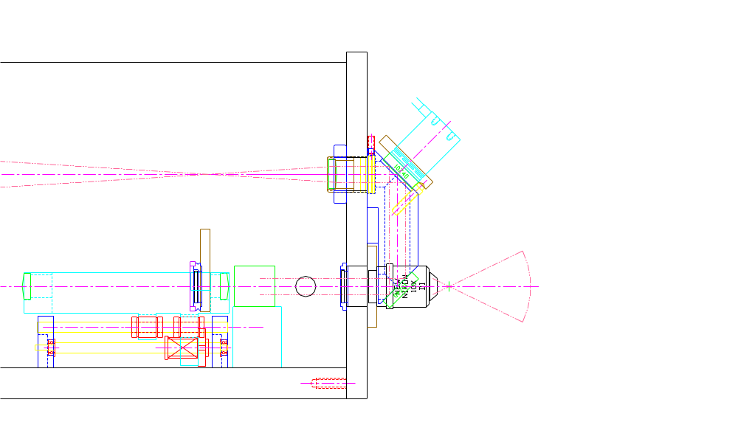
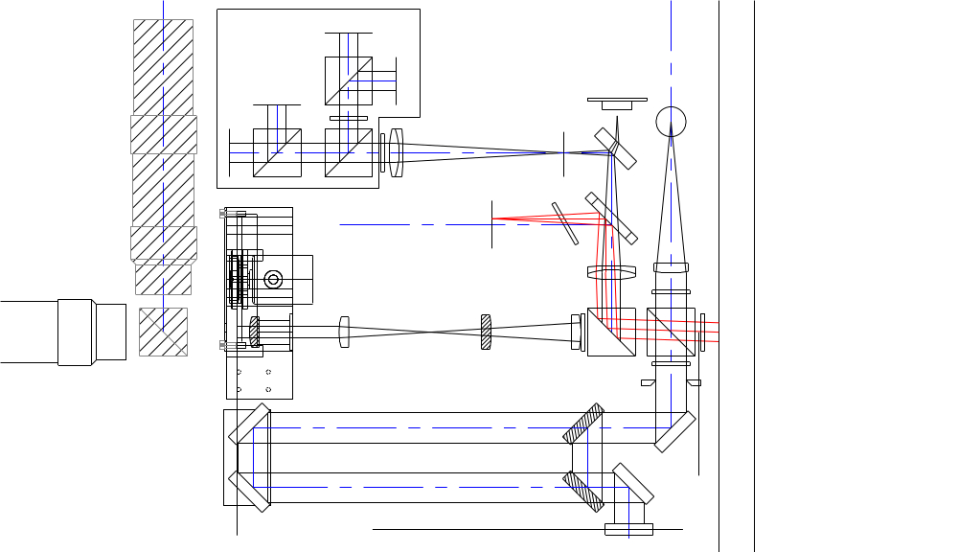
Controlling Tilt
486 Computer
PZT Tilt Driver
IO Board
Beam Expander
“Eyepiece” Lens
Quad Cell Decoder
High Speed
PZT Tilt Stage
Quad
Cell
Alignment
Camera
Advantages
High Quality Spot on Quad Cell
Tilt mirror near exit pupil
No “external” components
Mirror size not a problem
Disadvantages
Works only with the Large Beam
Small angles of tilt only (< 1 wave/radius)

Slide 17
System Components and Controls
Wireless Remote
Zoom
Focus
Intensity
Path Difference
Phase Sensor Position
100 foot range
72”
25 feet
Interferometer
Mainframe
19” Electronics Rack
Computer
Computer Monitor
Keyboard/mouse
Alignment Video Monitor
Phase Controller
EOM Power Supply
Tilt Controller
Power Supplies
Manual Adjustments
Reference tip-tilt
Beam ratio
Analyzer angle
EOM
Driver
Laser
Power
Supply
110
VAC
Output
10 mm aperture
50 mm aperture
Manually switchable
110
VAC

Slide 18
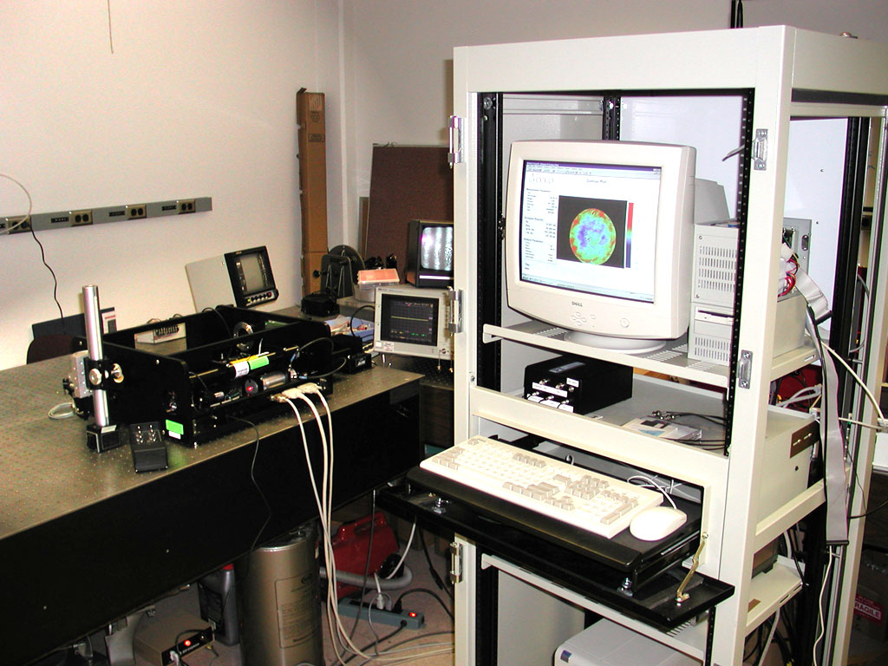
AVCS Full System
All the covers removed...

Slide 19
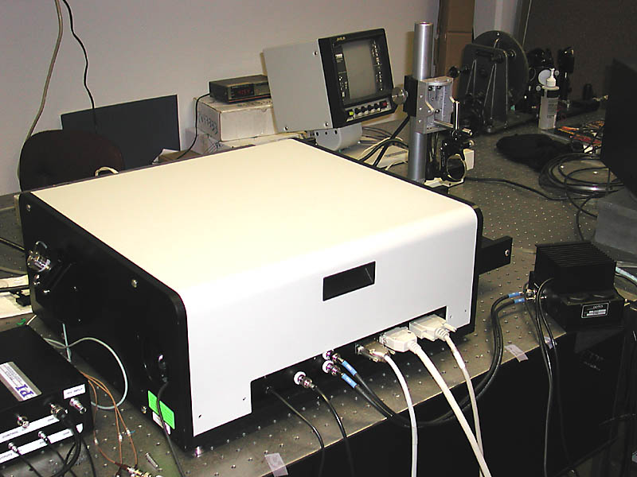
AVCS with Cover

Slide 20
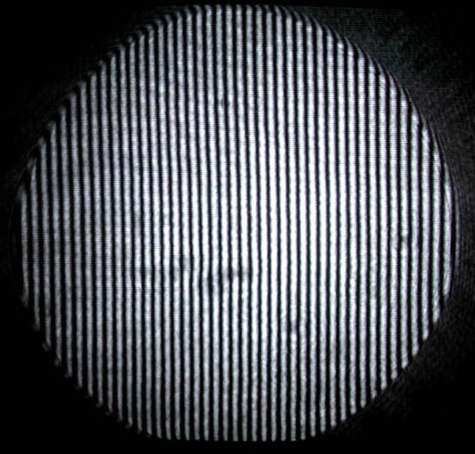
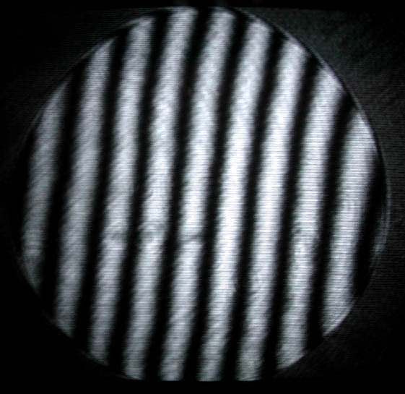
Fringe Output
About 45 Tilt Fringes
Non AVCS measurement
with 75 fringes works fine
About 10 Tilt Fringes

Slide 21
Prototype Performance
Dual measurement repeatability
  No Vibration (w/moderate air turbulence)
    Average of 12 single measurements
    0.009 waves rms (surface)
  With Vibration (w/same air turbulence)
    Amplitude > 1 wave, Frequency 200-500 Hz
      Completely un-measurable without AVCS
    Average of 12 single measurements
    0.011 waves rms (surface)
  Almost no difference in results!
Measure to 75 fringes of tilt w/o compensation
AVCS stable with up to 8-10 fringes of tilt

Slide 22
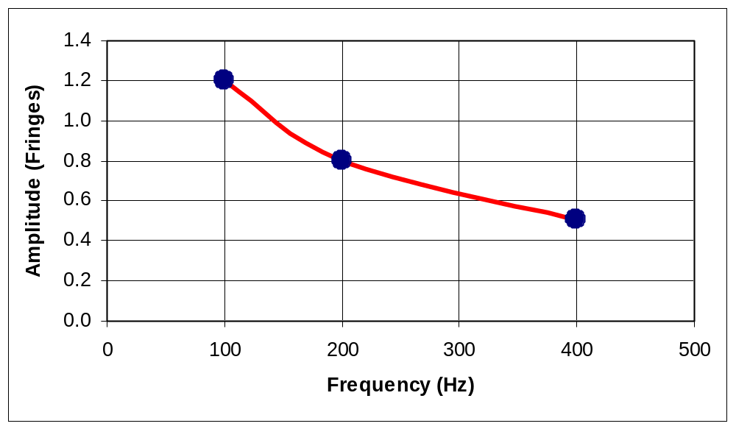
Piston Correction Performance
Piston correction works quite well
Performance (rough measurement) with compensation loop running at 10-12 kHz

Slide 23
Tilt Correction Performance
Proportional control loop closed
Works well for “macro” displacements
Noise is about 0.3 - 0.5 Fringes
  Electronic noise probably due to cable issues
  Reference beam suppression may not be sufficient
    Polarization filter may have too much crosstalk
    May be an adjustment issue (?)
  Probably will not work well in its current state

Slide 24
What Works Well...
AVCS for piston (this works amazingly well!)
Zoom imaging system
Radio control system
“Basic” alignment system
Uncalibrated accuracy “looks about right”
  About 1/4 wave P-V

Slide 25
Issues not resolved with Prototype
Intensity is not properly matched between the two channels.
  This affects the ability to zoom
High frequency phase noise
  Stray light?
    Tilt QWP in both arms?
    Baffles?
    QWP quality?
Small FOV for alignment system w/B.E.
  Need another alignment camera
Tilt compensation not very good
Not much tilt (or aberration) can be present at PPS
  PPS needs to be aligned
  Higher magnification in PPS imaging channel

Slide 26
“Version 2” improvements
Faster electronics and controller!
  Would like to run at 100kHz for 5-10 kHz correction
Much smaller detectors relative to image size
Different intensity control (at camera)
New alignment system for B.E. (very simple)
More room for cables (bigger box)
Much lower noise for tilt sensor
Better electronics configuration
  Preamps at detectors, etc.

