Slide 1
TPF-C Optical Requirements
Stuart Shaklan
TPF-C Architect
Jet Propulsion Laboratory, California Institute of Technology
with Contributions from
Luis Marchen, Oliver Lay, Joseph Green, Dan Ceperly, Dan Hoppe, R. Belikov, J. Kasdin, and R. Vanderbei
TPF-C Coronagraph Workshop
September 28, 2006

Slide 2
Overview
Flowdown of science requirements to engineering requirements
Meeting the requirements: TPF-C FB-1 Error Budget
Optical surface requirements
  Related to wave front control system and bandwidth
  Effect of uncontrolled spatial frequencies (frequency folding)
  Related to finite size of the star
Image plane mask surface roughness requirements
Thermal/Dynamics requirements
  Sensitivity of different coronagraphs to low-order aberrations
  System requirements

Slide 3
High-Level Requirements
SCIENCE: Detect 30 potentially habitable planets assuming η_{earth} =1.
  Also measure orbital semi-major axis, perform spectro-photometry, detect photons from 0.5 – 1.1 um, perform spectroscopy.
Ongoing MISSION STUDIES have been used to derive engineering requirements from science requirements.
  For the Flight Baseline 1 (FB-1) study, emphasis was first placed on the detection requirement.
ENGINEERING: The Mission Studies reveal that the detection requirement is satisfied with IWA = ~65 mas and SNR=5 at Δmag = 25.5 (Contrast = 6.3e-11), using a100 nm wide channel.
  Orbit, spectro-photometry, and spectroscopy requirements will likely drive us to a deeper contrast requirement.
FLOWDOWN:
  Control Scattered light to below Zodi + ExoZodi, ~ 1e-10
  Measure, estimate, or subtract speckles to 5x below Δmag = 25.5 or 1.2e-11
  Work at 4 λ/D with D=8 m (equiv to 2 λ/D for D=4 m).

Slide 4
Speckle Floor, Stability
CONTRAST
CONTRAST STABILITY
Contrast = I_{s} + <I_{d}>
Stability = sqrt(2I_{s}<I_{d}> + <I_{d}²>)
STATIC BUDGET
DYNAMIC BUDGET
I_{s} = Static Contrast
Wave Front Sensing
Wave Front Control
Gravity Sag Prediction
Print Through
Coating Uniformity
Polarization
Mask Transmission
Stray Light
Micrometeoroids
Contamination
I_{d} = Dynamic Contrast
Pointing Stability
Thermal and Jitter
Motion of optics
Beam Walk
Aberrations
Bending of optics

Slide 5
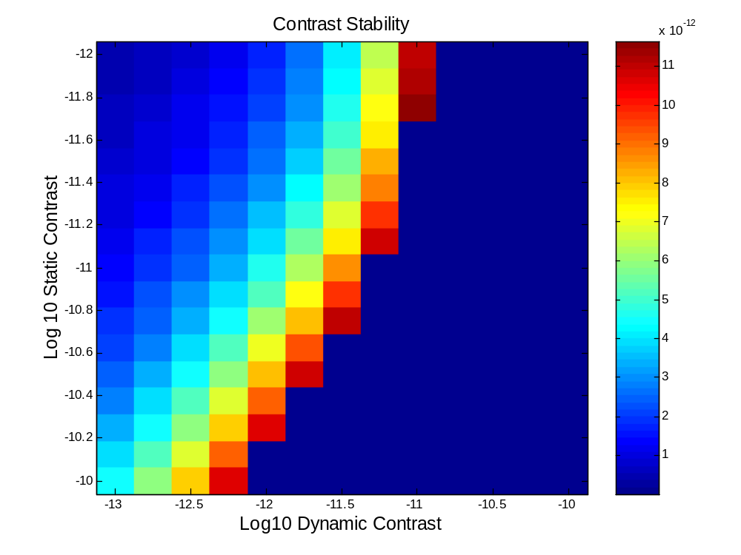
Static vs. Dynamic
TPF-C Baseline Error Budget
Speckle variability exceeds requirement in this region.

Slide 6
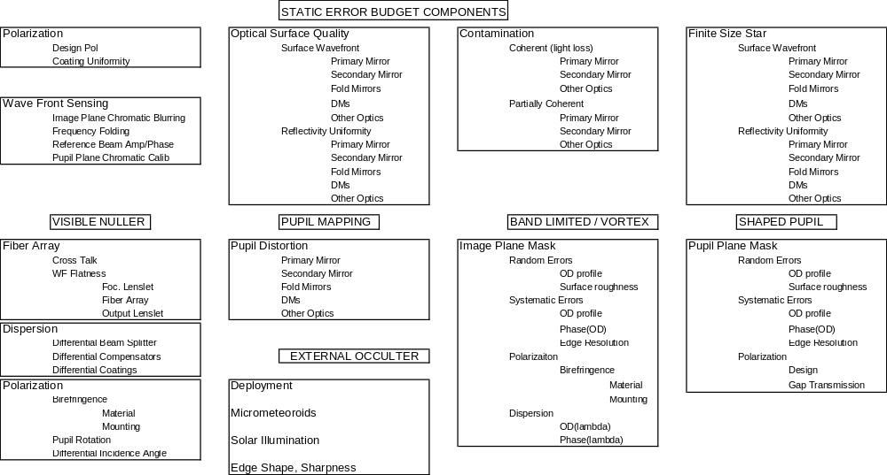
System Static Error Budget

Slide 7
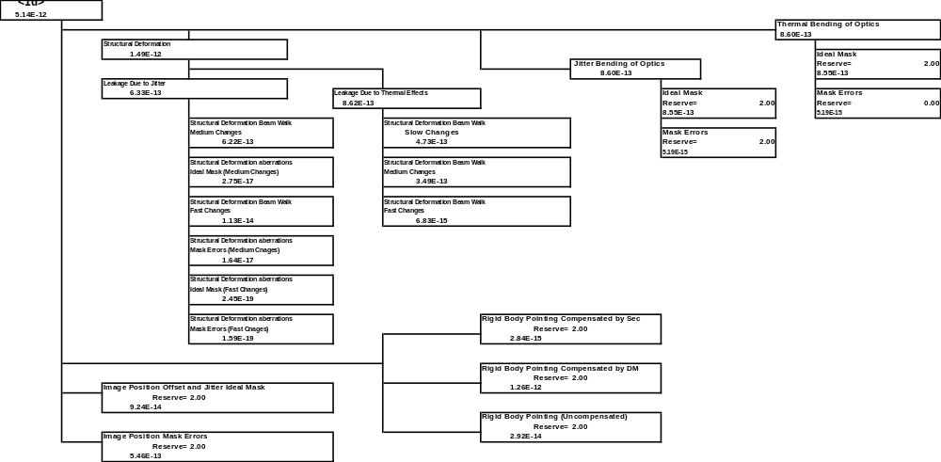
System Thermal/Dynamic Error Budget

Slide 8
Where do TPF-C surface requirements come from?
Axiom: Given a pair of ideal DMs, a stable telescope, and monochromatic light, all energy in the dark hole can be completely removed.
- Independent of the wave front quality of the optics.
What happens in broad-band light?
- Phase and amplitude variations across the pupil F_{p}(λ)
- Phase and amplitude dependence of DM correction F_{c}(λ)
Contrast
If F_{p}(λ)≠F_{c}(λ)
F_{p}(λ) comes from unpropagated (‘direct’) terms, and propagated energy. Both must be considered.
Residual
Contrast
λ_{o}-Δλ/2
λ_{o}
λ_{o}+Δλ/2

Slide 9
Michelson Wave Front Control
y
Incoming Light
P
Pupil Conjugate
D
θ
DM
z
α=4πs/λ
DM
Phase control: 1/λ
Ampl. Control: 1/λ²
To Coronagraph
Collimated light reflects from an optic having a periodic surface deformation of r.m.s. height s. The light propagates a distance z to the pupil (or conjugate plane) where the wave front correction system is located. The system shown is a dual deformable mirror (DM) corrector in a Michelson configuration. The DMs control both amplitude and phase.

Slide 10
Sequential WFC
Incoming Light
D
DM_{p}
z_{DM}
DM_{np}
Pupil Image
Phase control: 1/λ
Ampl. Control: λ independent
To Coronagraph
Two DMs are separated by distance z_{DM}. One is at the pupil. The pupil DM controls phase. The non-pupil DM adjusts its phase, which propagates to the pupil and becomes wavelength-independent amplitude.

Slide 11

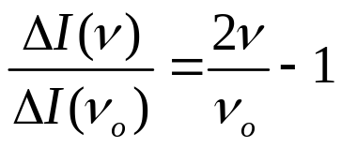
Visible Nuller
DM element tip-tilt
Output power θ
SM Fiber
θ
λ_{long}
Coupling vs. tilt
I
Coupling vs. frequency
ΔI(ν_{o})
ν_{ο} coupling
λ_{short}
ΔI(ν)
The factor of 2 scaling with frequency arises from the combined scaling of both the image and fiber mode with frequency.
θ
ν coupling
Phase control: 1/λ
Ampl. Control: 1/2λ
A segmented-DM is matched to a lenslet array that couples light into a single-mode fiber optic. DM-element tilt adjusts the coupling efficiency, resulting in a change in the output light level.

Slide 12
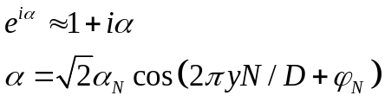
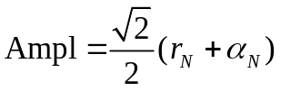


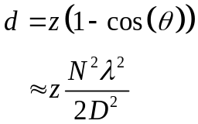
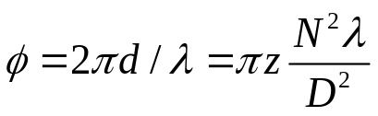
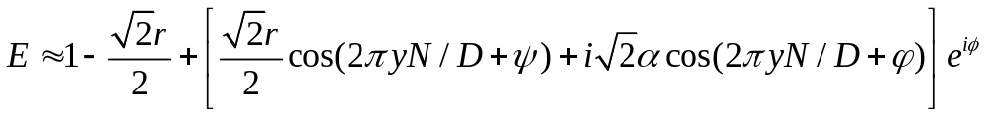
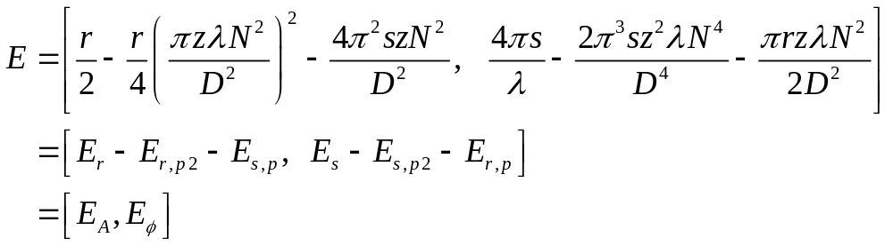
Propagation Kernel
Image Plane
α
Pupil Plane
D
z
d
D/N
r = reflectivity
Diffracted component phase delay is

Slide 13
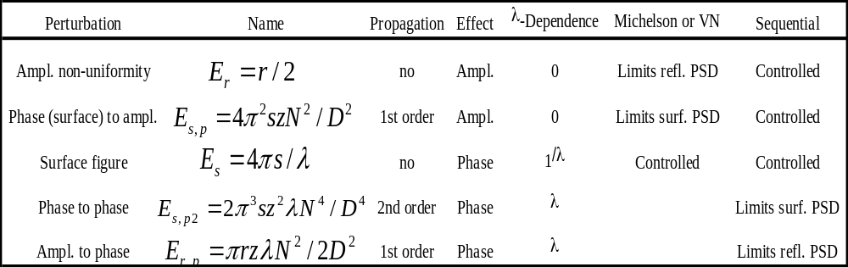
Direct and Propagated Terms

Slide 14
TPF-C Layout
SM
PM
M4
M3
Cyl1
CDM
and PM
DMcol
Cyl1
DMcol
M4
M3
Cyl2
SM
Cyl2
Image-space images of the optics
Final beam is collimated at the exit pupil. All optics appear to have the same diameter as seen from the exit pupil.

Slide 15
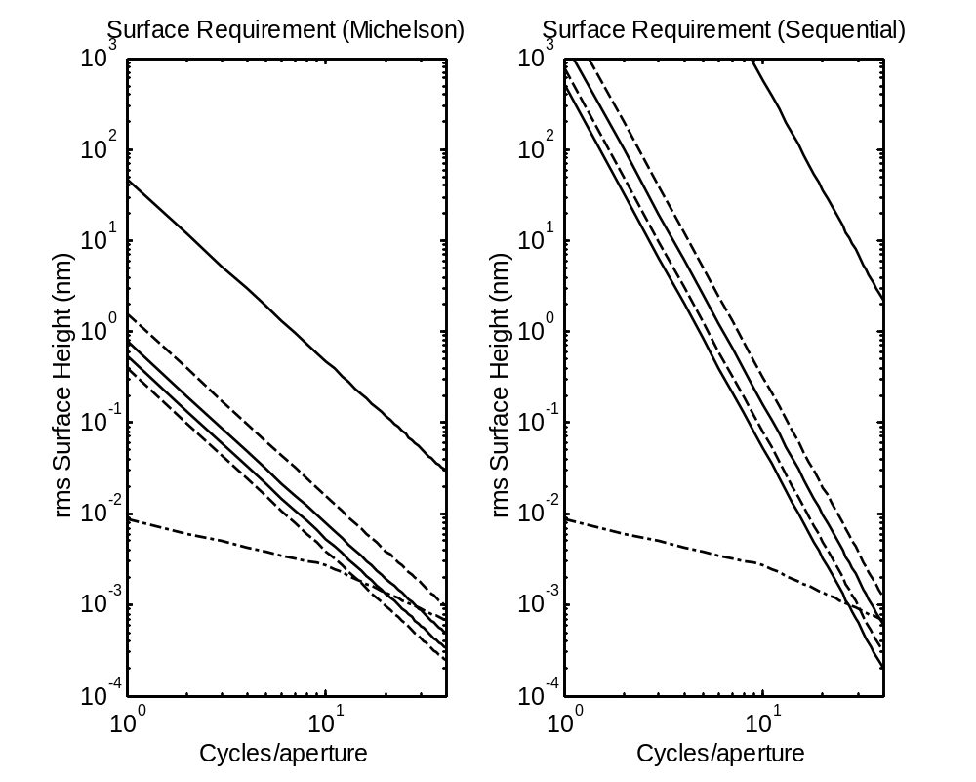
Surface Height Requirements
for R=6.3 and C = 1e-12 per optic
Surface Requirement
Michelson and Visible Nuller
Surface Requirement
Sequential
Secondary
DMcol
Secondary
DMcol
DMcol Δλ=50 nm
M4
DMcol Δλ=50 nm
DMcol
Δλ=200 nm
M4
EUV
EUV
DMcol
Δλ=200 nm

Slide 16
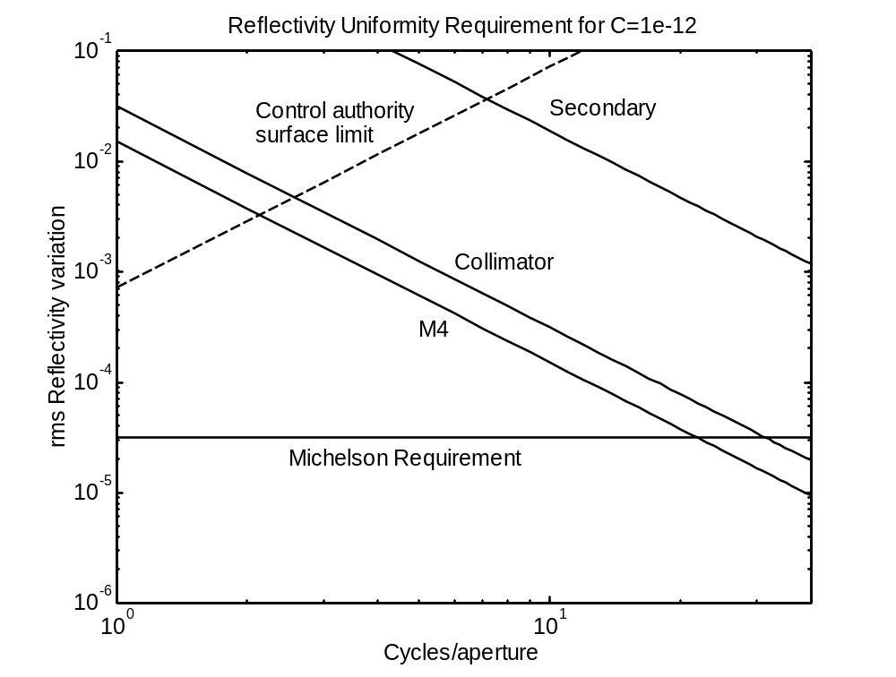
Reflectivity Uniformity Requirement for R=6.3, C=1e-12
Limited by ampl.-to- phase prop.
Control limit for
30 nm piston, DM is 3 m from pupil
Limited by direct reflectivity.
Michelson and Visible Nuller Requirement
We believe that the state-of-the-art in large optics coatings is about 0.5% r.m.s., with a 1/f³ PSD. This leads to ~ 1e-11 contrast at 4 cycles/aperture (worse at 2 cycles/aperture).

Slide 17
Finite Size Source
DM compensation is sheared for an off-axis element of the target.
Incoming Light
D
DM_{p}
z_{DM}
DM_{np}
Pupil Image
To Coronagraph
Two DMs are separated by distance z_{DM}. One is at the pupil. The pupil DM controls phase. The non-pupil DM adjusts its phase, which propagates to the pupil and becomes wavelength-independent amplitude.

Slide 18
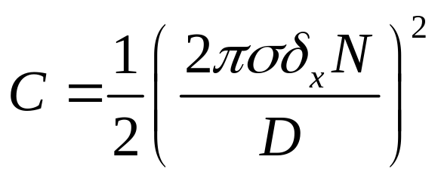
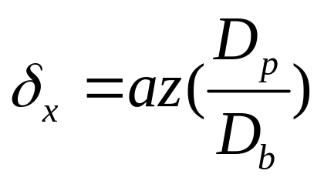
Contrast Due to Finite Size Source
C = Contrast
σ = r.m.s. wavefront (radians)
or r.m.s. (reflectivity/2)
δ_{x} = beam shear
N = cycles/aperture
D = beam diameter
a = Source radius
z = effective distance of optic
from pupil
D_{p} = pupil diameter
D_{b} = beam diameter

Slide 19
Surface Height Requirements
for Finite Size Star (1.7 mas diam.), C = 1e-12 per optic
Surface Requirement
Michelson and Visible Nuller
Surface Requirement
Sequential
Secondary
DMcol
Secondary
Secondary
Secondary
DMcol
DMcol Δλ=50 nm
M4
DMcol Δλ=50 nm
M4
M4
DMcol
Δλ=200 nm
M4
EUV
EUV
DMcol
Δλ=200 nm

Slide 20
Reflectivity Uniformity Requirement for Finite Size Star (1.7 mas diam.), C = 1e-12 per optic
PM & SM
Control limit for
30 nm piston, DM is 3 m from pupil
Requirement on PM & SM for sequential controller, with z_{np}=3 m from the pupil
Michelson and Visible Nuller Requirement

Slide 21
Preferred DM Configuration
Collim.
CDM
M1
M2
DM_{np,1}
DM_{p}
DM_{np,2}
Cass. Focus
1
f₁=2.5
f₂=2.5
1
z_{DM}=3
z_{DM}=3
3-DM fully redundant system. This diagram depicts an unfolded layout that provides for 2 non-pupil DMs placed z_{DM}=3 m from the pupil DM_{p}. A unity magnification telescope images the coarse DM pupil plane CDM to DM_{p} (dashed line). The design provides 1 m between CDM-M1 and M2-DM_{np,1} to fold the beams at a shallow angle.

Slide 22
LESSON 1
Use a sequential wave front controller.
  Relaxes optical surface requirements
  Increases the useful size of the dark hole
  Allows a wider optical bandwidth
  Relaxes coating requirements on PM and SM to within state-of-the-art
  Provides redundancy
A Michelson controller, and fiber spatial-filter amplitude controller make broad-band amplitude control very challenging.
  Pushes Silver coating beyond state-of-the-art
  Is Aluminum coating uniformity sufficient?
    Aluminum is desired on PM, SM, and M3 to enable general astrophysics.

Slide 23
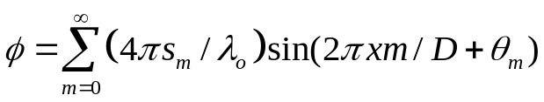
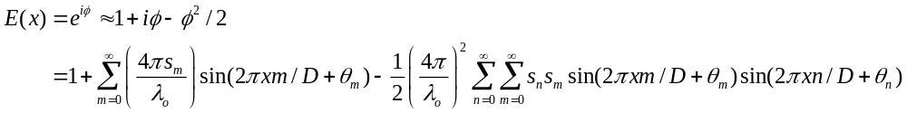

Frequency Folding: Uncontrolled High Spatial Frequencies Appear in the Dark Hole
The previous charts addressed controllable spatial frequencies – those below the DM Nyquist frequency.
Give’on has shown that frequency folding terms scatter light into the dark hole.
Phase in the pupil:
Field in the pupil:
Ideal diffraction,
removed by coronagraph
Mixing of spatial frequencies. We are concerned with |m-n|<N /2.
These pure-amplitude terms .
Scatter removed by DM,
up to N cycles across
the dark hole

Slide 24
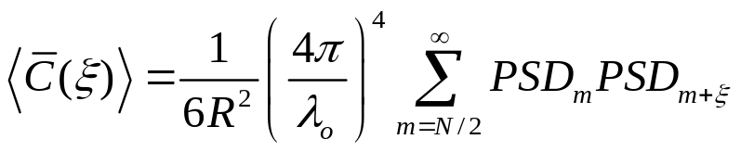
Frequency Folding Residual
The Michelson controller has 1/λ² amplitude dependence and completely
removes the light.
The Visible Nuller fiber array does not pass spatial frequencies above N/2. The frequency folding problem is eliminated.
The sequential controller has λ-independent amplitude control. The resulting
contrast in the dark hole is:

Slide 25
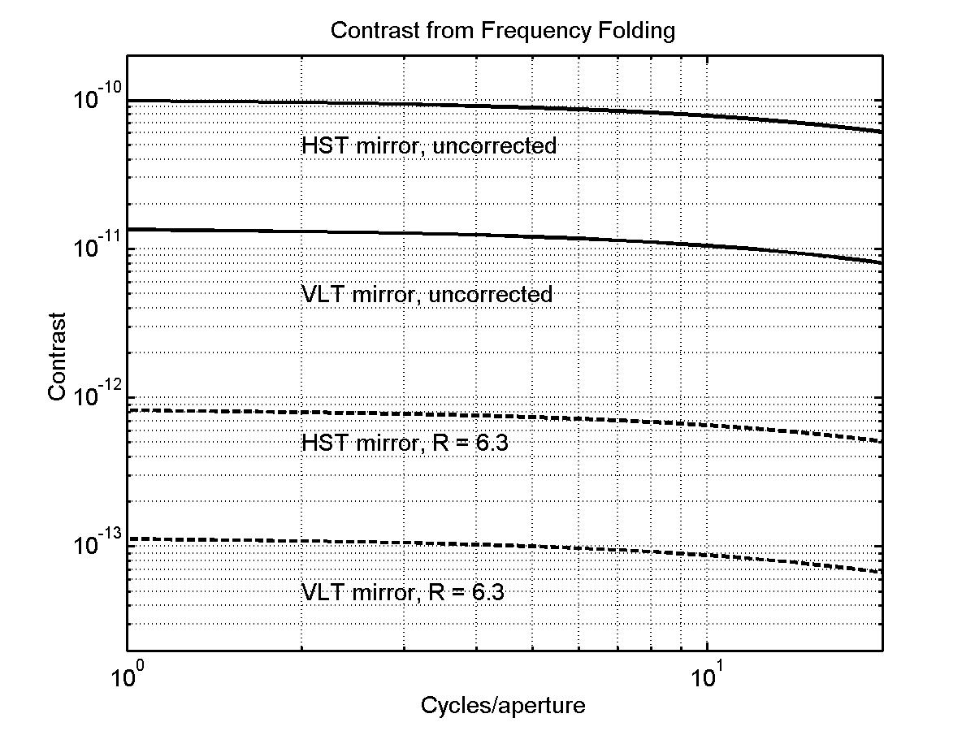
Frequency Folding Contrast for R=6.3, Sequential DMs (96 x 96)

Slide 26
LESSON 2
Uncontrolled high-spatial frequencies look manageable.
  Existing optics lead to acceptable frequency folding
    What happens when we light-weight the PM???
  Requires large format DM
  Becomes an issue for bandwidth >> 100 nm

Slide 27
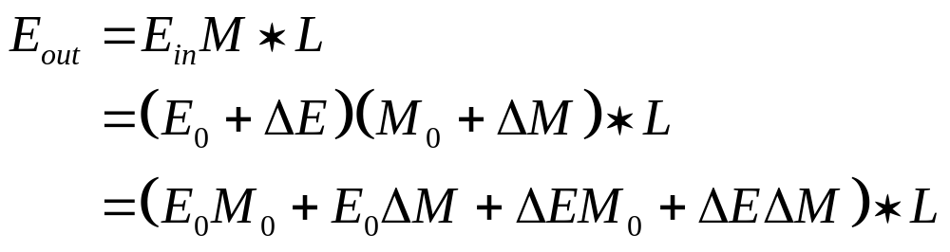
Image Plane Mask errors
Static contrast
Mask error
Random
Systematic
Spatially random variations in
mask transmission amp and phase
Variations in mask transmission amp and
phase that are correlated with mask pattern
Unaberrated input field with mask errors

Slide 28
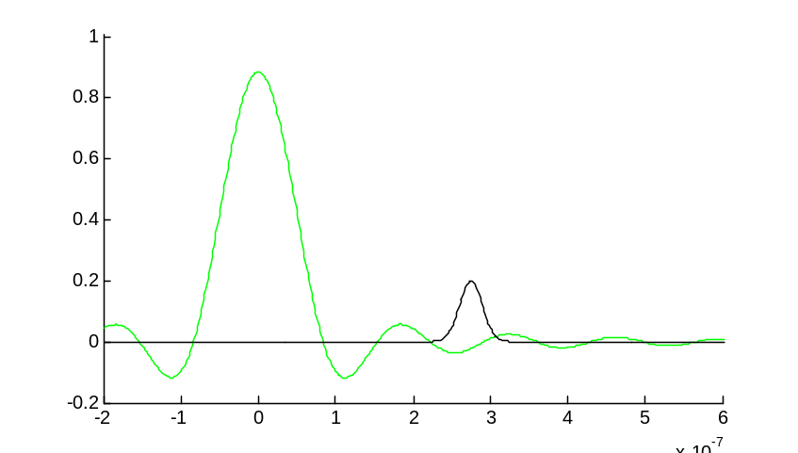
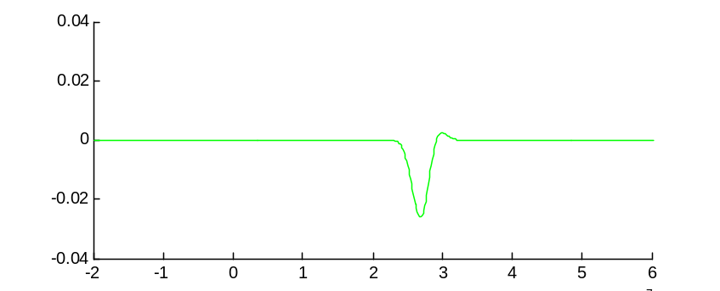
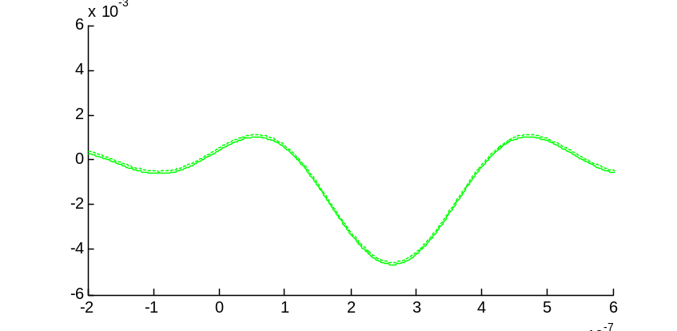
Gaussian error, monochromatic
Unaberrated sombrero function E₀
Gaussian mask error ΔM at ~ 4λ / D
550 nm
E field
E field error exiting mask = E₀ΔM
E field
Diffracted by Lyot stop
E₀ΔM *L
Perfect DM correction (dotted line)
E field
Angular offset / rad

Slide 29
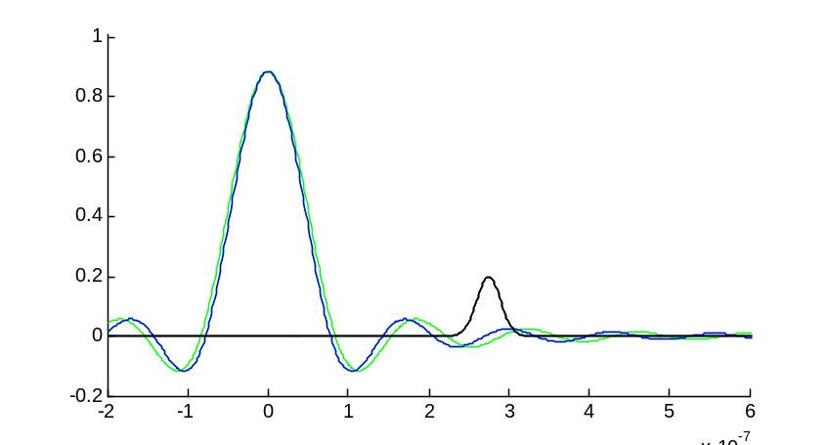
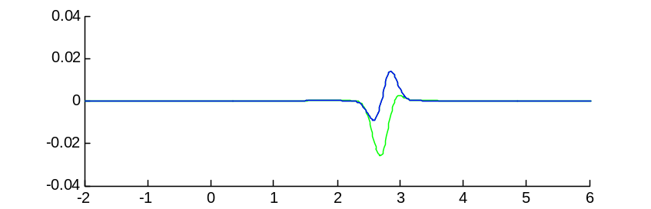
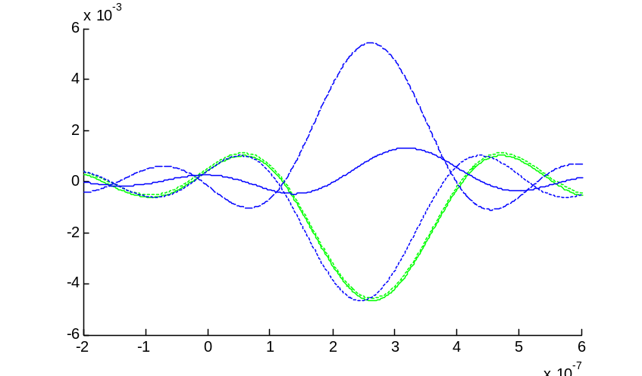
Gaussian error, broadband
550 nm + 510 nm
Two wavelengths to illustrate broadband case
Blue sombrero function is compressed
E field
E field at mask exit is quite different at 510 nm
E field
DM correction still perfect for 550 nm, but compressed for 510 nm
DM correction is completely inappropriate for 510 nm
510 nm error before
DM correction
510 nm after
DM ‘correction’
E field
DM ‘correction’
@ 510 nm
550 nm error
and correction
Angular offset / rad

Slide 30
Dependence on error spatial scale for a 100 nm bandpass 500-600 nm, evaluated at 4 λ/D
Mask error scale size (FWHM) |  | Rms mask error for 10⁻¹¹ contrast
fλ / D | F/60
2 | 60 μm | 91 pm
1 | 30 μm | 31 pm
1/2 | 15 μm | 24 pm
1/4 | 7.5 μm | 27 pm
1/8 | 4 μm | 38 pm
1/16 | 2 μm | 50 pm
Simple 1-D analysis used to predict
contrast in image plane from a grid of
random Gaussian mask errors
Light scattered from both very
small features is blocked by Lyot stop
Large scale errors are effectively controlled over a broad band.
Large
Most sensitive to scales
comparable to sidelobes of
sombrero function:
Small

Slide 31
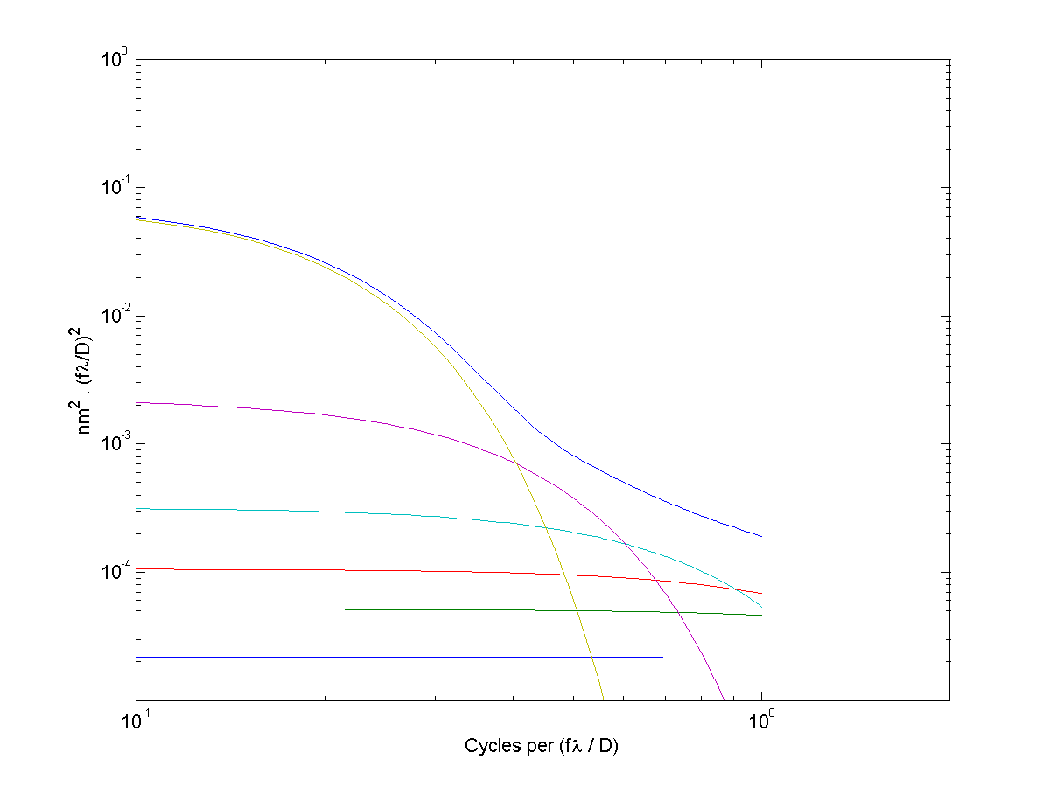
Mask error PSD requirement
Each component has different characteristic spatial scale
Each represents 10⁻¹¹ contrast
Overall contrast can be suballocated to different scales to match actual PSD of mask errors
Period = 100 μm
Period = 30 μm
No
requirement
91 pm rms (60 um scale size)
Overall surface r.m.s. ~ 1 A for scales 2 – 60 um.
31 pm rms
24 pm rms (15 um scale size))
sum
27 pm rms
38 pm rms
50 pm rms (2 um scale size)

Slide 32
LESSON 3
If you’re going to put a transmissive mask in the image plane, it should have <1 A rms for spatial scales up to 2 λF#
  Due to inherent scaling of spatial frequency with wavelength in the image plane
  A mask-leakage error looks like a planet – it does not scale with wavelength.
  Calibrate by rotating the mask, but still requires 1 A rms to keep scattered light level near 1e-11.

Slide 33
Thermal/Dynamics Error Budget
Observing Scenario
Coronagraph sensitivity to Low-Order Aberrations
Control systems
Key Requirements

Slide 34
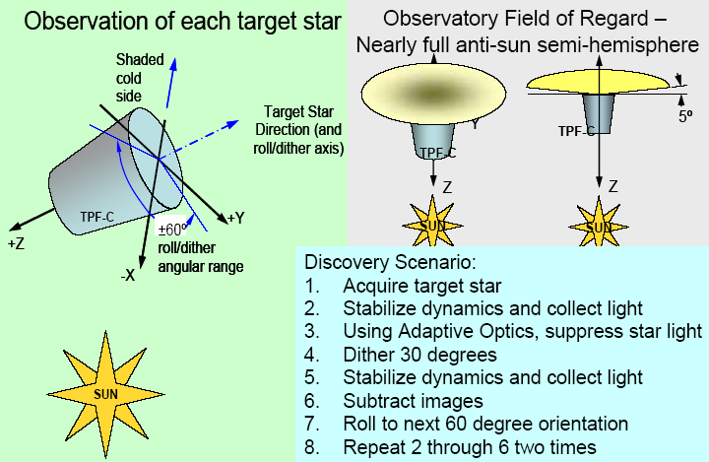
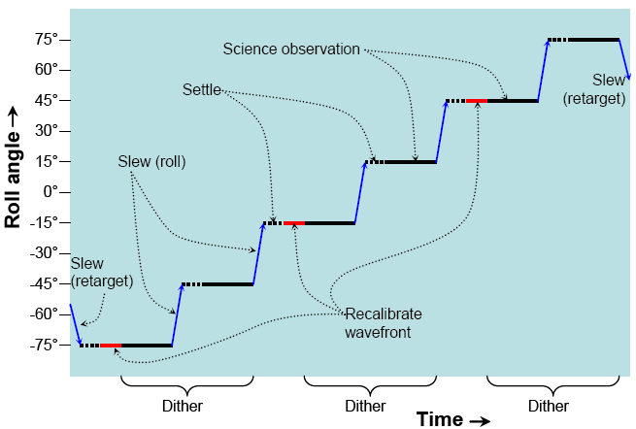
Observing Scenario
Scattered Light must be stable to ~ 1e-11 during this time

Slide 35
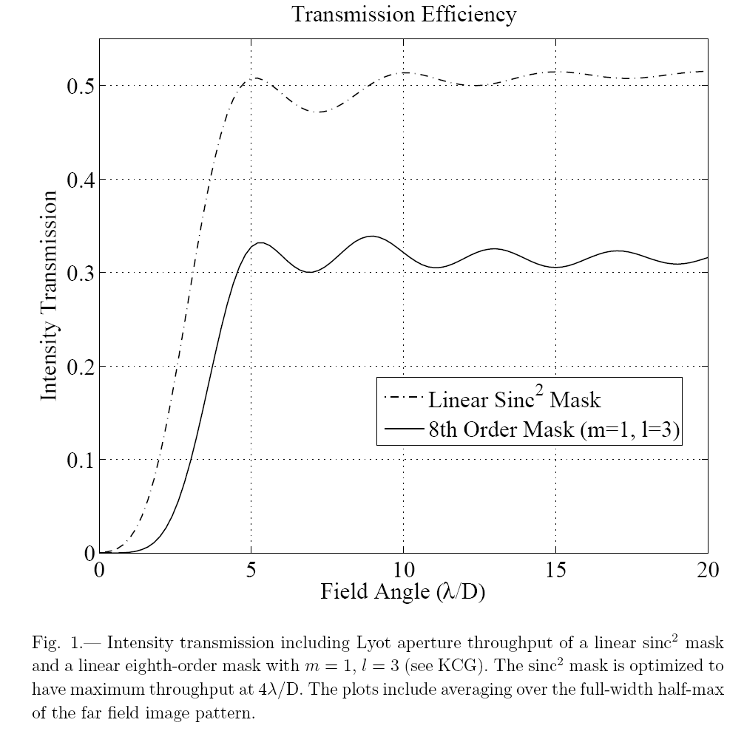
Aberration Sensitivity 1
Mask Throughput

Slide 36
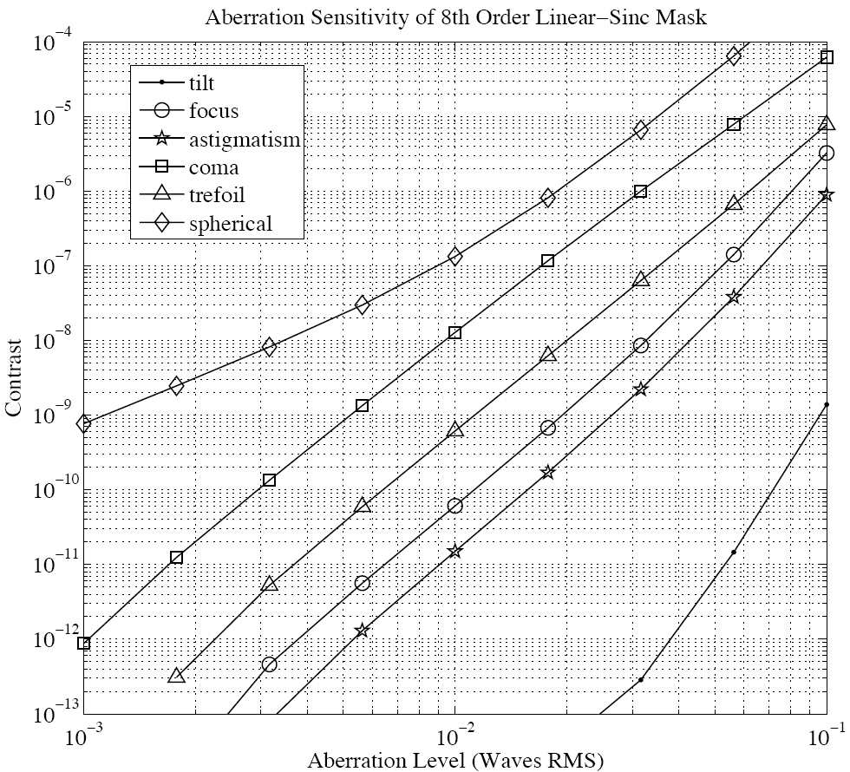
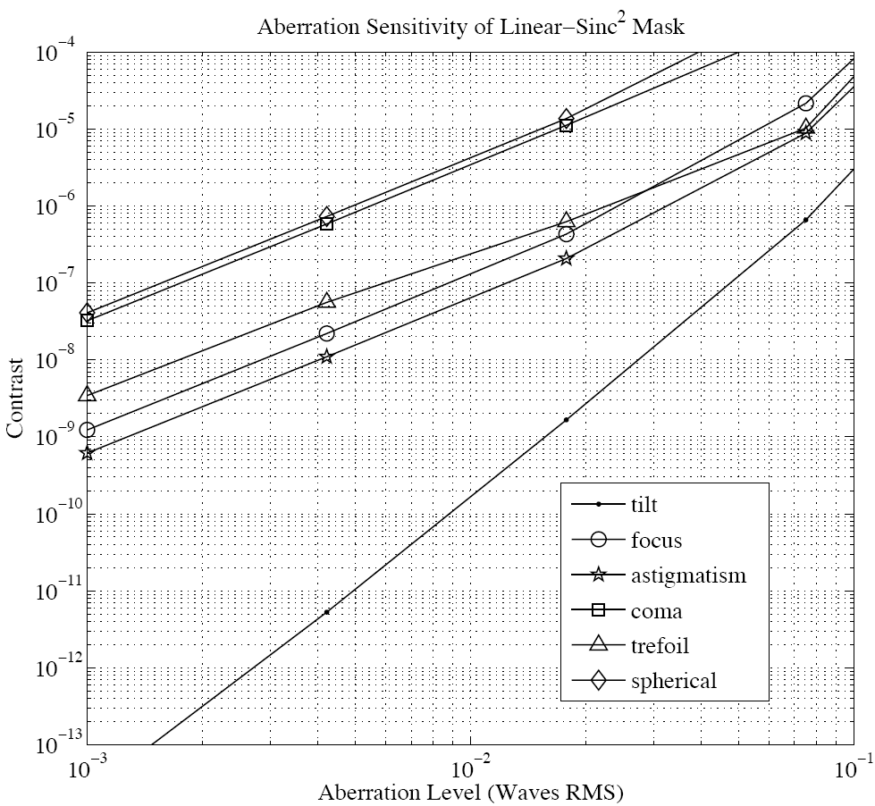
Aberration Sensitivity 2
Contrast Sensitivity Curves
Evaluated at 4 λ/D
Coma, 4 λ/D
Coma, 4 λ/D
Coma, 3 λ/D
Focus, 3 λ/D
Focus, 4 λ/D
Focus, 4 λ/D
Linear dual-shear VNC aberration sensitivity and Lyot throughput are identical to a linear 4th order mask of the form T = 1-cos(x). Sensitivity is almost identical to 1-sinc²(x).

Slide 37
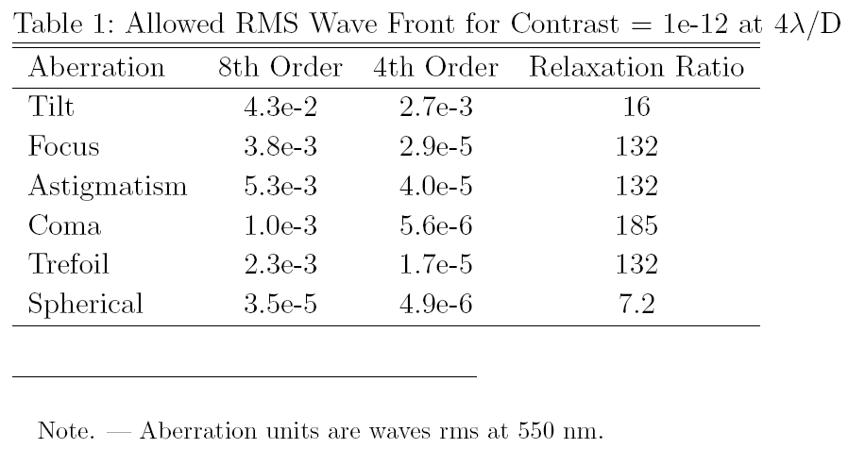
Aberration Sensitivity 3
Allowed WFE

Slide 38
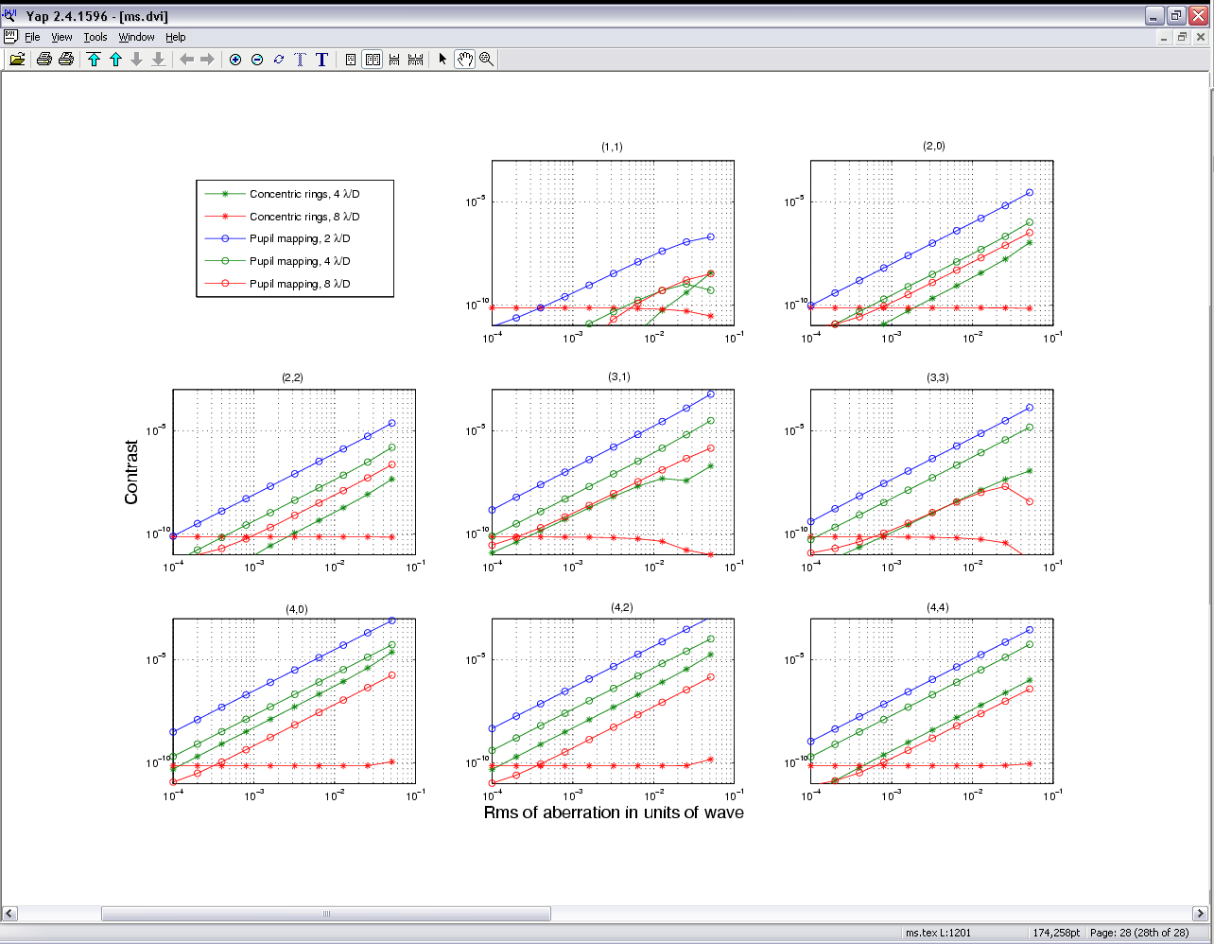
Aberration Sensitivity 4
Pupil Mapping Sensitivity Curves
TILT
FOCUS
ASTIG
COMA
TREFOIL
SPHERICAL
ASTI2

Slide 39
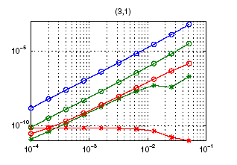
Aberration Sensitivity 5
Pupil Mapping Sensitivity Curves
Pupil Mapping, 2 lambda/D
COMA
BL4, VNC
4 lambda/D
10⁻⁸
Pupil Mapping, 4 lambda/D
Shaped Pupil,
4 lambda/D
BL8,
4 lambda/D

Slide 40
Open-Loop Aberration Sensitivity Summary
The 8th-order null of a properly built BL8 provides orders-of-magnitude reduction to low-order aberrations.
Working at 4 λ/D, the mask sensitivity to aberrations increases in order:
  BL8, Shaped pupil, Pupil Mapping, BL4/VNC
  BL4/VNC is 100 x more sensitive to aberrations than BL8 (C=1e-12)
  OVCn behaves like 2nth null (OVC4 = 8th order null). Still studying the tradeoff between sensitivity and throughput.
Working at 3 λ/D increases aberration sensitivity by an order of magnitude.
  3x tighter WF tolerance to work at 3 λ/D with BL8
Working at 2 λ/D is harder yet – BL8 throughput too low, so must go to BL4/VNC, OVC2 or OVC4 (?), or pupil mapping.
  This is 1000x more sensitive to aberration than BL8 at 4 λ/D.

Slide 41
Thermal/Dynamic Error Budget
Low-order aberrations arise by
  Thermal deformation and misalignment of optics
  Jitter induced deformation and misalignment of optics
  The BL8 mask at 4 lambda/D is quite insensitive to these.
  BL4/VNC are the most sensitive
Beam Walk (shearing of spatial frequencies) is the same for all coronagraphs.
  If planet light is transmitted at x lambda/D, then a spatial frequency of x cycles/aperture is also transmitted.
  Beam walk is mitigated by
    Control of optics positions: secondary mirror + FSM
    Quality of optics
Beam walk drives the optical surface quality at a few cycles/aperture.

Slide 42
Control Systems
3-tiered pointing control
  Rigid body pointing using reaction wheels or Disturbance-Free Payload
  Secondary mirror tip/tilt (~ 1 Hz)
  Fine-guiding mirror (several Hz)
PM-SM Laser Metrology and Hexapod
  Measures and compensates for thermal motion of secondary relative to primary.

Slide 43
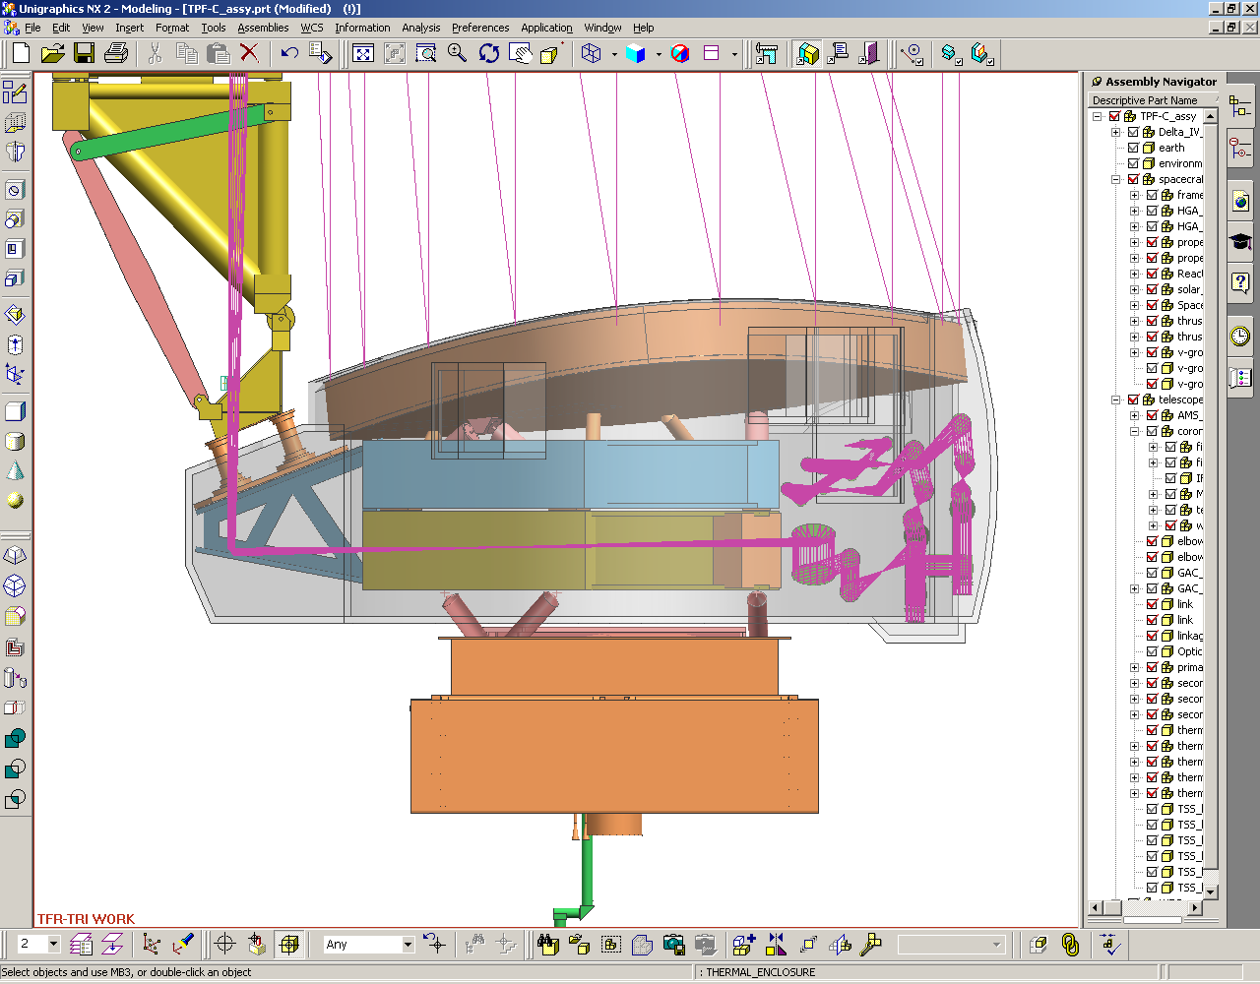
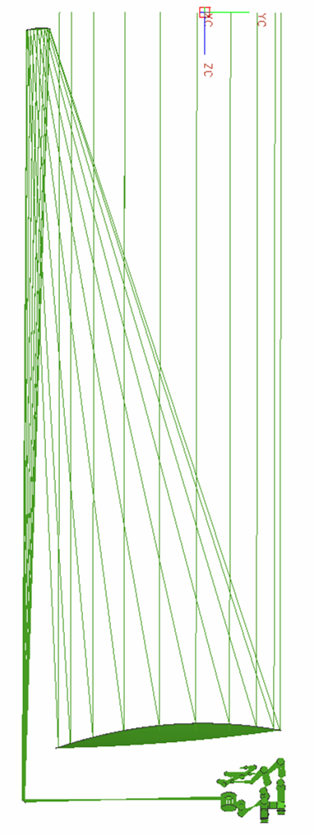

Key Dynamics Requirements
PM shape: (Thermal and Jitter)
z4=z5=z6=z8=z10=0.4 nm
z7=0.2 nm, z11=z12=5 pm
Secondary:
Thermal: Δx=65 nm, Δz=26 nm,
tilt=30 nrad
Jitter: 20x smaller
z
Laser metrology:
ΔL=25nm
Δf/f=1x10⁻⁹
Mask centration:
offset=0.3 mas
amplitude=0.3mas
Mask error = 5e-4 at 4 λ/D
Fold mirror 1:
rms static surf =0.85nm
Thermal: 10nrad, 100 nm
Jitter: 10 nrad, 10 nm
4 mas rigid body pointing
Figure 5. We identify the major engineering requirements to meet the dynamic error budget. Thermally induced translations lead to beam walk that is partially compensated by the secondary mirror. Jitter is partially compensated by the fine guiding mirror.
Coronagraph optics motion:
Thermal:10nrad, 100nm
Jitter: 10 nrad, 10 nm

Slide 44
Changes from Baseline
Baseline design assumes BL8 mask.
  Relatively insensitive to low-order aberrations.
Baseline observing scenario is:
  Difference two images made at 30 deg LOS ‘dither’ positions
  No DM reset for several hours during this time
If we switch to BL4, VNC (and to a lesser extent pupil mapping and shaped pupil), and if we keep the same observing scenario
  We can NOT move secondary mirror to compensate tip-tilt because moving the secondary introduces significant low-order aberration
  We must therefore maintain very strict pointing accuracy – sub milli-arcsec – on the telescope
  We also tighten primary mirror bending stability by orders of magnitude.
Going to 2 lambda/D with pupil mapping requires even tighter tolerances.

Slide 45
LESSON 4
Working at 2 or 3 λ/D is much, much harder than 4 λ/D. Breakthroughs in wave front control, optical surface quality, and a change in observing paradigm are needed.
  Single-digit picometer wave front control for low-order aberrations
  Sub-pm control of spherical aberration and higher order terms
  Wave front control that is faster than the rigid body pointing errors
    Or, require extremely tight rigid-body pointing
Hopefully we will hear some ideas on how to do this tonight and tomorrow.

Slide 46
Summary
Design Reference Mission modeling provides flow down of science requirements to engineering requirements.
Optical Surface Requirements
  We have a good handle on surface height and reflectivity uniformity requirements through the system.
  The requirements are imposed by
    Wavelength-dependence of scatter vs. compensation
    Finite size of the star
    Thermal/Dynamic beam walk
  High-spatial frequency errors on large mirrors appear to be acceptable for 100 nm bandwidth
  Correction beyond ~ 25 cycles/aperture does not look feasible (but maybe can live with reduced performance at large working angles).
Image plane mask requirements
  We have a good handle on the PSD of random mask transmission errors.
  Superpolish surfaces (<1 Angstrom r.m.s.) are probably adequate.
Stability Requirements
  Thermal and jitter requirements are well understood.
  Modeling described in the FB-1 report and STDT report shows that the required stability can be achieved assuming an 8th-order band limited mask at 4 λ/D.
Smaller IWA using masks that are more sensitive to aberrations requires a new approach to WFS/C, one that meets picometer stability requirements and 1e-11 calibration of speckles.

Slide 47
Pointing Control
Disturbance
Rigid Body
Pointing Control
PSD Models
4 mas
Secondary
2ndry Beam Walk
C-Matrix
Dx
C_{BW}
0.4 mas
Telescope Model
MACOS
FGM
FGM Beam Walk
C-Matrix
Dx
C_{BW}
Contrast
0.04 mas
Telescope
Telescope Beam
Walk C-Matrix
Dx
C_{BW}
Figure 2. Pointing control. The CEB assumes a nested pointing control system. Reaction wheels and/or a Disturbance Reduction System control rigid body motions to 4 mas (1 sigma). The telescope secondary mirror tips and tilts to compensate the 4 mas motion but has a residual due to bandwidth limitation of 0.4 mas. A fine guiding mirror in the SSS likewise compensates for the 0.4 mas motion leaving 0.04 mas uncompensated.

Slide 48
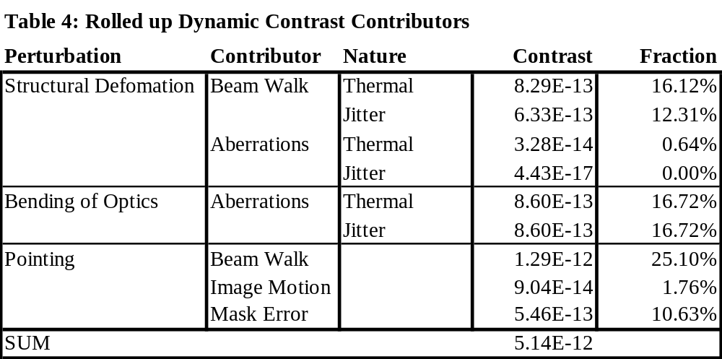
Contrast Roll Up

