Slide 1
NPARC Flow Simulation System

Slide 2
What is NPARC?
The NPARC (National Project for Application-Oriented Research in CFD) Alliance is a partnership between NASA GRC and the U.S. Air Force AEDC, with significant participation from Boeing, dedicated to providing an applications-oriented computational fluid dynamics (CFD) capability for the U.S. aerospace community, centered around the NPARC Flowfield Simulation System.
The NPARC Vision:
The Computational Tool of Choice for Aerospace Flow Simulation

Slide 3
NPARC Alliance History
1993 • Formation of NPARC Alliance
1994-96 • Significant development of NPARC leads to large user base
1996 • McDonnell Douglas becomes an active partner
• Code development groups at AEDC merge
• Decide to merge NPARC, NASTD, NXAIR into WIND
1997 • Work begins on the NPARC Alliance Flowfield Simulation
System centered on the WIND Navier-Stokes Code
• McDonnell Douglas merges with Boeing
1998 • WIND Version 1.0 released
1999 • WIND Version 2.0 released
• NASA Software of the Year Honorable Mention winner
2000 • WIND Version 3.0 released
2001 • WIND Version 4.0 released
2002 • WIND Version 5.0 released
• BCFD (unstructured grid version) released to the Alliance

Slide 4
Alliance Organization
AEDC
GRC
Executive
Direction
Committee
Jere Matty
Manager
Mary Jo Long-Davis
Manager
Technical
Liaisons
Greg Power
Technical Lead
Nick Georgiadis
Technical Lead
NPARC Steering
Committee
Bonnie Heikkinen
Support Lead
John Slater
Support Lead
Ray Cosner
(Boeing - PW)
Technical
Direction
Committee
Chris Nelson
Development Lead
Charlie Towne
Development Lead
Ted Reyhner
(Boeing-Commercial)
Ken Tatum
Validation Lead
Julie Dudek
Validation Lead
Bob Bush
(UTRC)

Slide 5
Flow Simulation System
The NPARC Flow Simulation System has at its core the WIND CFD solver, but also consists of…
common, portable file structure
pre-processing utilities to set up the simulation
post-processing utilities for examining the results
web-based version control software
web-based documentation
web-based validation and verification archive
The NPARC Flow Simulation System assumes that the grid is generated using some other software system (i.e. ICEM CFD, Gridgen).

Slide 6
Supported Platforms
Silicon Graphics
- IRIX 6.5, R4400, R5000, R10000, R12000, R14000 processors
- Multi-processing IRIX 6.5, R10000, R12000, and R14000 processors
Hewlett-Packard
- Multi-processing HPPA11, PA-8500 processor
Sun
- SunOS 5.x, SPARC4U processor
- Multi-processing SunOS 5.x, SPARC4U processor
Linux, X86 processor

Slide 7
Flow Simulation System
Grid Generator
Create Grid
Set Boundary
Conditions
Download Code
IVMS
GMAN
Utilities
Convert File Formats
Mirror Zones
Split/Merge Zones
Reorder/Delete Zones
Wall Function Pre-Processor
Run Flow
Solver
WWW
Documentation
Validation
WIND
CFPOST
RESPLT
Examine
Results
Monitor Convergence
Post-Processor

Slide 8
Class Flowchart
run.ic.q (PLOT3D initial solution file)
CFCNVT
(convert files)
run.x (PLOT3D grid file)
run.cgd (common grid file)
run.cfl (common solution file)
GMAN
(set boundary conditions)
run.cgd (common grid file with BCs set)
run.mpc (multiprocessor control file)
run.dat (data input file)
WIND
(solve flow)
run.cgd (common grid file)
run.lis (list output file)
run.cfl (common solution file)
RESPLT
(read residuals)
CFPOST
(plot and process)
nsl2.gen (GENPLOT file of NS residuals)
run.q (PLOT3D solution file)
output.gen (output GENPLOT file)
output.lis (output list file)
Indicates an optional file
Notes:
This is the flowchart that is the focus of the remainder of the class. We will discuss in depth the use of the five main programs (cfcnvt, gman, wind, resplt, and cfpost) and the files that are inputs and outputs to each of these programs.

Slide 9
Primary Parts of the System
CFCNVT
Converts the PLOT3D grid and solution files (run.x, run.ic.q) into the common file format (run.cgd, run.cfl).
GMAN
Reads the common grid file and allows for manipulation of the grid and setting of boundary condition types onto zone boundaries and overlapping regions.
WIND
Solves the flow equations with inputs from the common files and input data file. Outputs the solution to the common solution file and creates a list output file.
RESPLT
Reads the list output file and generates GENPLOT files of convergence histories.
CFPOST
Post-processor. Reads the common grid and solution files and lists flow field variables, integrates fluxes and forces, creates and plots line and surface GENPLOT files, creates PLOT3D files, and generates output reports.

Slide 10
Other Utilities
B4WIND GUI interface for converting NPARC files to WIND common file format
CFBETA Creates a mirror image of the grid for sideslip (beta) cases
CFCOMBINE Combines zones of common grid and solution files for which grid points match
CFREORDER Deletes and reorders zones from the grid or solution file
CFSPLIT Splits a zone of the common grid and solutions files
FPRO Performs manipulations of the common solution file
GPRO Performs grid generation and manipulation
JORMAK Creates a *.com file containing the solid boundaries for analyzing the surface properties
TIMPLT Reads a common time history file (.cth) and creates a GENPLOT file
CFSEQUENCE Extracts a sequence grid and solution from existing files
CFSUBSET Removes grid points from the log-layer for wall function applications
ADFVIEWER From the CGNS project, is an ADF file viewer and editor with a nice GUI interface
MADCAP Replacement for GMAN and a unified GUI for many of these utilities
Plus several more utilities that are listed and explained in the online documentation

Slide 11
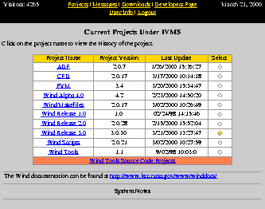
IVMS
Internet Version Management System
(IVMS) used for software version
control and for distribution of
software to users
Accessed via the WWW
GUI interface based on RCS,
developed at Boeing
Users can easily download current
(and earlier) versions of WIND
and its associated utilities
Allows collaborative development at
multiple sites

Slide 12
Code Distributions
WIND Application Distribution - Contains the executable programs and files needed to run WIND on a specific supported platform.
WIND Build Distribution - Contains all source code needed to build the code, plus Makefiles for several platforms.
Tools Distribution - Contains executables for the pre- and post-processing tools used with WIND, including GMAN and CFPOST, for a specific supported platform. Tools also available individually as source code, with Makefiles.

Slide 13
Availability
NPARC Alliance software is available at no cost to U. S. companies,
government agencies, and universities.
May not be used for contract work with a non-U. S. organization.
Release point is through AEDC.
Non-government organizations must have an Export Control Number,
i.e., be registered with the Defense Logistics Services Center Joint
Certification Program.
See the “Acquiring the Software” link on the NPARC Alliance
home page (www.arnold.af.mil/nparc) for details and application
forms, or send email to nparc-support@info.arnold.af.mil.
Approved users download the software from the IVMS web site.

Slide 14
WIND Access at NASA Glenn
Source and executables for WIND, and the various tools, are available from zargon via automount (contact Charlie Towne).
Requires setting of environment variables in .login file.
Executables for SGI, Sun, and Linux.
Run without installing on your own system.
Run codes using scripts.
For details see “WIND at NASA Glenn” in the WIND Installation Guide, at http://www.grc.nasa.gov/www/winddocs/install/grc/grc.html
WIND can be installed from tar file of Application distribution.
Installation documentation is available at
http://www.grc.nasa.gov/www/winddocs/install

Slide 15

Documentation
All documentation is available at
www.grc.nasa.gov/www/winddocs
in both HTML and PDF formats
WIND User’s Guide - Describes the
operation and use of the WIND code,
including a tutorial, and descriptions of
the physical and numerical models,
boundary conditions, convergence
monitoring, files, run scripts, parallel
operation, and input keywords
Separate user’s guides for GMAN and
CFPOST, and for several smaller
utilities distributed with WIND

Slide 16
Additional Documentation
WIND Installation Guide - Describes how to download and install the executables for WIND and its associated “tools,” how to build a new executable from the WIND source code, and how to access WIND via automount here at GRC.
WIND Developer’s Reference - Contains detailed information about the structure of the WIND code useful for those modifying the code (only available to WIND users).
Common File User’s Guide - Detailed information about the common file library, a set of routines providing access to common files.
Guidelines Documents - Programming, documentation, and testing guidelines created for use by the NPARC Alliance during software development projects.

Slide 17
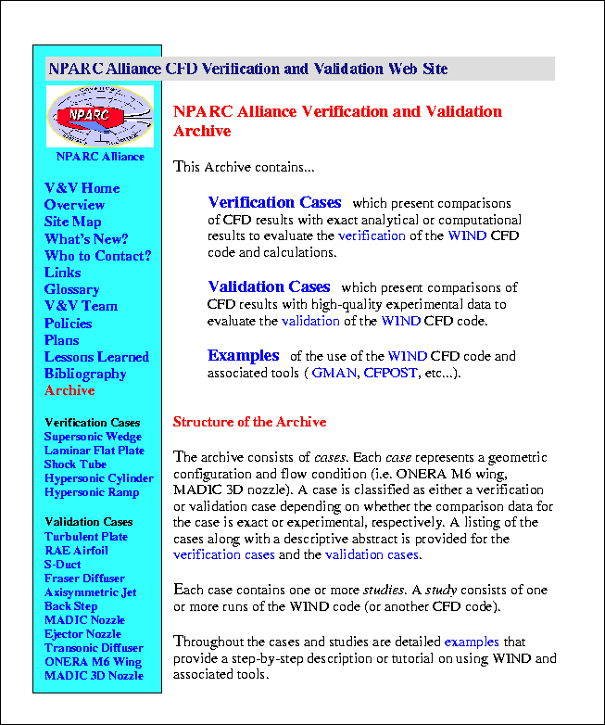
Verification & Validation
NPARC Alliance Verification &
Validation (V&V) WWW site at
www.grc.nasa.gov/www/wind/valid
Validation archive presents WIND code
results; all input/output files may be
downloaded.
Verification cases present comparisons of
CFD results with exact analytical or
computational results.
Validation cases present comparisons
of CFD results with high-quality
experimental data.
Includes detailed examples showing how
to set up and run a case, using GMAN,
WIND, CFPOST, and other WIND utilities.

Slide 18
Support
NPARC Alliance Support Team provides direct user support via email
(nparc-support@info.arnold.af.mil) or telephone (931-454-7455).
National user’s meetings once a year (AIAA Aerospace Sciences Meeting)
Dedicated technical paper session (AIAA Aerospace Sciences Meeting)
Training classes.
Annual newsletter (The Predictor / Corrector).
Annual Workshop produces Policies and Plans document.
User’s mailing list (nparc-users@info.arnold.af.mil).
NPARC Alliance WWW site (www.arnold.af.mil/nparc).
Online documentation (www.grc.nasa.gov/www/winddocs).

Slide 19
Code Development
Development of WIND and utilities is continuous (Boeing, AEDC, NASA GRC).
GRC efforts focused on developing tool for simulating inlet and nozzle flows (VG model, turbulence, bleed).
Development efforts / contributions / suggestions by users are encouraged for all aspects of the system.
IVMS allows distributed development while maintaining strict version control.

Slide 20
Future Activities
Unstructured and hybrid grids. BCFD was released to Alliance and we will be running cases to learn how to use it.
Enhanced physical modeling capabilities: turbulence, transition, chemically reacting flows, boundary conditions, vortex generators.
Complete conversion to CGNS database format. Version 5 capability will be tested.
Consolidation of tools under a common GUI (MADCAP). This will eventually replace GMAN.
Investigate framework options for future CFD systems and multi-disciplinary applications (store-drop, aeroelasticity, structures).

Slide 21
Class Flowchart
run.ic.q (PLOT3D initial solution file)
CFCNVT
(convert files)
run.x (PLOT3D grid file)
run.cgd (common grid file)
run.cfl (common solution file)
GMAN
(set boundary conditions)
run.cgd (common grid file with BCs set)
run.mpc (multiprocessor control file)
run.dat (data input file)
WIND
(solve flow)
run.cgd (common grid file)
run.lis (list output file)
run.cfl (common solution file)
RESPLT
(read residuals)
CFPOST
(plot and process)
nsl2.gen (GENPLOT file of NS residuals)
run.q (PLOT3D solution file)
output.gen (output GENPLOT file)
output.lis (output list file)
Indicates an optional file
Notes:
This is the flowchart that is the focus of the remainder of the class. We will discuss in depth the use of the five main programs (cfcnvt, gman, wind, resplt, and cfpost) and the files that are inputs and outputs to each of these programs.

Slide 22
WIND Files
Principal Input Files
  Input Data File (*.dat). Contains keyword input describing the flow problem and how WIND is to be run. (ASCII file)
  Common Grid File (*.cgd). Contains the computational grid (x,y,z) and boundary condition types and zone coupling data set using GMAN. (binary file)
Principal Output Files
  List Output File (*.lis). Contains listing of input parameters, job statistics, error messages, residuals and integrated convergence information. (ASCII file)
  Common Flow File (*.cfl). Contains the flow, turbulence, and chemistry field, as well as reference state and basic information on simulation. (binary file)
Common File Format (CFF)
Used for common grid (*.cgd) and flow (*.cfl) files.
Also used for some other WIND-related files.
Self-documenting database structure developed at Boeing.
Compact, easily accessible, portable.
Common grid and common Flow files supported by several commercial grid-generation (ICEM, Gridgen) and post-processing packages (Fieldview).
CGNS now supported.

Slide 23
WIND Files (cont)
Other / Optional Input Files
Multi-processor control file (*.mpc)
Chemistry Input file (*.chm)
WIND Stop File (NDSTOP)
Transition and temperature specification files
Other / Optional Output Files
Global Newton file (.cfk)
Boundary data file (.tda)
Time history file (.cth)
Further information is in WIND User’s Guide:
www.lerc.nasa.gov/www/winddocs/user/files.html

Slide 24
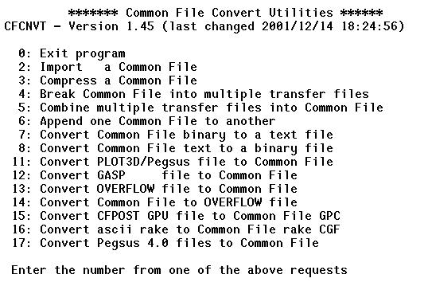
CFCNVT
Common File Convert (CFCNVT).
Converts several file formats to the common file format for WIND.
Grid and flow files can be converted.
Flow file can be used as initial condition for flow field in WIND.
Text-based program can be run interactively or in batch.
Reply to a few prompts depending on the input file format.
Start analysis process assuming we have a grid file.
PLOT3D format (option 11) is a common grid file format output by grid generation software.
An initial flow field can be generated with another small program, output to the PLOT3D format, and then converted to a common flow file using CFCNVT.

Slide 25
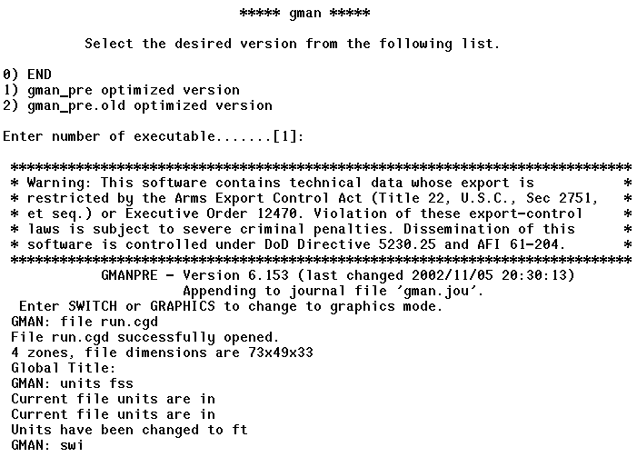
GMAN
Grid Manager (GMAN).
GMAN can be run in interactive mode using graphical menus or commands or in batch mode using scripts.
Input is the common grid file (*.cgd).
Switching to graphics mode is done by “swi” or “switch”.
Journal file is output for rerunning GMAN in batch mode.
What does GMAN do?
Set units for grid and flow (EE or SI)
Set boundary condition types
Display grid and boundary condition types
Compute zonal connectivity
Perform hole-cutting and grid overlapping
Scale, translate, rotate grid
Add or replace zone from other file
Basic grid generation (seldom used)
Red boxes indicate inputs to prompts
The MADCAP program will eventually replace GMAN

Slide 26
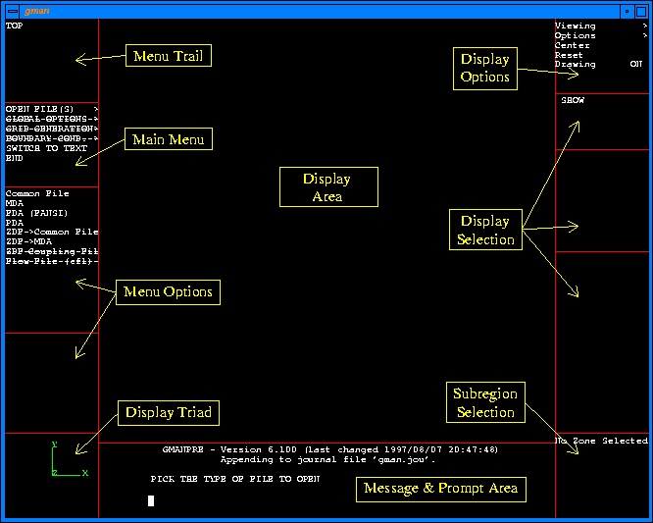
GMAN: Graphics Mode
Quick Reference:
Hierarchy of menu items is from top to bottom.
Left mouse button selects a menu item.
A line through a menu item indicates that item can’t be chosen.
A “*” in front of a menu item indicates that item is the default.
Mouse Buttons in Display:
  LEFT: Rotation
  MIDDLE: Zooming
  RIGHT: Translation

Slide 27
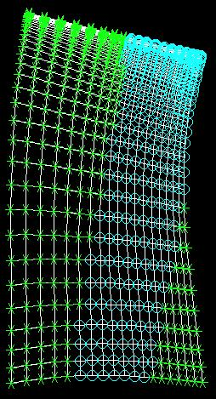
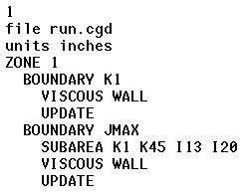
GMAN: Boundary Conditions
GMAN is used to assign boundary condition types to each grid point on a zonal boundary.
Zonal boundaries:
    I1, IMAX, J1, JMAX, K1, KMAX
Subregions of boundary grid points can be defined to specify multiple BC types on a zonal boundary.
Process for specifying BC type:
  Select zone (i.e. zone 1)
  Select boundary (i.e. K1)
  Select subregion (i.e. j1 j21 i2 i14) optional
  Select BC type
  Update file
BC types available:
Undefined
Reflection
Freestream
Viscous wall
Arbitrary Inflow
Outflow
Inviscid Wall
Self-Closing
Singular Axis
Mixed-Axis Wall
Bleed
Pinwheel Axis
Frozen
Chimera Boundary
Sample of journal file created
created during an interactive
session with GMAN
Green = viscous wall
Aqua = bleed region

Slide 28
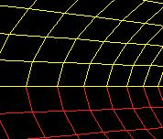
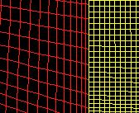
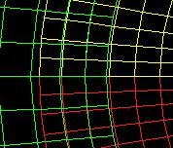
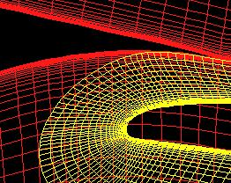
GMAN: Zonal Connectivity
Flow information is exchanged across zonal boundaries.
Connectivity defines how a zonal boundary is connected to other zonal boundaries.
Types of Zonal Connectivity
1) Abutting, Point-to-point match
2) Abutting, Non point-to-point match
3) Overlapping, Point-to-point match
4) Overlapping, Non point-to-point match
1 & 3
2
Outer boundary
4
GMAN can automatically compute zonal connectivity for abutting (1 & 2).
Overlapping (overset) grids use tri-linear interpolation to exchange information.
Point-to-point match is best since direct transfer is possible and interpolation errors are minimized.
Interior boundary

Slide 29
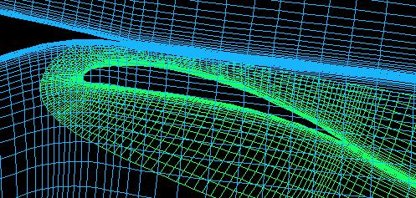
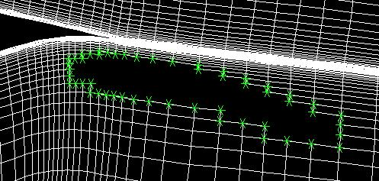
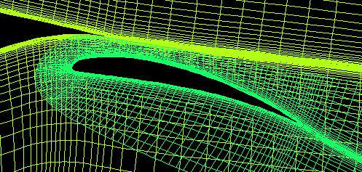
GMAN: Overlapped Grids
Hole
Fringe points
Example of NLR Airfoil with flap
Flap grid overlaps airfoil grid.
Use flap grid to cut a hole in airfoil grid.
Indicate edge points of cut are fringe points to interpolate boundary information from flap grid solution.
Outer edge of flap grid is fringe boundary of flap grid and receives interpolated data from the airfoil grid.
Fringe points

Slide 30
WIND
Equation Sets in WIND:
Reynolds-Averaged Navier-Stokes (RANS)
Turbulence
Chemistry
Magneto-Fluid Dynamics (MFD)
WIND is not an acronym.
Solves several types of equations.
Contains variety of features and numerical methods.
Basic input files required are:
  Input data file (*.dat)
  Common grid file (*.cgd)
  Common solution file (*.cfl) optional
WIND is executed using the WIND script with text prompts and responses.
WIND is run as a batch execution.
Simulation times to iterative convergence can range from minutes to days.
Features of WIND:
Cell-vertex, finite-volume formulation
Time-marching (steady or unsteady)
Space-marching for supersonic flows
Propulsion-specific boundary conditions
Multi-zone, structured grids
Abutting or overlapped zones
Parallel and multi-processor operation

Slide 31
WIND: Input Data File
Input data file (.dat) is ASCII file.
File contains descriptive keywords.
“test” options used for special cases.
Online documentation lists all keywords.
First 3 lines are
for titles.
Example Input Data (*.dat) file:
RAE 2822 Airfoil. 2D Transonic Flow.
Mach = 0.729. Alpha = 2.31 deg.
Single zone C-grid 369 x 65.
/Freestream Mach p(psi) T(R) AOA Beta
freestream static 0.729 15.8 460.0 2.31 0.0
downstream pressure freestream zone 1
turbulence model spalart allmaras
dq limiter on
implicit boundary on
cycles 200
iterations per cycle 10 print frequency 10
cfl 5.0
end
“/” indicates a comment line .
Freestream keyword sets reference
conditions, which are input in units
consistent with grid file.
Specifies choice of
turbulence model.
Specifies additional information for
the outflow boundary condition.
Specifies use of limiter for change
in solution (dq) over an iteration.
Specifies the number
of cycles to run.
Specifies use of implicit boundary
conditions on the airfoil surface.
Specifies the number of iterations per cycle
and print frequency to list output file.
Specifies the CFL number.

Slide 32
WIND: Select Keywords
Some of the other most commonly used keywords include:
AXISYMMETRIC Indicates flow domain is planar, axisymmetric.
BLEED Specifies inputs for mass flow and porous bleed models.
FIXER Turns on algorithm to fix bad points in flow (I.e. negative pressure).
IMPLICIT Specifies algorithm to use for implicit time-marching.
MASS FLOW Specifies inputs for outflow boundary condition.
RHS Specifies algorithm to use for numerical flux.
SEQUENCE Option to use coarser grid that is sequence of full grid.
SMOOTHING Specifies algorithm for artificial dissipation.
THIN SHEAR LAYER Option to use thin shear layer assumption.
TVD Specifies algorithm for TVD limiting of flux terms.
WALL FUNCTION Option to use a wall function for turbulence modeling.

Slide 33
WIND: Block Keywords
Block keywords are input as a block of keywords that follow a certain format:
ARBITRARY INFLOW Proves inputs for the arbitrary inflow boundary condition
CHEMISTRY Provides inputs for the chemistry model
LOADS Provides inputs for summing forces on surfaces
ACTUATOR / SCREEN Provides inputs for the actuator disk / screen model
VORTEX GENERATOR Provides inputs for the vortex generator model
arbitrary Inflow
total
hold_totals
zone 1
uniform 0.6 14.0 460.0 0.0 0.0
endinflow
loads
print totals zones lift frequency 10
reference area 1.0
reference length 1.0
reference moment center 0.0 0.0 0.0
zone 1
subset I 33 337 j 1 1 k 1 1 force noslip
endloads
chemistry
fuel air ratio 1.0
file h2air-7sp-std-15k.chm
finite rate
mass fractions 0.993 0. 0.007 0. 0. 0. 0.
endchemistry

Slide 34
WIND: Flow Initialization
WIND requires an initial flow field to start the marching
schemes. Some options for obtaining this include:
Default initialization is uniform flow based on “freestream” values.
Initial flow solution can be from common solution file (*.cfl).
Arbitrary inflow can initialize a zone.
Boundary layer initialization on a wall (one j or k surface per zone).
Re-initialization of a “bad” zone.
Initialization of turbulence and chemistry values.

Slide 35
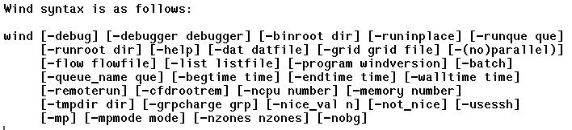
WIND Script
Command-line script to run WIND.
Graphical interface also available (B4CFD).
WIND may be run interactively, via Unix at/batch commands, or via NQS system.
Executable need not reside on local system.
May run on a remote system.
Type wind –help to get list of options.

Slide 36
WIND: Parallel Operation
WIND may be run in parallel on a multi-processor system, or on a cluster of heterogeneous systems.
Fault-tolerant master-worker approach.
Grid zones are distributed from the master to the worker systems for processing.
PVM message passing is used on clusters; PVM or MPI may be used on multi-processor systems.
WIND and PVM / MPI need not be pre-installed on worker systems.
User specifies hosts via Multi-Processing Control (*.mpc) file.
Multi-Processing Control (*.mpc) file:
# loadlimit 1800
host saturn nproc 12

Slide 37
WIND: New in Version 5
Version 5 released November 2002
Improved time history tracking
Improved CGNS compatibility
Vortex generator model
Direction specification at arbitrary inflow boundary
Improved smoothing algorithm
Chemistry improvements
OVERFLOW options
- Time step selection
- ARC3D 3-factor diagonal scheme
- Roe differencing
Koren and van Albada TVD limiters
Additional explicit operators

Slide 38
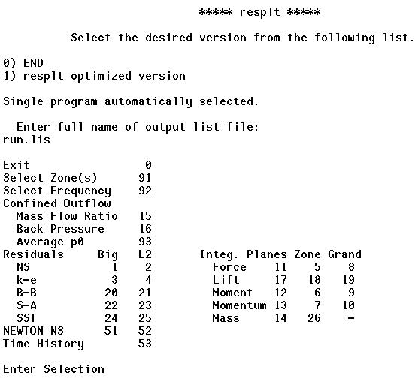
RESPLT
RESPLT: Residual Plotter.
Reads the List Output File (*.lis) and extracts residual and other iterative convergence information and creates an ASCII GENPLOT file (*.gen) for plotting by CFPOST.
Text-based program can be run interactively or in batch.
Reply to a few prompts depending on what information is to be extracted.
Asks for the name of the GENPLOT file to output.
Red box indicate inputs to prompts
Sample of Selections:
2 L2 norm of residual of RANS equations per zone
23 L2 norm of residual of Spalart-Allmaras turbulence equation
17 Lift on surfaces as indicated by the LOADS keyword

Slide 39
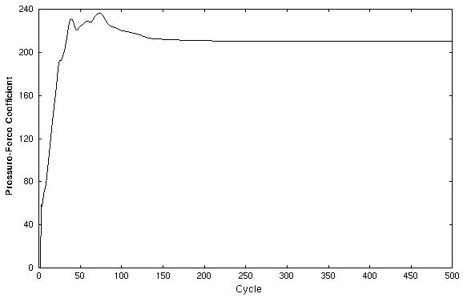
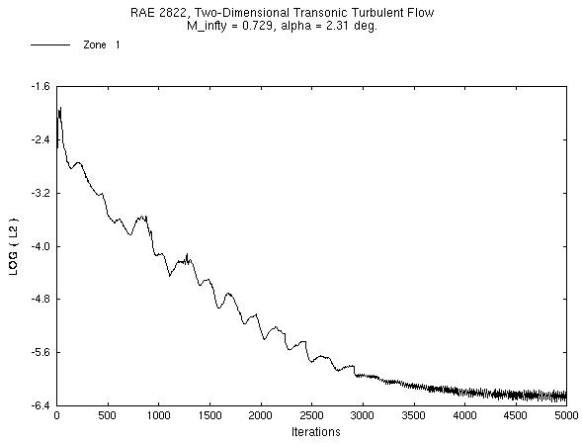
RESPLT: CFPOST Plotting
Airfoil lift –vs- Cycles
RANS L2 residual –vs- Iterations
CFPOST can then plot the
ASCII GENPLOT file.

Slide 40
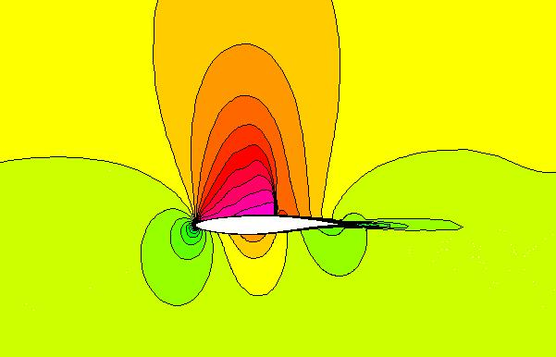
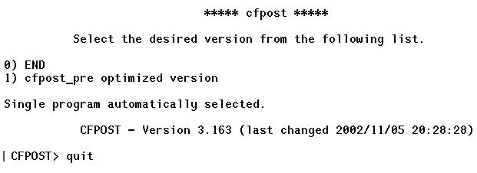
CFPOST
CFPOST: Common File Post-Processor.
Text-based program requires sequence of commands and can be run interactively or in batch.
What does CFPOST do?
Plots GENPLOT files
Creates contour plots
Creates velocity vector plots
Outputs PLOT3D grid & solution files
Computes forces and moments
Integrates fluxes (mass, momentum, …)
Averages flow over a cut or surface
Propulsion-specific analysis (rakes)
3D flow visualization is better performed using
packages such as FAST, Fieldview, or Ensight.
Prompt waiting for commands

Slide 41
CFPOST: Command Sequence
To plot a GENPLOT file:
plot data nsl2.gen
quit
General sequence of CFPOST commands:
1) Specify grid file
2) Specify solution file
3) Specify units
4) Specify zone
5) Specify surface, cut, subset, etc…
6) Specify operation (plot, integrate, …)
7) quit to exit
To create PLOT3D files:
grid run.cgd
solution run.cfl
units fss
zone 1 to last
subset i all j all k all
plot3d x run.x q run.q unformatted mgrid
quit
To create a report of forces on a wing:
grid run.cgd
solution run.cfl
units fss
zone 3
subset k all i all j 1
integrate force output forces.lis –
iviscous –
reference length 1.0 –
reference area 1.0 –
reference moment 0.0 0.0 0.0
quit
To create a plot file of Cp distribution at a cut along a wing:
grid run.cgd
solution run.cfl
units fss
zone 2
subset i all j 1 k all
cut at z 0.25
variables x; Cp scale –1
genplot output cp.gen
quit

Slide 42
Summary of the System
Many options exist for using the programs that make up the NPARC Flow Simulation System.
The previous presentation discusses one approach:
CFCNVT ⇒ GMAN ⇒ WIND ⇒ RESPLT ⇒ CFPOST
Online documentation provides further information.
Best way to learn is to see a demonstration and get some hands-on experience (next few hours).

