Slide 1

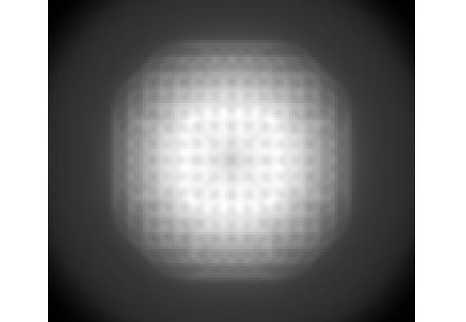
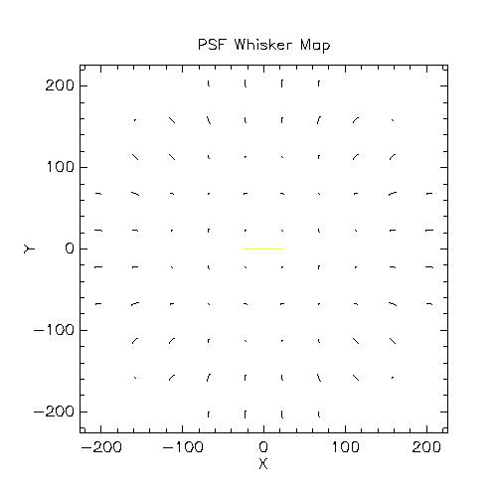
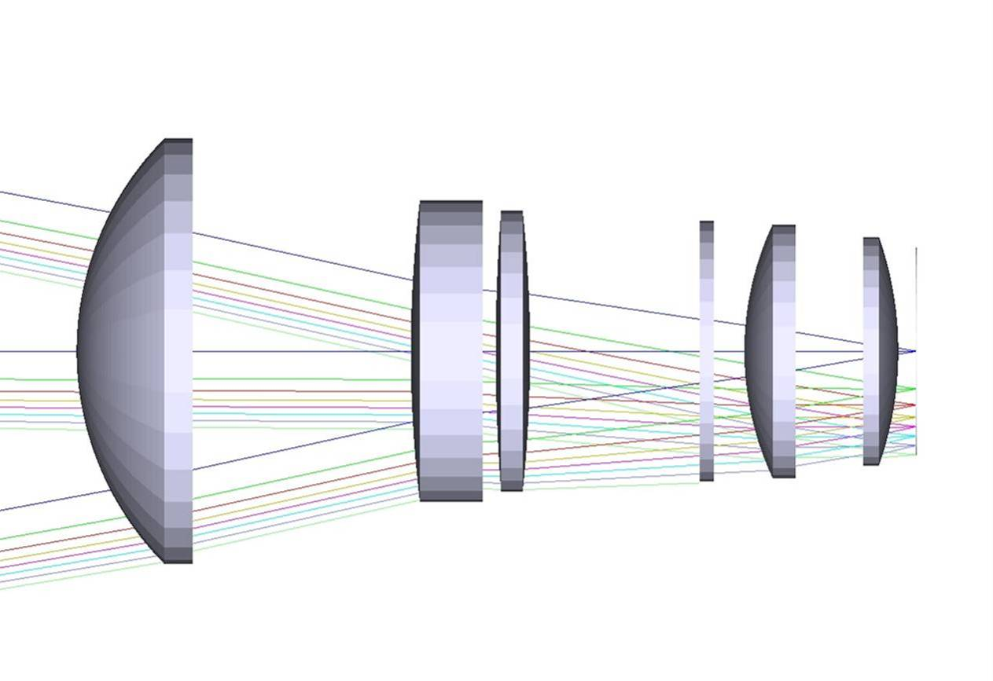
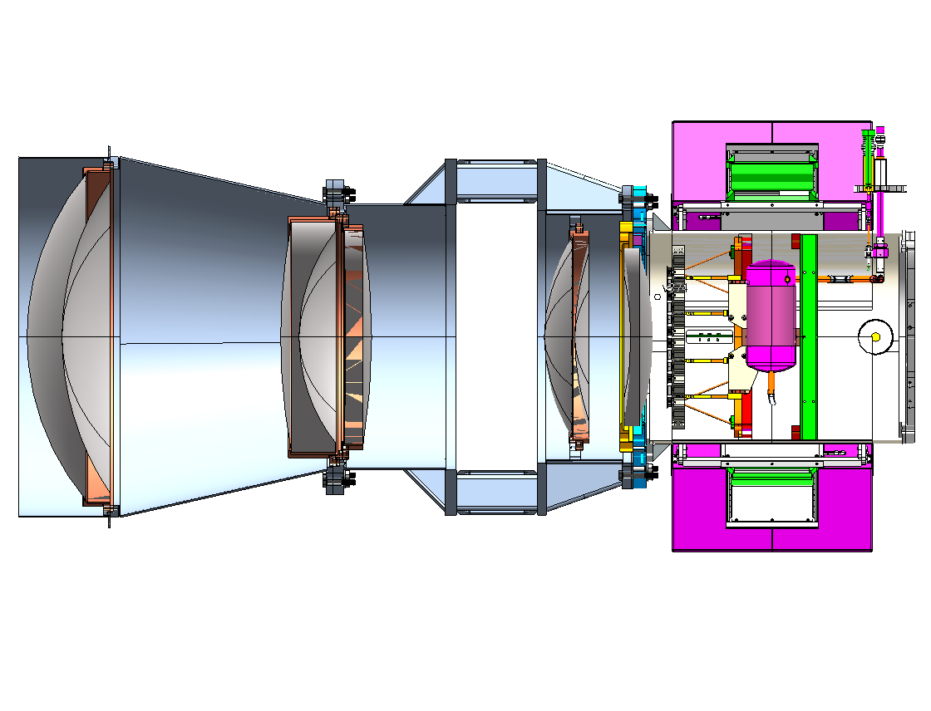
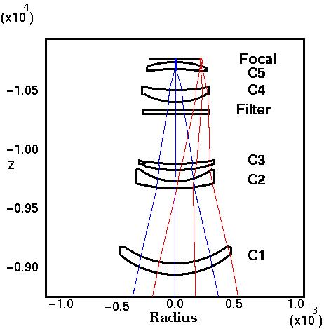
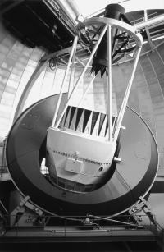
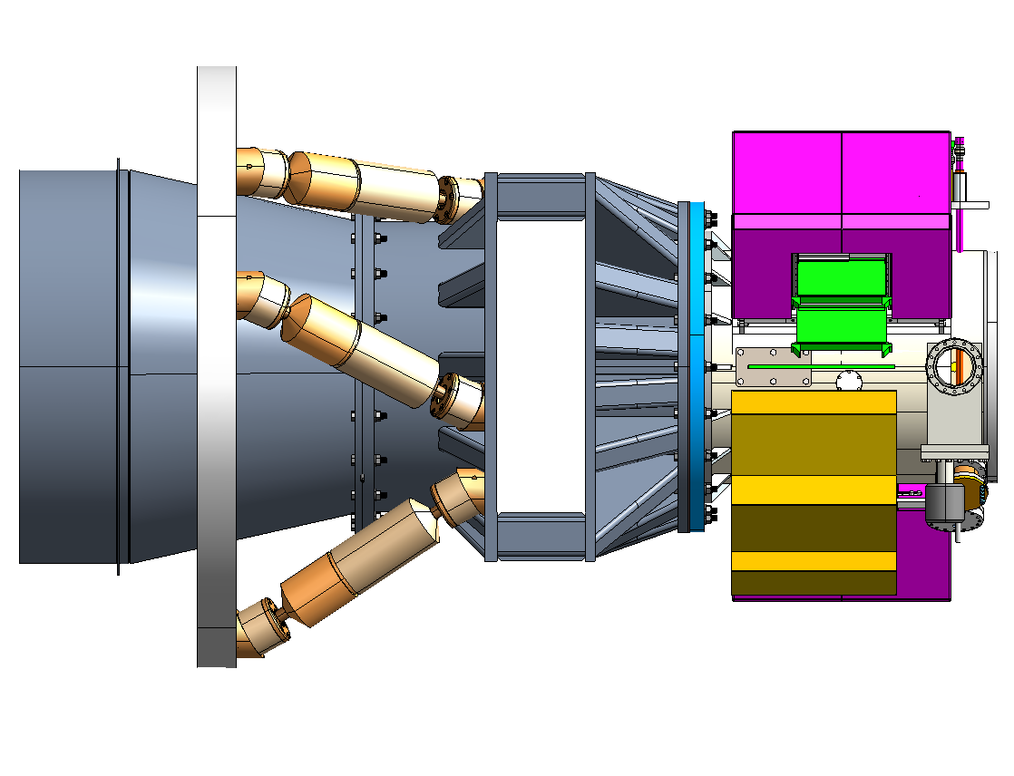
Preliminary Optical and Mechanical Designs for a 2.2
Degree Diameter Prime Focus Corrector for the
Blanco 4 Meter Telescope
Who?
S. Kent (Fermilab), R. Bernstein (U. Michigan), B. Bigelow (U. Michigan), H. Cease (Fermilab), F. Leger (Fermilab), A. Stefanik (Fermilab),T. Abbot (CTIO/AURA), D. Brooks (UCL), P. Doel (UCL), B. Flaugher (Fermilab), M. Gladders (OCIW), A. Walker (CTIO/AURA), S. Worswick (UK) for the DES collaboration
What?
Why?
Requirements
Corrector Performance
Prime Focus corrector for Blanco
Eight times bigger field than current corrector
Use for Dark Energy Survey
500 Megapixel Camera
Mode: Imaging
Image size: 0.27" FWHM
Bands: g, r, i, z
(u desirable)
Pixel size: 15 microns
Scale: 0.27"-0.3" per pixel
Field: 2.2 deg diameter
Focal plane: Flat
Temp.: -5 to +25 C
Radiation: < 0.01 events/cm^2/sec
Throughput 75% (including primary)
Pupil Ghost: < 0.05%/mm
Halo Ghost: < 25 mag/arcsec^2
(from mag 6 star)
PSF "whisker ": Residual amplitude of
0.04" (for weak lensing)
Exit Pupil Ghost
(0.04% per mm)
Static Whisker Pattern
(0.20" max. length, 0.05"
rms residual)
C4
Dewar
window
Mechanical Design Concept
C2
C3
C1
Where?
How?
Design
C1
C2+C3+C4+
Filter+ Shutter
C5+Imager
Hexapod Support Concept Design
Features
5 elements
Last element is dewar window
No ADC
All Fused Silica
Two aspheric surfaces
Refocus allowed for each filter
PSF meets requirement (r, i, z)
Usable UV performance
6x6 Hexapod supporting DECam
Provide full 5-axis motion
Hexapod outer support attaches to
  PF Cage Assembly
Concept design only - details will change
Load is heavy!
Blanco 4 m telescope
Cerro Toloto Inter-American
Observatory, Chile

