Slide 1
Dark Energy Survey
Science Requirements
and
Technical Specifications

Slide 2
Science Goals
IMAGING SURVEY
  5000 Square Degrees
    South Pole Survey
    Equatorial Stripe
    Connector area
  1/2 L* elliptical galaxies @ z = 1
  Photometric redshifts to 20 galaxies per sq. arcmin (10 galaxies/sq. armin for weak lensing)
TIME DOMAIN SURVEY
  1900 Supernovae 0.25 < z < 0.75
  Sampling 3 to 6 nights

Slide 3
Constraints and Conditions
Operating Parameters
  30% observing time for 5 years
  CTIO Site seeing (90% of time FWHM < 1.1 arcsec)
Technology Constraints
  4 meter primary mirror
  LBNL CCDs
    15 μ pixels
    7.5 μ (sigma) diffusion

Slide 4
Science Requirements - Overview
Science program is design based on existing performance of Blanco + P.F. Corrector + Mosaic II
  ==> DES should do no worse than existing telescope.
Operational constraints drive the requirements as much as science requirements
Requirements require balance of cost, performance, schedule, and risk

Slide 5
Wavelength Coverage
Coverage is 400nm to 1000nm in 4 bandpasses (g, r, i, z)
UV: Good performance is not a requirement, but we are asked to report on image quality and throughput (BIRP committee report)
  Current design at 0.35 μ
    0.5 arcsec FWHM
    Glass transmission is 68%

Slide 6
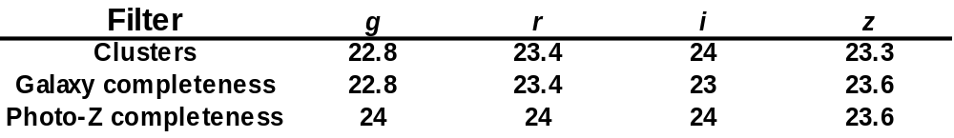
Limiting Magnitude
Bottom row gives final requirement
Note: The actual survey will do better in g and r.

Slide 7
Photometric Calibration
Systematic error in each filter shall be no more than 2%.
  Main impact is on ghosting - require 0.6% rms residual error due to ghosting

Slide 8
Point Spread Function
Requirement: Instrument + telescope shall degrade PSF by no more than 0.55 arcsec
  This is performance of current telescope + Mosaic II + PF corrector
  Further breakdown later in PSF budget
Weak Lensing: Systematic errors in calibrating PSF shall contribute no more than 10% to statistical error on a scale of 2º.
  Estimated statistical error is 0.1% shear (1 sigma)
  Equivalent "whisker" for galaxy 1.2 arcsec in diameter is 0.06 arcsec
  No requirement on static PSF

Slide 9
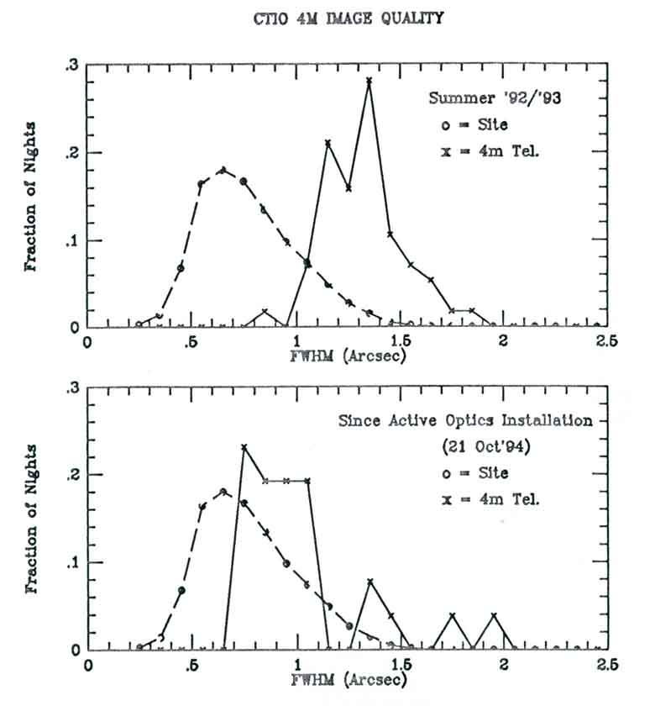
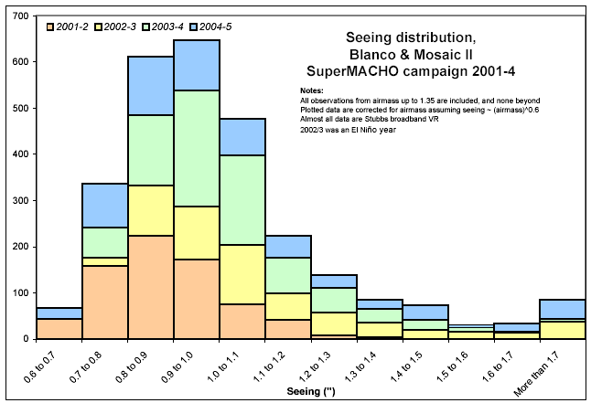
Current Performance
Actual image quality from SuperMACHO
campaign
Site Seeing

Slide 10
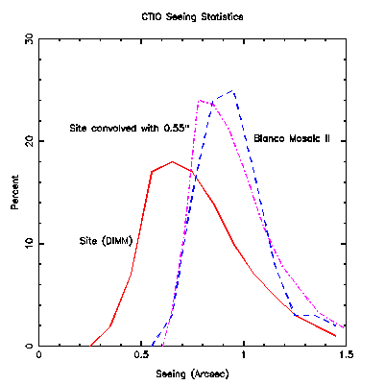
CTIO Seeing

Slide 11
Model of a PSF
=
*
Elliptical PSF
Circular PSF
"Whisker"
Circular PSF has contributions from intrinsic PSF & seeing
Whisker PSF has contributions from intrinsic PSF & tracking
errors.
I will use the amplitude of a "whisker" from the intrinsic PSF
as my metric for weak lensing calibration, since this mimics
the gravitational shear signal and is easy to calculate.
For convolution, FWHM's add in quadrature.
A 0.1% error in shear for 1.2" FWHM galaxies => 0.06"
FHWM error in the equivalent PSF "whisker".

Slide 12
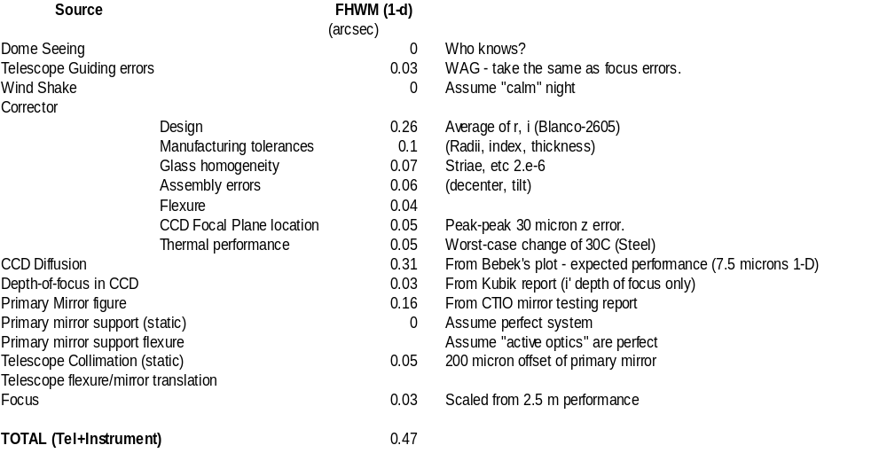
PSF Budget
Requirement: 0.55

Slide 13
PSF details
Requirements on optical corrector:
  Design: 0.27'' FWHM (r, i, z) - same performance as current PF corrector
  No requirements on static contribution to whiskers for weak lensing - assume we will calibrate with multiple frames.
  Manufacturing, assembly: Assume good engineering practices.
CCD Diffusion
  This is the biggest single item in the error budget!!!
  Performance of current CCDs is unknown.
    HST ACS WFC uses same devices - sigma is 5 to 10 μ

Slide 14
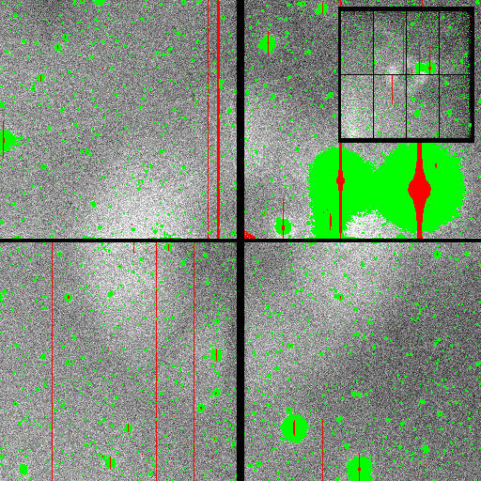
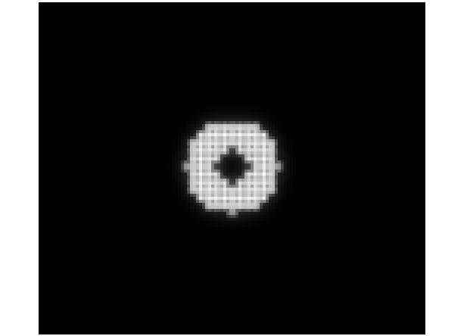
Ghosting
Prediction from design
Mayall 4 m Mosaic I image
Exit Pupil Ghosting

Slide 15
Ghosting Requirements
Exit Pupil: Gradient across length of 1 CCD no more than 3%.
  Assumes 15% CCD reflection, 1% lens surface reflection
  Induced photometric error (if uncorrected) is 0.9% for a single frame.
Bright star: 6th mag star produces ghost no brighter than 25th mag/sq. arcsec
  Main impact is spacing of window from focal plane.

Slide 16
Field of View
Field diameter of 2.2 degrees
  Needed to complete survey in 5 yrs
  25% contingency (last year)
  Minimum of 4 tilings (significant part of sky covered only 3 times)
  Minimum exposure time of 100 sec.
    Overhead is ~30 sec per exposure
  Note: Statement of achieved limiting magnitude assumes 4 tilings, all contingency used for observing.

Slide 17
Transmission
Original requirements presumed fused silica and thus no requirement was provided.
Science plan was constructed assuming ~75% throughput (mirrors + lenses)
Current Blanco is ~78%.
  Glass transmission 97%
  Coatings (SolGel + MgF2) 88% total.
  Note: UV transmission (glass only) is 68%

Slide 18
ADC (or lack thereof)
No requirement for ADC
  Detriment to weak lensing (r, i, z)
  In good seeing, image degradation due to diff. refraction is slightly smaller than degradation due to (secz)^{0.6} effects for g band; negligible for all other bands.
  Anecdotal evidence is that current observers do NOT use existing ADC (e.g, weak lensing survey, SuperMACHO).

Slide 19
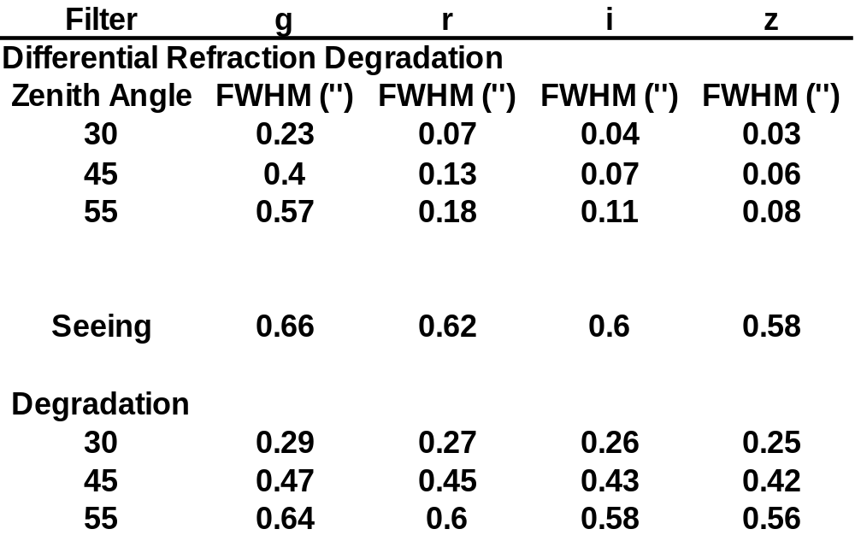
Impact of Diff. Refr. on Image Size

Slide 20
Whisker length vs. differential refraction
Filter zenith may11
angle Mean diff
r 0 0.15 0.00
r 30 0.21 0.20
r 45 0.32 0.29
i 0 0.23 0.00
i 30 0.23 0.11
i 45 0.24 0.17
z 0 0.23 0.00
z 30 0.23 0.06
z 45 0.23 0.09
Survey operates
to zenith = 45 deg

Slide 21
Trade Studies
Figure of merit: Exposure time per sq. deg. of sky to reach a target S/N for sky-limited objects. Small is better.
  t = FWHM² / (A*T)
  FWHM = Image size
  A = Field size
  T = Transmission (throughput)
For current design, increasing area wins over degradation of image size always.

