Slide 1
ILC Electronics Manufacturing
Opportunities
ILC Industrial Forum at Fermilab
September 21-22, 2005
Ray Larsen for SLAC ILC Electronics Group

Slide 2
Outline
I. Power Electronics
  Modulators
  Power Supplies
II. Controls & Networks
III. Instrumentation

Slide 3
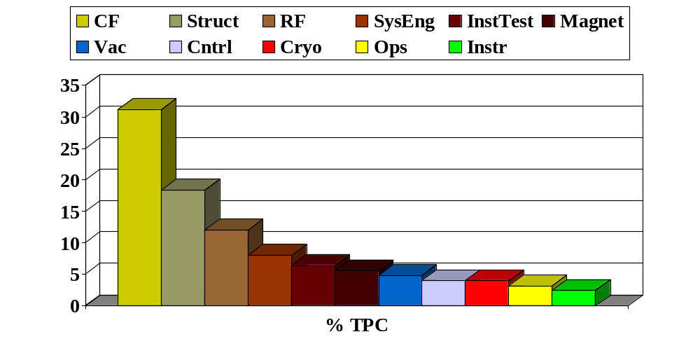
Subsystem Relative Costs

Slide 4
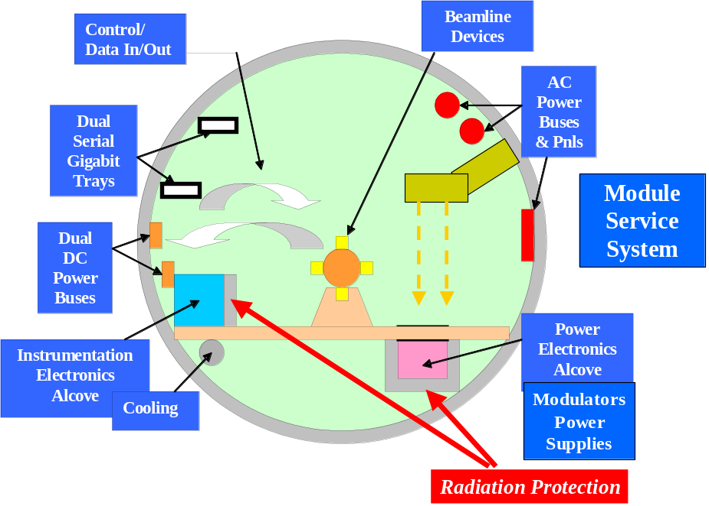
2-Tunnel Model w/~Penetrations
~6in. Penetration
Module
Tray

Slide 5
I. Power Electronics
Modulators
  Est. Production Cost 4% TPC
  Est. Range $100-200M
Power Supplies
  Est. Production Cost ~4% TPC

Slide 6
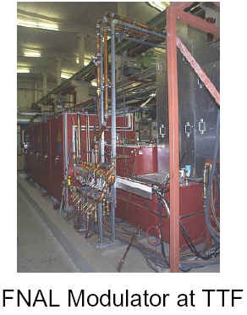
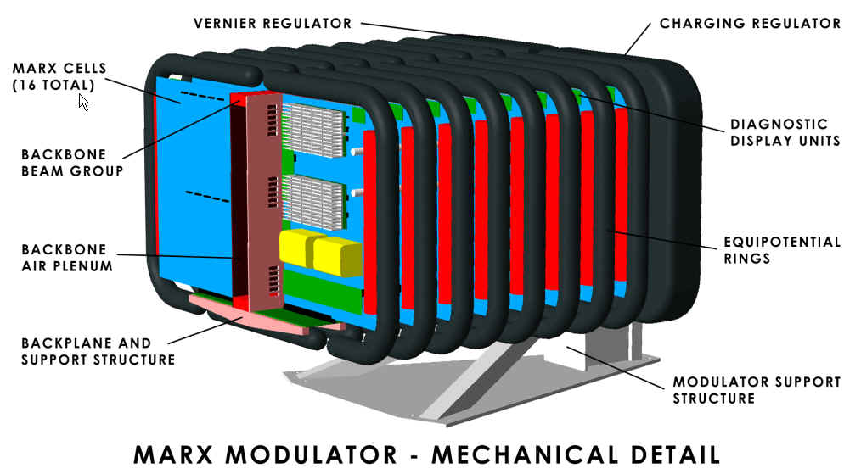
Modulators: TESLA and Marx

Slide 7
Design Comparison
600 Units total
Assume Dual Tunnels, short HV cables to klystron
TESLA – Current Baseline design
  PFN, IGBT redundant switch at 1/10 HV, bouncer flattener, step-up Xfmr to 120KV, 140A
MARX – R&D Design
  Potential 40-50% cost reduction, 10X lower switch current, losses.
  Plug-in module design to backplane, IGBT switch arrays each board, vernier board flattener, redundant switches, modules, diagnostic controllers, robotic module swap

Slide 8
Manufacturing Comparison
TESLA:
  Traditional capacitor banks in cabinets, point-to-point interconnects, separate charging source at 10KV DC, separate dual discharge switch, separate oil-filled transformer.
  Entire unit can be contracted to assembler
  Could subcontract switches, transformer, HV cable assemblies, controls subassemblies
  Modulators and Xfmrs separately factory tested.

Slide 9
Manufacturing Comparison 2
MARX
  Transformer-less oil-free design
  Each unit has 16 plug-in circuit board modules
  Total boards = 9600 for 600 units
  60% Parts cost in IGBT switch sub-modules
  Total sub-modules =10 per module, 96,000 for 600 units
  Capacitors mount on each module
  Operates in sealed box with air-water heat exchanger
  Contract for fully assembled factory tested units
  Subcontract all subassemblies to standard PC board manufacturers.

Slide 10
Installation Comparison
TESLA
  Install tested units in large cabinets, move units into tunnel position depending on how large can handle. May have to separate racks.
  Install transformer, HV connections separately
  Repair in situ or remove failed Xfmr
MARX
  Install box 2x2x1.5m, populated with modules optional.
  Option: Populate, service with robotic module remove and replace system. Can work 24/7 from maintenance depots along machine.

Slide 11
Power Supplies
High Availability 1/n Modular Designs where failure will interrupt machine
Apply as needed to:
  KW to 100KW single load or string supplies
  Multi-channel Corrector supplies
  Cryogenic magnet supplies

Slide 12
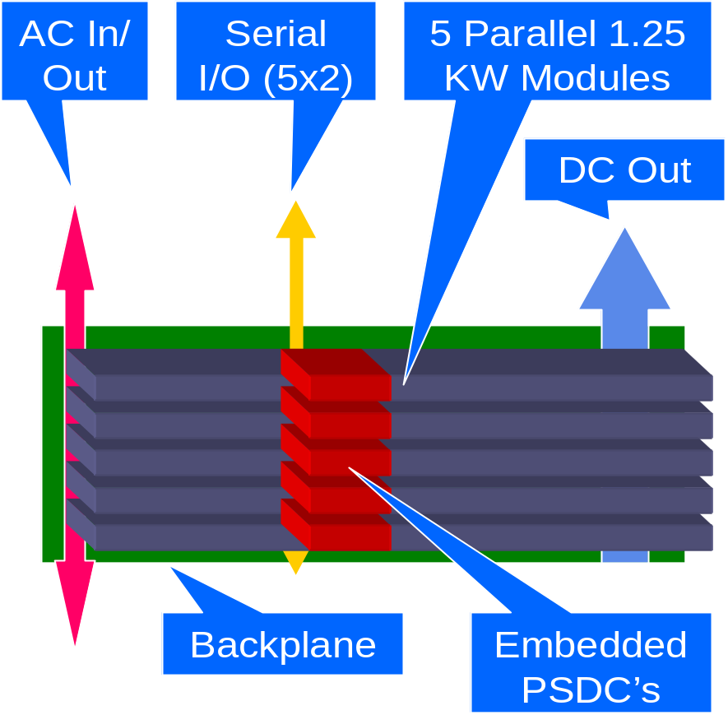
HA PS Concept – Quads, LGPS
n/N parallel modules for DC magnet supply (1/5 shown)
Overall load current feedback
Dual Diagnostics Controller Mezzanine Card each module

Slide 13

HA PS Module - Correctors, Cryo
  Motherboard
  Dual Serial Control IO
  Independent Carriers Hot Swappable
  Optional: Redundant n/N w/ Switchover
  Dual Bulk 48V DC In
DC
Out

Slide 14
Manufacturing
Injection, Damping Ring and Beam Delivery all warm supplies, LGPS & Modular
Main Linac quads, correctors cryogenic low voltage, high current, low power supplies
Total units estimates
  LGPS 1/n redundant supplies:1500?
  Modular n-channel supplies: 3000?
  Cryogenic modular supplies: 3000

Slide 15
II. Controls & Networks
Review of existing SLAC Linear Collider & PEP Control System
  Redundant DEC (HP) Alpha mainframes with 4 tandem processors each
  Remote Multibus SBC IOCs throughout systems
  IOCs fan out over multiple serial links to CAMAC simple communications controllers
  SLCnet, PEPnet, Pnet custom protocols
  Special fast timing net locked to Linac, PEP RF

Slide 16
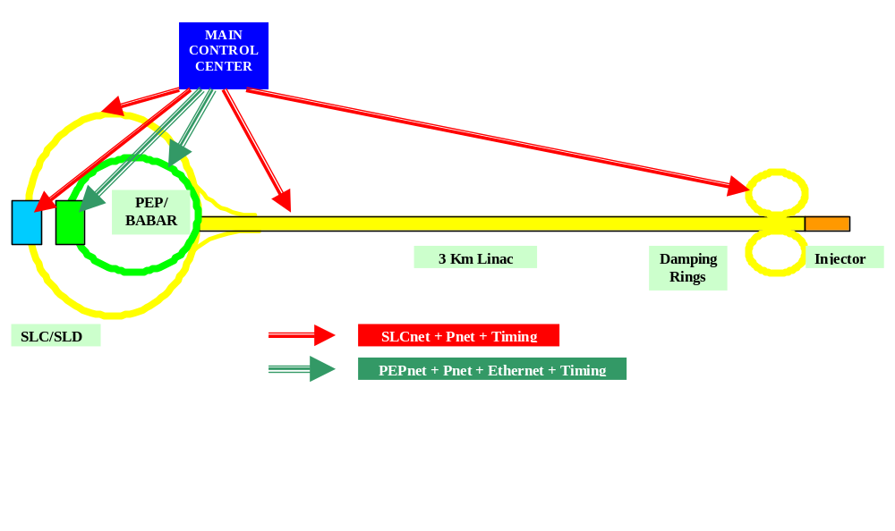
Existing SLC Layout, Networks

Slide 17
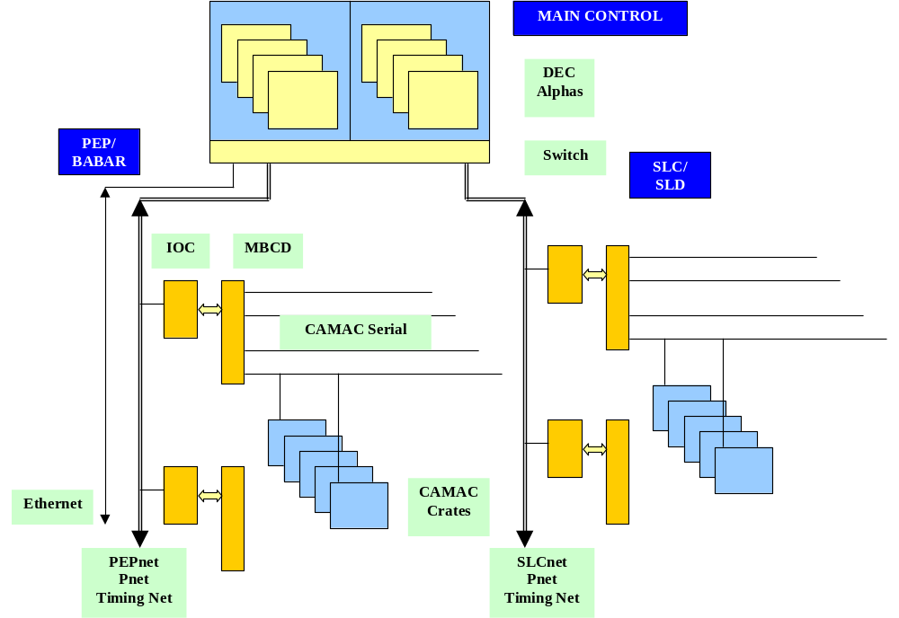
SLC-PEP Controls Architecture

Slide 18
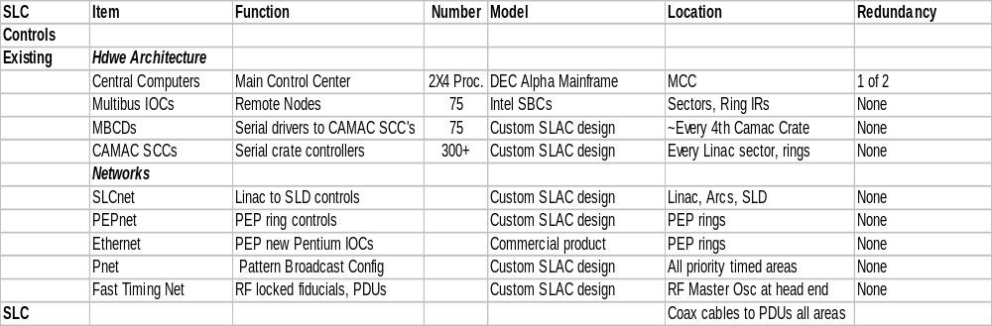
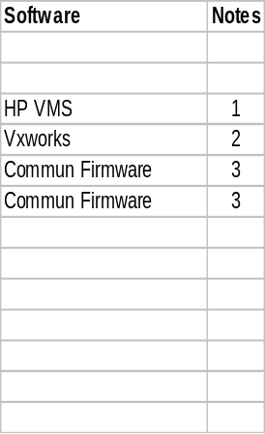

SLC-PEP Summary

Slide 19
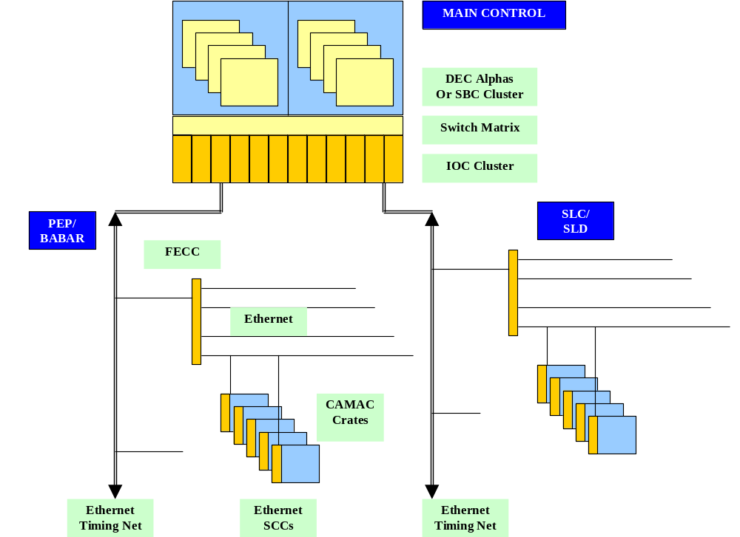
SLC-PEP Upgrade Plan

Slide 20

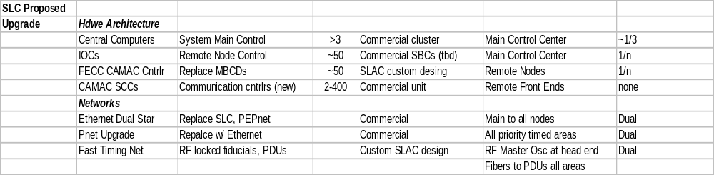
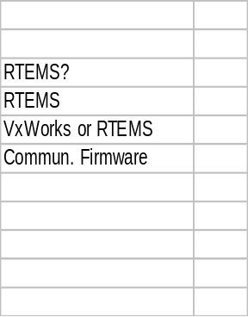
SLC-PEP Upgrade Summary

Slide 21
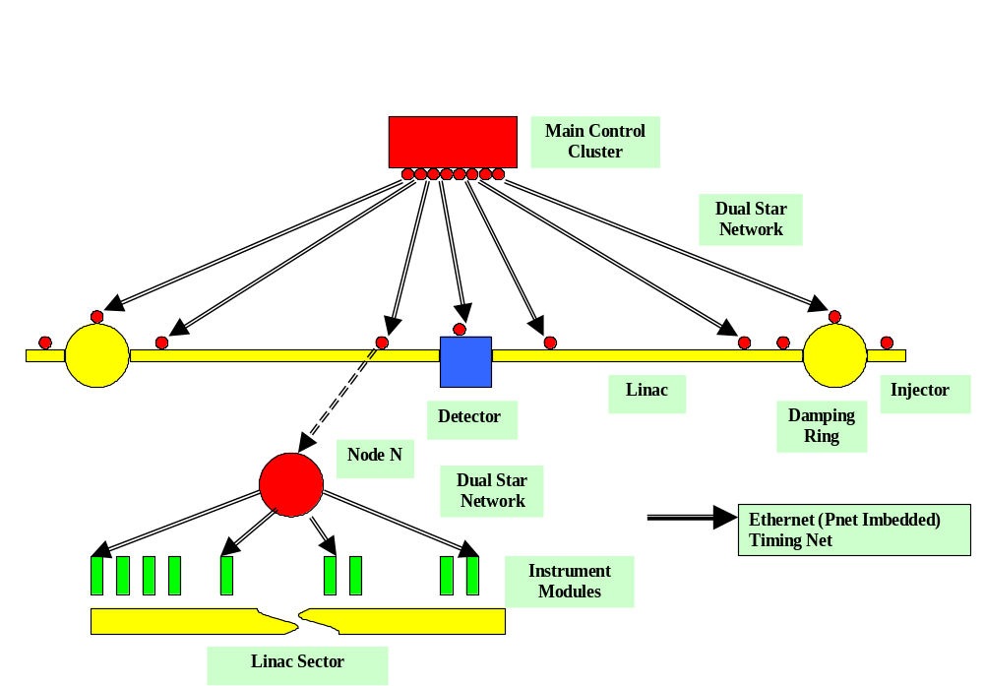
ILC Proposed Architecture

Slide 22

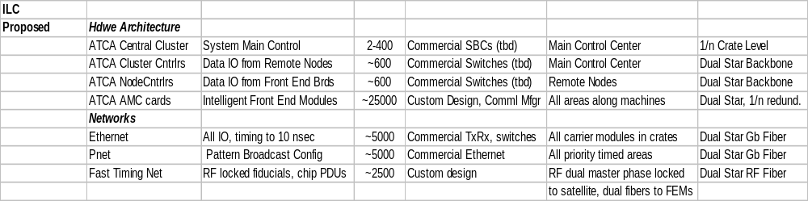
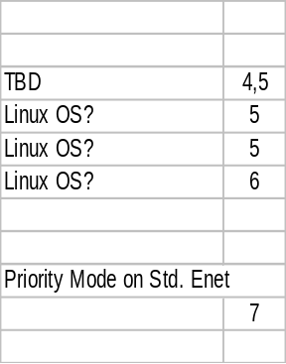

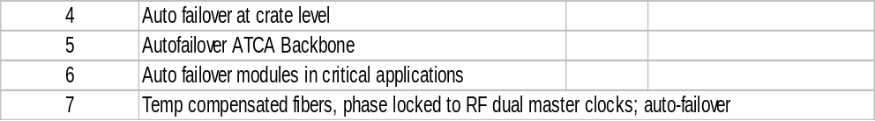
ILC Proposed Summary

Slide 23
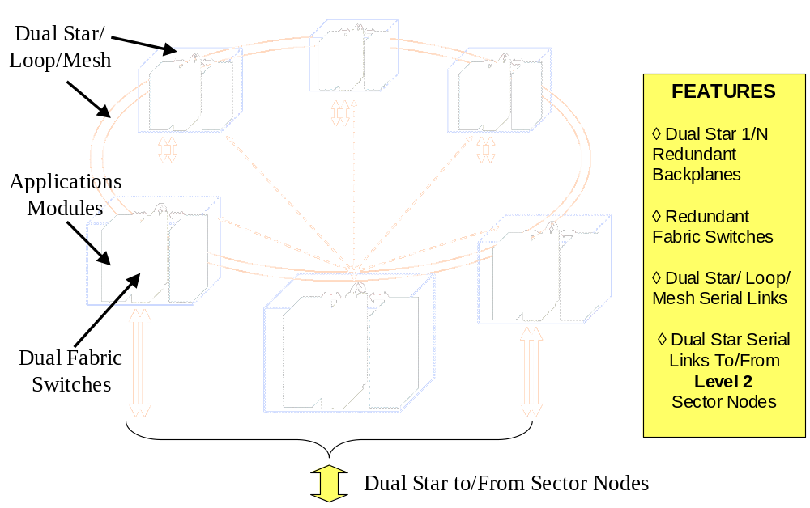
Central Controls Cluster

Slide 24
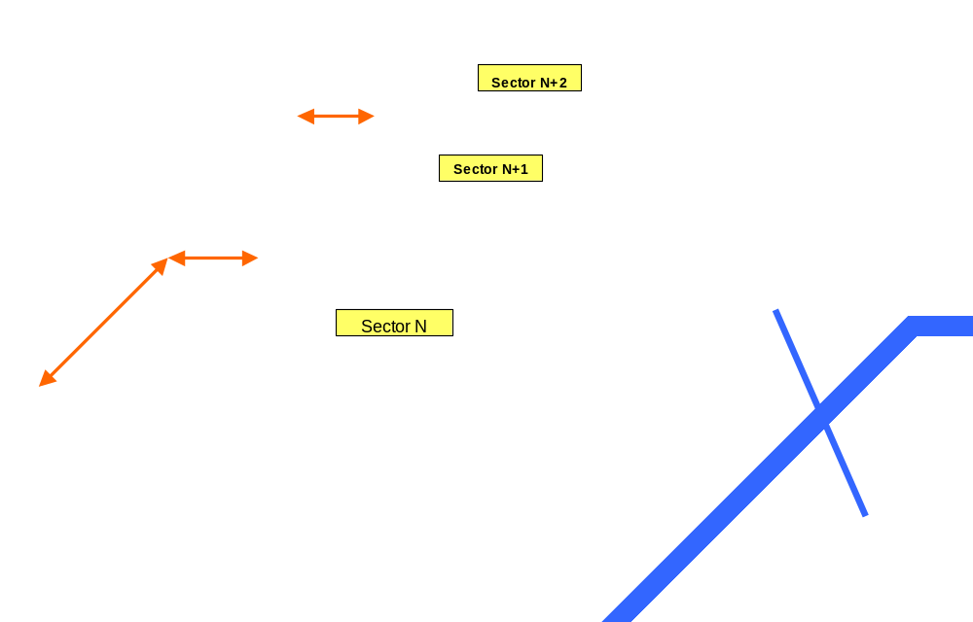
Linac Sector Nodes

Slide 25
Manufacturing
Controls Est. = 4% of TPC.
Propose all controls to be designed to HA platform.
ATCA under study as candidate de facto standard.
Modules, hardware, base software -- commercial contracts from standard suppliers.
Custom design necessary for some data switching, fast timing modules; commercial manufacture.
Total modules est. ~4,000 (not incl. instrumentation)
Ethernet & Timing fiber plants substantial cost item.
HA software major engineering effort, cost

Slide 26
III. Instrumentation
Front End Instrument Modules Est. at 2.5% of TPC.
Standard Packaging system required.
  Use ATCA HA packaging, concepts
  Some custom design necessary
  Assume 2-tunnel model for packaging
  R&D on Robotic Service System
  Assume 2-Tunnel Model
  Consider 1-Tunnel issues as backup (Cost vs. Availability)

Slide 27
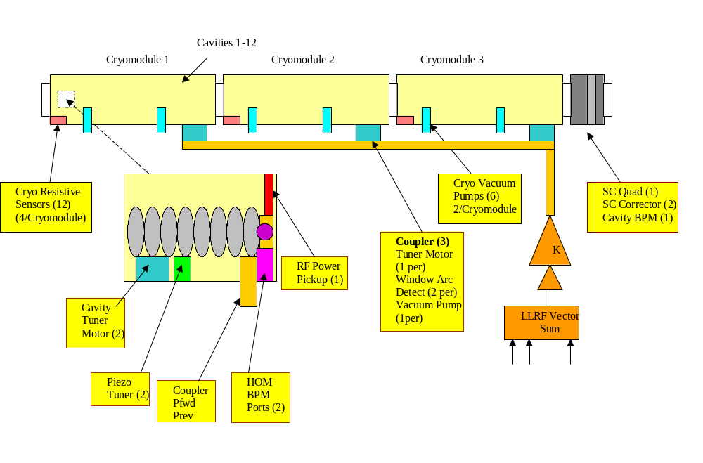
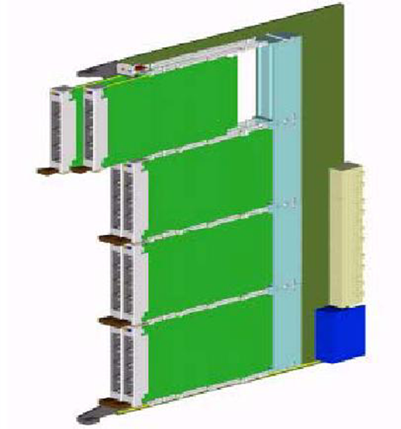
ILC Linac Instrumentation (~40m)
~1m
ATCA Standard
Module

Slide 28
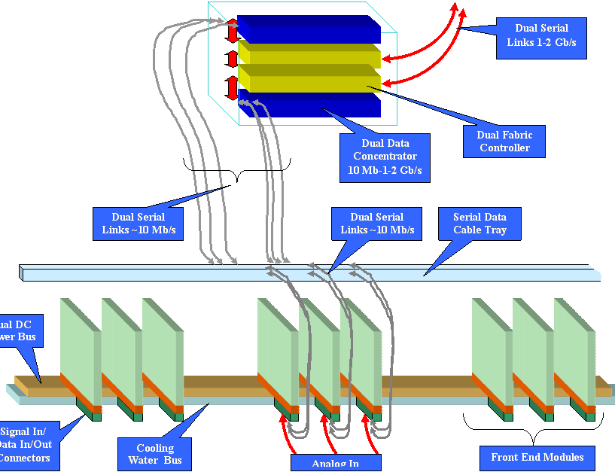
Sector Node Instrument Modules
ATCA Style Carrier Modules, Hot Swappable
ATM Mezzanine Modules, Hot Swappable
Stand-Alone or Shelf Cluster
Dual Redundant Serial I/O, Power
Robotic Replaceable

Slide 29
Manufacturing
All instrument packaging to be as far as possible in standard HA modules and hot-swappable sub-modules.
Estimate ~ 1 ATCA carrier card w/ sub-modules per meter of machine, ~25,000 total carriers, 100,000 mezzanine modules.
Standard hardware and PC board techniques.
Custom designs for high performance, reliability, minimum cost.

Slide 30
Addenda: Single Tunnel Cost Study
In 2001-2 post-Lehman Review studied placing instruments inside beam tunnel in concrete holes (TEEs) for radiation protection to reduce overall costs. Study known as CD0.4.
Seemed feasible but for availability would need remote robotics servicing.
Applied to BPMs, LLRF, vacuum pumps-gauges-valves, magnet movers, temperature, MPS-BCS-PPS...
Note: Study was not for HA redundant design, did not estimate civil or robotics costs.

Slide 31
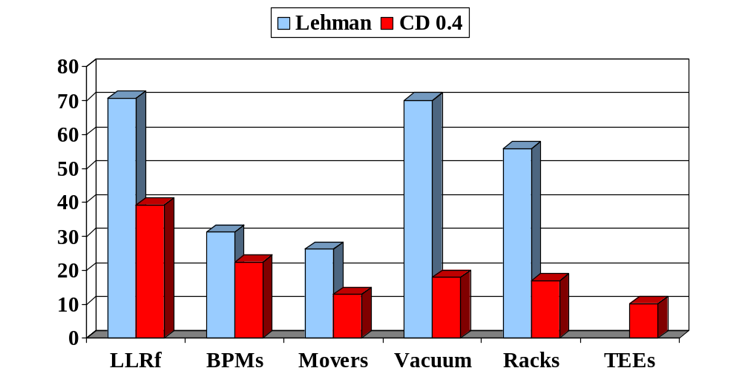
Lehman ($253M) vs. CD 0.4 ($118M)
Potential Cost Reduction: $135M (53%)

Slide 32
Comment on Robotics Servicing
Study of robotic service system conducted by J. Cornuelle in collaboration with Stanford ME department graduate engineering students. Simple manipulations of removing, replacing modules in tunnel.
  Cost payback appears viable; major positive impact on availability (avoid machine shutdown to replace modules).
  Viability in dual tunnel also significant in providing 24/7 operation to minimize size, cost of crews.
All ILC electronics systems planned to be modular, robotically serviceable, some hot-swappable.
Significant manufacturer system opportunity.

