Slide 1
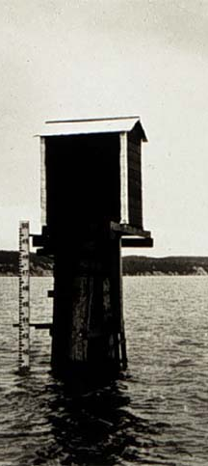
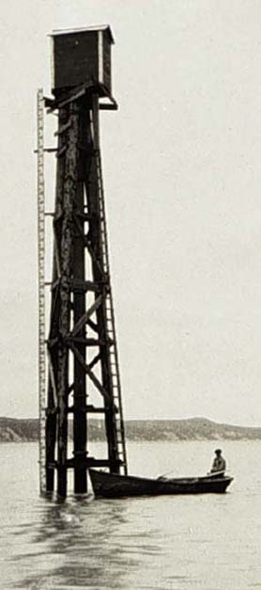
Tides
Jay Charland
Oregon Coastal
Management Program
October 8, 2007

Slide 2
Why do we have tides?
The common explanation is that the gravitational forces of the Moon and Sun pull water toward themselves, causing bulges of water on the near and far sides of the Earth.
More precisely, the Earth and Moon, and the Earth and Sun rotate around common centers of mass. This wobble is the actual source of tidal energy.
There are 37 separate periods which affect the tides. It takes 18.61 years to cover them all.
Both the atmosphere and the Earth’s crust also have tides, as does the Sun.
Center of
Mass
M = 1
M = 1/6
About 29,000 mi above the
Earth’s surface.
Earth
Moon

Slide 3
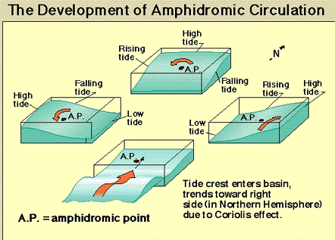
Magnitude of tidal range
Tides are waves which rotate around amphidromic points.
There are 12 open ocean amphidromic points.
The farther one is from an amphidromic point, the greater the tidal range.
  Interaction with land masses will also influence tidal range.

Slide 4
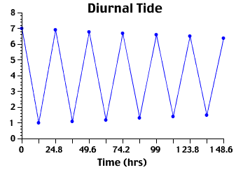
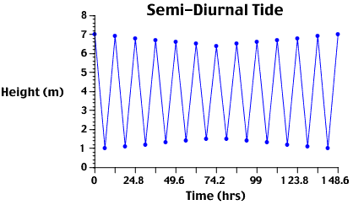
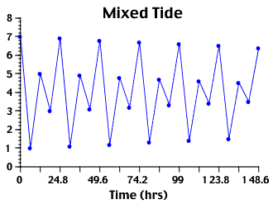
Daily Cycles:
Diurnal, Semi-Diurnal, Mixed
Diurnal tide - Having a period of one tidal day. The tide is said to be diurnal when only one high water and one low water occur during a tidal day (tidal day = 24 hours and 50 minutes).
Semidiurnal tide - Having a period of approximately one-half of a tidal day. The predominant type of tide throughout the world is semidiurnal, with two high waters and two low waters each tidal day.
Mixed Semi-Diurnal - Type of tide characterized by a conspicuous diurnal inequality in the higher high and lower high waters and/or higher low and lower low waters.

Slide 5
The interaction between waves may give rise to the various diurnal tidal cycles.
A location may be dominated by a single diurnal wave
1 tidal day

Slide 6
Interaction between waves
Or a location may be dominated by a single semidiurnal wave
1 tidal day

Slide 7
Interaction between waves
If a location is significantly influenced by a diurnal and semi-diurnal wave, a mixed semi-diurnal system results.
1 tidal day

Slide 8
Interaction between waves
If a location is significantly influenced by a diurnal and semi-diurnal wave, a mixed semi-diurnal system results.
1 tidal day

Slide 9
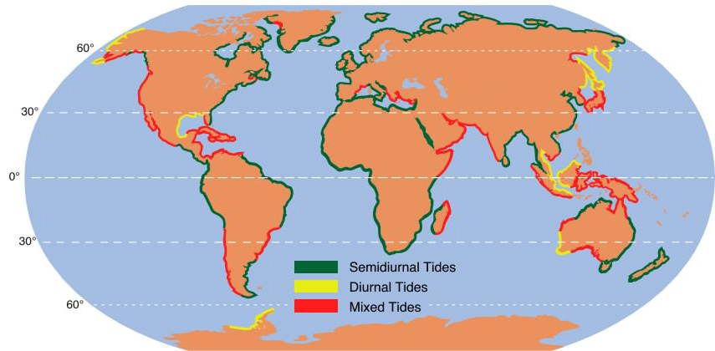
Green is semi-diurnal
Yellow is diurnal
Red is mixed

Slide 10
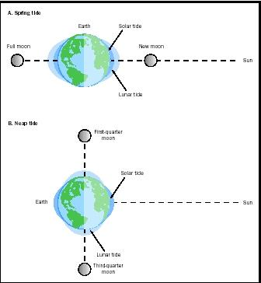
Monthly Cycles:
Spring and Neap Tides
Spring tides
The greatest range of tidal eleva-tion during the month. Spring tides occur around full and new moons.
Spring Tide
Neap tides The smal-lest range of tidal ele-vation. Neap tides occur around first and last quarters of the lunar cycle.
Neap Tide

Slide 11
Common Tidal Elevations
MHW - Mean High Water. The average height of all high tides.
MHHW - Mean Higher High Water. The average height of the higher of the two daily high tides (mixed systems only).
MLW - Mean Low Water. The average height of all low tides.
MLLW - Mean Lower Low Water. The average height of the lower of the two daily low tides (mixed systems only).
MSL - Mean Sea Level. The average height of the sea measured over 18.61 years.
Sea level is measured over a period of 18.61 years with reference to a geodetic datum.
Changes may be due to uplift or subsidence of the land, and also to sea level rise.
MSL is the datum on USGS topographic maps and aeronautical charts. MLW or MLLW used on nautical charts.

Slide 12
Tidal Elevations Defined
MHW - Mean High Water. The average height of all high tides.
MHHW - Mean Higher High Water. The average height of the higher of the two daily high tides (mixed systems only).
MLW - Mean Low Water. The average height of all low tides.
MLLW - Mean Lower Low Water. The average height of the lower of the two daily low tides (mixed systems only).
MSL - Mean Sea Level. The average height of the sea measured over 18.61 years.

Slide 13
Tidal Elevations Defined
MHW - Mean High Water. The average height of all high tides.
MHHW - Mean Higher High Water. The average height of the higher of the two daily high tides (mixed systems only).
MLW - Mean Low Water. The average height of all low tides.
MLLW - Mean Lower Low Water. The average height of the lower of the two daily low tides (mixed systems only).
MSL - Mean Sea Level. The average height of the sea measured over 18.61 years.

Slide 14
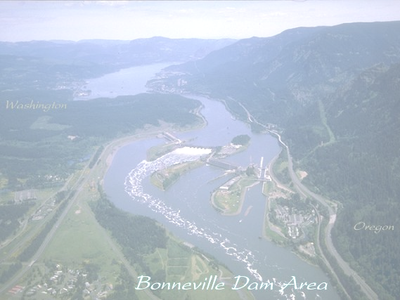
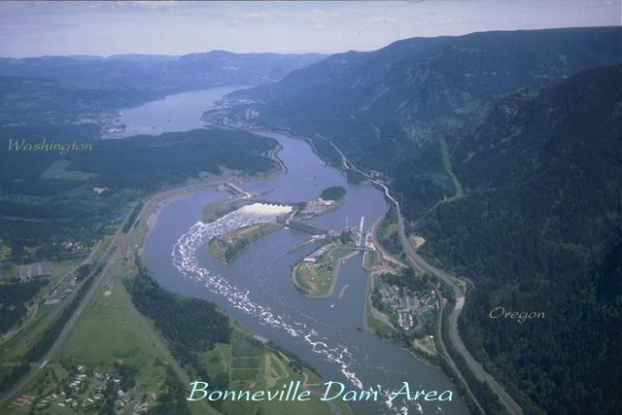
Head of Tide
Farthest point upriver where tidal variations can be detected.
Often at the fall line, or where exposed gravel bars begin as you move upriver.
Legal definition of “head of tide” usually corresponds to some visible landmark, like a bridge.
  Sometimes marked.
  May be boundary of Coast Guard authority.
  Often boundary between resource agencies.
  May change due to landslide or new dam.

Slide 15
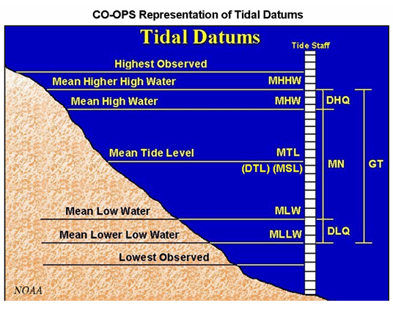

Slide 16
Elevations in Depoe Bay, Oregon
MHHW 11.64
MHW 10.93
MSL 7.81
MLW 4.77
MLLW 3.40
NAVD 4.03*
* The datum for these elevations is not NAVD. It is arbitrary and applies only to elevations at this tidal station.

Slide 17
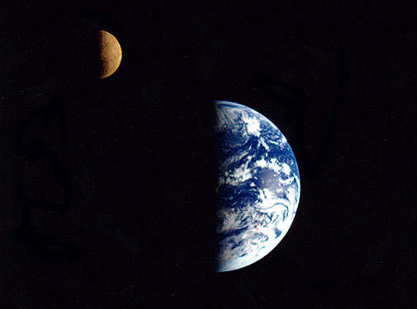
Tide Stations in Oregon
Brookings, Chetco Cove Wedderburn, Rogue River Port Orford Bandon, Coquille River Coos Bay CHARLESTON Empire Coos Bay Umpqua River Entrance Gardiner Reedsport Siuslaw River Entrance Florence Waldport, Alsea Bay Drift Creek, Alsea River Yaquina Bay and River Bar at entrance Newport Southbeach | Yaquina Winant Toledo Depoe Bay Taft, Siletz Bay Kernville, Siletz River Nestucca Bay entrance Netarts, Netarts Bay Tillamook Bay Barview Garibaldi Miami Cove Bay City Tillamook, Hoquarten Slough Nehalem River Brighton Nehalem Seaside, 12th Avenue bridge, Necanicum River

Slide 18
Geodetic Vertical Datums
National Geodetic Vertical Datum of 1929 (NGVD 29)
  NGVD 29 is no longer supported by NGS.
  NGVD 1947 was a slight adjustment to the 1929 model.
North American Vertical Datum of 1988 (NAVD 88)
  Supersedes NGVD 29 and 1947.
  Based on many thousands more observations of local gravitational vectors.
  Also uses a better system for defining its datum.
Vertical Datums are tied to Geoids. A Geoid is a model of a theoretical sea level.
Thus an elevation measurement based on NGVD 1929 or NAVD 88 represents an elevation relative to a theoretical sea level.

Slide 19
Datums and Elevations
To convert between NGVD 1929 and NAVD 88:
http://www.ngs.noaa.gov/cgi-bin/VERTCON/vert_con.prl
You will enter a longitude and latitude.
To find data on tidal elevations at tide stations:
http://egisws01.nos.noaa.gov/website/co-ops/stations/viewer.htm?ActiveLayer=0&Layers=100000000

Slide 20
MSL elevation to MLLW
Find a tide station near the site.
Find the local elevation of MSL.
Find the local elevation of MLLW.
Elev_{MLLW} = Elev_{MSL} + (MSL-MLLW)
Note: MSL and MLLW will be based on a local datum, not the NGVD or NAVD. You only need the difference in elevations, so the local datum does not matter.

Slide 21
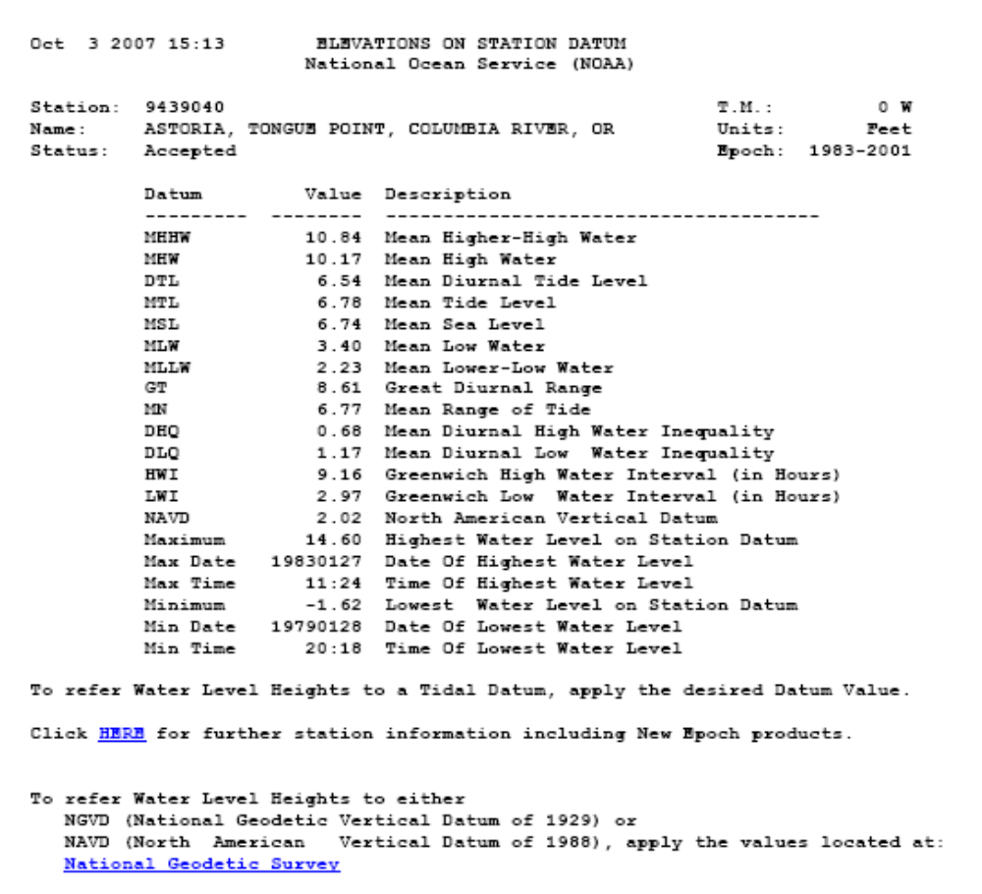
MSL elevation to MLLW
Example
A site near Astoria is 4 feet above MSL.
MSL in Astoria is 6.74;
MLLW is 2.23.
The site is 4 feet + (6.74-2.23) feet, or 8.51 feet above MLLW.

Slide 22
MSL elevation to MHHW
Exercise
Find the elevation of a site near Astoria with respect to MHHW if the site is 3 feet above MSL.
Elev_{MHHW} = Elev_{MSL} + (MSL – MHHW)
Elev_{MHHW} = 3 + (6.74 – 10.84)
Elev_{MHHW} = 3 + (-4.10)
Elev_{MHHW} = -1.10 feet

Slide 23
Tidal Elevations on Site
Tidal amplitudes decrease as you move upriver.
  May increase as you move up a fjord, sound, or narrow bay.
Mean water level may also rise with the bottom.
Some methods
  Vegetation breaks (MD, MS)
  Wrack line (deposited debris)
  Marine growth; decayed pilings; eroded rocks; jellyfish
  Stains on rocks; silt or clay on the ground
  Land survey from a benchmark (NJ)
  Survey grade GPS receiver
  Local knowledge
  Corps of Engineers: No tricks or special methods.

Slide 24
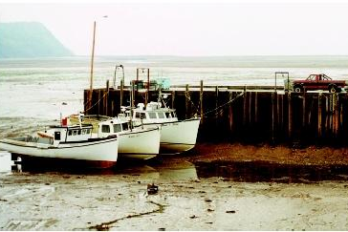

World Famous Tides
Bay of Fundy, Nova Scotia

Slide 25
Obscure Tidal Elevations
MHWS - Mean High Water Spring
HW - High Water
MHWN - Mean High Water Neap
ML - Mean Level
MLWN - Mean Low Water Neap
MLWS - Mean Low Water Spring
LAT - Low Astronomical Tide
(I’ve never heard of any of these. I got them off of a sailing website, but also found them in a coastal engineering manual.)

Slide 26
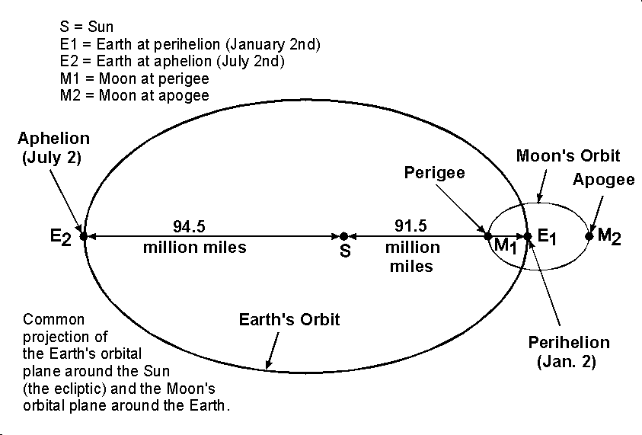
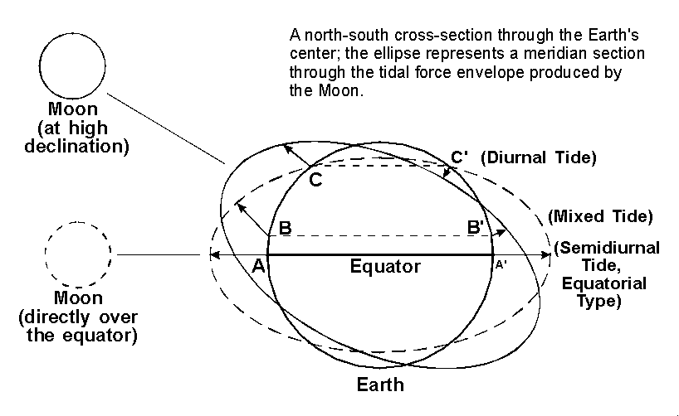
Parallax and Declination
Parallax Effects (Moon and Sun). The distance between the Earth and Moon will vary throughout the month by about 31,000 miles. Once each month, when the moon is closest to the earth (perigee), the tide-generating forces will be higher than usual, thus producing above-average ranges in the tides. Approximately two weeks later, when the moon (at apogee) is farthest from the earth, the lunar tide-raising force will be smaller, and the tidal ranges will be less than average.
Similarly, in the earth-sun system, when the earth is closest to the sun (perihelion), about January 2 of each year, the tidal ranges will be enhanced, and when the earth is farthest from the sun (aphelion), around July 2, the tidal ranges will be reduced.
Lunar Declination Effects: The Diurnal Inequality. The plane of the moon's orbit is inclined only about 5 degrees to the plane of the earth's orbit (the ecliptic). The ecliptic is inclined 23.5 degrees to the earth's equator, north and south of which the sun moves once each half year to produce the seasons. In similar fashion, the moon, in making a revolution around the earth once each month, passes from a position of maximum angular distance north of the equator to a position of maximum angular distance south of the equator during each half month. (Angular distance perpendicularly north and south of the celestial equator is termed declination.) Twice each month the moon crosses the equator.

Slide 27
Geoid
An imaginary elliptical surface around the earth with constant gravitational potential.
A marble placed anywhere on the Geoid would not roll.
The surface of the sea, measured over time and without waves, would be a Geoid.
  The surface of a still body of water like a bath tub is a geoid.
Any one particular Geoid model is probably not at sea level.

Slide 28
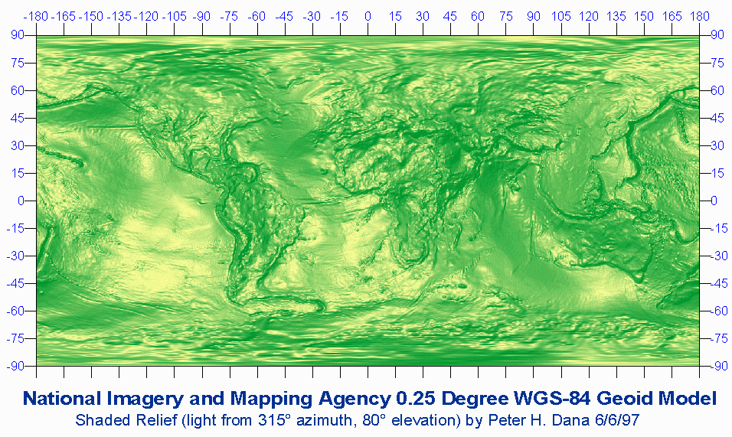
The Geoid reflects surface and sub-surface geology.

