Slide 1
Pharmacy Program Initiatives
Threshold, Mandatory Generic,
Maximum Allowable Cost (MAC)
Javier Menendez, RPh
Pharmacy Manager
Department of Medical Assistance Services

Slide 2


Pharmacy Programs
ProDUR Enhancements
OTC Drug List
Mandatory
Generic
MAC
PDL
Threshold/ PolyPharmacy
PDL

Slide 3
Threshold Program
This program was required by the 2003 Appropriations Act, which directed the department to review recipients’ drug profiles after a threshold of nine prescriptions.
The purpose of this program is to improve the health and safety of recipients and offer DMAS enhanced opportunities to improve quality by:
  Reducing potential and actual severe adverse reactions to drugs,
  Retrospectively monitoring high drug utilization by Medicaid recipients,
  Providing pharmacists with additional support for Drug Utilization Review,
  Enhancing continuity and coordination of care in the use of prescription drugs, and
  Identifying clinical abuse/misuse and fraud of prescriptions.

Slide 4
Threshold Program
Two-Step Program
  Step-one: Coordination of Care Initiative
  Patients with multiple prescriptions from multiple medical providers dispensed from multiple pharmacy providers (Implemented October 1, 2004)
  Step-two: Threshold/Polypharmacy Program
  Retrospective review of all patients with greater than 9 prescriptions in 30 days (Implemented October 15, 2004)

Slide 5
Coordination of Care
This initiative would use the following criteria (for a 30 day period) to identify recipients with potential coordination of care issues:
  Prescriptions filled at ≥ 3 different pharmacies
  Prescriptions written by ≥ 3 different prescribers
  Received ≥ 6 prescriptions
1307 letters to prescribers involving 412 recipients
To determine the impact of the initiative on prescription volume and prescription costs, the identified recipients will be compared after six months to a group of recipients with similar prescription utilization.

Slide 6
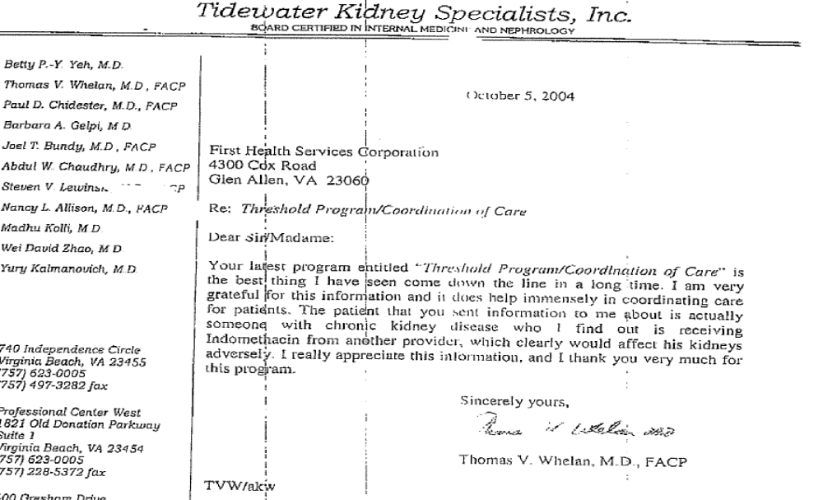

Slide 7
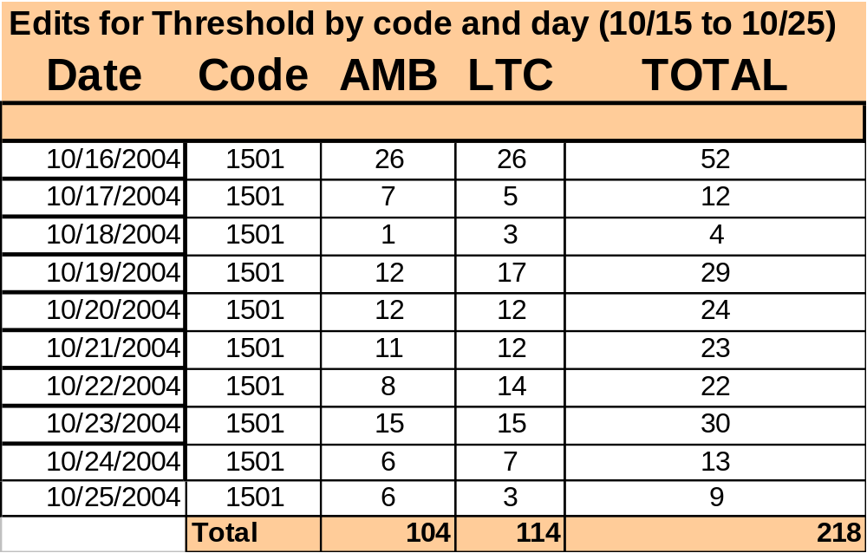
Threshold - First 10 days

Slide 8
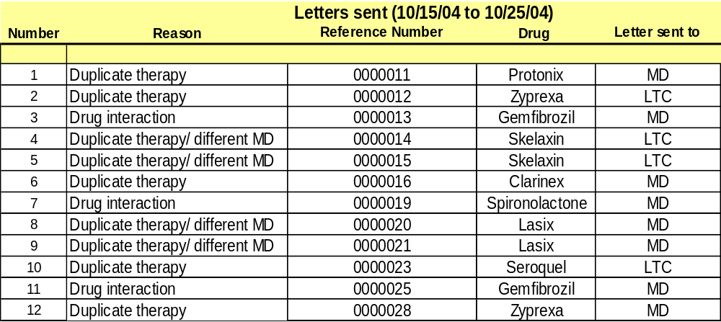
Threshold - First 10 days generated 12 letters

Slide 9
Pharmacy Programs
ProDUR Enhancements
OTC Drug List
MAC
Mandatory
Generic
PDL
Threshold/ PolyPharmacy
PDL

Slide 10
Background
What is a Brand name drug? A brand name drug is an innovator drug that holds a patent to prevent other manufacturers from copying and is usually available from a single source or one manufacturer.
What is a Generic drug? A generic drug is a copy of a brand name drug. It is the same medicine with the same active ingredients as the brand name drug, but usually made by another company at a less expensive cost.
What is a Multi-source drug? Multi-Source drug is a drug that is made by both a brand name manufacturer and is also available from several generic manufacturers.

Slide 11
Mandatory Generic Program
Previous to September 1st 2004, this edit messaged the dispensing pharmacist to substitute with the generic, most commercial insurers have the same edit.
11.74% of total claims processed in calendar year 2003 were filled with multi-source brand name drugs
Effective September 1st, 2004 , ALL multi-source prescriptions require a DAW of “1” (brand necessary) for claim to adjudicate for a brand name drug

Slide 12
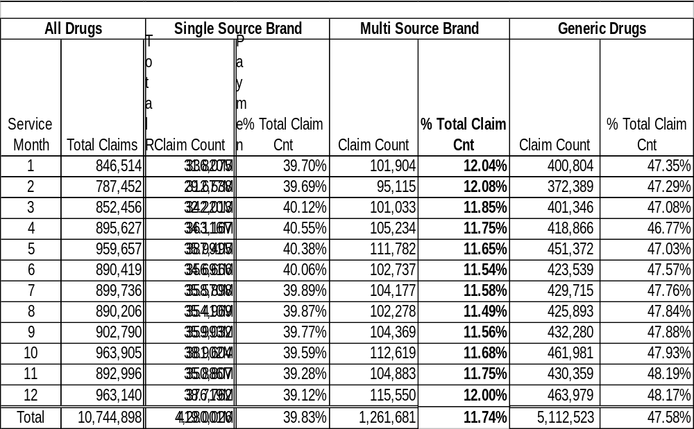
2003 Results

Slide 13
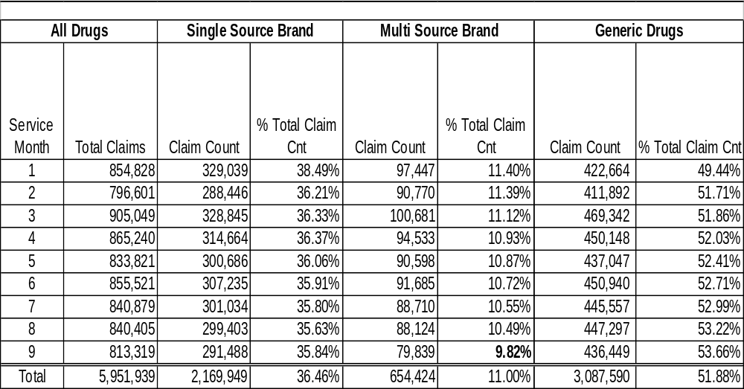
2004 Results

Slide 14
Pharmacy Programs
ProDUR Enhancements
OTC Drug List
MAC
Mandatory
Generic
PDL
Threshold/ PolyPharmacy
PDL

Slide 15
Nomenclature
MAC- Maximum allowable cost (also known as VMAC)
FUL- Federal Upper limit (federal-MAC)
AWP- Average Wholesale Price
WAC- Wholesale Acquisition Cost
U & C- Usual and Customary- Price charged to paying customers

Slide 16
Current VMAC
Current Virginia MAC based on Virginia Voluntary Formulary
Pricing methodology = 75th percentile and 60th percentile for unit-dose drugs
“Lower Of Logic” applied to determine the price paid(AWP-10.25%, FUL, MAC, Usual & Customary)
Most claims use the FUL price, because current MAC is higher
Great opportunity for improvement

Slide 17
Key MAC Program Notes
30-60 days notice to pharmacy providers
Pro-active work with VaPHA and select pharmacy providers in September to facilitate provider acceptance
Easy Dispute Resolution Process (phone, fax, email)
Easy access to MAC list through Mailing and Website
Complete MAC list (800+ drugs) in easy to read and understand format
IT coordination with Optima-FHSC-VAMMIS
Reporting framework with DMAS policy department
Projected utilization data on target for estimated budget savings

Slide 18
Dispute Resolution Process
The intent of the MAC (maximum allowable cost) program is to reimburse providers fairly based on accurate generic drug costs. If a provider discovers that the MAC price does not accurately reflect the drug cost, the provider should explore alternative manufacturers or wholesalers that more accurately reflect the MAC price. If there are no manufacturers or wholesalers that are at or below the established MAC price, the providers may request a review for resolution.
The providers may call 1-866-312-8467, or fax the designated form to 1-866-312-8470 or e-mail disputeresolution@dmas.virginia.gov. with dispute resolution requests with the proper information; NDC, drug name, strength and dosage form, manufacturer, package size, wholesaler, lowest price found and search date. All the information will be researched and the appropriate action taken.
Providers will be notified of the receipt of their dispute resolution request within one business day. A resolution and notification to the provider will take place within three business days. The providers will either receive a notice stating that there has been confirmation of alternative manufacturers or wholesalers who have the product available at or below the MAC price, or the MAC price will be adjusted accordingly to reflect the collected data. The revised price will be effective from the date of the request. Providers may reverse and resubmit all affected claims made from the effective date forward. The MAC list will be updated monthly and can be found and downloaded from our website at www.dmas.virginia.gov.

Slide 19
MAC Pricing For Generics
At least 41 other state Medicaid programs utilize MAC pricing for generics
MAC pricing is used throughout commercial insurance market
State Medicaid programs and private insurers vary in how aggressive they are in setting their MAC pricing
The MAC that is set for each drug must be reviewed and updated periodically to ensure appropriate pricing
DMAS estimates the net savings for its proposed MAC program to be $5.15 million (GF) in each of the 2004-2006 biennium

