Slide 1
NASA - STEP for Aerospace Workshop
Rules Driven Software for STEP
January 18, 2001
NASA - Jet Propulsions Laboratories
Pasadena, CA.
Gregory L. Smith
Boeing Space & Communications Group
253-773-5947
Gregory.L.Smith@Boeing.com

Slide 2
Agenda
Rules Discussion
COTS Rules Environment -
    Benefits / Architecture / Challenges
Generic Rules Environment -
    Benefits / Architecture / Challenges
Introduction of STEP data
System Demonstration

Slide 3
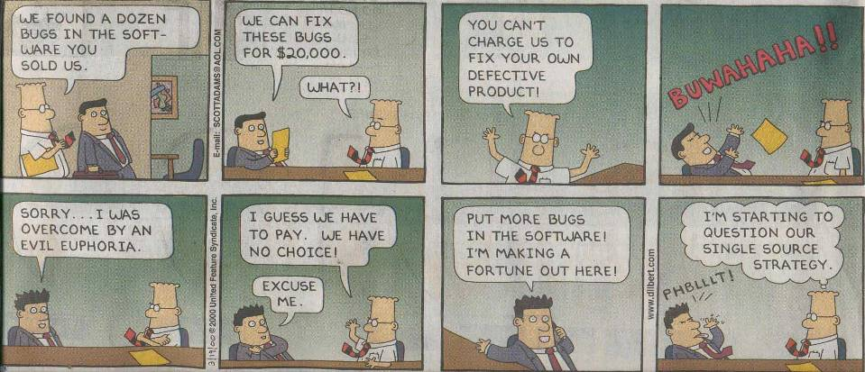
Rules Discussion
What is the greatest challenge facing conventional software development?

Slide 4
Rules Discussion
Artificial Intelligence
  Robotics
  Machine Learning
  Voice Recognition
  Semantic Understanding
  Neural Networks
  Knowledge Representation
  Experts Systems/ Rules Based Systems
  others
Notes:
Consists of various technologies and fields

Slide 5
Rules Discussion
What problems are rules based systems best at solving?
  Configuration
  Analysis
    Design for X
      Producibility
      Manufacturability
    Data Verification
  Diagnostics
  Knowledge discovery
Notes:
EX systems being used for Income tax form analysis, font analysis (Adode)
EX tool vendors have been selling knowledge empty systems are 20 years
Most vendors are out of business or transitioning to other businesses

Slide 6
COTS Rules Environment - Benefits
Why should one consider a rules based systems approach?
  Functionality is localized
  Data validation & verification is localized
  Introducing additional functionality has minimum effect on existing functionality
  Information can be discovered / acted on
  Complexity can be managed
  System can be easily extended
Notes:
Problems with Conventional Software Applications
Computer Aided Design report, December 2000
Why are bugs winning?
Bugs creeping up in sections of code where nothing new had been added!
Ault lies in the method by which software are created
bad pointers
failure to free memory
bad data

Slide 7
COTS Rules Environment - Architecture
Rules Definition
Environment
-----
Rules
Editing Facility
Syntax Checking
Rules Execution
Environment
-----
Rules
Selection Mechanism
Rule Agenda
Inference Mechanism
Rule Strategies
Initiation Mechanism
Trace Facility
Report Facility
COTS Rules
(External Storage)
COTS
Rules
Notes:
Rule Definition facilities
Rules
If - Then code routines
Supporting attributes
Rule Execution facilities
Rules
Selection Mechanism
which rules should executed (initially)
Rule Agenda
as rules are executed, they execute other rules by placing them on the agenda
Inference Mechanism
pattern matching algorithm that runs rules on the agenda
Rule strategies
Best first, depth first, depth first
Initiation mechanism
Kicking the rules off
Trace facility
which rules have been rule
Report facility
output results to user.

Slide 8
COTS Rules Environment - Challenges
Multiple operating environments
Numerous rule representations
  Specific syntax and semantics
  Rule ‘experts’ can not cross vendor tools
Multiple disparate rule strategies
Inability to migrate rules between COTS rule environments
Environments are DATA INTENSIVE!

Slide 9
Generic Rules Environment - Benefits
Rules can be written in a ‘generic’ language
Rules can be ‘migrated’ to:
  Multiple vendors
  Multiple platforms
  Multiple rule environments
  Multiple rule execution facilities
Rules can be stored in a computer interpretable representation (STEP).

Slide 10
Generic Rules Environment - Architecture
Generic
Rules Definition
Environment
-----
Rules
Editing Facility
Syntax Checking
Rule Conversion
Rules Execution
Environment
-----
Rules
Selection Mechanism
Rule Agenda
Inference Mechanism
Rule Strategies
Initiation Mechanism
Trace Facility
Report Facility
Rules
Meta Data
Generic Rules
ProKAPPA
COTS
Rules
KAPPA-PC
CLIPS
J2EE (JAVA)

Slide 11
Generic Rules Environment - Architecture
Rules attributes
COTS
Rule
Attributes
  Identifier Name Sets
  Priority Comment Code
  Justification Description Notes
  Versioning Supercede Author
  Organization Timestamps Status
  Structured & Free Form Code Type
  Code Meta Knowledge Source
  Set Maintenance
Additional
Generic
Rule
Attributes

Slide 12
Generic Rules Environment - Challenges
Each COTS Environment has:
  Its own subset and/or superset of code functions
    Logic, math, list, string, set, I/O, etc.
  Its own rule control strategies
    Backward chaining
    Forward chaining
    Exhaustive back tracking
    Assertive/ Non-Assertive execution
    Goal-based/ Non-Goal-based execution
Notes:
Longevity of vendors and their tools
Functions are different between vendors and tools
Control strategies different between vendors and tools

Slide 13
Generic Rules Environment -
Introduction of STEP data
Vendor CAD Tools
Domain
Independent
Domain
Specific
Vendor &
DeFacto
Formats
Vendor Neutral
Files
Vendor
APIs
GDSII
DXF
Gerber
Proprietary
Formats &
Standards
User / Programmer
Aggravation Level!
IDF
ODB++
GenCAD
National &
International
Standards
PDM
GenCAM
STEP
IGES
EDIF
SDAI
CAD Applications

Slide 14
Rules Architecture - Data
STEP
AP210
Generation
Vendor
ECAD Data
AP210 Part 21
AP210 Schema
Fact Extraction
Application
ARM semantic data
Rules
Data
Files
Rules
Execution
Facility
Rule
Code
Rules
Results Files
STEP
Extraction
Utility
Fact Part 21
Fact Schema
Rules
Definition
Facility

Slide 15
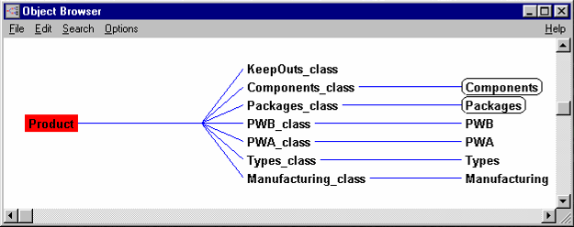
Rules Architecture - Data
PWB_class attributes:
board_type
connector_on_primary
connector_on_secondary
diagonal_placement_allowed
diagonal_routing_allowed
drill_origin
ground_plane_layer
layer_names
layer_numbers
length
max_x
max_y
milling_origin
min_x
min_y
number_of_layers
orthogonal_placement_only
placement_outline
power_plane_layer
preferred_orientation
side_components_permitted
side_names
width
Packages_class attributes:
allowable_surface
diagonal
extents
id
layout_type
no_via_keepout
not_in_bom
orthogonal
outline_overhang
package_class
package_type
pin_count
pin_locations
polarized
required_rotation
thermal_outline
Manufacturing_class attributes:
any_bottom_smd
any_smd
any_top_smd
axials
bottom_smd
chips
dips
gp_smds
ict_auto
manual
radials
sips
smd_auto
th_auto
top_smd
wave_solder
Components_class attributes:
active_passive current_maximum
current_typical extents
height junction_max_temp
location no_comp
package_class package_id
package_object package_type
part_number part_symbol
planned_characteristics power_maximum
power_minimum power_typical
raw_location reference_designator
rotation spice_parameter
surface thermal_junction
value
PWA_class attributes:
description
mother_board
name
number_of_components
number_of_packages
other_components
revision
revision_description
version
version_description
Types_class attributes:
axials
chips
classes
dips
gp_smds
radials
sips
types

Slide 16
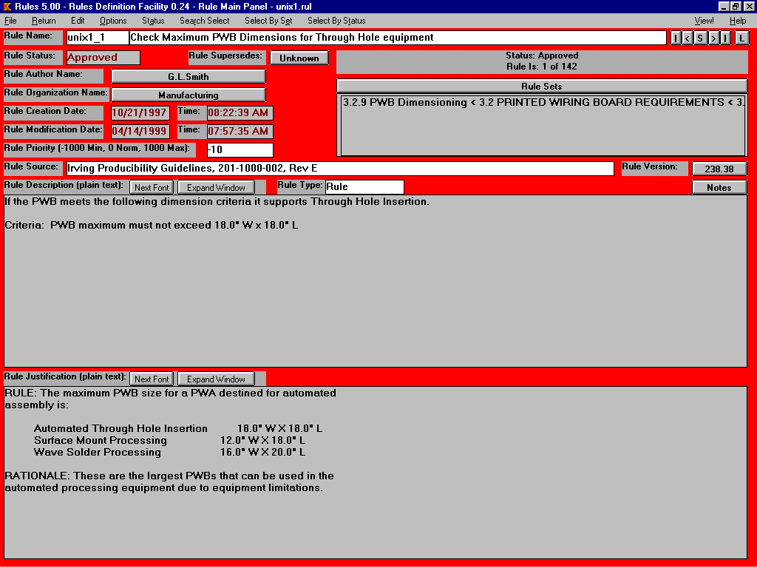
Rules Definition Facility - Rule Meta Data

Slide 17
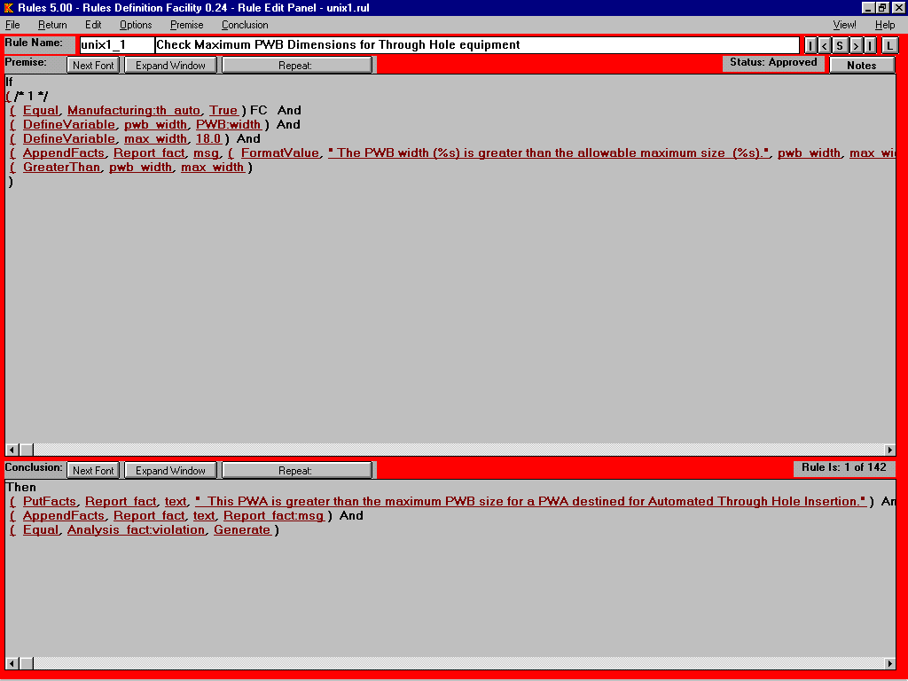
Rules Definition Facility - Code Definition
PWB_class attributes:
board_type
connector_on_primary
connector_on_secondary
diagonal_placement_allowed
diagonal_routing_allowed
drill_origin
ground_plane_layer
layer_names
layer_numbers
length
max_x
max_y
milling_origin
min_x
min_y
number_of_layers
orthogonal_placement_only
placement_outline
power_plane_layer
preferred_orientation
side_components_permitted
side_names
width

Slide 18
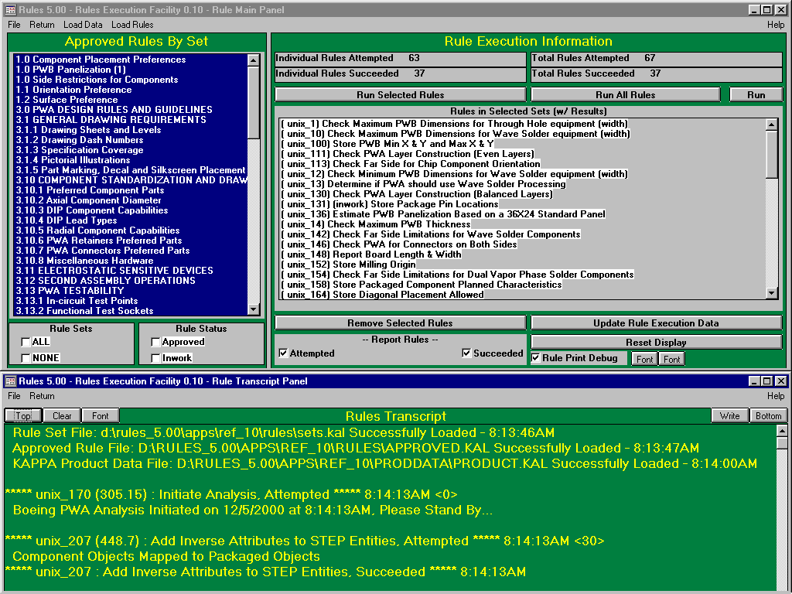
Rules Execution Facility

Slide 19

Questions?

Slide 20
Generic Rule Format
/********** Start of Rule **********/
Rule:
Rule1
Author:
G.L.Smith
Conclusion:
SimpleConclusion3
SimpleConclusion4
SimpleConclusion2
SimpleConclusion3:
PutFacts
Analysis_fact
violation_text
`( " This PWA is greater than the maximum PWB size for a PWA destined for Automated
Through Hole Insertion." )
SimpleConclusion4:
PutFacts
Analysis_fact
violation_text
SimpleConclusion5
SimpleConclusion5:
AppendLists
SimpleConclusion6
?msg
SimpleConclusion6:
GetFacts
Analysis_fact
violation_text
SimpleConclusion2:
ChainOn
Analysis_fact
violation
Generate
RULE_SET
Comment
Key rule attributes are delimited by
a colon (:)

Slide 21
Generic Rule Format
Date:
10/21/1997
Description:
If the PWB meets the following dimension criteria it supports Through Hole Insertion.
Criteria: PWB maximum must not exceed 18.0" W x 18.0" L
Justification:
RULE: The maximum PWB size for a PWA destined for automated
assembly is:
Automated Through Hole Insertion 18.0" W X 18.0" L
Surface Mount Processing 12.0" W X 18.0" L
Wave Solder Processing 16.0" W X 20.0" L
RATIONALE: These are the largest PWBs that can be used in the
automated processing equipment due to equipment limitations.
MajorVersion:
238
MinorVersion:
38
ModificationDate:
04/14/1999
ModificationTime:
07:57:35 AM
Name:
Check Maximum PWB Dimensions for Through Hole equipment
Notes:
Not Defined
Organization:
Manufacturing

Slide 22
Generic Rule Format
Premise:
ComplexPremise1
ComplexPremise2
ComplexPremise3
ComplexPremise4
ComplexPremise1:
SimplePremise3
SimplePremise6
SimplePremise30
SimplePremise1
SimplePremise14
SimplePremise5
SimplePremise8
SimplePremise21
SimplePremise9
SimplePremise3:
Equal
Succeeded
Status_fact.data_capture
SimplePremise6:
Equal
Mfg_fact.th_auto
True
SimplePremise30:
AppendFacts
Analysis_fact
execution_list
`( 30209, "3.2.9", ?rule, "Rule" )
SimplePremise1:
DefineVariable
?width
SimplePremise2
SimplePremise2:
GetFact
PWB_fact
width
SimplePremise14:
DefineVariable
?length
SimplePremise15
SimplePremise15:
GetFact
PWB_fact
length
SimplePremise5:
DefineVariable
?max_width
18.0
SimplePremise8:
DefineVariable
?max_length
18.0
SimplePremise21:
DefineVariable
?msg
`( )
SimplePremise9:
Not
True
ComplexPremise2:
SimplePremise16
SimplePremise4
SimplePremise22
SimplePremise10

Slide 23
Generic Rule Format
SimplePremise16:
Equal
Mfg_fact.th_auto
True
SimplePremise4:
GreaterThan
?width
?max_width
SimplePremise22:
DefineVariable
?msg
SimplePremise23
SimplePremise23:
AppendToList
?msg
SimplePremise24
SimplePremise24:
AppendStrings
" The PWB width ("
?width
") is greater than the allowable maximum
size ("
?max_width
")."
SimplePremise10:
Not
True
ComplexPremise3:
SimplePremise12
SimplePremise7
SimplePremise25
SimplePremise11
SimplePremise12:
Equal
Mfg_fact.th_auto
True
SimplePremise7:
GreaterThan
?length
?max_length
SimplePremise25:
DefineVariable
?msg
SimplePremise26
SimplePremise26:
AppendToList
?msg
SimplePremise27
SimplePremise27:
AppendStrings
" The PWB length ("
?length
") is greater than the allowable maximum
size ("
?max_length
")."
SimplePremise11:
Not
True
ComplexPremise4:
SimplePremise29
SimplePremise17
SimplePremise29:
Equal
Mfg_fact.th_auto
True

Slide 24
Generic Rule Format
SimplePremise17:
GreaterThan
SimplePremise28
0
SimplePremise28:
ListLength
?msg
Priority:
-10
Sets:
3.2.9 PWB Dimensioning (set108)
Source:
Irving Producibility Guidelines, 201-1000-002, Rev E
Status:
Approved
Supersedes:
Not Defined
Time:
08:22:39 AM
/***** End of Rule *****/

