Slide 1
Entry Criteria
Activities
Exit Criteria
1) All inputs are available
2) NASA has authorized use of project data
3) NASA has authorized the taxonomy extension project
1) Select generic requirement fault taxonomy
2) Examine problem reports for projects in Class A, B, C, and/or D
3) Categorize the faults for each project according to the generic taxonomy
4) Determine frequency fault types for each class
5) Identify crucial fault categories for each class
1) A Class-specific requirement fault taxonomy has been developed (Class A, B, C, and/or D)
Inputs
Process controls/Metrics
Outputs
1) Generic fault taxonomy
2) NASA project requirement faults/problem reports
3) Class project definitions
1) Maintenance of configuration control of taxonomy
2) Maintenance and management of NASA project data by class
1) Frequency counts of faults per class
2) Crucial fault categories for each class

Slide 2
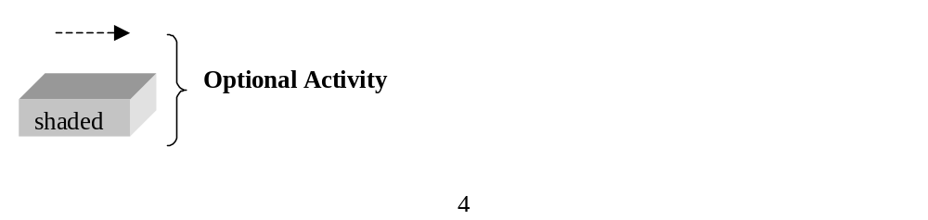
Generic fault
NASA project
taxonomy
requirements
faults/problem reports
Process (A) to extend a fault taxonomy
for a software project Class
1) Class A
2) Class B
3) Class C
4) Class D
Project
-
(e.g., Manned
(e.g., Aerospace,
(e.g., Biological/
(e.g., Other
specific
Exploration,
Earth Science,
Physical projects)
projects which
information
Manned
Space Science
do not fall into
(goals,
Missions)
projects)
Class A, B or C)
priorities)
Process (B) to extend a fault
taxonomy for a project
Fault taxonomy for a
specific project
Tolerance Analysis
Prioritized fault list for
a project

Slide 3
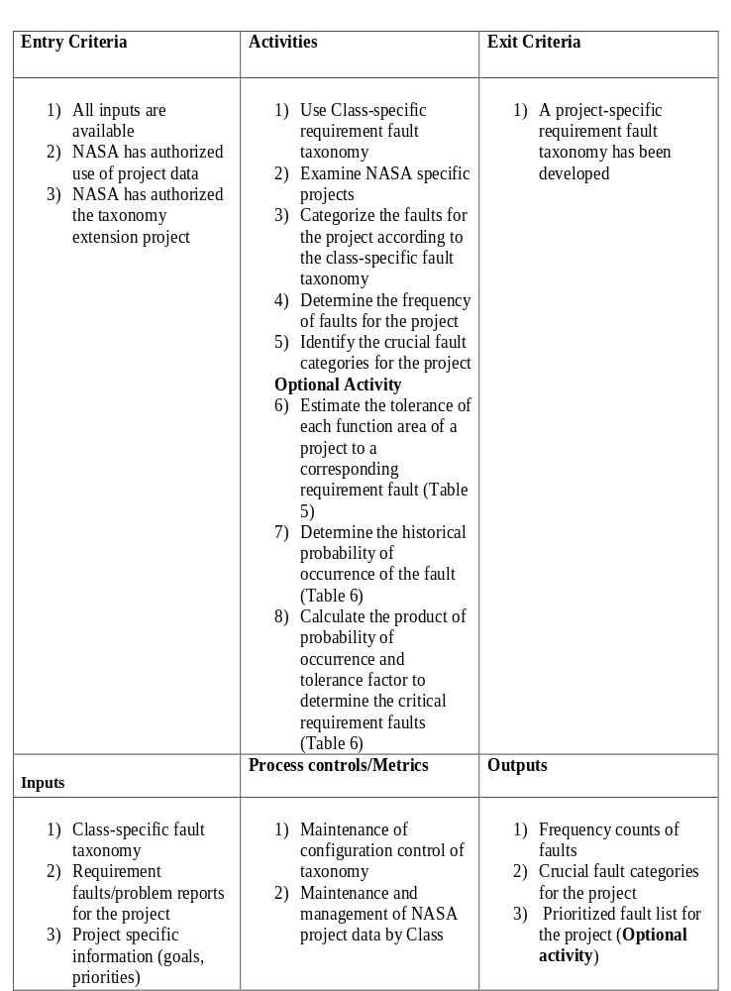

Slide 4
