Slide 1
Channel Archiver
Oct 2000
Kay-Uwe Kasemir, LANL

Slide 2
Channel Archiver
Generic archiving system for EPICS
Stores independent “Channels”
= any Process Variable served by Channel Access
Sampling options
  a) periodically
  b) on change

Slide 3
Goals
Fast:
  Hash-table channel lookup,
  binary data format with direct access to recent values.
Generic and Portable:
  Win32, Linux, Solaris, HPUX,…
  Data archived: EPICS dbr_time_*, providing system-independent access
  to float, int, string, enum, … with time & status, units, limits, …
Networked:
  Remote access to both Engine status/configuration and archived data
Extendable:
  I/O library meant to be extended to make Engine, CGI Tool etc. work with different storage formats
Attractive for both casual users and “experts”
  Web interface, Win32 archive viewer for generic access to raw samples
  scripting support (SWIG) for automated analysis, creation of input for other programs

Slide 4
Components
Engine: Taking data from ChannelAccess
CGIExport: Web access to data
ChannelArchive ScriptingInterface: SWIG access for more sophisticated analysis
WinBrowser: Win32 tool for fast archive browsing
Archive I/O library: portable archive I/O, extendable for different file formats

Slide 5
Interactions
Workstation
IOC
Web Browser
(data)
Web Browser
(Engine cfg.)
CA Server
EPICS Db
CA
CA
HTTP
HTTP
Network
CA
HTTP
HTTP
HTTPD
Web Server
Engine
Viewer
Scripting
CGIExport
I/O Lib
I/O Lib
I/O Lib
I/O Lib

Slide 6
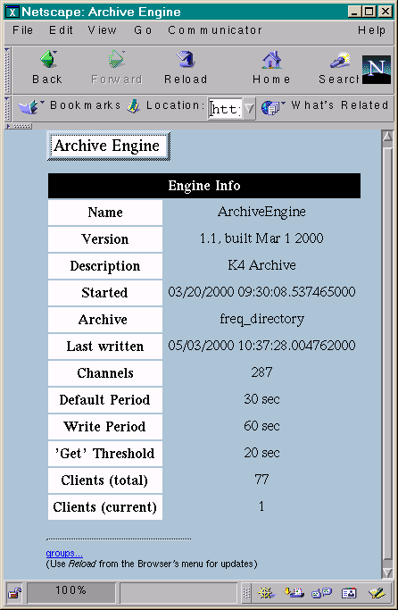
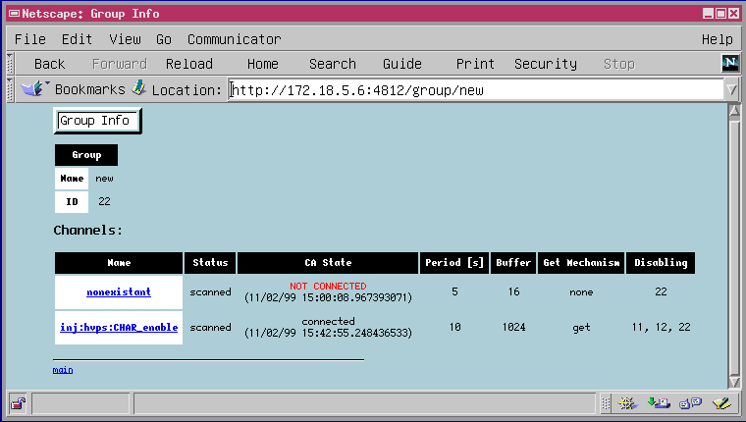
Engine
Networked via HTTP
Up to 10000 values/sec
(450Mhz PC)
WIN32, Linux, Solaris

Slide 7
Engine: Start
USAGE: ArchiveEngine [Options] <config-file> [<directory-file>]
Options:
-port <port> WWW server's TCP port (default 4812)
-description <text> description for HTTP display
-log <filename> write logfile
Default directory-file: 'freq_directory'
Engine is ChannelAccess client: may have to set
  EPICS_CA_ADDR_LIST, EPICS_CA_SERVER_PORT
TCP port has to be unique per machine
Log-file: copy of messages/warnings

Slide 8
Engine: Configuration
ASCII File:
# Comments
!default_period 30
!group <Another config. file>
  For building disabling groups, otherwise like an #include in C/C++
<Channel Name> <Period [sec]> [Monitor] [Disable]
  Scan period is also important for “Monitor” channels:
  It determines size of buffer.
  If more samples arrive than anticipated, “overwrites” occur.
Example:
#Archive channels of example CA server (excas)
fred Monitor
freddy Monitor
jane 5
janet 10

Slide 9
Engine: Groups
“disabling” channel !=0 ⇒ group disabled:
Main: # Main archive file
!default_period 30
!write_period 60
!group power_supply
!group another_subsystem
power_supply: # Power Supply:
# Archive only when power is on!
power_off Monitor Disable
power_setpoint
power_readback
power_temperature

Slide 10
Engine: More Options
!write_period <seconds>
Time between writes to disk
!get_threshold <seconds>
Internally, CA ‘get’ is used for channels scanned at period > threshold, remaining channels are ‘monitored’
!buffer_reserve
Engine keeps memory buffer per channel to buffer between writes to disk.
Size: buffer_reserve * write_period/scan_period
Since writes can be delayed by other tasks, disk activity etc., buffer is usually bigger than the minimum required (default: 3).
If receiving "override" messages, one should
  Check if the offending channel is tagged Monitor.
  In that case the period estimate might be too large.
  Increase buffer_reserve (global for all channels)

Slide 11
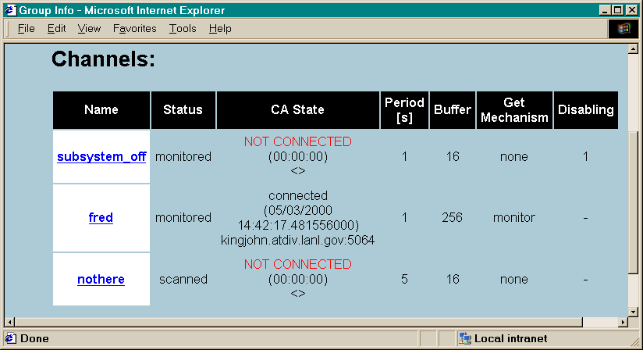
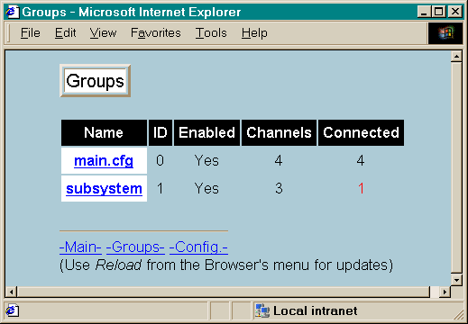
Engine: Status
URL of engine’s HTTPD: http://<machine>:<port>
“Client Pull”: Updates on reload
Changes (added groups/channels) written to cfg subdirectory, original config. files unchanged

Slide 12
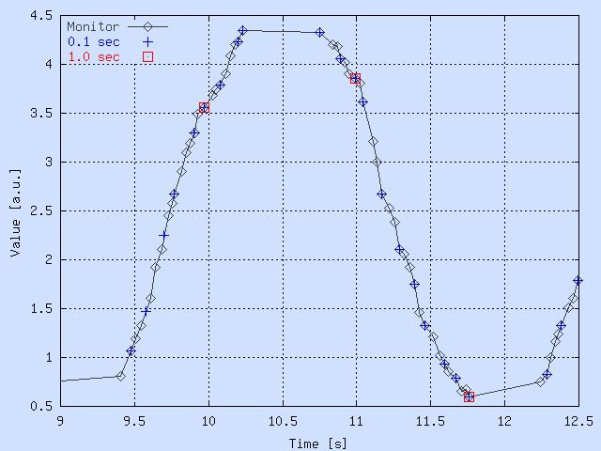
Engine: Sampling
Original time stamps of CA Server / IOC preserved, not adjusted/rounded to period!
Example:
“1.0 sec”
⇒ every sec.,
last value
is saved

Slide 13
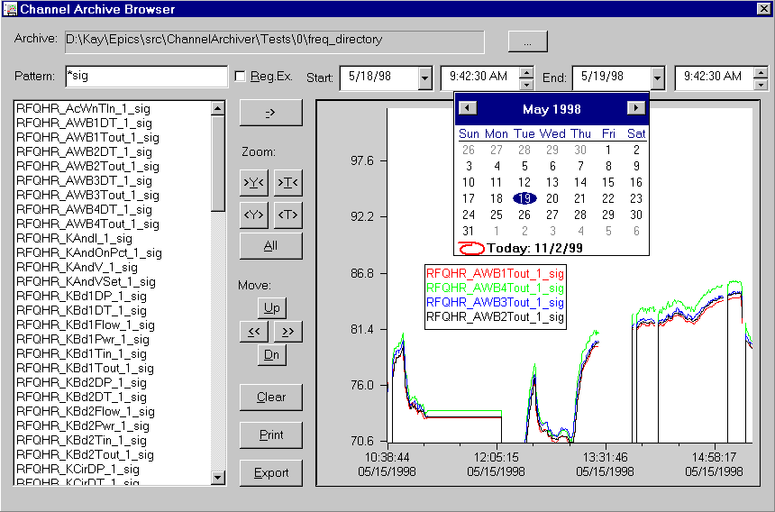
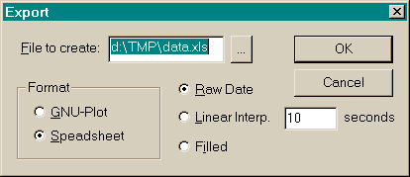
WIN32 Browser
Familiar User Interface
Win. Only

Slide 14
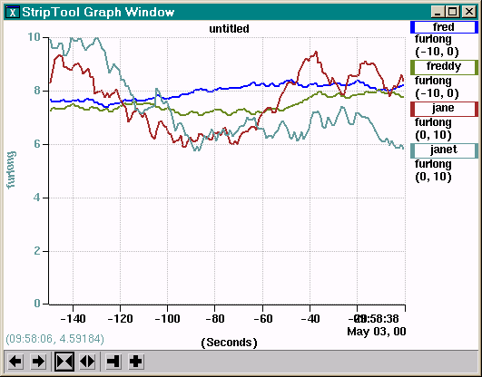
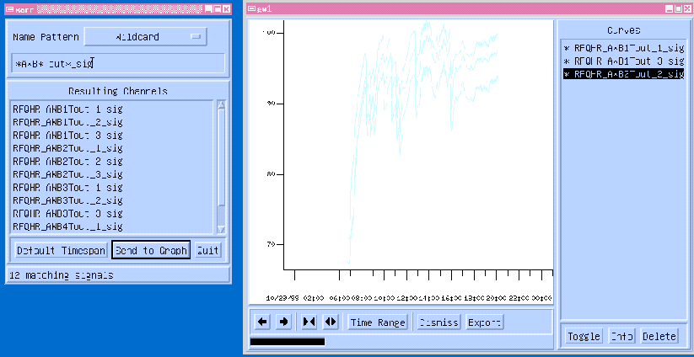
XARR, StripTool (Chris Larrieu, JLab)
View/Export Tools for UNIX (X11/Motif)
XARR: access to archive via older lib.
Plan: Support LibIO for both

Slide 15
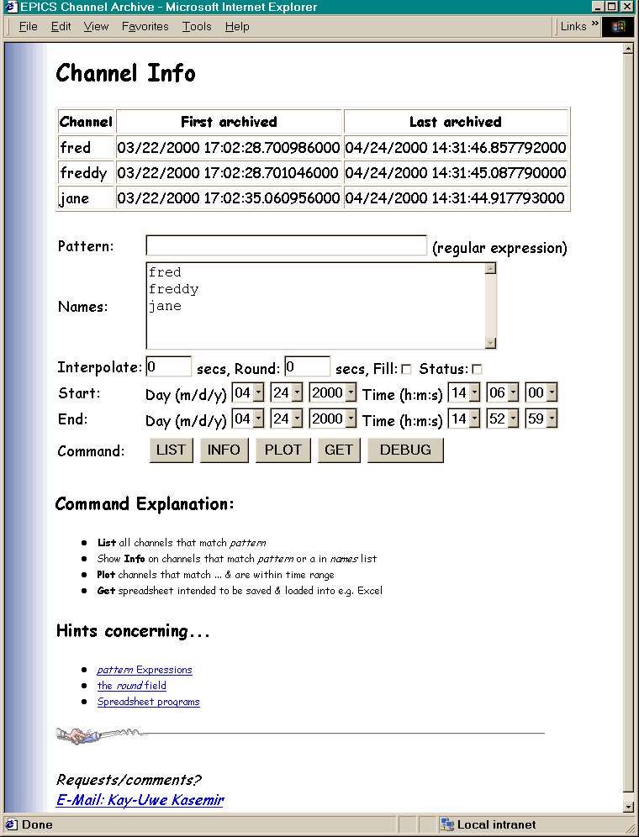
CGIExport
HTTP
Web Server
CGIExport
I/O Lib
For any Web Browser,
any Web Server w/ CGI
Archive Info
Simple Plots (GNUPlot)
Export in Spreadsheet format

Slide 16
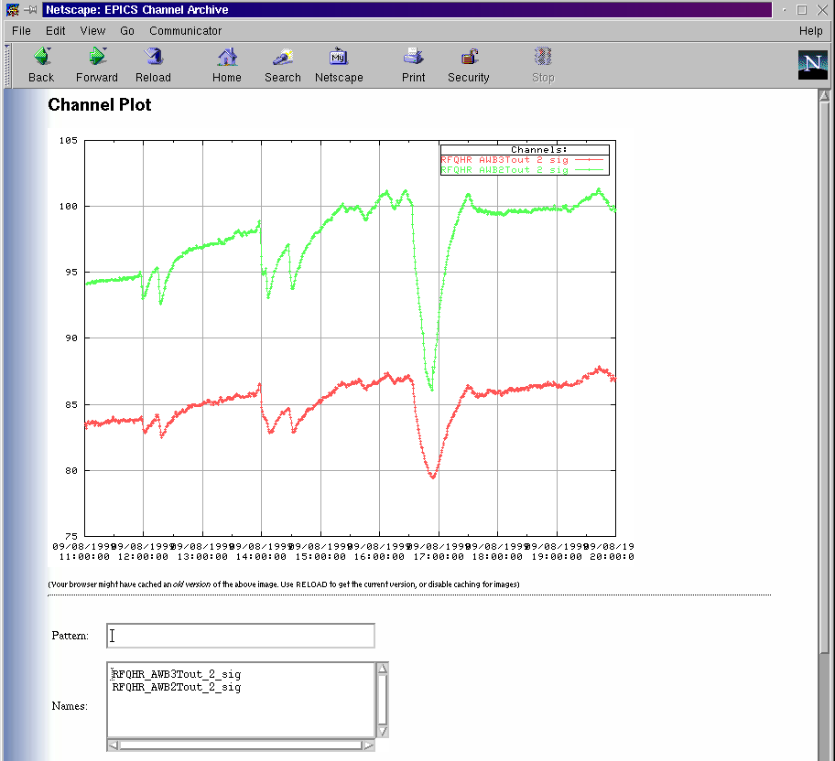
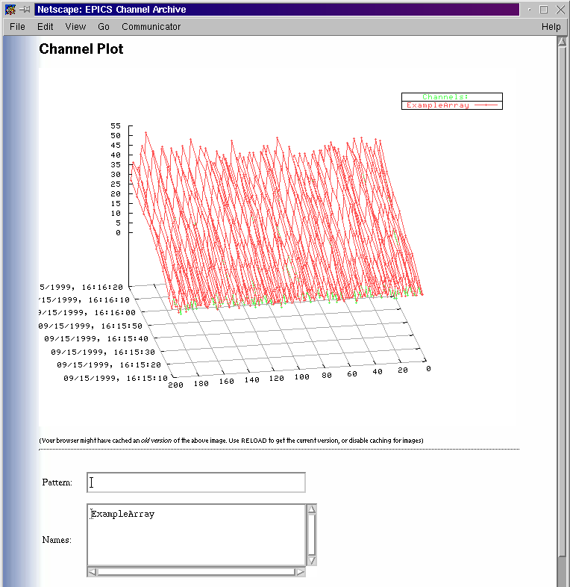
CGIExport: Plots

Slide 17
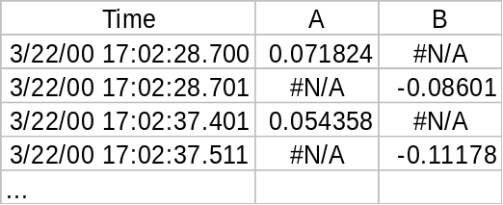
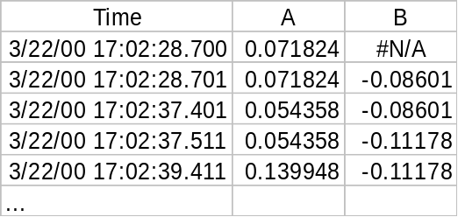
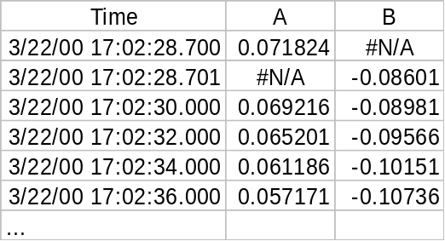
CGIExport: Spreadsheet Options
Original Time Stamps:
ill-suited for Spreadsheets
“Fill” missing values
by repetition
Linear Interpolation
for given period
(initial #N/A until all channels have valid value)

Slide 18
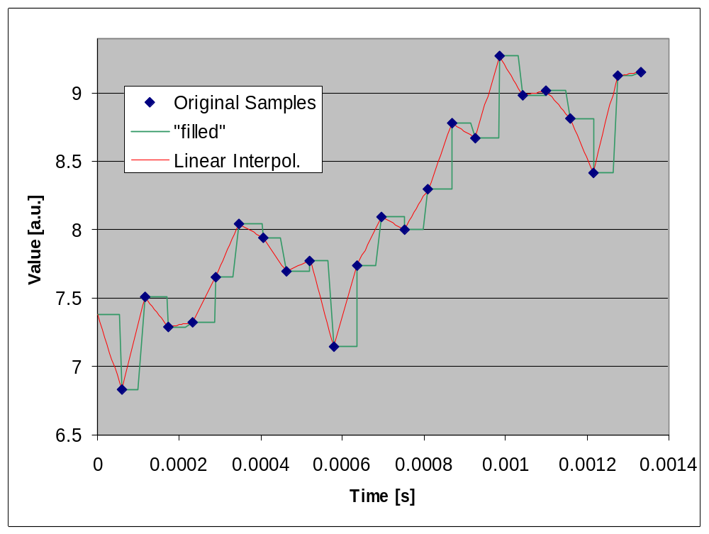
CGIExport: “Fill”, “Interpol.”, ...

Slide 19
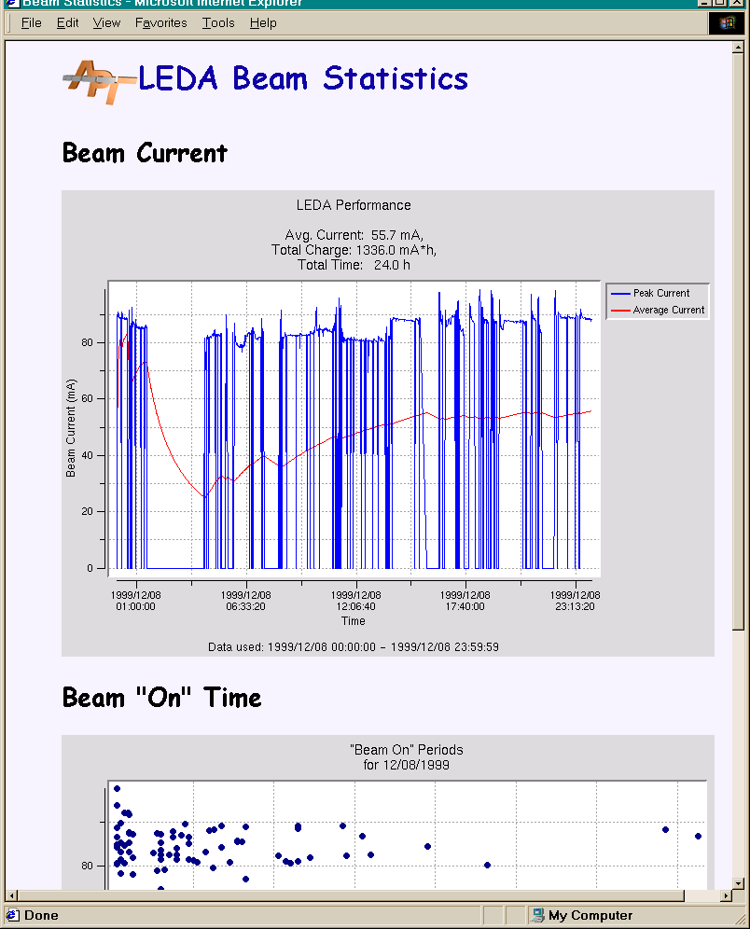
Scripting Interface
Not optimal for “end users”,
but allows programmers to
  provide adjustable scripts: Time/Y Plot, X/Y Plot, List,...
  automatically generate e.g. daily statistics for Web
  write filters for Matlab, Mathematica, …
  answer questions like:
  “How often was XX below 10.0 and for how long?”

Slide 20
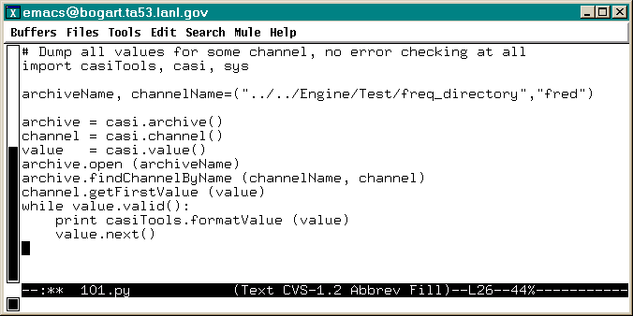
CASI: Channel Archive Scripting Interface
SWIG - based:
  allows access from tcl, perl, python
  available for Win32 and Unix
  Available Examples: tcl/tk and python
  for Win32 and Linux: loadable module
API:
  Plain adaption
  of ChannelArchive
  LibIO

Slide 21
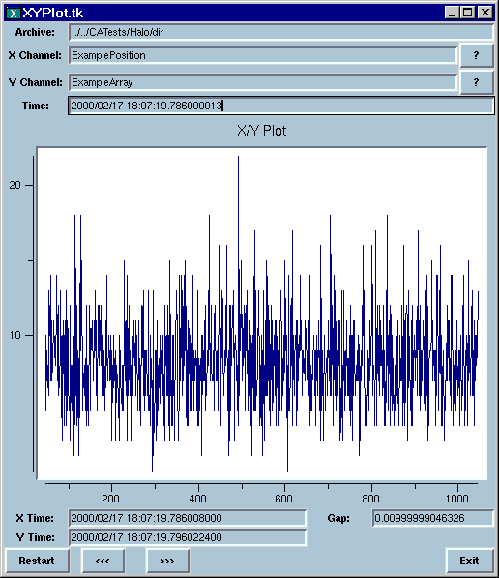
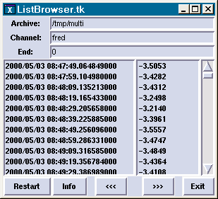
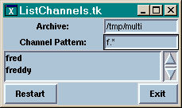
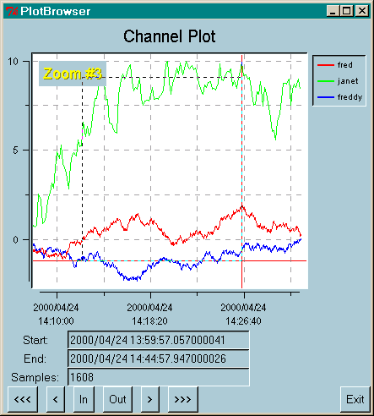
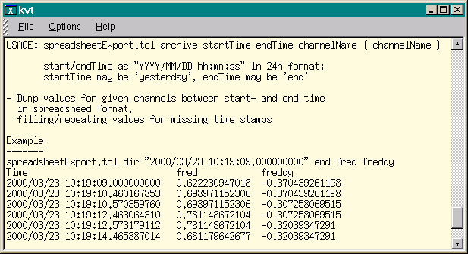
Generic Examples

Slide 22
Channel Archiver LibIO
Portable C++ code (handling e.g. byte swapping)
Based on generic “Iterator” interface:
  Archive: list channels
  ChannelIterator/Channel:
  first/last time available, find value before/after/near time
  ValueIterator/Value:
  get time, status, value both as string and “raw”
Supported: BinArchive, MultiArchive

Slide 23
LibIO: Example
#define ARCHIVE_TYPE BinArchive
void list_values
(const stdString &archive_name, const stdString &channel_name, const osiTime &start, const osiTime &end)
{
Archive archive (new ARCHIVE_TYPE (archive_name));
ChannelIterator channel(archive);
ValueIterator value(archive);
if (! archive.findChannelByName (channel_name, channel))
return;
channel->getValueAfterTime (start, value);
while (value && value->getTime() < end)
{
cout << *value << endl;
++ value;
}
}

Slide 24
BinArchive File Layout
Directory File
Disk-based Hash Table
Data File 1
Data File 2
Control Info
units, limits, ...
Control Info
units, limits, ...
Channel “X”
start time
end time
first data buffer
last data buffer
Data Buffer (X)
buffer info: start/end, type, …
prev buffer, next buffer
{ Samples }
Data Buffer (X)
buffer info: start/end, type, …
prev buffer, next buffer
{ Samples }
Control Info
units, limits, ...
Control Info
units, limits, ...
Channel “Y”
start time
end time
first data buffer
last data buffer
Data Buffer (Y)
buffer info: start/end, type, …
prev buffer, next buffer
{ Samples }
Data Buffer (Y)
buffer info: start/end, type, …
prev buffer, next buffer
{ Samples }
Data Buffer (Y)
buffer info: start/end, type, …
prev buffer, next buffer
{ Samples }

Slide 25
BinArchive Features
Hash Table
  fastest lookup by name
  less suited for sorted listing or wildcard lookup
Binary Data File, Multiple Channels per File
  minimized open/close calls, fastest read/write access
  byte swapping required, harder to maintain
Double-Linked Data Blocks
  fastest access to most recent values
  links must not be broken

Slide 26
ArchiveManager Program
Extraction of channels and time range into new archive
  attempt is made to skip/repair “broken” values while copying
Channels/time ranges can be appended to existing archive
  no “insert” nor “prepend”!
Possible Approach:
  Create extracts of reasonable size for backup (e.g. monthly CD-ROM)
  Original archive can be recreated from extracts, starting with the oldest one,
  not going
  back in
  time
1999
(orig.)
Jan.’99
1999
(copy)
Feb.’99
Mar.’99
...
Dec.’99

Slide 27
MultiArchive
Allows read-access to list of archives
  compile-time option for CGIExport, Tcl extension, WinBrowser
  first archive that holds requested data is used
  when iteration meets end of data, archive list is searched again
  no sophisticated merging, i.e. archives should not overlap in time
  for now each individual archive has to be a BinArchive
Format:
# ChannelArchiver master file
master_version=1
# Order in which archives are checked for data:
/archives/fast/dir
/archives/main/SinceJan2000/freq_directory
/archives/main/Jul99-Dec99/freq_directory
/archives/main/Jan99-Jun99/freq_directory
/home/fred/xyzarchive/dir

Slide 28
More Information
“ChannelArchiver” under
http://mesa53.lanl.gov/lansce8/epics/PC
Documentation is part of sources: ChannelArchiver/doc
Bob Dalesio: ldalesio@lanl.gov
Kay-Uwe Kasemir: kasemir@lanl.gov

