Slide 1
Operational Readiness – Rocky 8/CLARAty
Issa A.D. Nesnas
Jet Propulsion Laboratory
March 5, 2002
http://claraty.jpl.nasa.gov
Mars Technology Program
Intelligent Systems Program

Slide 2
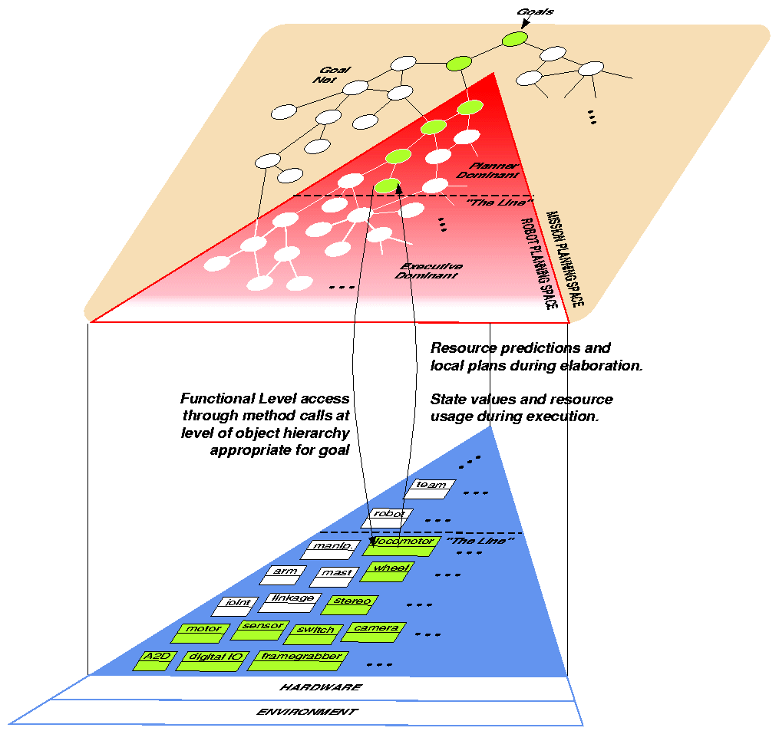
A Two-Layered Architecture
CLARAty = Coupled Layer Architecture for Robotic Autonomy
THE DECISION LAYER:
Declarative model-based representation of system capabilities and constraints. Various high-level autonomy technologies can provide planning, scheduling, and execution capabilities – (e.g. CASPER, CLEaR, TDL, MDS GEL, CRL)
VARIABLE GRANULARITY INTERFACE:
Interface between high- and low-level autonomy capabilities of the system. Interface for commanding, multi-level resource queries and predictions, and state updates.
THE FUNCTIONAL LAYER:
Generic and reusable robotic software components. Object-oriented design that can be adapted to various robotic, rover, and simulation platforms. Provide basic functionality and low-level autonomy capabilities. Packages include: I/O, Motion Control, Manipulation, Locomotion, Navigation, Perception, Resource Management, and System Control.

Slide 3
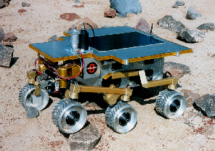
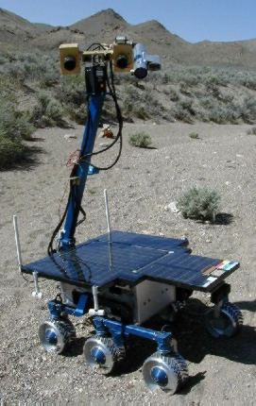
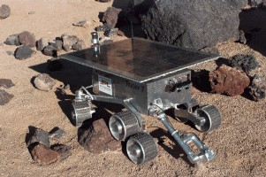
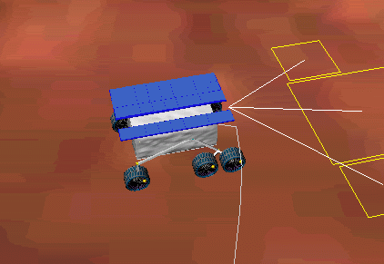
Currently Supported Platforms
Rocky 7
Rocky 8
VxWorks
Motorola 68K
VxWorks
JPL
Intel x86
JPL
K9
Linux
Solaris CC
Intel x86
Intel x86
Ames
ROAMS
Linux
JPL AI
CMU
Solaris
Mac OS X
New
JPL
Other

Slide 4
Working Groups
Working Groups:
Existing Working groups (no new changes)
  CLARAty Navigation Group (Lead: Reid Simmons - CMU)
  CLARAty Vision Group (Lead: Issa Nesnas - JPL)
  CLARAty Mobility & Manipulation Group (Lead: Hari Das - JPL)
  CLARAty Estimation Group (Lead: Ashitey Trebi-Ollennu - JPL)
  CLARAty Decision Layer Group (Lead: Tara Estlin - JPL)
  CLARAty Test/Release Group (Lead: ? - JPL)
  CLARAty Rocky 8 Group (Lead: Richard Petras - JPL)
  K9 CLARAty Developers (Lead: Anne Wright - ARC)
  CLARAty Science Working Group (Lead: Meemong Lee - JPL)
  CLARAty Simulation Group (Lead: Gene Chalfant/Jain - JPL)
http://claraty.jpl.nasa.gov/groups

Slide 5
Team
Up-to-date CLARAty team information now available online:
  Actively funded team members and their responsibilities
  Contributors to CLARAty
  Users and Collaborators
  Former team members
available at:
http://claraty.jpl.nasa.gov/team

Slide 6
General
Started a series of presentations of various CLARAty pkgs
ITAR Update
  Prepared and submitted a package describing current and planned CLARAty modules to International Affairs office for clearance of CLARAty infrastructure and glue code
  Working on a complete package for submission to State Department
New Participants:
  University of Washington
  MIT

Slide 7
CLARAty Testbed
Setup a CLARAty testbed in 198-B labs to include:
  CLARAty embedded platforms with complete remote operations (remote access and GUI based remote power cycling)
    Rocky 8 benchtop system (cPCI)
    Dexter manpulation system (hybrid Rocky 8/7 control) (cPCI)
    Rocky 7 benchtop computational module (VME)
    Rocky 7 benchtop system (VME) (in progress)
    Rocky 8 upgrade benchtop system (cPCI) - (in progress)
  CLARAty benchtop/simulation platforms
    1 Linux server for OS booting of networked machines
    2 Linux graphics workstations for CLARAty/ROAMS development
    http://claraty.jpl.nasa.gov/targets
Submitted request for Lab changes

Slide 8
Current Lab Setup
old A/C
B5A
B5

Slide 9


Proposed Lab Setup
Rover
CLARAty Benchtop System
Shelves
Rocky 8 Bed
Ceiling mounted WebCAM
Work-
station 2
B5
Work-
station 2
Cabinets
Work-
station 3

Slide 10
System Infrastructure
Operating System Upgrade:
  Procured a complete upgrade for all VxWorks targets ($25K)
    Wind River initially agreed to release Tornado 2.2 (not officially released till 6/2002)
    Wind River changed its position and will not even release gcc 2.95 x86
    Will upgrade all architectures (m68k, x86) to Tornado 2.02 - 6 licenses
  CLARAty needs to cross compile gcc 2.95 for x86 and m68k
GNU C++ for m68k
  Added support to Makefile for m68kVx5.3 gcc version 2.95
  Cross compiled GNU C++ for m68k architecture
  Successfully cross compiled and tested Rocky 7 software
  Ran continuous driving locomotion as a validation test
GNU C++ for x86
  Leveraged existing installation gcc2.96 (x86) from TMR.
  Successfully compiled Rocky 8 software
  Software failed to operate on Rocky 8
  Need to cross compile gcc2.95 for x86

Slide 11
Software Infrastructure
Built, tested, and released a set of core modules for all supported platforms, including Linux, VxWorks, Solaris (both gcc and SparcWorks) and IRIX
Built and tested ACE for m68kVx5.3 under gcc version 2.95 and sparcSol2.6-CC

Slide 12
CLARAty Packages
Module Updates

Slide 13
Adapting to a Rover
Decision Layer
(e.g. CASPER/TDL)
Rocky 8
Models/
Heuristics
Connector
Multi-level access Connector
Generic
Functional Layer
Rocky 8
Specialized
Classes
&
Objects
Simulation
Hardware Drivers

Slide 14
The Functional Layer
Adaptations
Rover
Navigation
Behaviors
Simulation
Rocky 8
Path Planning
Manipulation
Locomotion
FIDO
Estimation
Vision
Science
K9
Transforms
Math
Rocky 7
Sensor
Motion Control
Communication
Input/Output
Hardware Drivers

Slide 15
The Decision Layer
CASPER Planner
Task Description
Language (CMU)
CLEaR Integration
Rover Models
FL Interface

Slide 16
Hardware Drivers
Hardware Drivers
Motor Controllers
I/O Boards/Chips
Custom Boards
HCTL 1100 Motor Controller
VPAR10 – Digital I/O Board
Widget Board – Motion Control
LM 629 Motor Controller
Sensoray S720 Digital I/O Board
Widget Board Firmware
...
VADC20 – Analog Input Board
...
Framegrabbers/Vision
MAX186 Analog to Digital Conv.
Imagenation CX100 Framegrabber
MAX528 Digital to Analog Conv.
Imagenation PX610 Framegrabber
1394 Camera Driver
Other
...
VISA – Vme to ISA Converter
I2C Master Controller
PCI Controller
...
Crossbow DMU – Interial Measurement Unit

Slide 17
Base Package
Base Package
Share
Common Definitions
Math Constants
Function Operators
Display Functions
Frame
Coordinate Frames
Locations (Poses)
Linked List
Linked List
Doubly Linked List
Array
1D Arrays
2D Arrays
Sub Arrays
Point
2-D Points
3-D Points
State
State data logging
Database
Matrix
1D matrices (math)
2D matrices (math)
Fixed size matrices
Rotation matrices
Resource
Timers
Tasks
Transforms
Homogeneous Transforms
Quaternions
Greyed Out – will be implemented
Orange – non-JPL/non-CLARAty development
Green – JPL-non-CLARAty development
...

Slide 18
Input Output Package
Input Output Package
I/O
I/O
Digital I/O
Composite Digital I/O
Analog I/O
Bits
Bits data structure
(various implementations)
...

Slide 19
Motion Control Package
Motion Control Package
Motor
Open Loop Motors
Controlled Motors
Trajectory
Trajectories
Trajectory Generators
Coordinated Systems
Motor Coordinators
...

Slide 20
Vision Package
Vision Package
Camera
Framegrabbers
Cameras (single, multi)
Generic camera models
Visual Tracking
2-D Feature based tracking
3-D shaped based tracking
Combined 2-D & 3-D tracking
Visual odometry
Basic Vision
2-D Image processing
  Filtering & smoothing
  Edge detection
  Blob detection
  Corner feature detection
Visual Tracking
Filtering & smoothing
  Edge detection
  Blob detection
  Corner feature detection
Stereo Vision
Stereovision Interface
Stereo Implementations
JPL Stereo engine
SRI Stereo engine (commercial)
Ames Stereo engine
...

Slide 21
Communication Package
Motion Control Package
Ethernet
Socket Communication
  TCP Comm
  UDP Comm
Serial I/O
Serial Comm
Messages
Object serialization
Socket messages
Connector
Client/server comm.
Executives
...

Slide 22
Locomotion Package
Locomotion Package
Wheel Locomotion
2-D Wheel Locomotion
3-D Rocker Bogie Locomotion
Continuous driving modules
Legged Locomotion
Legged Locomotors
Hybrid Locomotion
Wheel/Legged Locomotors
...

Slide 23
Sensor Package
Sensor Package
IMUs
Generic inertial measurement
unit infrastructure
Voltage & Current Sensors
Tilt Sensors
Generic Electronic Tilt sensors
Generic Accelerometers
Rate Sensors
Generic Gyros structures
Temperature Sensors
...

Slide 24
Estimation Package
Estimation Package
Kalman Filter
Kalman Filter implementation
Pose Estimators
Wheel-based Pose Estimators
Legged-based Pose Estimators
...

Slide 25
Navigation Package
Navigation Package
Local Navigators
Generic local navigator structure
Path Planner
Generic path planner structure
Navigation Implementations
MER/GESTALT Navigator
Morphin (CMU) Navigator
Fuzzy Navigator
...

Slide 26
Path Planning Package
Path Planning Package
Global Path Planners
Generic path planner structure
Path Planner Implementations
D* Path Planner (CMU)
Tangent Graph Path Planner (JPL)
ISE Path Planner (CMU)
...

Slide 27
Simulation Package
Simulation Package
Simulator Connectors
Interfaces to ROAMS simulation
  Rover Sim
  Navigator Sim
  Locomotor Sim
  Motor Sim
  I/O Sim
  IMU Sim
Simulation Implementations
ROAMS Rover Simulation (JPL)
...

Slide 28
Manipulation Package
Manipulation Package
Manipulators
Limited DOF manipulators
Redundant manipulators
End effectors
Sensor-based Manipulation
Stereovision based manipulation
Vision/tactile manipulation
...

Slide 29
Science Package
Science Package
Spectrometers
Generic Spectra classes
Generic Spectrometer classes
Science Cameras
Special science cameras
(inherits for Cameras of Vision Package)
...

Slide 30
Behavior Package
Behavior Package
Behaviors
Basic rover behaviors
Behavior Coordination
Arbiters
Behavior combinators
...

Slide 31
Rocky 8 Package
Rocky 8 Package
Rocky 8 Specialized Physical Components
Rocky 8 Motors
Rocky 8 Cameras
Rocky 8 IMUs
Rocky 8 Hardware Map
Rocky 8 Digital I/O
Rocky 8 Analog I/O
Rocky 8 Specialized Functional Components
R8 Locomotor
R8 Contrained Locomotor
R8 Navigator
R8 Rover
...

Slide 32
Rocky 7 Package
Rocky 7 Package
Rocky 7 Specialized Physical Components
Rocky 7 Motors
Rocky 7 Cameras
Rocky 7 Accels
Rocky 7 Gyros
Rocky 7 Hardware Map
Rocky 7 Digital I/O
Rocky 7 Analog I/O
Rocky 7 Specialized Functional Components
R7 Locomotor
R7 Contrained Locomotor
R7 Navigator
R7 Rover
...

Slide 33
FIDO Package
FIDO Package
FIDO Specialized Physical Components
FIDO Motors
FIDO Cameras
FIDO Accels
FIDO Gyros
FIDO Hardware Map
FIDO Digital I/O
FIDO Analog I/O
FIDO Specialized Functional Components
FIDO Locomotor
FIDO Contrained Locomotor
FIDO Navigator
FIDO Rover
...

Slide 34
Decision Layer Package
Decision Layer Package
General Planners
Basic planner infrastructure
Activity Database
Generic Activity database structure
Planner Implementations
CASPER
ASPEN
Executives
Task Description Language
...
Interfaces
Functional Layer Interface
...
...

Slide 35
Base Package
Share Module:
Continued maintenance of shared module
Arrays and Matrices Modules:
Improvements to Matrix classes to guarantee compilation and running on all target architectures.
State Module:
Continued work on the design of a state class that will allow the logging and monitoring of local state

Slide 36
Vision Package
Image Module
Added new operations (specializations) for Image_Op (rescale, convolution).
Implemented Image_IO (file operations) and added support for TIFF format
Camera Module
Designed and implemented generic Camera and Multi_Camera classes
Developed specialization/interface for 1394-FireWire Linux implementation..
Stereo Module
Designed and implemented a Stereo_Processor_Impl class to support various stereo implementations
Interfaced JPL stereo implementation to the generic CLARAty stereo classes and successfully tested stereo on synthetic images.

Slide 37
Input/Output Package
Bits Module
Updated Bits class to use a more efficient implementation
Digital I/O Module
Re-implemented digital input/output class structure to be consistent with the CLARAty latest designs. New classes are DIO, DIO_Impl, and Composite_DIO which will replace DIO and DIO_PORT classes
Redesign a new AIO class

Slide 38
Locomotion Package
Made Locomotion package vxWorks independent. Provided the option to use VxWorks or ACE
Presented Locomotion package to CLARAty team
Tested Locomotion using gcc 2.95
  Successfully ran continous driving
Provided documentation of locomotion algorithms
Working on a Locomotor design that will incorporate ATRVs
x
y
z
Front
C
Front
x
y
C
z
(d)
Partially Steerable
(e.g. Rocky 7)
(e)
All wheel steering
(e.g. Rocky8, Fido, K9)

Slide 39
Estimation Package
Ran first tests of the Kalman-based pose estimator in the Mars Yard sand box
Collected first set of IMU and odometry data using the FIDO IMU.
Data collected had systematic error. IMU driver need to be updated to reflect the version of this spare unit.
Data will be validated against that collected under Linux
Continued interactions with MDS/GREASE team on their Kalman-filter software implementation

Slide 40
Navigation Package
Discussions and iterations between CMU, JPL and Ames on the design of Navigator module proposed by CMU
Developed a design for a stereo-vision based navigator class
Provided a UML description of the Navigation classes that tightly integrates local navigation with global path planning

Slide 41
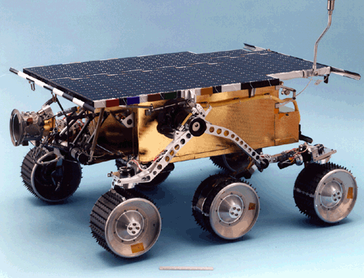
Generic Reusable Algorithms
Wheeled Locomotion – works for Rocky 8, Rocky 7, Fido, K9, ...
x
y
z
Front
C
Front
Front
Front
x
x
C
x
x
y
C
y
C
z
y
y
C
z
z
z
(b)
Tricycle
(one steering wheel)
(c)
Two –wheel steering
(d)
Partially Steerable
(e.g. Sojourner,
Rocky 7)
(e)
All wheel steering
(e.g. MER, Rocky8,
Fido, K9)
(a)
Skid Steering
(no steering wheels)

Slide 42
Code Resuability Results
Analysis of amount of resuable code across implementations:
Module
Lines of Code
Status
Depends On
Wheel Locomotor
1445
Reusable
Motion Sequence, 1D Solver, Homogeneous Transforms
Motion Sequence
540
Reusable
Vector
Matrix, Vector, Array
1083
Reusable
-
1D Solver
356
Reusable
-
Location, Homogeneous Transforms
341
Reusable
Rotation Matrix, Point 2D
Rotation Matrices
435
Reusable
-
Point 2D
131
Reusable
-
Controlled Motor
2080
Reusable
Rocky 8 Locomotor
250
Non-reusable
Rocky 8 Motor
Rocky 8 Motor
334
Non-reusable
Widget Motor, etc...
Total
6995
584 (non-reusable)
Total Reusable
~92%

Slide 43
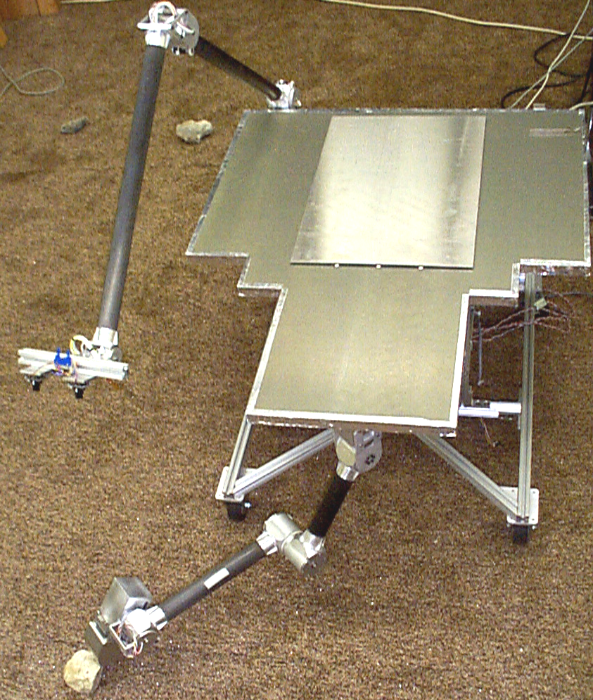
Manipulation Package
Setup manipulation platform as part of the CLARAty testbed.
Platform will be used to continue manipulation development and to support MDS/CLARAty infusion
Currently running an older version of CLARAty code
Wrote detailed s/w descriptions for Manipulator and Motion Control packages
Developed a h/w diagram of the dexter platform
Dexter

Slide 44
Simulation Package
Restored CLARAty/ROAMS demo from FY01 and presented it to Mars Smart Lander project
Defined various levels of integration between ROAMS and CLARAty.
Started implementation of interactions at various levels
Set up two Linux machines to support the integration and use of CLARAty and ROAMS.
Configured JPL Linux machines to use CLARAty - minor bug fixes

Slide 45
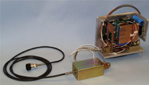
Science Package
Developed generic class designs for Spectra and Spectrometer classes
Collaboration between Ames and JPL
Collaboration with Vision working group to ensure consistency of design and implementation

Slide 46
Decision Layer Package
Analyzing and designing a Mapper package that will use several vision and terrain modules to generate a seamed panorama
Completed port and test of Decision Layer binaries on Solaris 2.7
Identified component technologies that are needed to transfer terrain data between rover’s Functional Layer and the Decision Layer
Defined first draft of the communication infrastructure and interface that will allow the sharing of terrain information between two layers

Slide 47
Rocky 8
cPCI x86 233MHz
6 Wheel Drive/6 Wheel Steering
5 CMOS camera pairs - 3 Framegrabbers
30 Widget boards – I2C
Crossbow IMU
4 DOF mast with head
4 DOF arm with 1 DOF scoops
Camera sun sensor
Wireless Ethernet
Rocky 8
VxWorks
Intel x86
JPL

Slide 48
Rocky 8 & Rocky 7
VME – m68k 40 MHz
6 Wheel Drive/2 Wheel Steering
3 camera pairs – 2 framegrabbers
15 LM629 motor controllers
2 DOF Arm/2DOF scoops
3 DOF Mast
3 Accels
3 Gyros
Analog sun sensor
Wireless ethernet
Instrument – filter wheel/Raman Spectrometer
Rocky 7
VxWorks
Motorola 68K
JPL

Slide 49
Rocky 8 Plan
Software and OS
  Upgrading operating system to Tornado 2.02, and all BSPs
Upgrading processor to 1.2 GHz with 256 MB of RAM for faster development/debug and testing – lower CPU plug and play
Controllable Power System
  Software control on battery usage/charging/solar – Li ion with 8 hour operation
Motion Control Upgrade
  Upgrade encoders to HP COTS (16 lines/rev)
  Upgrade I2C to a master - use a parallel to I2C dongle to remove host locking interrupts - bandwidth 100kb
  Long Term – next generation widget board with high speed serial
Upgrade vision to high resolution FireWire Cameras

Slide 50
Rocky 7 Plan
Software and OS
  Upgrading operating system to Tornado 2.02, and all BSPs
Need to:
  Upgrade backplane to cPCI
  Upgrade processor to PPC 750
  OS both Linux and VxWorks or just Linux
  New Firewire cameras or new framegrabbers
  New batteries
  Mechanical refurbishing

Slide 51
Concerns
IP and ITAR
Changes in personnel and the large number of new members getting up to speed is expected to lead to slower progress for several months.
Infrastructure tools (such as YaM which is used by MER, Starlight, and CLARAty) are not supported institutionally. Progress has been hindered due to lack of funding and personnel. CLARAty will provide 0.25 FTE to ensure progress

Slide 52
Discussion Slides

Slide 53
Interactions (1/2)
Interactions:
  Mars Smart Lander Project and MDS
    Supporting meetings for the Technology Infusion Task - MDS compatibility sub-task lead by Steve Peters.
  MDS/CLARAty Infusion
    Setup Dexter (PDM platform) for the task
    Supporting meeting between CLARAty and MDS to establish plan of migrating technology from CLARAty to MDS framework
  ROAMS
    Progress reported in Simulation Package
  Navigation on Slopes Task
    Planned field test for data collection postponed several times due to delays in data collection software, hardware limitations, and limited bandwidth data rates. Some upgrades to Rocky 8 hardware are necessary to meet requirements for data collection.

Slide 54
Interactions (2/2)
  Visual Tracking Task
    Close participation of members of Visual Tracking Task in the development of the Vision package for CLARAty
  FIDO Team
    Working with FIDO team on the integration of CLARAty onto FIDO (more in the FIDO integration task report)
  Fuzzy Navigation Task
    Task members successfully used Locomotion package to control Rocky 8
    Separate funding is supporting plans for integrating Fuzzy Navigation algorithms into the CLARAty navigation package. Participation of various navigation technologists will ensure that the generic framework can support the various candidate technologies.

Slide 55
Why Develop? – Challenges ahead
Why develop vs. buy?
  No product currently exists to address the scope of problems
  Decades of robotics and rover expertise at JPL
  Needs to be a collaborative effort within the robotics community
Challenges:
  Getting full ITAR clearance and making CLARAty open source
  Migrating capabilities into a flight environment (MDS)
  Getting various researchers and technologists integrated into the architecture – requires time and support
  Developing and maintaining a high quality complex product
  Having enough test platforms while maintaining convergence
  Maintaining a highly-skilled, stable, and efficient team to develop the product

Slide 56
Schedule – where are we?
FY 00
  Designed and documented architecture
FY 01
  Developed a complete end-to-end prototype with basic capabilities and tested it on Rocky 8 and Rocky 7. Also portions of architecture running on K9 rover at Ames.
  Established close collaborative environment with Ames and CMU
FY 02
  Developing a more sophisticated set of capabilities
  Initial integration of selected MTP competed task technologies for long range traverse scenario demonstration
  Extending supported platforms to include: FIDO rover, ATRV (used by research community)
FY 03
  Demonstrate instrument placement from various rovers
FY 04
  Sophisticated mission-like capabilities on various rover prototypes

Slide 57

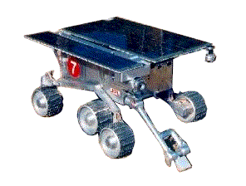
Decision Layer - Full Navigation Scenario
Goal discarded due to energy resource conflict
Unknown obstacles causes obstructed path. Science targets are re-sequenced
Global map knowledge
(Orbit or decent imagery)
Local map knowledge
Science goal target
Original path
New / Actual path
Deleted path segment
Unknown obstacle causes navigation s/w to take rover off course
Deleted Science Target
Goal discarded due to memory resource conflict
Courtesy of Fisher, Estlin et al.

Slide 58


Comparing Different Implementations
ControlledMotor
Mz<Type>
Controlled_Motor_Impl
Joint
Linear_Axis
Non-Resuable Layer
Fido_Motor
R7_Motor
R8_Motor
Sim_Motor
PID_Servo
Trajectory
HCTL_Chip
LM629_Chip
Trajectory_Generator
Widget_Motor
R7_MC_Board
Widget_Board

Slide 59
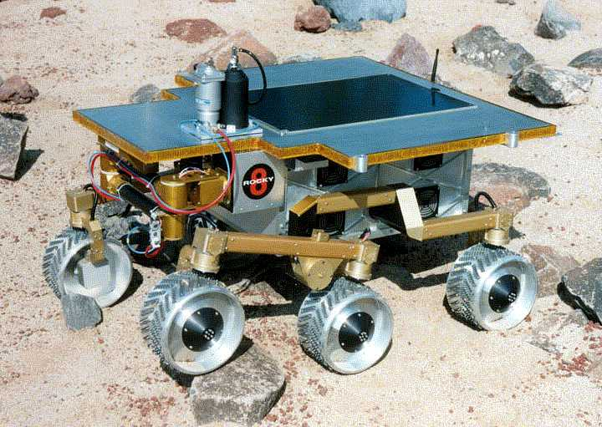
R8 Specific Rover Implementation
Non reusable Code
Reusable Code
CoordMotionSystem
R8
Implements general fwd &
inv. kinematics & joint ctrl
Locomotor
Manipulator
R8_Rover
LeggedLoc
Wheeled Locomotor
Arm
Mast
R8_Arm
R8_Locomotor
R8_Arm
R8_Mast
R8_Locomotor
R8_Mast
Attaches proper motors
Restricts Steering to 2 wheels
Specialized inv. Kinematics (overrides default)
Attaches proper motors
Attaches proper cameras for mast
Adds filter wheel
Motor
ControlledMotor
BBMotor
IO
Digital_IO
Analog_IO
R8_Motor
Trajectory
Widget Board
Timers
Widget DIO
Widget AIO
Trajectory_Generator
Widget Motor
HCTL 1100 Chip

Slide 60
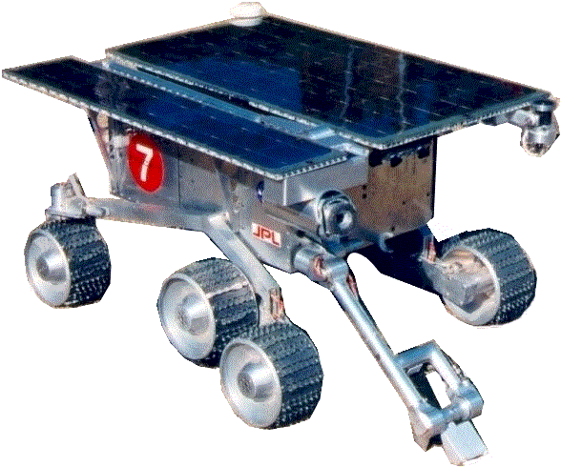
R7 Specific Rover Implementation
Non reusable Code
Reusable Code
CoordMotionSystem
R7
Implements general fwd &
inv. kinematics & joint ctrl
Locomotor
Manipulator
R7_Rover
LeggedLoc
RBLoc
WheeledLoc
Arm
Mast
R7_Arm
R7_Locomotor
R7_Arm
R7_Mast
R7_Locomotor
R7_Mast
Attaches proper motors
Restricts Steering to 2 wheels
Specialized inv. Kinematics (overrides default)
Attaches proper motors
Attaches proper cameras for mast
Adds filter wheel
Motor
ControlledMotor
BBMotor
LM629Motor
IO
LM629Chip
Digital_IO
Analog_IO
VPAR10Board
Device Drivers

Slide 61
Code Reusability for Hardware Modules
Actual Examples of Code Reusability for Hardware modules:
  Controlled Motor Hierarchies for Rocky 8 and Rocky7
Rocky 8
Rocky 7
Module
Lines of Code
Status
Module
Lines of Code
Status
Controlled Motor
2080
Reusable
Controlled Motor
2080
Reusable
Trajectory Generator
338
Reusable
Bits
756
Reusable
Resources (Timers, etc)
143
Reusable
Input Output
706
Reusable
Bits
756
Reusable
Rocky 7 Motor
415
Non-reusable
Rocky 8 Motor
334
Non-reusable
Rocky 7 I/O Maps
131
Non-reusable
Widget Motor
383
Reusable – widget
Motor Controller LM629
1014
Reusable – LM629
Motor Controller HCTL
900
Reusable – HCTL
VPAR10 Parallel I/O
534
Reusable – VPAR10
I2C Master
1446
Reusable – I2C
Total
6380
334 (non-reusable)
Total
5636
546 (non-reusable)
Total Reusable
~95%
Total Reusable
~90%
Total Reusable – Strict
~52%
Total Reusable – Strict
~63%

Slide 62
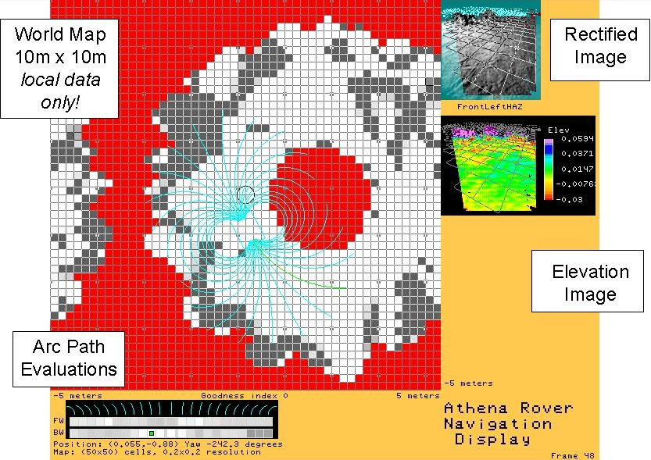
GESTALT Navigator on Rocky 8

Slide 63
Publications & Website
http://claraty.jpl.nasa.gov
I.A.D. Nesnas, R. Volpe, T. Estlin, H. Das, R. Petras D. Mutz, "Toward Developing Reusable Software Components for Robotic Applications" Proceedings of the International Conference on Intelligent Robots and Systems (IROS), Maui Hawaii, Oct. 29 - Nov. 3 2001. pdf (8 pages, 2MB)
T. Estlin, R. Volpe, I.A.D. Nesnas, D. Mutz, F. Fisher, B. Engelhardt, S. Chien, "Decision-Making in a Robotic Architecture for Autonomy." Proceedings of 6th International Symposium on Artificial Intelligence, Robotics, and Automation in Space (i-SAIRAS), Montreal Canada, June 18-21 2001. pdf (8 pages, 72KB)
R. Volpe, I.A.D. Nesnas, T. Estlin, D. Mutz, R. Petras, H. Das, "The CLARAty Architecture for Robotic Autonomy." Proceedings of the 2001 IEEE Aerospace Conference, Big Sky Montana, March 10-17 2001. pdf (12 pages, 470 KB)
R. Volpe, I.A.D. Nesnas, T. Estlin, D. Mutz, R. Petras, H. Das, "CLARAty: Coupled Layer Architecture for Robotic Autonomy." JPL Technical Report D-19975, Dec 2000. pdf (116 pages, 904 KB)

Slide 64
Thank you for your Attention

