Slide 1
Impact of Neutrino Oscillation
Measurements on Theory
Hitoshi Murayama
NuFact 03
June 10, 2003

Slide 2
Past

Slide 3
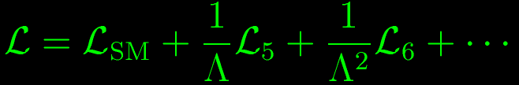
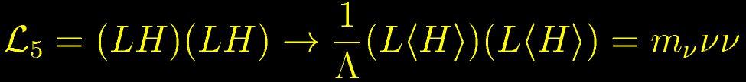
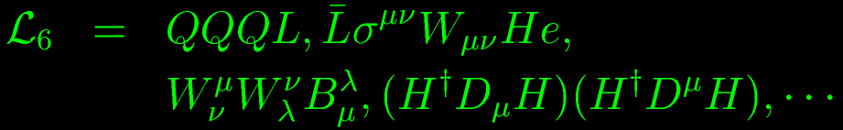
Rare Effects from High-Energies
Effects of physics beyond the SM as effective operators
Can be classified systematically (Weinberg)

Slide 4
Unique Role of Neutrino Mass
Lowest order effect of physics at short distances
Tiny effect (m_{ν}/E_{ν})²~(eV/GeV)²=10^{–18}!
Interferometry (i.e., Michaelson-Morley)!
  Need coherent source
  Need interference (i.e., large mixing angles)
  Need long baseline
Nature was kind to provide all of them!
“neutrino interferometry” (a.k.a. neutrino oscillation) a unique tool to study physics at very high scales

Slide 5
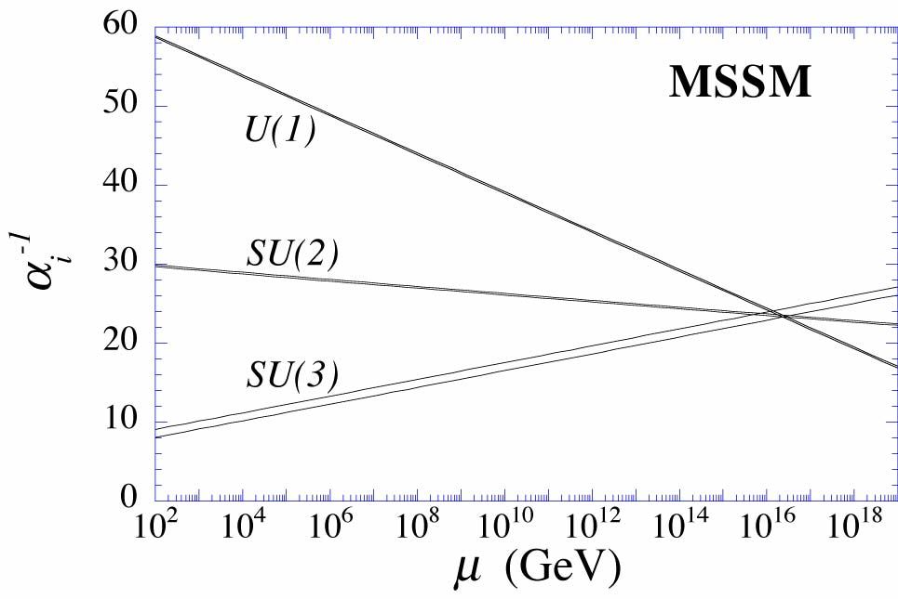
Grand Unification
electromagnetic, weak, and strong forces have very different strengths
But their strengths become the same at 10¹⁶ GeV if supersymmetry
A natural candidate energy scale Λ~10¹⁶GeV
⇒ m_{ν}~0.003eV
m_{ν}~(Δm²_{atm})^{1/2}~0.03eV
m_{ν}~(Δm²_{LMA})^{1/2}~0.007eV
Neutrino mass may be probing unification:
Einstein’s dream

Slide 6
Present

Slide 7
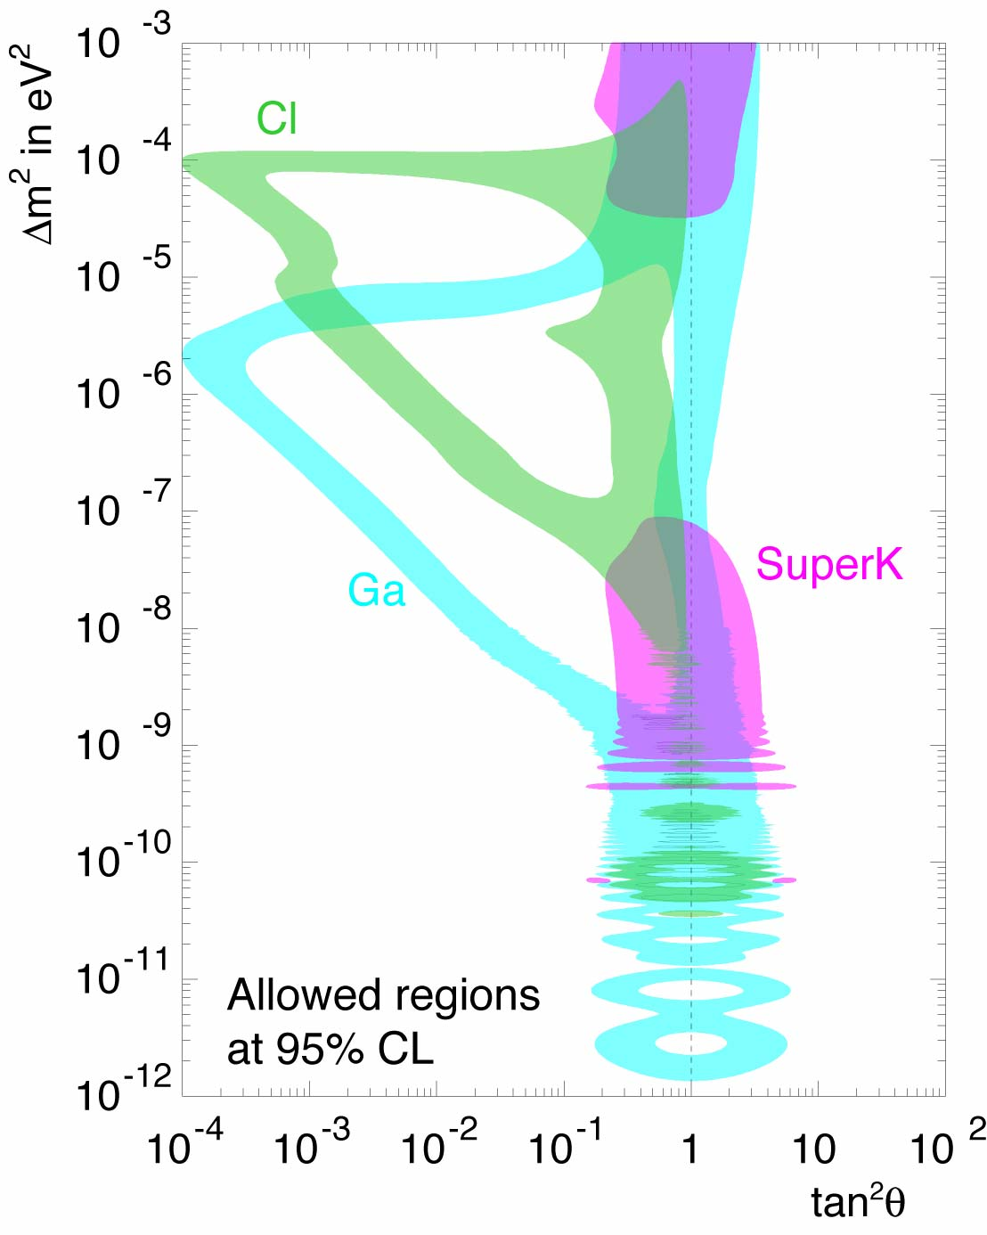
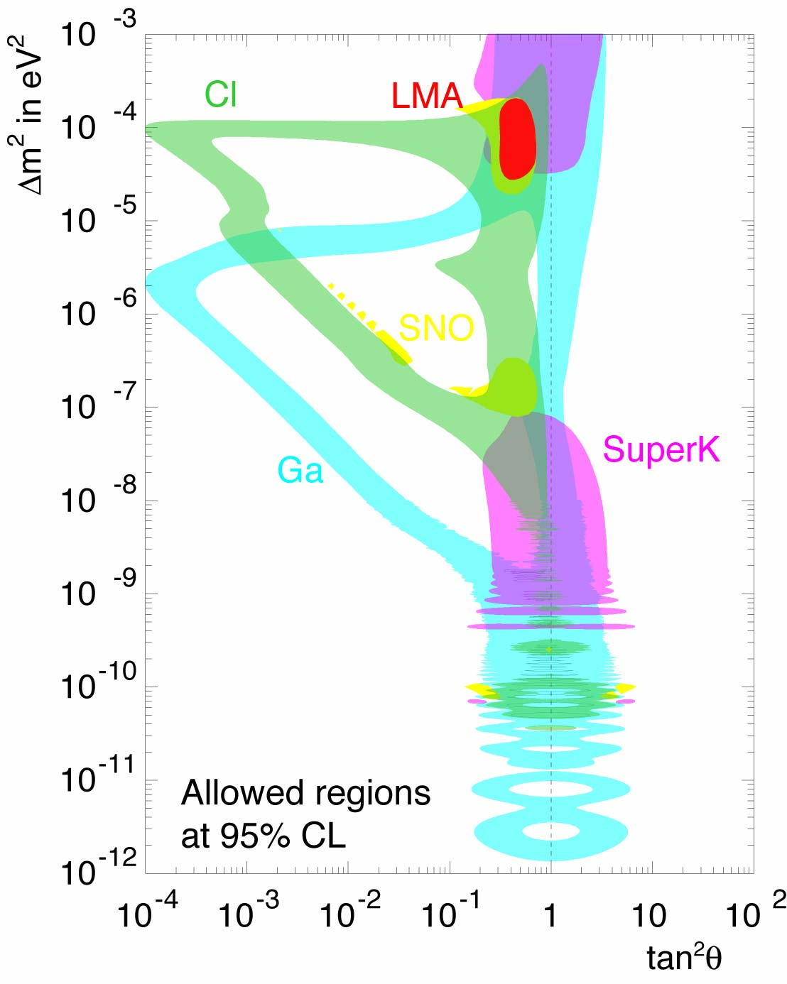
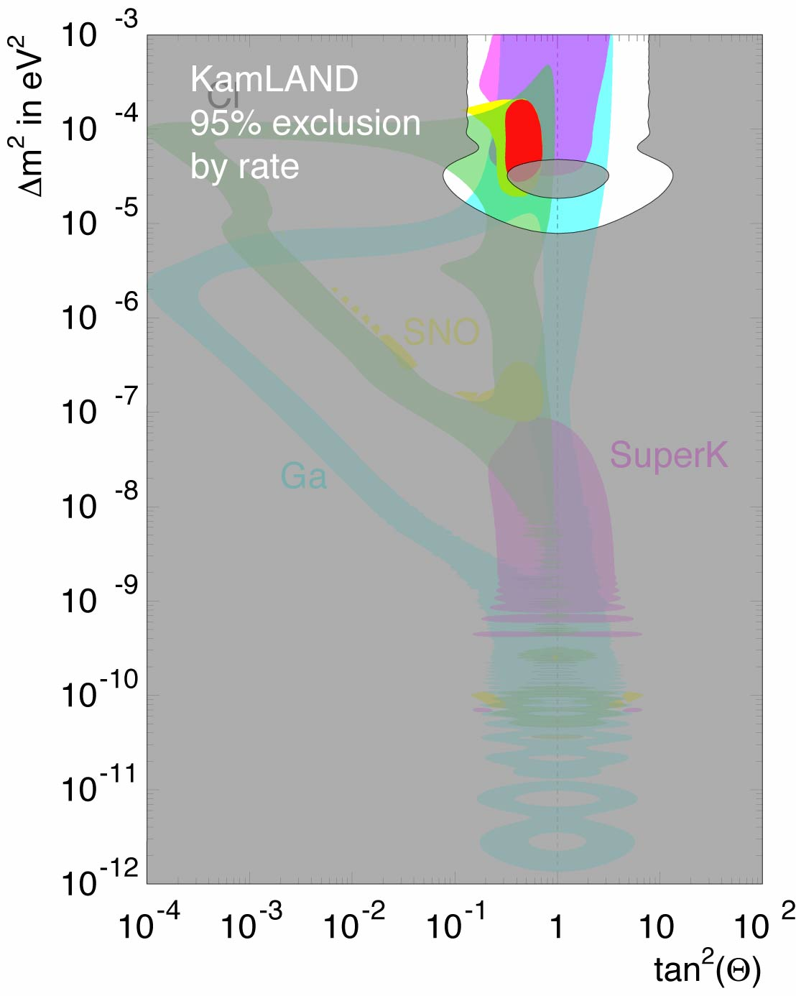
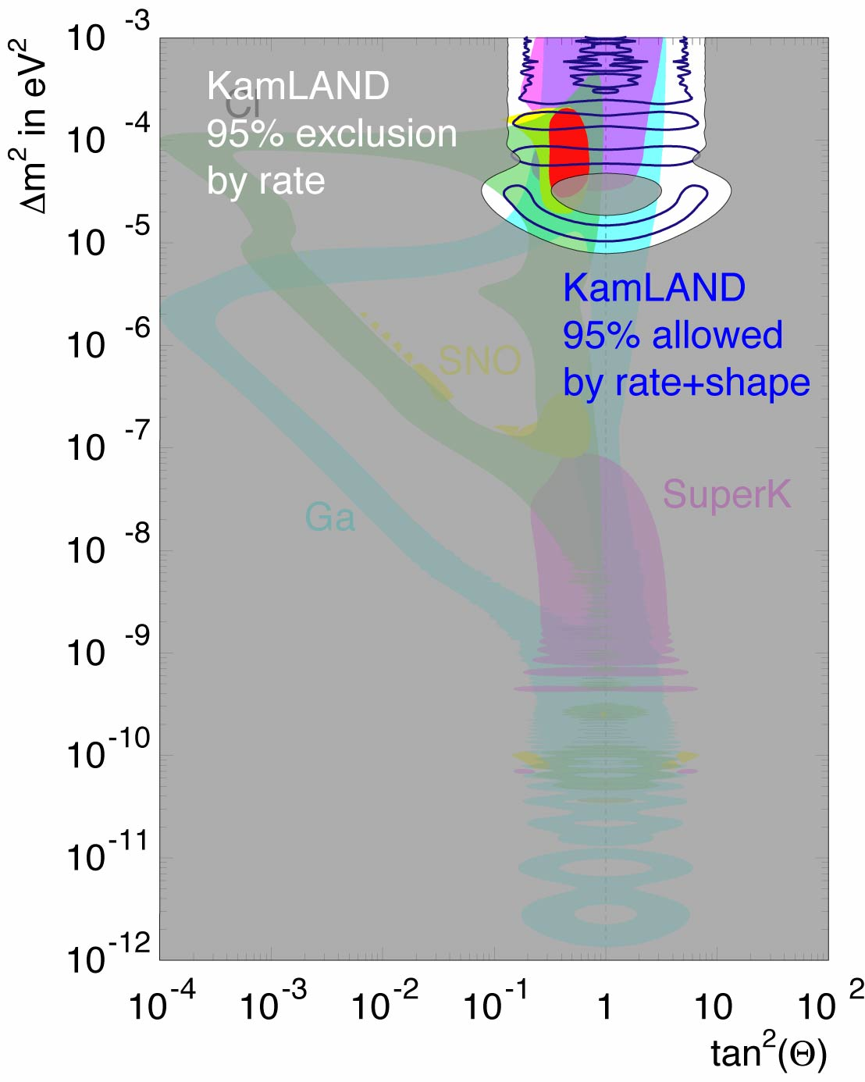
Progress in 2002 on the Solar Neutrino Problem
March 2002
April 2002 with SNO
Dec 2002
with KamLAND

Slide 8
Typical Theorists’ View ca. 1990
Solar neutrino solution must be small angle MSW solution because it’s cute
Natural scale for Δm²₂₃ ~ 10–100 eV² because it is cosmologically interesting
Angle θ₂₃ must be of the order of V_{cb}
Atmospheric neutrino anomaly must go away because it needs a large angle
Wrong!
Wrong!
Wrong!
Wrong!

Slide 9
Surprises
Prejudice from quarks, charged leptons:
  Mixing angles are small
  Masses are hierarchical
In LMA, all mixing except U_{e3} large
  Two mass splittings not very different
  Atmospheric mixing maximal
  Any new symmetry or structure behind it?

Slide 10
Question of Flavor
What distinguishes different generations?
  Same gauge quantum numbers, yet different
Hierarchy with small mixings:
⇒ Need some ordered structure
Probably a hidden flavor quantum number
⇒ Need flavor symmetry
  Flavor symmetry must allow top Yukawa
  Other Yukawas forbidden
  Small symmetry breaking generates small Yukawas
Try to find underlying symmetries from data (bottom-up)
  Repeat Heisenberg, Gell-Mann–Okubo

Slide 11
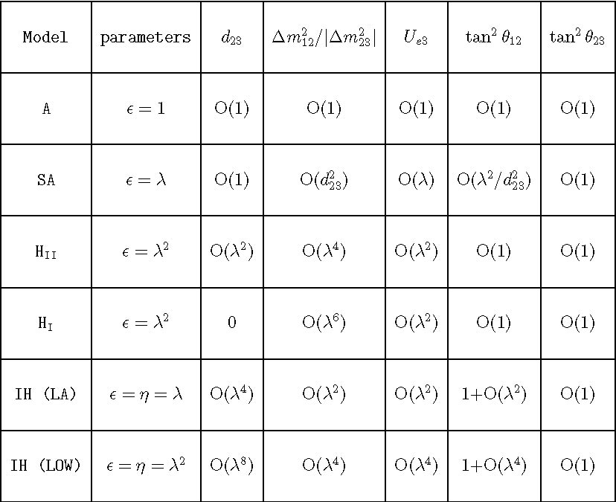
Different Flavor Symmetries
Altarelli-Feruglio-Masina hep-ph/0210342
Hall, HM, Weiner
Sato, Yanagida
Barbieri et al

Slide 12
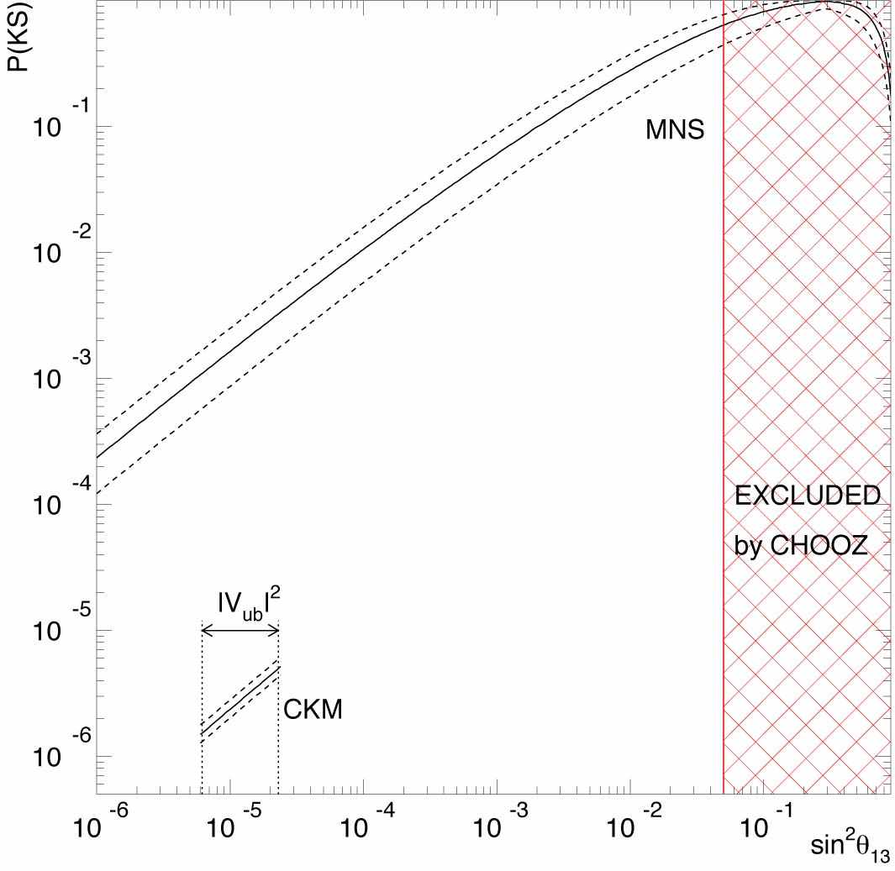
Lack of symmetry explains data
Kolmogorov–Smirnov test
(de Gouvêa, HM)
Suppose there is no symmetry behind the neutrino masses and mixings (“anarchy”)
Random 3 by 3 matrix
MNS matrix distributed to the group invariant measure (Haba, HM)

Slide 13
Future

Slide 14
Critical Measurements
sin² 2θ₂₃=1.00±0.01?
  Determines a need for a new symmetry to enforce the maximal mixing
sin² 2θ₁₃<0.01?
  Determines if the flavor quantum number of electron is different from mu, tau
Normal or inverted hierarchy?
  Most symmetries predict the normal hierarchy
CP Violation?
  Plausibility test of leptogenesis

Slide 15
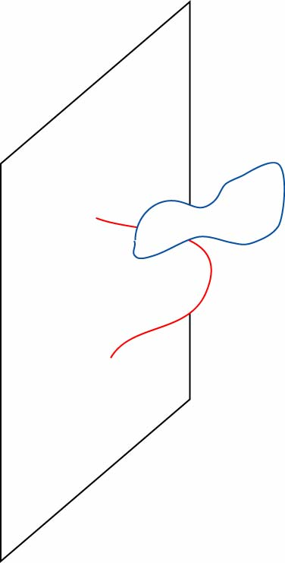
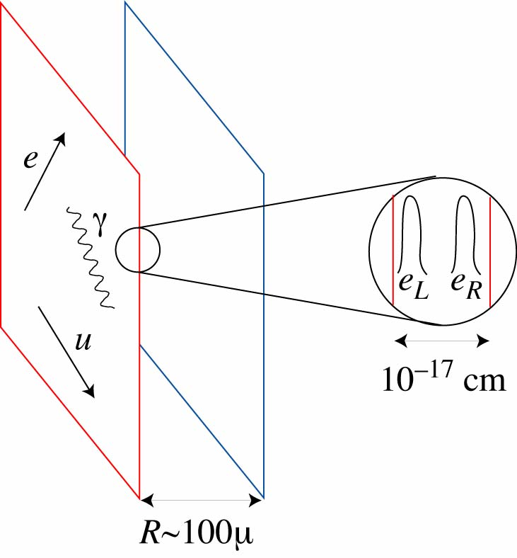
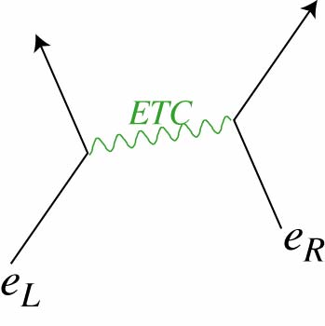
Dynamics behind flavor symmetry?
Once flavor symmetry structure identified (e.g., Gell-Man–Okubo), what is dynamics? (e.g., QCD)
Supersymmetry:
  Anomalous U(1) gauge symmetry with Green-Schwarz mechanism
Large Extra Dimensions:
  Fat brane with physically separated left- and right-handed particles
Technicolor:
  New broken gauge symmetries at 100TeV scale

Slide 16
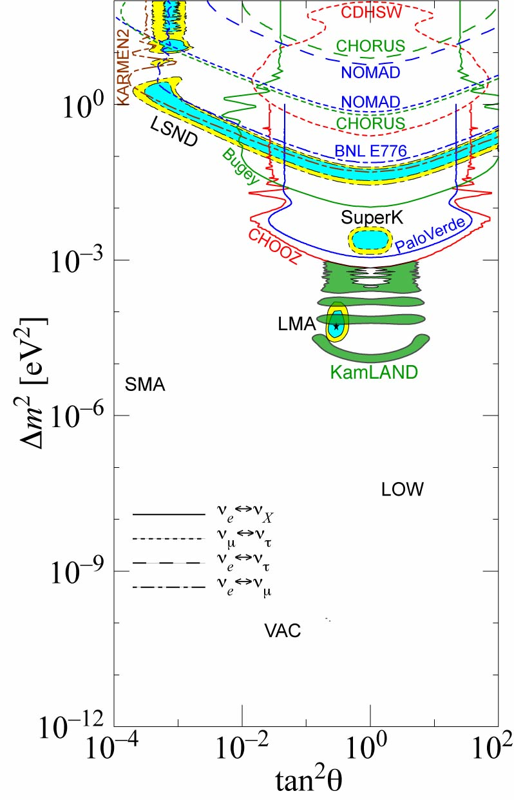
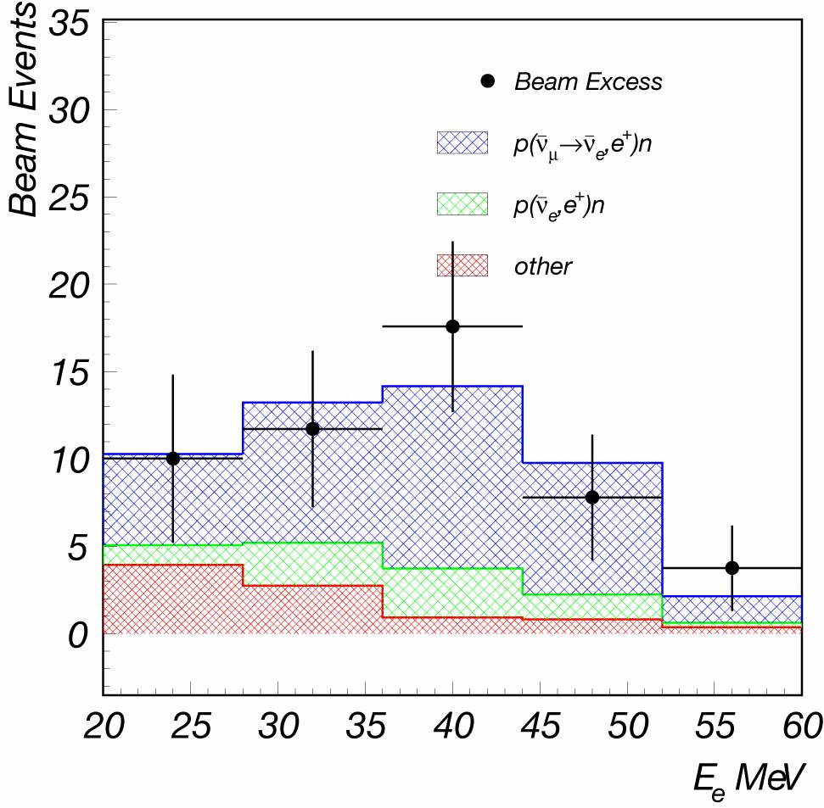
LSND
3.3σ Signal
Excess positron events over calculated BG

Slide 17
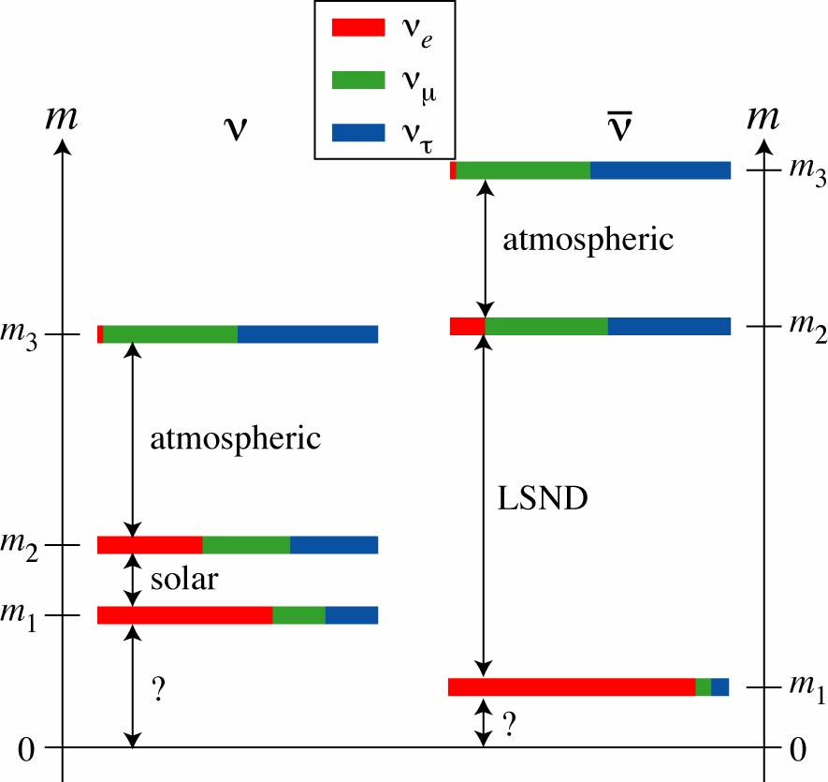
CPT Violation?
“A desperate remedy…”
LSND evidence:
anti-neutrinos
Solar evidence:
neutrinos
If neutrinos and anti-neutrinos have different mass spectra, atmospheric, solar, LSND accommodated without a sterile neutrino
(HM, Yanagida)
Best fit to data < 2002
(Strumia)

Slide 18
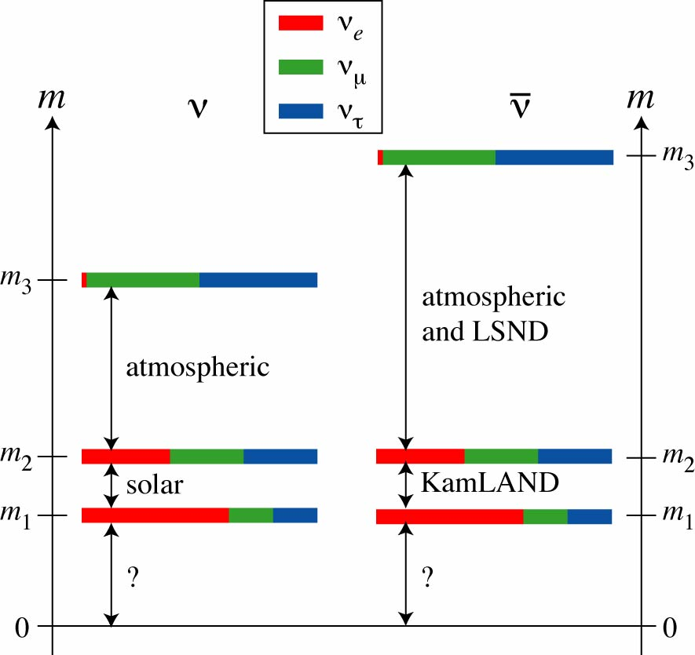
KamLAND impact
However, now there is an evidence for “solar” oscillation in anti-neutrinos from KamLAND
Barenboim, Borissov, Lykken: evidence for atmospheric neutrino oscillation is dominantly for neutrinos. Anti-neutrinos suppressed by a factor of 3.
New CPT violation:

Slide 19
CPT Theorem
Based on three assumptions:
  Locality
  Lorentz invariance
  Hermiticity of Hamiltonian
Violation of any one of them:
big impact on fundamental physics
Neutrino mass: tiny effect from high-scale physics
  Non-local Hamiltonian? (HM, Yanagida)
  Brane world? (Barenboim, Borissov, Lykken, Smirnov)
  Homeotic theory? (Barenboim, Lykken)

Slide 20
Conclusion
Still a lot to learn from neutrino oscillation
  θ₂₃, θ₁₃, normal or inverted hierarchy, CP violation
Determine the underlying symmetry behind flavor (masses and mixing)
In conjunction with data from energy frontier, we hope to understand dynamics behind the flavor symmetry
Maybe even more surprises
  CPT violation? Sterile neutrinos?

