Slide 1
ESTIMATING THE MASSES OF ELEMENTARY PARTICLES
Rajan Gupta
Los Alamos National Laboratory

Slide 2
A FASCINATING STORY OF THE DISCOVERY AND IDENTIFICATION OF ELEMENTARY PARTICLES, AND THE SUBSEQUENT DETERMINATION OF THEIR MASSES.

Slide 3
Elementary Particles
With our current understanding, the world of elementary particles is first encountered at the level of atoms (10⁻¹⁰ m)
Electrons
Nucleus
nucleons (protons, neutrons)
quarks and gluons

Slide 4
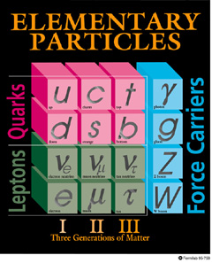

Slide 5
Standard Model
L = L(QCD) + L (SU(2)_{L} ⊗ U(1)_{Y} ) + L (Higgs) + L (Y)
L(QCD) = - 1/4 Gª_{μν} G_{a}^{μν} + Q ( i∂_{μ} γ^{μ} + gλ_{a}Aª_{μ} γ^{μ} )Q
L (SU(2)_{L} ⊗ U(1)_{Y} ) = - 1/4 Wª_{μν} W_{a}^{μν} - 1/4 B_{μν} B^{μν}
+ Ψ_{L} (g₂τ_{a}Wª_{μ} γ^{μ} + g₁Y B_{μ} γ^{μ} ) Ψ_{L}
+ Ψ_{R} (g₂τ_{a}Wª_{μ} γ^{μ} + g₁Y B_{μ} γ^{μ} ) Ψ _{R}
+ L (i∂_{μ} γ^{μ} ) L
L (Y) = Q M_{q} Q + L M_{l} L + M_{q}/v QHQ + M_{l}/ v LHL
L (Higgs) = (D_{μ} φ )†(D_{μ} φ ) - (-μ_{h}² φ †φ + λ_{h} /4 (φ†φ)² )

Slide 6
History of the Standard Model
Electro- Coulomb, Faraday, Maxwell (1864) magnetism
QED Tomonaga, Schwinger, Feynman 1949
Weak Fermi 1934 (Fermi Theory) Marshak & Sudarshan, Feynman & Gell-mann 1958 (V-A)
Electro- Glashow, Salam, Weinberg 1969; weak ‘t Hooft & Veltman 1972 (renormalizable)
QCD Gellmann, Zweig 1963 (quarks) Quarks and gluons (dynamics) 1972 Politzer, Gross & Wilczek (1973 asymptotic freedom)

Slide 7
KEY IDEAS IN THE THEORY
Relativity: Einstein 1905-1915
Quantum Bohr, Born, de Broglie, Heisenberg, Mechanics: Pauli, Schrodinger, 1913-1927
Antimatter: Dirac 1928
Non-abelian Yang & Mills, 1954
Higgs Higgs 1964

Slide 8
WHERE ARE THE ELEMENTARY PARTICLES
ELECTRONS (e), MUONS (μ), THEIR NEUTRINOS (ν_{e} , ν_{μ}), PHOTONS (γ), ARE THE ONLY ELEMENTARY PARTICLES THAT EXIST COPIOUSLY IN NATURE.
ALL OTHERS HAVE TO BE CREATED IN HIGH ENERGY ACCELERATORS AND THEN STUDIED IN COMPLEX DETECTORS

Slide 9
PARTICLE ACCELERATORS
Accelerators are based on 2 properties of the electromagnetic force F = q(E + v×B)
E increases E by ΔE = Fd = qV = qEd
Constant B bends beam in a circle of radius ρ = pc/qB
S₁
V=Ed
B
S₂
ρ
ΔE = qV

Slide 10
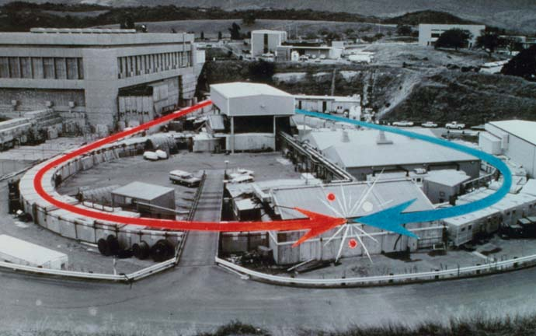
SLAC (e⁻, e⁺)
OTHER (e⁻, e⁺) MACHINES: CORNELL, DESY, LEP

Slide 11
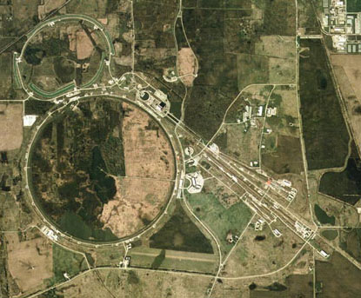
FERMILAB (p,‾p)
OTHER (p,‾p) MACHINES: CERN (LHC)

Slide 12
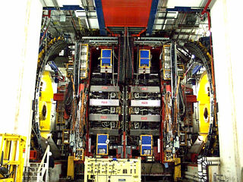
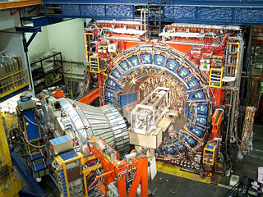
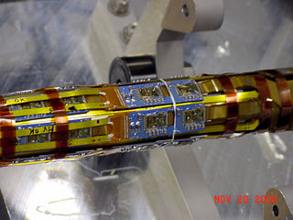
PARTICLE DETECTORS
COMPLEX, MULTILAYERED & HUGE
CDF in collision hall
Inserting the silicon vertex tracker in the 2000 ton central detector. West plug also shown
Electronics on beam pipe
Curtsey of FNAL & CDF collaboration

Slide 13
WHAT IS MASS
E² = p²c² + m²c⁴ & p = mv
E = hν and p = h/λ
Pole in the propagator
Axial Symmetry → relation between currents
knowing E & p gives m

Slide 14
DETERMINING MASSES
PROPERTIES THAT FACILITATE DETECTION
Are the particles sufficiently “long-lived” to leave a measurable track
Are they electrically charged
Do they have well-defined decay channels

Slide 15
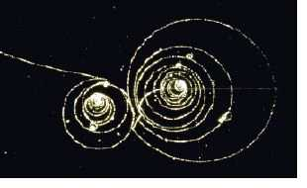
e Tracks in B field
e, μ LEPTONS ARE EASY TO PRODUCE & DETECT

Slide 16
CHARGED LEPTONS
Mass
Mean life time
e⁺ , e⁻ 0.511 MeV Stable
μ⁺, μ⁻ 105.7 MeV 2.197 × 10⁻⁶ sec
τ⁺, τ ⁻ 1777 MeV 290.6 × 10⁻¹⁵ sec
Experiments utilize incident beams of e⁺, e⁻ and of μ⁺, μ⁻

Slide 17
HISTORY OF CHARGED LEPTONS
e⁺ , e⁻ J. J. Thompson using cathode tube at Cavendish in 1897. Millikan measured the basic unit of charge in 1909
μ⁺, μ⁻ Neddermeyer and Anderson in cosmic ray experiments in 1937(also Stevenson & Street and Nishina Group)
τ⁺, τ⁻ Martin Perl at SLAC in 1976

Slide 18
FORCE CARRIERS
Mass
Width |Mean life time
γ (photon) 0 Stable
g (gluons) 0 Confined
W⁺, W⁻ 80.42 GeV 2.12 GeV (3.1 × 10⁻²⁵ sec )
Z 91.19 GeV 2.50 GeV (2.6 × 10⁻²⁵ sec )
Experiments can create photon beams

Slide 19
HISTORY OF FORCE CARRIERS
γ Antiquity. Planck introduced “quanta” in 1900. Einstein established particle nature by describing photoelectric effect in 1905.
g 3 jet events reported at DESY in 1979; the third jet interpreted as due to a gluon
W, Z Discovered at CERN in 1982 (Rubbia)

Slide 20
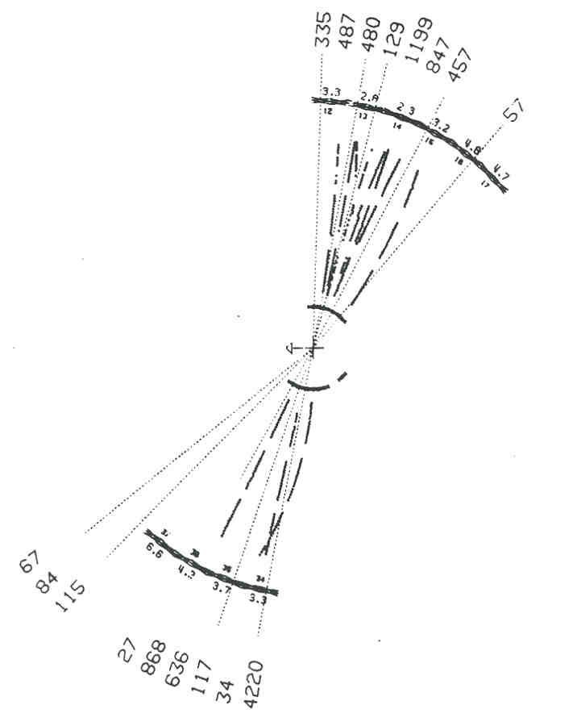
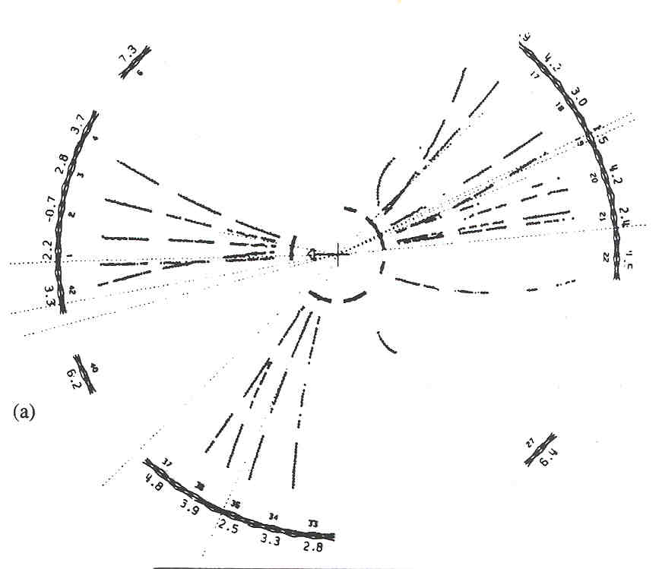
q
q
e⁺
e⁻
e⁺
e⁻
q
q
g
Examples of 2-jet and 3-jet events observed in the JADE detector at the PETRA e⁺ e⁻ collider at 30, 31 GeV in cm (DESY)

Slide 21
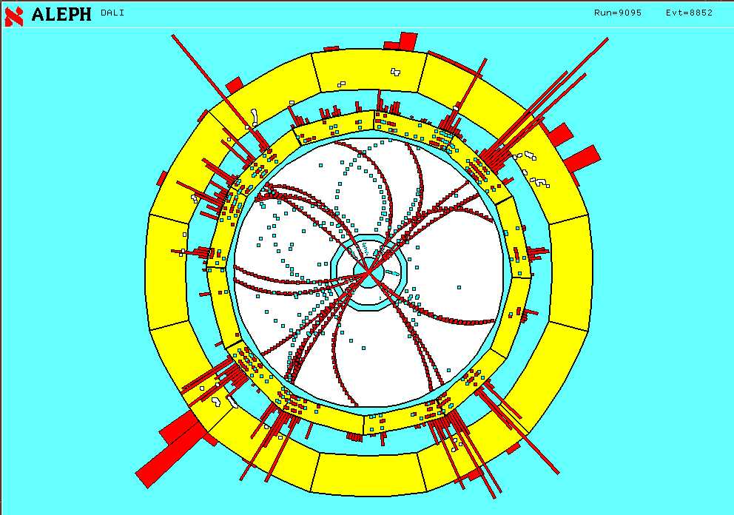
4-JET EVENT

Slide 22
JETS → GLUONS
Three or more jets signify production of qq and additional particles (gluons within the framework of QCD) that also form jets.
The ratio of 3-jet/2-jet (and 4-jet/2-jet, …) cross-sections is consistent with gluon production in QCD
The change in these ratios of cross-sections with energy is consistent with QCD

Slide 23
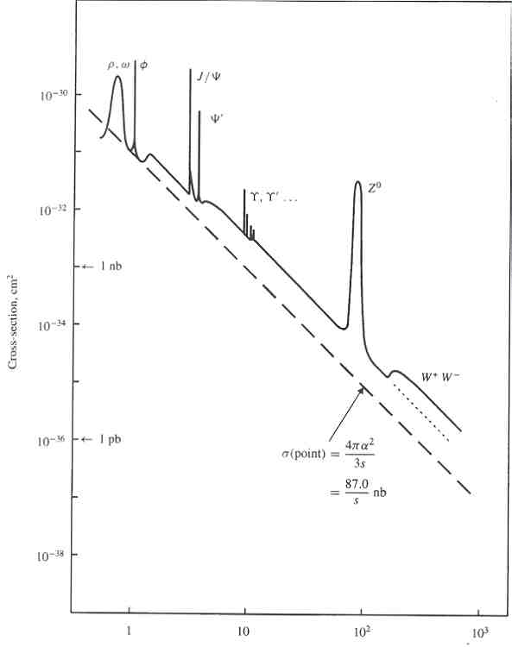
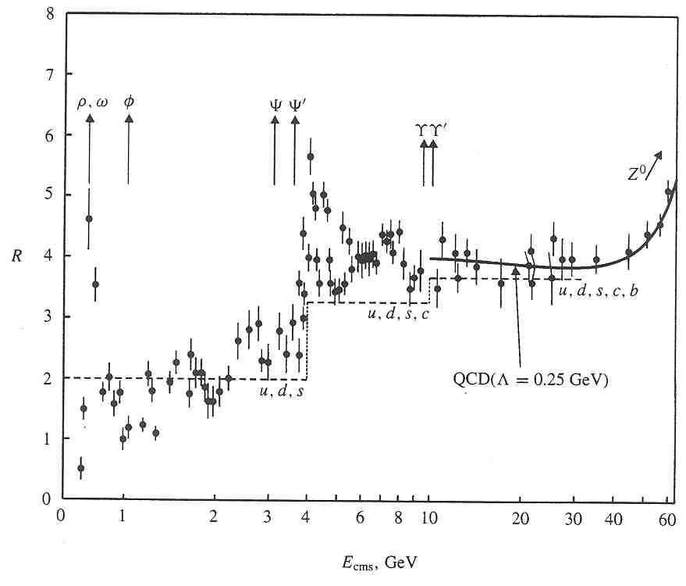
States produced as resonances in e⁺e⁻ Annihilation
e⁺
l, q
X
γ , Z⁰
e⁻
l, q
√s = cm energy, GeV
√s = cm energy, GeV
σ(e⁺e⁻ → hadrons)
σ(e⁺e⁻ → μ⁺ μ ⁻ )
R = N_{c} Σ_{i} e_{i}² =
Vector boson resonances

Slide 24
Resonance in p⁺p⁻ Interactions
q
X
l, q
g, γ , Z⁰
q
l, q

Slide 25
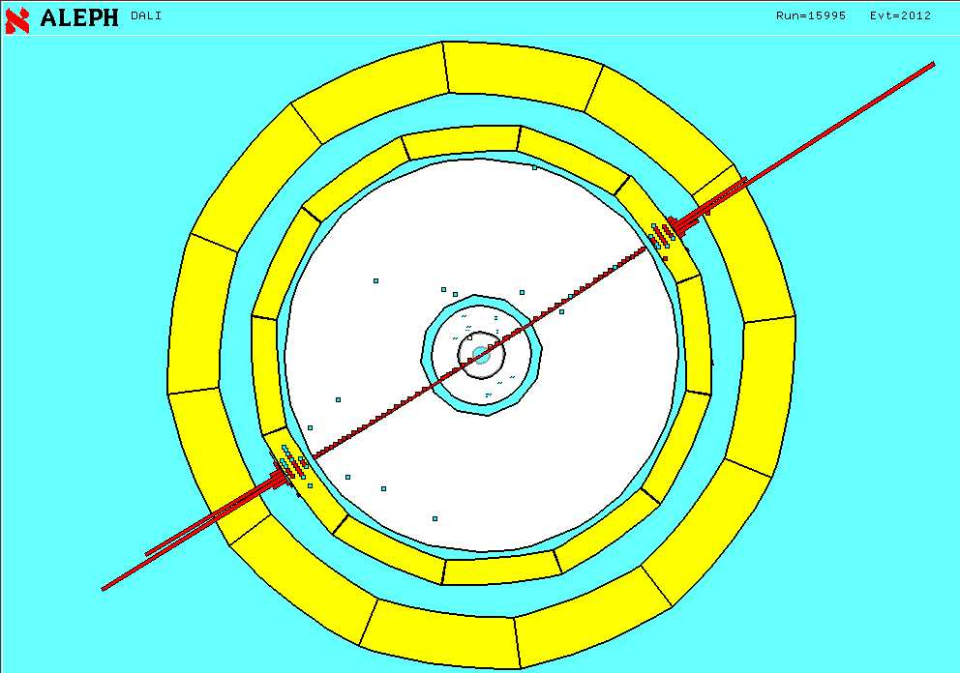
e⁺e⁻ final state

Slide 26
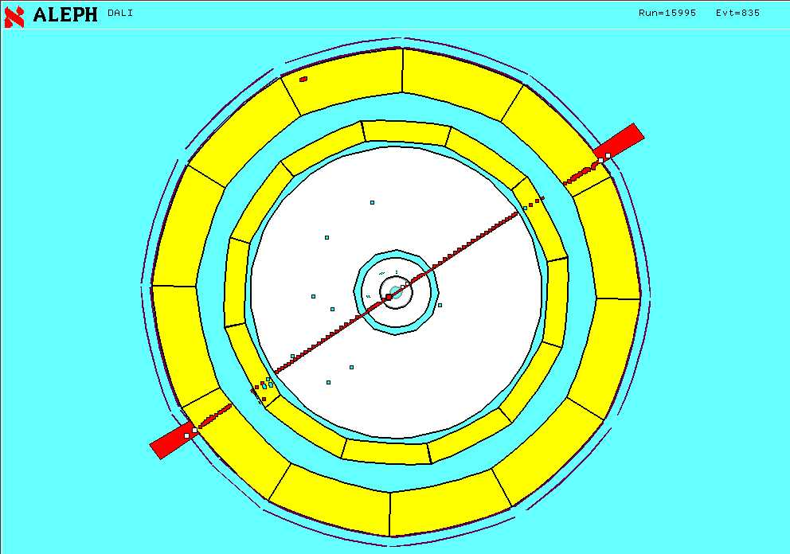
μ⁺ μ⁻ final state

Slide 27
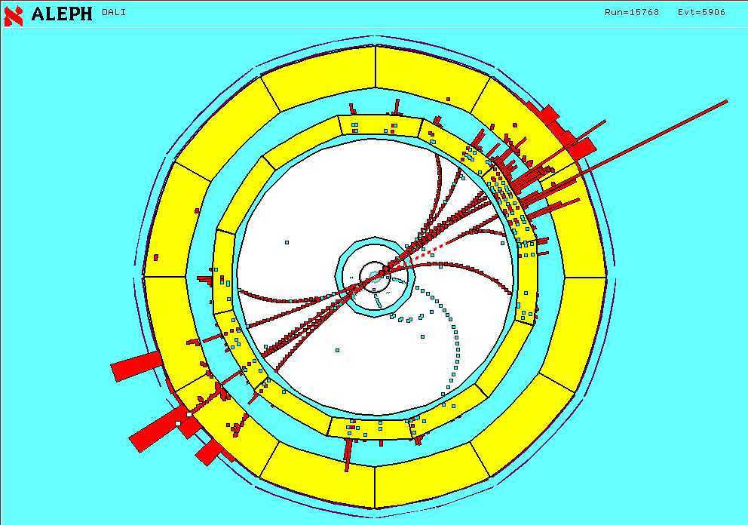
2-JET EVENT

Slide 28
RESONANCES → PARTICLES
LEAD TO THE DISCOVERY/PRODUCTION OF
μ⁺ μ⁻
τ⁺ τ ⁻
W⁺ W⁻
Z⁰
Charmonium (J/ψ, ….)
Bottomonium (ϒ ϒ/ ϒ// , …..)
Top

Slide 29
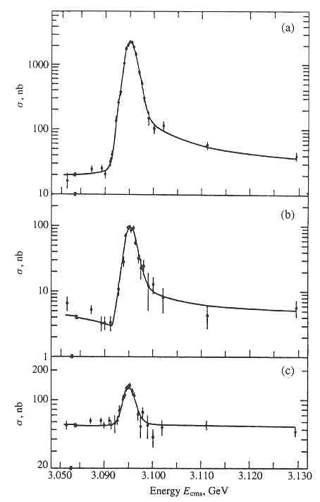
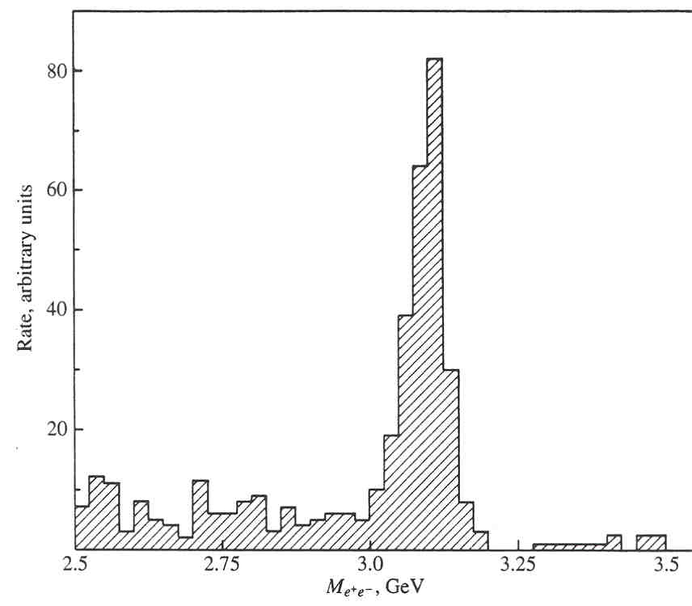
CHARMONIUM (cc)
SLAC (Richter, 1974)
BNL (Ting, 1974)
e⁺e⁻ → ψ → hadrons
e⁺e⁻ , μ⁺μ⁻
p + Be → J/ψ + anything
e⁺e⁻
Such experiments gave the masses of cc bound states. m_{c}?

Slide 30
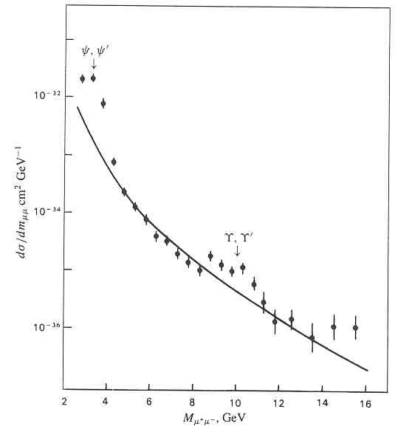
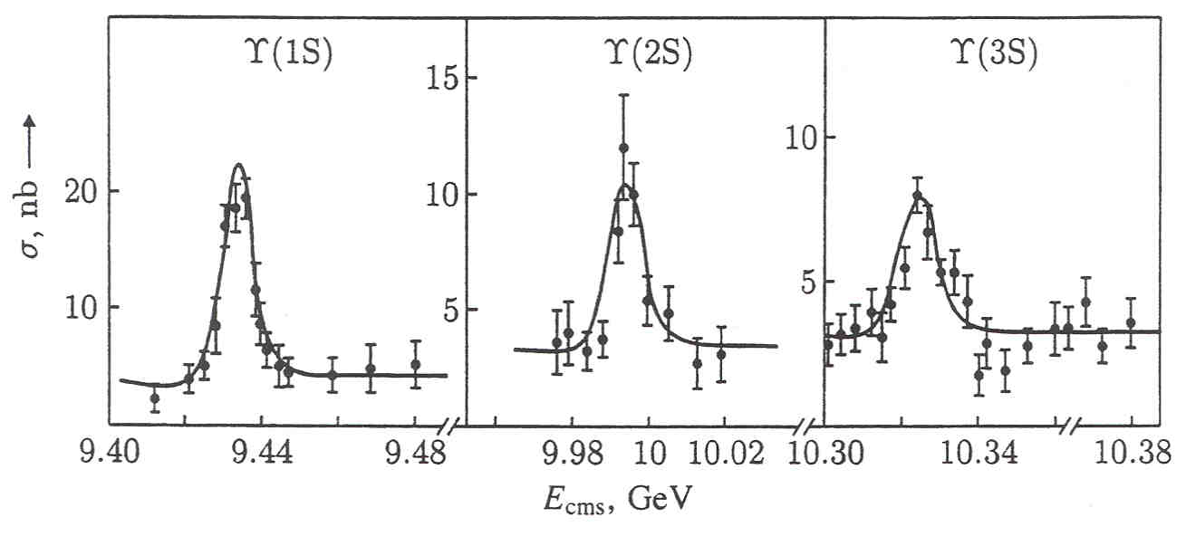
BOTTOMONIUM (bb)
FNAL (1977)
CLEO at CESR
p + Be, Cu, Pt
→ μ⁺ + μ⁻ + anything
e⁺e⁻ → ϒ → hadrons
e⁺e⁻ , μ⁺μ⁻
The ϒ ϒ/ ϒ// are not resolved in the broad peak

Slide 31
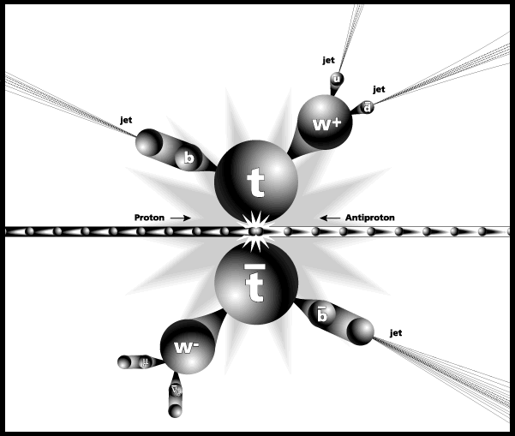
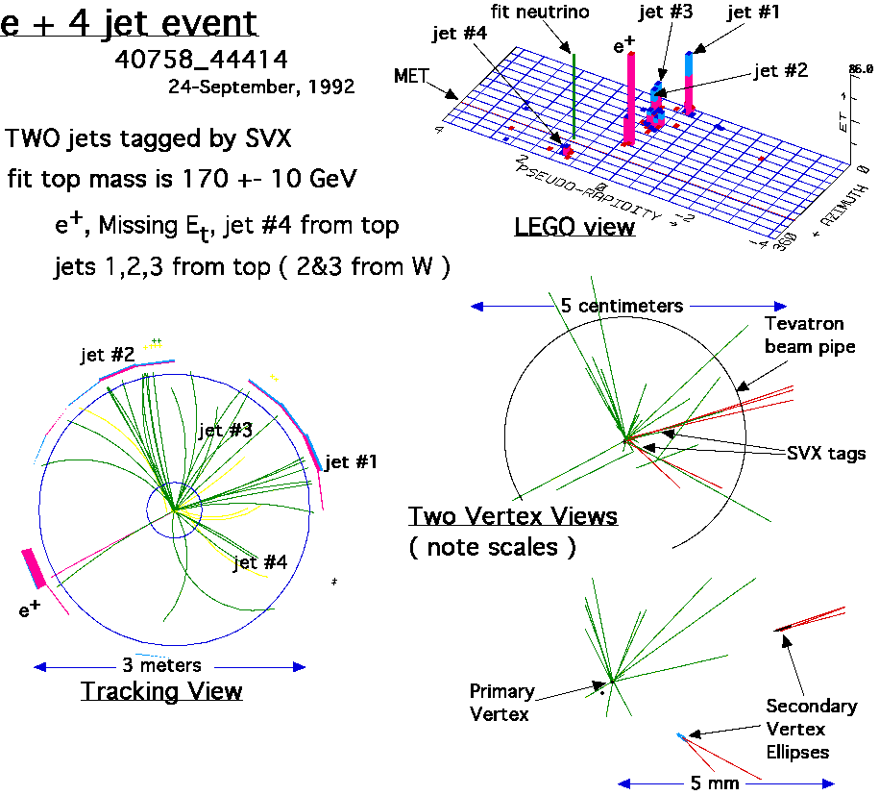
(t t ) too short lived to form onia
p⁺ p⁻ → t + t + anything
W⁻ b
W⁺ b
W → e ν
W → μ ν
W → q q → jet
b, b → jet
Artist’s view of top event at CDF

Slide 32
QUARKS
quark
Name
Mass (MS)
u up 2-4 MeV < Λ_{QCD}
d down 4-6 MeV < Λ_{QCD}
s strange 70-120 MeV < Λ_{QCD}
c charm 1.15-1.5 GeV
b bottom 4.0 - 4.4 GeV
t top 168⁺¹⁰ GeV
1963
1974
1977
1995
-7

Slide 33
MASSES OF QUARKS
Quarks are not seen as asymptotic states but confined within hadrons!
Experiments provide masses of mesons (π, K, η, η/, ρ, ω, J/ψ, ϒ,...) and baryons (N, Σ, Ξ, Δ, Ω, ...)
Decays products are heavier than the quarks due to hadronization! Quarks always dressed by gluons
The QCD coupling is large, α_{s} ∼1, at hadronic scales. Gluon effects are large (~ 300 MeV ~ Λ_{QCD})
How do we measure quark masses?

Slide 34
RESORT TO THEORY AND RELATE HADRON MASSES TO QUARKS
QCD: Cannot solve it analytically in the low energy region. USE
Chiral Lagrangian: Low energy effective theory of π, K, η mesons. Same symmetries as QCD. Quark masses are parameters.
LATTICE QCD
QCD SUM RULES

Slide 35
CHIRAL PERTURBATION THEORY
Parameters of this effective theory include quark masses.
Determine these parameters by fitting the observed meson masses and decays to predictions of χPT
Can extract only ratios of light quark masses (m_{u}/m_{d}, m_{d}/m_{s}) as theory has an overall unknown scale.

Slide 36
DEFINITION OF m_{q} in QCD
CURRENT CONSERVATION IN QCD
∂^{μ} (A¹²)_{μ} = (m₁ + m₂) P¹²
∂^{μ} (V¹²)_{μ} = (m₁ - m₂) S¹²
Calculate 2-point correlation functions
< Σ_{x}∂^{μ} (A¹²)_{μ} (x,t) J(0,0) >
(m₁ + m₂) =
< Σ_{x} P¹² (x,t) J(0,0) >
(J is a source for pions)

Slide 37
QCD SUM-RULES
< ∂^{μ} (A¹²)_{μ} (x,t) ∂^{μ} (A¹²)_{μ} (0,0) > =
(m₁ + m₂)² < P¹² (x,t) P ¹² (0,0) >
Spectral function
OPERATOR PRODUCT EXPANSION
+ PERTURBATION THEORY

Slide 38
SOLVE QCD NUMERICALLY
Solve for the spectrum of mesons and baryons using Monte Carlo simulations of LATTICE QCD with input values for
masses of quarks
the gauge coupling
Tune m_{quark} until masses of all hadrons agree with experimental values.

Slide 39
LATTICE QCD
Field theory in Euclidean space
Generate background gauge configurations {U_{μ}(x)} distributed with probability given by the QCD action
Calculate Feynman quark propagators S_{F}[U] on these background configurations
Average correlation functions constructed out of {U_{μ}(x)} and S_{F}[U] over these configurations (do the functional integral)

Slide 40
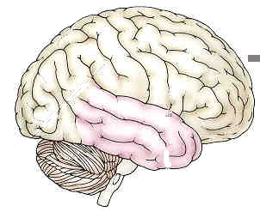
LATTICE QCD
QCD (g, m_{u}, m_{d}, m_{s}, m_{c}, m_{b})
GAUGE CONFIGURATIONS
$
LATTICE QCD
QUARK PROPAGATORS
Systematic errors
Statistical errors

Slide 41
QUARK MASSES (MS)
Chiral Perturbation theory
m_{u} / m_{d} = 0.55(4)
2m_{s} / (m_{u +}m_{d}) = 24.4(1.5)
LQCD
Sum Rules
m_{u} (2GeV) 2.2-2.7 MeV 2.4-3.8 MeV
m_{d} (2GeV) 4.3-6.9 MeV 4.3-6.9 MeV
m_{s} (2GeV) 78-100 MeV 83-130 MeV
M_{c} (M_{c}) 1.2-1.6 GeV 1.25(10) GeV
M_{b} (M_{b}) 4.3(1) GeV 4.2(1) GeV

Slide 42
NEUTRINOS ν_{e},ν_{e},ν_{μ},ν_{μ},ν_{τ},ν_{τ}
Electrically neutral
Have only weak interactions
Masses very small

Slide 43
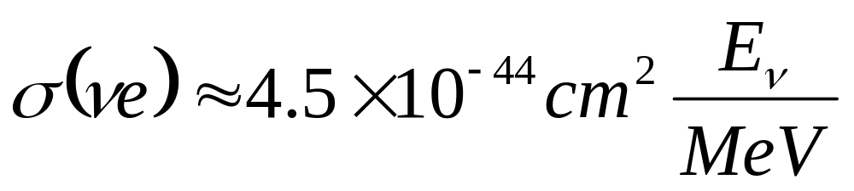
Neutrino interactions are weak
ν_{e}
ν_{e}
ν_{e}
ν_{e}
+
Z
W⁻
e⁻
e⁻
e⁻
e⁻
time
time
Charged current
Neutral current
very small!

Slide 44
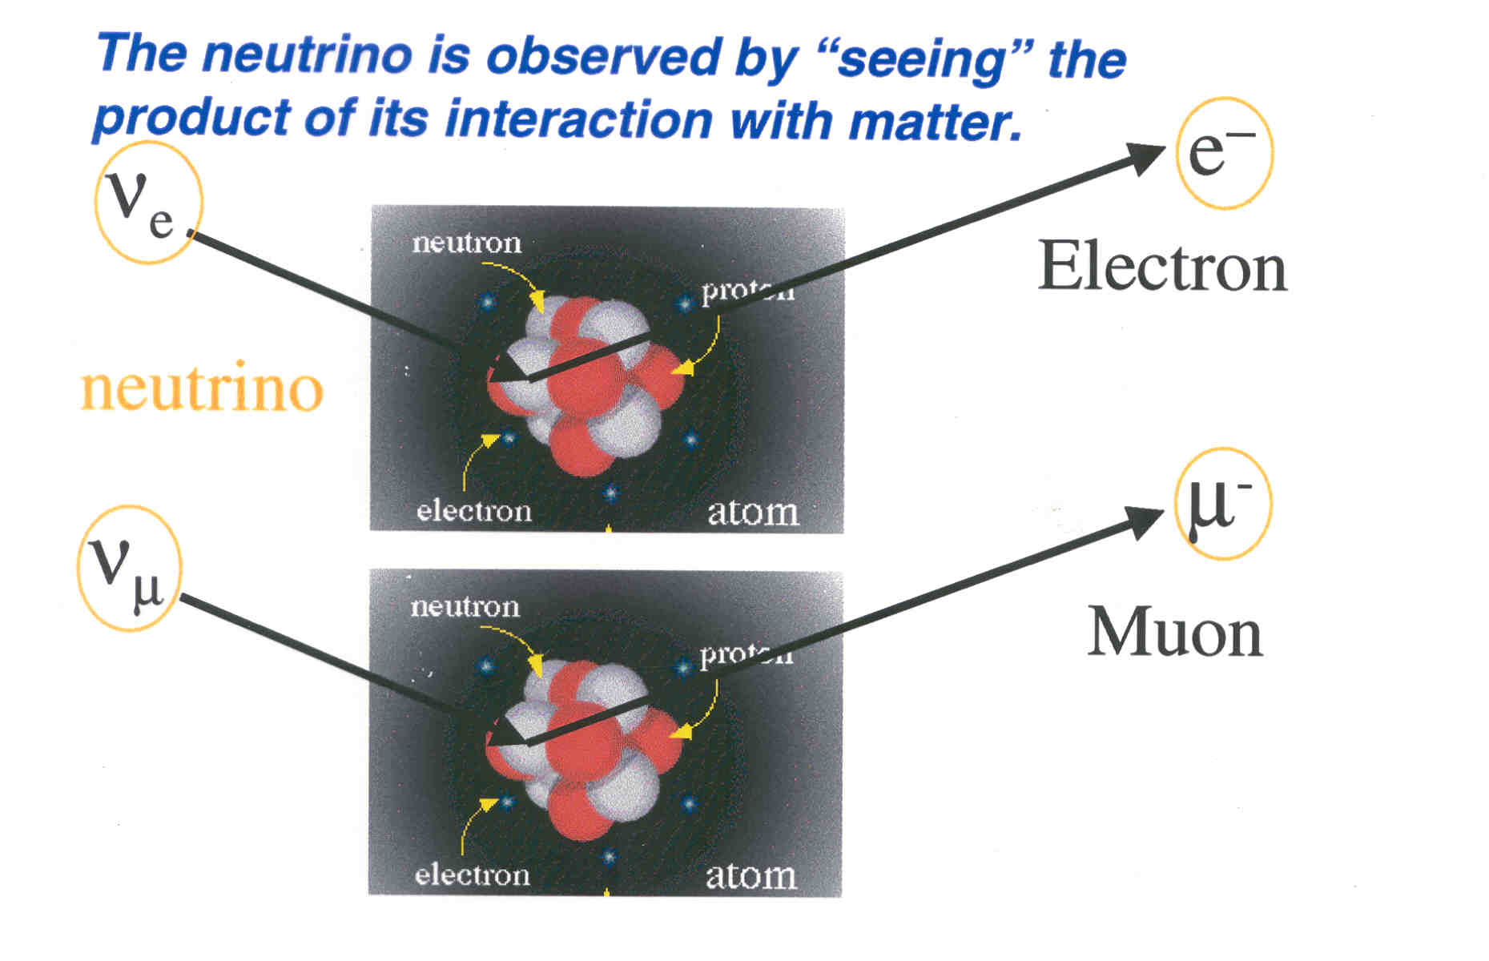
DECTECTING NEUTRINOS
THE INCIDENT NEUTRINO IS INVISIBLE. DETECTORS “SEE” THE CHARGED PRODUCTS

Slide 45
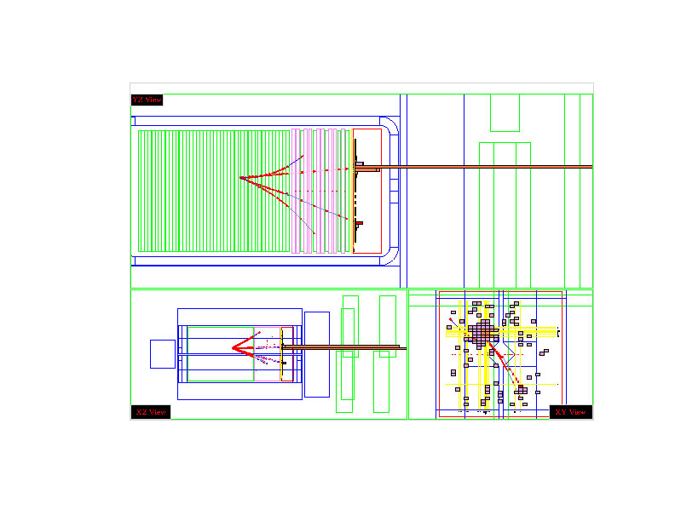
e type event
Curtsey: B Blumenfeld, JHU

Slide 46
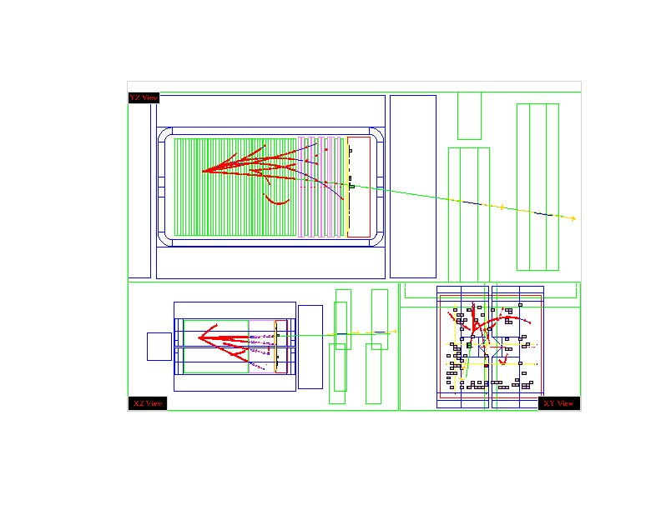
μ type event
Curtsey: B Blumenfeld, JHU

Slide 47
NEUTRINOS
Mass
τ/mν
ν_{e} < 3 eV > 7× 10⁹ sec/eV
ν_{μ} < 0.19 MeV > 15.4 sec/eV
ν_{τ} < 18.2 MeV
Experiments utilize incident beams of ν_{e} ν_{e} ν_{μ} ν_{μ}

Slide 48
History of Neutrino Physics
1914: Chadwick finds β decay spectrum to be continuous
1930: W. Pauli proposed ‘neutron’ as an explanation
1936: Fermi-Gamow-Teller theory with a “neutrino”
1956: Cowan and Reines observe ν_{e} interactions
1958: V-A theory of weak processes
1962: Danby et al, observe ν_{μ} interactions
1990: Precisely 3 light neutrinos exist in nature
2000: DONUT collaboration observes ν_{τ} interactions

Slide 49
NEUTRINO MASSES
ν_{e} : End point of the tritium beta decay spectrum
n → p + e + ν_{e}
ν_{μ} : End point of the pion decay spectrum
π → μ υ_{μ}

Slide 50
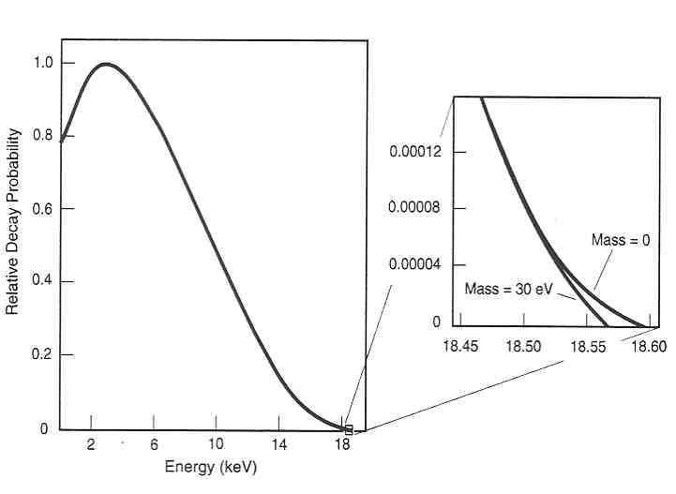
M from missing energy
Beta decay spectrum for molecular tritium

Slide 51
MASSES FROM OSCILLATIONS
(
)
⎛
L
⎞
(
)
P
ν
→
ν
=
sin
2
2
θ
sin
2
⎜
Δ
m
2
ν
⎟
⎜
⎟
osc
μ
e
E
⎝
⎠
ν
where
Δ
m
2
=
m
2
−
m
2
(eV)²
b
a
L_{ν} = 1.27 × distance in meters
θ = mixing angle between the 2 ν
E_{ν} = Energy of ν in MeV

Slide 52
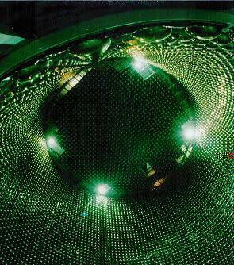
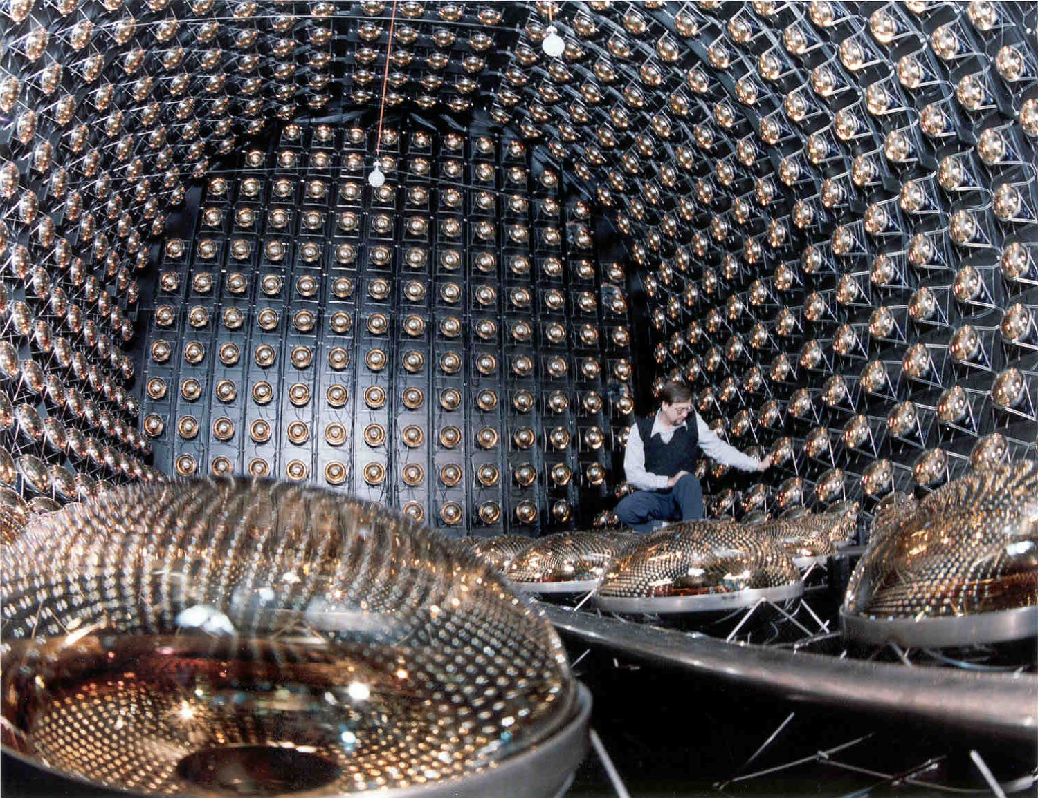
MASSES FROM OSCILLATIONS
Detecting Cherenkov light from electron produced in interaction
Superkamiokande
SOLAR: ν_{e} → ν_{x}
LSND
Accelarator: ν_{μ} → ν_{e}

Slide 53
The LSND Experiment
π⁺/π⁻
Target
ν_{μ},‾ν_{μ}, ν_{e}, (‾ν_{e} )
800 MeV protons
1 mA
6% duty ratio
μ⁺/μ⁻
CH₂
Cu Beam Dump
L = 30 meters
167 tons CH₂
1220 PMT’s
Active Veto Shield
Neutrino Targets in CH₂ :
ν_{μ}, ν_{e} : neutrons in ¹²C + electrons
‾ν_{μ, ,}‾ν_{e} : protons in ¹²C + electrons + free protons

Slide 54
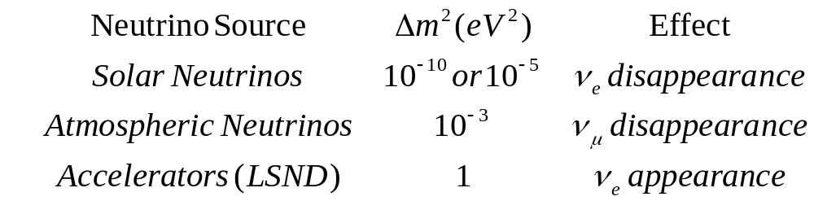
CURRENT PICTURE
There are three signals of neutrino oscillations:
With three flavors there are
only two independent Δm² !

Slide 55
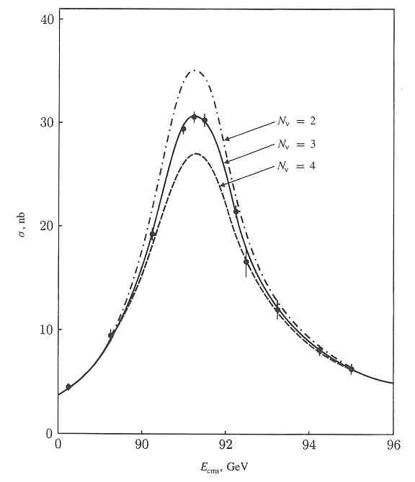
# OF LIGHT NEUTRINOS?
Z → ν_{e}ν_{e} , ν_{μ}ν_{μ} , ν_{τ}ν_{τ}
Z → e⁺e⁻ , μ⁺μ⁻ , τ⁺τ⁻
Z → q q
The total Z width depends on the number of light neutrinos. Current data restricts the number to 3

Slide 56
Possible solutions
One of the experimental value is wrong or the effect is not due to neutrino oscillations
There are additional (sterile) neutrinos lurking in the universe
Oscillations are not due to mass but due to the effects of extra dimensions /string theory.
It is crucial to verify whether all three
Δm² measurements are due to oscillations.

Slide 57
FUTURE
Refine the mass estimates of quarks
Masses and mixing of neutrinos
Discover the Higgs particle
Look for supersymmetric particles

