Slide 1
The story of the bad muon data
General Computing and Software Meeting
Jan 16th, 2003
The sad tale
How we found the problem
That won’t happen again but …
The worry.

Slide 2
What happened
The PDT front-end control boards
  run firmware that, among other things, buffers and formats the L2 and L3 data.
  The firmware is under development.
On Nov. 27th we loaded a version that didn’t send L2 or L3 data under certain error conditions.
  I believe it passed the standard test procedure (as it was defined at that time).
That mistake was discovered by a non-standard procedure and confirmed on Dec. 16th.
The code was immediately replaced.
The runs receive Grade = F for muon.

Slide 3
Symptoms
Online monitoring shows unusual number of readout errors. Experts said it was expected with this code version. Minute to Hourly monitoring.
L2 accept rate shows a fine “sawtooth” structure related to SCLINIT. See picture (T.T.). This is how it was discovered and isolated. Daily to Weekly monitoring.
L2 rejection instability. See picture. This is how it was confirmed. Weekly to Monthly monitoring.
L3 data wrecked: comparison (R.M.) of the L1 trigger hardware against L1 trigger simulator with L3 data as input showed missing L3 data. Weekly to Monthly monitoring?
Offline Ratio of Forward muon vs Central muon tracks. See T.G.’s slides. Weekly to Monthly monitoring?

Slide 4
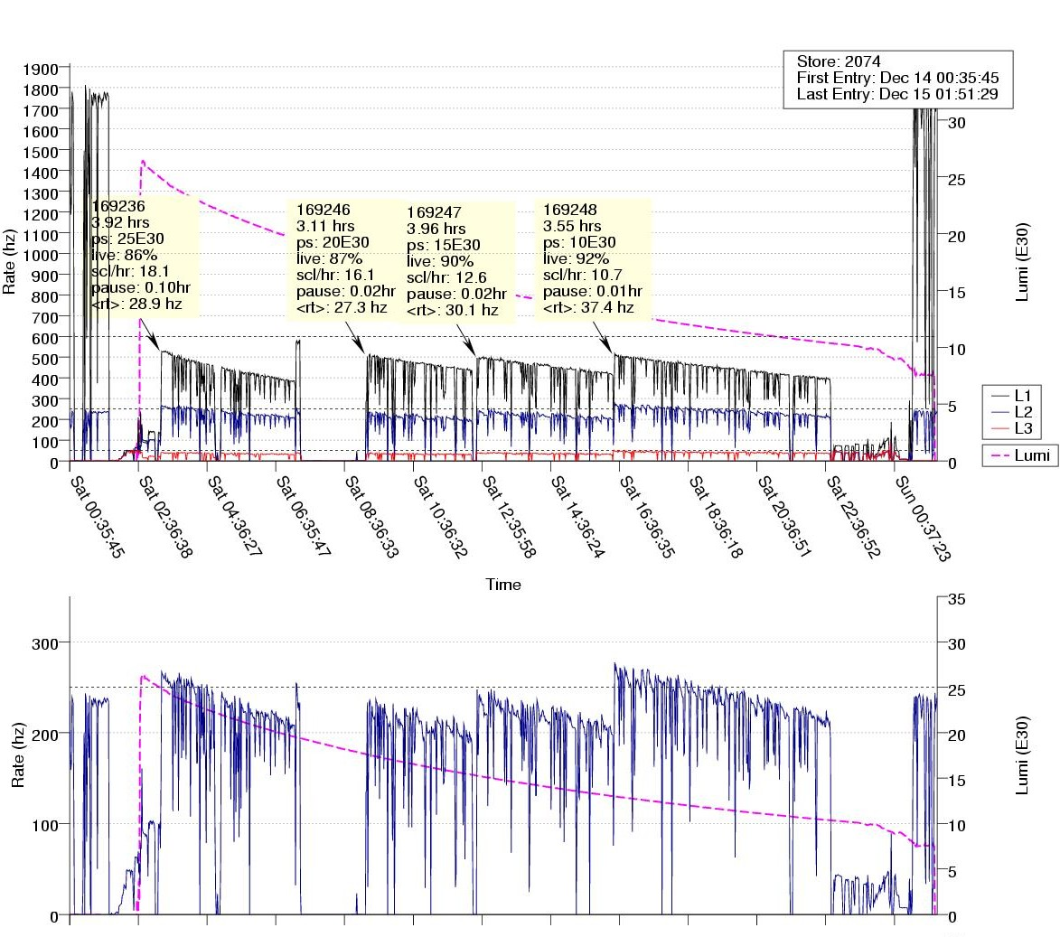
Trigger Rate Plots
“sawtooth” L2 accept rates

Slide 5
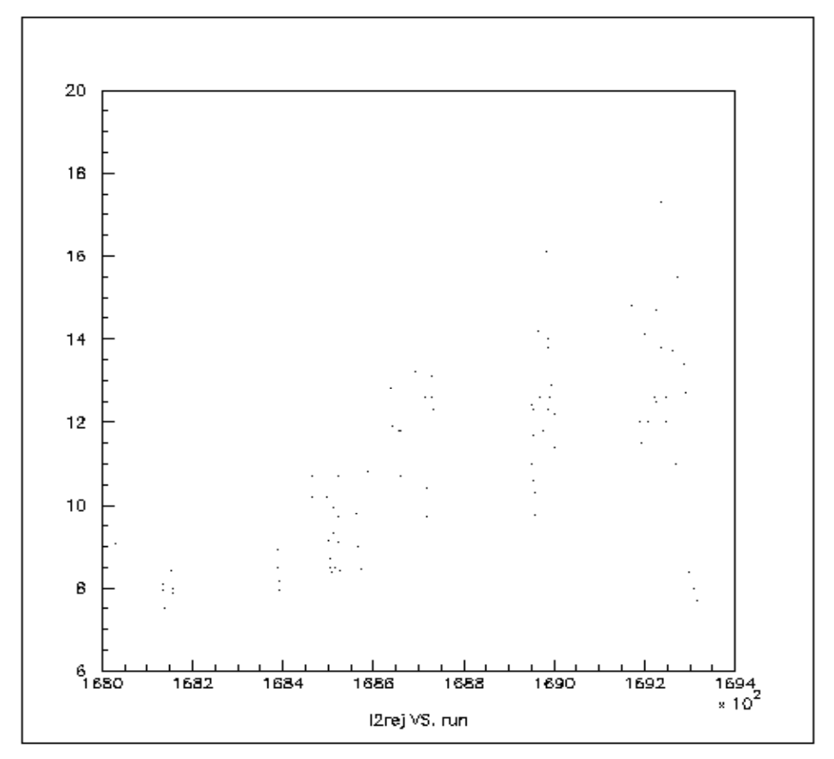
L2 Rejection
Runs 168618 to 169295 have higher avg. L2 Rej.
The dashed lines
indicate the run range
for version changes.
Note L2 Rej. returns to
Previous lower level.

Slide 6
That won’t happen again …
Written procedure requires special run with new code.
Procedures used to isolate this problem are applied to the special run and comparison is made against a special run taken with the current version.
Only after an informal sign-off (by muon algorithms) do we load in the new code for regular use.
But …

Slide 7
Thoughts on Muon Quality
Headline on D0 World News
Perfectly good muon data wrecked!
Usual suspects rounded up for questioning.
It’s happened two or three times to us.
It could happen to you.
It might be preventable.
I wrote this slide for the Oklahoma workshop.
I don’t recall what the problem was that time but I bet it was more subtle.

Slide 8
Summary
The muon data was corrupted in spite of testing procedures.
It took 18 days to figure that out and fix it.
In spite of many places we could have noticed the problem the discovery came from an unexpected source.
I believe this indicates systematic problem(s).

