Slide 1
American Community Survey
Getting the Most Out of ACS
Jane Traynham
Maryland State Data Center

Slide 2
A Tale of Two American Community Surveys
“It was the best of times, it was the worst of times” Charles Dickens

Slide 3
Best of Times
Fresh data every year
Not having to tell clients that you only have data that are seven years old
Additional products from FactFinder – ranking tables and subject tables
Data users will have more options for what best suits their needs – single year or multi-year
Rural Area Profiles proposed for participating States

Slide 4
Worst of Times
Fresh data every year means having to update your products every year
Having to calculate statistical significance every time you want to make a comparison of two geographic areas, two time periods, add data items together, calculate a ratio
Sample size for ACS is much smaller than the decennial (which was 1 in 6 HH)– creating a larger sampling error

Slide 5
Worst of Times (cont’d)
How will the ACS sample size which is based on a set number (3 million addresses yr) reflect growing populations
Multi-Year estimates in addition to single year estimates (yes I also had that under best of times)
Concerns that including seasonal population, which most likely will be higher income, will affect towns with lower income full time population in applying for grants
Notes:
Jerry Deichert Nebraska SDC – not sure how we should refer to multi year estimates, when should we use the multi year over the single year. If we need to assign a specific year do we use the final year?
Comparing time periods. To have an independent estimate you should not include the same year in the two time periods. For example, if you were using 3 year estimates you should compare 2003-2005 to 2000 – 2002.

Slide 6
Worst of Times (cont’d)
Explaining to media and other users that they should not just look at the estimate without considering the MOE
Have you seen the formula for determining statistical significance between two estimates?

Slide 7
Comparing Two ACS Estimates
Given that estimates should now be viewed as ranges with confidence intervals
When is a difference between two estimates “statistically significant?”
There is the “easy way” and the (more correct) “hard way”
Then, there is an easy way to do the hard way

Slide 8
Comparing Two Estimates
If have two estimates, need to determine if the apparent differences are “real”
Quick and dirty method is to “eye ball” whether the confidence intervals overlap

Slide 9
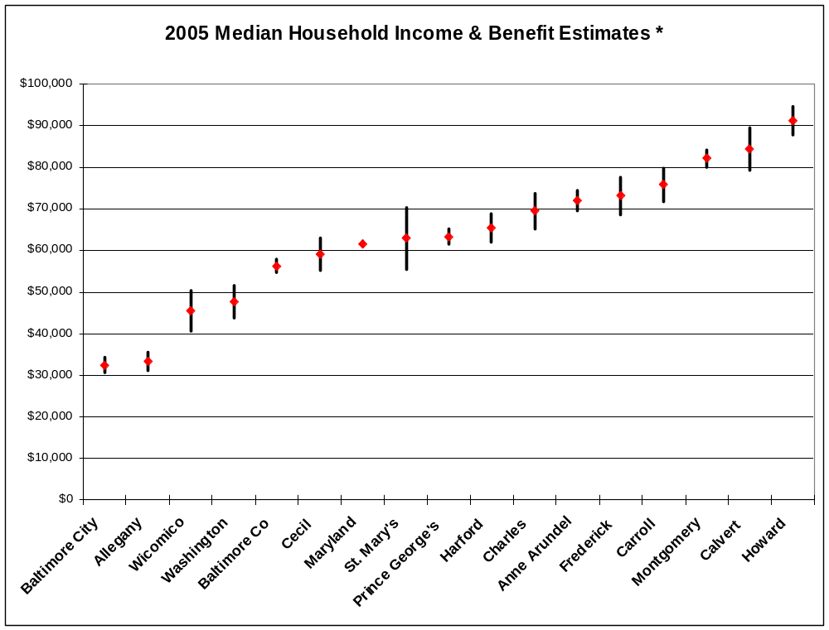

Slide 10
Comparing Two Estimates
(the easy way)
If the confidence intervals of two estimates do not overlap, then the two estimates are statistically different
If the confidence intervals of two estimates do overlap, then the two estimates are not statistically different (maybe)

Slide 11
Comparing Two Estimates
Need to do a formal test of statistical significance if the confidence intervals do overlap
(The Hard Way)

Slide 12
Statistical Testing - Steps
Calculate the difference in the estimates
Calculate the standard errors of each estimate
Calculate the standard error of the difference
Calculate the MOE of the difference
Compare the difference between the estimates to the MOE of the difference

Slide 13
Statistical Testing - Steps
6. If the difference in the estimates is greater than the MOE of the difference, then you conclude that the two estimates are statistically different
7. If the difference in the estimates is less than the MOE of the difference, you conclude that the two estimates are not statistically different.

Slide 14

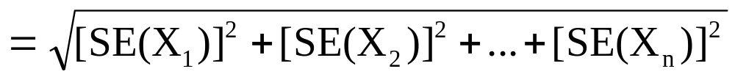
Standard Error – Sum
SE(X₁+X₂+…+X_{n})
If you want to add/collapse categories (i.e. ages) you would have to calculate a new SE – the HARD WAY

Slide 15
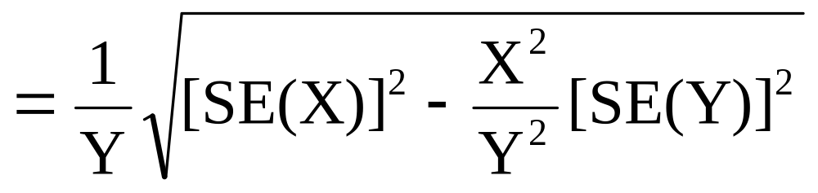
Standard Error – Proportions
P= X / Y – X is a subset of Y
SE(P)
If you wanted to create a ratio – again you have to go through this each time – the HARD WAY

Slide 16
Does It Need to Be So Hard?

Slide 17
Should Everyone Have to Do This?
NY SDC developed spreadsheets with examples for calculating the MOE and SE for summing/subtracting, calculating a new ratio.
MD SDC developed a spreadsheet for our affiliates to compare two areas to determine statistical significance
The EASY WAY - formulas are in the spreadsheet – just input your numbers

Slide 18
Proposed Application for ACS Website
Instead of users each trying to figure out the HARD WAY or trying to develop spreadsheets to calculate the statistical significance perhaps the Census Bureau ACS site could have a section that allows data users to input their numbers depending on whether they are summing or subtracting categories; calculating ratios or just comparing two different geographies

Slide 19
Concerns
Funding issues
  Increasing sample size takes money
  Money for ACS Methods Panel analysis cut this FY – more analysis needed, not less. These analyses focus on data collection efficiencies and questionnaire content
  How will State and Federal programs handle funding and policy decisions for areas with large MOEs and for areas that may fall in and out of the funding “window” annually?

Slide 20
Least Ambitious of Times
Radical thoughts
Do we need to have 3 year estimates each year and 5 year estimates (for tracts and BGs) each year? How about “independent” 3 year and 5 year estimates? Five year estimates would be released every 5 years so there would be separate 5 year aggregations to compare (i.e. no overlap of years).
By 2010 we will have 5 year estimates for every geography every year, we will have 3 year estimates for every geography over 20,000 every year and we will have single year estimates for every geography over 65,000.
Invest the extra money in increasing the sample size.

Slide 21
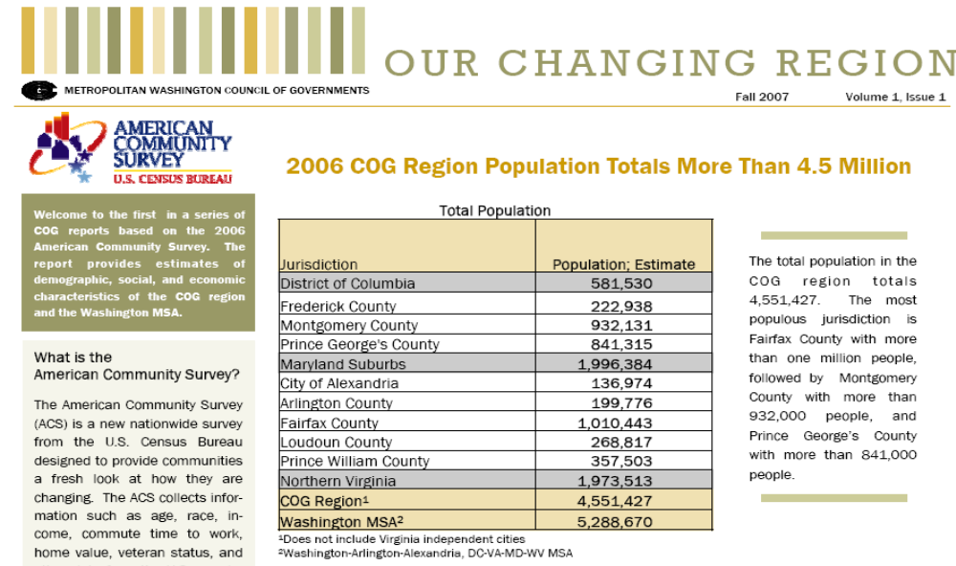
ACS Newsletter Prepared by a Metropolitan Council of Government

Slide 22
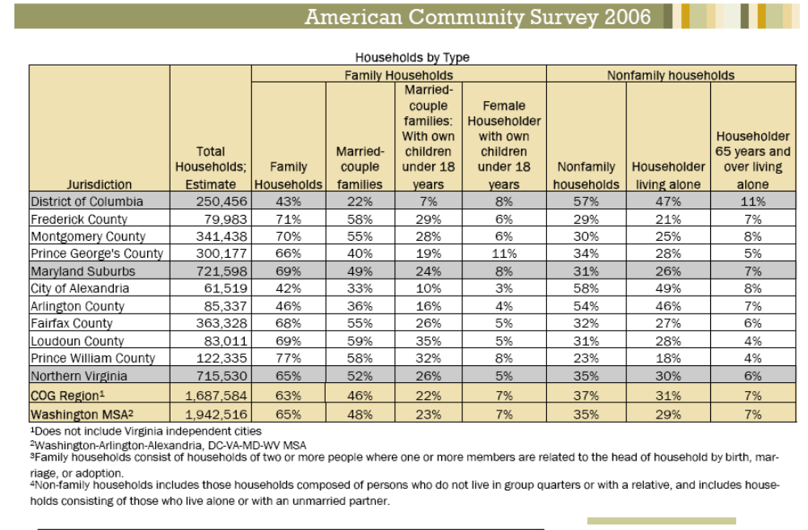
It appears that for each of the household types by county the estimate is taken and added together for the three counties to use as numerator – no additional statistical analysis was done to factor in MOEs

