Slide 1
Voluntary Genomic Data Submissions:
One Year Later
41st Annual DIA Meeting
Washington, DC
June 28, 2005
Felix W. Frueh, PhD
Associate Director for Genomics
Office of Clinical Pharmacology and Biopharmaceutics
CDER/FDA

Slide 2
Agenda
History/milestones of VGDS process development
What the guidance does and does not do
A word about biomarkers
VGDS (and PGx) as a business strategy
Role of VGDS in education and policy development
VGDS goes global
VGDS Best Practices
Summary

Slide 3
VGDS Milestones
May 2002: First FDA-DIA PGx workshop – Introduction of “Safe Harbor” concept for PGx data submissions
November 2003: Release of draft Guidance for Industry: Pharmacogenomic Data Submissions
November 2003: Second FDA-DIA PGx workshop – Discussion around biomarkers, voluntary vs. required submissions, first public comments
February 2004: Docket for guidance “officially” closed – 35 sets of comments received
March 2004: First VGDS received
July 2004: First IPRG-sponsor meeting to discuss VGDS

Slide 4
VGDS Milestones, cont’d
January/February 2005: IPRG formally created
March 2005: Final Guidance for Industry: Pharmacogenomic Data Submissions published, together with two companion documents detailing the VGDS process and the IPRG
March 2005: Genomics at FDA website goes live
April 2005: Third FDA-DIA PGx workshop – Looking ahead: translating PGx into clinical trials and clinical practice
May 2005: First FDA/IPRG-EMEA/PGWP-sponsor meeting to discuss VGDS

Slide 5
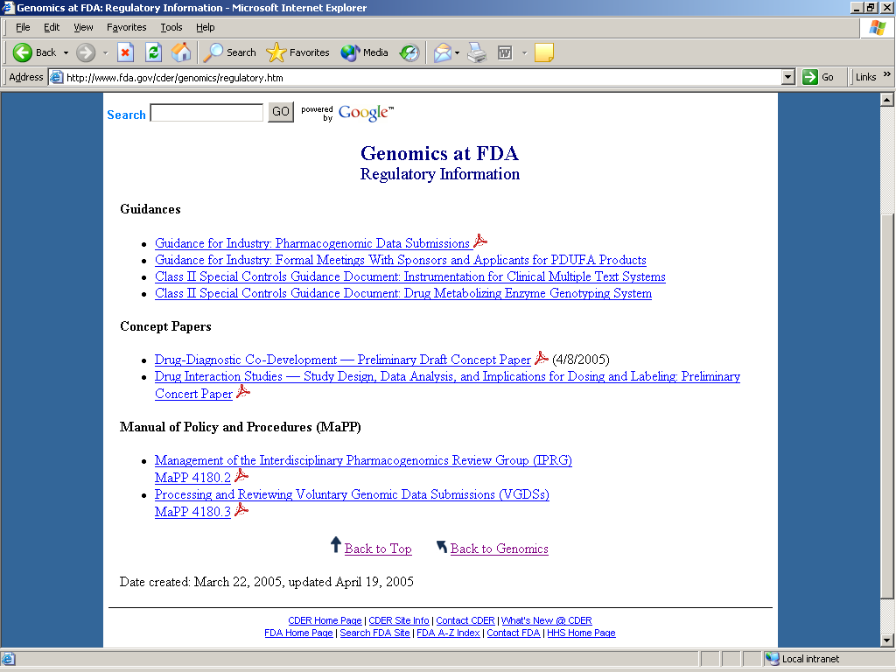

Slide 6
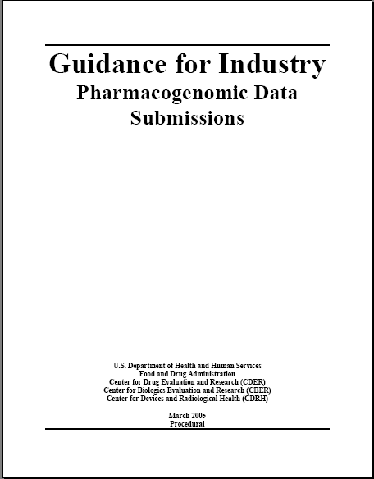

Guidance for Industry: Pharmacogenomic Data Submissions
March 22, 2005

Slide 7
Why this Guidance Is Important
FDA Review: Genomics can help to assess benefit/risk decisions – facilitates review decisions
Drug Development: Guidance empowers FDA to make drug development more efficient (i.e. in IND meetings)
Targeted Therapy: Genomic data submissions are an enabling step for medicines to become more precisely tailored to a patient's unique pathophysiology
Communication: Encouragement of voluntary submissions, which will help to better understand variability in drug-response, foster use of new technologies, …
Outreach: Stakeholders (i.e. industry, patient advocacy groups, Personalized Medicine Coalition, …) have expressed great interest and support

Slide 8
What Does the New PG Guidance Do?
Introduces a classification for genomic biomarkers
Clarifies what type of genomic data needs to be submitted to the FDA and when
Introduces a new data submission pathway to share information with the FDA on a voluntary basis
Encourages the voluntary submission of exploratory genomic data
Introduces new agency-wide PG review group (IPRG)
Clarifies how the FDA will review genomic data submissions

Slide 9
What Does the New PG Guidance Not Do?
Does not provide information on how to validate genomic biomarkers
Does not provide information on how to use genomic biomarker during drug or device development process (scientific vs. regulatory guidance)
Does not expand into other “-omics’ areas such as proteomics or metabolomics
Does not equal genomic data with voluntary data
Does not create new processes for the review of required data submissions

Slide 10
VGDS:
A Novel Data Submission Path
Submission of exploratory PG data submission regardless if subject of an active IND, NDA, or BLA
Data may result from, e.g., DNA microarrays, single or limited gene expression profiles, genotyping or SNP profiling, or from other studies using evolving methodologies
Intent to build expertise and foundation for developing scientifically sound regulatory policies
VGDS creates a forum for scientific discussions with the FDA outside of regular review process
Data not used for regulatory decisions

Slide 11
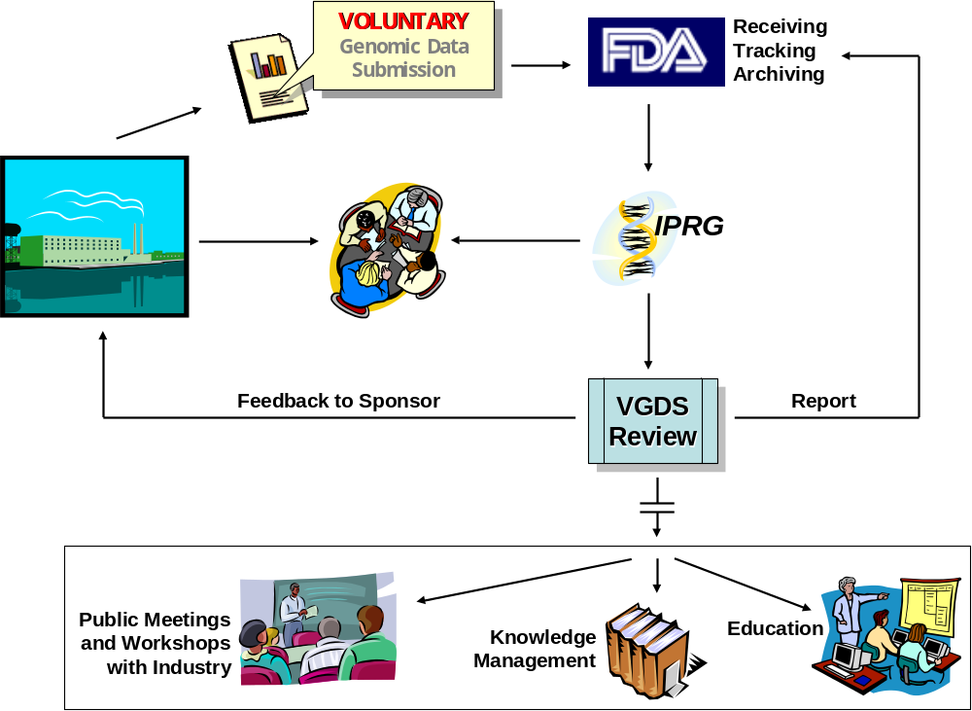
VGDS Review Process
internal
external

Slide 12
IPRG: A New Interdisciplinary Agency-wide Review Group
Representatives of CBER, CDER, CDRH, CVM, NCTR
Reviews VGDS
Consults for review divisions
Provides advice to industry (VGDS and non-voluntary GDS)
Ability to identify gaps in knowledge, e.g., validation, analytic methods, study design
Presents educational/professional development courses within FDA and organizes public workshops

Slide 13
Genomic Data Submissions:
IPRG and Clinical Review Divisions
Voluntary submissions are received by the IPRG and are handled confidentially – data and submission are kept separate from regular, required submissions
Experience shows that most sponsors ask for review divisions to be present at meetings: mutually beneficial to have their expertise part of the discussion
Contact to review division might already exist – if not, this is a good way to get them interested in sponsor’s genomic data, reviewed and evaluated jointly with IPRG
IPRG does not make regulatory decisions; however, sometimes scientific and regulatory aspects of questions asked in a VGDS are difficult to separate: presence of review division at IPRG meeting can facilitate the process

Slide 14
The New Role of Biomarkers:
Current Conceptual Framework for Surrogate Development Is Limited
Historically, successful surrogates have linked effects on markers for single effects in large populations (i.e. BP, HIV mRNA, etc.)
This framework needs to be expanded because:
  It is at odds with current goals for individualized therapy
  Does not recognize multidimensional quality of clinical response
  Does not include possibility of multiple biomarkers providing useful information in aggregate

Slide 15
Biomarker: Definition
Characteristic that is objectively measured and evaluated as an indicator of normal biologic or pathogenic processes or pharmacologic response to a drug
Biomarkers are nothing new – genomic biomarkers complement traditional biomarkers
A biomarker is valid if:
  It can be measured in a test system with well established performance characteristics
  Evidence for its clinical significance has been established

Slide 16
Classification of Biomarkers
Known valid
  Accepted by scientific community at-large to predict clinical outcome
Probable valid
  Appears to have predictive value but not yet replicated or widely accepted
Classification leads to specifications for validation in the context of intended use for biomarker

Slide 17
Use of Probable or Known Valid Biomarkers in Clinical Setting
Entry criteria for a clinical trial
Patient stratification
Indicator for disease status
Drug response predictor test
Monitor drug response
Predict adverse events
Guide dose selection

Slide 18
Exploratory Biomarkers
Lay groundwork for probable or known valid biomarkers
  Hypothesis generation
Fill in gaps of uncertainty about disease targets, variability in drug response, animal – human bridges and new molecule selection
  Learn and improve success in future drug development programs
Can be “de novo” or “sidebar” study embedded in (pivotal) clinical efficacy trials
  Biomarkers associated with clinical outcome

Slide 19
Biomarkers – the Holy Grail ?
Genomic biomarkers provide:
  “progressive reduction of uncertainty” about effects
  “increasing level of confidence” about outcomes
They are part of a bigger picture
  Perhaps some will become surrogates for endpoints (i.e. toxicogenomics)
  Most will remain a factor in a multidimensional set of information along the drug development process

Slide 20
Examples of VGDSs
Candidate gene approach vs. whole genome SNP scan
  Statistical approach feasible?
  Which SNPs to take forward?
  Mechanistic explanation
Gene expression profile in peripheral blood
  Can expression profile be obtained?
  Is it predictable?
Gene expression pattern as genomic biomarker to predict responders and non-responders
  Hypothesis vs. validation
  Statistics
  Clinical utility

Slide 21
Experience with VGDS
Submission:
Summary of studies, goals, data, analytic issues and questions
Sponsor – IPRG Meeting:
Informal, free exchange of ideas, partial answers to questions
  “qualification” of genomic biomarkers, potential pathways of diagnostic/test development, alternative predictive models, performance criteria of diagnostics, statistical dilemmas (replication, subsets, multiple test corrections)
Follow-Up:
Meeting minutes, evaluation of benefits of meeting, ways to improve, what could have been done better

Slide 22
VGDS Feedback
“Our thanks to you and the rest of the Interdisciplinary Pharmacogenomics Review Group for meeting with us. The meeting was quite useful for us. We are proceeding with the study and the VGDS being careful to acknowledge the limitations.”
“Thanks for a very productive meeting - I got a lot of positive feedback, even from folks who were not there which means the attendees were indeed happy and felt both [company] and FDA scientists benefited. We need to work on the follow up and use this a case example for our workshop.”
“As we proceed with our activities, we fully intend to continue our most productive dialogue.”

Slide 23
Why You Need to Submit a VGDS:
A VGDS provides an opportunity to have informal, scientific meeting with FDA PGx experts
  may assist in reaching strategic decisions
  receive and benefit from informal peer-review feedback on PGx issues and/or questions
  gain insight into current FDA thinking about PGx
  familiarize FDA with PGx experiments, data analysis and interpretation approaches
Pave the way for potential time- and cost-savings by familiarizing FDA with PGx and avoiding future delays in review
Make a contribution to the VGDS repository so future policies and guidances are data-driven
Impact FDA thinking and help build consensus around PGx standards, policies and guidances

Slide 24
Drug(-Test) Co-Development Process:
Device/Test
Development
IDE Review
Application
Review
Investigational Phase pre-IDE or IDE Meeting as appropriate
PMA or 510(k)
Application
Voluntary
Submissions
VGDS
Basic
Research
Prototype
Design or
Discovery
Preclinical
Development
Clinical Development
FDA Filing/
Approval &
Launch
Phase 1
Phase 2
Phase 3
Pre-IND
Meeting
End of Phase
2A Meeting
Drug Market
Application
Initial IND
Submission
End of Phase
2 Meeting
Ongoing
Submission
Pre-BLA or
NDA Meeting
Application
Review
Drug Development
IND Review

Slide 25
Drug Development Timeline:
Use of Biomarkers
Prototype
Design or
Discovery
Prototype
Design or
Discovery
FDA Filing/
Approval &
Launch
Prototype
Design or
Discovery
FDA Filing/
Approval &
Launch
Clinical Development
FDA Filing/
Approval &
Launch
Clinical Development
Basic
Research
Clinical Development
Basic
Research
Preclinical
Development
Basic
Research
Preclinical
Development
Preclinical
Development
Phase 1
Phase 1
Phase 2
Phase 2
Phase 3
Phase 1
Phase 2
Phase 3
Phase 3
Target
Selection
Pre-IND
Meeting
End of Phase
2A Meeting
Drug Market
Application
Identification of
Stratification Markers
Clinical Utility for
Stratification Marker
Label Considerations
Based on Trial Results
Target
Validation
Initial IND
Submission
End of Phase
2 Meeting
Label Considerations
Based on Marker Status
Clinical Validation for
Stratification Marker
Analytical Validation
Ongoing
Submission
Pre-BLA or
NDA Meeting
Pre-Clinical Feasibility
Application
Review
Drug Development
IND Review
Clinical Validation
Clinical Utility

Slide 26
Strategic Thinking:
How a VGDS Can Help
Basic
Research
Prototype
Design or
Discovery
Preclinical
Development
Clinical Development
FDA Filing/
Approval &
Launch
Phase 1
Phase 2
Phase 3
Target
Selection
Identification of
Stratification Markers
Clinical Utility for
Stratification Marker
Label Considerations
Based on Trial Results
Target
Validation
Label Considerations
Based on Marker Status
Clinical Validation for
Stratification Marker
Analytical Validation
Pre-Clinical Feasibility
Clinical Validation
Clinical Utility

Slide 27
Strategic Use of Genomic Biomarkers
Use Genomic Biomarker for:
  Stratification to separate responders from non-responders
  Stratification to exclude patients at risk for AE
  Enrichment of responder population
Get:
  Increased chance of winning,
  In a shorter period of time,
  At less cost (decreased size of trial).

Slide 28
Making the Business Case: FDA’s Regulatory and Exclusivity Incentives
Orphan Drug Act
  Facilitate development of medicines for treating diseases affecting <200,000 patients
    PGx diagnostic may define orphan indication
    New or old drugs (may have additional indications)
  7 yr of market exclusivity for indication
  Grants and tax credits to subsidize development costs
  Expedited review
http://www.fda.gov/orphan.htm

Slide 29
Regulatory and Exclusivity Incentives
3 year exclusivity
  Facilitate development of new claims for medicines supported by new clinical trails
  PGx diagnostic may define target population
  Effect larger than previously demonstrated or a superiority showing = new claim
http://www.fda.gov/cder/about/smallbiz/exclusivity.htm

Slide 30
VGDS, PGx, and Education
A successful FDA internal education program for pharmacogenomics has been setup
VGDS data (with permission from the sponsor) is used to illustrate the use and analysis of DNA microarray data in drug development
Goal is to understand how data is evaluated and interpreted by the sponsor, not to conduct complete and new data analysis (re-interpretation)
Meetings with sponsors are planned in “dual-mode”: i.e. both parties will present their findings and discuss the parameters that are critical for analysis

Slide 31
VGDS, PGx, and the Development of new Policy
Many of the submissions raised interesting questions that are being discussed by IPRG more broadly than just in the context of the submissions themselves: i.e.:
  Statistical issues surrounding clinical trial design
  Retro- vs. prospective clinical trials
These discussions lead to new guidance and policy development that are critical to the use of pharmacogenomics in drug development
Sponsor contributions are critical

Slide 32
VGDS Goes Global
May 17, 2005: first joint FDA/IPRG – EMEA/PGWP – sponsor meeting
Videoconference, two screens: one for presenter, one for slides
Preparation is key:
  Interaction before meeting included in depth scientific evaluation of sponsor questions
  This pre-meeting dialogue between FDA and EMEA resulted in a better product
  Sponsor provided excellent presentation for interactive discussion via videoconference: presenters were present at EMEA (London, UK) and FDA (Rockville, MD)

Slide 33
VGDS Goes Global, cont’d
Meeting minutes are jointly prepared by FDA and EMEA and are shared with sponsor
What we learned, next steps:
  FDA and EMEA evaluated, with only minor differences, the submission similarly, no dispute over science
  Both agencies adjusted their usual format to accommodate the requirements necessary for a joint event
  Communication is critical: clear definitions are a must
Positive experience: next meeting planned for Q3 2005
First step to “harmonizing”? This could provide a new paradigm for this process: learning while doing!

Slide 34
VGDS and Use of Genomic Data:
What Are the Obstacles ?
Why some companies decide NOT to submit a VGDS:
  It’s not a “safe harbor”
  It’s “voluntary”, why bother?
  Fear of inappropriate data interpretation
  FDA will ask for MORE information if genomic data is part of submission
Genomic data and its use in drug development:
  Business incentives
  Clinical trial designs: how far can we go
  Impediments: statistics and economics, what can we do?
  Should FDA simply REQUIRE genomic data to be submitted?

Slide 35
OK, you’re forward thinking and you decided to submit a VGDS
How to do it –
Best Practices

Slide 36

First Steps:
It might be a good idea to simply contact the Executive Secretary or IPRG Chair to discuss…
Determine the scope of the meeting
Put request for meeting in writing and include:
  Scope of meeting
  List of sponsor attendees
  List of FDA attendees, if available
  Executive Summary
  List of questions
Send background package with request or immediately after request is acknowledged

Slide 37

Background is extremely important…
Package should include:
  Scope of the meeting
  Agenda
  List of attendees
  Specific questions IPRG should address
  ! Avoid general questions like: “Is the protocol ok?”
Provide package at least 4 weeks prior to meeting, or by date requested, in order for IPRG to fully prepare for meeting

Slide 38
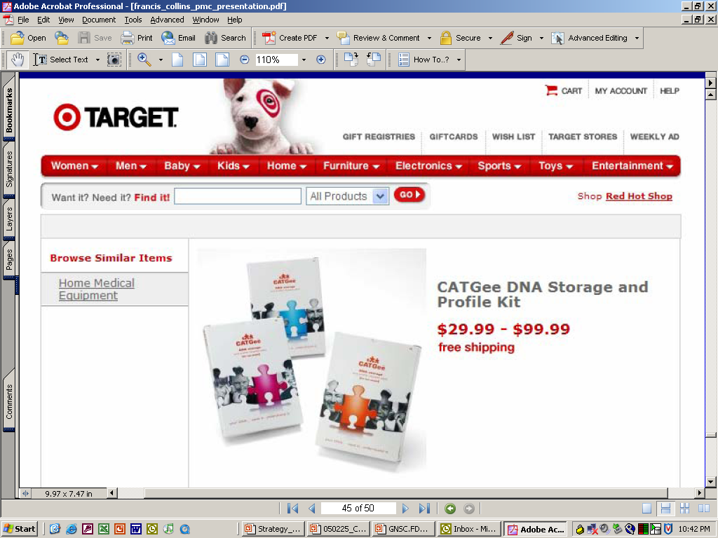
It’s a voluntary genomic DATA submission !

Slide 39
Presentations should …
Be short and to the point
Leave time for discussion
Focus on scope of meeting and your questions
Focus on issues at hand (scientific, regulatory or administrative)
Keep company history to a minimum and make relevant to agenda
Indicate where you are in product timeline
Please Note: Have handouts and copies of presentation available for all attendees at the meeting

Slide 40
During Meeting …
Stick to the designated scope and questions
Limit meeting to 1 hour or less for presentation, questions, responses, and action items
Start and end on time
Be open to advice from FDA
Get action items reiterated or recapped at the end of the meeting
Take meeting minutes

Slide 41

Avoid …
Requesting meeting before you have adequate information and data ready to discuss
Surprising IPRG at meeting with new information not included in background package, or sending new information just before meeting. Re-schedule instead.
Having side discussions before, during or after meeting – stick to agenda and timeframe

Slide 42
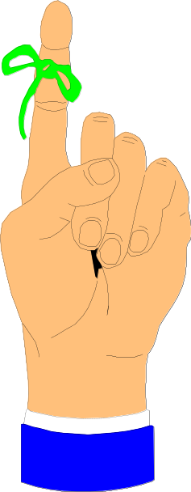
IPRG Disclaimer
PLEASE NOTE: The views expressed in this document are the opinion of the members of the Interdisciplinary Pharmacogenomics Review Group (IPRG) and may not reflect the opinion of a review division. Therefore, the provided answers should not be interpreted as regulatory guidance, but as a scientific assessment of the issues raised. Should aspects of the subject matter discussed herein become part of a non-voluntary data submission, application, or supplement, it is at the full discretion of the appropriate review division to completely and independently assess the product(s) in question.

Slide 43


General Advice
Keep meeting informal
Provide several options for dates when scheduling – be flexible
Begin meeting with an introduction of attendees
If you have to cancel a meeting, do so at least 48 hours ahead
(Bring your own laser pointer)

Slide 44
In Conclusion
First VGD submission a little over one year ago, approx. 15 since
Diversity in submission quality led to the development of best practices; since, the quality has been consistently high.
Despite it being a critical point in comments to the draft guidance, most sponsors would like to have Clinical Review Divisions participate in IPRG – sponsor meetings
Informal feedback has been very positive – more formal feedback will be collected (questionnaire)
The two first sponsors have submitted a second, follow-up VGDS
VGDS can be part of drug (and device) development strategy
There are good business reasons to use PGx in drug development
The VGDS process has taken on an international spin
Discussions around expanding VGDS into VXDS have started…

Slide 45
Acknowledgements
Larry Lesko, PhD
Janet Woodcock, MD
Allen Rudman, PhD
Shiew-Mei Huang, PhD
Federico Goodsaid, PhD
All of IPRG
Colleagues at EMEA
Colleagues at Industry

Slide 46
www.fda.gov/cder/genomics
Felix.Frueh@FDA.gov
Office of Clinical Pharmacology and Biopharmaceutics
FDA/CDER

