Slide 1
Impact of Inhalant Use in Venezuela
Elvia Amesty, MGSc
Jose Felix Ribas Foundation

Slide 2
Introduction
In Venezuela, epidemiological data demonstrates:
A continued increase in legal and illegal drug use during adolescence
A decrease in the age of first use
Increase in the incidence of substance use among youth

Slide 3
Inhalant Use in Venezuela
Three aspects must be considered:
1. Data from drug use in high school students
2. Data from drug use in risk groups
3. Data from drug abusers in treatment

Slide 4
High School Students
Epidemiological study completed with secondary students in Zulia State
To evaluate drug use prevalence, onset age and risk factors
Data were collected from private and public schools
Age:12 -17 years
Years: 1996-2000-2002-2004
Drug Use Screening Inventory (DUSI)
The same methodology was utilized across all years
Source: Amesty et al (2005)

Slide 5
Age of Onset in Students
Tranquilizers
Alcohol Intoxication
Inhalants
Stimulants
Marijuana
Tobacco
Cocaine
Alcohol
11 12 13 14 15
Age
Source: Amesty et al (2005)

Slide 6
Lifetime Prevalence in High School Students
Drug | 1996 N=1015 | 2000 N=1354 | 2002 N=1283 | 2004 N=1205
Alcohol | 47.2 | 50.1 | 58.7 | 60.7
Tobacco | 11.7 | 10.5 | 10.8 | 11.4
Cocaine | 0.6 | 2.1 | 2.4 | 2.6
Marihuana | 0.7 | 1.4 | 1.6 | 0.9
Inhalants | 0.8 | 1.9 | 2.3 | 3.6
Pills | 3.8 | 8 | 7.3 | 6.9
Inhalant use lifetime prevalence has been increasing since 1996 to 2004
Source: Amesty et al (2005)

Slide 7
Comparative Study in High School Students
A research conducted in some central and south American countries by Organization of American States (OAS,2003)
Standardized Methodology (similar ages, questionnaire, grade levels and analysis)
Countries: Ecuador, Paraguay, Uruguay, Panama, Guatemala, Nicaragua and Venezuela.
Students with 13,15 and 17 years
Public and private secondary schools
Source: CICAD/OAS (2003) Comparative Study of Drug Use in American Countries

Slide 8
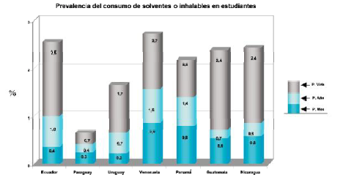
Inhalant Use Prevalence
Venezuela has the highest last month prevalence and actual use of inhalants as compared to the other countries

Slide 9
Drug Use in Risk Groups
Research conducted Zulia State
Data were collected from 1205 students, 100 street youths, 100 youth offenders and 35 addicts
Age: 12-17 years
Instruments: The Psychological Dysregulation Inventory previously standardized in Venezuelan population
Source:Murelle&Amesty(2003)

Slide 10
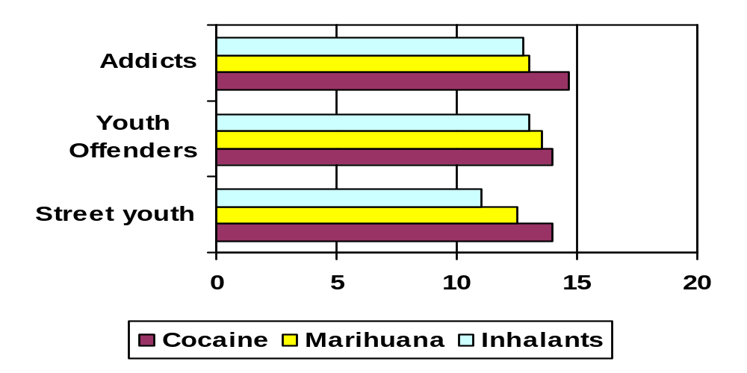
Onset Age on Drug Use in Risk Groups
*
Onset age of inhalants in street youth (11y) is the lowest as a compared to the other groups and this difference was statistically significant
Inhalant lifetime prevalence in street youths and offenders was the same (6%) and 20% in addicts

Slide 11
Drug Abusers in Treatment
In the general treatment population cocaine and marihuana are the drugs for which patients request treatment
It appears that the inhalant use may not be a critical issue, because only 1% reported actual use of this drug
Source:Amesty&Díaz(2004); CONACUID,2004

Slide 12
Drug Abusers in Treatment
Requests for treatment for vulnerable youths have increased and they have a different drug use pattern
Information from de 91 drug abusing teenagers treated during 2004 indicated that 12% reported actual inhalant use (Youth Program)
Source:Amesty et al

Slide 13
Conclusion
Inhalant is the first drug of use by students
Inhalant use lifetime prevalence have been increasing in students
Venezuelan students have the highest past month prevalence and actual use of inhalants as compare to other American countries
Age of onset of inhalant in street youth was lower than youth offenders and addicts
Inhalant use in general treatment population and youth treatment group is different

Slide 14

Thanks

