Slide 1

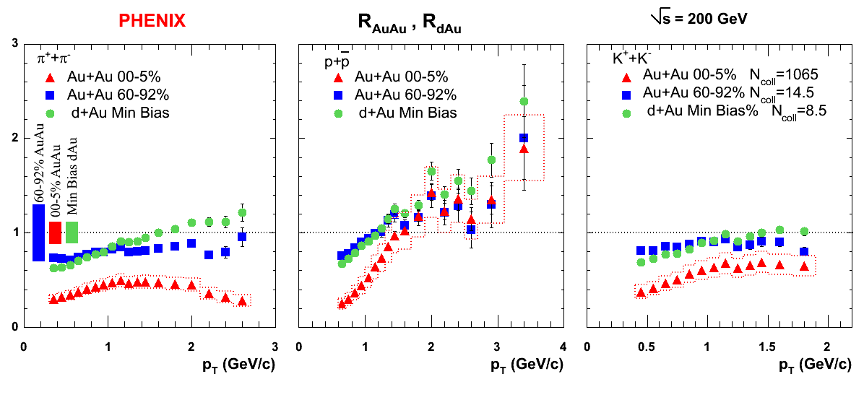

Variations on a Theme:
Identified Particle production in Au+Au, d+Au and p+p collisions
21st Winter Workshop
on Nuclear Dynamics,
Breckenridge, Colorado
5-12 February, 2005
Andy Warhol, Marilyn Monroe, 1967
Felix Matathias
Columbia University
the PHENIX experiment, R_{AuAu} and R_{dAu} , 2005
for the
Collaboration
*Dissertation work done at SUNY Stony Brook

Slide 2

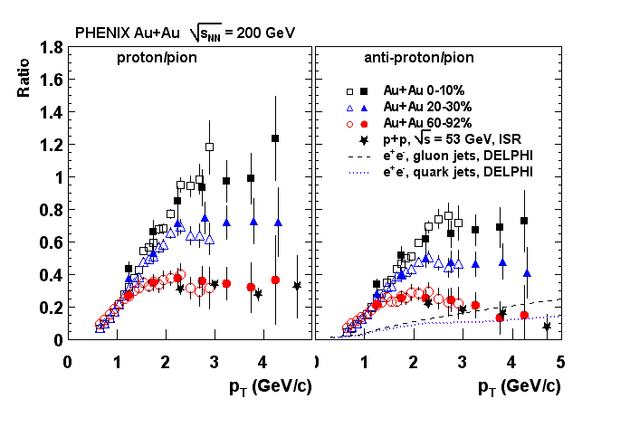
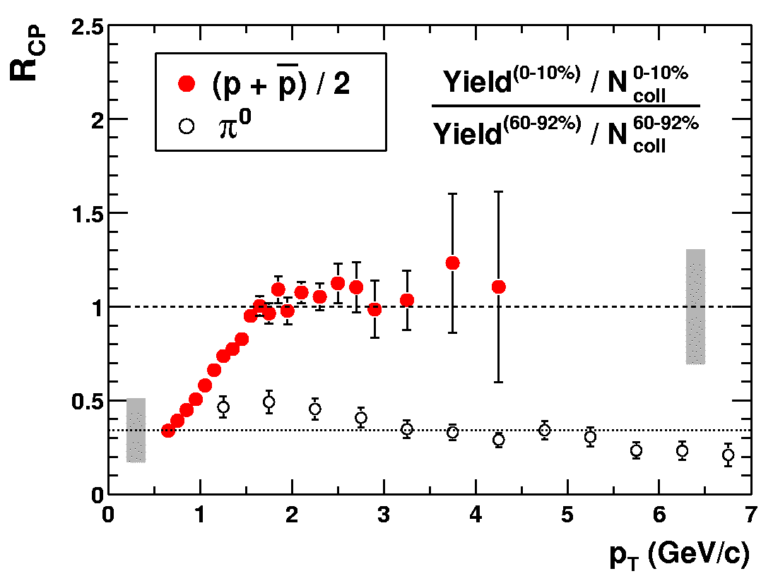
Motivation:
Variation:
= 200 GeV Au+Au
Measurement of identified particle production in p+p collisions at the same energy, establishes the elementary hadronic reference that spectra are compared to. From R_{CP} to R_{AuAu}
Measurement of identified particle production in d+Au collisions at the same energy establishes the size of initial state nuclear matter effects. Detailed study of the Cronin effect for pions, kaons and protons.
Strong suppression of π⁰ yields above p_{T} ~ 2 GeV/c at 200 GeV central Au+Au collisions at RHIC, but no suppression for proton and antiproton at intermediate p_{T} ~ (2-5 GeV/c): “Baryon anomaly at RHIC”
“Anomalous” proton to pion ratio at 200 GeV central Au+Au collisions at RHIC.
Measurement of identified particle production in Au+Au collisions at lower energies, 62.4 GeV, absence or presence of the baryon anomaly ? What is the magnitude at lower energies ?
PHENIX: PRL 91, 172301 (2003), PRC 69, 034909 (2004)
Au+Au collisions at √s_{NN} = 200 GeV

Slide 3
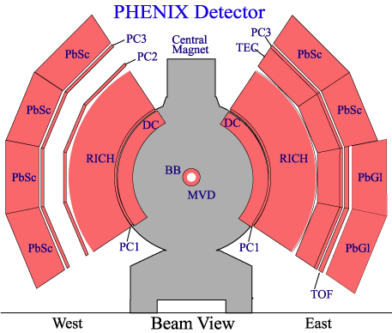
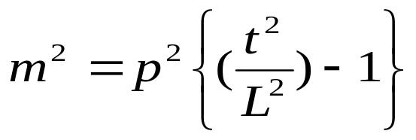
BBC start/DCH track/TOF stop
Acceptance:
  Δφ = π/4
  |n|< 0.35
Method: PID based on particle mass
Calculated by:
  BBC: start time
  DCH, PC: tracking, momentum
  Track Model: path length
  TOF: Time of Flight
σ_{TOF} = 100-130 ps
δp/p= 0.7% + 1.1%p (GeV/c)
Pion identification : p_{T}~2.5-3.0GeV/c
Kaon identification : p_{T}~2.0 GeV/c
Proton identification: p_{T}~ 3.5-4.0 GeV/c

Slide 4
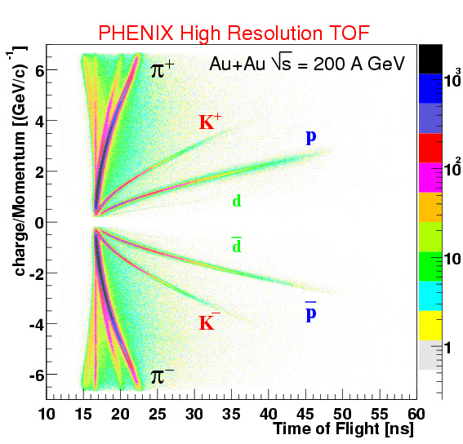
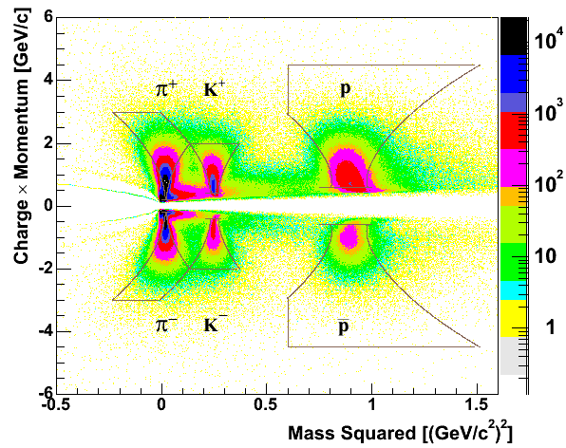
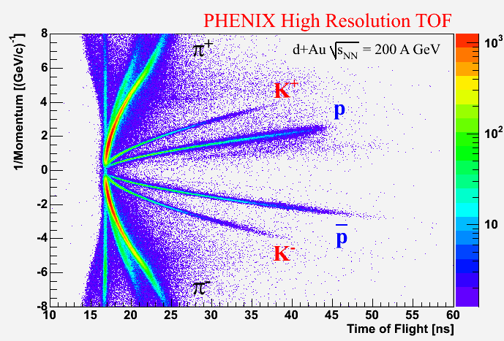
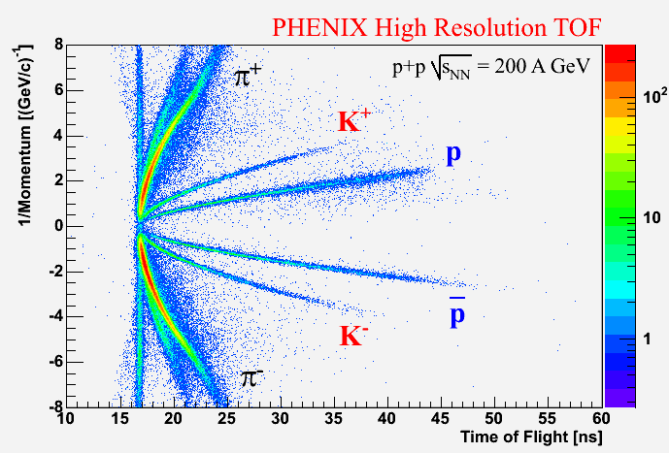
High Resolution TOF Solid performance, year after year
PHENIX High Resolution TOF
Au+Au √s = 62.4 GeV

Slide 5
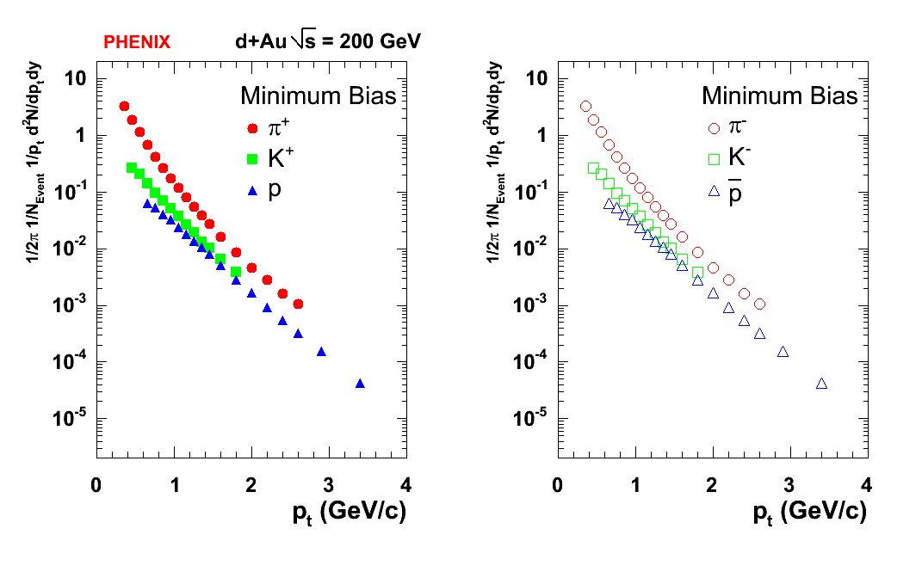
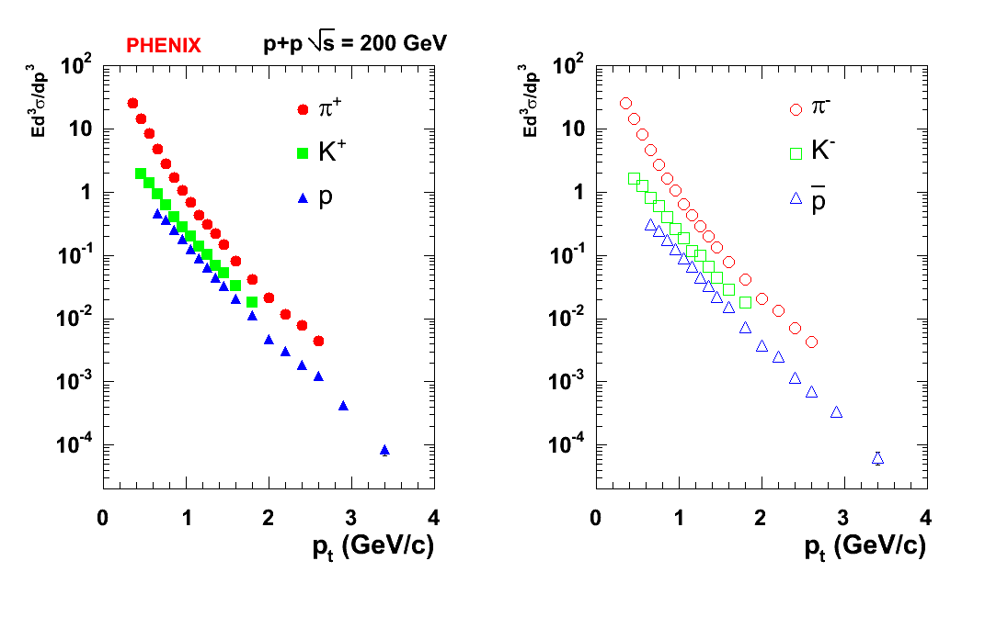
The Baseline: p+p and d+Au
p+p and d+Au data from RHIC RUN 03 at √s_{NN}=200 GeV
p+p and d+Au data have been corrected for feed-down corrections
42M d+Au Events
  Minimum Bias trigger accepts 88.5+/-4% of all d+Au collisions
25M p+p Events
  Minimum Bias trigger accepts 51.6+/-9.8% of total inelastic p+p cross section at √s_{NN}=200 GeV
Au+Au at √s_{NN}=62.4 GeV from RHIC RUN 04: 37M Au+Au Events
PRELIMINARY

Slide 6
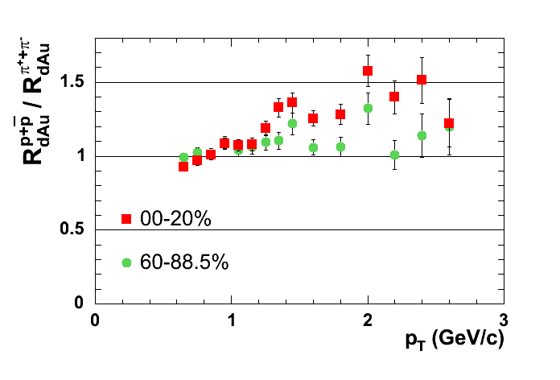
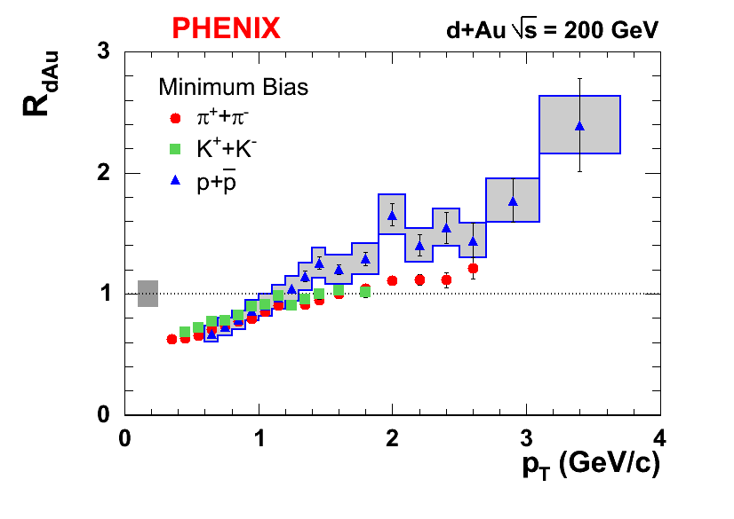
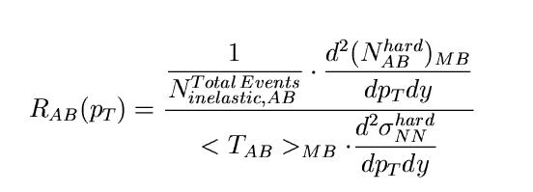
Nuclear Modification Factors in Minimum Bias d+Au
Systematic errors are always shown in boxes: Overall normalization and point-to-point
No suppression at intermediate and high p_{T} at midrapidity
Protons have a significant enhancement, traditionally called “the Cronin effect”
On the order of 40%
Pions show smaller enhancement, Kaons seem to scale with Ncoll
Notice: Phenix measures directly differential invariant p+p differential cross section, with no assumptions made
PRELIMINARY
PRELIMINARY

Slide 7
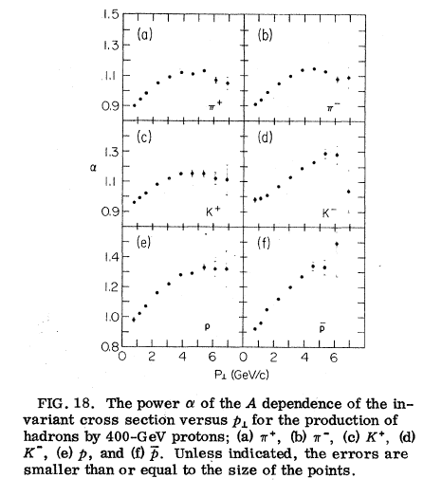
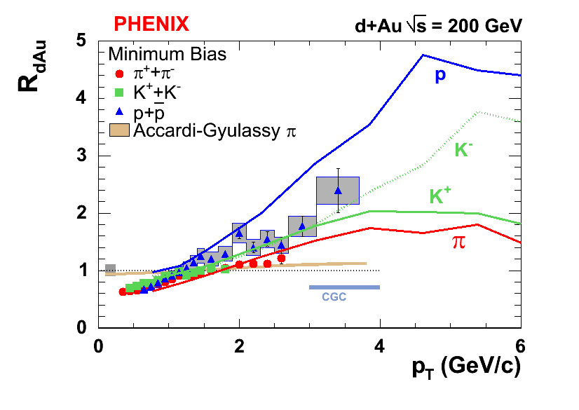
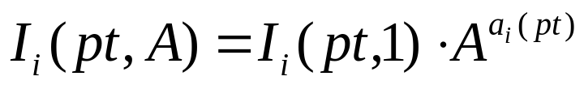
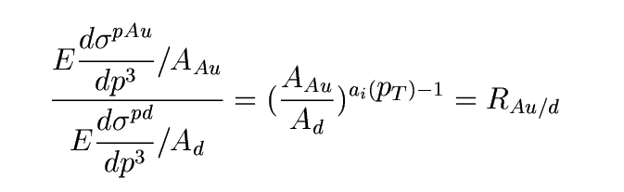
Energy Dependence of the Cronin Effect
Antreasyan et.al.Phys.Rev.D19(3)1979
Antreasyan, Cronin, et. al demonstrated that the p+A cross sections (A=D₂, Be, Ti, W) can be parameterized as:
The alpha-factors are momentum dependent and species dependent and have been tabulated for √s_{NN}=27.4 GeV
We can make a conversion from the a-factors to nuclear modification factors with modest assumptions:
  σ^{pD} = 2xσ^{pp}
  σ^{dAu} ~ 2xσ^{pAu}
PRELIMINARY
lines: √s_{NN}=27.4 GeV

Slide 8
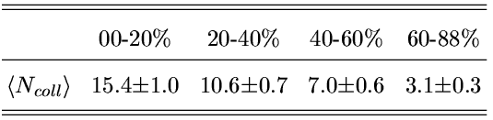
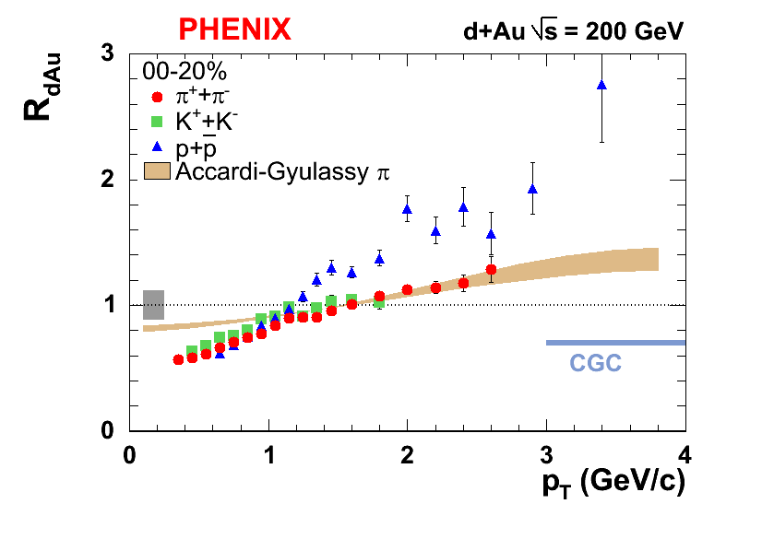
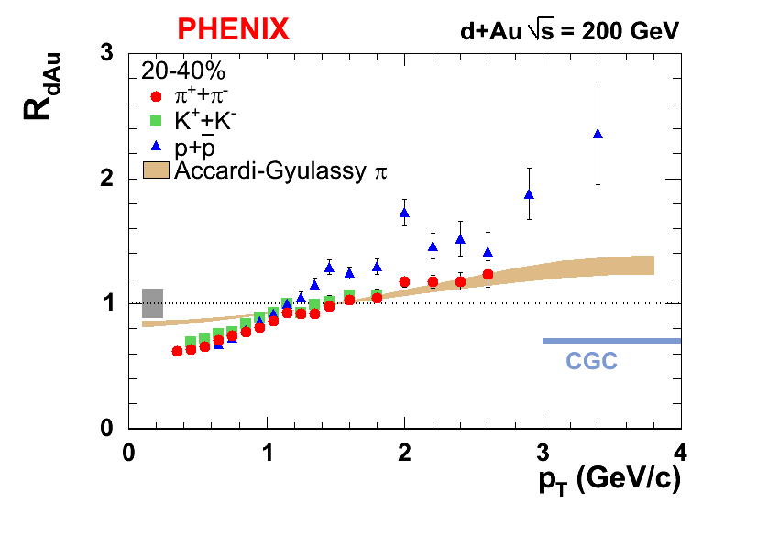
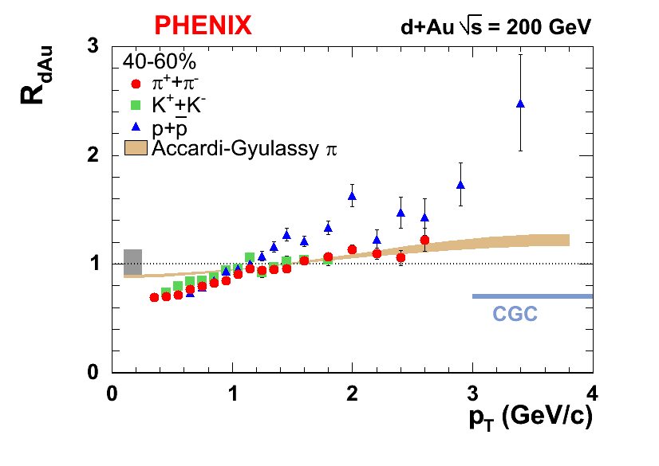
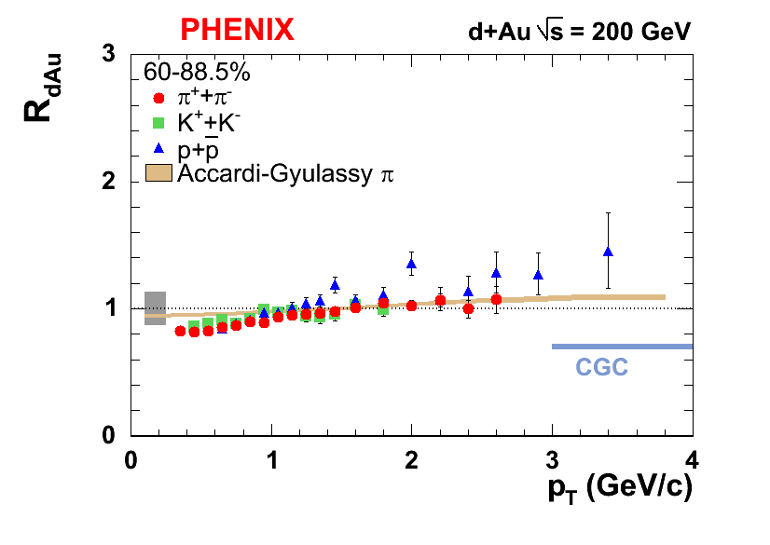
Centrality Dependence of the Cronin effect
Centrality selection in d+Au using BBC south, assume that BBC signal on Au-going side is proportional to number of participating nucleons in Au nucleus.
Number of collisions for centrality bins calculated with a Glauber Model.
Initial Glauber-Eikonal multiple scattering model by Accardi and Gyulassy describes the data very well
..
PRELIMINARY
Very little room for additional dynamical shadowing.
Phys. Lett. B 586, 244 (2004)
CGC: Kharzeev, Levin, McLerran
Phys. Lett. B 561, 93 (2003)

Slide 9



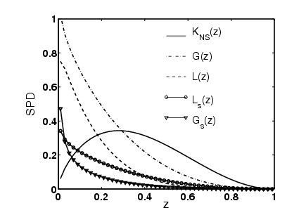
Recombination model for Fragmentation: the Hwa-Yang programme
A hard parton with high virtuality initiates a parton shower through gluon radiation and pair creation.
Non perturbative process.
The fragmentation function (FF) can be written in terms of the shower parton distributions (SPD) and the recombination function (RF).
Use the measured FFs.
Solve the equation for the SPDs.
Use the SPDs in different environments (d+Au, Au+Au).

Slide 10



Recombination of Shower Partons in A+A and p+A Collisions: Thermal and Shower components
First application of SPD outside the realm of parton fragmentation.
Start with the meson production.
Fix all the parameters, involves fitting at low momentum.
Predictive power of the model is at moderate to high p_{t} through the TS and TT term.
Proton term will have: TTT+TTS+TSS+SSS+…
Thermal
Fragmentation (one jet)
Thermal+Shower
Different jets.
low-p_{T} moderate-p_{T} high-p_{T} Negligible

Slide 11
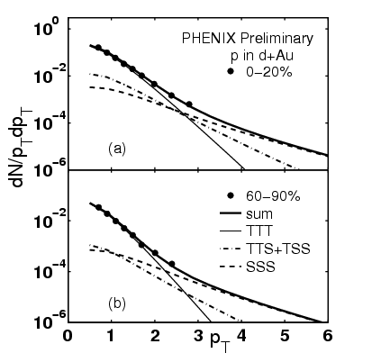
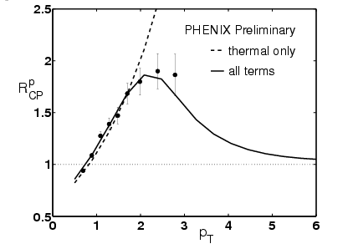
Recombination in d+Au as the Origin of the Cronin effect
This radical interpretation of he Cronin effect introduces a reinterpretation of particle production with far reaching consequences
Separation of partons into two non-interacting components, soft and hard, is perhaps an oversimplification ?
The same framework can successfully account for the baryon anomaly observed at central Au+Au collisions.
PROTON PRODUCTION IN D+AU COLLISIONS AND THE CRONIN EFFECT.
Phys.Rev.C70:037901,2004 , e-Print Archive: nucl-th/0404066

Slide 12
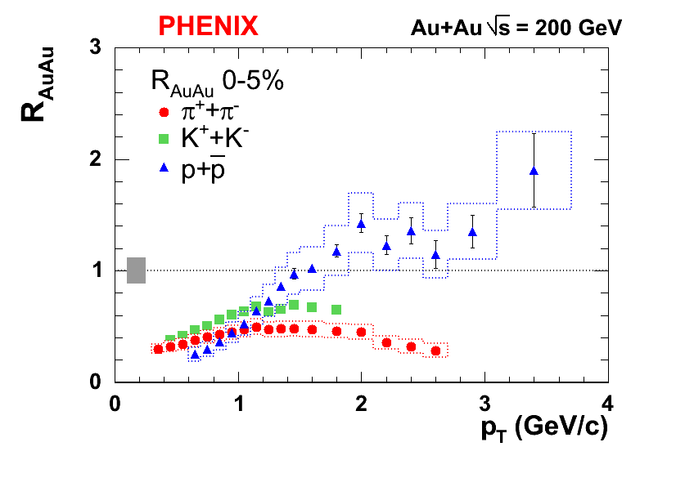
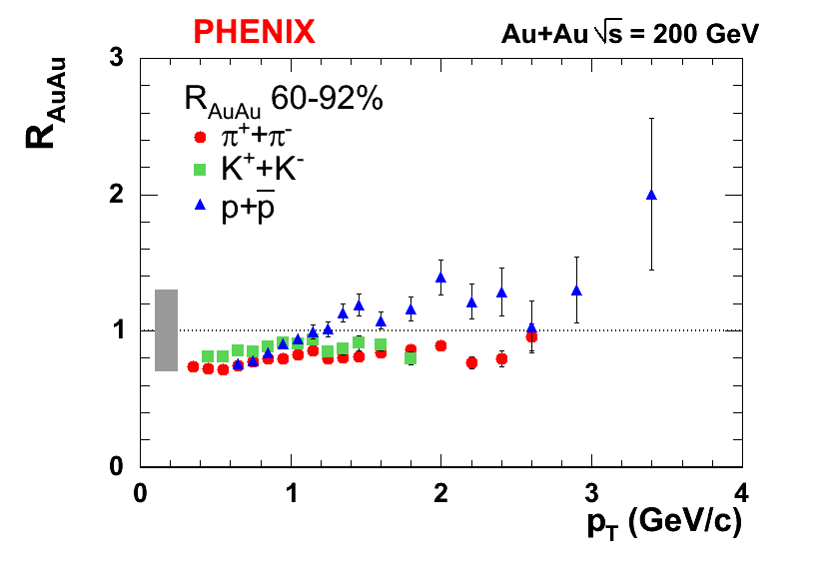
Identified Nuclear Modification Factors in Au+Au
The measurement of identified particle production in p+p establishes the elementary hadronic reference.
We do not have to use anymore the peripheral Au+Au centrality, with its large uncertainties, as the reference for nuclear modification factors.
Central Au+Au collisions show a large suppression for pions, less for Kaons, and a small enhancement for protons.
Peripheral Au+Au collisions are consistent with point-like scaling.
PRELIMINARY

Slide 13
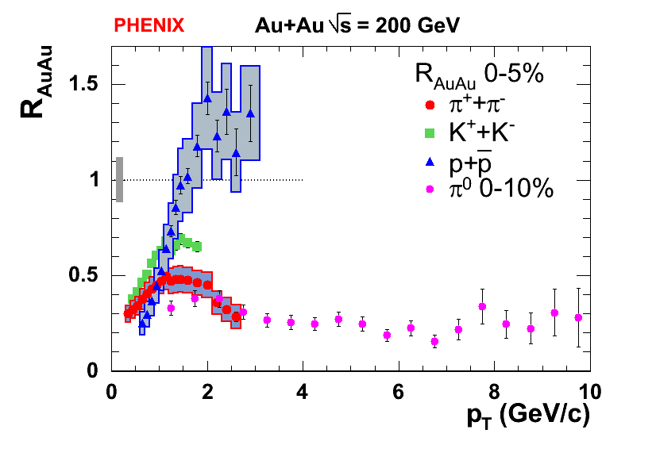
The gap has been bridged in d+Au
PRELIMINARY
Pions suppressed by a factor of ~6 with respect to protons
With the identified spectra from p+p, d+Au and Au+Au at the same energy we can make quantitative statements about the baryon anomaly in central Au+Au collisions
d+Au collisions can not account for the huge gap between protons and pions in central Au+Au collisions.
PRELIMINARY
Proton Cronin effect larger by ~30%

Slide 14
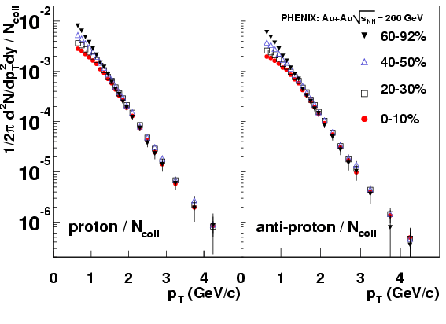
Comparing R_{dAu} and R_{AuAu}: same species
Striking effect for protons and antiprotons, unique behavior.
The remarkable scaling of the protons and antiprotons, now expressed in an absolute scale by using the p+p reference.
PRELIMINARY

Slide 15
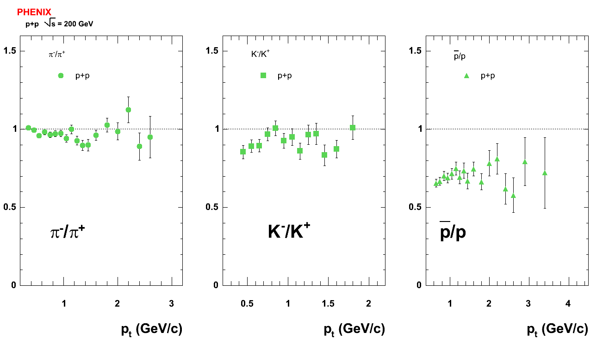
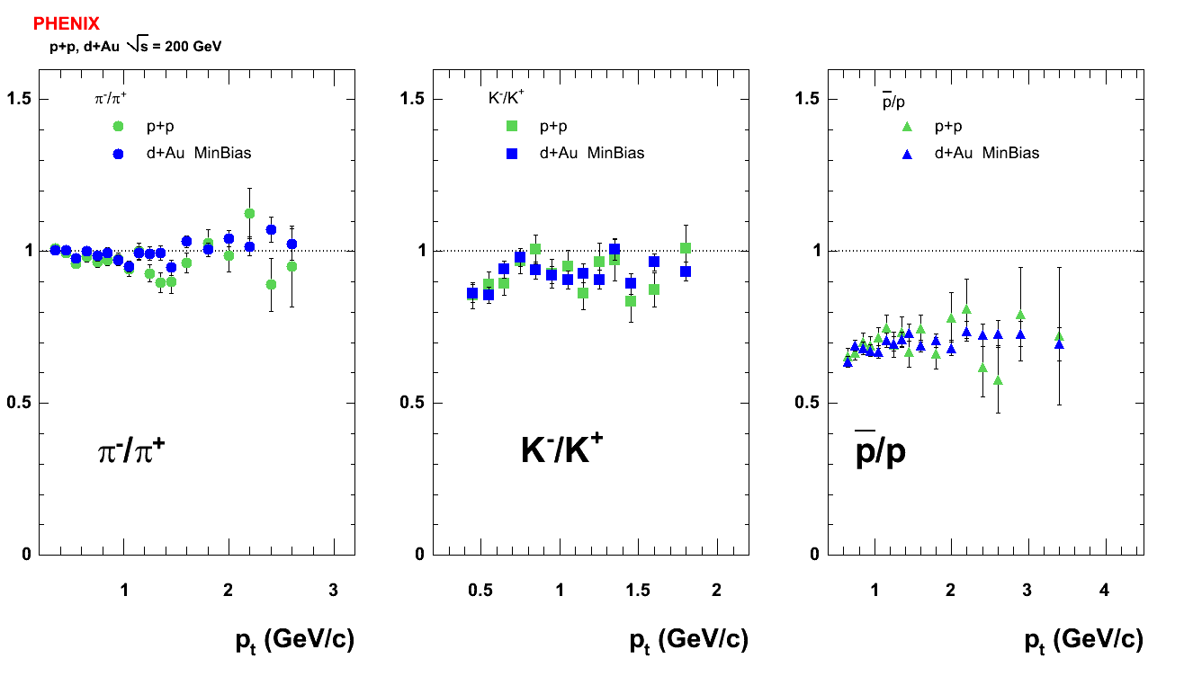
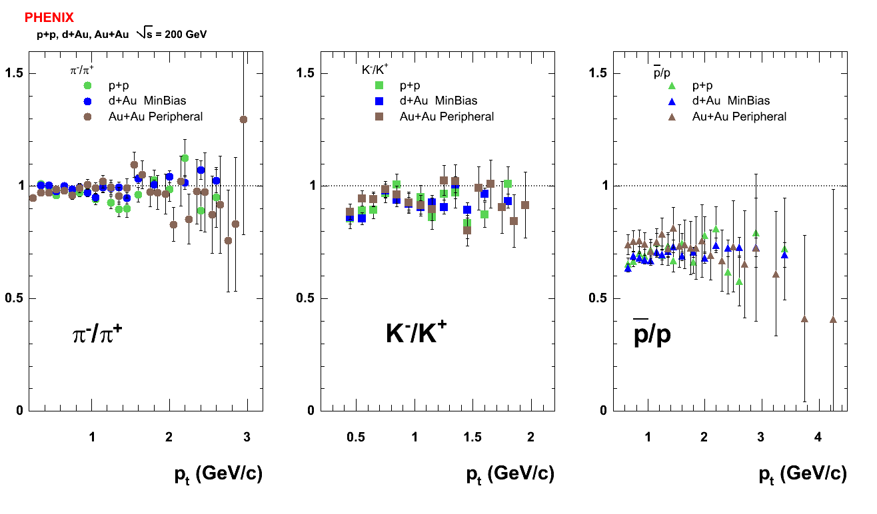
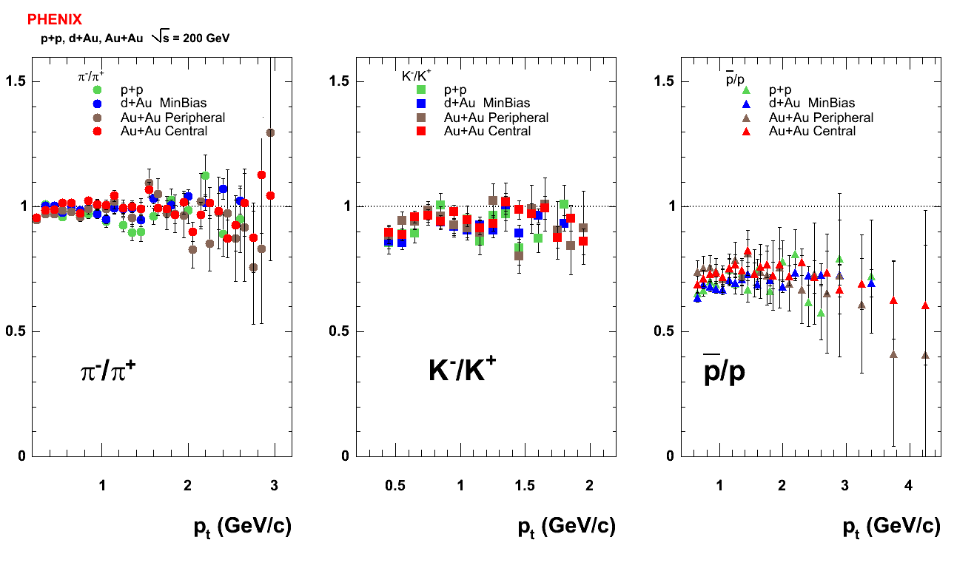
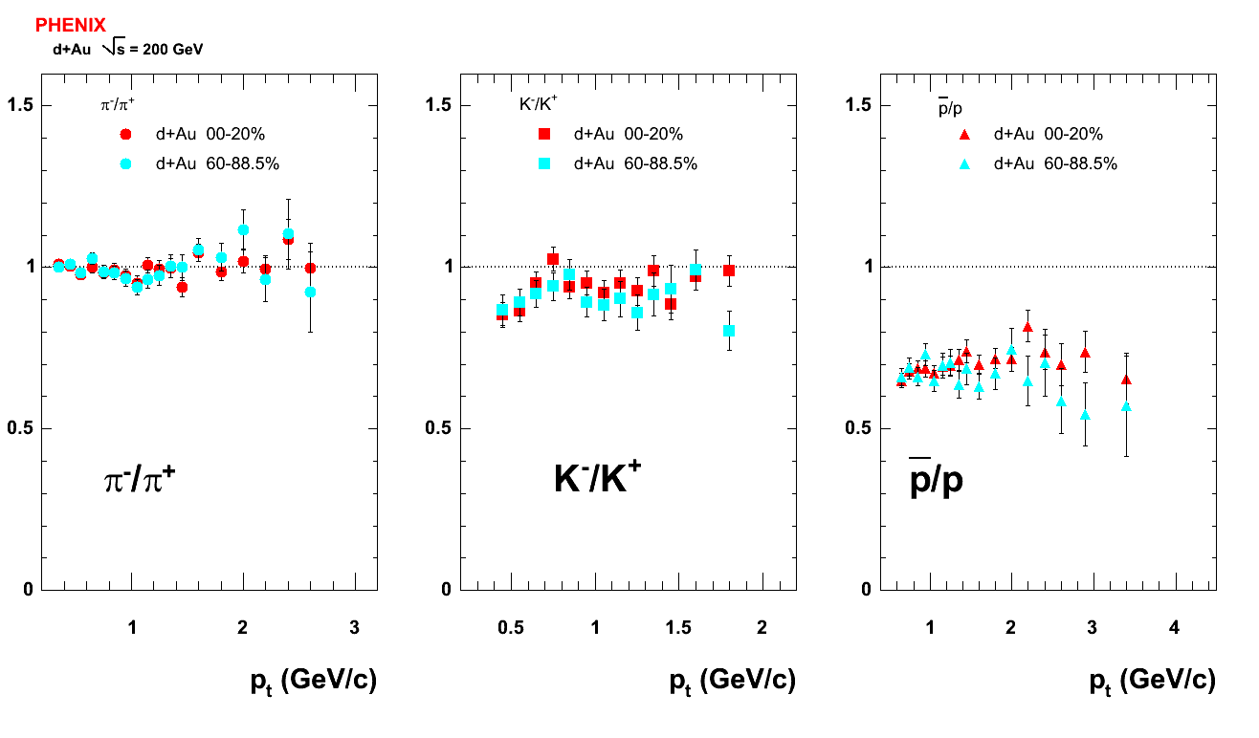
Antimatter/Matter: flat in p_{T} and collision species independent
PRELIMINARY
No centrality dependence in d+Au either.

Slide 16
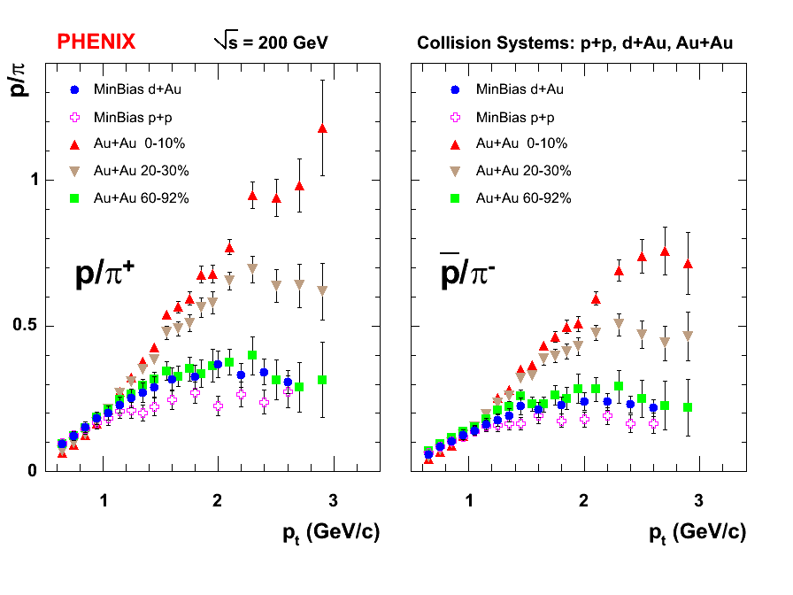
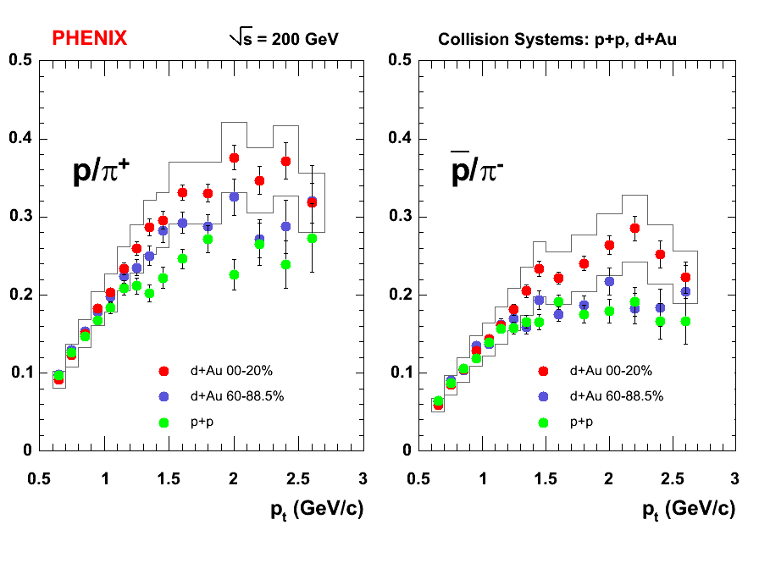
Proton to pion ratio: baseline measurement is different
Closer look at baseline: p+p and d+Au
Peripheral Au+Au and Minimum Bias d+Au have the same behavior
Smaller ratio in p+p due to larger Cronin effect for protons than pions in d+Au
Central Au+Au show a large effect that can not be accounted for by the baseline systems
PRELIMINARY
Protons and antiprotons feed-down corrected in all systems

Slide 17
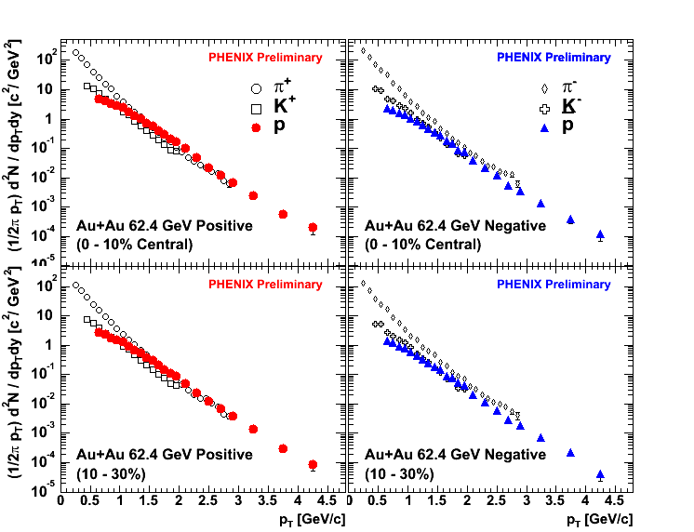
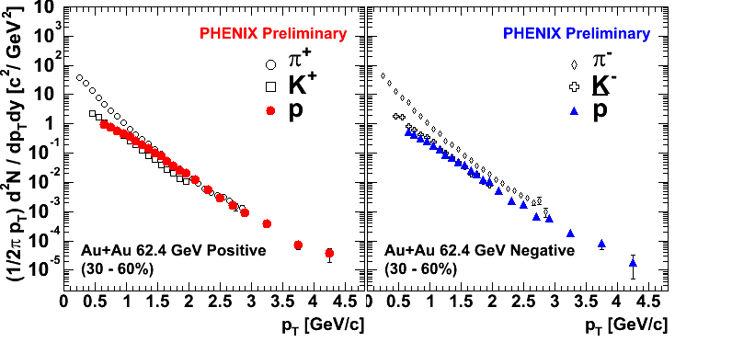
√s_{NN}=62.4 GeV Au+Au: spectra
Three centrality bins defined at the moment
Large proton content at intermediate p_{T}
The familiar 200 GeV picture reemerges
Antiprotons though are not as copiously produced as in the higher energy case
0-10%
10-30%
30-60%

Slide 18
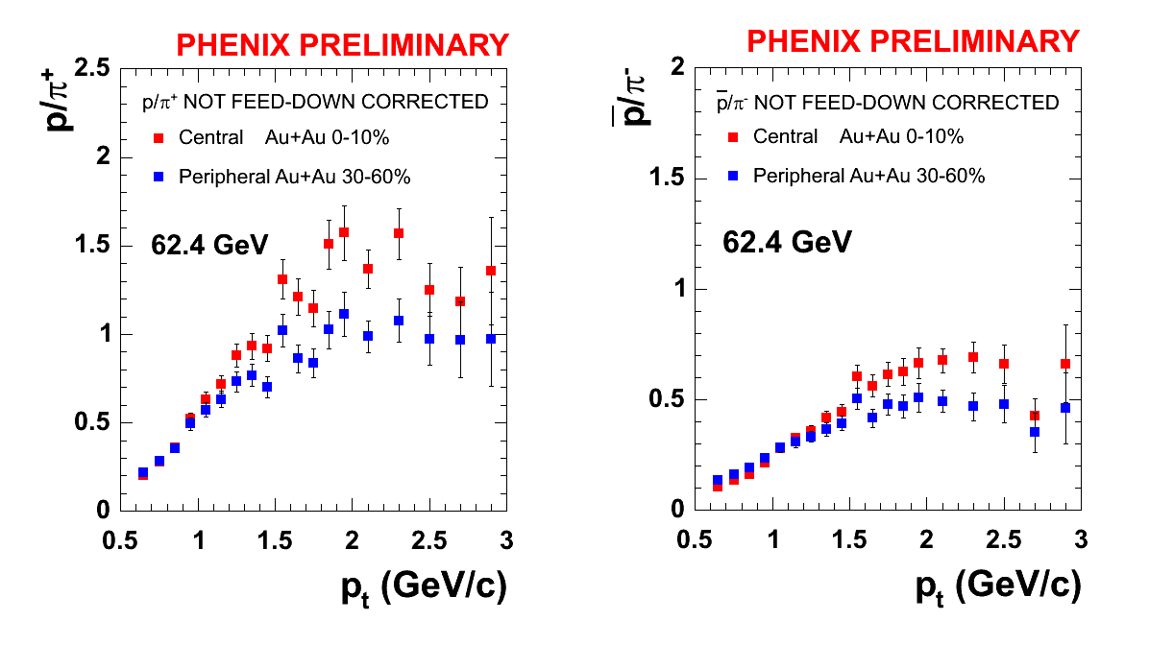
Proton to Pion ratio at 62.4 GeV
Significantly enhanced proton to pion ratio > 1
Notice: protons and antiprotons are not feed-down corrected
Smaller antiproton to pion ratio ~0.7 compared to the 200 GeV data
Indicates more baryon transport at 62.4 GeV and less p-pbar pair creation
Weaker centrality dependence for both ratios compared to the higher collision energy

Slide 19
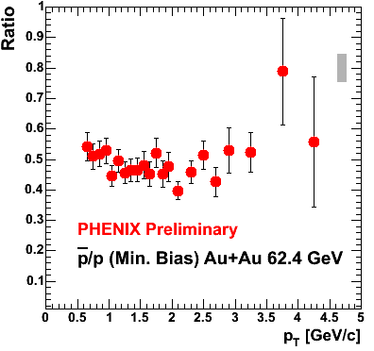
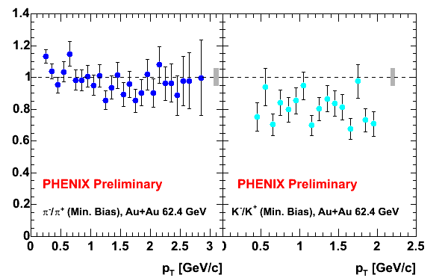
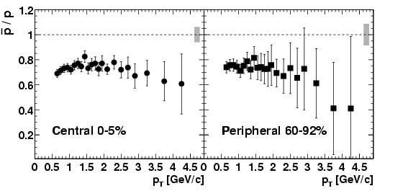
Antimatter/Matter at 62.4 GeV
Flat p_{T} dependence for all ratios
Same picture as in 200 GeV data
Smaller antiproton/proton ratio
Particle ratios (Central 0-10%) PHENIX Preliminary
  π⁻/π⁺ = 1.097 ± 0.022 (stat.) ± 0.063 (sys.)
  K⁻/K⁺ = 0.816 ± 0.027 (stat.) ± 0.046 (sys.)
  pbar/p = 0.495± 0.012 (stat.) ± 0.029 (sys.)
√s_{NN}=200 GeV

Slide 20
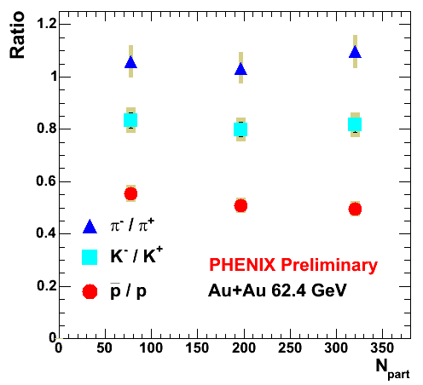
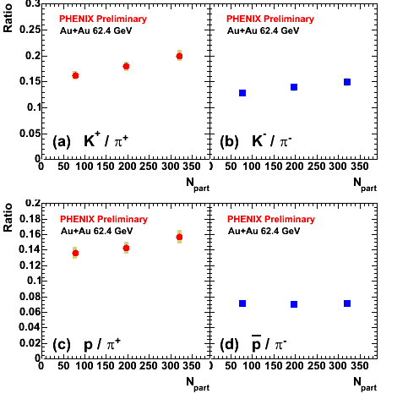
Centrality dependence of particle ratios
Antimatter/Matter ratios are flat with centrality.
K/π increases as a function of centrality.
p/π⁺ small increase.
pbar/π⁻ independent of centrality.
Ratios (Central 0-10%): PHENIX Preliminary
  K⁺/π⁺ = 0.199 ± 0.003 (stat.) ± 0.010 (sys.)
  K⁻/π⁻ = 0.148 ± 0.005 (stat.) ± 0.008 (sys.)
  p/π⁺ = 0.156 ± 0.002 (stat.) ± 0.008 (sys.)
  pbar/π⁻ = 0.070± 0.002 (stat.) ± 0.004 (sys.)

Slide 21
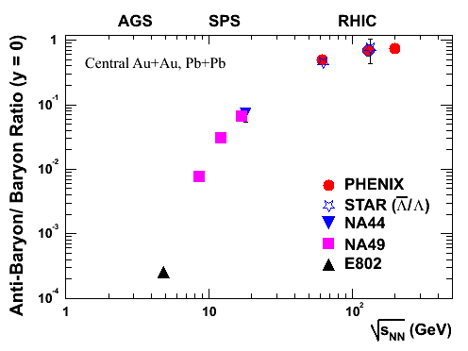
Antibaryon/ baryon ratios vs. √s_{NN} at mid-rapidity
Smooth excitation function from SPS to RHIC
Consistent with Λbar/Λ (STAR preliminary) at 62.4 GeV
pbar/p (PHENIX)
@ 62.4 GeV
Experimental Data:
AGS:
E802, 2650 PRL 83, (1998)
SPS:
NA44: PRC 66, 044907 (2002)
NA49: J. of Phys. G 30, S357 (2004)
RHIC:
PHENIX
62 GeV (preliminary, no feed-down)
PRL 88, 242301 (2002), PRC 69, 034909 (2003), PRL 89 092302 (2002).
STAR
62 GeV (Preliminary, HQ2004); 130 GeV PRL 89, 092301 (2002).

Slide 22
Summary and Conclusions
Variations on a theme: Identified particle production in Relativistic Heavy Ion Collisions at RHIC.
p+p and d+Au data at the same energy as the “discovery energy” at RHIC, √s_{NN} = 200 GeV.
Establish the baseline spectra.
Sizeable Cronin effect for the protons and antiprotons in d+Au, in lesser degree for pions and Ncoll scaling for kaons.
No suppression observed at intermediate p_{T.}
Recombination in d+Au or initial multiple scattering ?
Baryon anomaly is clearly a final state effect.
Identified nuclear modification factors in Au+Au.
Remarkable scaling of protons and antiprotons.
Au+Au at √s_{NN}=62.4 GeV.
Large proton contribution persists.
Antiproton production is reduced compared to the 200 GeV data.
Smooth transition from SPS to RHIC of baryon production.

Slide 23
Backup slides

Slide 24
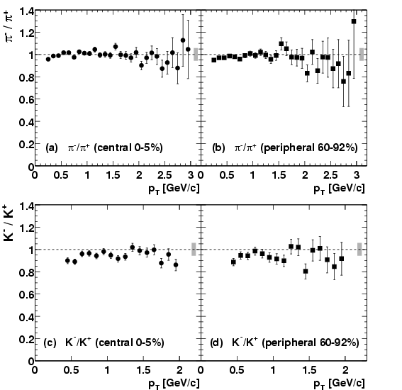
π⁻/π⁺ and K⁻/K⁺ vs. p_{T} at 200 GeV Au+Au
For each of these particle species and centralities, the particle ratios are constant within the experimental errors over the measured p_{T} range.

Slide 25
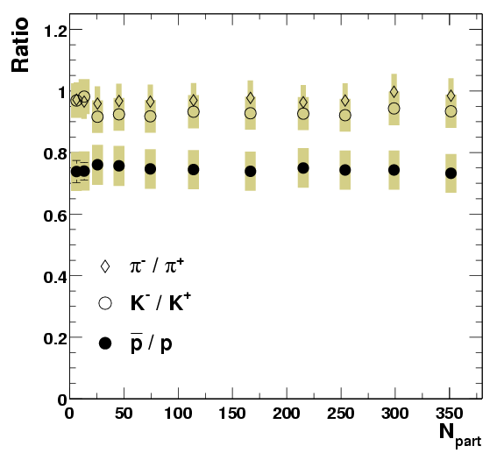
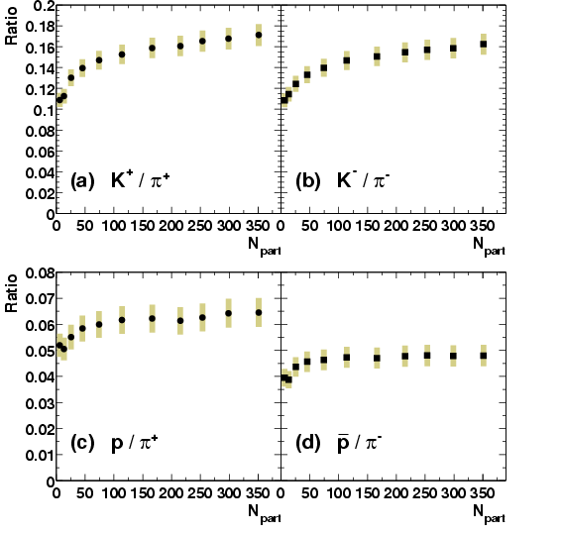
Particle Ratio vs. N_{part} at 200 GeV Au+Au
Ratios for equal mass particle are independent of N_{part}.
K/π : increase rapidly for peripheral and then saturate (or rise slowly to central).
p/π : similar to these of K/π.

Slide 26
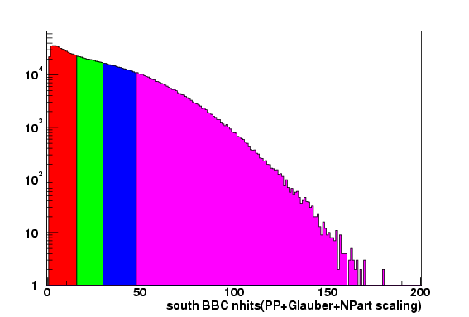

Centrality determination in d+Au
Centrality determination in d+Au is done with the South BBC (Au-side).
Assumption: BBC signal is proportional to participating Au nucleons.
Glauber Model calculation and BBC simulation response, map the BBCS signal to impact parameter distributions.
Corresponding N_{coll} distributions in d+Au are then used to define the nuclear modification factors.

Slide 27




Recombination in d+Au and Au+Au
Au+Au

