Slide 1




π/K/p production and Cronin effect from p+p, d+Au and Au+Au at √s_{NN} =200 GeV from the PHENIX experiment
for the
collaboration
Felix Matathias
The Seventeenth International Conference on Ultra-Relativistic Nucleus-Nucleus Collisions (Quark Matter 2004)
Oakland, January 11-17, 2004

Slide 2
Overview.
The role of identified particles.
Final results from Au+Au collisions.
The d+Au and p+p run: Initial state and how to disentangle cold vs. hot nuclear matter effects.
Comparisons: What remains the same, what is different.
Cronin effect in d+Au.
Conclusions.

Slide 3
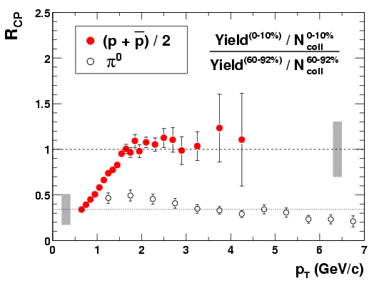
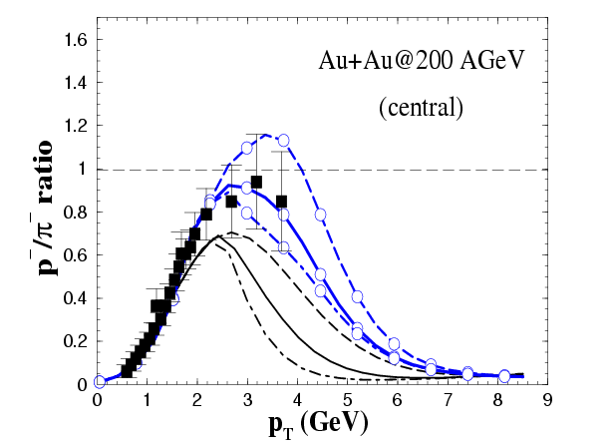
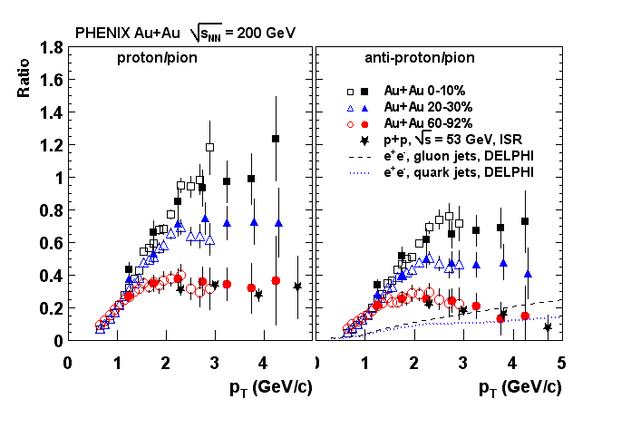
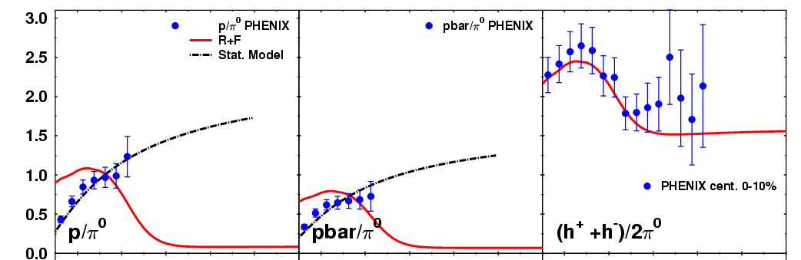
Production of particles in a dense medium.
PHENIX: PRL 91, 172301 (2003), nucl-ex/0305036
PHENIX: Phys. Rev. C, nucl-ex/0307022
Greco, Ko, Levai: nuclt-th/0301093
Striking differences between protons and pions.
Protons scale with Ncoll above pt~1.5 GeV.
Pions stay suppressed even at pt~7 GeV.
Particle composition inconsistent with known fragmentation functions 2-5Gev.
Exciting Possibility: a new dominant source for protons from recombination requiring a dense partonic system.
Other candidates: Baryon junctions, strong radial flow.
Fries, Nonaka, Muller,Bass: nucl-th/0306027

Slide 4
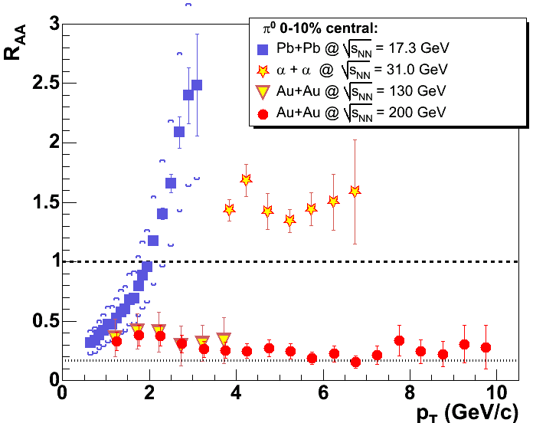
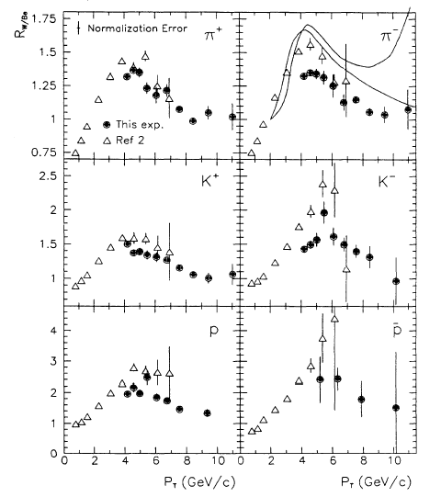
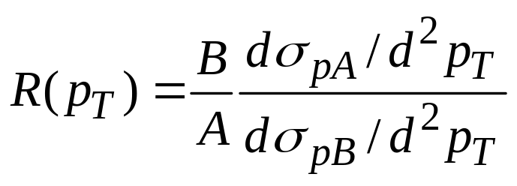
The Cronin Effect & Initial State
J.Cronin et al. Phys.Rev. D11, 3105(1975)
Copious production of hadrons in proton-nucleus collisions.
R=1 in absence of nuclear effects.
Bound nucleons “cooperate” producing high-pT particles.
Suppression at small pT.
Explained by initial multiple scattering.
P.B.Straub et al., Phys.Rev.Lett., 68,452(1992)
Why is it important to know the size of the effect ?
Because:
A)Cronin.
B)Shadowing.
C)Saturation.
constitute the initial state effects that provide the reference for Au+Au calculations.
A survey of theoretical models: A.Accardi, hep-ph/0212148

Slide 5
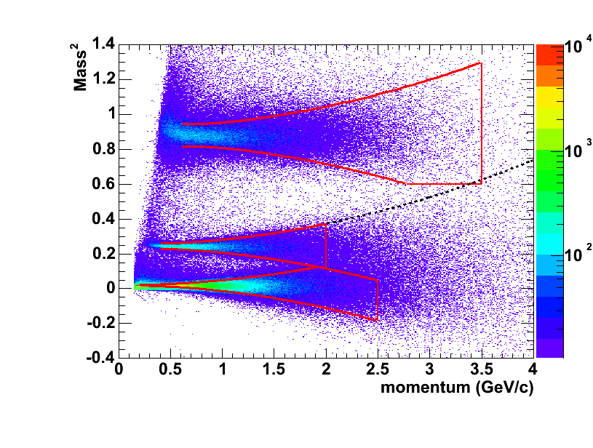
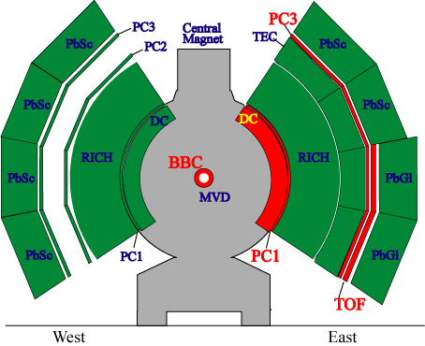
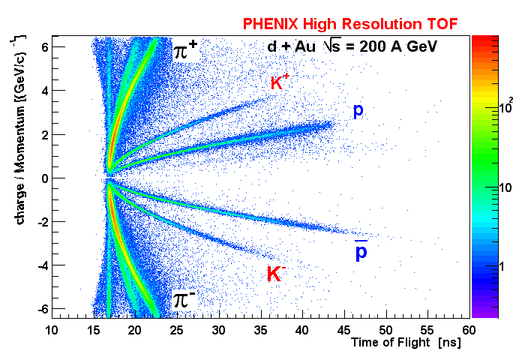
PHENIX RUN03: the d+Au run
Time of Flight Particle Identification.
Same techniques and analyses in p+p,d+Au, Au+Au.
TOF resolution ~135ps
π/K < 2 GeV/c
K/p < 3.5 GeV/c
Acceptance: Δφ=π/8 , Δη = 0.7
14.3M Events, 30 cm vertex cut.
p
Κ
π

Slide 6
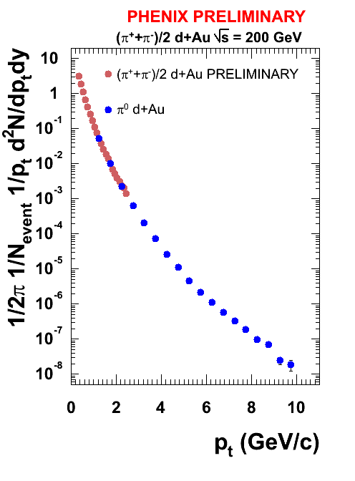
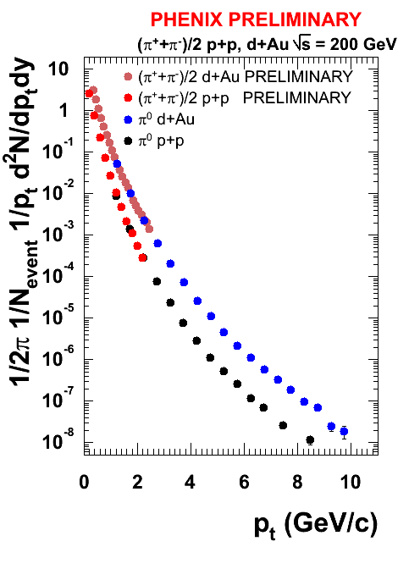
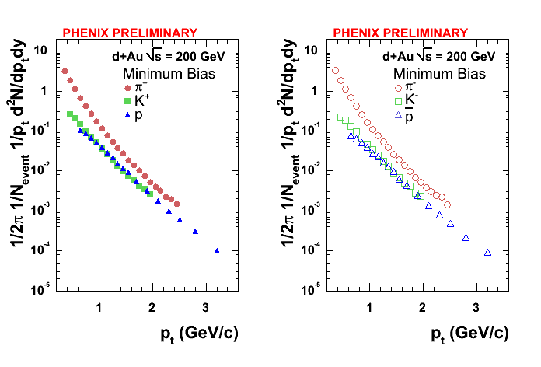
Minimum Bias d+Au
Completely different behavior from central Au+Au.
Protons do not cross the pions.
Remarkable agreement with neutral pions.
Phenix measures pions up to 10 orders of magnitude.
Mark Harvey: Identified Charged Hadrons at Midrapidity in p+p collisions at RHIC.

Slide 7
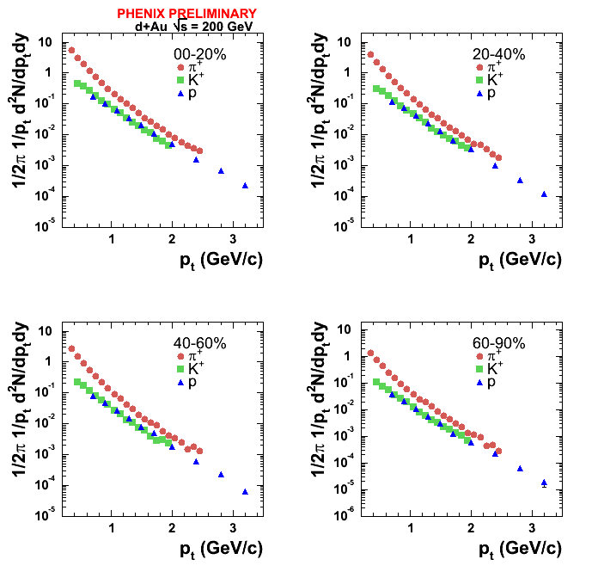
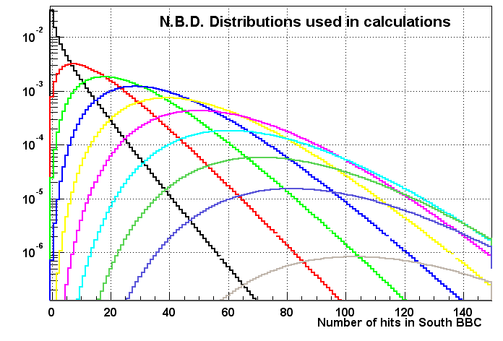
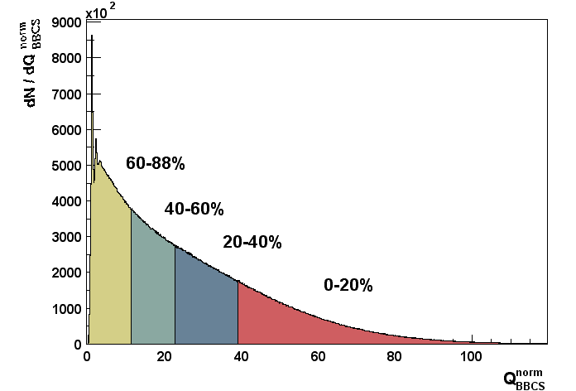
Centrality determination in d+Au
BBCS (Au-side) response scales with the number of participants in the Au nucleus.
Use Negative binomial distributions weighted by a Glauber model to reproduce the BBC charge distribution.
Assumption is validated by the excellent description of the BBC charge distribution.
Ncoll
0-20 % : 15.0 ± 1.0
20-40 % : 10.4 ± 0.7
40-60 % : 6.9 ± 0.6
60-88 % : 3.2 ± 0.3
Poster by Sasha Milov.

Slide 8
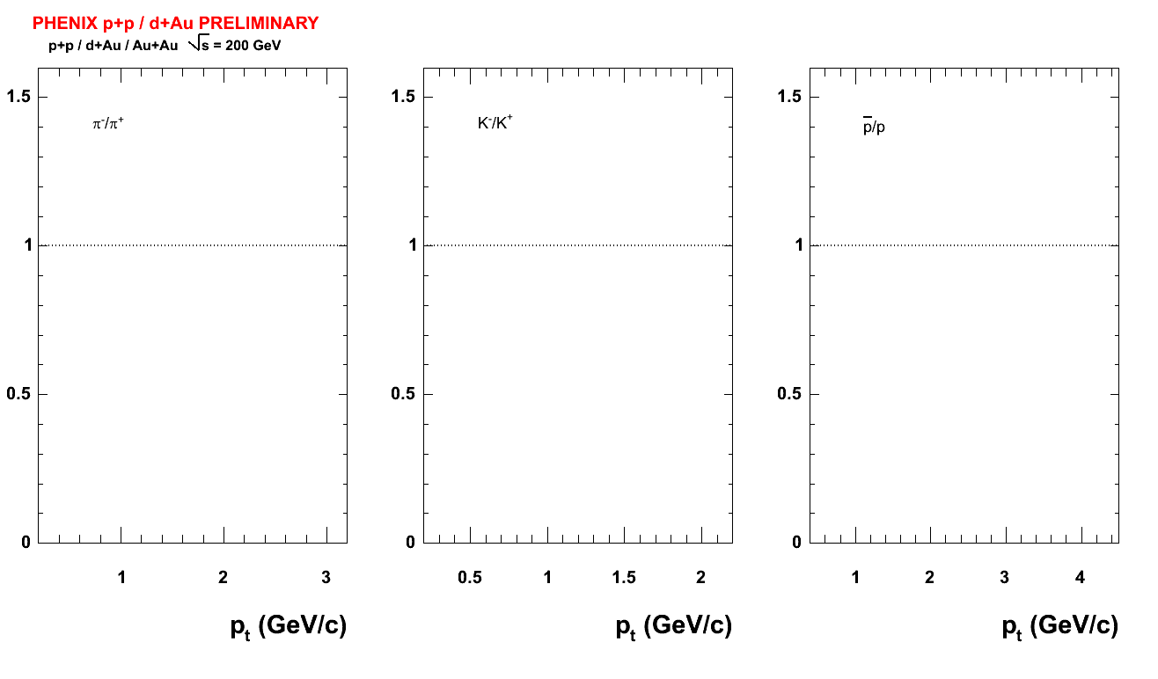
Antimatter over Matter the 200 GeV case
Phenix beam pipe
A Journey through Quark Matter.
π⁻/π⁺ K⁻/K⁺ p/p

Slide 9
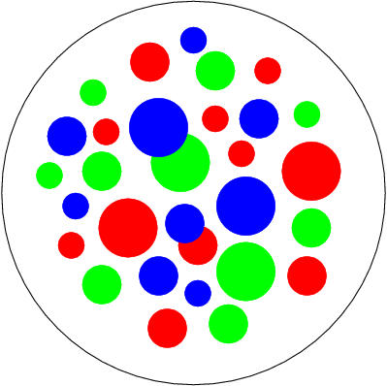
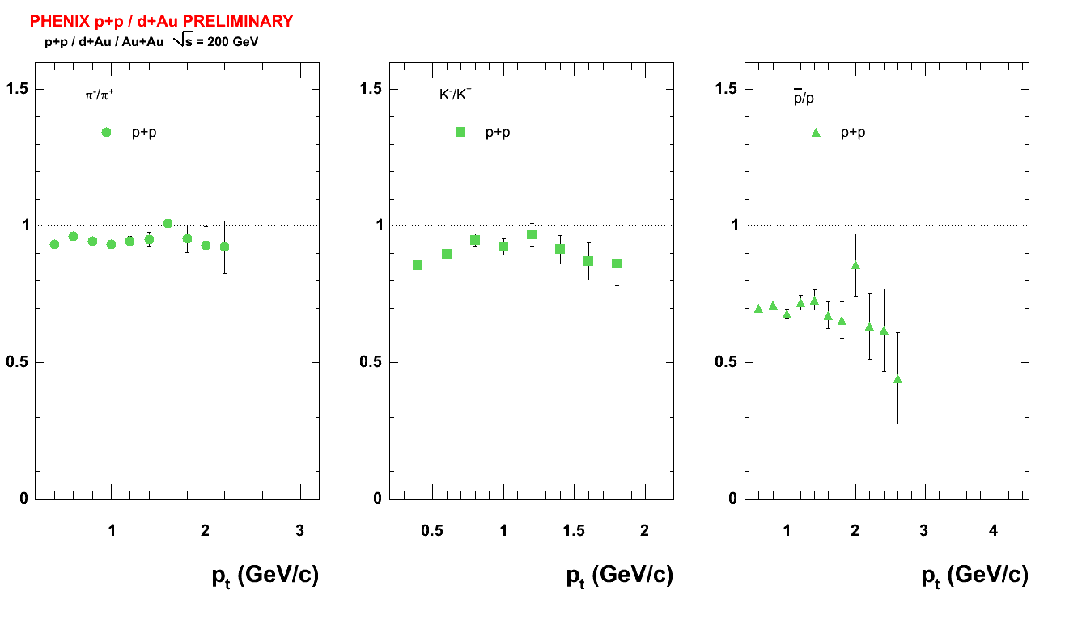
Antimatter over Matter
the 200 GeV case
p
p
π⁻/π⁺ K⁻/K⁺ p/p

Slide 10
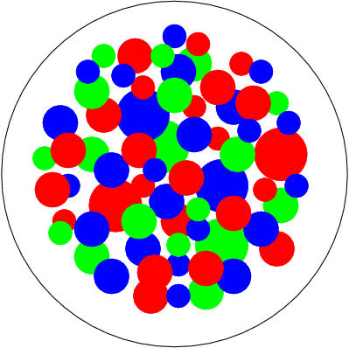
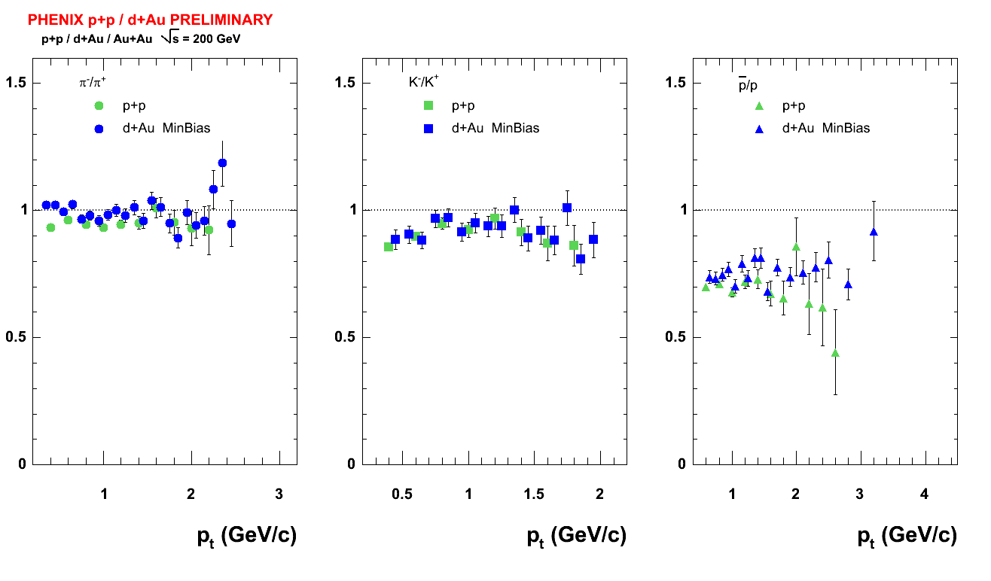
Au
Antimatter over Matter
the 200 GeV case
d
π⁻/π⁺ K⁻/K⁺ p/p

Slide 11
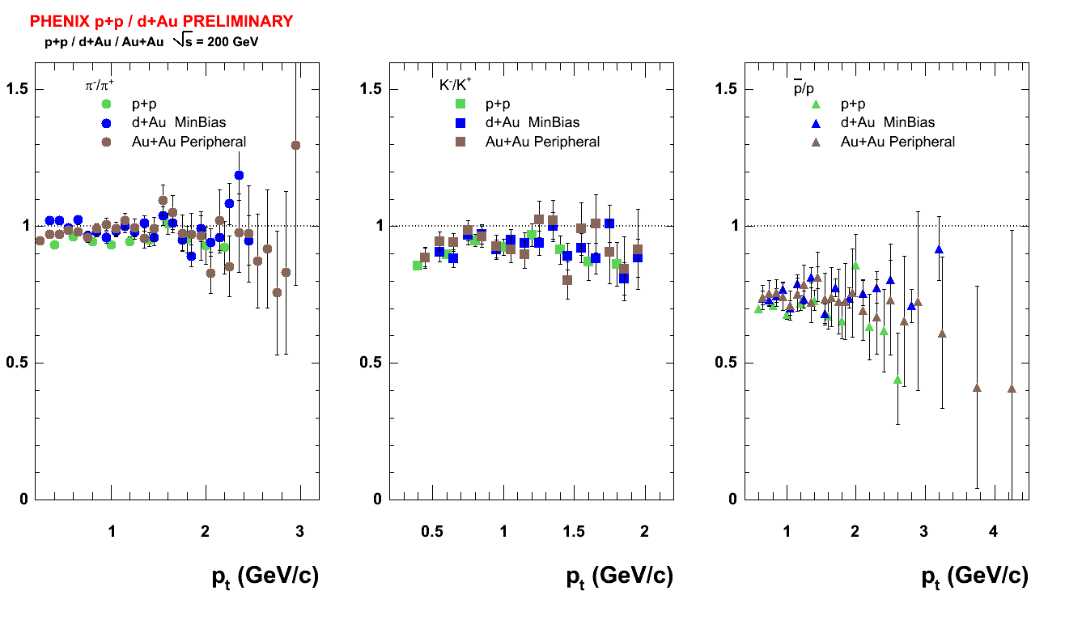
Antimatter over Matter the 200 GeV case
Au
Au
m
π⁻/π⁺ K⁻/K⁺ p/p

Slide 12
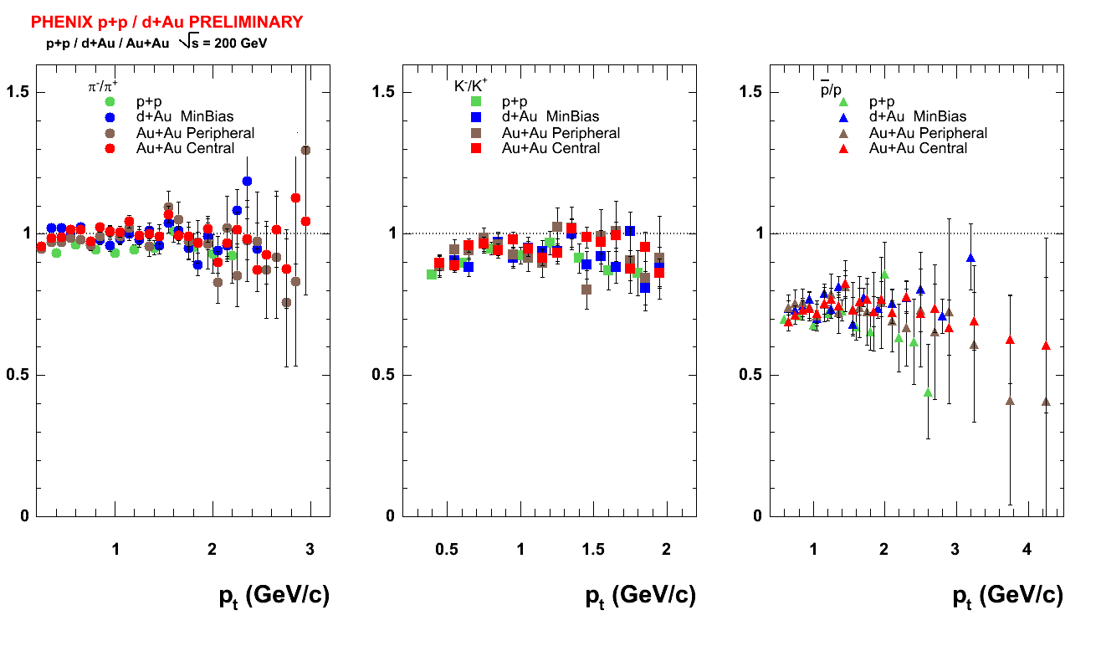
Antimatter over Matter the 200 GeV case
Au
Au
Independent of colliding system, ~flat in p_{T} at midrapidity
π⁻/π⁺ K⁻/K⁺ p/p

Slide 13
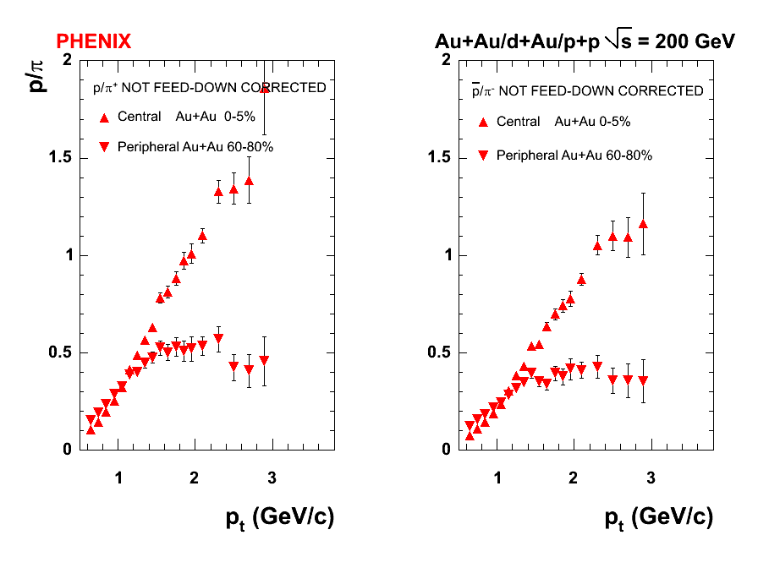
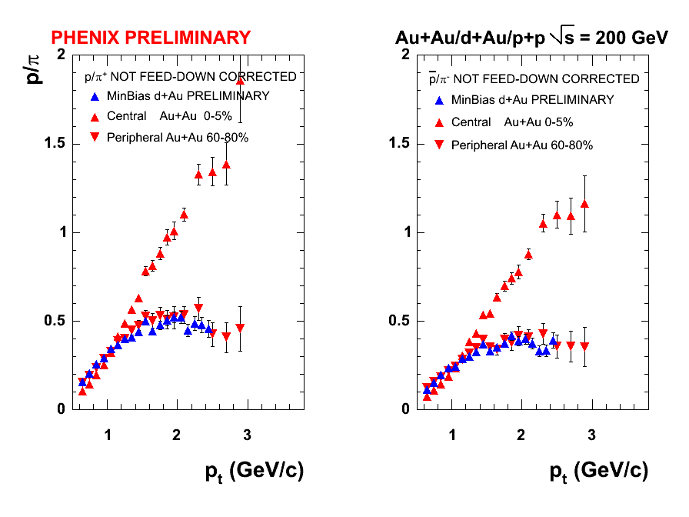
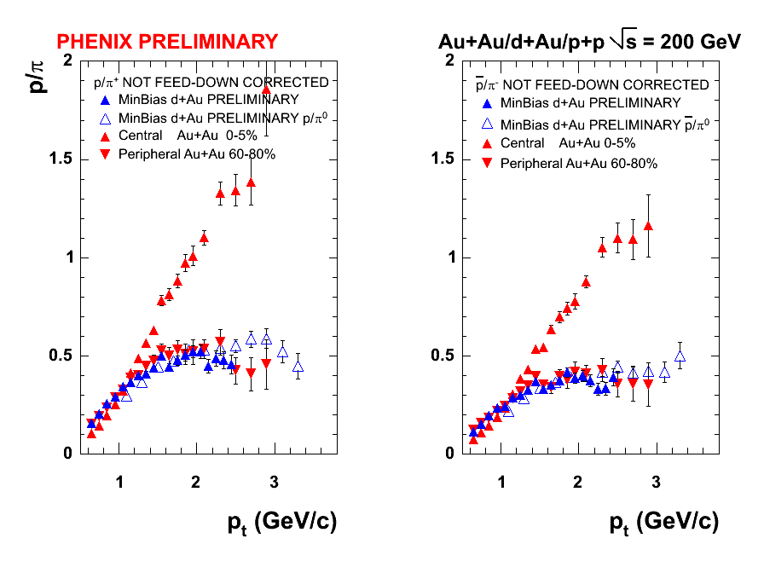
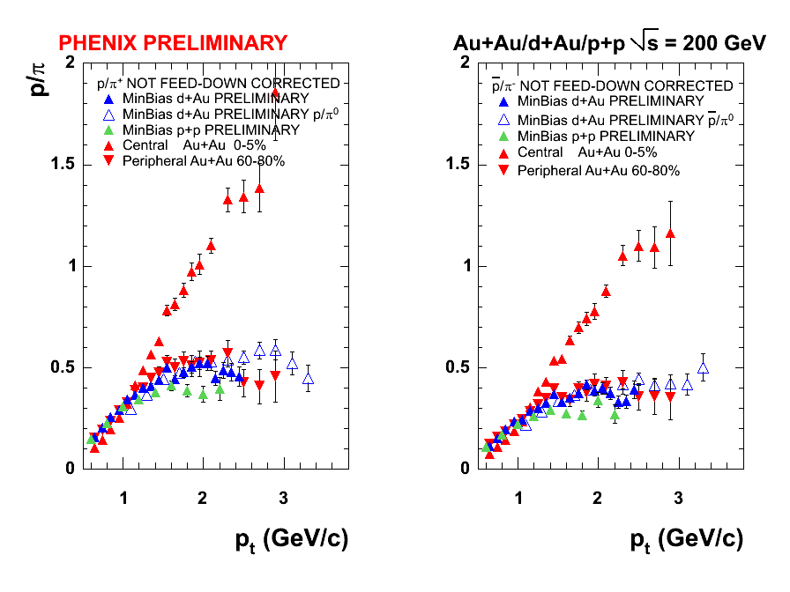
Proton to Pion Ratio.
d+Au is following peripheral Au+Au.
p+p is lower.
Notice: Not Feed-down corrected.
Assumes that Λ/p ratio is similar in d+Au and Au+Au.
Neutral pions used to extend the pt range.

Slide 14
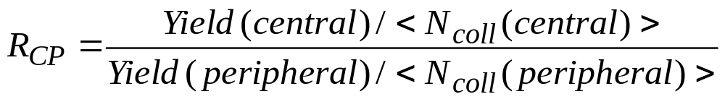

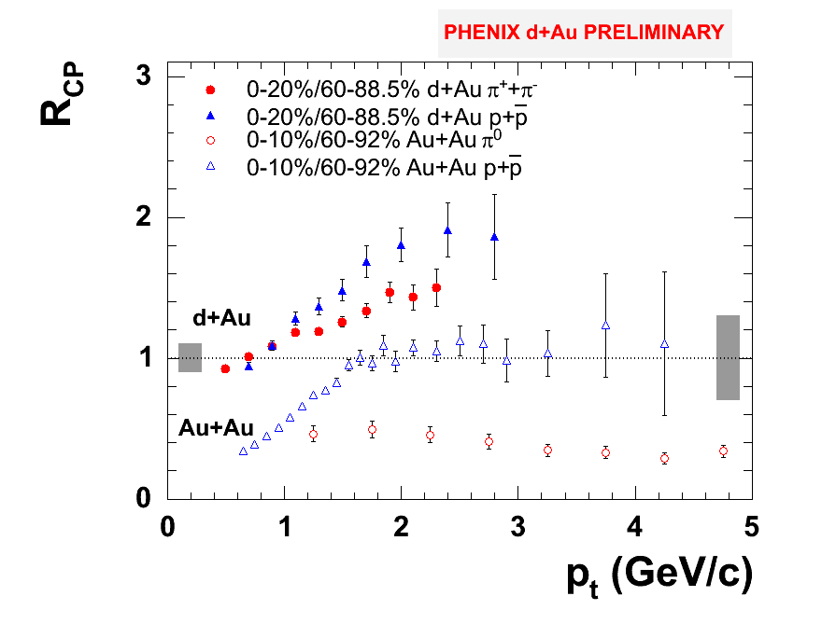
Nuclear Modification from d+Au: Cronin
Strikingly different behavior in Au+Au and d+Au.
Clearly pion suppression is a final state effect from a new state of matter.
d+Au measurement establishes once and for all the initial state at RHIC: shadowing, Cronin, saturation scenarios at y=0.

Slide 15
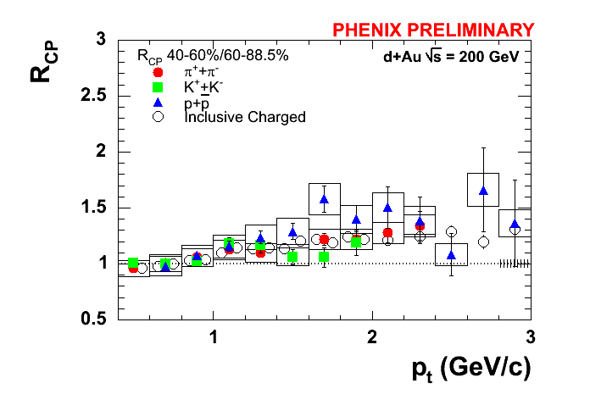
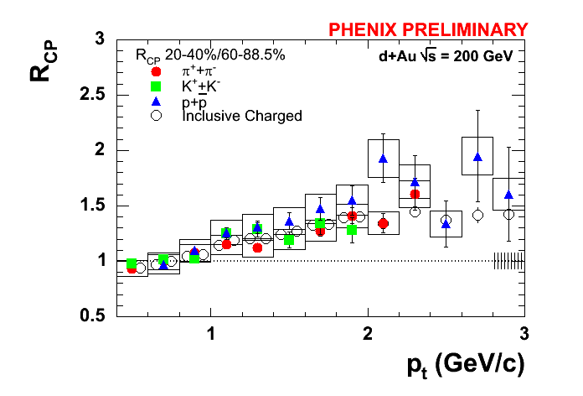
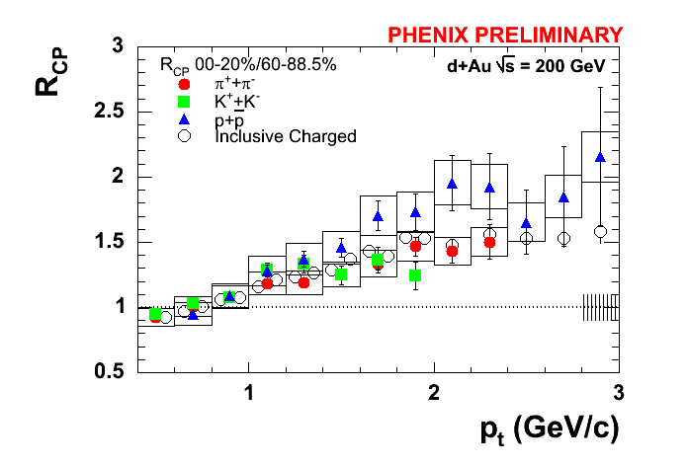
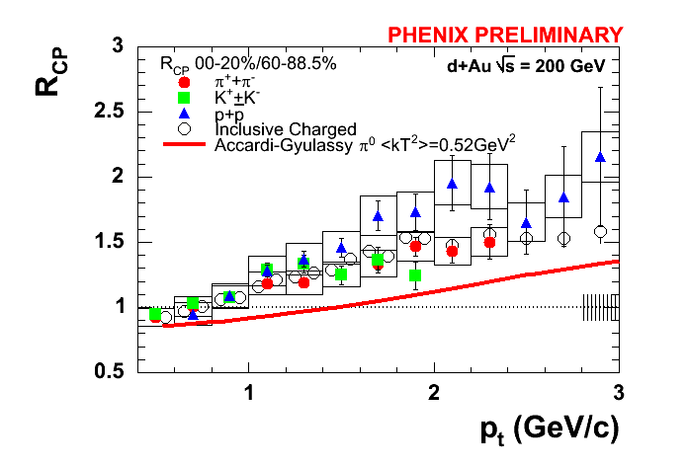
Centrality dependence of Cronin.
Importance of multiple centrality classes.
Probing the response of cold nuclear matter with increased number of collisions.
Propagation of quarks through the color field of a nucleus.
Qualitative agreement with model by Accardi and Gyulassy. Partonic Glauber-Eikonal approach: sequential multiple partonic collisions. nucl-th/0308029

Slide 16
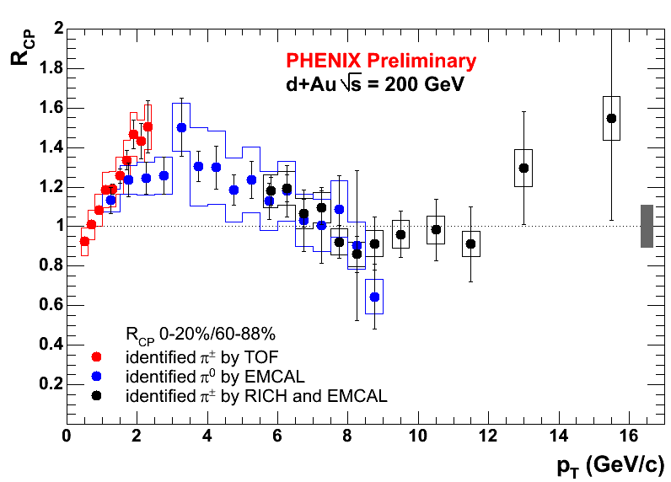
Pion R_{CP} from 3 different detectors.
Charged pions from TOF.
Neutral pions from EMCAL.
Charged pions from RICH+EMCAL.
H. Buesching: Centrality Dependence of Neutral Pion Production in d+Au collisions at 200 GeV
J.Jia: High p_{T} π± production and correlation in d+Au/p+p collisions at √s = 200 GeV

Slide 17
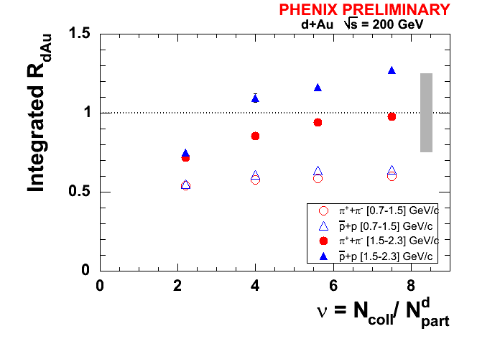
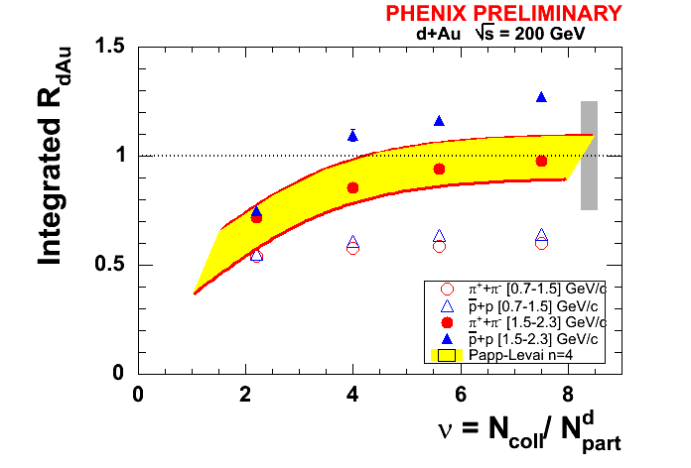
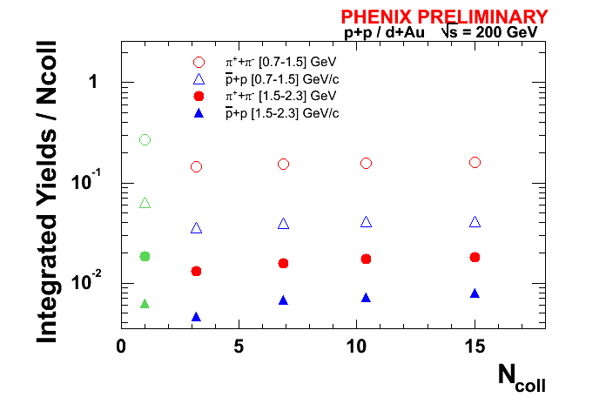

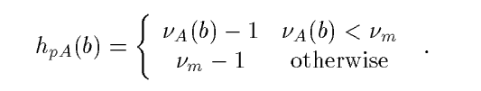
Another Microscopic Mechanism:
Saturated Cronin or not ?
A different approach to the Cronnin effect:
Intrinsic momentum broadening in the excited projectile proton:
h_{pA}: average number of collisions:
X.N.Wang, Phys.Rev.C 61 (2000): no upper limit.
Zhang, Fai, Papp, Barnafoldi & Levai, Phys.Rev.C 65 (2002): n=4 due to proton d dissociation.

Slide 18
Summary
Properties of identified particle production have been presented for all available colliding systems at RHIC so far.
Antimatter to matter ratios are independent of colliding systems and consistent with flat in pt at midrapidity.
Centrality, pt and species dependence of Cronin effect in d+Au fully studied.
Cronin enhancement increases with centality, quantitative constraints for theoretical models of multiple scattering.
Proton Cronin higher than pions but can not explain factor of 5 baryonic enhancement in central Au+Au.
d+Au looks very similar to peripheral Au+Au.
Initial state effects in Au nuclei are established at y=0.
d+Au collisions strongly point towards interpreting Au+Au phenomena as final-state within a dense partonic medium.

Slide 19

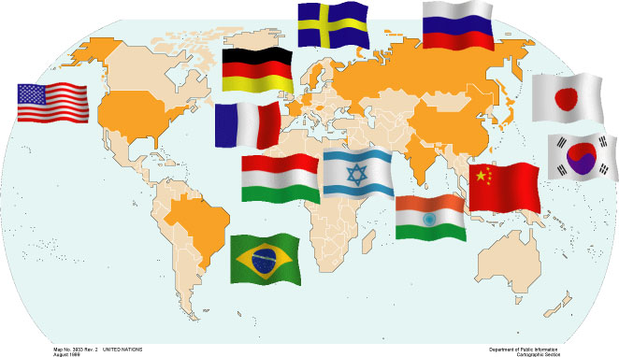
Brazil University of São Paulo, São Paulo
China Academia Sinica, Taipei, Taiwan
China Institute of Atomic Energy, Beijing
Peking University, Beijing
France LPC, University de Clermont-Ferrand, Clermont-Ferrand
Dapnia, CEA Saclay, Gif-sur-Yvette
IPN-Orsay, Universite Paris Sud, CNRS-IN2P3, Orsay
LLR, Ecòle Polytechnique, CNRS-IN2P3, Palaiseau
SUBATECH, Ecòle des Mines at Nantes, Nantes
Germany University of Münster, Münster
Hungary Central Research Institute for Physics (KFKI), Budapest
Debrecen University, Debrecen
Eötvös Loránd University (ELTE), Budapest
India Banaras Hindu University, Banaras
Bhabha Atomic Research Centre, Bombay
Israel Weizmann Institute, Rehovot
Japan Center for Nuclear Study, University of Tokyo, Tokyo
Hiroshima University, Higashi-Hiroshima
KEK, Institute for High Energy Physics, Tsukuba
Kyoto University, Kyoto
Nagasaki Institute of Applied Science, Nagasaki
RIKEN, Institute for Physical and Chemical Research, Wako
RIKEN-BNL Research Center, Upton, NY
Rikkyo University, Tokyo, Japan
Tokyo Institute of Technology, Tokyo
University of Tsukuba, Tsukuba
Waseda University, Tokyo
S. Korea Cyclotron Application Laboratory, KAERI, Seoul
Kangnung National University, Kangnung
Korea University, Seoul
Myong Ji University, Yongin City
System Electronics Laboratory, Seoul Nat. University, Seoul
Yonsei University, Seoul
Russia Institute of High Energy Physics, Protovino
Joint Institute for Nuclear Research, Dubna
Kurchatov Institute, Moscow
PNPI, St. Petersburg Nuclear Physics Institute, St. Petersburg
St. Petersburg State Technical University, St. Petersburg
Sweden Lund University, Lund
12 Countries; 58 Institutions; 480 Participants*
USA Abilene Christian University, Abilene, TX
Brookhaven National Laboratory, Upton, NY
University of California - Riverside, Riverside, CA
University of Colorado, Boulder, CO
Columbia University, Nevis Laboratories, Irvington, NY
Florida State University, Tallahassee, FL
Florida Technical University, Melbourne, FL
Georgia State University, Atlanta, GA
University of Illinois Urbana Champaign, Urbana-Champaign, IL
Iowa State University and Ames Laboratory, Ames, IA
Los Alamos National Laboratory, Los Alamos, NM
Lawrence Livermore National Laboratory, Livermore, CA
University of New Mexico, Albuquerque, NM
New Mexico State University, Las Cruces, NM
Dept. of Chemistry, Stony Brook Univ., Stony Brook, NY
Dept. Phys. and Astronomy, Stony Brook Univ., Stony Brook, NY
Oak Ridge National Laboratory, Oak Ridge, TN
University of Tennessee, Knoxville, TN
Vanderbilt University, Nashville, TN
*as of January 2004

Slide 20
backups

Slide 21
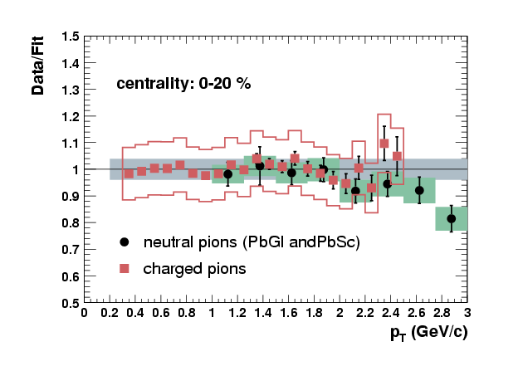
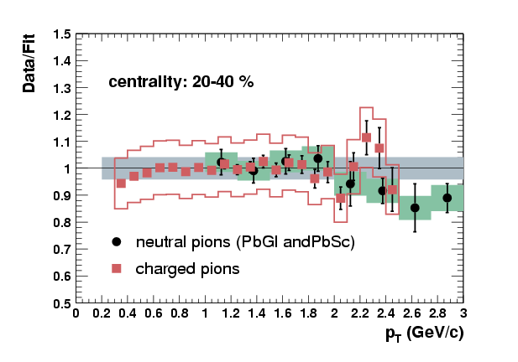
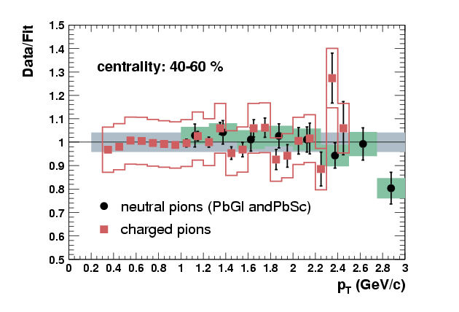
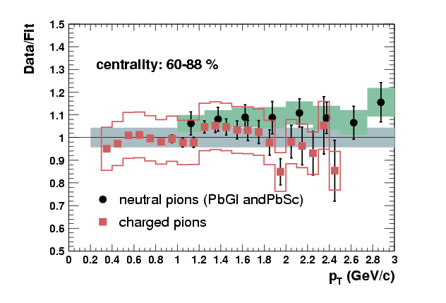
Comparison with neutral pions

Slide 22
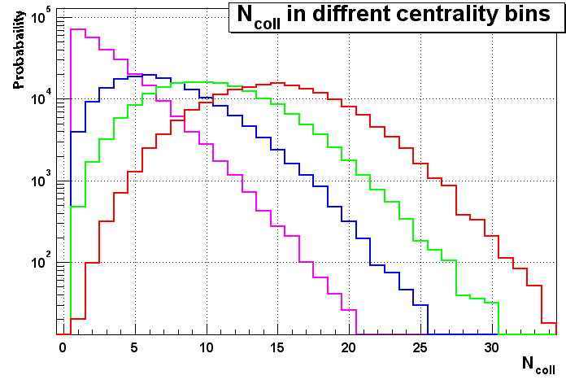
Number of collisions in d+Au.

