Slide 1
Maximal Flavor Violation
Arvind Rajaraman
University of California, Irvine
based on work in:
1. arXiv/0711.3193
AR & Shaouly Bar-Shalom
2. arXiv/0803.3795
AR, Daniel Whiteson, Felix Yu & Shaouly Bar-Shalom

Slide 2
The “New Physics Flavor puzzle” & MFV
The hierarchy problem, dark matter, unification, EWSB …
The SM is incomplete – need new physics at TeV scale
The NP favor puzzle: given new particles at the TeV scale, why does the NP not induce LARGE flavor violating dynamics?
Traditional solutions:
M(new particles) > 10-100 TeV
(somewhat in conflict with e.g., the hierarchy problem, dark matter)
Impose FV(new particles) very small; e.g. use MFV ansatz.

Slide 3
MFV
(Minimal Flavor Violation)
All flavor violation is “aligned” with the SM i.e. all sources for FV are governed solely by the SM’s Yukawa interactions and are hence proportional to the small off-diagonal CKM elements (Ambrosio, Giudice, Isidori, Strumia (NPB645, 2002) )

Slide 4
MFV
(Minimal Flavor Violation)
e.g. consider a 2HDM model, with an extra scalar coupled as
_
_
(ξ^{u})_{ij} Φ u_{Ri} Q_{Lj} + (ξ^{d})_{ij} Φ d_{Ri} Q_{Lj.}
Minimal flavor violation implies that
√2
(
)
__
0 0 0
0 0 0
0 0 0
ξ^{d} ~ M^{d}
~
v
(
)
√2
0 0 0
0 0 0
0 0 1
ξ^{u}
__
~
~ M^{u}
v

Slide 5
MFV
(Minimal Flavor Violation)
The MFV ansatz is useful for satisfying constraints from low-energy flavor data, e.g. meson mixings
BUT: is it necessary ?
Can we have O(1) flavor transitions (e.g., charged t→d, b →u or neutral t→u or both!) and still satisfy those constraints?

Slide 6
Motivation - Why go beyond MFV
MFV only an ansatz;
has not been tested so far except in low-energy FCNC
Should look for all possibilities;
may help in constructing models extending the SM
Most important;
we may overlook/miss important signals at colliders
which are not predicted by MFV models …

Slide 7
MxFV
(Maximal Flavor Violation)
New textures
Bar-Shalom, AR
(
)
0 0 0
0 0 0
0 0 0
ξ^{d}
~
Maximal flavor violation-1
(
)
ξ^{u}
~
0 0 a
0 0 0
c 0 0
or
(
)
0 0 0
0 0 0
0 0 0
ξ^{d}
~
Maximal flavor violation-2
(
)
~
0 0 0
0 0 b
0 d 0
ξ^{u}

Slide 8
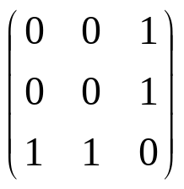
MxFV (Maximal Flavor Violation)
Maximally departing from MFV (in flavor space):
MxFV ∝ O(1) non-diagonal CKM physics ~
Compare
⎛
0
0
0
⎞
MFV ∝
⎜
⎟
⎜
0
0
0
⎟
⎜
⎟
0
0
1
⎝
⎠

Slide 9

Models of MxFV (cont.)
Not difficult to construct realistic models where, e.g.,
ξ₃₁ , ξ₃₂ ~ V_{tb} >> ξ₃₃ ~ V_{td}
A simple example: a Z₂ symmetry under which
Φ_{SM} & 1st+2nd generation quarks are even and Φ_{FV} & 3rd generation quarks are odd:
Z₂(MxFV):
Z₂(MxFV) suppresses the CKM elements V_{td} , V_{ts} , V_{ub} , V_{cb} & simultaneously suppresses also the new η⁺ tb , η⁰ tt interactions ~ ξ₃₃

Slide 10
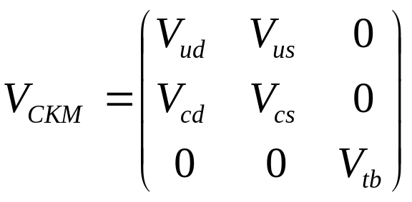
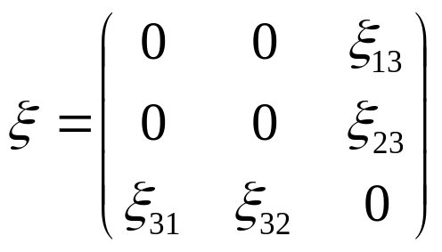
Models of MxFV (cont.)
IF Z₂(MxFV) is exact then:
&
with ξ_{ij} ~ V_{ij} ~ O(1)
When Z₂(MxFV) is weakly broken (as we expect it to be e.g., by a very small Φ_{FV} condensate or by higher dimensional operators) then a very small value for the CKM elements V_{td} , V_{ts} , V_{ub} , V_{cb} as well as for all zero entries in ξ are generated.
We thus expect (after Z₂(MxFV) breaking):
e.g. ξ₃₃ ~ V_{td} , V_{ts} while maintaining ξ₃₁ , ξ₃₂ ~ V_{tb} ~ O(1)

Slide 11
Models of MxFV (cont.)
after Z₂(MxFV) breaking we expect e.g.:
η η⁺ td , η⁰ tu ~ V_{tb}
η⁺ tb , η⁰ tt ~ V_{td}
t
t
η+
η⁰
;
~ V_{td}
b
t
η⁺ td , η⁰ tu ~ V_{tb}
t
t
η+
η⁰
;
~ V_{tb}
d
u

Slide 12
Experimental constraints
Are these viable textures? After all, they do not follow MFV.
e.g. kaon mixing could be problematic.
d
s
_
_
s
d
But in the first texture, there is only a coupling between the
first and third generations, and in the second, there is only a
coupling between the first and third generations.
In either case, the diagram vanishes. No constraints.

Slide 13
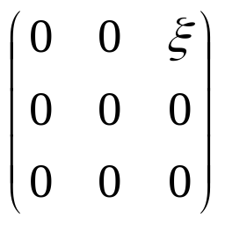
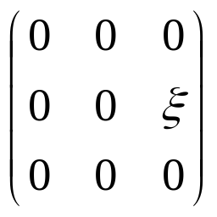
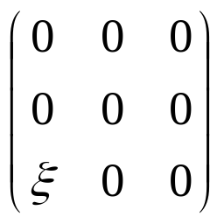
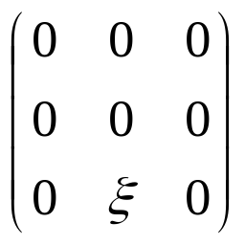
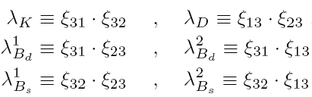
Experimental constraints on MxFV
Any model with only one O(1) entry CANNOT be ruled out
ALL O(1) single-coupling textures are viable:
Constraints apply only to the following MxFV coupling products:

Slide 14
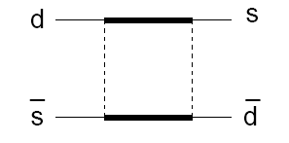
Experimental constraints (cont.)
K⁰-K⁰ mixing: Δm_{K},ε_{K} ∝ Re,Im (δM₁₂(MxFV))
t
t
δM₁₂(MxFV) ∝
η⁺
η⁺
+
W⁺
η⁺
t
t
Only constrains the product ξ₃₂ ξ_{31.}

Slide 15
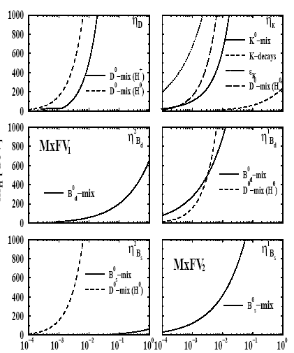
The Viable MxFV coupling products
λ_{K}
λ_{D}
λ²_{Bd}
λ¹_{Bd}
m_{η} [GeV]
η+ only
λ²_{Bs}
λ¹_{Bs}
η+ only

Slide 16
Collider signatures of MxFV₁
t;u
t
η⁺
η⁰
i.e. from O(1)
d;b
u
Leads to a very well defined set of processes that basically fall into 4 categories:
tΦ_{FV} production
Φ_{FV}Φ_{FV} production
s-channel Φ_{FV} resonance
t-channel Φ_{FV} exchanges

Slide 17
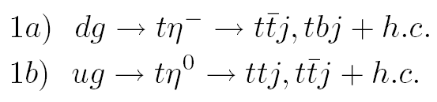
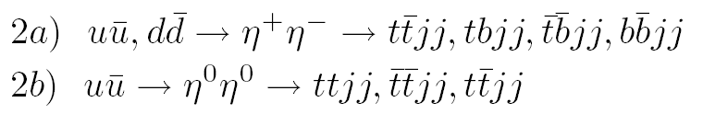
1. tΦ_{FV} production:
same-sign tops
2. Φ_{FV} Φ_{FV} production:
j = light quark (u or d) jet

Slide 18
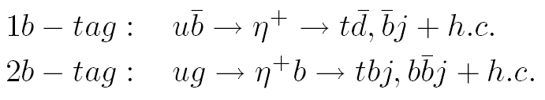
3. s-channel Φ_{FV} resonance:
No resonance production of η⁰ .
Resonance production of η⁺ via either the 1-b tag or 2-b tag processes:
leads to a resonance peak in the invariant mass of the t+j pair

Slide 19
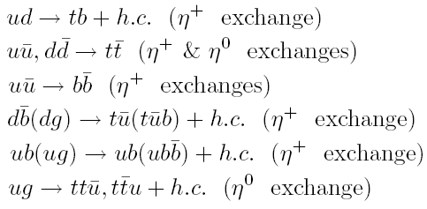
4. t-channel Φ_{FV} exchanges:

Slide 20


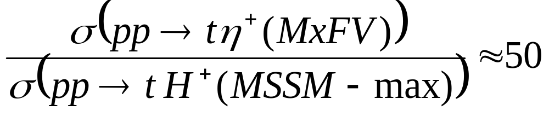
Collider signatures of MxFV
1. Enhanced production of a “charged Higgs” in association with a top or a bottom quark:
&
i.e. enhanced mainly by a factor of [PDF(d or u)/PDF(b)] over MSSM and MSSM-like Higgs sectors
e.g., at the LHC
if ξ~1 & m_{H+} , m_{η+} ~ 200 GeV!

Slide 21

Collider signatures of MxFV
2. Enhanced production of a “charged Higgs” on resonance via:
i.e. enhanced over MSSM and MSSM-like Higgs sectors
by a factor of (for ξ~1)

Slide 22
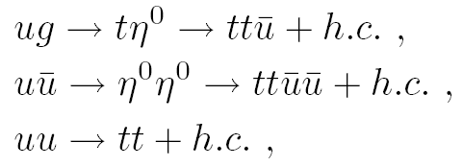
Collider signatures of MxFV
3. Same-sign top quark pair production:
When both tops decay leptonically (t→bW →blν), this leads to a
striking low background signature of
same-sign leptons + missing energy + b-jets
A. Rajaraman, D. Whiteson, F. Yu & SBS , arXiv/0803.3795

Slide 23


Same-sign leptons from same-sign tops at the Tevatron
Define the inclusive same-sign top reaction:
reacll the underlying hard processes:
Yielding (after both tops decay leptonically) the same-sign lepton signature:
+ jets

Slide 24
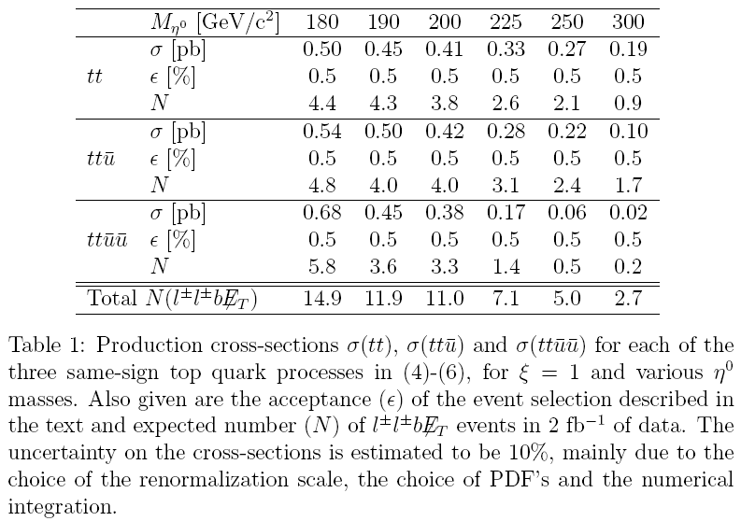

# of expected signal events at CDFII :
Total expected:
N(l± l± b E_{T}) = 14.9 11.9 11.0 7.1 5.0 2.7
e.g., about 11 signal events for m_{η0} ~ 200 GeV

Slide 25
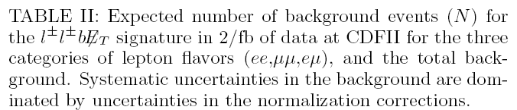
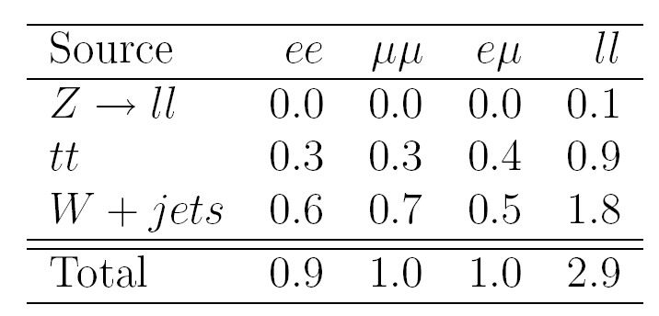
# of expected background events at CDFII :
background estimated using simulated events with ALPGEN, showering modeled by PYTHIA and CDFII response by CDFSIM
2.9 ± 1.8
background from diboson production ZZ,WZ,Wγ,Zγ is essentially eliminated by the requirement of a b-tag.

Slide 26
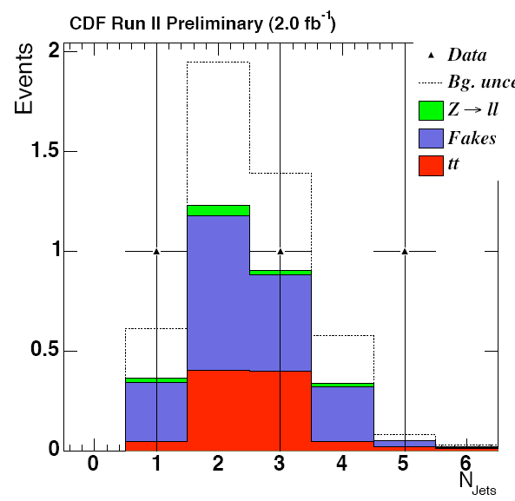
Observed
3 events

Slide 27
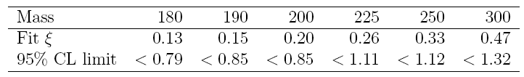
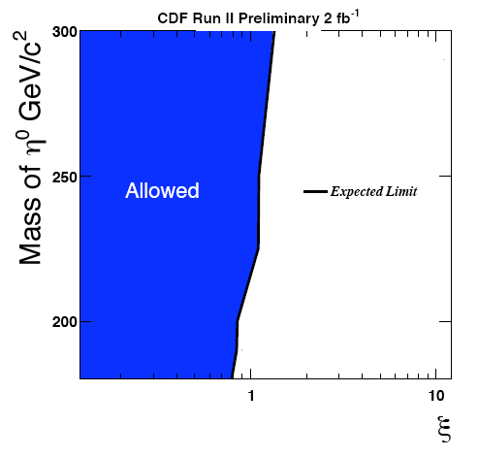
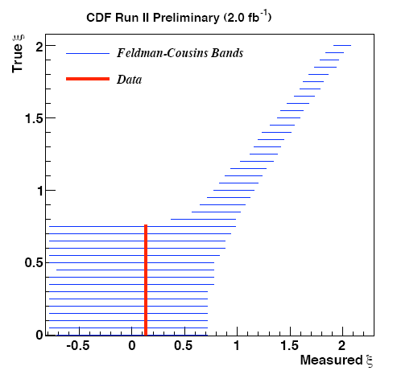
Tevatron bounds on MxFV

Slide 28
Expect improved sensitivity at the LHC
to the MxFV same-sign lepton signal :
If ξ ~1 & m_{η0} ~ 200 GeV, expect 10000 events with
10/fb luminosity.
Background 2500 ± 500 events.
Work in progress.

Slide 29
Summary & outlook
Can have maximally flavor violating sectors: not ruled out
Fairly easy to construct such models.
Leads to surprising new phenomenology e.g., same-sign leptons
from same-sign tops at hadron colliders
Unfortunately, no signal found at the Tevatron.

Slide 30
Summary & outlook
But: limits obtained by CDFII are rather weak
⇒ do not exclude large signals of MxFV at the LHC !
Several other interesting signatures: e.g., enhanced t-H+
production & new H+ resonance channels.

