Slide 1


Health CAP
Greeley and Wallace Counties, Kansas
Notes:
Good morning. Thank you for joining us in this very early morning session. For those of us on mountain time or western time, it is still time to be waking up. I’m pleased to tell you our story of this developing program and look forward to your comments and questions.
My name is Chrysanne Grund, I serve as the Program Administrator for HealthCAP, our patient access and outreach program.
HealthCAP is an access program created with CAP funding in September of 2001. The safety net providers in our area have a long history of cooperation to care for the residents of western Kansas and eastern Colorado. This cooperation was in the form of loosely held partnerships with no formal means of communication. Each partner was also independently responsible for connecting their patients with any financial or social resources that might be available. The HealthCAP proposal is a two pronged approach to increasing the access to care for our patients. First we created a virtual private network linking the various providers and resources they might need. Second we created an Access office to bring behavioral, financial, social and educational resources to patients in our area. This office is staffed by a Community Health Resource Specialist, a Patient Educator and directed by our Access Coordinator, a licensed clinical social worker. The ability to offer the services through a social worker enabled our program to develop the integration of behavioral health care.

Slide 2
Integrating Behavioral Health Services into the Primary Practice Setting
Creating the Reality of Accessible Primary Behavioral Health Care Services in Rural, Western Kansas
Notes:
Integrating Behavioral Health Services in our practice did not happen overnight. Many factors contributed to this decision and it could not have happened without the leadership of our medical, Dr. Robert Moser. He brings a tremendous amount of direction and vision to this program. He is a tremendous advocate of primary behavioral health care. He has instilled the philosophy, Caring for the patient at the right time with the right provider and the right resources. This “patient care first” motto has led us to discover new and challenging ways to bring resources to our population. The Sustainability of those programs keeps me up nights but the opportunity to develop them has been unique. I’d like to recognize, Ann Schumacher, our licensed clinical social worker. She joined the program in 2001 and has been instrumental in the program development and operation.

Slide 3
Integrate Primary Behavioral Health Care in Western Kansas
Are we nuts?
Notes:
I think it’s important for you to have a good understanding of our practice, our geographical location and our population. All of these factors contribute to why PBHC has become an important component to our health care services. Many small rural areas have a had a difficult time simply covering the healthcare bases, family medicine, OB care and delivery, and emergency services. We’ve certainly been there. However our mission has largely been led by the vision that not only should we simply be there to take care of our patients but to go that extra mile and make sure that they have access to the services they need. That vision has led our healthcare system from a fractured clinic versus hospital system to an integrated delivery system which now includes hospital services, nursing home care, physical therapy, home health, out-patient surgery, and our latest addition behavioral health care.

Slide 4
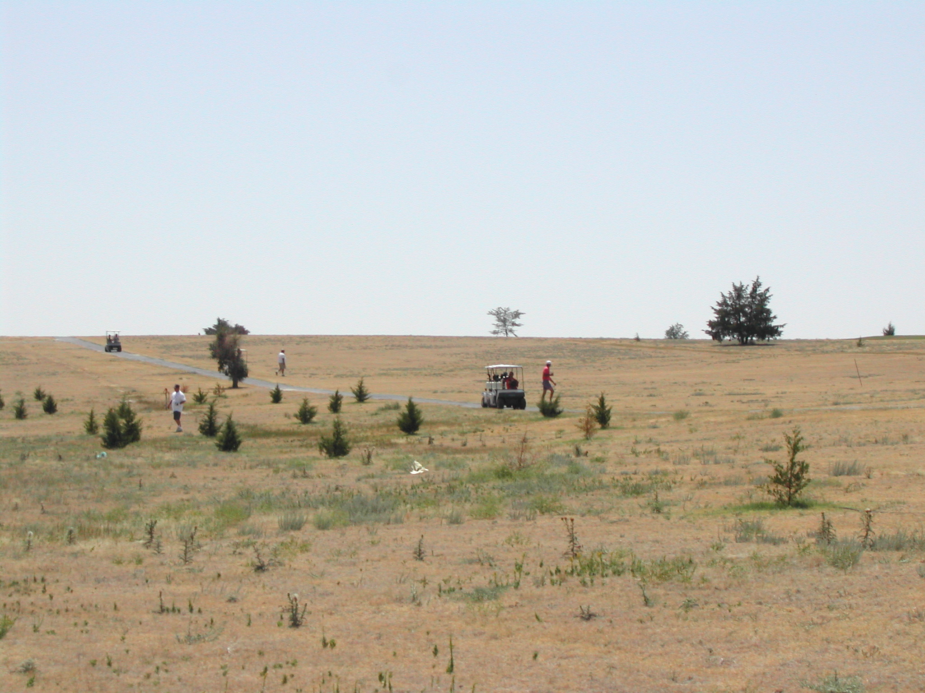
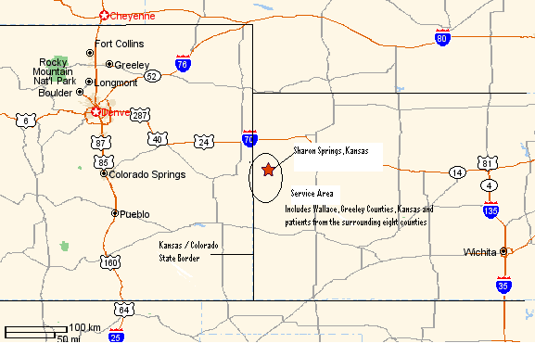
Who we are
You can’t get there from here.
Notes:
Greeley County Health Services is located on the Kansas-Colorado border. Some perspective – we are over 90 miles from the nearest tertiary care center, 2 hours from the nearest in-door mall and there is one stop light in our two county-basic service area. Another commonly recognizable description – over an hour from the nearest Wal-Mart!!
We serve agricultural communities with a tremendous sense of pride and loyalty to their region. That both helps and hinders our mission at times. As agriculture has changed dramatically over the last ten years, so have our communities. This past two years in particular have been very difficult as we suffered from a very serious drought. I thought I would show you a picture of one of our lush golf courses to help illustrate drought effects.

Slide 5
Our Communities
Our population – Greeley County-1600 residents, Wallace County – 1750 residents
Practice population is 3600
Community Dynamics – ag-related business, Co-op, insurance, and implement dealerships
  The vast majority of residents make their living in one way or another from agriculture
  Community members very traditional, church-going, community-orientated population, members report a high sense of “social capital” (Felix and Burdine, 1998)
Notes:
Our communities are very small as you might expect with a frontier designation. My favorite story to tell is that when I made plans to move to Wallace County my insurance rep told me that I would get a real break on my insurance because I was moving to a “non-populated” area. Our two core communities are Greeley and Wallace Counties with 16-1800 residents. Our practice pulls patients from the surrounding eight counties and has a base population of approximately 3600. Wallace and Greeley Counties are the two most geographically isolated counties in the state with 1.9 people per square miles. We have a federal designation as frontier. I often feel like I should wear my cowboy hat and boots to these conference to serve as an appropriate representative.
Our community dynamics are centered around agriculture with the majority of our residents making their living one way or another from agriculture. Many are families like mine where either one or both members are employed outside of the home with a full time farming or ranching “hobby”. I always find it hard to answer a question that asks me what I do in my spare time. I’m not sure that working cows are checking fence qualifies as a hobby but it does keep us busy.
Our population is primarily traditional with a lot of community pride and spirit. A 1997 Felix and Burdine survey reported a tremendous sense of social capital in our area, or the “sense of having the social capacity, trust and networks in our community to effect change”.

Slide 6
Define our population
6% uninsured, (2002 CAP Evaluation, Fonner)
16.35% report self pay (UDS report, 2002)
42% under the 200% FPL (County Health Profiles, 1999)
31.65% ages 0-14, 18.96% ages 65 & over (UDS report, 2002)
Prevalence of Disease – Coronary Heart Disease, Stroke and Diabetes
Risk Factors – Sedentary Lifestyle, Failure to include fruits and vegetables, Work-related accidents / deaths
Notes:
Our population is consistent with a typical profile for a rural, ag-related community. We find that although we have a relatively low uninsured population at only 6%. That more than 16% of our clinic population is reported at self-pay and a more important factor in healthcare decision making may be the 42% of our population below the 200% federal poverty level. With only approximately 6% that are Medicaid eligible this leaves a significant portion of the population unable to afford ancillary services or with an extremely high deductible.
Our clinic population largely reflects county statistics with over 30% under 18 and almost 20% over 65. Both groups are routinely high users of primary care services. Our population is has all of the chronic diseases associated with a sedentary lifestyle – coronary heart disease, stroke and diabetes. Additionally, we find a high rate of work-related accidents and deaths as compared to a state or national average.

Slide 7
Community Access Program
….Integrating behavioral healthcare services
Our vision – bringing the benefits of behavioral health services into the primary care office.
The benefits – increasing the access to these resources and reducing the stigma associated with traditional mental health care
The barrier – Very few sites were actively involved with this process.
Notes:
The behavioral health care program has many exciting success stories in its two years of operation within the HealthCAP program. Developing this program did not happen overnight but we approached it with the unrestricted enthusiasm of people who didn’t fully comprehend what we were trying to do. We began by providing the services and trying to access resources that would help in the administrative process. Our current techniques are largely the result of trial and error and lessons learned during program development. I remember a technical assistance call early in our development where we spent some time talking to a federal employee with some experience in this area. We had been working with her for about 15 minutes asking questions and trying to gain some insight when she realized we were actually providing the services. Her shocked response was, “No one’s actually DOING this yet!” Our response was Why Not?

Slide 8
Why care for this population?
What affects the mind affects the body affects the person affects the community
We already are
According to the American Psychological Association, more than 60% of patients with mental health problems seek treatment with their primary care physicians, and as many as 1 in 5 primary care patients suffer from a treatable mental illness.
Primary care patients with mental diagnoses-even sub-threshold mental diagnoses-show profound functional impairment. (dcGruy, 2000)

Slide 9
Why care for this population? (Cont’d)
Less than 20% of patient visits to primary care physicians are for symptoms with discoverable organic causes and 10% are clearly only psychological in nature. (Kroenke & Mangelsdorff 1989)
A study of the ten most common physical complaints in primary care revealed that 85% end up with no diagnosable organic etiology during a three year follow-up period. (Kroenke & Mangelsdorff 1989)
Psychologically distressed patients experience increased physical symptomatolgy. (Katon et al. 1990)

Slide 10
The Benefits
A system of care that brings full access to behavioral health resources
Empowered patients – success stories
Satisfied primary care providers
Notes:
Our model is not just a story of successful co-location but true integration. Our primary care providers work hand in hand with our behavioral health consultant. For the patient, there is a seamless transition from the primary provider to the behavioral provider. They are introduced to behavioral health services by their trusted physician. Much of the stigma traditionally associated with mental health services has been eliminated.

Slide 11
Our Challenge
Creating financial sustainability for a viable system
Navigating insurance reimbursement
Fine-tuning the model
Notes:
We have enjoyed the success stories of our individual patients, the benefits to our providers and the growing understanding of behavioral health care. As third year HCAP grantees, we look towards the future of sustainability.
Currently insurance reimbursement is a less than certain funding source. The Primary Behavioral Health Codes are recognized by major payors. That does not mean that they actually have protocol in place for paying them. I have notes on at least three different interpretations from Blue Cross provider relations representatives on how they perceive these codes. Medicare has made the determination that these services are incident to primary care and may be paid following those guidelines. This does not even begin to touch the legal and HIPPA restrictions and their interpretations. We try to work through these issues as we keep our eye on the ball – what services do our patient need…
The traditional Primary Behavioral Health Care models also tend to be defined for more urban populations. They assume that those individuals who need traditional mental health or substance abuse services will be able to access them through private channels. That is simply not the case in frontier America. Our population is simply geographically and financially isolated from those services. Recently we have begun to recognize a population not currently carved out in primary behavioral health models or those in need of specialty mental health services. Those individuals who routinely seek services through their primary care provider with depression, anxiety or other stress related complaints. This is the population who has lost their farm, their spouse, perhaps a death in the family. They don’t have serious chronic illness, they don’t have access to grief counseling or group therapy – they quietly suffer. We have brought access to this population and have begun to truly recognize the importance of caring for our population in body – and mind.

