Slide 1
North American Drought Briefing
Climate Prediction Center/NCEP/NOAA
September 13th, 2007
http://www.cpc.ncep.noaa.gov/products/Drought

Slide 2
Outline
Precipitation and soil moisture patterns
Regional hydrological conditions
Atmospheric support
Analysis of extreme events
Historical perspective from SPI
GFS week1/week2 drought outlook

Slide 3
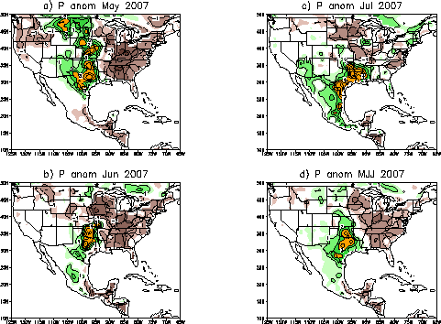
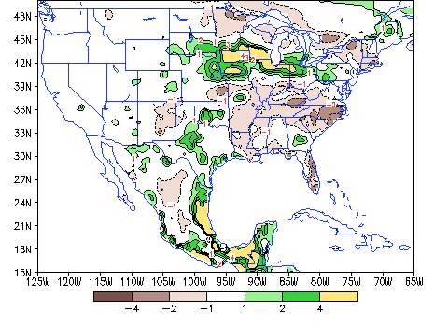
Precipitation Anomaly
The dipole with wet S-Plains & Dry SE persists from May-August
August: a 3-cell P pattern
1.Wet N-Plains
2. The S-Plains-SE dipole is slightly weaker
3. Weak monsoon
d) P anom Aug 2007

Slide 4
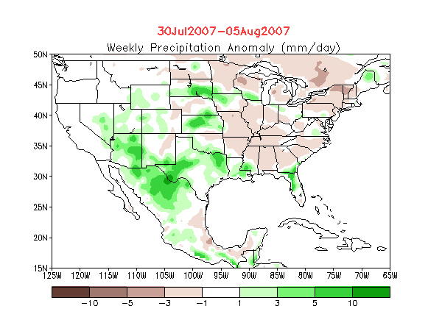
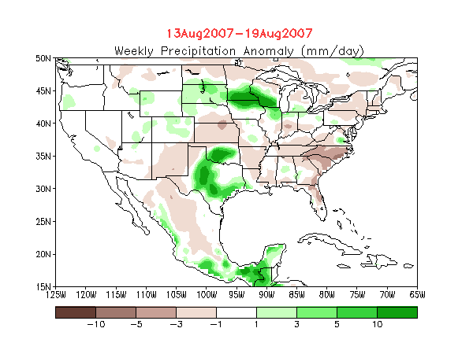
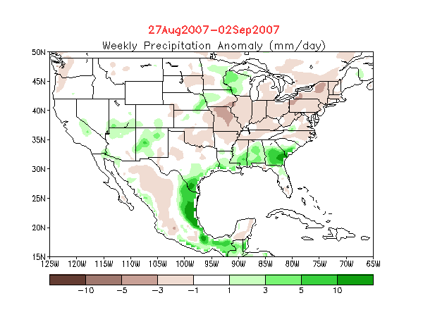
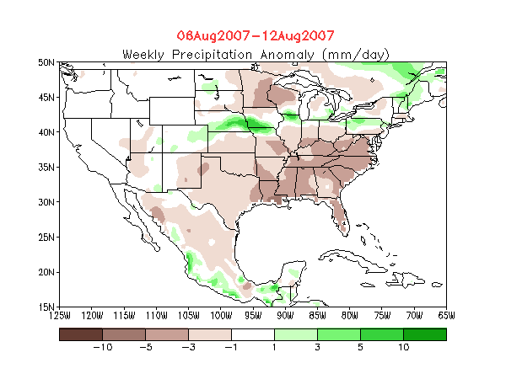
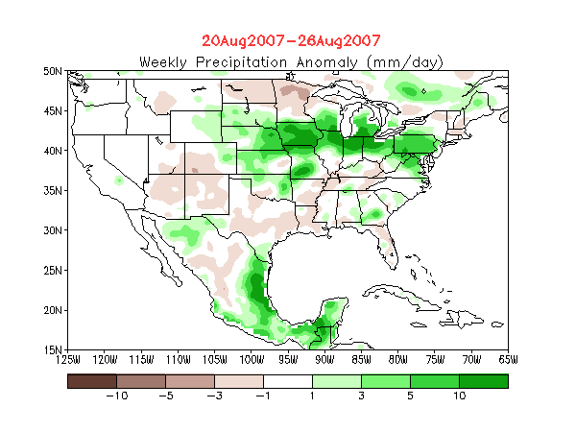
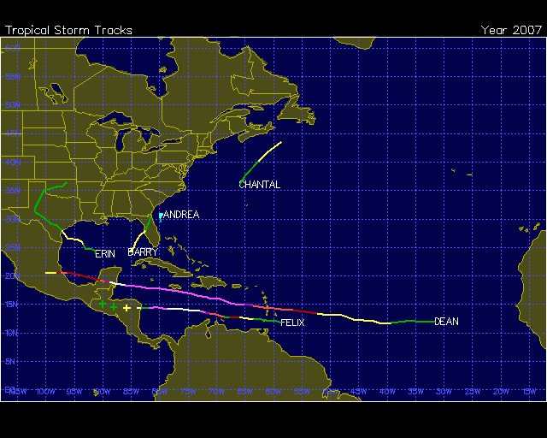
Precipitation Anomaly - Weekly
1
3
5
Erin
Dean
2
4
Dean
August:
Erin (TS) 8/15 - 8/19 Dean (Cat. 5) 8/13 - 8/23 Felix (Cat. 5) 8/31 - 9/5
(From Climate Review)
Influence of tropical storms

Slide 5
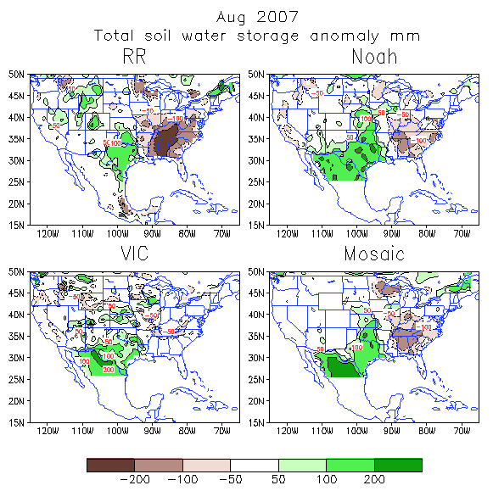
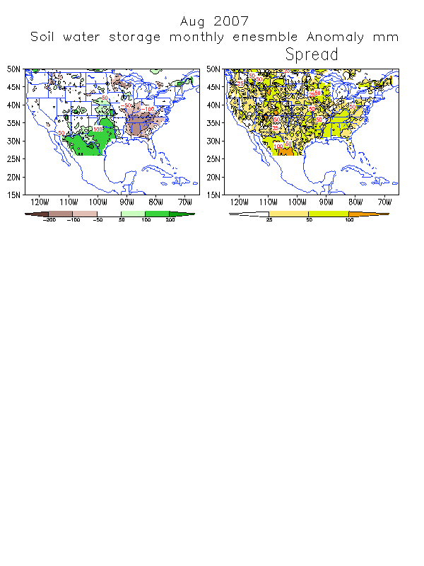
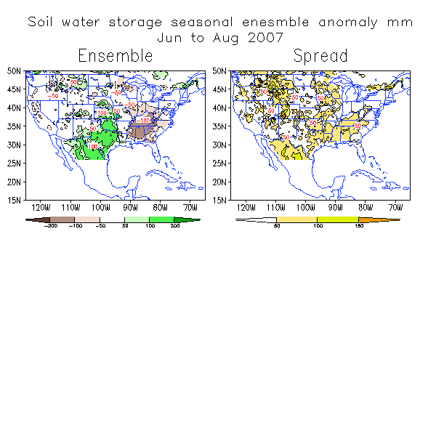
Soil Moisture Anomaly
Ensembles
AUG 2007
JJA 2007
Dipole feature persists

Slide 6
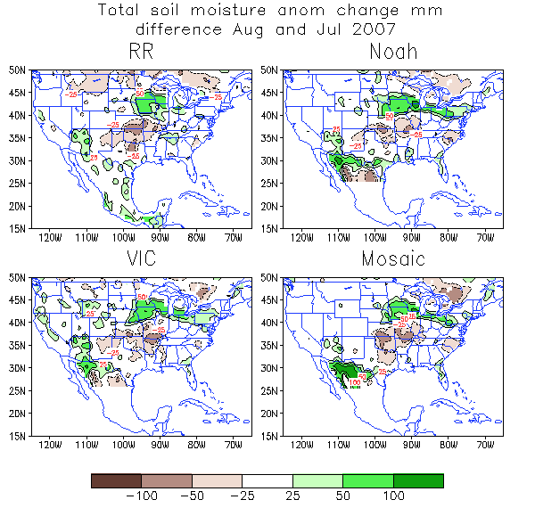
Soil Moisture Change
August:
S-Plains – decrease
N-Plains – increase
SE – not much change
SW - increases

Slide 7
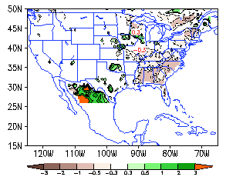
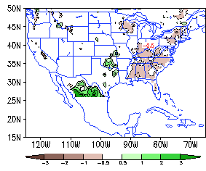
Runoff Anomaly Ensembles
August 2007
JJA 2007
Less runoff over the SE and more over Oklahoma

Slide 8
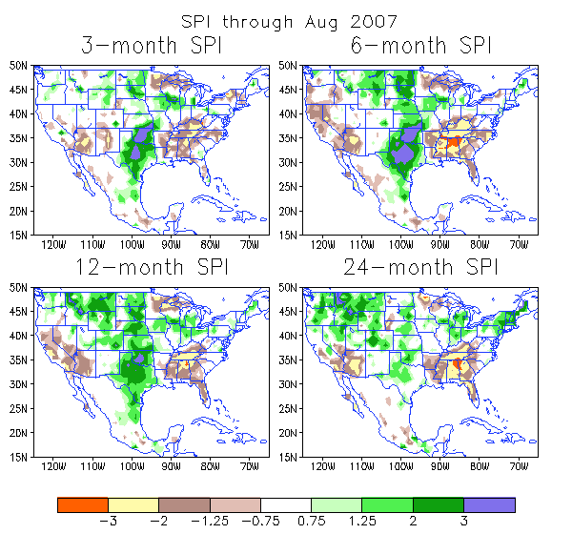
Long-Term Perspectives

Slide 9
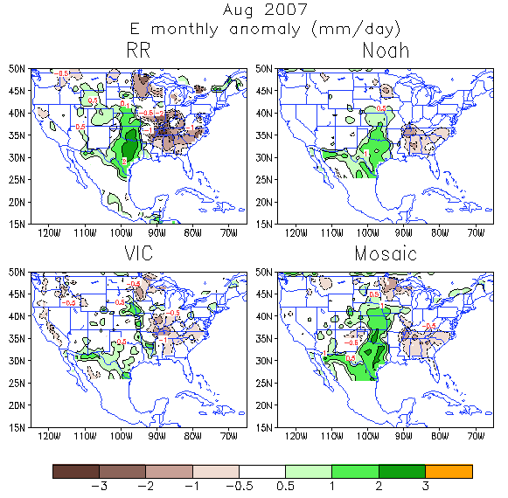
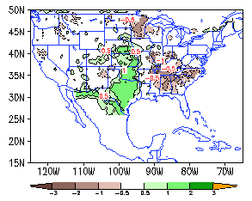
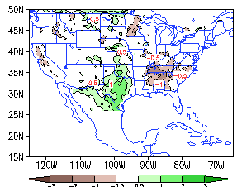
Evaporation Anomaly
Ensembles
AUG 2007
JJA 2007

Slide 10
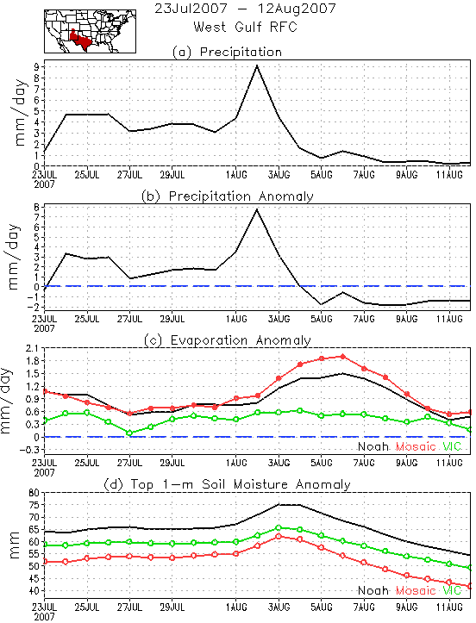
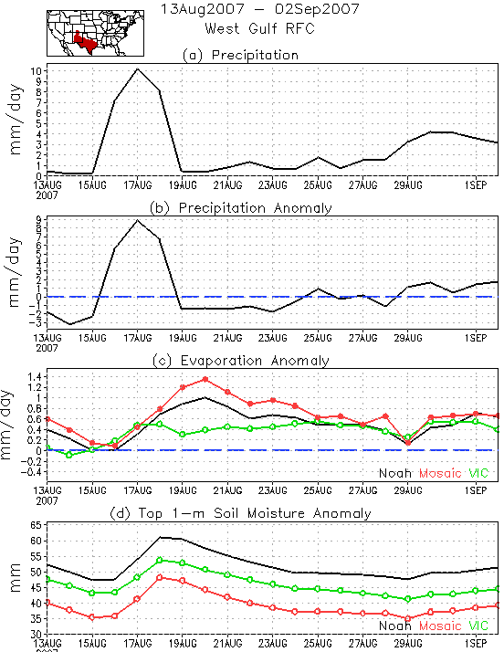
Regional Time Series: S-Plains
Anomalies of P, E and SM suggest evidence of SM-Atmos. interaction over S-Plains

Slide 11
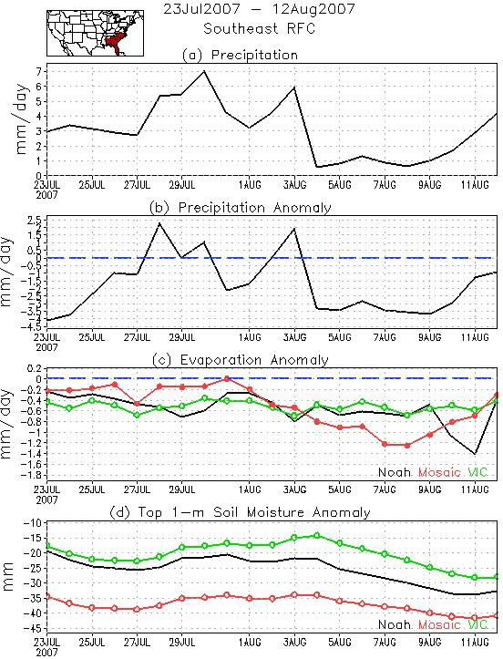
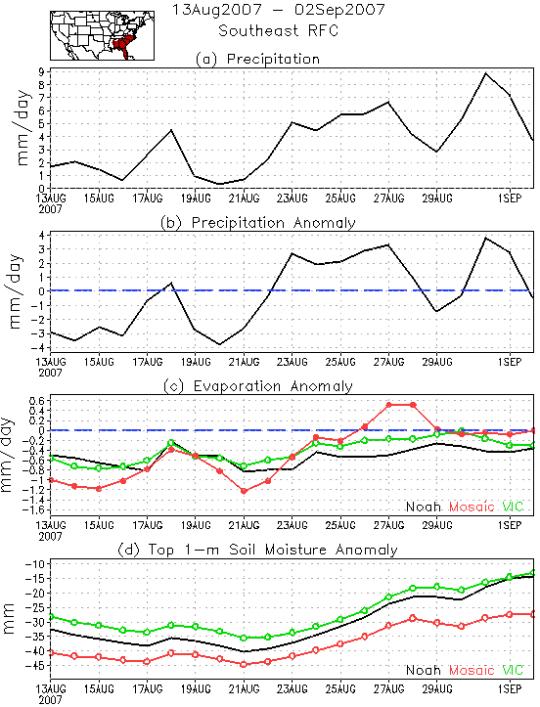
Regional Time Series: SE
Atmospheric condition dominates in SE

Slide 12
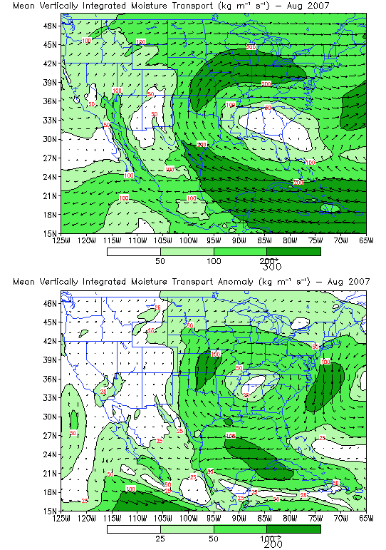
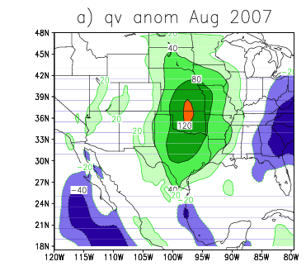
Strong GPLLJ
Weak GCLLJ
Heavy P over the N-Plains
Light SW monsoon rainfall

Slide 13
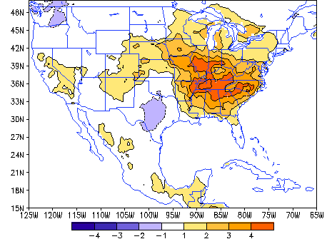
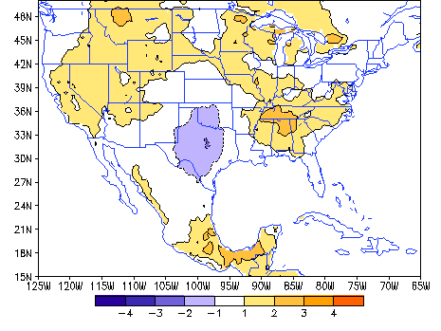
Surface Air Temperature Anomaly (RR)
AUG 2007
JJA 2007
Cooling S-Plains
Warming Central-East
Cooling S-Plains
Warming Elsewhere

Slide 14
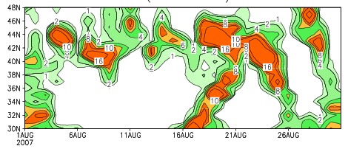
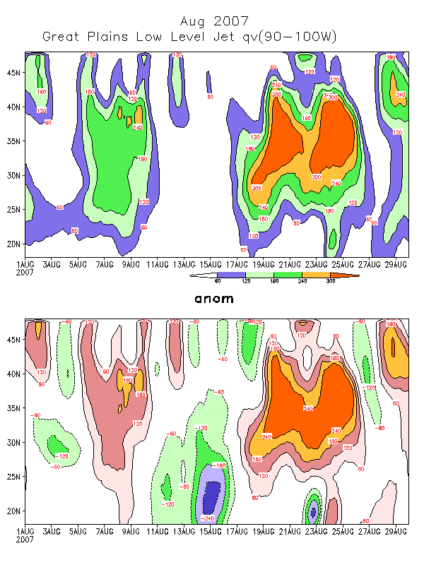
(a) P (90-100W) August 2007
(b) GPLLJ – Qv Anomaly
A good correspondence between GPLLJ & P over the N-Plains
Notes:
A good correspondence between the GPLLJ and the P over the Northern Plains

Slide 15
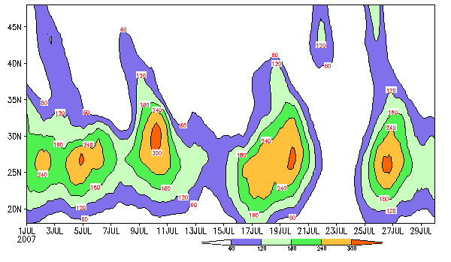
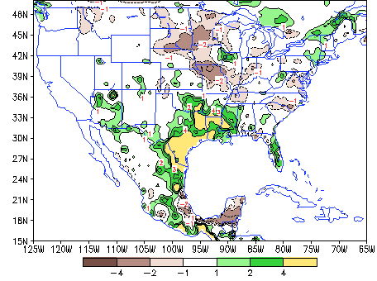
Great-Plain Low-Level Jet (90-100W)
AUG 2007
JUL 2007
P Anomaly – 20-26 AUG 2007
P Anomaly – JUL 2007
S-Plain P
GPLLJ had a maximum over Texas-Gulf
N-Plain P
GPLLJ extended north

Slide 16
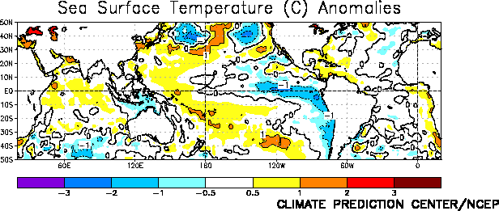
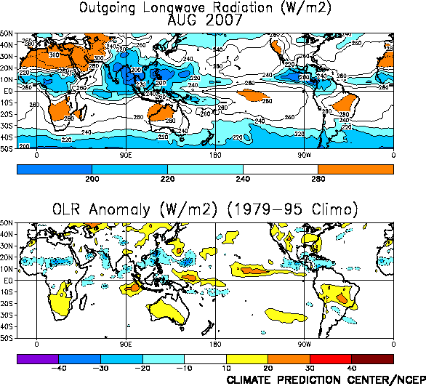
From Climate Review AUG 2007
The Gulf & the Caribbean continues to be slightly warm
Developing a cold event
Convection over the E Pacific

Slide 17
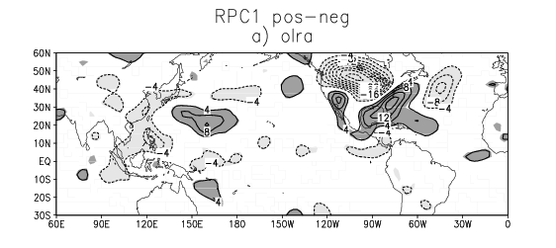
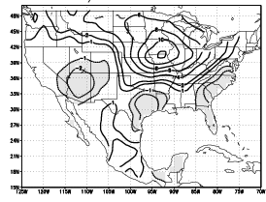
The 3 cell P pattern in August has strong projection on the
First REOF for JJAS
There is no tropical convection associated with it except negative OLRA in the tropical Pacific as indicated by the composite of OLRA based on RPC 1
REOF 1 JJAS
Possible soil moisture influence ?

Slide 18
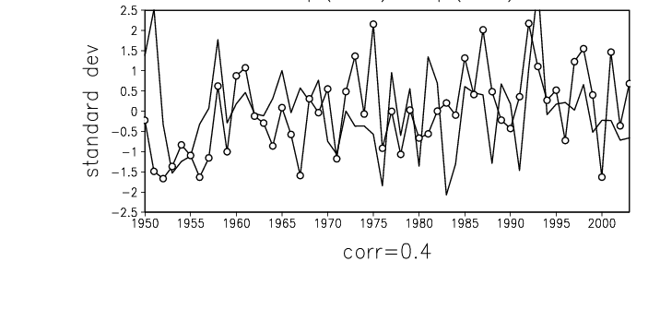
A possibility ?
Over the S-Plains, P (JFM) anomaly was above 1 std and positive SM anomalies persisted through spring and early summer. That may contribute to the rainfall over the N-Plains .
SM anomaly over S-Plains for JFM (open circles)
And P anomaly over the N-Plains for JAS (solid line)
S-Plains: 31-35N,95-105W
N-Plains: 36-45N,90-100W

Slide 19
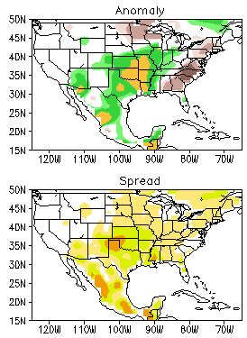
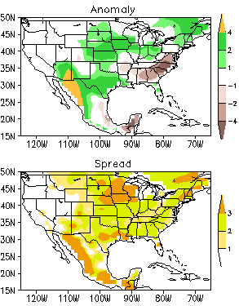
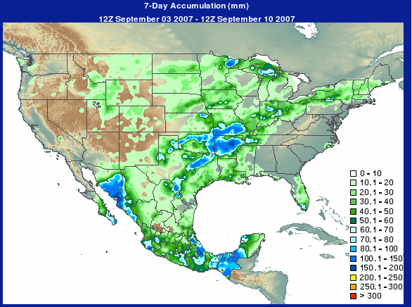
GFS Forecasts
Weekly Mean Anomaly Sep 03 – Sep 09 2007
CPC Real-Time Precipitation Analysis 7-day accumulation 12Z03Sep – 12Z10Sep 2007
GFS week1 forecasts made 02Sep2007
GFS week2 forecasts made 27Aug2007
The first week of Sept,
P over the Great Plains, dry over the SE
P over SW due to TC
The GFS NAEF fcst captures the P pattern in general

Slide 20
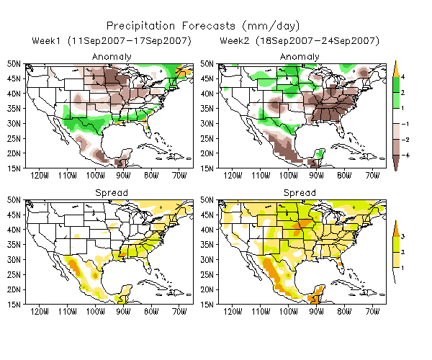
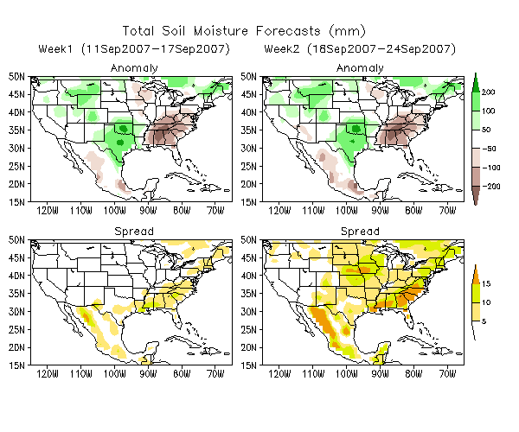
GFS Week1/Week2 Forecasts
Made 10Sep2007
P fcsts
SM fcsts
week1
week2
week1
week2
Week1-Expecting more P over Southern
US, dryness over the N-Plains
Week2- 3 cell pattern returns
Dipole pattern persists

Slide 21
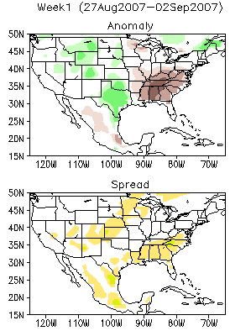
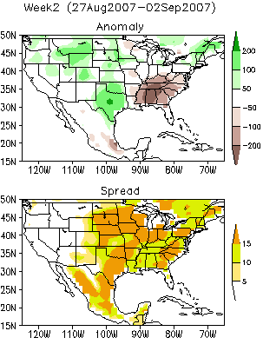
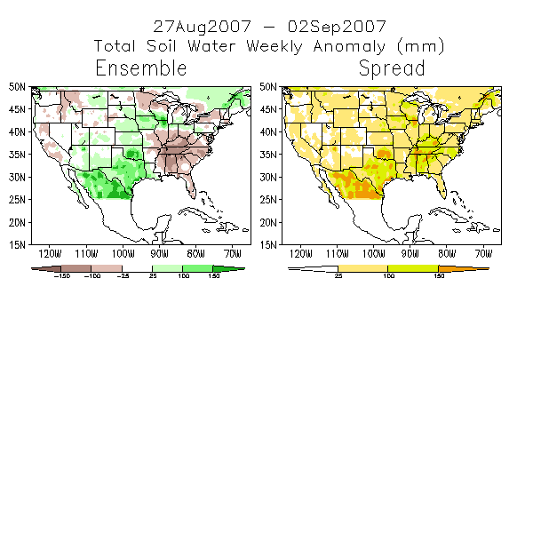
GFS Forecast Verification – Soil Moisture
Week1 Forecast Made 26Aug2007
Week2 Forecast Made 19Aug2007
Verification 27Aug2007-02Sep2007
Errors corresponding to large uncertainties

Slide 22
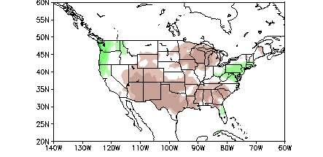
If this cold ENSO event intensifies…..
P composite for the ENSO cold phase – suggesting less P over the Southern US.
Composite of P for ASO for cold events from historical data

Slide 23
Summary
The dipole features of dry SE and wet S-Plains established in April, persisted to now, alleviated in August.
The E over S-Plains are SM-control; in the SE atmospheric condition control.
The strong GPLLJ enhances the N-Plains rainfall and the weak GCLLJ decreases the monsoon region rainfall.
Forecasts show the dipole pattern will keep persisting but less severe.

