Slide 1
Implementing Component-Based Government Enterprise Architecture with Semantic Web Services
Presentation for Session 3-2: Using Web Services to Support Your Enterprise Architecture, September 11, 1:15-2:30 p.m.
E-Gov Enterprise Architecture Conference, September 10-13, 2003
Brand Niemann, US EPA Office of Environmental Information, Chair, XML Web Services Working Group, and Member, CIO Council’s Emerging Technology Subcommittee
niemann.brand@epa.gov, http://web-services.gov
Submitted August 18th and Updated September 11, 2003

Slide 2
Topic Map
1. The CIO Council’s Architecture and Infrastructure Committee.
2. Semantic Technologies for eGov.
3. Repurposing Government Enterprise Architecture Documents Into Semantic Web Services.
4. Components Registry and Repository:
  4.1 Basic Working Implementation the Standards.
  4.2 Taxonomies with FEA Reference Models.
  4.3 Example of Components.
  4.4 XML Schema Components.
  4.5 Component-Oriented Programming with .NET.

Slide 3
1. The CIO Council’s Architecture and Infrastructure Committee
The CIO Council’s Architecture and Infrastructure Committee Leadership wants more collaboration across all three Subcommittees so from:
  Emerging Technology – select Semantic Web Services.
  Components – select Registry and Repository (Task 2).
  Governance – select Government Enterprise Architecture Framework and Data and Information Reference Model (Goal 3).
This brings about a union, an index, a tool, a repository, a super-set, a hierarchy, etc. of component-based architectures and components themselves (A Proposal for Reducing Redundancy in and Improving the Quality of Federal, State, Local, and Tribal Information, OMB, FEA PMO, August 27, 2003).
Note: The FEAC Institute wants to explore supplementing its Virtual University collaboration, instruction, and exams with something like this (Felix Rausch, Executive Director, FEAC Certificate Program, August 4, 2003).
  See Session 3-6 - Technologies for EA: Future Vision (XML, Topic Maps, repositories, Ontologies, etc.).

Slide 4
1. The CIO Council’s Architecture and Infrastructure Committee
The CIO Council’s Emerging Technology Subcommittee:
  Vision: A long-term lifecycle methodology to facilitate discovery and exchange, identify gaps, sponsor incubator pilots, & support the other subcommittees.
  Mission: Support the effective use of new technology across the Federal government through the identification and maturation of components for adoption within the Federal Enterprise Architecture.
  Goal: Enable more rapid identification of and “time to value”, communities of interest, and subcommittee cooperation (e.g. “flatten the hype curve”).
    See next two slides.

Slide 5
Gartner Hype Cycle
Note: Our purpose is to try flatten the curve for the Semantic Web.
Visibility
* Five to 10 years
Less than two years
Semantic Web*
Web-Services-Enabled Business Models*
External Web
Services
Deployments*
Extensible Business Reporting Language*
Internal Web Services
Note: Non-Web Services omitted.
Technology
Trigger
Peak of Inflated
Expectations
Trough of
Disillusionment
Slope of
Enlightenment
Plateau of
Productivity
Maturity
Source: Gartner as of July 2003.

Slide 6
Gartner Hype Cycle
Hype Cycle for Government Technologies, 2003 (Gartner Strategic Analysis report, June 13, 2003):
  Semantic Web:
    Definition: Extends the World Wide Web through semantic markup languages such as Resource Description Framework (RDF), Web Ontology Language (OWL), and Topic Maps that describes entities and their relationships in the underlying document (see “Innovative Approaches for Improving Information Supply,” M-14-3517).
    Time to Plateau/Adoption Speed: Five to 10 Years.
    Justification for Hype Cycle Position/Adoption Speed: So far, there has been little deployment of the Semantic Web and there is a significant skill shortage.
    Business Impact Areas: Can affect the management of public sector information. Can provide breakthroughs to make the most of government metadata modeling.
    Analysis By: Alex Linden.

Slide 7
2. Semantic Technologies for eGov
Semantic Technologies for eGov Conference, September 8, 2003, White House Conference Center, Agenda Topic Map:
  Part 1 in the Morning:
    The W3C’s Semantic Web Activity.
    Data Independence (see two next slides) and the Semantic Web Roadmap.
    The Emerging Vendor Landscape (see slide 10).
    The Gallery and the Vendors.
    Audience Participation.
    Gallery Lunch.
  Part 2 in the Afternoon:
    Pilots.
    Interactive Panels of Problem Owners and Solution Providers.
    Closing Keynote.
    Closing Remarks, Awards, and Some Next Steps.

Slide 8
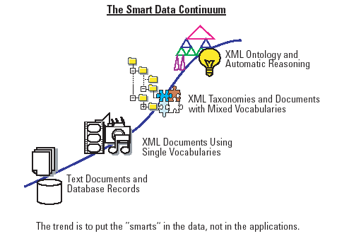
The Smart Data Continuum and
Road to Data Independence
Source: "The Semantic Web: A Guide to the Future of XML, Web Services, and Knowledge Management“, Wiley Technology Publishing, June 2003.

Slide 9
Declaration of Data Independence
1. Data is more important than applications.
2. Data value increases with the number of connections it shares.
3. Data about data can expand to as many layers as there are meanings.
4. Data modeling harmony is the alignment of syntax, semantics, and pragmatics.
5. Data and logic are the yin and yang of information processing.
6. Data modeling makes the implicit explicit and the transparent apparent.
7. Data standardization is not amenable to competition.
8. Data modeling must be decentralized.
9. Data relations must not be based on probability or luck.
10. Data is truly independent when the next generation need not reinvent it.
Source: Michael Daconta, Data Independence and the Semantic Web Roadmap,
White House Conference Center, September 8, 2003.

Slide 10
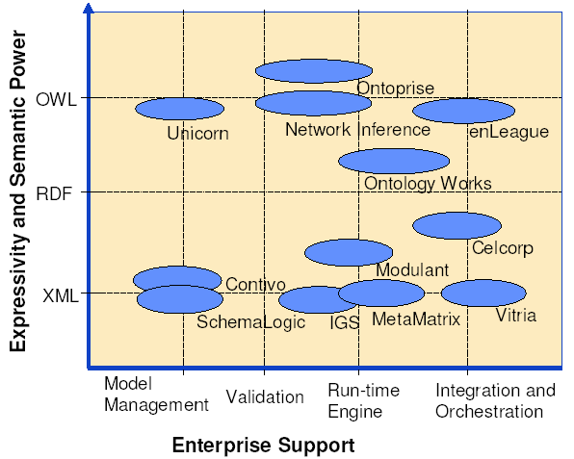
Positioning of Vendor’s Solutions within the Semantic Integration Space
Source: Irene Polikoff, The Emerging Vendor Landscape, White House Conference Center, September 8, 2003.

Slide 11
Semantic Web Services
Source: Derived in part from two separate presentations at the Web
Services One Conference 2002 by Dieter Fensel and Dragan Sretenovic.
Dynamic
Resources
Semantic Web
Services
Web Services
Static
Resources
WWW
Semantic Web
Interoperable
Syntax
Interoperable
Semantics

Slide 12
Community of Practice
Semantic Web Services
Agency 1
Agency 2
State 1
Government Data and Information
Reference Model (GDIRM)
Local 1
Local 2
State 2
Component Registry
& Repository
Adapted from Reeves and Bernard, “How FEA Reference Models Impact
Agency-Wide Strategies, Enterprise Architecture 2003, September 10-12.

Slide 13
Collaboration Opportunity
Relationship to SBIR (Small Business Innovation Research Act)
Componenttechnology.org -
A public-private partnership
This opens two doors for
small businesses*:
GSA Schedule, and
Venture Capitalists.
Government
(eGov/FEA)
SBIR/
STTC
Small
Businesses
(eGov/FEA)
Venture
Capitalists
(eGov/FEA)
*Meets Competition and Contractual Requirements in SBIR Phase I and II allowing
for sole-source contracts and pre-vetted Venture Capital Support in Phase III.

Slide 14
Collaboration Opportunity
(1) Inform, encourage, and assist agencies with eGovernment Component Technology topics that would be useful to their agencies and others starting at the SBIR Agency Meeting on September 11th.
(2) Set as a goal for FY 2004 the funding of about 1% of the SBIR/STTR projects in support of eGovernment Component Technology.
(3) Conduct the regular Emerging Components Conference Series* starting at the National Entrepreneurial Conference and Expo, September 17-19, 2003, and subsequent regional town hall meetings, etc. (http://www.sba.gov/50/index.html).
  2003 NASVF Conference, Presentation, November 2-5, 2003 (http://www.nasvf.org/conference)
  Web-Enabled Government 2004 Conference, February 3-5, 2004, Proposed Session (http://www.e-gov.com/speaking.asp)
  FOSE 2004, Regular Emerging Component Conference, March 23-25, 2004 (http://www.fose.com)
*Will include vendor interoperability demonstrations
(c.f. http://www.xmethods.net/wsid/).

Slide 15
3. Repurposing Government Enterprise Architecture Documents Into Semantic Web Services
Some of the types of XML Information Object Documents that individual paragraphs could be converted to:
  1. Document Structure – Table of Contents, Index, Title, etc.).
  2. Finding – A short fact the document asserts as true possibly through empirical evidence.
  3. Instruction – A tutorial on a topic.
  4. Terminology Definition – A definition of a term.
  5. Definition Example – A specific instance that illustrates a definition is accurate and true.
  6. Process Definition – A description of a sequence of steps that causes an effect.
All these information object types were extracted from the document by looking at each paragraph and saying, "what is this information trying to accomplish?".
Source: Michael Daconta, Chief Scientist, APG, McDonald Bradley, Inc. August 6, 2003

Slide 16
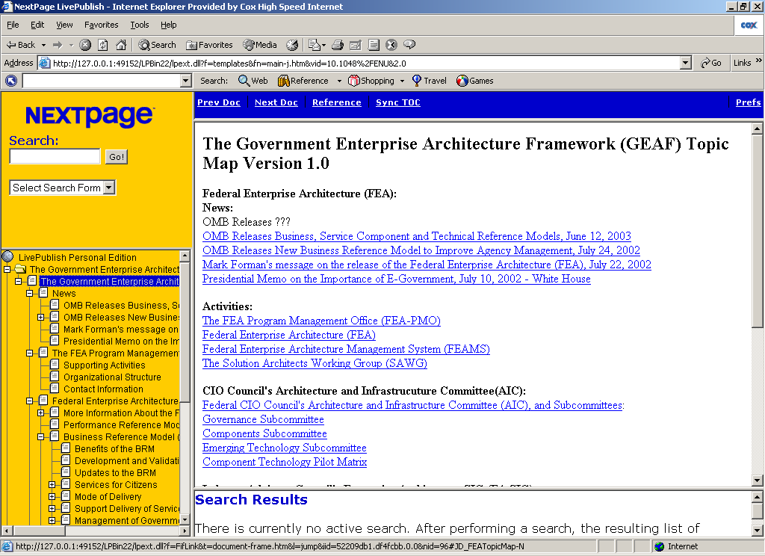
3. Repurposing Government Enterprise Architecture Documents Into Semantic Web Services
Integrate content from FEAPMO, NASCIO, IAC, Agencies (Federal and State), etc. and across the three CIOC AIC Subcommittees*.
Add structure, interoperability (XML), interlinking and search.
Standardize terminology (on way to Government Core Ontology and “smart data”) for machine & EA tool processing.
Include XML Schemas and structured data (forms).
Show best practices of standards-based, reusable, interoperable components.
See http://web-services.gov
*Governance, Components, and Emerging Technology Subcommittees.

Slide 17
4. Components Registry and Repository
(as of August 6, 2003)
Name | Source | Status
Justice XML Data Model | Global Justice Information Sharing Initiative | DRM Version 18 http://it.ojp.gov/topic.jsp?topic_id=43
Web Services UDDI Vendor Templates (12) | June 2nd and June 26th Workshops | Available at http://web-services.gov
Semantic Web Services Vendor Templates (expect 10 or so) | September 8th Conference | To be available at http://web-services.gov
XML Schemas | E-Grants | http://www.grants.gov/pmo_ITIntegration.html
XML Schemas for Government Forms | E-Forms for E-Gov Pilot Team | http://www.fenestra.com/eforms/
ebXML Core Components | Joe Chiusano, XML Working Group Registry Team | http://xml.gov/agenda/rrt20030723.htm Posted to QuickPlace on August 2, 2003
Geospatial Portal | Open GIS Consortium (OGC) | Template part of June 2nd Workshop at http://web-services.gov

Slide 18
4. Components Registry and Repository
(continued) (as of August 6, 2003)
Name | Source | Status
Geospatial Portal | Open GIS Consortium (OGC) | Template part of June 2nd Workshop at http://web-services.gov
Web Services Design Patterns | HP for September 24th Workshop | http://sys-con.com/xml/articleprint.cfm?id=649
XML Data Integration Architecture | IAC White Paper pages 25-26 and XML Web Services WG Pilot | Posted to QuickPlace on July 31, 2003
Goal 3-Tasks 3&4 | Government Enterprise Component Registry and Repository Using Native XML Database Technology Pilot | Posted to QuickPlace on July 29, 2003
Business Compliance One-Stop | Four Integrated Pilots in Revised Business Case and Work Plan | See Upcoming Meetings, August 13-14, 2003, The "E-Forms for E-Gov" Business Case Story at http://web-services.gov
Proposed Semantic Web Technologies for EPA Pilot | Five Integrated Pilots | See Announcements, June 28th, at http://web-services.gov

Slide 19
4.1 Basic Working Implementation of the Web Services Standards
WSDL Document
1. Client queries registry to locate service.
2. Registry refers client to WSDL document.
3. Client accesses WSDL document.
4. WSDL provides data to interact with Web service.
5. Client sends SOAP-message request.
6. Web service returns SOAP-message response.
UDDI
Registry
2
1
3
4
5
Client
Web
Service
6

Slide 20
4.1 Simple Explanation of the Basic Web Services Standards
Acronyms:
  UDDI
  WSDL
  SOAP
  HTTP, SMTP, FTP
  Programming (DOM, SAX)
  Schema (DTD, XSD)
  XML
Practical Examples:
  Phone Book
  Contract
  Envelope
  Mailperson
  Speech
  Vocabulary
  Alphabet

Slide 21
4.2 Taxonomies with FEA Reference Models
Example: Show me all the data structures that have been classified as part of the Business Compliance One-Stop Initiative and as a work product of the IRS:
  DRM – the data structures themselves (e.g. data dictionary)…
  SRM – expressed as a reusable component (e.g. XML Schema) …
  TRM – provided in an interoperable way (e.g. an XML Web Service) ….
  BRM – classified according to a taxonomy (e.g. Business Reference Model Version 2).
  PRM – Doing all this demonstrates performance!
Source: Kevin Williams, Creating Taxonomies in XML Collaborator,
Presentation to the XML Web Services Working Group, April 15, 2003.

Slide 22
4.3 Example of Components*: Eforms
Components Subcommittee Process:
  Identification.
  Classification.
  Standardization.
  Publication.
  Utilization.
XML Web Services WG “Eforms for E-Gov” Pilot:
  eGrants SF424.
  eGrants(BRM & XNS).
  XML Schema.
  XML Collaborator.
  XML Web Service.
*An Enterprise Architecture Component is a self-contained business process
or service with predetermined functionality that may be exposed through a
business or technology interface.

Slide 23
4.3 Example of Components*: Eforms
Components Subcommittee Process:
  Target Agency Pilot.
  Provide Incentive.
  Create Sharable Item.
  Involve Industry.
XML Web Services WG “Eforms for E-Gov” Pilot:
  Census’s GIDS.
  Cost Savings.
  Open Source.
  Vendor Support for Open Standards (XSD, XForms, and SVG)
*An Enterprise Architecture Component is a self-contained business process
or service with predetermined functionality that may be exposed through a
business or technology interface.

Slide 24
4.3 Example of Components:
Federation (loosely coupled)
Granularity:
  Components
  Metadata Models
  Registries
Examples:
  Eforms (e.g. eGrants)
  Data Elements and XML Schema (e.g. DOD ISO 11179 Registries)
  ebXML (e.g. GSA-NIST XML Registry)
E.g. Subcomponent of XML Schema to E-Gov Portal (e.g. Geospatial One-Stop) to Complete Line of Business (e.g. Data and Statistics Development, Health Informatics, etc.).
E.g. The XML Collaborator Pilot is federating components, metadata models, and registries by supporting XML, ebXML, and UDDI standards.

Slide 25
4.4 XML Schema Components
A good XML Authoring and Editing Tool (e.g. XML Spy) provides:
  Viewing of the XML Schema Components:
    Graphical Representation.
    Component Type.
    Component Name.
    Component Description (Annotation).
    Attributes
      Note: Entities are not supported in XML Schema.
    Entry Helper (components, details, and facets).
Source: The Official XMLSPY Handbook, Wiley Publishing, Inc., Larry Kim, 2003.

Slide 26
4.4 XML Schema Components
A good XML Authoring and Editing Tool (e.g. XML Spy) provides (continued):
  Design flexibility and modularity:
    Name and reuse fragments, deriving types from existing types, etc.
    Schemas in multiple files:
      Impossible to build advanced XML Schemas entirely in just a single file, XML Schemas can be defined and assembled from components residing in multiple documents.
      Global constructs serve to greatly improve the reusability and modularity of XML Schemas.
    To support true extensible object-oriented design, the XML Schema defines a straightforward mechanism for deriving complex types and specifying equivalency between elements. (RDF Schema does this even better.)
    Class files can be generated from XML Schemas to create a run-time environment.
Source: The Official XMLSPY Handbook, Wiley Publishing, Inc., Larry Kim, 2003.

Slide 27
4.5 Component-Oriented Programming
Component-oriented programming is the predominant software development methodology.
Attain much greater reusability, extensibility, and maintainability than giant, monolithic, hard-to-maintain code bases.
Lead to faster time-to-market, more robust and highly scalable applications, and lower development and long-term maintenance costs.
Current component technologies have their drawbacks (DCOM is too difficult to master, Java doesn’t support interoperation with other languages, etc.).
.NET, the newest entrant, is unique and vastly easier to use, because .NET architects learned from the mistakes of previous technologies.
Component-oriented programming is different from object-oriented programming although the two methodologies have things in common.
Source: Programming .Net Components - Design and Build Maintainable Systems Using
Component-Oriented Programming, Chapter 1 (free) - Introducing Component-Oriented
Programming, Juval Lowy, O'Reilly Books, 2003.
  Note: Future Phase 2 of the XML Web Services for E-Gov Pilots Meeting Topic.

Slide 28
4.5 Component-Oriented Programming
A component is a .NET class and every .NET class is a binary component.
A component-oriented application comprises a collection of interacting binary application modules–its components and the calls that bind them (see Figure I-2).
Effective component design skills are primarily acquired through experience and there is a skills gap among object-oriented and component-oriented developers.
There is a core set of principles for component-oriented systems and programmers that continues to evolve (see next slide).
To simplify development and use, .NET doesn’t enforce some of the core principles, but merely enforces a few and enables the rest.

Slide 29

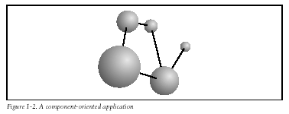
4.5 Component-Oriented Programming
Principles of Component-Oriented Programming:
  Separation of interface and implementation (Figure I-1).
  Binary compatibility (Figure I-2).
  Language independence.
  Location transparency (Figure I-3).
  Concurrency management.
  Version control.
  Component-based security.

Slide 30
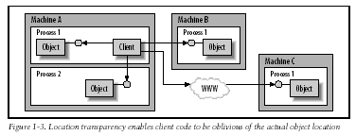
4.5 Component-Oriented Programming

