Slide 1


Site Evaluation
Dr. Mark Rodekohr
Energy Information Administration
January 2000

Slide 2
Overview
Introduction
Log File Analysis
Using Customer Feedback
Cognitive Web Site Testing

Slide 3
Introduction
There is a wealth of information available from your web logs, customer comments and customer testing that can and should be used to evaluate and improve the functionality of your web site.
All relatively large web sites are difficult to navigate, using the available information can improve the ease of navigation.
As many studies have shown people will not spend much time on a site if they cannot find what they are looking for quickly they will leave.

Slide 4
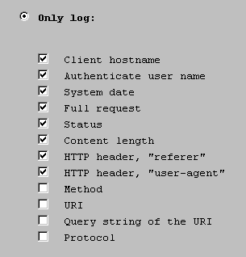
Web Logs

Slide 5
Typical Log Entry
206.246.87.67 - - [18/Jan/2000:15:20:31 -0500] "GET /cneaf/electricity/page/images2/overview_on.gif HTTP/1.1" 200 1478 "http://www.eia.doe.gov/cneaf/electricity/page/data.html" "Mozilla/4.0 (compatible; MSIE 5.01; Windows 98)"

Slide 6
What the Log Tells You
On Jan 18 at 3:20pm user 206.246.87.67 download a gif file that was part of a electricity page
The download worked I.e. the http 200 code
The file was 1478 bytes
They were using Internet explorer 5.01
They were running Windows 98
206.246.87.67 is addr67.pechan.com who happens to be a contractor

Slide 7
Review Your Error Logs
[18/Jan/2000:15:42:44] warning ( 7615): for host 207.220.183.166 trying to GET /emeu/sep/ga/cosnum/eu.txt, send-file reports: can't find /Info1/www/emeu/sep/ga/cosnum/eu.txt (No such file or directory)

Slide 8
Log Analysis 1
Number of Hits for home page 179
Total No. of Successful Hits 265969
Total No. of User Sessions 9666
User Sessions from (United States) 0%
International User Sessions 0%
Origin Unknown User Sessions 100%
Average Hits per Day 265969
Average User Sessions per Day 9666
Average User Session Length 00:15:16

Slide 9
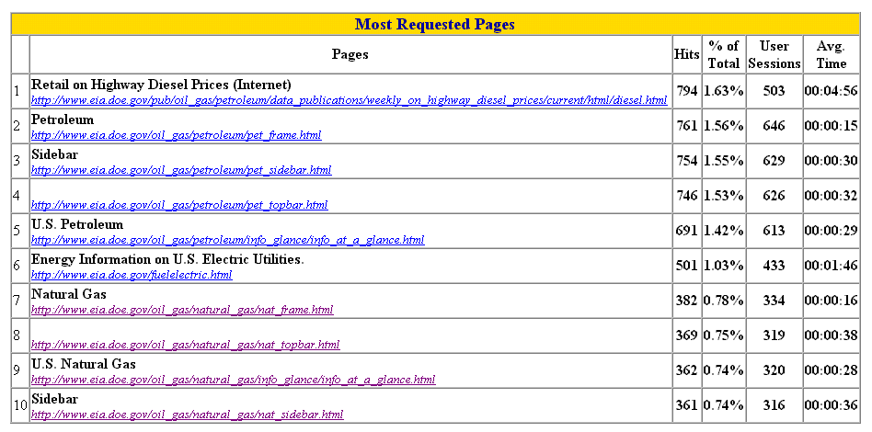
Log Analysis 2

Slide 10
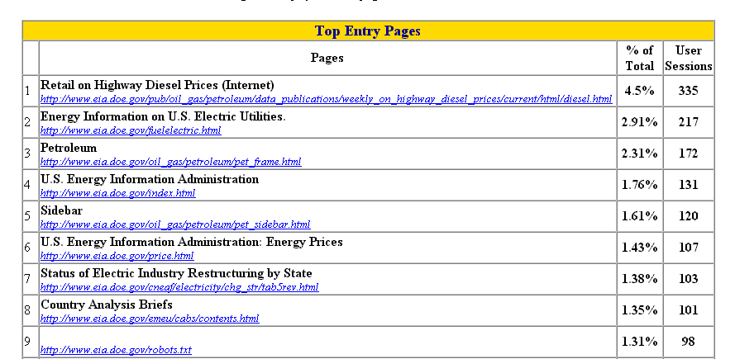
Top Entry Pages

Slide 11
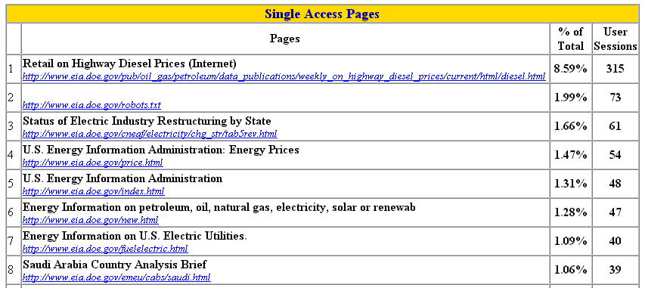
Single Access

Slide 12
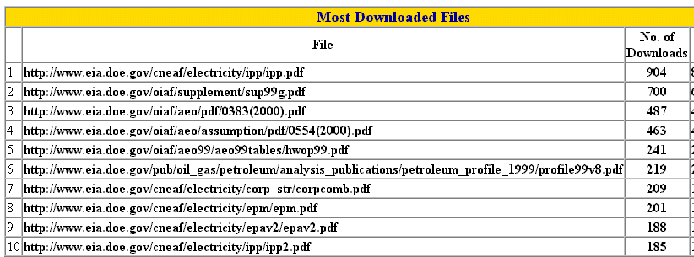
Most Downloads

Slide 13
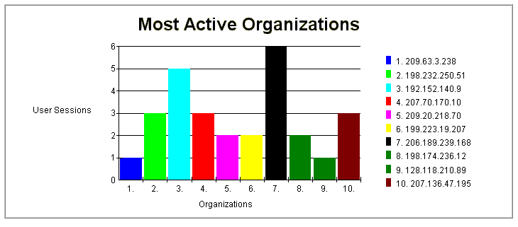
Most Active Organizations

Slide 14
Who Are These Organizations
209.63.3.238 was some ISP I never heard of could be run by AOL
198.232.250.251 belongs to Westat a survey design and analysis company
192.152.140.9 belongs to Enron the natural gas company

Slide 15
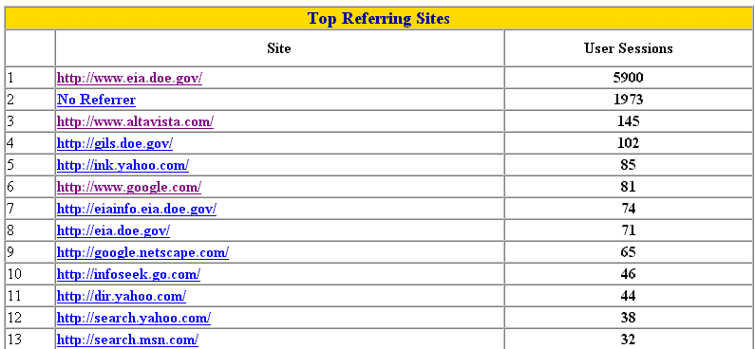
Referring Sites

Slide 16
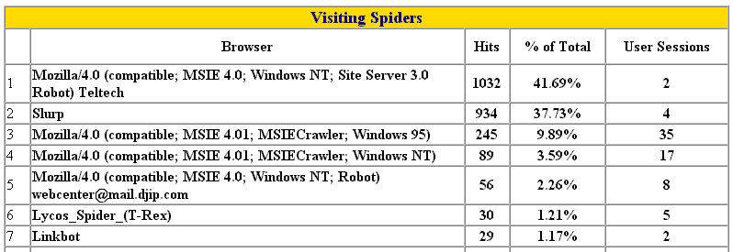
Spiders

Slide 17
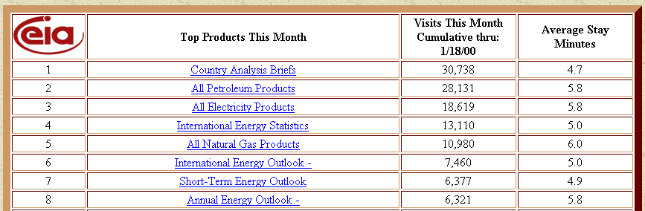
Detailed Results by Product

Slide 18
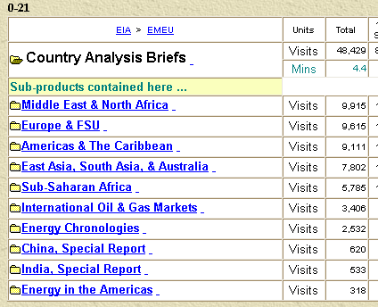
Detailed Results by Subproduct

Slide 19
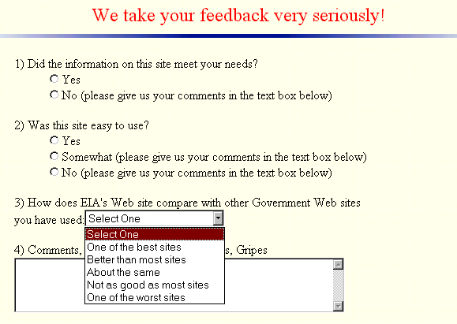
Customer Feedback

Slide 20
Sample Comments I
12/13/99 20:5:21 | Paul | Little_rubs | academic | best | no | yes | You provided me with great info on how we have a problem with energy consumption, but I would like to get some soultions you may have for the future, and if you did then please make them easier for a pearson like me to find
.....@concentric.net
FYI, "This Week at EIA" is a good idea. Good for your customers, and good for EIA. The fact that it lists the new issues of monthly pubs is useful, as is the announcement of one-time pubs that a user might not know about
.......lehn@maui.net
EIA: I'm a high school teacher and all I want is the energy in the USA by economic sector in the latest year you have data for. But your system is so slow and so user unfriendly it is a real pain.

Slide 21
Sample Comments II
10/15/99 1:7:6 ........@yahoo.com | selectone | worst | no | some | needs info on australia.
10/28/99 12:18:45 ...... @tmcc.edu | library | better | yes | yes | Thanks for a FANTASTIC site! The data here is great. One thing I missed was energy use before 1949
.......@infovia.com.gt (re. CABs) how about one from Guatemala we will be having elections for president this month best regards, Felix

Slide 22
Example of Using Feedback
When are web site was started we used to get several questions per day relating to finding energy price data. Users reported having a very hard time finding it.
We created the energy prices shown in the next slide and questions quickly fell.

Slide 23
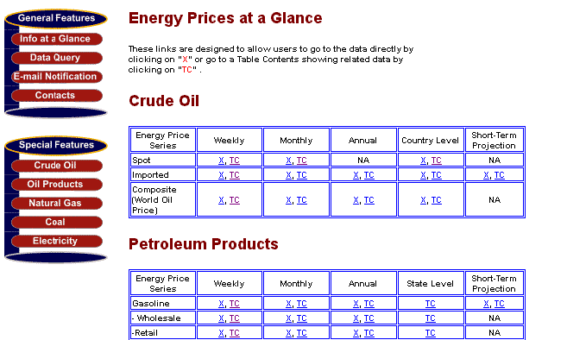
Energy Price Page

Slide 24
Cognitive Testing: What is it?
In this type of testing you take some customers (not staff), ask them a series of questions about information that is on your web site then:
  See if they find the correct answers
  Review how they found these answers
  Sometime video tapes and even keystrokes are used to recreate their every move.

Slide 25
Questions Asked in a Recent Test of the EIA Site
How much electricity was used by U.S. households in 1997?
What is the forecast for unleaded regular gasoline prices for summer 1999?
How much oil did Saudi Arabia produce in 1998?
What percentage of oil used in the U.S. in 1997 was imported?
How much gasoline was used in Massachusetts in December 1998?
How much did gasoline cost in 1969?

Slide 26
Results of Testing

Slide 27
Summary from Session IV
We reviewed what is contained in a typical web server log file
We used Web Trends to perform an analysis of these data and reviewed the results
We examined some other techniques that can be used to improve the usefulness of a web site.

Slide 28
Summary from Session I
At this point we have:
  Identified the purpose of the site and the user community
  Reviewed usability studies and what they have found with regard to page and site design
  Developed a file structure
  Have chosen the hardware, software and vendor
  Now we are ready to start site construction

Slide 29
Summary from Session II
We created two sites using different tools and noted the advantages and disadvantages.
The sites we created were generally consistent with the standards we discussed in the previous session.
We quickly reviewed the need for your own standards.
We reviewed some more advanced issues including the addition of search engines and the improved navigation through the use of Java.

Slide 30
Summary from Session III
We reviewed the file characteristics with regard to owners/groups/permissions to illustrate why site management is so expensive.
We looked at security issues including recent events and discussed the various risks.
We discussed some tools that can be used to monitor your web site for security problems.

Slide 31
Summary from Session III (continued)
While this presentation has been fairly technical it illustrates some of the problems associated with maintaining a web site. It also illustrates the reason for using a ISP if you have a fairly small site as they are responsible for dealing with these technical issues.

Slide 32
Thank you for your patience.

