Slide 1
Presentation to the
NASA Supply Chain Conference
Greenbelt, MD
J-STD-001x and xS Transition Plan
November 14, 2007
Jeannette Plante,
Manager, NASA Workmanship Standards Project
NASA GSFC, Greenbelt, MD 20771
Code 300, Office of Systems Safety and Mission Assurance
Phone: 301-614-5944; Fax: 301-614-5599
Jeannette.F.Plante@nasa.gov

Slide 2
Overview
Current NASA Requirements for Workmanship Standards
Modifying Policies
J-STD-001 Space Addendum Adoption
    Obstacles
    Past activities to remove obstacles
    Current activities
Adoption Timeline

Slide 3
Workmanship Standards Crash Course
Conformal Coating, Bonding, Staking, Encapsulation (.1)
Hand (.2) and Automated Soldering (.3)
Connector Assembly, Cable Harnessing (.4)
Fiber Optic Connector Assembly (.5)
ESD Safety (S20.20)

Slide 4
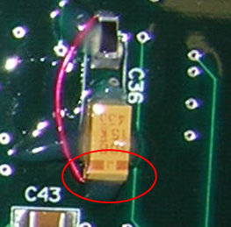
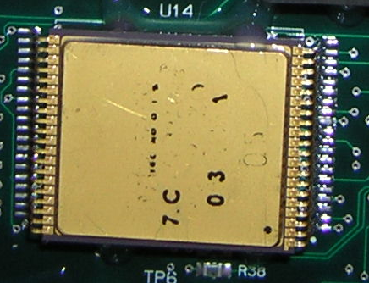
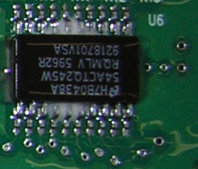
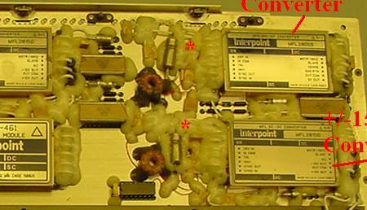
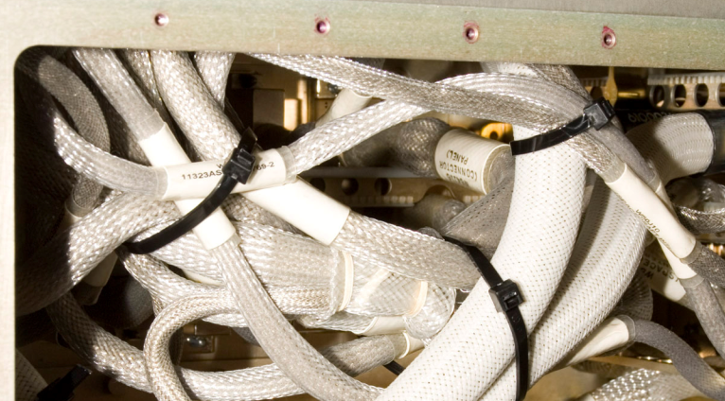
NASA Workmanship Standards Requirements:
Is there still a need? Most Definitely Yes.
Bonding material interfering with lead compliancy Nov 2006
Part misaligned on solder pad creating defective solder joints. Marking destroyed. Nov 2006
Jumper wire attached directly to component terminations. (These components are very sensitive to soldering heat) Nov 2006
Staking as encapsulation? 2001
Non-compliant cable routing and retention. Feb 2007

Slide 5
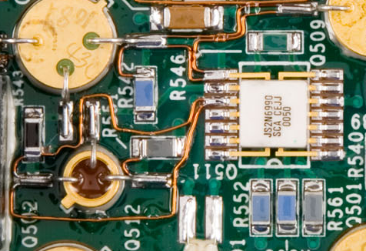

NASA Workmanship Standards Requirements:
Is there still a need? Most Definitely Yes.
This board contained 100+ jumper wires w/o design review. June 2007
(as of Aug 2007, technical support for repair rather than redesign is still being sought)
2 wires attached to single pad
2 wires attached to single pad
Jumper appears to extend beyond termination
No Stress relief
2 wires attached to single pad

Slide 6
NASA Workmanship Standards
NPD 8730.5 Calls out NASA Workmanship Standards for all new builds/contracts as of October 27, 2005
NASA-STD-8739.1 Polymeric Applications
NASA-STD-8739.2 Hand Soldering
NASA-STD-8739.3 Surface Mount Soldering
NASA-STD-8739.4 Electrical Cable Harnesses
NASA-STD-8739.5 Fiber Optics (installation of connectors)
ANSI/ESD S20.20 ESD (replaces NASA-STD-8739.7)
NPR 8715.3, Para. 1.13 requires HQ OSMA approval to vary from this at the Program level and Center Director approval to vary from this at the Project level.
Suppliers must show that all of their internal procedures include all of the requirements in the 8739 documents and that their operators and inspector training is traceable to the NASA Training Center Level A Instructors.

Slide 7
Scope of 8739 Requirements
Use known GOOD materials, geometries and processes ← “how to” or “lessons learned”
Disallow use of known BAD materials, geometries and processes ← “how NOT to” or “lessons learned”
Inspection requirements and definition of defects at the Printed Wiring Assembly (PWA) level ← “manufacturing quality defect reduction at low level of assembly”
Heighten role of customer in decision-making about risks associated with using new processes, rework and repair. ← “customer participation in risk mitigation”
Requirements for trained and certified operators, inspectors and local instructors. ← “build in compliance to requirements”

Slide 8
NASA Workmanship Project
Objectives: To provide technical advice to NASA HQ OSMA for the development of Workmanship policy. To manage and maintain Workmanship requirements documents. To facilitate leveraging off of industry and military requirements where there is benefit to NASA.
Project Lead: Jeannette Plante, GSFC
Technical Support: Bob Humphrey, Jose Sancho, Terry James, Felix Frades, Craig Furman, GSFC-HTSI
Workmanship Technical Committee: ARC, JPL, DFRC, JSC, MSFC, SSC, KSC, LaRC, GRC
Training Centers: GSFC, JPL

Slide 9
New Emphasis on Requirement Review
From an October 29, 2007 joint message from Bryan O’Conner, Director OSMA HQ and Mike Ryschkewitsch, Director OCE HQ:
“…Some key points to be kept in mind:
1) NASA's primary purpose is to execute missions and deliver the products associated with them. Program or Project managers are charged with leading those implementations. When they identify an institutional requirement, standard or other constraint which is impeding their efficient and effective progress they can and should challenge them. This is not a unilateral decision process i.e. "the program cannot grade their own homework." But with that said, the clear intent of Mike's written remarks is that institutional requirements, standards, and constraints must provide value to the program and the agency. If they do not, they will be challenged and removed.
2) The line organizations from HQ through the Center Directors and on down are the stewards of NASA’s capability to execute missions. Their responsibility is to help the Programs and Projects be successful in both the short term and the long term. This does not mean that they simply throw out the requirements, standards, lessons learned rules, etc of for the sake of expediency but neither should they try to enforce rules for rules sake.
3) What is required of all parties is a constructive dialogue among respectful partners to find a way forward….”

Slide 10
Circular A-119 1995, 1998
MEMORANDUM FOR HEADS OF EXECUTIVE DEPARTMENTS AND AGENCIES
SUBJECT: Federal Participation in the Development and Use of Voluntary Consensus Standards and in Conformity Assessment Activities
Revised OMB CircularA-119 establishes policies on Federal use and development of voluntary consensus standards and on conformity assessment activities. Pub. L. 104-113, the "National Technology Transfer and Advancement Act of 1995," codified existing policies in A-119, established reporting requirements, and authorized the National Institute of Standards and Technology to coordinate conformity assessment activities of the agencies…
….Your agency must use voluntary consensus standards, both domestic and international, in its regulatory and procurement activities in lieu of government-unique standards, unless use of such standards would be inconsistent with applicable law or otherwise impractical. In all cases, your agency has the discretion to decline to use existing voluntary consensus standards if your agency determines that such standards are inconsistent with applicable law or otherwise impractical.
(1) "Use" means incorporation of a standard in whole, in part, or by reference for procurement purposes, and the inclusion of a standard in whole, in part, or by reference in regulation(s).
(2) "Impractical" includes circumstances in which such use would fail to serve the agency's program needs; would be infeasible; would be inadequate, ineffectual, inefficient, or inconsistent with agency mission; or would impose more burdens, or would be less useful, than the use of another standard.
“Voluntary” = authors participate voluntarily.
“Consensus” = all dissenting opinions of voting members must be resolved prior to publication.

Slide 11
IPC Workmanship Standards Most Closely Associated with NASA Workmanship Standards
J-STD-001DS, Space Applications Electronic Hardware Addendum for J-STD-001D, RevDS dated Nov 2006 [includes base spec Class 3]
Training program for DS being administered through IPC, Beta class run at end of May, coming on line via independent suppliers.
J-STD-001, Requirements for Soldered Electrical and Electronic Assemblies, RevE in Initial Draft, RevD dated 2005, (Base Rev dated 1992)
IPC/WHMA-A-620AS DRAFT, IPC/WHMA-A-620A Space Applications Electronic Hardware Addendum, First copy to be available for comment ~ Dec Sept 2007
Training program not yet developed.
IPC/WHMA-A-620A-CN, Requirements and Acceptance for Cable and Wire Harness Assemblies, RevC dated August 2007

Slide 12
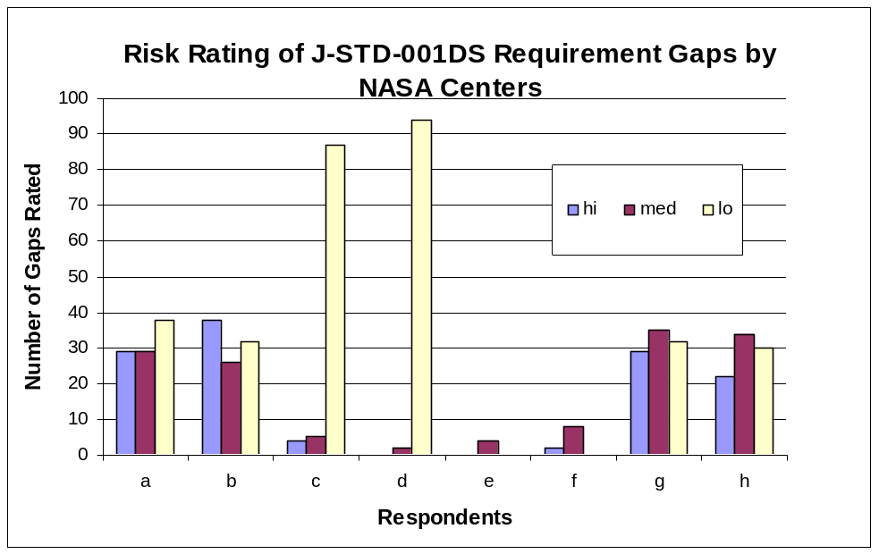
Fast Track Directed for J-STD-001xS Adoption
Schedule is driven by CxP Program requirements effort.
Direction from NASA HQ OSMA was to pursue adoption as a priority over updating 8739 documents.
Requirement Gap Analysis performed (8739 minus J-STD-001DS)
Training program reviewed during IPC Beta run.
Low participation in process by Space industry.
90+ requirement gaps found
Risk rating of gaps results were bimodal
Training found to have significant drawbacks.
Workmanship’s and IPC’s industry distribution is <25% representative of NASA stakeholder community

Slide 13
Overcoming Obstacles to J-STD-001xS Adoption
Close Requirements Gaps – Especially for High Risk Concerns
Coordination meeting held in September at GSFC
All “hi” and “med” rated comments sorted and combined into 51.
J-STD-001xS paragraphs modified or added to address key concerns. Some existing J-STD-001xS paragraphs go unchanged however interpretation will include NASA requirement.
J-STD-001xS WILL NOT BE CONSIDERED A REPLACEMENT FOR 8739.1 for Polymeric Applications.
30 comments prepared with reasons for submission to IPC Space Addendum Subcommittee. NASA will request an interim change (implemented by coversheet).
NASA HQ requires notification and coordination with industry to be represented in final submission to IPC. Currently seeking industry reviewers and participants in J-STD-001DS activity.

Slide 14
Overcoming Obstacles to J-STD-001xS Adoption
Snapshot of Technical Requirements to be Added to J-STD-001DS
Stop Work allowed by operator, inspector, manager
Pure tin [also] not allowed for application conditions which support the growth of tin pest. Lot sampling required.
Review and approval prior to use of new materials and technologies
Documented and approved, prior to use, instructions for preventing the presence of energized sharp points in high voltage applications.
Solder shall be Sn60A (Sn60Pb40), Pb36B(Sn62Pb36Ag02), or Sn63A (Sn63Pb37) and qualified in accordance with J-STD-006. Lead-free allows (<Pb03) shall not be used. The use of alternate alloys require prior approval.
Gold shall be removed from soldered surfaces. ENIG plating is exempt.
Wire shall also meet solderability requirements.
Part bodies must have sufficient clearance around solder joints.
Part marking must be visible
Use of more than two mass reflows must be approved in advance.
Please request a review copy

Slide 15
Overcoming Obstacles to J-STD-001xS Adoption
Training program is developed by J-STD-001 Training Subcommittee
IPC Training Materials: 2-5 “modules”, Classes 1-3 in book, hands-on can focus on a particular Class, 4-hour Space Addendum course (book only), training card “travels” with operator. Training card notes modules taken but not Class trained to.
Local instructors must be traceable to Master Sites (IPC License holder).
NASA suppliers are creating their own versions of training programs outside of this process: Class 3 + Space Addendum + Local Requirements, not Master Site traceable.
Workmanship Project is negotiating a new one-week class “Class 3 + Space” which resembles NASA suppliers’ solution. New subcommittee will be required. Goal is to finish by Nov 08.

Slide 16
Overcoming Obstacles to J-STD-001xS Adoption
Workmanship Project must build working relationship with supplier base.
Engineers working in the PWA and Cable Harnessing are encouraged to become a member of the NASA Workmanship Committee via the PBMA site
(send an email to jeannette.f.plante@nasa.gov - or – rhumphre@pop300.gsfc.nasa.gov)
xLockheed Martin Space Systems Denver
XLockheed Martin ??
Lockheed Martin Palo Alto
Northrup Grumman Baltimore
XNorthrup Grumman ??
xBall Aerospace
Raytheon El Segundo
XRaytheon Missile Systems AZ
XHamilton Sundstrand ??
x Hamilton Sundstrand Windsor Locks
XHoneywell Aerospace Clearwater
XL-3 Communications??
L-3 Communications Bud Lake
XRockwell Collins ??
Aeroflex Colorado Springs
ITT Space Systems Fort Wayne
Orbital Sciences Dulles
Lucix Camarillo
Boeing Huntington Beach
SwRI San Antonio
Los Alamos Labs Los Alamos
Pratt & Whittney
xApplied Physics Lab Laurel
GD/Spectrum Astro
MOOG
Assurance Technology Corp Chelmsford
Assurance Technology Corp Carlisle
ITT Fort Wayne
Babcock
BAE Systems
Cincinnati Electronics Cincinnati
DRS Sensor & Targeting Systems Dallas
xZentek Hayward
USA Cocoa Beach
Eagle Pitcher
xAerospace Corporation Chantilly & El Segundo

Slide 17
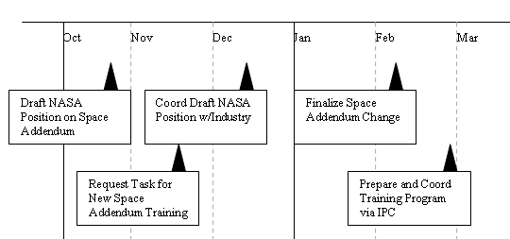
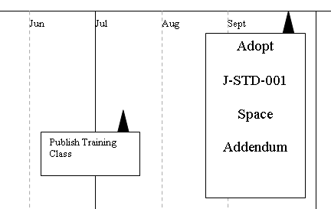
J-STD-001xS Adoption Timeline

Slide 18
J-STD-001xS Transition Summary
Current NASA climate is encouraging critical technical review of all requirements. OMB mandates serious look at using industry standards.
All effort being placed on making J-STD-001 Space Addendum a replacement for NASA-STD-8739.2 and NASA-STD-8739.3 as soon as possible. (Space Addendum includes Class 3, Does not include 8739.1 Polymeric Apps).
NASA’s position on requirements is in industry coordination phase. Goal is an Early 2008 document change (without revision change, will stay DS). Request will be for addition or modification of 29 requirements.
Seeking a change from IPC on training offered. Requesting a week-long class for Class 3 + Space Addendum with hands on at Space Addendum level. Goals is mid-to-late 2008 for course offering.
NASA Workmanship Project will be required to provide high level of participation in IPC process to support the Space Addendum process. Goal for adopting J-STD-001DS w/change is late 2008.

