Slide 1
Envisioning Greater Possibility:
Open Collaboration & Open Standards in E-government.
Expedition Workshop Series #27
August 26, 2003
National Science Foundation
Stafford I Building, 4121 Wilson Blvd., Room 555
Susan Turnbull, GSA, and Brand Niemann, EPA Emerging Technology Subcommittee, (ET S/C)

Slide 2
Purpose of Workshops
Open up communication circles among diverse stakeholders.
Accelerate commitments and maturation of open standard components for e-government.
Collaborative “incubator” process for our sponsors.

Slide 3
Sponsors
Architecture and Infrastructure Committee of the CIO Council (http://www.cio.gov):
  Governance, Components, and Emerging Technology Subcommittees:
    http://cio.gov/documents/architecture_subcommittee_charters.html
Interagency Working Group for Information Technology Research and Development:
  http://www.itrd.gov

Slide 4
Emerging Technology Subcommittee
Key Messages:
  Supports Federal Agencies as they asses new technologies because:
    Organizations have limited capacity of expertise and resources; and
    Individualized vendors marketing to multiple agencies is not cost-effective nor possible for new, small innovative companies.
  Provide process for pilot projects and technology assessment initiatives in support of:
    Vendor clearinghouse;
    Government-wide reusable components; and
    Federal lines of business.

Slide 5
Monthly Open Workshops
Explore common purposes with scope beyond what government can do alone.
Participation by innovators/bridge-builders.
Contributes to culturally expansive learning among separate communities.
Collaboration site at http://ua-exp.gov

Slide 6
Workshop Community Values
Accommodate Difference
  Greater Diversity of Participation around Shared Purpose.
Faster Innovation Diffusion
  Improved Ability to Appreciate the Whole Picture and Engage in Sustained Dialogue.
Better Marketplace Discernment
  Nexus of common sense and good science.

Slide 7
Outcomes
Fostered Two CIO Council Award Recognitions.
ET/Standards Leadership Award to Brand Niemann.
Distributed the “Digital Dividends” Guide to 3500 Senior Executives
New incubator pilot projects from collaboration with the XML Web Services WG.
Development of the e-Health and FEA/XML Web Services Tracks of the GWU e-Gov Conference that will become part of FOSE in 2004.
Initial XML Topic Map Web Service of FEA and Two E-Gov Conferences.
Initiated the Emerging Components Conference Series with the SBA with focus on the SBIR (Small Business Innovation Research Act)

Slide 8
Workshop #27
Purpose:
  To Explore the Potential and Realities of Multi-stakeholder Collaboration Practices, in light of Federal Enterprise Architecture (FEA) goals toward transformative e-government.
    The President's Management Agenda requires all federal agencies to transform the roles and relationships among their people, processes, and technology in order to become a citizen-centered government.

Slide 9
Questions
How can we fulfill these expectations at the federal enterprise level?
How can we collaboratively prepare to work together across institutional boundaries?
How can these smarter "work-forms" help mature technologies for enterprise sustainability?

Slide 10
Questions
These questions will be explored within an experiential workshop:
  We'll learn by doing. Continuing from last month's success, we'll gain additional experience and practice with social science techniques (including reflection exercises and games for knowledge elicitation and sharing) to facilitate the collaborative practice skills needed for Federal Enterprise Architecture adoption.
In future workshops, these techniques will help us as we explore how to advance Component-Based Government-Enterprise Architectures with Semantic Web Services in light of Federal Enterprise Architecture goals.

Slide 11
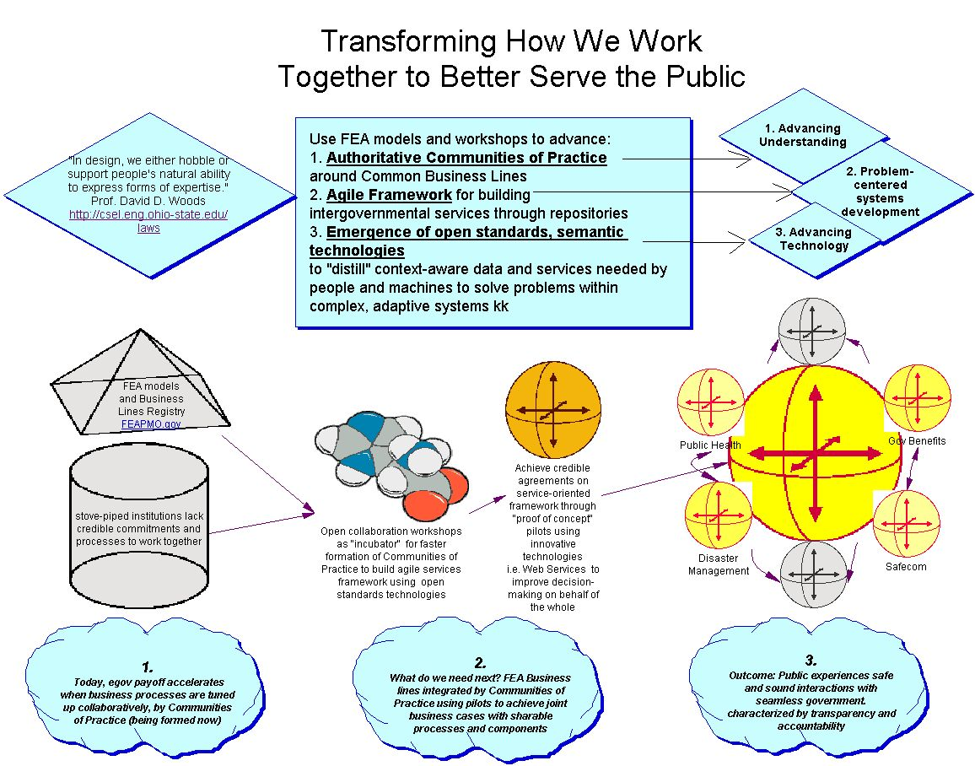

Slide 12
CIO Council’s Architecture & Infrastructure
Committee (AIC) & Federal Enterprise Architecture (FEA)
Collaboration Communities
Small Businesses
Industry Advisory Council
Agencies (SBIR)
E-Gov Initiatives
NASCIO
Technology Associations
Venture Capitalists
Etc. (Who is missing?)
Pilots
1. XML Data Model
& Registry
2. XML E-Forms
3. XML Database
4. XML Collaboration
Network
5. Etc.
BCOS*
XML and Component Repository
XML Documents
UBR** Templates
Topic Maps
Semantic Web (RDF)
GIDS, etc.
*BCOS: Business Compliance One-Stop E-Gov Initiative
A Component is a self-contained business process or service with predefined functionality that may be exposed through a business or technology interface.
**UBR: UDDI Business Registry
UDDI: Universal Description, Discovery, and Integration

Slide 13
Agenda
8:30 a.m. – Coffee and Registration.
8:40 a.m. – Welcome, Susan Turnbull, GSA, Emerging Technology Subcommittee and Brand Niemann, EPA, Emerging Technology Subcommittee.
9:10 a.m. – Introduction and Concept Café, Martine Devos, Researcher at Avaya Labs (formerly Bell Labs) specializing in System Dynamics and Organizational Development.

Slide 14
Agenda (continued)
12:30 p.m. – Lunch and Networking.
1:30 p.m. – Concept Café continued
4:00-5:00 p.m. – Formal workshop adjourns- Informal networking.

Slide 15
Some Coming Attractions and Announcements
September 4, 2003, IRMCO, On Being Open: Tapping the Transformational Power of Collaboration, Standards, Components, and Code, Tony Stanco, Director of the Center of Open Source & Government and Associate Director of the Cyber Security Policy and Research Institute at the George Washington University.
September 8, 2003, Semantic Technologies for E-Gov Workshop at the White House Conference Center. Register with TopQuadrant to obtain an invitation due to space limitations (see slide 17.)
September 10-12, 2003, Enterprise Architecture eGov Conference, September 11, Session 3-2: Using Web Services to Support Your Enterprise Architecture, 1:15-2:30 p.m. Implementing Component-Based Government Enterprise Architecture with Semantic Web Services (see slide 19).
September 17-19, 2003, National Entrepreneurial Conference and Expo, Washington Hilton & Towers, Washington, D.C. Participation details in process.

Slide 16
Some Coming Attractions and Announcements
September 24, 2003, HP Federal Services Web Services Best Practices Workshop (Outline) - The first in a series of special one-day vendor technical workshops on Web Services as part of Phase 2 of the XML Web Services for E-Gov Pilots, at the White House Conference Center. Register with HP Federal Services to obtain an invitation due to space limitations (see slide 18).
September 29, 2003, XML Authoring and Editing Forum (FREE), 9 a.m. - 4 p.m., hosted at Booz Allen Hamilton Inc., 8283 Greensboro Drive, McLean, Virginia 22102. Registration for Vendors and Attendees. See http://xml.gov for details.
September 30, 2003, Collaboration Expedition Workshop #28 and XML Web Services Working Group Meeting. Agendas in process. XML Web Services Working Group graduates all pilots and itself - come join the celebration!

Slide 17
Some Coming Attractions and Announcements
September 8th Agenda Highlights:
  Part 1. W3C Standards, Data Independence and Implementation Roadmap, Semantic Integration Vendor Space and Gallery, and Audience Participation:
    Keynote: "The Semantic Web" - Eric Miller, Activity Lead for W3C's Semantic Web Initiative.
    Invited Talk: "Data Independence and the Roadmap to the Semantic Web", Michael Daconta, McDonald Bradley.
    Semantic Integration Vendor Space and Gallery (see next slide) – Irene Polikoff and Dean Allemang, TopQuadrant.
      Semantic Vendors: enLeague, Entopia, Intellidimensions, Ontoprise, Semagix, Software AG, and Unicorn.
      System integrators: Cool Heads, McDonald Bradley, and TopQuadrant.
  Part 2. Solution Envisioning, Solution Owners and Providers, and Voices of Experience. Ralph Hodgson, CEO TopQuadrant and Pilot Lead:
    Original Pilot and Proposed EPA Integrated Pilot, Ralph Hodgson.
    Panel Session: "Semantic Technologies Solution Owners and Providers" - Robert Coyne,TopQuadrant.
    Voices of Experience (York Sure, Dr. Leo Obrst, Ralph Hodgson, and Professor Jim Hendler

Slide 18
Some Coming Attractions and Announcements
September 24th Agenda Highlights:
  Web Services Case Studies (9:30 a.m.):
    Client-business portal and major application integration.
  Best Practices for Web Services Development (10:45 a.m.):
    Interoperability issues with WSDL and XML Schemas, design patterns architectures, and development and testing practices.
  Web Services Emerging Standards (1:15 p.m.):
    Web Services Security and Web Services Orchestration.
    Comparison of BPEL4WS and WSCI.
  Web Services Management (3 p.m.):
    Monitoring and metering SOAP messages, etc.
See for example: http://sys-con.com/xml/articleprint.cfm?id=649.

Slide 19
Implementing Component-Based Government Enterprise Architecture with Semantic Web Services
AIC Leadership wants more collaboration across all three Subcommittees so from:
  Emerging Technology – select Semantic Web Services.
  Components – select Registry and Repository (Task 2).
  Governance – select Government Enterprise Architecture Framework and Data and Information Reference Model (Goal 3).
The Enterprise Architecture eGov/FEAC Institute Conference wants to explore supplementing its Virtual University collaboration, instruction, and exams with something like this (Felix Rausch, Executive Director, FEAC Certificate Program, August 4, 2003).

Slide 20
Implementing Component-Based Government Enterprise Architecture with Semantic Web Services
Semantic Web Services (Source: Derived in part from two separate presentations at the Web Services One Conference 2002 by Dieter Fensel & Dragan Sretenovic.
Dynamic
Resources
Semantic Web
Services
Web Services
Static
Resources
WWW
Semantic Web
Interoperable
Syntax
Interoperable
Semantics

Slide 21
Implementing Component-Based Government Enterprise Architecture with Semantic Web Services
Name | Source | Status
Justice XML Data Model | Global Justice Information Sharing Initiative | DRM Version 18 http://it.ojp.gov/topic.jsp?topic_id=43
Web Services UDDI Vendor Templates (12) | June 2nd and June 26th Workshops | Available at http://web-services.gov
Semantic Web Services Vendor Templates (expect 10 or so) | September 8th Conference | To be available at http://web-services.gov
XML Schemas | E-Grants | http://www.grants.gov/pmo_ITIntegration.html
XML Schemas for Government Forms | E-Forms for E-Gov Pilot Team | http://www.fenestra.com/eforms/
ebXML Core Components | Joe Chiusano, XML Working Group Registry Team | http://xml.gov/agenda/rrt20030723.htm Posted to QuickPlace on August 2, 2003
Geospatial Portal | Open GIS Consortium (OGC) | Template part of June 2nd Workshop at http://web-services.gov

Slide 22
Implementing Component-Based Government Enterprise Architecture with Semantic Web Services
Name | Source | Status
Geospatial Portal | Open GIS Consortium (OGC) | Template part of June 2nd Workshop at http://web-services.gov
Web Services Design Patterns | HP for September 24th Workshop | http://sys-con.com/xml/articleprint.cfm?id=649
XML Data Integration Architecture | IAC White Paper pages 25-26 and XML Web Services WG Pilot | Posted to QuickPlace on July 31, 2003
Goal 3-Tasks 3&4 | Government Enterprise Component Registry and Repository Using Native XML Database Technology Pilot | Posted to QuickPlace on July 29, 2003
Business Compliance One-Stop | Four Integrated Pilots in Revised Business Case and Work Plan | See Upcoming Meetings, August 13-14, 2003, The "E-Forms for E-Gov" Business Case Story at http://web-services.gov
Proposed Semantic Web Technologies for EPA Pilot | Five Integrated Pilots | See Announcements, June 28th, at http://web-services.gov

Slide 23
Implementing Component-Based Government Enterprise Architecture with Semantic Web Services
Repurposing Government Enterprise Architecture Documents Into Semantic Web Services:
  Some of the types of XML Information Object Documents that individual paragraphs could be converted to:
    1. Document Structure – Table of Contents, Index, Title, etc.).
    2. Finding – A short fact the document asserts as true possibly through empirical evidence.
    3. Instruction – A tutorial on a topic.
    4. Terminology Definition – A definition of a term.
    5. Definition Example – A specific instance that illustrates a definition is accurate and true.
    6. Process Definition – A description of a sequence of steps that causes an effect.
  All these information object types were extracted from the document by looking at each paragraph and saying, "what is this information trying to accomplish?".
Source: Michael Daconta, Chief Scientist, APG, McDonald Bradley, Inc. August 6, 2003

Slide 24
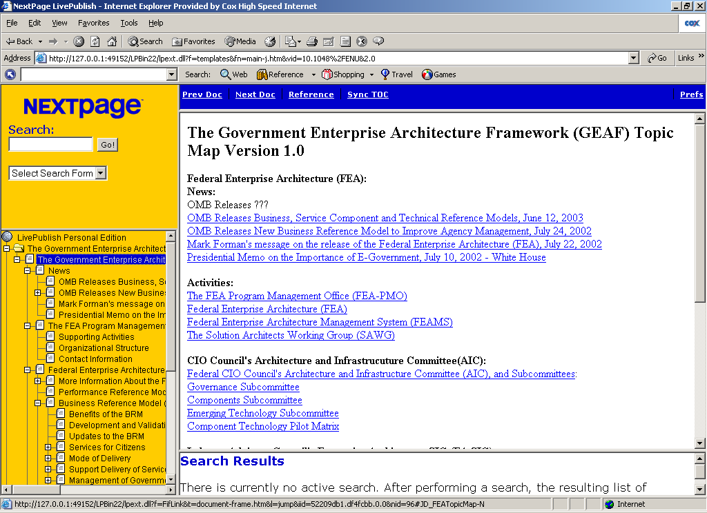
Implementing Component-Based Government Enterprise Architecture with Semantic Web Services
Integrate content from FEAPMO, NASCIO, IAC, Agencies (Federal and State), etc. and across the three CIOC AIC Subcommittees*.
Add structure, interoperability (XML), interlinking and search.
Standardize terminology (on way to Government Core Ontology and “smart data”) for machine & EA tool processing.
Include XML Schemas and structured data (forms).
Show best practices of standards-based, reusable, interoperable components.
See http://web-services.gov
*Governance, Components, and Emerging Technology Subcommittees.

