Slide 1
Agenda
Spaceward Bound Planning Session #2
April 11, 2006
Homework review (Liza)
Group discussion on exploration processes (Chris)
Homework (Liza)
Questions (and answers!)

Slide 2
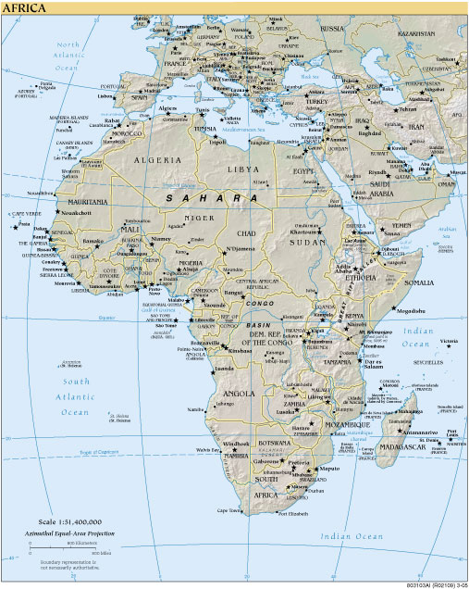
Negev Desert
Extremely arid
Water: environmental limiting factor
Comparison with Gobi: lack water but dissimilar climatic factors
Tunisia
Geomorphology
Microbial Structures
Robots & Drills
Jebel Uweinat
Extremely arid
Mars-like soils

Slide 3
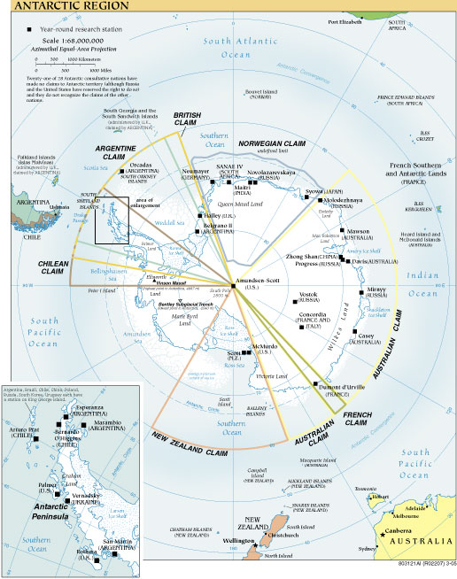
South Pole
Extreme environment
Habitation
Human factors
Lake Vostok
Ancient ice
Microbiology
Dry Valleys
Microbiology
Pluvial environment

Slide 4
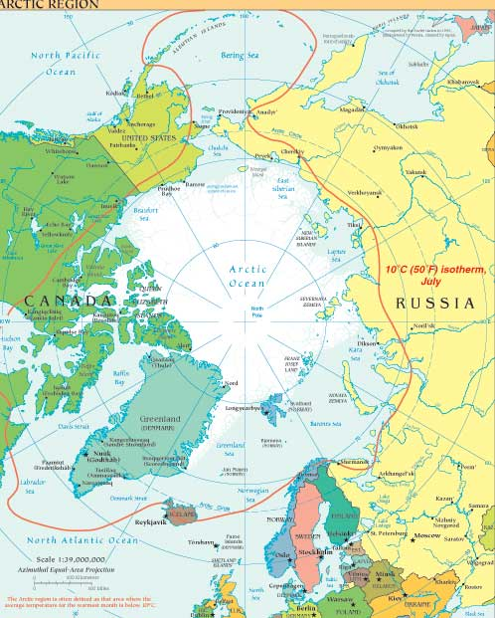
Devon Island
Haughton Crater
Flashline Mars Arctic Research Station
SIMULATION
Habitation
Human factors
Systems Engr.
Techniques for human exploration of Mars
Axel Heiberg Island
McGill Arctic Research Station
Permafrost hydrology
Geomorphology
Microbiology
Krafla Region
Euro-Mars
SIMULATION
Habitation
Human factors
Geology
Systems engr.
Astrobiology
Svalbard Island
Hydrothermal activity
Water-rock interactions

Slide 5
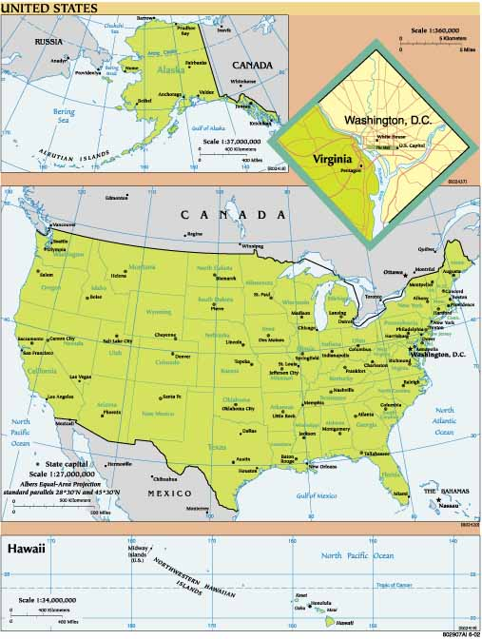
Lassen Volcanic Nat’l Park
Snowpacks
Snow algae
Nevada Test Site
and China Lake
Comparison of remote IR spectra here and from Mars
Great Sand Dunes
Geomorphology: sand: dunes, waves, ripples
Wind effect
Utah
Mars Desert Research Station
SIMULATION
Geology
Grand Canyon
Geomorphology: canyon formation
Mojave Desert
Rover software devel; operations team training
Geomorphology: stream beds, sand
Sedimentary geochemistry
Aeolian, pluvial feature formation
Mauna Loa
Kilauea
Shield volcanoes

Slide 6
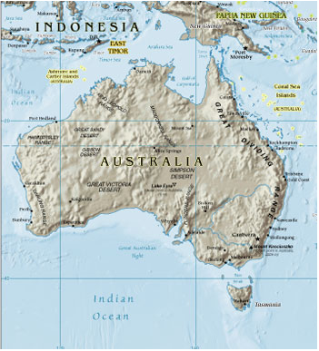
Aerodrome Lake
Saline lake environment
Arkaroola
MARS-Oz
SIMULATION
Geology
Pilbara Region
Ancient life
Geology

Slide 7
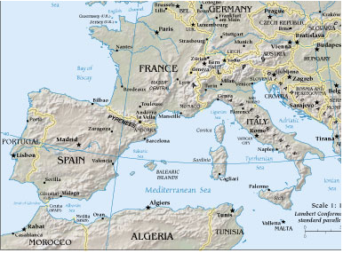
Rio Tinto
Subsurface life
Basaltic volcanism
Hydrothermal activity
drilling
Mt. Etna
Shield volcano

Slide 8
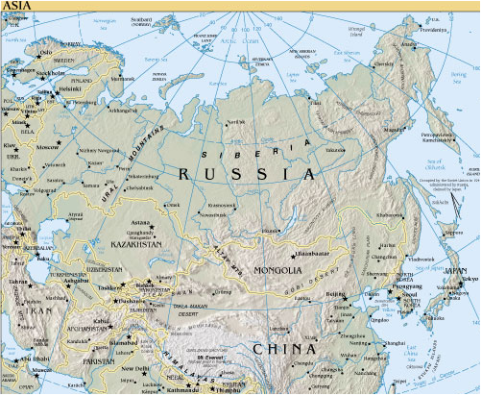
Kolya River
Ancient permafrost
Drilling
Khubsughul
Microorganisms from ancient phosphorites
Gobi Desert
Extremely arid
Water: environmental limiting factor
Comparison with Negev: lack water but dissimilar climatic factors

Slide 9
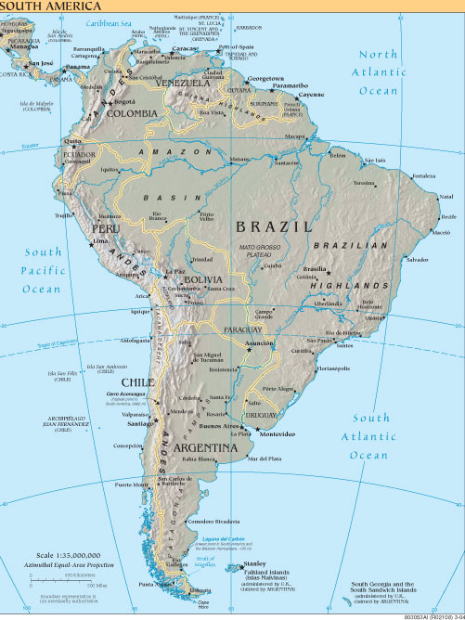
Licancabur
Very high, very cold
UV studies
Saline environments
Microbial habitation
Atacama Desert !!!

Slide 10
Take Home Ideas
Mars Analog Sites
There are LOTS of them! (maybe some in your own backyard - discovered or not yet discovered!)
International cooperation is key!
Some are hot and some are cold ….??
Some focus on science, others on technology ….??
--> Simulation

Slide 11
The Next Generation of Space Explorers Must….
understand how to establish and maintain outposts in harsh environments
be trained to live and work in these environments
learn how to the explore the surfaces of other worlds
    Their experience base must include a deep understanding of human factors, life support, transportation, safety through redundancy, and technology-assisted exploration in a remote (off-the-grid) setting.
Simulation - where theory meets practicality

Slide 12
Teacher Learning Content
Processes of exploration in the field
  Logistics and transportation
  Energy and life support
  Human factors
  Exploration and EVA activities
Science content and processes
  Atacama science
  Concepts and theories of Moon/Mars analog research

Slide 13
Homework due April 28
Study the analog sites developed by the Mars Society
  MDRS - Hanksville, UT
  MARS-Oz - Arkaroola, Australia
  Euro-MARS - Iceland
  Flashline MARS - Devon Island
Write four brief essays on how each of the exploration processes is simulated at each of the sites
  Logistics and transportation
  Energy and life support
  Human factors
  Exploration and EVA activities
Write two brief essays that compare and contrast the differences between the sites with respect to the exploration processes simulated, for example….
  Why one site simulates a process and another doesn’t
  What are the strengths and weaknesses of each site with respect to simulation fidelity
Summarize all the above with an essay on what we can do on our expedition to as effectively as possible to simulate the processes in our focus area
Everyone must do #1-3 individually. For #4, submit one essay from your team.

