Slide 1
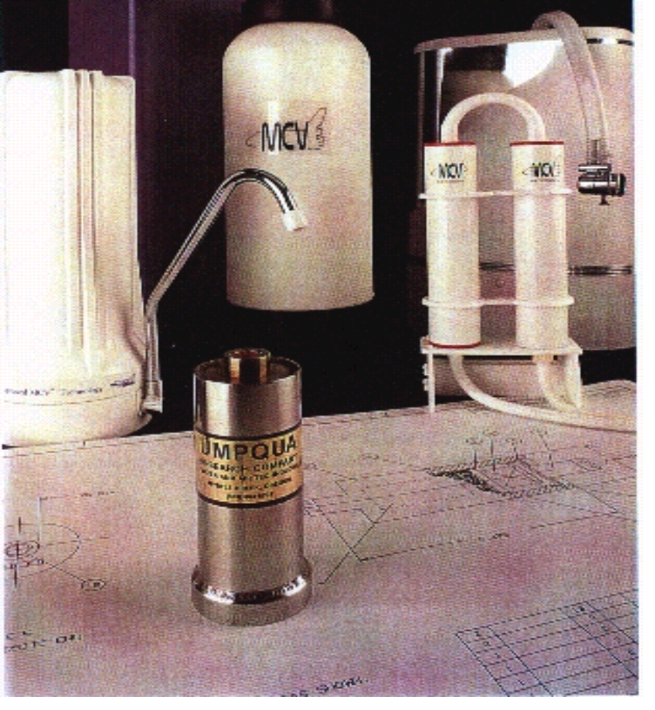
Hygiene Water Prefilter
Umpqua, Houston, TX
Innovation
Apparatus developed for use in zero gravity Shower and Laundry
Systems includes particulate filters, laundry cleansing agents, phase
separators, soap dispensers and foam removers.
Accomplishments
Simple and reliable means of removing particulate matter from shower and
laundry waste waters.
Simple and reliable means of dispensing soap and removing foam from
space shower and laundry waste waters.
Advancement in space laundry cleansing agent and laundry phase
separation technology.
Products; Shower Sock Prefilter, Laundry Phase Separator, Shower Soap
Dispenser and Mechanical Foam Remover.
$60K support from Life Systems Inc.. prior to reconfiguration of Space
Station.
Contact with Boeing, Life Systems, ILC, A.D. Little and other potential
contractors for Space Station Life Support Systems is ongoing.
Hygiene Water Prefilter
Commercialization
Funding for life support and housekeeping hardware related to long term
manned space habitation will dictate the rate of commercialization
NASA represents the immediate market.
Support for Space Shower and Laundry system is anticipated during Phase
C/D of Space Station Life Support Development.
Government/Science Applications
Space Station requirements for personal hygiene waste
water redemption.
Application is specifically directed to resolve shower
and laundry problems associated with zero gravity.
Johnson Space Center
August 12, 1999
SS# 9-018
Points of Contact:
- Jane I Fox, 281-483-4815
- Umpqua, umpqua.hq@fpioneer-net.com
1987 SBIR Phase I; NAS 9-17953 SS # 09-17

