Slide 1
Appeal of Staff Denial of
Building Permit
BP 13453
Michael A. Wakem, Eva Ouellette,
Kathy J. Williams, and Edwina Vincent
T16 R 4 WELS, Aroostook County

Slide 2
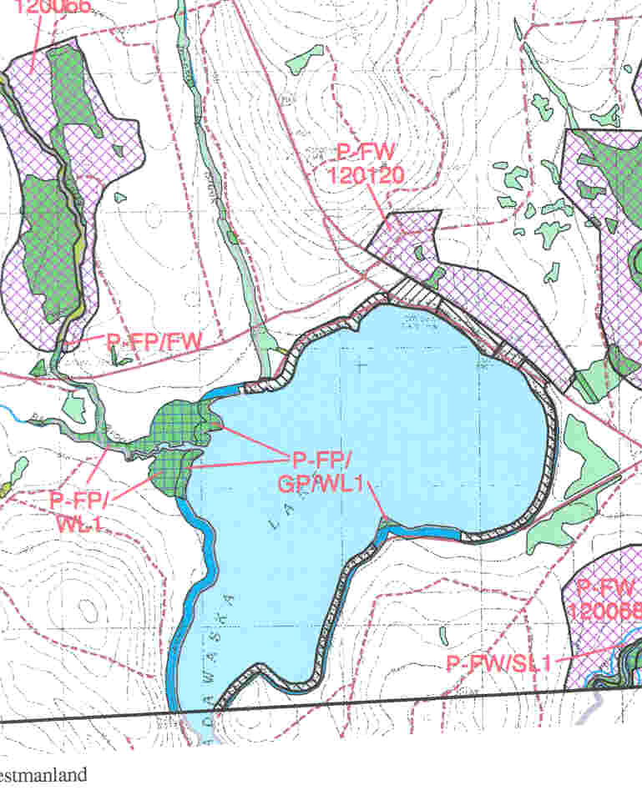

Site Location and Description
Lot #128
South Shore Road
Madawaska Lake
1.54 acres (67,082 sq. ft.)
173.87 feet of shore frontage
212 feet of road frontage
(D-RS) General Development Subdistrict
(P-GP) Great Pond Protection Subdistrict
(M-GN) General Management Subdistrict
Notes:
Lot was forested, heavily cut two? years ago, now regenerating well.

Slide 3
Administrative History
Pre-Commission seasonal camp, garage, outdoor dining shelter, and shed on lake side of road.
Pressurized water supply and combined sewage disposal system.
Summer 2006, three self-contained camper trailers were installed without a permit - EC 06-034. One has been removed.
BP 13453 Application received October 2, 2006 for 2 self-contained camper trailers across road.
Denial of BP 13453 Application issued by staff on November 30, 2006.

Slide 4
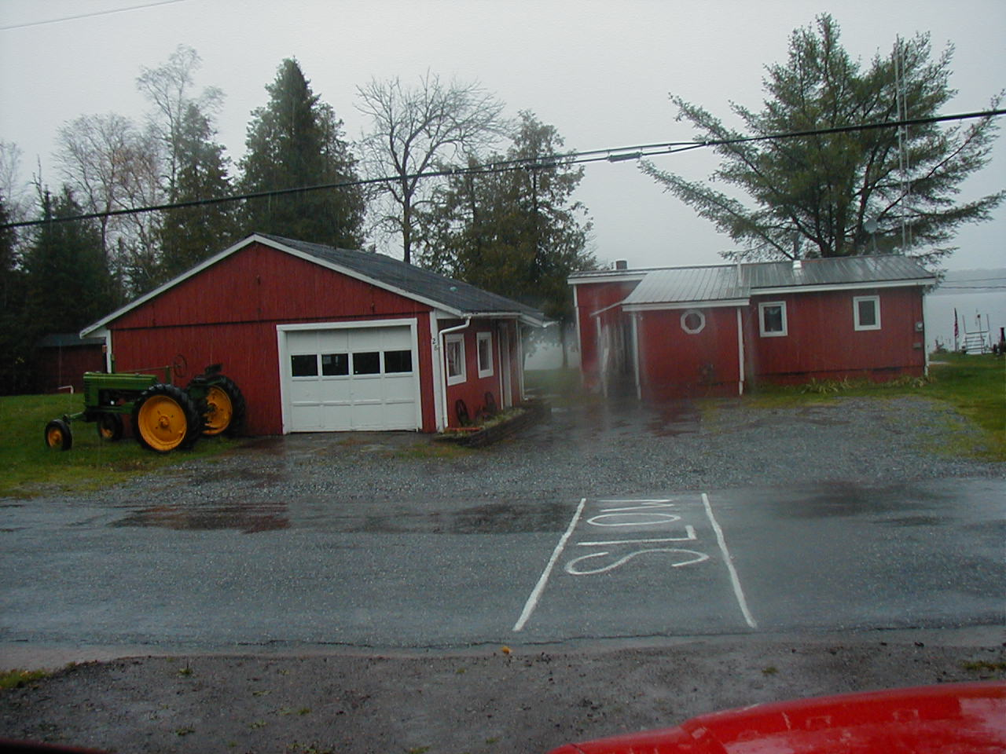

Slide 5
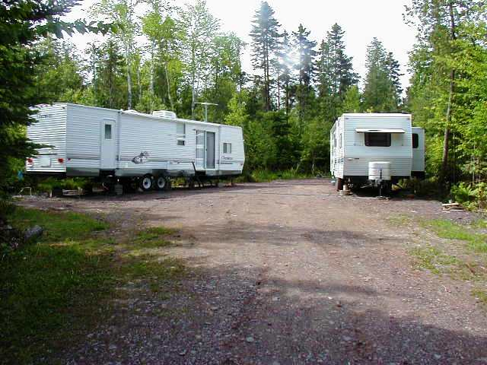

Slide 6
Proposal
Two After-the-fact Self-Contained Camper Trailers
8’x38’ and 8’x39’ in size.
Used 30-40 days/year primarily for sleeping and closed up for winter.
245 feet from lake, 60 feet from road.
Campers contain plumbing but not proposed to be hooked up to an external pressurized water supply or waste water disposal system.
Notes:
Fence never constructed

Slide 7
Review Criteria
10.02,189 - Campsite – “does not include a camping location that has access to a pressurized water system or permanent structures…”
10.02,46 - Dwelling Unit – “Accessory structures intended for human habitation that have plumbing are considered dwelling units.”
10.26,A – 40,000 sq. ft. per dwelling unit.
10.26,B – 200 feet of shoreline frontage per dwelling unit.
10.26,C – 100 feet of road frontage per dwelling unit.

Slide 8
Appeal Request
Appeal Filed on December 19, 2006 by Kathy J. Williams.
Appellant states that the lot owners were given verbal permission by staff to place the two self contained campers on the lot without a permit for basic sleeping purposes and were not informed that there was a 90 day limit. They indicate that money has been invested since then and the time of issuance of the denial.

Slide 9
Conclusions
The proposal does not meet the definition of “campsite” but does meet “dwelling unit” definition.
The proposal does not meet the minimum lot size, shoreline frontage and road frontage requirements per dwelling unit under Sections 10.26,A, B, and C.
Would need 120,000 sq. ft., 600 feet, and 300 feet, respectively.
The proposal does not meet the Criteria for Approval, 12 M.R.S.A. section 685-B(4) of the Commission’s Statutes.

Slide 10
Staff Recommendation
Staff recommends that the Commission uphold the staffs’ Denial of the application for BP 13453 for after-the-fact approval of the two self-contained camper trailers.

