Slide 1

The FDA Process for Approving Generic Drugs
Blue Cross Blue Shield of Michigan
Continuing Medical/Pharmacy Education Program
Gary J. Buehler, R.Ph
Director
October 29, 2002

Slide 2
Did you know that generic drugs...
Are safe and effective alternatives to brand name prescriptions
Can help both consumers and the government reduce the cost of prescription drugs
Are currently used in 44% of all prescriptions dispensed

Slide 3
And...
Save an average of $45.50 for every prescription sold
Currently save consumers $56.7 billion/year
Can save consumers an additional $1.32 billion/year for every 1% increase in the use of generic drugs
Source: National Association of Pharmaceutical Manufacturers, December 15, 2000

Slide 4
Hatch-Waxman Amendments to FFD&C Act - 1984
Considered one of the most successful pieces of legislation ever passed
Created the generic drug industry
Increased availability of generics
    1984 12% prescriptions were generic
    2000 44% prescriptions were generic - yet only 8% of revenue for prescription drugs
Compromise legislation to benefit both brand and generic firms
Continued

Slide 5
Hatch-Waxman Amendments to FFD&C Act - 1984
Allowed generic firms to rely on findings of safety and efficacy of innovator drug after expiration of patents and exclusivities (do not have to repeat expensive clinical and pre-clinical trials)
Allowed patent extensions and exclusivities to innovator firms

Slide 6
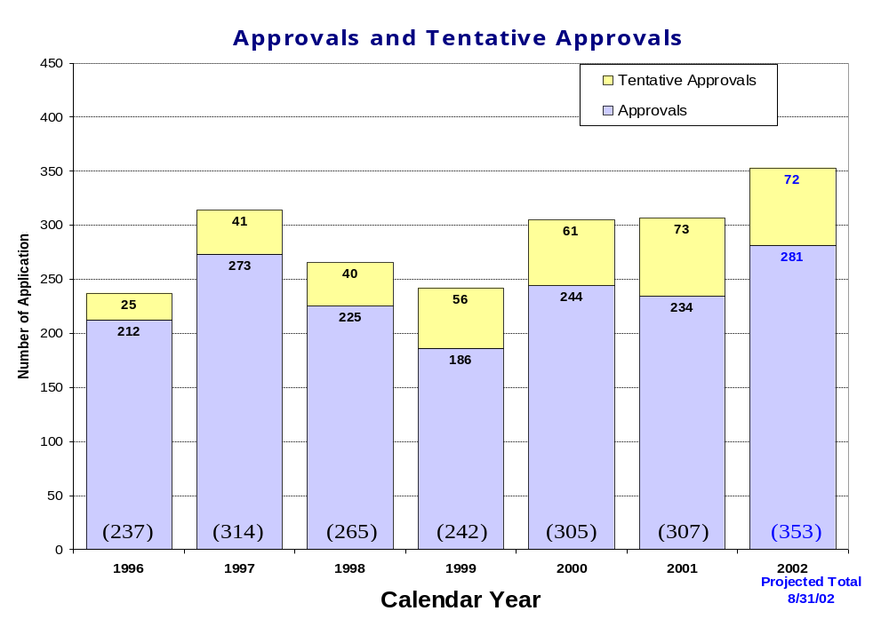
Office of Generic Drugs

Slide 7
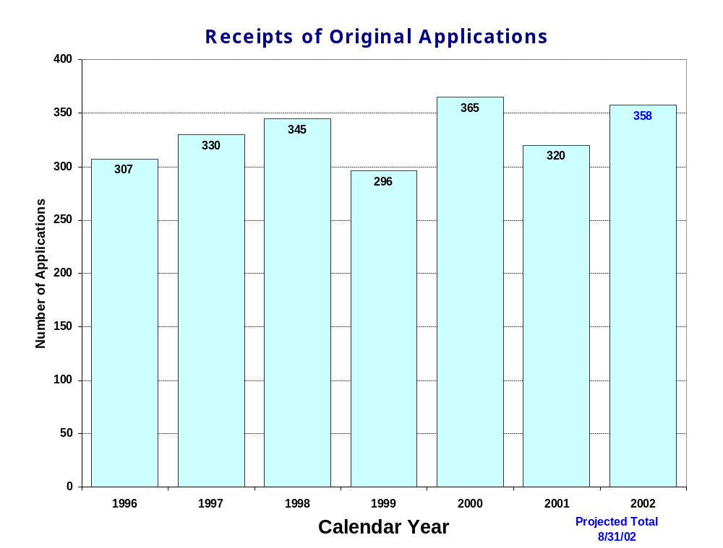
Office of Generic Drugs

Slide 8
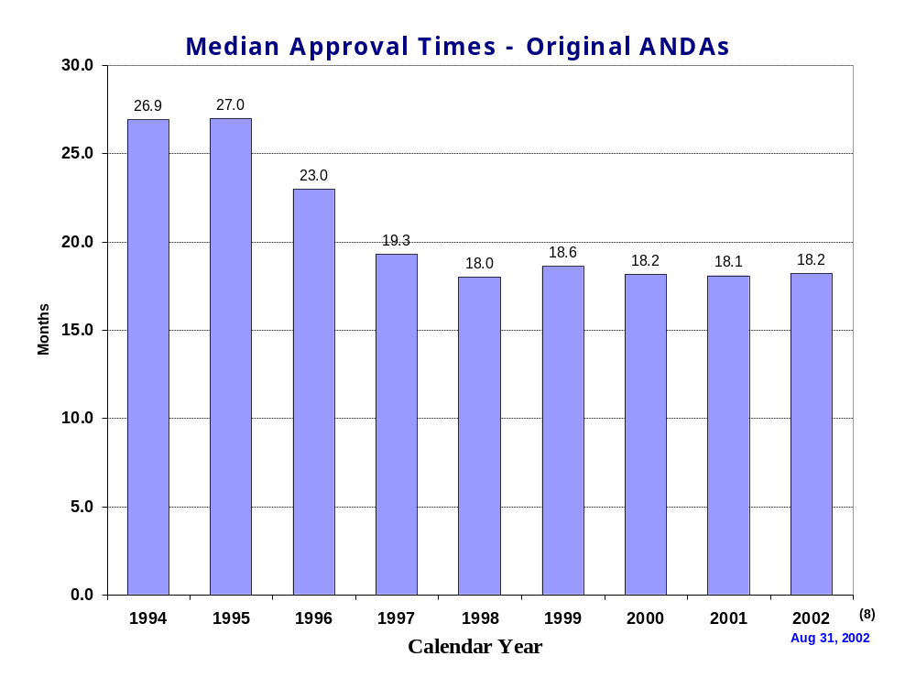
Office of Generic Drugs

Slide 9
NDA vs. ANDA Review Process
Brand Name Drug Generic Drug
NDA Requirements ANDA Requirements
1. Chemistry 1. Chemistry
2. Manufacturing 2. Manufacturing
3. Controls 3. Controls
4. Labeling 4. Labeling
5. Testing 5. Testing
6. Animal Studies
7. Clinical Studies 6. Bioequivalence
8. Bioavailability

Slide 10
What are the requirements for a generic drug?
Labeling
Chemistry/Microbiology
Bioequivalence
Legal

Slide 11
How do we assure the quality of generic drugs?
First 5 steps of review process are identical to NDA process
Bioequivalence for complicated products is discussed with the same staff that reviewed the brand product
FDA has experience with the product
Scientific literature published
Product is known to be safe

Slide 12
Generic Drug Review Process

Slide 13
What are the requirements for a generic drug?
Same active ingredient(s)
Same route of administration
Same dosage form
Same strength
Same conditions of use
Compared to reference listed drug (RLD) - (brand name product)

Slide 14
Labeling
“Same” as brand name labeling
May delete portions of labeling protected by patent or exclusivity
May differ in excipients, PK data and how supplied

Slide 15
Chemistry
Components and composition
Manufacturing and controls
Batch formulation and records
Description of facilities
Specs and tests
Packaging
Stability

Slide 16
Examples of Information Covered in a Chemistry Review
Qualitative and quantitative listing of all active and inactive ingredients; including grade of each component
Continued

Slide 17
Examples of Information Covered in a Chemistry Review
Review of manufacturing and controls includes evaluation of:
  Process for manufacturing
  Controls (Inspections, sample points, test, methods, acceptance criteria) in place from the receipt of the raw material to the labeling and storage of the finished product; includes the Certificate of Authorization (COA) from the raw material manufacturer and the firm’s own testing and specifications in a COA
  Synthesis of the active pharmaceutical ingredient(s) (API) (raw material, drug substance) or authorization to reference a Drug Master File (DMF)
Continued

Slide 18
Examples of Information Covered in a Chemistry Review
  Impurity profile of the API
  Stability of the API
  Characterization of degradation products with drug substance and drug product
  Microbiological testing when appropriate (Reviewed by Microbiologists)
Continued

Slide 19
Examples of Information Covered in a Chemistry Review
Batch formulation and batch records
  Manufacturing record provides a representation of the formula, manufacturing instructions, description and size of manufacturing equipment
Continued

Slide 20
Examples of Information Covered in a Chemistry Review
Description of the manufacturing facilities in general; identification of all firms and facilities involved
Stability profile (with information on such things as container/closure system); adequacy of protocol and methods
Evaluation of methods validation information prior to laboratory evaluation

Slide 21
Examples of Information Covered in a Chemistry Review
Container/Closure Systems
Environmental Assessment compliance

Slide 22
Manufacturing Compliance Programs
Purpose - To assure quality of marketed drug products
Mechanisms - Product Testing
  Surveillance
  Manufacturing/Testing plant inspections
  Assess firm’s compliance with good manufacturing processes

Slide 23

APPROVED
DRUG PRODUCTS
WITH
THERAPEUTIC EQUIVALENCE EVALUATIONS
22nd EDITION
THE PRODUCTS IN THIS LIST HAVE BEEN APPROVED UNDER
SECTION 505 OF THE FEDERAL FOOD, DRUG, AND
COSMETIC ACT.
U.S. DEPARTMENT OF HEALTH AND HUMAN SERVICES
PUBLIC HEALTH SERVICE
FOOD AND DRUG ADMINISTRATION
CENTER FOR DRUG EVALUATION AND RESEARCH
OFFICE OF INFORMATION TECHNOLOGY
DIVISION OF DATA MANAGEMENT & SERVICES
2002
Electronic Orange Book - http://www.fda.gov/cder/ob/

Slide 24
“Orange Book”
All FDA approved drug products listed (NDA’s, OTC’s & ANDA’s)
  Therapeutic equivalence codes
    “A” = Substitutable
    “B” = Inequivalent, NOT Substitutable
  Expiration dates: patent and exclusivity
  Reference Listed Drugs/brand drugs identified by FDA for generic companies to compare with their proposed products

Slide 25
B-Rated Drugs
Exist because of the evolution of FFD & C Act
  FFD & C Act 1938 - safety only
  1962 Amendments - Added effectiveness requirement
  DESI program to assess efficacy of drugs approved between 1938 and 1962
  1970 - Regulation initiating the ANDA procedure
Continued

Slide 26
B-Rated Drugs
  1977 - Bioavailability/Bioequivalence (BA/BE) regulations finalized
    Required BA data in NDAs; BE data in ANDAs
    Divided DESI effective drugs - products that needed BE shown in vivo and in vitro (bio problem drugs) and products that BE may be shown in vitro only (non-bio problem drugs)
  Many bio problem drugs approved as safe and effective before 1977 - in vivo determination of BE deferred for reasons such as inadequate methodology
  FDA determined BA/BE regulations could not be used retrospectively
Continued

Slide 27
B-Rated Drugs
  1984 Hatch-Waxman - gave FDA statutory authority to require a demonstration of BE before an ANDA could be approved. No longer allowed approval of bio problem drugs
  Products for which in vivo demonstration of BE was deferred are listed as therapeutic inequivalent or “B” rated
  Those still appearing in the Orange Book are about 3% - FDA does not have data demonstrating equivalence or inequivalence

Slide 28
Definition of Bioequivalence
Pharmaceutical equivalents whose rate and extent of absorption are not statistically different when administered to patients or subjects at the same molar dose under similar experimental conditions

Slide 29
Bioequivalence Example
8
Test/Generic
7
Reference/Brand
6
5
4
3
2
1
0
6
12
18
24
30
36
42
48

Slide 30
Purpose of BE
Therapeutic equivalence (TE)
Bioequivalent products can be substituted for each other without any adjustment in dose or other additional therapeutic monitoring
The most efficient method of assuring TE is to assure that the formulations perform in an equivalent manner

Slide 31
Model of Oral Dosage Form Performance
Pharmacokinetic Measurement
Clinical/PD Measurement
Dosage Form Performance
Dosage
Form
Drug in
Solution
Gut Wall
Blood
Site of
Activity
Therapeutic
Effect
Dose
ln Dose

Slide 32
Clinical/PD Dose-Response
Clinical/PD Response
Log Dose

Slide 33
Plasma Concentration-Dose
Plasma Conc.
Dose

Slide 34
Approaches to Determining Bioequivalence (21 CFR 320.24)
In vivo measurement of active moiety or moieties in biologic fluid
In vivo pharmacodynamic comparison
In vivo limited clinical comparison
In vitro comparison
Any other approach deemed appropriate by FDA
  FeV₁ Albuterol
  Blanching Study
  Topical Corticosteroid
  Topicals
  Nasal Suspensions
  Questran - Binding Studies
  Nasal Solutions-Sprayer Evaluation
  Propofol - Droplet Size

Slide 35
Study Designs
Single-dose, two-way crossover, fasted
Single-dose, two-way crossover, fed
Alternatives
  Single-dose, parallel, fasted
  Single-dose, replicate design
  Multiple-dose, two-way crossover, fasted
  Clinical endpoint study
  Long Half-Life (wash-out)
  Amiodarone, Etidronate
  Highly Variable Drugs
  Less Sensitive
  Clozapine (Patient Trials)
  Chemotherapy Trials
  Topicals
  Nasal Suspensions

Slide 36
Waivers of In Vivo Study Requirements
Definition
Criteria (21 CFR 320.22)
  In vivo bioequivalence is self-evident
  Parenteral solutions
  Inhalational anesthetics
  Topical (skin) solution
  Oral solution
  Different proportional strength of product with demonstrated BE

Slide 37
Statistical Analysis
(Two One-sided Tests Procedure)
AUC and Cmax
  90% Confidence Intervals (CI) must fit between 80%-125%

Slide 38
Statistical Analysis
80 - 125 %
What does this mean?
Can there be a 46% difference?
What is a point estimate?
What is a confidence interval?

Slide 39
Statistical Analysis
Bioequivalence criteria
  Two one-sided tests procedure
    Test (T) is not significantly less than reference
    Reference (R) is not significantly less than test
    Significant difference is 20% (α = 0.05 significance level)
      T/R = 80/100 = 80%
      R/T = 80% (all data expressed as T/R so this becomes 100/80 = 125%)

Slide 40
Possible BE Results (90% CI)
80%
T/R (%)
125%

Slide 41
Narrow Therapeutic Range (NTI) Drugs
Drug Products that are subject to therapeutic drug concentration or pharmacodynamic monitoring
  Examples are: Digoxin, Lithium, Phenytoin, Warfarin
Traditional bioequivalence limit of 80-125% is unchanged for these products

Slide 42
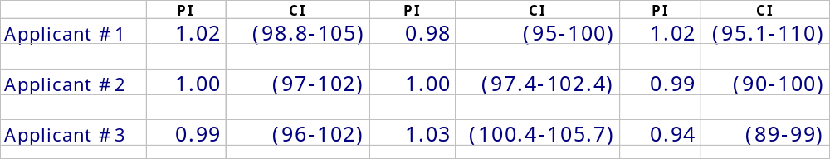
Generic Warfarin
10mg Tablets
AUC_{0-τ} AUC_{0-} Cmax

Slide 43
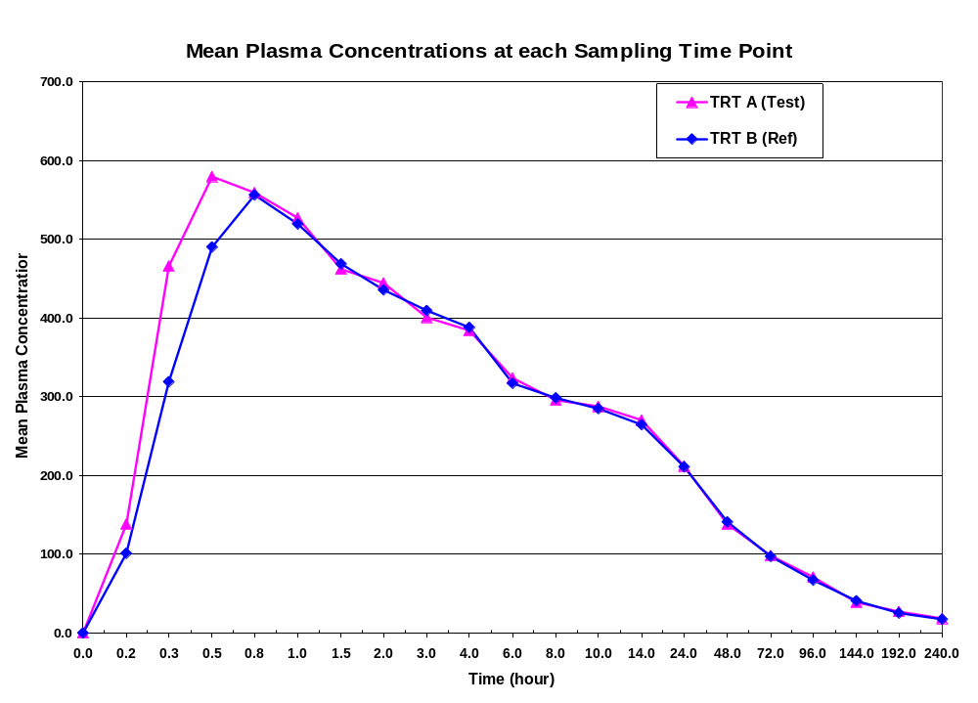
Warfarin Bioequivalence Example

Slide 44
In Vivo Bioequivalence Inspections
Covers clinical and analytical components
Objectives
  Verify quality and integrity of the scientific data
  Ensure rights and welfare of human subjects are protected
  Ensure compliance with the regulations and promptly follow-up on significant problems (research misconduct; fraud)

Slide 45
Generic Drug Education Program
Congress acknowledged overall need for educational program
FY‘02 $400,000 allocation
Program to educate the public on the quality of generic drug products

Slide 46
Physician Focus Group Findings
MDs know little about FDA review and approval process--especially how it differs for generic products
Lack of knowledge and understanding of bioequivalence (sameness) evaluation testing
“Placebo” effect - product looks different
Need more information

Slide 47
Getting the Message Out
Target health care providers (Physicians, Pharmacists) as well as consumers
Continuing Education (CE) Programs
Office of Training and Communications (OTCOM) Specialists in CDER

Slide 48
Educational Program Activities
Print PSA Focus Testing
Brochures NAPs Article
Posters Give-Aways
Web Site Consumer Page Bus/Train Ads
Magazine Ads Movie Theater Ads

Slide 49
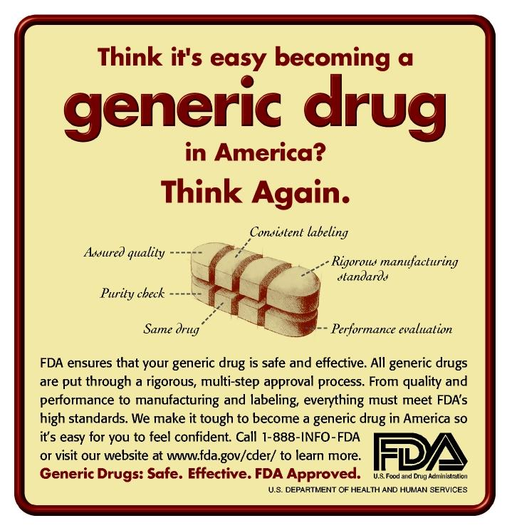

Slide 50
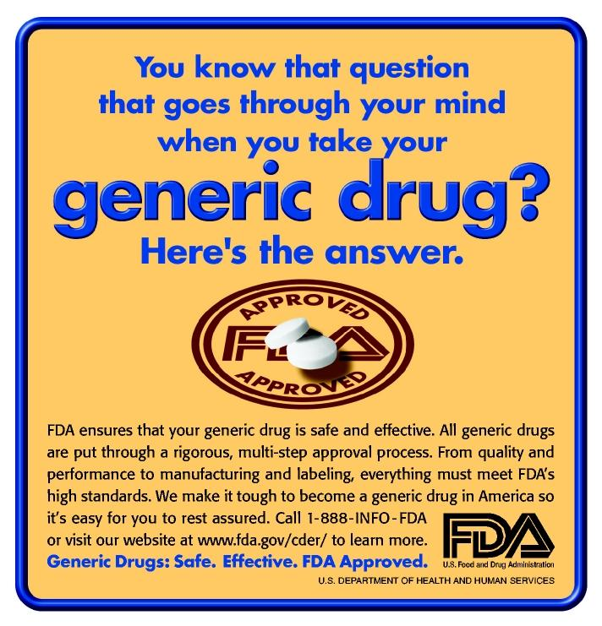

Slide 51
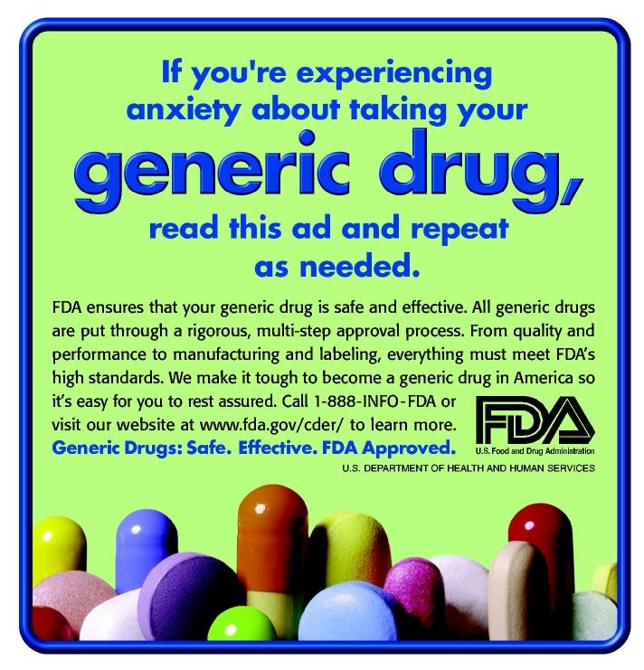

Slide 52
Generic Drug Education Program Posters
Contact: Ellen Shapiro
Director, Div. of Public Affairs
Center for Drug Evaluation and Research
phone: 301-827-1667
Web address:
www.fda.gov/cder/consumerinfo/DPAdefault.htm

Slide 53

Office of Generic Drugs
Center for Drug Evaluation and Research

