Slide 1
Micro Arcsecond Xray Imaging Mission: Pathfinder (MAXIM-PF)
Final Version
Launch Vehicle Information
Larry Phillips
MAY 13th-17th, 2002

Slide 2
Launch Vehicle Options
Projected Launch: Year: 2015
Mission Life 4 Years (5 Years Goal)
LAI-MAXIM: S/C weight: X,XXX kg Dry Mass
2,800 kg Wet Mass Approx. (Lift-off weight)
Earth escape C3 (km2/s2)= 0 / -.7 / -2.2 / -2.7
Launch Vehicle Case Study:
Ariane-5
Atlas V (521, 531, 441, 551)
Delta IV (4040, 4240, 4450, 4050H)

Slide 3
Launch Vehicle Options (Ariane V)
Ariane V (Fairings: 12.7m, 13.7m, 17m x 5.4m wide)
Launches: 7. Failures: 1. Success Rate: 85.71% pct. First Launch Date: 04 June 1996. Last Launch Date: 14 September 2000.
LEO Payload: 16,000 kg. to: 407 km Orbit. at: 51.6 degrees.
Payload: 6,800 kg. to a: Geosynchronous transfer, 7 deg inclination
trajectory. Liftoff Thrust:
Payload: Escape Missions: To be demonstrated in the near future: Target orbit: V# 3 380m/s, Declination 1.99’, Cost Phase Duration 7000s,
Payload Performance: A5 ES 3,500 kg
Launch Price $: 180.00 million. in 2000 price dollars.
Stage Number: 0. 2 x Ariane 5-0 Gross Mass: 277,500 kg. Empty Mass: 39,800 kg. Thrust (vac): 660,000 kgf. Isp: 275 sec. Burn time: 129 sec. Isp(sl): 250 sec. Diameter: 3.0 m. Span: 3.0 m. Length: 31.6 m. Propellants: Solid No Engines: 1. P230
Stage Number: 1. 1 x Ariane 5-1 Gross Mass: 170,800 kg. Empty Mass: 12,700 kg. Thrust (vac): 113,600 kgf. Isp: 430 sec. Burn time: 589 sec. Isp(sl): 340 sec. Diameter: 5.5 m. Span: 5.5 m. Length: 30.5 m. Propellants: Lox/LH2 No Engines: 1. Vulcain
Stage Number: 2. 1 x Ariane 5-2 Gross Mass: 12,500 kg. Empty Mass: 2,700 kg. Thrust (vac): 2,800 kgf. Isp: 324 sec. Burn time: 1,100 sec. Diameter: 4.0 m. Span: 5.5 m. Length: 3.4 m. Propellants: N2O4/MMH No Engines: 1. Aestus
Note: All prices are estimated in FY 2001 dollars based on current contracts or publicly disclosed information. Actual prices may vary
based on market conditions, competitive negotiations and mission unique requirements. Figures do not include efforts to
support flying Dual Payload Configurations, major modification cost or Western Range Launches. Escalation figures for out
years (2002-2003) are approximately 4% cumulative. For budget planning purposes for AO/Future Studies.

Slide 4
Launch Vehicle Options (Atlas V)
Atlas V (521)
Performance: (C3 (km2/s2): 0: 4,545 kg Generic performance
(C3 (km2/s2): -.7: 4,605 kg Generic performance
(C3 (km2/s2): -2.2: 4,725 kg Generic performance
(C3 (km2/s2): -2.7: 4,765 kg Generic performance
Est. Cost (Fy’01) $112M std. Fairing
Atlas V (531)
Performance: (C3 (km2/s2): 0: 5,210 kg Generic performance
(C3 (km2/s2): -.7: 5,275 kg Generic performance
(C3 (km2/s2): -2.2: 5,420 kg Generic performance
(C3 (km2/s2): -2.7: 5.470 kg Generic performance
Est. Cost (Fy’01) $116M std. Fairing
Note: All prices are estimated in FY 2001 dollars based on current contracts or publicly disclosed information. Actual prices may vary
based on market conditions, competitive negotiations and mission unique requirements. Figures do not include efforts to
support flying Dual Payload Configurations, major modification cost or Western Range Launches. Escalation figures for out
years (2002-2003) are approximately 4% cumulative. For budget planning purposes for AO/Future Studies.

Slide 5
Launch Vehicle Options (Atlas V)
Atlas V (541)
Performance: (C3 (km2/s2): 0: 5,820 kg Generic performance
(C3 (km2/s2): -.7: 5,895 kg Generic performance
(C3 (km2/s2): -2.2: 6,055 kg Generic performance
(C3 (km2/s2): -2.7: 6,105 kg Generic performance
Est. Cost (Fy’01) $120M std. Fairing
Atlas V (551)
Performance: (C3 (km2/s2): 0: 6,330 kg Generic performance
(C3 (km2/s2): -0.7: 6,410 kg Generic performance
(C3 (km2/s2): -2.2: 6,585 kg Generic performance
(C3 (km2/s2): -2.7: 6,640 kg Generic performance
Est. Cost (Fy’01) $124M std. Fairing
Note: All prices are estimated in FY 2001 dollars based on current contracts or publicly disclosed information. Actual prices may vary
based on market conditions, competitive negotiations and mission unique requirements. Figures do not include efforts to
support flying Dual Payload Configurations, major modification cost or Western Range Launches. Escalation figures for out
years (2002-2003) are approximately 4% cumulative. For budget planning purposes for AO/Future Studies.

Slide 6
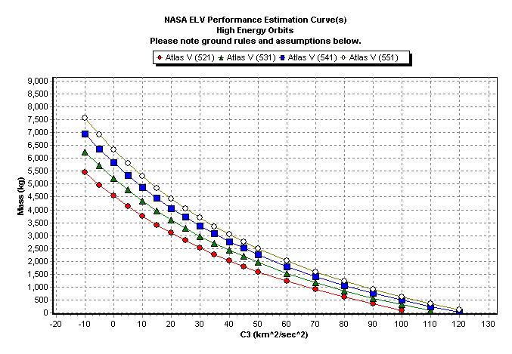
Micro Arcsecond Xray Imaging Mission: Pathfinder (MAXIM-PF)
Atlas V (521) (531) (541) (551)

Slide 7
Micro Arcsecond Xray Imaging Mission: Pathfinder (MAXIM-PF)
Atlas V (521) (531)
Assumptions:
Atlas V (521)
- 3-sigma mission required margin, plus additional reserves as determined by the LSP.
- Launch from SLC-41 at CCAFS (Cape Canaveral Air Force Station).
- Performance values assume harness, logo, reradiating antenna, 3 payload fairing doors.
- Payload mass greater than 9000 kg may require mission unique accommodations.
- Type B2 payload adapter plus type C2 spacer.
- 5-meter Short Payload Fairing.
- 185 km (100 nmi) minimum park orbit perigee altitude.
- 185 km (100 nmi) minimum escape orbit perigee altitude.
- Performance shown is applicable for declinations between 28.5 deg. and –28.5 deg.
Last Updated: 7/3/01 4:34:09 PM
Atlas V (531)
- 3-sigma mission required margin, plus additional reserves as determined by the LSP.
- Launch from SLC-41 at CCAFS (Cape Canaveral Air Force Station).
- Performance values assume harness, logo, reradiating antenna, 3 payload fairing doors.
- Payload mass greater than 9000 kg may require mission unique accommodations.
- Type B2 payload adapter plus type C2 spacer.
- 5-meter Short Payload Fairing.
- 185 km (100 nmi) minimum park orbit perigee altitude.
- 185 km (100 nmi) minimum escape orbit perigee altitude.
- Performance shown is applicable for declinations between 28.5 deg. and –28.5 deg.
Last Updated: 7/3/01 4:34:24 PM

Slide 8
Micro Arcsecond Xray Imaging Mission: Pathfinder (MAXIM-PF)
Atlas V (541) (551)
Assumptions:
Atlas V (541)
- 3-sigma mission required margin, plus additional reserves as determined by the LSP.
- Launch from SLC-41 at CCAFS (Cape Canaveral Air Force Station).
- Performance values assume harness, logo, reradiating antenna, 3 payload fairing doors.
- Payload mass greater than 9000 kg may require mission unique accommodations.
- Type B2 payload adapter plus type C2 spacer.
- 5-meter Short Payload Fairing.
- 185 km (100 nmi) minimum park orbit perigee altitude.
- 185 km (100 nmi) minimum escape orbit perigee altitude.
- Performance shown is applicable for declinations between 28.5 deg. and –28.5 deg.
Last Updated: 7/3/01 4:34:39 PM
Atlas V (551)
- 3-sigma mission required margin, plus additional reserves as determined by the LSP.
- Launch from SLC-41 at CCAFS (Cape Canaveral Air Force Station).
- Performance values assume harness, logo, reradiating antenna, 3 payload fairing doors.
- Payload mass greater than 9000 kg may require mission unique accommodations.
- Type B2 payload adapter plus type C2 spacer.
- 5-meter Short Payload Fairing.
- 185 km (100 nmi) minimum park orbit perigee altitude.
- 185 km (100 nmi) minimum escape orbit perigee altitude.
- Performance shown is applicable for declinations between 28.5 deg. and –28.5 deg.
Last Updated: 7/3/01 4:34:56 PM

Slide 9
Launch Vehicle Options
(Delta IV) (4040-12)(4240-12)
Delta IV (4040-12)
Performance: (C3 (km2/s2): 0: 2,735 kg Generic performance
(C3 (km2/s2): -.7: 2,780 kg Generic performance
(C3 (km2/s2): -2.2: 2,880 kg Generic performance
(C3 (km2/s2): -2.7: 2,915 kg Generic performance
Est. Cost (Fy’01) $87M std. Fairing (4m Fairing std./ 5m Fairing NA)
Delta IV (4240-12)
Performance: (C3 (km2/s2): 0: 4,075 kg Generic performance
(C3 (km2/s2): -.7: 4,135 kg Generic performance
(C3 (km2/s2): -2.2: 4,265 kg Generic performance
(C3 (km2/s2): -2.7: 4,310 kg Generic performance
Est. Cost (Fy’01) $97M std. Fairing (5m Diameter)
Note: All prices are estimated in FY 2001 dollars based on current contracts or publicly disclosed information. Actual prices may vary
based on market conditions, competitive negotiations and mission unique requirements. Figures do not include efforts to
support flying Dual Payload Configurations, major modification cost or Western Range Launches. Escalation figures for out
years (2002-2003) are approximately 4% cumulative. For budget planning purposes for AO/Future Studies.

Slide 10
Launch Vehicle Options
Delta IV (4450-14) (4250H-19)
Delta IV (4450-14)
Performance: (C3 (km2/s2): 0: 4,580 kg Generic performance
(C3 (km2/s2): -.7: 4,650 kg Generic performance
(C3 (km2/s2): -2.2: 4,795 kg Generic performance
(C3 (km2/s2): -2.7: 4,845 kg Generic performance
Est. Cost (Fy’01) $107M std. Fairing (5 Meter Diameter)
Delta IV (4250H-19)
Performance: (C3 (km2/s2): 0: 9,305 kg Generic performance
(C3 (km2/s2): -.7: 9,410 kg Generic performance
(C3 (km2/s2): -2.2: 9,645 kg Generic performance
(C3 (km2/s2): -2.7: 9,725 kg Generic performance
Est. Cost (Fy’01) $150-160M std. Fairing (5 Meter Diameter)
Note: All prices are estimated in FY 2001 dollars based on current contracts or publicly disclosed information. Actual prices may vary
based on market conditions, competitive negotiations and mission unique requirements. Figures do not include efforts to
support flying Dual Payload Configurations, major modification cost or Western Range Launches. Escalation figures for out
years (2002-2003) are approximately 4% cumulative. For budget planning purposes for AO/Future Studies.

Slide 11
Launch Vehicle: Baseline
Delta IV (4040-12)
Delta IV (4040-12)
Performance: (C3 (km2/s2): 0: 2,735 kg Generic performance
(C3 (km2/s2): -.7: 2,780 kg Generic performance
(C3 (km2/s2): -2.2: 2,880 kg Generic performance
(C3 (km2/s2): -2.7: 2,915 kg Generic performance
Est. Cost (Fy’01) $87M std. Fairing (4m Fairing std. / 5m Fairing NA)
Note: All prices are estimated in FY 2001 dollars based on current contracts or publicly disclosed information. Actual prices may vary based on market conditions, competitive negotiations and mission unique requirements. Figures do not include efforts to support flying Dual Payload Configurations, major modification cost or Western Range Launches. Escalation figures for out years (2002-2003) are approximately 4% cumulative. For budget planning purposes for AO/Future Studies.

Slide 12
Launch Vehicle: Baseline
Delta IV (4240-12)
Delta IV (4240-12)
Performance: (C3 (km2/s2): 0: 4,075 kg Generic performance
(C3 (km2/s2): -.7: 4,135 kg Generic performance
(C3 (km2/s2): -2.2: 4,265 kg Generic performance
(C3 (km2/s2): -2.7: 4,310 kg Generic performance
Est. Cost (Fy’01) $97M std. Fairing (5m Diameter)
Note: All prices are estimated in FY 2001 dollars based on current contracts or publicly disclosed information. Actual prices may
vary based on market conditions, competitive negotiations and mission unique requirements. Figures do not include efforts
to support flying Dual Payload Configurations, major modification cost or Western Range Launches. Escalation figures for out years (2002-2003) are approximately 4% cumulative. For budget planning purposes for AO/Future Studies.

Slide 13
Launch Vehicle: Baseline
Delta IV (4450-14)
Delta IV (4450-14)
Performance: (C3 (km2/s2): 0: 4,580 kg Generic performance
(C3 (km2/s2): -.7: 4,650 kg Generic performance
(C3 (km2/s2): -2.2: 4,795 kg Generic performance
(C3 (km2/s2): -2.7: 4,845 kg Generic performance
Est. Cost (Fy’01) $107M std. Fairing (5 Meter Diameter)
Note: All prices are estimated in FY 2001 dollars based on current contracts or publicly disclosed information. Actual prices may vary based on market conditions, competitive negotiations and mission unique requirements. Figures do not include efforts to support flying Dual Payload Configurations, major modification cost or Western Range Launches. Escalation figures for out
years (2002-2003) are approximately 4% cumulative. For budget planning purposes for AO/Future Studies.

Slide 14
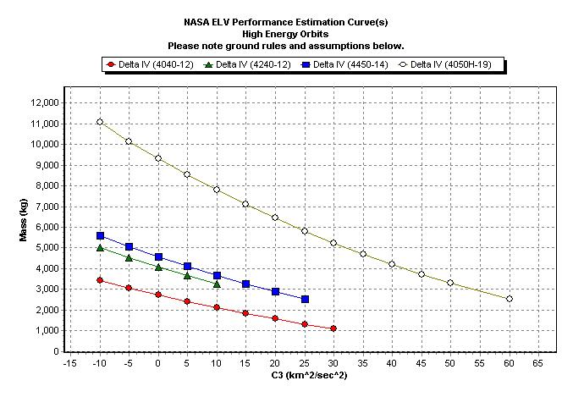
MAXIM Pathfinder (LAI-MAXIM)
Delta VI: (4040-12,4240-12,4450-14,4050H-19

Slide 15
MAXIM Pathfinder (LAI-MAXIM)
Delta VI: (4040-12,4240-12)
Assumptions:
Delta IV (4040-12)
- 3-sigma probability of Stage 2 commanded shutdown, plus additional reserves as determined by the LSP.
- 1194-4 payload adapter.
- Launch from SLC-37 at CCAFS (Cape Canaveral Air Force Station).
- 185 km (100 nmi) circular park orbit at 28.9 deg. inclination.
- 185 km (100 nmi) escape orbit perigee.
- Performance shown is applicable for declinations between 28.9 deg. and –28.9 deg.
Last Updated: 7/3/01 4:30:12 PM
Delta IV (4240-12)
- 3-sigma probability of Stage 2 commanded shutdown, plus additional reserves as determined by the LSP.
- 1194-4 payload adapter.
- Launch from SLC-37 at CCAFS (Cape Canaveral Air Force Station).
- 185 km (100 nmi) circular park orbit at 28.9 deg. inclination.
- 185 km (100 nmi) escape orbit perigee.
- Performance shown is applicable for declinations between 28.9 deg. and –28.9 deg.
Last Updated: 7/3/01 4:30:49 PM

Slide 16
MAXIM Pathfinder (LAI-MAXIM)
Delta VI: (4450-14,4050H-19)
Assumptions:
Delta IV (4450-14)
- 3-sigma probability of Stage 2 commanded shutdown, plus additional reserves as determined by the LSP.
- 1194-5 payload adapter.
- Launch from SLC-37 at CCAFS (Cape Canaveral Air Force Station).
- 185 km (100 nmi) circular park orbit at 28.9 deg. inclination.
- 185 km (100 nmi) escape orbit perigee.
- Performance shown is applicable for declinations between 28.9 deg. and –28.9 deg.
Last Updated: 7/3/01 4:31:05 PM
Delta IV (4050H-19)
- 3-sigma probability of Stage 2 commanded shutdown, plus additional reserves as determined by the LSP.
- 1194-5 payload adapter.
- Launch from SLC-37 at CCAFS (Cape Canaveral Air Force Station).
- 185 km (100 nmi) circular park orbit at 28.9 deg. inclination.
- 185 km (100 nmi) escape orbit perigee.
- Performance shown is applicable for declinations between 28.9 deg. and –28.9 deg.
Last Updated: 7/3/01 4:31:20 PM

