Slide 1
Regulation of Generic Drugs
        Office of Generic Drugs
        Craig Kiester
        Regulatory Support Branch

Slide 2
Outline
Mission
Legislative History and Waxman-Hatch
What is a Generic Drug?
Patents/Exclusivity
Orange Book

Slide 3

OGD Mission
To ensure that safe and effective generic drugs are available to the American People.

Slide 4
Legislative History
1906 Pure Food and Drug Act - establishes regulation of Food and Drugs.
1938 Food, Drug and Cosmetic Act - introduced safety standards.
1962 Kefauver-Harris Amendments to the FDA&C Act - tightened safety standards and introduced requirement that drugs must be effective.
1984 Waxman-Hatch Act - created an abbreviated mechanism for approval of generic copies of all drugs approved approved after 1962, by stating that preclinical and clinical tests did not have to be repeated for generics.

Slide 5
Innovator Incentives (Patents)
Prior to 1984, a patent would run for 17 years from issue date or 20 years from filing
W/H set to restore some incentive for innovation because pre-market approval requirements have increased
W/H may restore up to 5 years not to exceed 14 years from the product’s approval date

Slide 6
Innovator Incentives(cont.)
URAA (June 8, 1995) made all patents in force or filed as of this date have the longer term of 17 years from issuance or 20 years from filing
All patents filed after June 8, 1995 have an expiration date of 20 years from filing

Slide 7
Exclusivity Incentives
NCE protection - 5 years
New salt or ester - 3 years
New use or dosage form - 3 years

Slide 8
Generic Incentives
All approved products eligible for generic competition
Eliminated requirement for duplicative clinical trials
Created a regulatory process for faster approval of generic drugs

Slide 9
Definition of a Generic Drug
A drug product that is comparable to a brand/reference listed drug product in
dosage form, strength, route of administration, quality and performance characteristics,
and intended use.

Slide 10
NDA vs. ANDA Review Process
Brand Name Drug Generic Drug
NDA Requirements ANDA Requirements
1. Chemistry 1. Chemistry
2. Manufacturing 2. Manufacturing
3. Controls 3. Controls
4. Labeling 4. Labeling
5. Testing 5. Testing
6. Animal Studies
7. Clinical Studies 6. Bioequivalence
8. Bioavailability

Slide 11
What are the
Generic Drug Requirements?
Same active ingredient(s)
Same route of administration
Same dosage form
Same strength
Same conditions of use

Slide 12
Labeling
“Same” as brand name labeling
“Sameness” eliminates confusion and unsupported claims by different manufacturers
May differ in excipients, PK data and how supplied

Slide 13
When can a Generic Drug
be Marketed?
After patent & exclusivity protection ends, or
patent owner waives its rights, or
patent challenge is won, and
FDA requirements are met

Slide 14
Patent Protection
Applies to NDAs only
Delays final approval of ANDAs
Agency is concerned with drug substance, drug product and method of use patents
Published in Orange Book

Slide 15
Patent Certifications
Paragraph I - Patent not submitted to FDA
Paragraph II - Patent already expired
Paragraph III - Tentative approval
Paragraph IV - Court involvement

Slide 16
Exclusivity Provisions
Market protection
3 or 5 year period
NCE prohibits ANDA submission
Mutually exclusive
180 day exclusivity for first ANDA applicant(s) filed with a p IV certification to a particular patent/drug product

Slide 17
180 Day Exclusivity
Blocks approval of subsequent ANDAs
Awarded to first applicant(s) to file PIV to a listed patent/drug product, on the same day
Triggered by either first commercial marketing or a court decision.
Shared Exclusivity (multiple patents or multiple filers)

Slide 18
Tactics to delay Generic Competition
Serial Patent Filings: multiple 30 month stays
Agreements not to market: Generic and Innovator
Agreements not to initiate litigation: Generic and Innovator
Citizen’s Petitions: change in BE studies, not same drug product…
Changes to Reference Listed Drug Product.

Slide 19
Title XI of the Medicare Modernization Act
Passed as law 12/8/2003
Some provisions retroactive to August of 2003
Only one 30 month stay per ANDA (some exceptions)
Exclusivity based on drug product not by patent
Provisions for Forfeiture of 180 day exclusivity

Slide 20
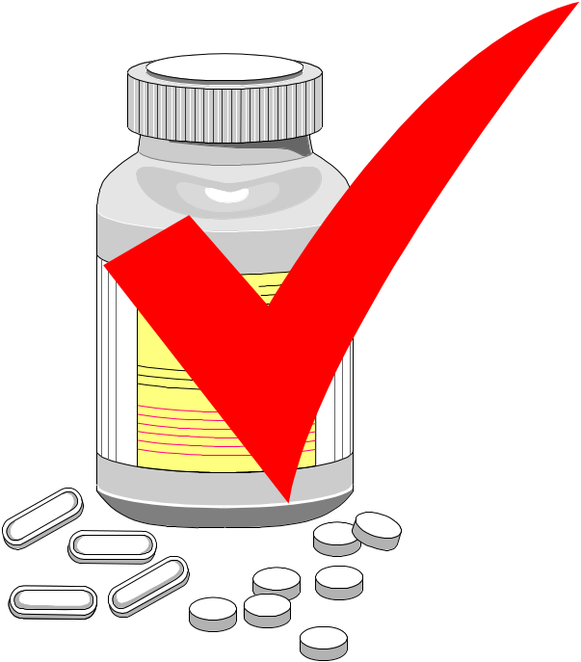
APPROVED
DRUG PRODUCTS
WITH
THERAPEUTIC EQUIVALENCE EVALUATIONS
20TH EDITION
THE PRODUCTS IN THIS LIST HAVE BEEN APPROVED UNDER
SECTION 505 OF THE FEDERAL FOOD, DRUG, AND
COSMETIC ACT.
U.S. DEPARTMENT OF HEALTH AND HUMAN SERVICES
PUBLIC HEALTH SERVICE
FOOD AND DRUG ADMINISTRATION
CENTER FOR DRUG EVALUATION AND RESEARCH
OFFICE OF MANAGEMENT
DIVISION OF DATABASE MANAGEMENT
2000

Slide 21
“Orange Book”
All FDA approved drug products listed (NDA’s, OTC’s & ANDA’s)
Therapeutic equivalence codes
  “A” = Substitutable
  “B” = Inequivalent, NOT substitutable
Expiration dates: patent and exclusivity
Reference Listed Drugs/brand drugs identified by
FDA for generic companies to compare their
proposed products with

