Slide 1
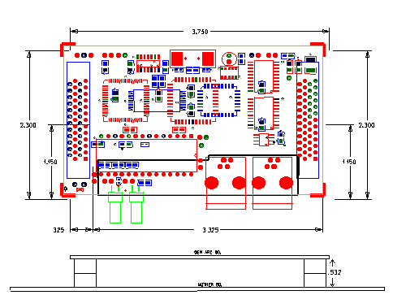
GENERIC ARCNET BOARD

Slide 2
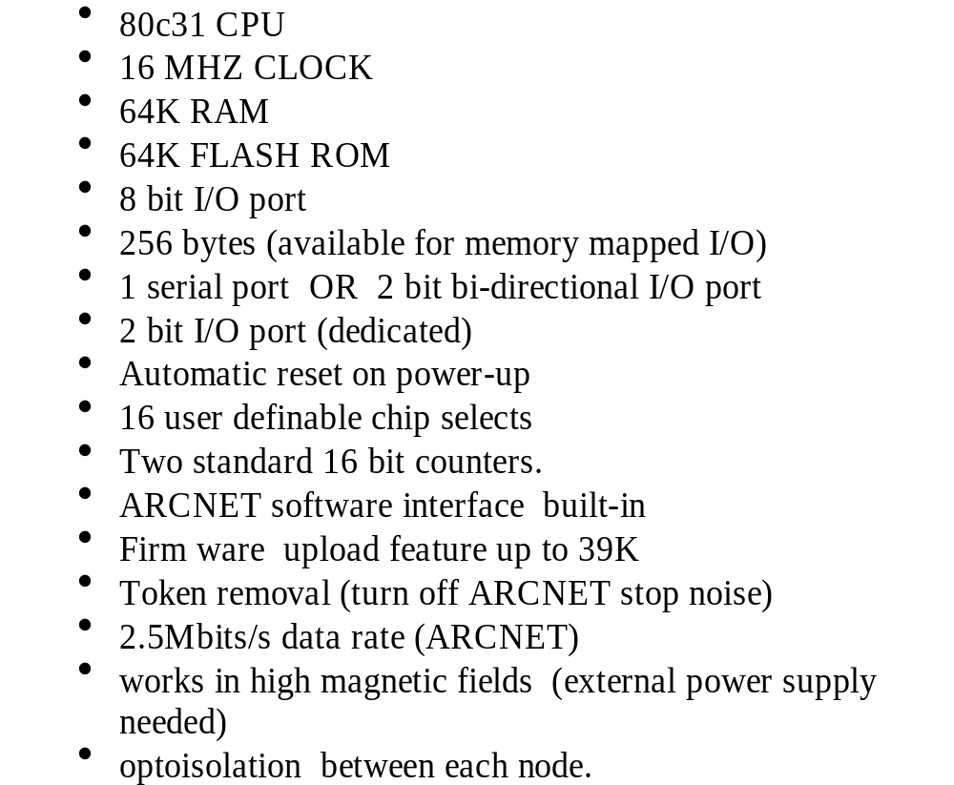
GENERIC ARCNET BOARD FEATURES

Slide 3
GENERIC ARCNET MEMORY MAP

Slide 4
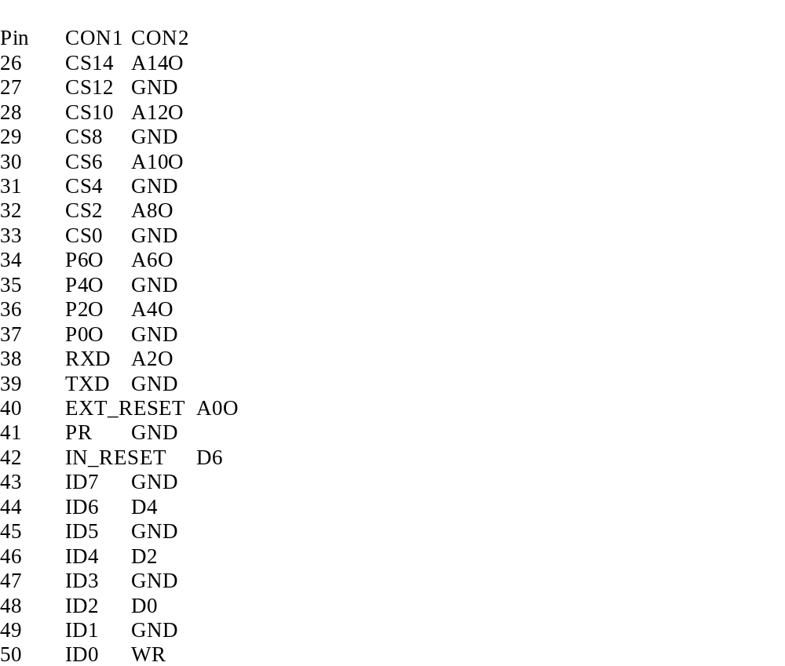
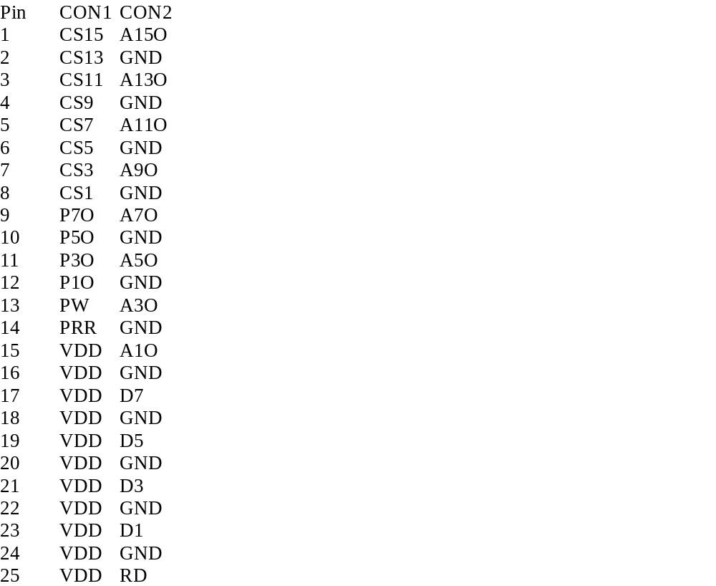
GENERIC ARCNET BOARD
PIN OUT

Slide 5
GENERIC ARCNET BOARD
BOOT PROGRAM

Slide 6
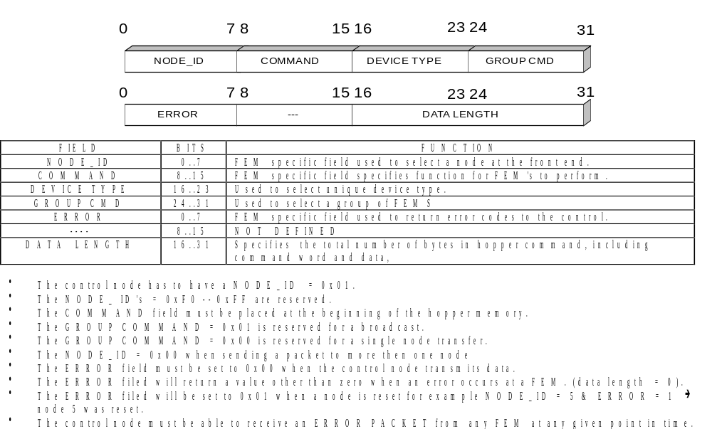
GENERIC ARCNET HEADER

Slide 7
GENERIC ARCNET BOARD
USER PROGRAM

Slide 8
GENERIC ARCNET BOARD
GAB
17 nodes
GAB
Copper
GAB
17 nodes
HUB
GAB
FIBER
WORKSTATION
Copper
GAB
17 nodes
GAB
FIBER
HUB
Copper
GAB
17 nodes
GAB

Slide 9
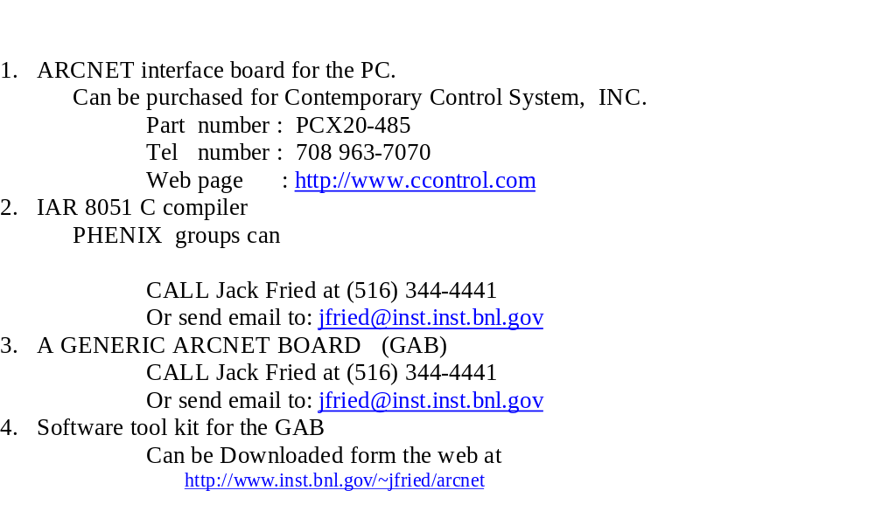
GETTING STARTED

