Slide 1
Conditions of Law Equations as Communicable Knowledge
Symposium on Computational Discovery of Communicable Knowledge
March, 24th -25th, 2001
Takashi Washio
Hiroshi Motoda
I.S.I.R., Osaka University.

Slide 2
What are the conditions of communicable law equations?
Question to clarify criteria and knowledge which can
be implemented in computational discovery systems
Generic conditions of law equations
Domain dependent conditions for communicable law equations

Slide 3
Generic conditions of law equations
What are law equations?
Are objectiveness and generality of equations sufficient to represent laws?
Heat transfer between fluid and the wall of a round pipe under enforced turbulence flow
Dittus-Boelter Equation Nu = 0.023 Re^{0.8} Pr^{0.4}
(Nu,Re,Pr：defined from heat conductivity,
density and flow velocity of the fluid.)
Law Equation of Gravity Force
F=G M₁M₂/R²

Slide 4
What are the generic conditions of law equations?
“Law equation” is an emprical terminology. Its axiomatization without any exception may be difficult.
Its axiomatic analysis is important for the basis of the science.
  (R.Descartes: distinctness and clearness of reasoning, divide and conquer method, soundness, consistency)
  I.Newton: removal of non-natural causes (objectiveness), minimum causal assumptions (simplicity, parsimony), validity in wide phenomena (generality), no exception (soundness)
  H.A.Simon: parsimony of description
  R.P.Feynman: mathematical constraints (admissibility)

Slide 5
Generic conditions of law equations
A Scientific Region: T=<S,A,L,D>
where S={s is a syntactic rule.}, A={a is an axiom.}, L={l is a postulate}, D={o is an objective phenomenon.}．
S: definitions of coordinate system, physical quantity and some algebraic operators
A: axioms on distance and etc.
L: empirical laws and empirical strong believes
D: a domain on which the scientific region concentrates its analysis.

Slide 6
Generic conditions of law equations
Ex.) Law of Gravity Force is not always required for the objective phenomena of classical physics. →A law l is used to understand or model phenomena in the subset of D.
Objective domain of an equation e
An objective phenomenon of an equation e is a phenomenon where all quantities in e are required to describe the phenomenon.
A domain of e, De (⊆D), is a subset of objective phenomena of e in D.

Slide 7
Generic conditions of law equations
Satisfaction and Consistency of an equation e
An equation e is “satisfactory” for its objective phenomenon when e explains the phenomenon.
An equation e is “consistent” with its objective phenomenon when e does not show any contradictory relation with the phenomenon.
Ex.) Collision of two mass points
The law of gravity force is considered to be satisfactory under the sufficiently heavy mass of the two points, otherwise it is ignored. In any case, the law of gravity force is consistent with this collision phenomenon.

Slide 8
Generic conditions of law equations
In the objective domain of e, De
Objectiveness（All quantities in e is observable.)
Generality (e is satisfactory in wide phenomena.)
Reproducibility (an identical result on e is obtained under an identical condition.)
Soundness (e is consistent with the measurement.)
Parsimony (e consists of minimum number of quantities.)
Mathematical Admissibility (e follows S and A.)

Slide 9
Generic conditions of law equations
Heat transfer between fluid and the wall of a round pipe under enforced turbulence flow
Dittus-Boelter Equation Nu = 0.023 Re^{0.8} Pr^{0.4}
is satisfactory only in the region of 10⁴<Re<10⁵, 1<Pr<10. It does not satisfactory over entire De.
→It does not satisfy the soundness (consistency).
Law of gravity force
F=G M₁M₂/R²
→ It is general (satisfactory) over De.

Slide 10
Generic conditions of law equations
Conditions being confirmed
through experiments and/or observations
Objectiveness（All quantities in e is observable)
Generality (e is satisfactory in wide phenomena)
Reproducibility (identical result on e is obtained under identical condition)
Soundness (e is consistent with the measurement )
Conditions on law equation formulae
MDL, AIC, …..
Parsimony (e consists of minimum number of quantities)
Mathematical Admissibility (e follows S and A)
unit dimension and scale-types

Slide 11
What are the conditions of
communicable law equations?
Generic conditions of law equations
Domain dependent conditions for communicable law equations
Domain dependent heuristics

Slide 12
Domain dependent conditions for communicable law equations
(1) Relation on relevant and/or interested phenomena A Scientific Region: T=<S,A,L,D> where D={o is an objective phenomenon.}．
D should be relevant to the interest of scientists.
Ex.) f=ma is relevant to physicists’ interest.
sp=f(cb,fb,t,ir) is relevant to the interest of stock fund managers.

Slide 13
Domain dependent conditions for communicable law equations
(2) Relation on relevant and/or interested view
A Scientific Region: T=<S,A,L,D>
BK=A (axioms), L (postulates), D (domain): selection of quantities, selection of equation class
veiw
Ex.1) Model equation of ideal gass
PV=nRT : macroscopic veiw
f = 2mv : microscopic view
Ex.2) Model equation of air friction force
f = - c v² – k v : global view
f = - k v : local view

Slide 14
Domain dependent conditions for communicable law equations
(3) Clarity of terms (quantities) with background knowledge
A Scientific Region: T=<S,A,L,D>
BK=A (axioms) and L (postulates): quantities in other law equations, extensionally measurable quantities, intentional definitions of quantities having clear physical meaning
Ex.1) d = M/L³ ≡ V=L³, d=M/V
Ex.2) f=Gm₁m₂/r² ? A=m₁m₂, f=GA/r²
physically unclear

Slide 15
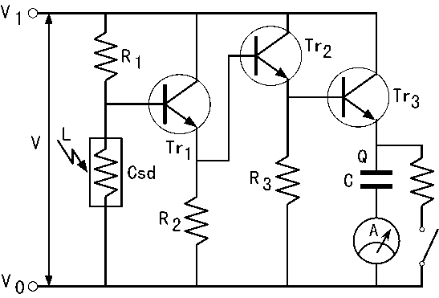
Domain dependent conditions for communicable law equations
(4) Appropriate simplicity and complexity for understanding
Is the optimum simplicity in terms of the principle of parsimony really appropriate for understanding?
The most of the law equations in physics involves 3 – 7 quantities. A complicated model is decomposed into multiple law equations in appropriate granule.
R
h
R
h
r
2
K
h
X
(
3
fe2
2
fe1
L
)
Q
ie3
(
V
-
V
) -
-
= 0
R
h
+
h
R
h
+
h
r
2
1
2
C
B
h
3
fe2
ie2
2
fe1
ie1
L
+
R
fe3
1
V=IR
I_{EC}=h_{fe}I_{BC}
I₀=I₁+I₂

Slide 16
Domain dependent conditions for communicable law equations
(5) Consistency of relation with Background Knowledge
A Scientific Region: T=<S,A,L,D>
BK=A (axioms) and L (postulates): other law equations, empirical fact and empirically strong evidence
Ex.1) f=m²a ≠ dv/dt=a, mdv=fdt
Ex.2) f=Gm₁m₂/r² – k/D^{α} ← space term
Universe should be static.
≠ Red shift of light spectrum
+ Doppler effect

Slide 17
A model of communicable
knowledge discovery
Generic conditions of law equations
Domain dependent conditions for communicable law equations
Is the communicable knowledge discovery
really learning and/or mining?
The most of the learning and data mining techniques
do not use generic and domain dependent conditions
for communicable knowledge discovery!

Slide 18
A model of communicable
knowledge discovery
Proposing framework:
abduction
model composition and learning
Data set
features
class
explaining quantities
objective quantity
Hypothesis
Model
model
diagnosis
-
Background Knowledge (Empirical Knowledge)
no
Confirmation of
current BK and EK
Anomaly?
yes
consistency
checking
belief revision and learning

Slide 19
Trial of Communicable Knowledge Discovery
using mathematical constraints and BK
Conditions to be confirmed
through experiments and/or observations
Objectiveness（All quantities in e is observable)
Generality (e is satisfactory in wide phenomena)
Reproducibility (identical result on e is obtained under identical condition)
Soundness (e is consistent with the measurement )
Conditions on law equation formulae
Parsimony (e consists of minimum number of quantities)
Mathematical Admissibility (e follows S and A)
scale-types
Application of SDS

Slide 20
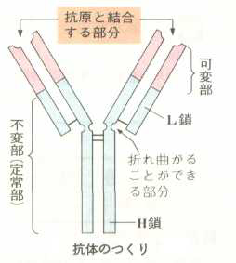
Example: Antigen=Antibody Reaction Data
Japanese domestic KDD challenge (Sep.,2000)
Data are provided by a biologist.
Reaction with Antigen
Antibody has Y-structure.
Antibody consists of 20 types of natural amino-acid.
H-chain：a chain of 110 amino-acid (VH 1-110)
L-chain：a chain of 120 amino-acid (VL 1-120)
An amino-acid is replaced by another type of amino-acid in a anti-body. Its thermo-dynamical features are measured.
Total data: 35X3=105
L-chain
H-chain
Antibody
Change of quantity values before
and after the reaction with antigen
Reaction constant:Ka，
Change of free energy:DG，
Change of enthalpy:DH，
Change of entropy:TDS
Change of specific heat:DCp

Slide 21
Trial of Communicable Knowledge Discovery using scale-type constraints (SDS) and BK
Objective of Analysis
Discovery of generic physical relations in data and its physical interpretation by domain experts
Discovery of (semi-)quantitative physical relations in data under the consideration of chemical features of amino-acid and its interpretation by domain experts

Slide 22
Mathematical scale-type constraints
Absolute scale
Invariance of value （radian angle）
Interval scale
Arbitrary origin and invariance of ratio of difference （temperature in Celsius, Fahrenheit）
Ratio scale
Absolute origin and invariance of ratio（length）
unit conversion
x,y ：ratio scale
x’,y’ ：ratio scale
x’ = kx
y’ = Ky
y = log x
y’ = log x’
y’ = Ky = log x + log k
Shift of origin，contradictory

Slide 23
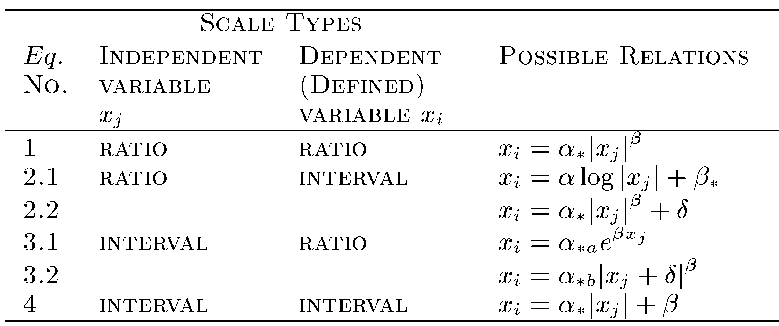
Mathematical scale-type constraints
[R.D.Luce 1959][T.Washio 1997]
Ex.）Fechner’ Law：
musical scale: s (order of piano’s keys)
Sound frequency: f (Hz)
s:interval scale，f:ratio scale
s = a log f + b

Slide 24
Background Knowledge used
The biologist is interested in bi-variate relation.
Ratio scale：Ka, Cp， interval scale：G, H, TS
G=αlog Ka + β
G=αKa^{β}+δ
G-G₀=αlog Ka + β- αlog Ka₀ - β
G-G₀ =αKa^{β}+δ- αKa₀^{β}-δ
DG=αlog Ka + β’
DG=αKa^{β}+δ’
G=αH + β
TS=αH + β
DG=αDH + (β’)
TDS=αDH + (β’)
H=αlog Cp + β
H=αCp^{β}+δ
DH=αlog Cp + (β’)
DH=αCp^{β}+(δ’)

Slide 25
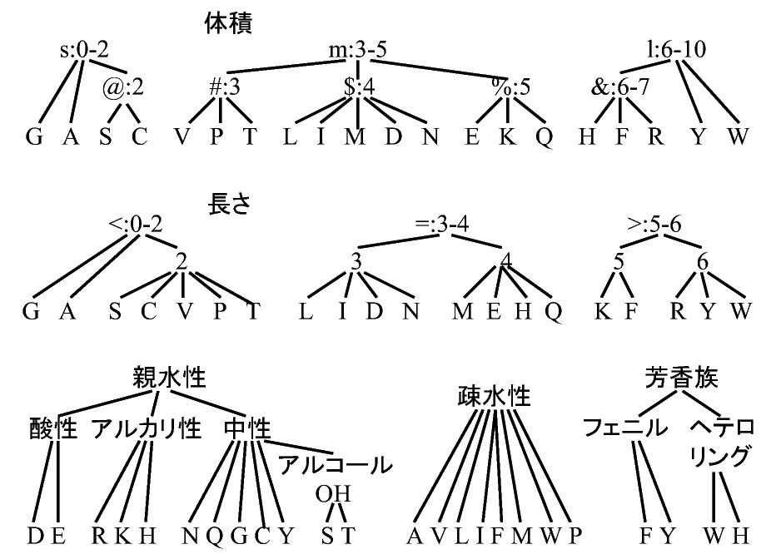
Background Knowledge used
Chemical features of amino-acids：
21 natural amino-acids
Volume
Length
Solvable
Unsolvable
Aromatic

Slide 26
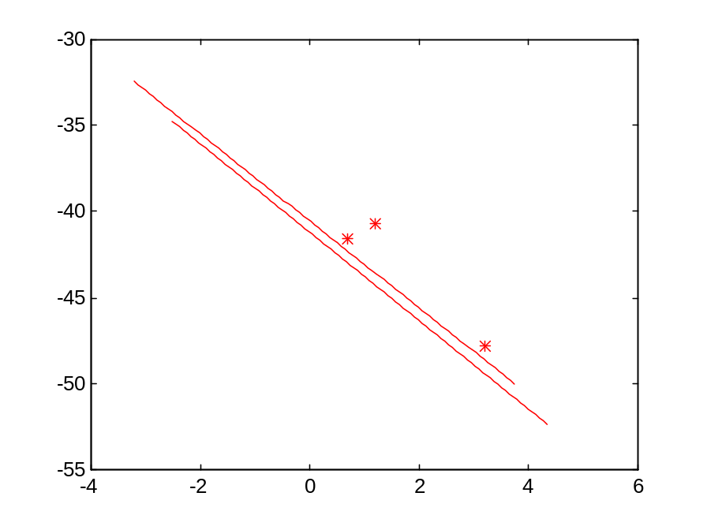
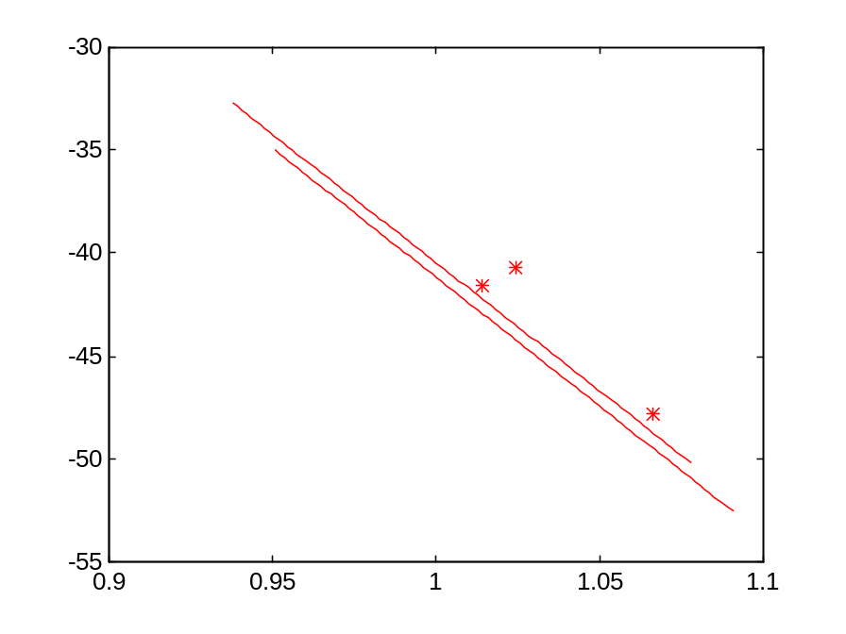

Result and Evaluation
A generic relation independent of replacement conditions
Ka：ratio scale，DG：interval sacle
DG=αlog Ka + β
DG=αKa^{β}+δ
DG
DG
log Ka
log Ka
F=547200>4.196
F=49240>4.96
（Biologist：definition of Ka）

Slide 27
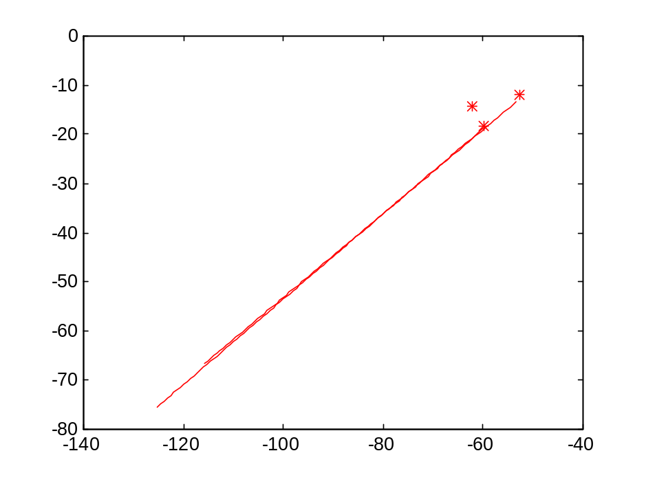

Result and Evaluation
A generic relation independent of replacement conditions
DH, TDS：interval sacle
TDS=αDH + β
TDS
DH
F=770.5>4.196
（ Biologist：physically
deducible relation）

Slide 28
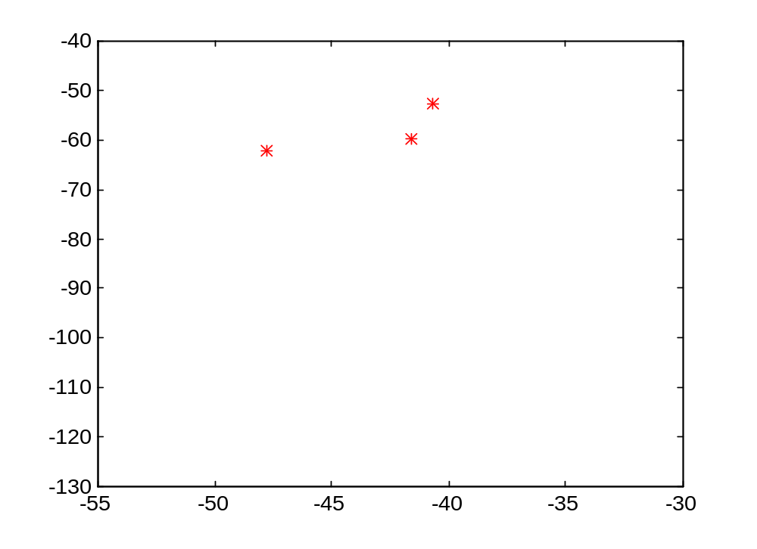

Result of Analysis
Change of H and G between before and after reaction (DH,DG)
*:298K
+:303K
x:308K
DG
DG
DH
DH
DH, DG:interval scale
Correlation coefficient: 0.690 ⇒ Relation is unclear.

Slide 29
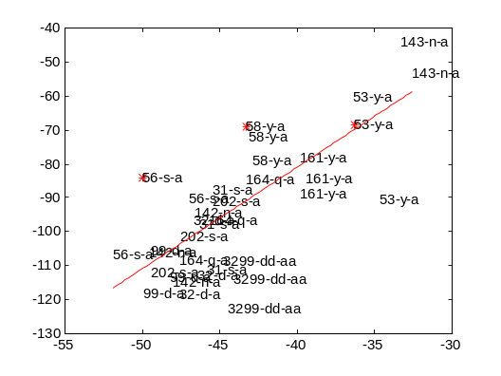
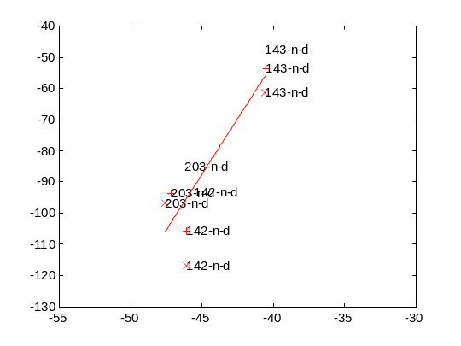
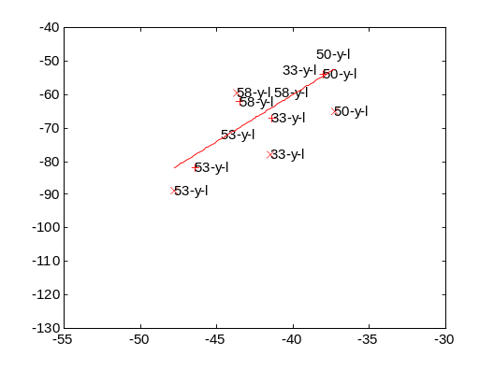
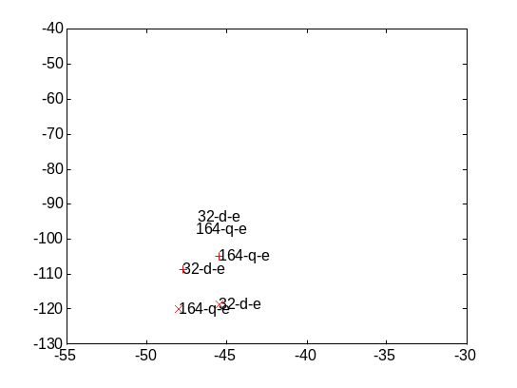
Result of Analysis: regression of Eq.
Change of H and G between before and after reaction (DH,DG)
To a（solvable，small）
To d（solvable，acid，middle）
DG
DG
DH
DH
To l（unsolvable，middle）
To e（solvable，acid，middle）
DG
DG
DH
DH

Slide 30
Summary of Result
For each type of amino-acid:
  Relation (DH,DG)
    ・Clear linear relation for unsolvable amino-acid. The gradient of the linear relation depends on the size of amino-acid.
    ・Unclear relation for solvable amino-acid.
  Relation (DH,DCp)
    ・ Clear linear relation for unsolvable amino-acid.
    ・ Unclear relation for solvable amino-acid.
Biologist : Comprehensible discovery for experts.
The relation for unsolvable amino-acid may show clear tendency,
since they do not change the molecule shape in solvent very much.

Slide 31
What was done in the model of communicable knowledge discovery
Proposing framework:
abduction
model composition and learning
Data set
features
class
explaining quantities
objective quantity
Hypothesis
Model
model
diagnosis
-
Background Knowledge (Empirical Knowledge)
no
Confirmation of
current BK and EK
Anomaly?
yes
consistency
checking
belief revision and learning

Slide 32
Summary
(1) Conditions of Law Equations as Communicable Knowledge
  1. Generic conditions of law equations
  2. Domain dependent conditions for communicable law equations
(2) Proposal of a model of communicable knowledge discovery
Discovery is not the matter of only learning and data mining but also model composition, belief revision, consistency checking, model diagnosis, knowledge representation and reasoning of BK and computer-human collaboration.

