Slide 1
Transient Recorder Support
EPICS Meeting at BESSY
May 2002
Marty Kraimer

Slide 2
GenericTransient Recorder GTR
GTR discussed at ICALEPCS 2001 EPICS Meeting
  Support for Joerger VTR1012, VTR10010
  Wanted support for VTR10012 and SIS3300
  Initial Goal: Be able to test all four recorders
  GTR: Is this a good idea?
Results now
  Joerger VTR1012, VTR10010, VTR10012, VRTR10012_8
  Struck SIS3300, SIS3301
  GTR seems like a good idea.
  BUT VTR10012 and SIS330x provide additional features that GTR does not support.

Slide 3
Generic Transient Recorder
Generic Transient Recorder – Definition
One or more ADCS with common gate, clock, trigger
Memory to record samples
Provides following methods for data collection.
  postTrigger – Data sampling starts when trigger occurs.
  prePostTrigger (optional) – Data samped continuously into circular buffer. When trigger occurs acquire additional set of samples and stop.
Device specific clock and trigger options.
Supports multiple events (optional)

Slide 4
GTR Support
GTR Support
  Generic adl file for controlling a TR.
  Generic set of records to control and collect waveforms from TR.
  Generic device support.
  Generic driver interface for communicating with specific TRs.
  Generic driver which calls TR specific drivers.
  TR specific drivers for Joerger and Struck TRs.
Other Features?
  VTR10012 and SIS330x provide many additional features
  Define other interfaces?
  Extend GTR – Only if generic!!

Slide 5
GTR Options
Most options provided by TR specific driver
clock – Rates, etc.
trigger – Source, etc.
multiEvent – If TR supports.
numberPTS – Number of post trigger samples
numberPPS – Number of prePost samples = total samples
numberPTE – Number post trigger events
arm – Provided by TR specific driver. Typical options are
  disarm
  postTrigger
  prePostTrigger
autorestart

Slide 6
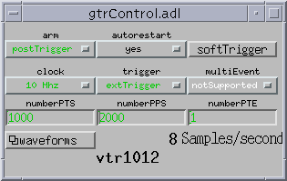
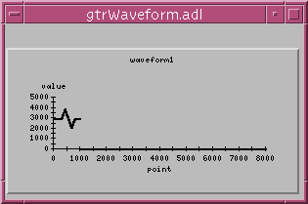
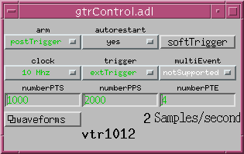
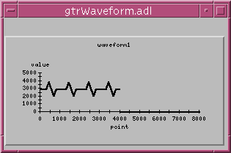
postTrigger

Slide 7
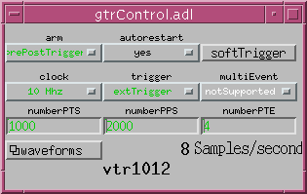
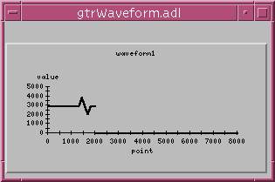
prePostTrigger

Slide 8
Performance
Testing showed that limit was 1 megaSample/sec.
Same limit with 68040 and with powerPC.
Limit was VME transfers from recorder memory.
Why? This is only 2 megaBytes/sec
With a VME bus analyzer we determined that
  VTR1012 responded in 190 nanoseconds.
  Rest of the overhead was VME interfaces.
Andrew Johnson provided generic DMA interface
  Needed for VTR10012_8
  Implemented for MV167 and for MV2700 and MV2100.
  Did not time difference between DMA and non DMA

Slide 9
Maximum Throughput
Guess at why 1 megaSample/sec limit (2 megaBytes/sec)
  VME max rate is 40 megaBytes/sec.
  No Block Transfer => 20 megaByte limit.
  16 rather than 32 bit transfers => 10 megaByte limit.
  VME bus interfaces cause additional factor of 5 performance hit.
Solution
  VTR10012 and SIS3300 both read with 32 bit transfers.
  Perhaps DMA can provide 3 to 5 performance gain
    Have not measured performance.
  At this point other limits may happen. For sure on mv167.
Limit with VME32 will still be 20 megaSample/sec.

