Slide 1

An Overview of Belos and Anasazi
October 16th, 11-12am
Heidi Thornquist
Teri Barth
Rich Lehoucq
Mike Heroux
Computational Mathematics and Algorithms
Sandia is a multiprogram laboratory operated by Sandia Corporation, a Lockheed Martin Company,
for the United States Department of Energy under contract DE-AC04-94AL85000.
Notes:
Questions from audience
Can you use another matrix-vector multiply?
Are multivectors supported?
Are Petsc and Hypre available via TSF?
How does Trilinos differ from Petsc?

Slide 2
Outline
Background
  AztecOO and ARPACK
Solver design requirements
Belos and Anasazi
  Current Status
  Current Development
Teuchos
  Arbitrary precision BLAS
Concluding remarks

Slide 3
Background
Several iterative linear solver / eigensolver libraries exist:
  PETSc, SLAP, LINSOL, Aztec(OO), …
  LOBPCG (hypre), ARPACK, …
None are written in C++
None of the linear solver libraries can efficiently deal with multiple right-hand sides
Current eigensolver libraries offer one algorithm for solving symmetric/non-symmetric eigenproblems

Slide 4
AztecOO Linear Solver Library
A C++ wrapper around Aztec library written in C.
Algorithms: GMRES, CG, CGS, BiCGSTAB, TFQMR.
Offers status testing capabilities.
Output verbosity level can be determined by user.
Uses Epetra to perform underlying vector space operations.
Interface to matrix-vector product is defined by the user through the EpetraOperator.

Slide 5
ARnoldi PACKage (ARPACK)
Written in Fortran 77.
Algorithms: Implicitly Restarted Arnoldi/Lanczos
Static convergence tests.
Output formatting, verbosity level is determined by user.
Uses LAPACK/BLAS to perform underlying vector space operations.
Offers abstract interface to matrix-vector products through reverse communication.

Slide 6
Some design requirements for
Linear Solvers /Eigensolvers
Abstract interface to an operator-vector product (Op(A)v) and preconditioning (if necessary).
Ability to allow the user to enlist any linear algebra package for the elementary vector space operations essential to the algorithm
Ability to allow the user to define convergence of any algorithm (a.k.a. status testing).
Ability to allow the user to determine the verbosity level, formatting, and processor for the output.
Generic programming

Slide 7
Generic Algorithm
Status Test
AlgorithmA( … )
while ( myStatusTest.GetStatus(…)
!= converged )
…
…
% Compute operator-vector product
myProblem.ApplyOp(NOTRANS,v,w);
α = w.dot(v);
…
end
myIO.print(something);
return (solution);
end
Generic Problem
Interface
Generic Linear
Algebra Interface
IO Manager

Slide 8
Benefits of Generic Programming
Generic programming techniques ease the implementation of complex algorithms.
Developing algorithms with generic programming techniques is easier on the developer, while still allowing them to build a flexible and powerful software package.
Generic programming techniques also allow the user to leverage their existing software investment.

Slide 9
New Packages: Belos and Anasazi
Next generation linear solvers (Belos) and eigensolvers (Anasazi) libraries, written in templated C++.
Provide a generic interface to a collection of algorithms for solving large-scale linear problems and eigenproblems.
Algorithm implementation is accomplished through the use of abstract base classes. Interfaces are derived from these base classes to operator-vector products, status tests, and any arbitrary linear algebra library.
Includes block linear solvers (GMRES, CG, etc.) and eigensolvers (IRAM, etc.).
Release: Spring/Summer 2004

Slide 10
Why are Block Solvers Useful?
(from an applications point of view)
Block Eigensolvers ( Op(A)X = ΛX ):
Block Linear Solvers ( Op(A)X = B ):
  Reliably determine multiple and/or clustered eigenvalues.
  Example applications:
    Stability analysis
    Bifurcation analysis (LOCA)
  Useful for when multiple solutions are required for the same system of equations.
  Example applications:
    Perturbation analysis
    Optimization problems
    Single right-hand sides where A has a handful of small eigenvalues
    Inner-iteration of block eigensolvers

Slide 11
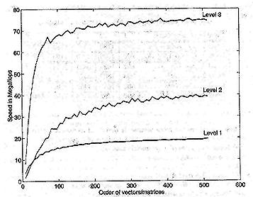
Why are Block Solvers Useful?
(from a computational point of view)
Remember: These are iterative solvers!
  Solutions for block solvers are obtained through operator-multivector computations (Op(A)V).
  However, single-vector iterative solvers use operator-vector computations (Op(A)v).
What’s the difference?
BLAS Performance
Op(A)v is Level 1
Op(A)V is Level 2

Slide 12
Current Status
(Trilinos Release 3.2d)
Belos:
  Solvers: BlockCG and BlockGMRES
  Interfaces are defined for Epetra and NOX/LOCA
  BelosEpetraOperator allows for integration into other codes
  Epetra interface accepts EpetraOperators, so can be used with ML, AztecOO, Ifpack, Belos, etc…
  Block size is independent of number of right-hand sides
Anasazi:
  Solver: Implicitly Restarted Arnoldi
  Interfaces are defined for Epetra and NOX/LOCA
  Can solve standard and generalized eigenproblems
  Epetra interface accepts EpetraOperators, so can be used with Belos, AztecOO, etc…
  Block size is independent of number of requested eigenvalues

Slide 13
Current Belos/Anasazi Development
LinearSolver / Eigensolver Class
LinearProblem / Eigenproblem Class
StatusTest Class
IOManager Class
Incorporate parameter lists ( developed in Teuchos ).
Replace current Belos/Anasazi abstract linear algebra classes with TSFCore abstract linear algebra classes.

Slide 14
Current Belos/Anasazi Development
LinearSolver / Eigensolver Class
Provide an abstract interface to Belos/Anasazi solvers.
Methods:
  Set Methods: SetProblem, SetParameters, SetStatusTester
  Get Methods: GetProblem, GetParameters, GetStatusTester, currIteration
  Solve Methods: Solve, Iterate
  Auxilliary Method(s): Reset

Slide 15
Current Belos/Anasazi Development
LinearProblem / Eigenproblem Class
Belos
Allows preconditioning, scaling, etc. to be removed from the algorithm.
Methods:
  Set Methods: SetOperator, SetLHS, SetRHS, SetL/RScale, SetL/RPrecond
  Get Methods: GetOperator, GetLHS, GetRHS, GetL/RPrecond
  Query Methods: IsL/RPrecond
  Apply Methods: ApplyOperator
Anasazi
Differentiates between standard and general eigenvalue problems.
Allows spectral transformations to be removed from the algorithm.
Methods:
  Set Methods: SetInitVec, SetOperator, SetMatrixA, SetMatrixB
  Get Methods: GetInitVec, GetOperator, GetMatrixA, GetMatrixB, GetEvals, GetEvecs, GetResids
  Apply Methods: ApplyOperator, ApplyMatrixA, ApplyMatrixB
  IP/Norm Methods: AInProd, BInProd, BMvNorm

Slide 16
Current Belos/Anasazi Development
StatusTest Class
Similar to NOX / AztecOO.
Allows user to decide when solver is finished.
Multiple criterion can be logically connected.
Abstract base class methods:
  StatusType CheckStatus( int currIteration, LinearProblem<Scalar>& myProblem );
  StatusType CheckStatus( int currIteration, Eigenproblem<Scalar>& myProblem );
  StatusType GetStatus() const;
  ostream& Print( ostream& os ) const;
Derived classes
  Maximum iterations/restarts, residual norm, combinations {AND,OR}, …

Slide 17
Current Belos/Anasazi Development
IOManager Class
Allows user to control I/O processor, precision, and verbosity.
Methods:
  Set Methods:
    void reset(Teuchos::ParameterList& myIOParams );
  Query Methods:
    bool isPrintProc() const;
    bool isPrintLevel() const;
    bool isPrintProcLevel() const;
  Output Methods: overload “<<“ operator using given precision.

Slide 18
Future Belos/Anasazi Algorithms
Anasazi
LOBPCG
Restarted Preconditioned Eigensolver (RPE)
  Generalized Davidson
Belos
CG/FCG
GMRES/FGMRES
BiCGSTAB

Slide 19
Future Belos/Anasazi Features
Anasazi
Preprocessing capabilties
User determined sorting
User determined Krylov-subspace breakdown tolerances
Belos
Preprocessing capabilities (CG)
User determined Krylov-subspace breakdown tolerances

Slide 20
Belos / Anasazi Development
(audience participation)
Are there any capabilities you may need from a linear/eigensolver that have not been addressed?
Do you have any questions, comments, or suggestions about the proposed user interface?
Are there any other solvers that you think would be useful?

Slide 21
Teuchos
Optional, lightweight utility package
Takes advantage of advanced features of C++:
  Templates
  Standard Template Library (STL)
Planned features:
  Parameter list of arbitrary types (NOX)
  Memory management package and error-handler (TSFCoreUtils)
  Templated interfaces to BLAS, LAPACK, dense matrix (TPetra)
  Command line and XML parsers, random number generators, and timers (TSF)

Slide 22
BLAS
Basic Linear Algebra Subroutines
  Robust, high-performance dense vector-vector, matrix-vector, and matrix-matrix routines
  Written in Fortran
    Fast and efficient
    Fortran is highly portable; however, the interface between it and C++ is platform-dependent
Templated C++ wrappers for the BLAS Fortran routines are created through autoconf.
Two main benefits of using a templated interface
  Template Specialization: template specialization can be used to support the four native datatypes of existing Fortran BLAS code
  General Implementation: a generic C++ implementation can be created to handle many arbitrary datatypes

Slide 23
Arbitrary Datatypes
Any datatype that defines zero, one, addition, subtraction, and multiplication can use nearly all BLAS functions
  Some require square root or division
Example: ARPREC
  arbitrary precision library that uses arrays of 64-bit floating-point numbers to represent high-precision floating-point numbers.
  ARPREC values behave just like any other floating-point datatype, except the maximum working precision (in decimal digits) must be specified before any calculations are done
  mp::mp_init(200);
  Illustrate the use of ARPREC with an example using Hilbert matrices.

Slide 24
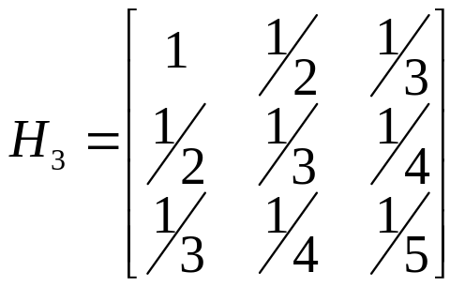
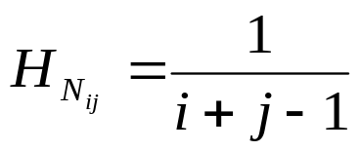
Hilbert Matrices
A Hilbert matrix H_{N} is a square N-by-N matrix such that:
Notoriously ill-conditioned
  κ(H₃) ≈ 524
  κ(H₅) ≈ 476610
  κ(H₁₀) ≈ 1.6025 x 10¹³
  κ(H₂₀) ≈ 7.8413 x 10¹⁷
  κ(H₁₀₀) ≈ 1.7232 x 10²⁰
Theoretically, Hilbert matrices are SPD

Slide 25
Cholesky Factorization and Hilbert Matrices
In practice, floating-point rounding error causes higher-order Hilbert matrices to no longer be positive definite
Cholesky factorization is often done to determine whether or not a given matrix is positive definite
As such, a Cholesky factorization will often fail on higher-order Hilbert matrices, even though such matrices “should” be positive definite
Precision | Largest N for which Cholesky Factorization is successful
Single Precision | 8
Double Precision | 13
Arbitrary Precision (20) | 29
Arbitrary Precision (40) | 40
Arbitrary Precision (200) | 145
Arbitrary Precision (400) | 233*

Slide 26
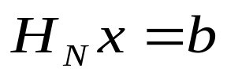
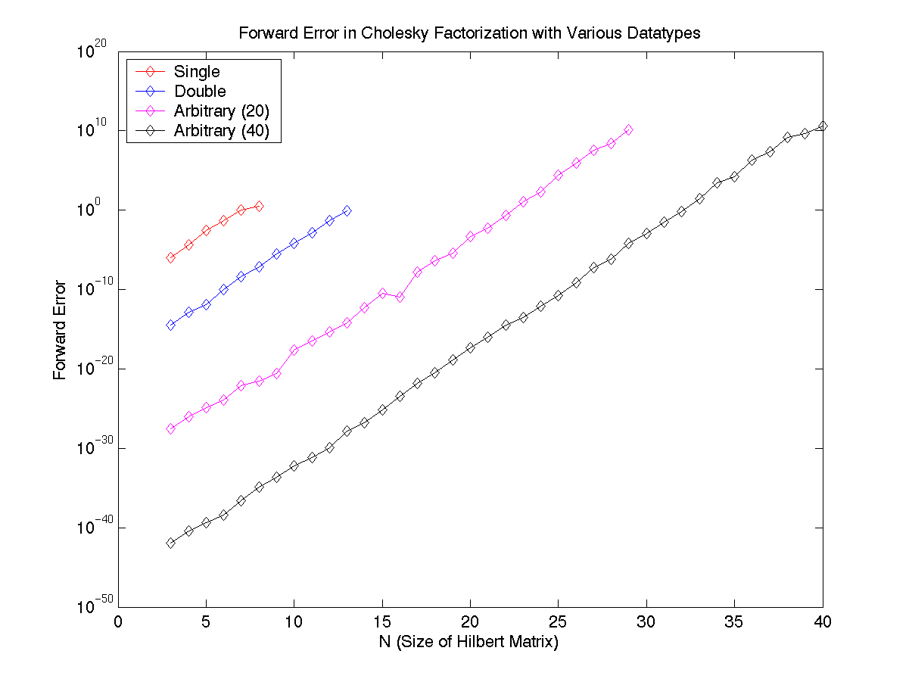
Cholesky Factorization and Hilbert Matrices
In addition to providing a higher limit on N, using arbitrary precision reduces error.
By solving the linear system: where the vector b is constructed such that the true solution x is equal to a 1-vector we can look at the forward error.

Slide 27
Templated BLAS Conclusions
Adding a templated interface to the BLAS allows the use of arbitrary datatypes
This is useful in particular for the inclusion of arbitrary-precision arithmetic
  Such arithmetic may be expensive, but the increased precision may be required for ill-conditioned problems
  Arbitrary-precision arithmetic can be used in only the places where it is needed most in order to retain speed
Templated tools libraries are essential for the development of templated solver libraries.

