Slide 1
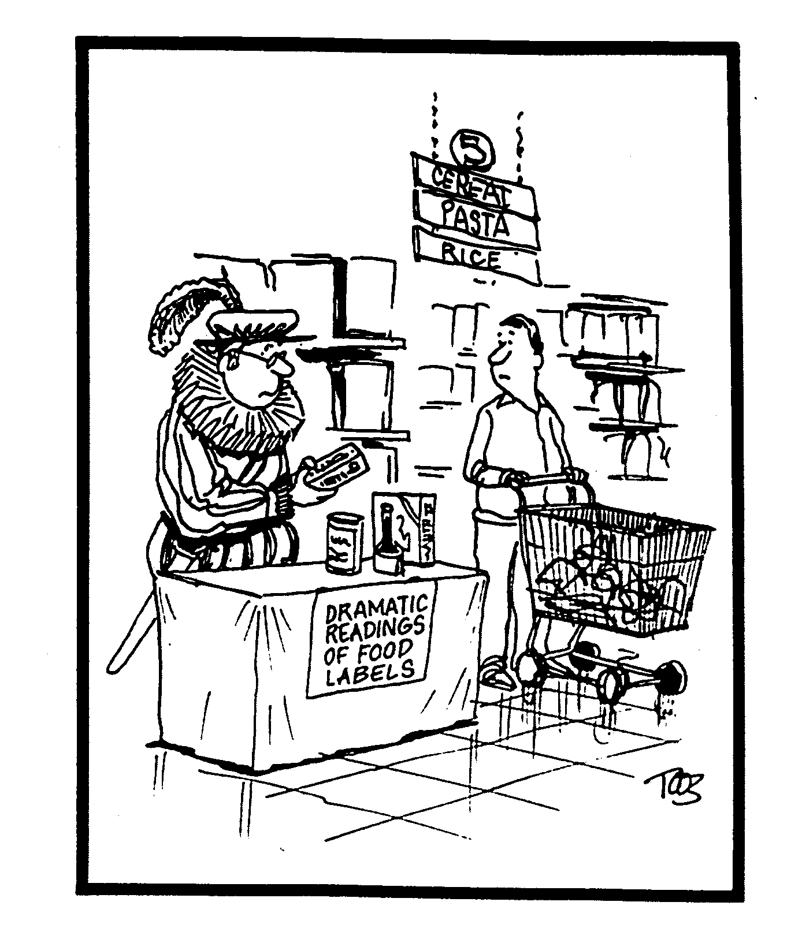
USDA Food Safety and Inspection Service
Labeling of FSIS-Regulated Foods

Slide 2
Required Information on a Label
(9 CFR 317.2/381 Subpart N)
Up to 8 required features
  Product name
  Inspection legend and est. number
  Handling statement
  Net weight statement
  Ingredients statement
  Address line
  Nutrition facts
  Safe handling instructions

Slide 3
A Food is Misbranded if
Its labeling is false or misleading in any particular
It is offered for sale under the name of another food
It is an imitation of another food without proper labeling

Slide 4
Prior Approval: Traditionally Required For All Product Labels
Meat and poultry plants submit labels for approval
Labeling “Policy Book” precedents become de facto regulation
FSIS inspection force monitors label usage and product formulation

Slide 5
Sketch
Company submits a printer’s proof showing all labeling material (including graphics)
Avoids unnecessary expense of printing incorrect labels

Slide 6
Temporary
Temporary approval of noncomplying labels may be granted under extenuating circumstances, for up to 6 months, only if:
  The label is not misleading
  The label does not pose a health, safety or dietary problem
  Approval would not give an unfair competitive advantage
  Denial would cause undue economic hardship

Slide 7
July 1996 Labeling Regulation
FSIS returned all label files to plants
Generic approved labels
  Plants are not required to submit certain types of labels for approval
FSIS only approves sketch and temporary labels
Inspector’s task performed periodically
    Verify presence of mandatory label features
    Ensure label is accurate representation of product

Slide 8
Company Responsibilities -
Labeling
Create a record of all final labeling including sketch approved labels
  Modifications per sketch approval are made to label before final printing
Maintain labeling records
  Final labeling
  Temporary approvals

Slide 9
Generic Approvals - New Labels
9 CFR 317.5/381.133
Standardized products without special claims, guarantees or foreign language
Single ingredient products without special claims, guarantees or foreign language
Products with contract specification for Federal Government agencies
Shipping containers
Inspection legends

Slide 10
Generic Approvals - New Labels
Products not intended for human food
Poultry heads and feet for export for processing as human food
Consumer test products not for sale
Inserts, tabs, liners, pasters, etc. that make no reference to the product
Prior approved sketch labeling or labeling with generic modifications

Slide 11
Generic Modifications
Proportionate enlargement or reduction
Abbreviations for unit of measurement
Master or stock label
Holiday designs
Opening instructions or serving directions
Coupons, cents-off statements, cooking instructions, packer product code information or UPC information

Slide 12
Generic Modifications
Address of packer, manufacturer or distributor
Net weight statement
Recipe suggestions
Punctuation
Newly assigned or revised establishment number for a particular establishment
Open dating information

Slide 13
Generic Modifications
Packaging material
Brand name changes
Deletion of the word “new”
Handling statements
Safe handling instructions
A change in the quantity of an ingredient without order of predominance change

Slide 14
Generic Modifications
Color changes
Vignette changes
Addition, deletion or substitution of USDA poultry grade shield
Deletion of a claim or non-mandatory information or features
Deletion or addition of English language translated into foreign language - for export only

Slide 15
Generic Modifications
Quantitative adjustments to the nutrition facts except for serving size
A change in establishment number by a corporation for a plant under its ownership
The use of the term fresh on poultry carcasses or parts
The use of the term frozen on poultry carcasses or parts

Slide 16
FSIS Promotes and Strictly Enforces Product Standards of Identity
Examples:
  Ham; Ham with Natural Juices; Ham Water Added; Ham and Water Product
  Hot Dogs/Frankfurters: maximum 40% fat and water
  Ground Beef: May contain no more than 30% fat
  Veal Cutlet: Single slice of veal from the round

Slide 17
Labeling Terms: Meat
“ ‘Meat’: muscle that is skeletal, or in the tongue, diaphragm, heart or esophagus…” (9 CFR 301.2(rr))
Includes product recovered from “advanced” meat recovery systems (AMRS) machinery
Does not include “mechanically separated” meat

Slide 18
Labeling Terms: Fresh
May not be used to designate a product that contains sodium/potassium nitrate/nitrite or has a brine concentration of 10% or more
May not be used to describe poultry carcasses or parts when the internal temperature has ever been below 26º F

Slide 19
Labeling Terms: Spring Lamb
Carcasses of new-crop lambs slaughtered in the Northern Hemisphere
During the period beginning in March and ending the close of the week containing the first Monday in October

Slide 20
Labeling Terms: Production
“Farm” or “country” should not be used on labels if the products are not prepared in the farm or country
Sausage containing cereal should not be labeled “farm style” or “country style”

Slide 21
Labeling Terms: Production
Free range
Farm raised
No added hormones
No antibiotics administered
Not fed animal by-products
“Certified organic by (name of certifying entity)” -- until 8/20/2002

Slide 22
Mandatory Handling Statements
Perishable product preserved by chilling
  “Keep Frozen”; “Keep Refrigerated”
  “Keep Refrigerated or Frozen”
Perishable cooked product shipped hot
  Product receives a heat lethality treatment
  “This product must either be maintained at no less than 140⁰ F during shipment or discarded”

Slide 23
Safe Handling Instructions
Mandatory when meat and poultry product is raw or partially cooked
Specific format for word size
Graphics mandated
Safe Handling
Instructions
This product was prepared from inspected and passed meat and/or poultry. Some food products may contain bacteria that could cause illness if the product is mishandled or cooked improperly. For your protection, follow these safe handling instructions.
Keep refrigerated or frozen. Thaw in refrigerator or microwave.
Keep raw meat and poultry separate from other foods. Wash working surfaces (including cutting boards), utensils, and hands after touching raw meat or poultry.
Cook thoroughly.
Keep hot foods hot. Refrigerate leftovers immediately or discard.

Slide 24
Labeling - Not Ready to Eat Products
A product containing a meat or poultry component that has received a lethality treatment for pathogens
Can also include dry cured products, e.g., country ham
Also contains non-meat/poultry component in need of a lethality treatment
Includes meals, dinners and frozen entrees
Cooking and preparation instructions on the product are sufficient to destroy pathogens

Slide 25
Labeling - Not Ready to Eat Products
Terms required on principal display panel displayed in a prominent manner in product name, in a starburst or elsewhere on principal display panel
  Uncooked
  Ready to cook
  Cook before eating
  Cook and serve
  Needs to be fully cooked
Safe handling instructions are recommended

Slide 26
Examples of Packaging Requirements
Packages for sliced bacon need a transparent opening for viewing the cut surface of a representative slice
Transparent or semi-transparent coverings shall not give a false impression of leanness to raw meat or cured meat

Slide 27
Protective Coverings
Processed Meat Products
Immediate packaging exempt from labeling requirements
  No marking or labeling permitted except for limited situations
Shipper must include all mandatory features since it is the immediate container
Statement of limited use required on shipper
Entire contents consumed on premises of hotel, restaurant or institution - no further distribution

Slide 28
Protective Coverings
Unprocessed Meat Cuts
Shipper must include all mandatory features since it is the immediate container
Products may be removed for resale if product or covering includes mark of inspection and establishment number

Slide 29
Protective Coverings
Poultry
Product in protective coverings for export or sold to hotels, restaurants or institutions are exempt from the mandatory labeling of immediate containers
  No marking or labeling permitted except for limited situations
Shipper must include all mandatory features since it is the immediate container
Shipper does not require a statement of limited use

Slide 30
FSIS-FDA Jurisdiction Determined by Meat / Poultry Content of Product
FSIS regulates products containing
  2% or more cooked meat or poultry meat
  3% or more raw meat or poultry meat
FDA regulates “meat flavored”sauces and soups with less than 2% meat or poultry meat

Slide 31
Marking
Applying of lettering or affixing of tags directly onto product
Branding is a form of marking

Slide 32
Branding
U.S. Inspected & Passed Brand
  Minimum of one required on each separate piece (side, quarter, primal part, etc.)
  Size and/or shape identify species
U.S. Inspected & Condemned Brand
  Applied to carcasses and parts that have been inspected and found to be adulterated and condemned under the regulations
U.S. Passed for Cooking Brand

Slide 33
Carcass Misbranding
If a mark of inspection is applied to uninspected adulterated or unwholesome carcasses
If a mark of inspection for one species of livestock is applied to another species

