Slide 1
LME Monitoring Option
Low Mass Emissions Units

Slide 2
LME Monitoring Option for
Determining Mass Emissions
Low Mass Emissions Methodology (§75.19)
  Generic NO_{x} Emission Rate or
  Fuel-and-unit specific NO_{x} Emission Rate
  Generic SO₂ Emission Rate or
  Fuel-and-unit specific SO₂ Emission Rate (using procedures in Appendix D section 2.3.6)
  Maximum Rated Heat Input Rate or
  Long Term Fuel Flow

Slide 3
Low Mass Emissions Unit Methodology
Procedure that may be used in lieu of CEMS or the excepted methods under App D and E for the purpose of determining hourly heat input, SO₂ mass emissions, and NO_{x} mass emissions
Natural gas and fuel oil only
Emissions limitations
  Year round reporting units: NO_{x} < 100 tons/year and
  < 50 tons/control period
  Ozone season only reporting units: NO_{x} < 50 tons/control period
  SO₂ < 25 tons/year
Notes:
LME is all or nothing!!

Slide 4
Low Mass Emissions Unit Methodology
Units must demonstrate that in each of the three years immediately preceding the year of the application, the SO₂ and NOx emissions did not exceed the annual and or seasonal threshold limits
In the absence of historical EDR’s, reliable estimates of the unit’s emissions for the previous 3 years may be based on records of unit operation, fuel usage etc.

Slide 5
Low Mass Emissions Unit Methodology
If at the end of a calendar year or ozone season, it is determined that the emissions from an LME unit exceeded the applicable threshold the unit is required to install Part 75 continuous monitoring systems by December 31 of the calendar year following the year in which the LME status is lost

Slide 6
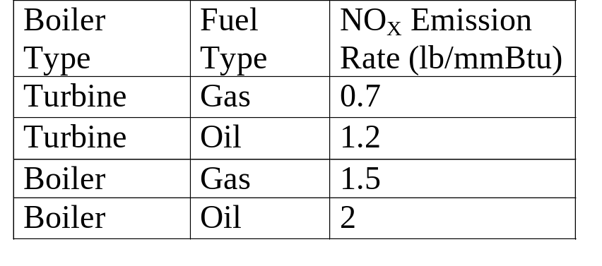
LME - NO_{x} Generic Emission Rate
Generic NO_{x} Emission Rate
  Table LM-2 of §75.19(c)

Slide 7
LME – SO₂ Generic Emission Rate
Generic SO₂ Emission Rate
  Table LM-1 of §75.19(c)
Fuel type | SO₂ emission factors
Pipeline Natural Gas | 0.0006 lb/mmBtu
Other Natural Gas | 0.06 lb/mmBtu
Residual Oil | 2.1 lb/mmBtu.
Diesel Fuel | 0.5 lb/mmBtu

Slide 8
LME - NO_{x} Emission Rate
Fuel-and-Unit Specific NO_{x} Emission Rate (§75.19(c)(1)(iv)(C))
  Perform four load Appendix E testing
    Use the highest 3-run average NO_{x} emission rate from the testing
  For units tested with SCR or SNCR
    Use the highest 3-run average NO_{x} emission rate from the testing, or
    0.15 lb/mmBtu whichever is greater
Fuel-and-Unit Specific NO_{x} Emission Rate (§75.19(c)(1)(iv)(G))
  Use the 95th percentile value from 3 years of quality-assured NO_{X} emission rate data from a NO_{X}-diluent CEMS
Notes:
4 load testing except for as provided under 75.19(c)(1)(iv)(I)

Slide 9
LME - NO_{x} Emission Rate
Reduced Testing requirements (§75.19(c)(1)(iv)(I))
  Rather than test at four load levels, testing may be conducted at one load level (for a single unit or all units in a group of identical units) if the data analysis required by §75.19(c )(1)(iv)(j) demonstrates that a unit or set of identical units operated at a single load level for at least 85.0 percent of all operating hours in the previous three years (12 calendar quarters) prior to the calendar quarter of the appendix E testing

Slide 10
LME - NO_{x} Emission Rate
Identical Units
Representative appendix E testing may be done on a subset of low mass emissions units in a group of identical units
Identical units must be of the same size (based on maximum rated hourly HI), manufacturer and model, similar operating conditions etc. (§75.19(c)(1)(iv)(B)(1))
If all the LME units in a group qualify as identical, then representative testing of the units may be performed according to Table LM-4 of §75.19

Slide 11
LME - Heat Input Rate
Maximum Rated Heat Input Method
  §72.2 defines the Maximum Rated Heat Input as “a unit-specific maximum hourly heat input (mmBtu) which is the higher of the manufacturer’s maximum rated heat input or the highest observed hourly heat input”
  Total Heat Input for the quarter is the product of the number of operating hours and the Maximum Rated Heat Input
  HI_{qtr} = OPHrs_{qtr} x MRHI

Slide 12
LME - Heat Input Rate
Long Term Fuel Flow Heat Input Method
  Fuel Flow
    Qualified fuel billing records
    A fuel measurement standard listed in §75.19(c)(3)(ii)(B)(2), or
    A fuel flowmeter certified, maintained, and quality assured according to Part 75 Appendix D

Slide 13
LME - Heat Input Rate
(LTFF Method)
GCV
  Part 75, Appendix D §2.2 and 2.3, or
  Default GCV in Table LM-5
    Pipeline Natural Gas - 1050 Btu/scf
    Natural Gas - 1100 Btu/scf
    Residual Oil - 19,700 Btu/lb or 167,500 Btu/gal
    Diesel Fuel - 20,500 Btu/lb or 151,700 Btu/gal
Total Heat Input is apportioned by load to each operating hour at the end of each reporting period
  EPA provides software to generate quarterly reports based on total HI and emission rate

