Slide 1

Transitioning
Capability Maturity Model for Software
To
Capability Maturity Model Integration
Software Engineering Process Group
Paul Meyers
DSCMO Systems Integration Organization

Slide 2
Agenda
Introduction
Why CMMI?
  CMMI Overview
  CMMI Structure vs. SW-CMM Structure
SW-CMM KPA’s to CMMI PA’s
Helpful Hints
Conclusion
Contact Information
Questions

Slide 3
Introduction
Notes:
I’m Paul Meyers
A lot to cover, please hold questions to the end, may find it is answered later in presentation
Today’s topic is transition from SW-CMM to CMMI

Slide 4
WHY CMMI?

Slide 5
Problems
Multiple CMM’s differed by
  Discipline (software, systems, acquisition, etc.)
  How Maturity is Defined (process improvement path)
  How Capability is Defined (institutionalization)
There were also a number of competing and complementary frameworks for process measurement and improvement
Notes:
There were multiple CMM’s - SEI initially delivered Capability Maturity Model (CMM) covering the disciplines of:
Software Engineering (SW-CMM)
Systems Engineering (SE-CMM)
System Acquisition (SA-CMM)
People CMM (P-CMM)
Personal Software Process (PSP)
Others: SPICE (Software Process Improvement and Capability dEtermination), ISO, EIA, Trillium, IEEE, US Government

Slide 6

Notes:
More like this.
Journey started about 1987

Slide 7
CMMI Project
SW
SE
Industry
...
CMMI
Product Suite
IPPD
SEI
Government
Assess
Training
SW
CMMI
SE
CMMI
SE/SW
CMMI
SE/SW/
IPPD
CMMI
...
Notes:
1993 – SEI Software CMM v1.1
1995– SPICE Baseline Practices Guide
1995– Systems Engineering CMM
1997 – SEI Software CMM v2 Draft C
1998– EIA 731 (Systems Engineering Capability Model)
1998– ISO/IEC 15504 type 2 technical reports
Members has average 21 years of experience, organizations with solid process improvement experience:
U.S. Army, Navy, Air Force, Federal Aviation Administration, National Security Agency, Software Engineering Institute, ADP, Inc., AT&T Labs, BAE, Boeing, Computer Sciences Corporation, EER Systems, Ericsson Canada, Ernst and Young, General Dynamics, Harris Corporation, Honeywell, KPMG, Litton, Lockheed Martin, Motorola, Northrop Grumman, Pacific Bell, Q-Labs, Raytheon, Rockwell Collins,Thomson CSF, TRW

Slide 8
CMMI Product Suite
Framework for generating integrated products to support product and process development
Bodies of Knowledge
  Software Engineering, Systems Engineering, Integrated Product and Process Development, and Supplier Sourcing
Two Representations
  Continuous
  Staged
Notes:
Why called product suite?
Because it is a framework – reference models, training models, appraisal models – allow for other models to be developed by individual industries based on need
Products share – common terminology and common components
Each body of knowledge related to a product or process development in CMMI is considered a discipline

Slide 9
CMMI Product Suite
Staged Representation
  Process Areas grouped and measured by Maturity Levels (Ala CMM)
Continuous Representation
  Process Areas grouped by category (e.g., Project Management, Engineering) and measured by Capability Level
Multiple Model Options
  Systems, Software, Systems + Software,
  Systems + Software + Integrated Product and Process Development
Notes:
Disciplines can be grouped into Model Options:

Slide 10
CMMI Model Components
Process Area
Goals (specific and generic)
Practices (specific and generic)
Typical Work Product
Sub-practices
Notes
Discipline Amplifications
Generic Practice Amplifications
References
Notes:
Meaning of each will become clearer as presentation progresses

Slide 11
CMMI Product Suite
CMMI Generic Levels
  5 Optimizing
  4 Quantitatively Managed
  3 Defined
  2 Managed
  1 Performed/Initial
  0 Incomplete (continuous model only)
Notes:
5 Process Improvement is a continuous focus
4 Process are both measured and controlled
3 Process are characterized for the organization and is proactive
2 Process are characterized for projects and actions are often reactive
1 Processes are unpredictable, poorly controlled and reactive
0 Incomplete not done or not fully done
Required
Must be achieved
Essential for rating the achievement of the PA
Expected
Describe what is typically implemented to achieve a required component (i.e., a goal)
Alternatives are allowed
Informative
Provide details that help model users understand a PA and how they can be achieved

Slide 12
Continuous Representation

Slide 13
Process Capability
The capability of an implemented process can be represented by a bar.
3
2
1
0
This point
represents
a higher level
of capability
than this point
in a specific
process area
Capability
Process Area n
Process

Slide 14
Capability Levels are Cumulative
Because capability levels build upon one another, there can be no gaps.

Slide 15
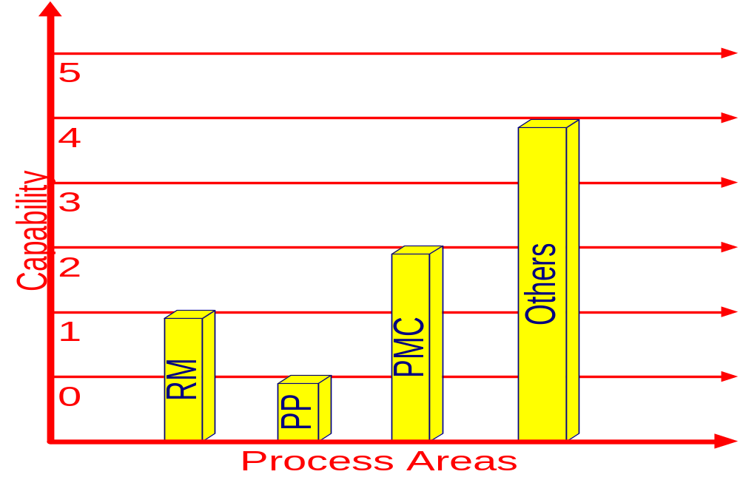
Process Capability Profile
Notes:
Capabilities can vary process area to process area, no requirement that they be aligned

Slide 16
Staged Representation

Slide 17
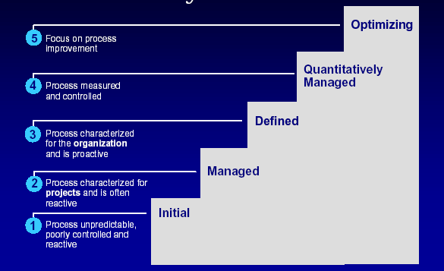
Staged Model
Notes:
The staged representation organizes process areas into five maturity levels
Level One - Initial
Level Two - Managed
Level Three - Defined
Level Four - Quantitatively Managed
Level Five – Optimizing
Maturity Levels are cumulative, can not skip levels, e.g, from ML 2 to ML 4

Slide 18
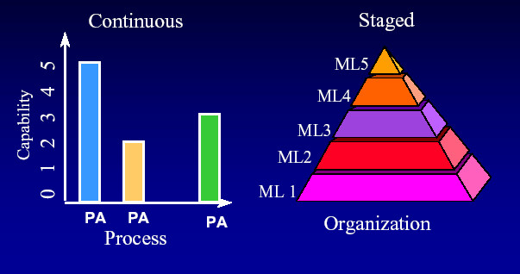
Model Comparison

Slide 19
SW-CMM Structure

Slide 20
SW-CMM Model Components
Maturity Level
  Indicate Process Capability
Key Process Areas
  Achieve Goals
Common Features
  Address Implementation or Institutionalization
  Commitment, Ability, Activities, Measurement and Analysis, Verifying
Key Practices
  Describe Infrastructure or Activities

Slide 21
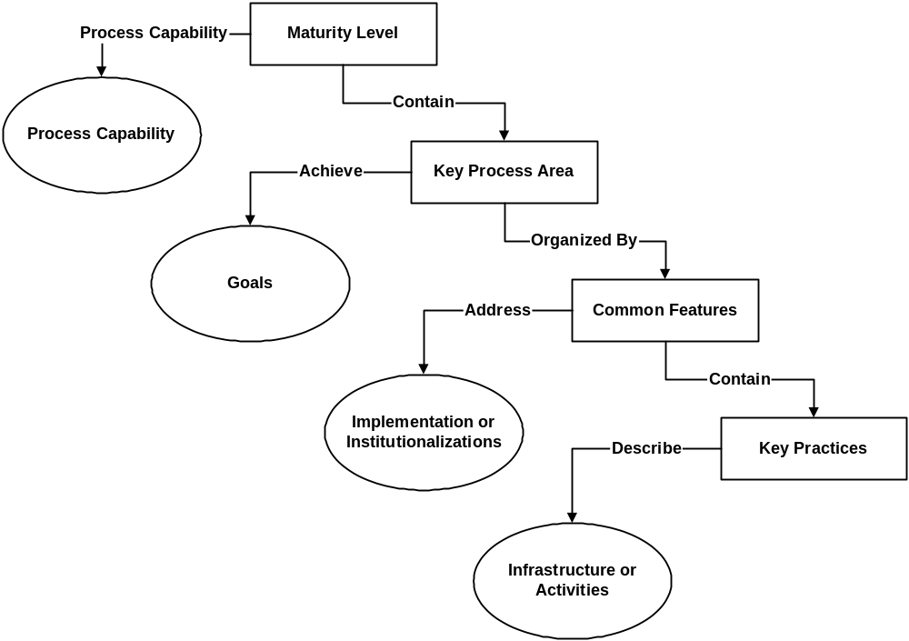

Slide 22
CMMI Structure

Slide 23
CMMI Model Components
Process Area
Goals (specific and generic)
Practices (specific and generic)
Typical Work Product
Sub-practices
Notes
Discipline Amplifications
Generic Practice Elaborations
References
Examples
Notes:
As we noted earlier

Slide 24
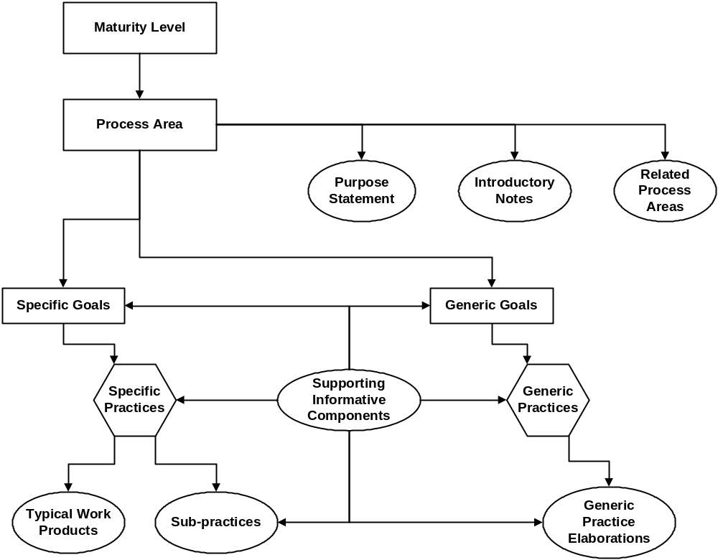
Notes:
For the staged representation
Represent the “core” of the process specification

Slide 25
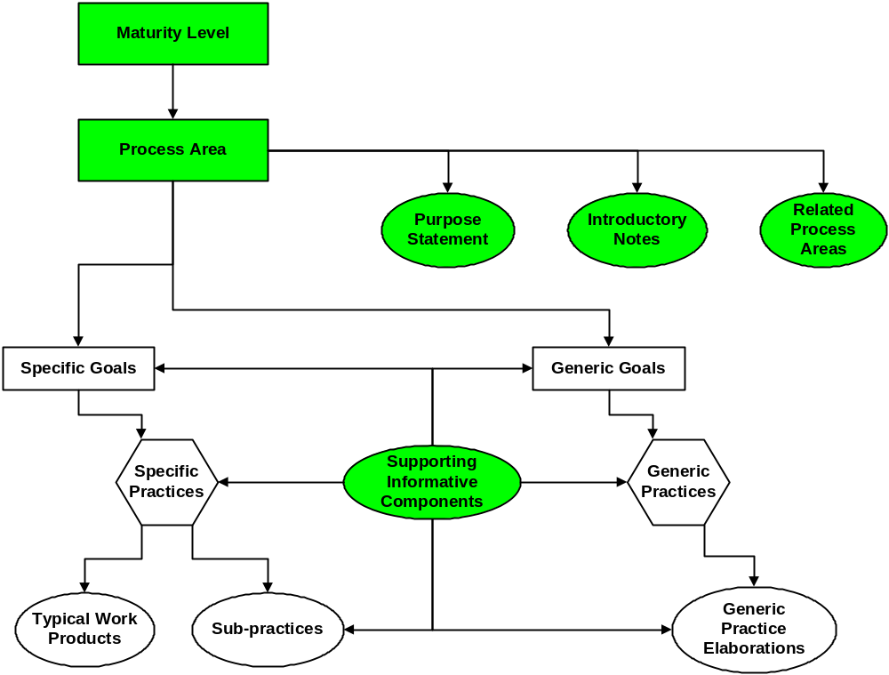
Model Components
Notes:
For the staged representation
The maturity level of an organization provides a way to predict the future performance of an organization within a given discipline or set of disciplines (e.g., Systems Engineering).
Maturity levels still consist of a predefined set of process areas. - The maturity levels are measured by the achievement of the specific and generic goals that apply to each predefined set of process areas.
A maturity level is still a defined evolutionary plateau of process improvement
A process area is a cluster of related practices in an area that, when performed collectively, satisfy a set of goals considered important for making significant improvement in that area
Practices are actions to be performed to achieve the goals of a process area
A process area is not a process description, but a description of a process
Purpose Statement – Brief statement of what is to be accomplished by the implementation of the practices of a particular process areas
Introductory Notes – Notes provide details that help understand the core information of the model.
Related Processes – Identify other process areas that interact and provides context for process
Discipline Amplifications – Specialized piece of information that is relevant to a particular discipline
Notes – Can accompany nearly any other model component to provide detail, background or rational
References – Can accompany nearly any other process component and is a pointer to additional or more detailed information in a related process area
Examples – Can accompany nearly any other model component to provide concept clarification or describe activity

Slide 26
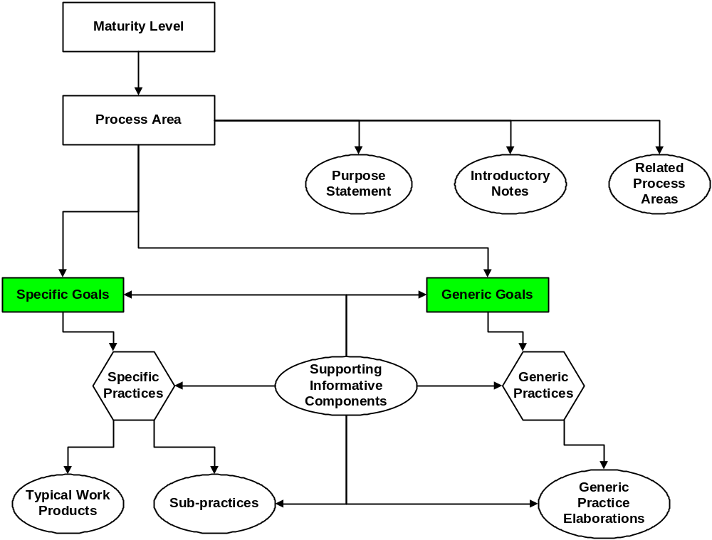
Model Components
Notes:
There are two types of goals in CMMI – Specific and Generic
Specific goals apply to a specific process area and address the unique characteristics that describe what must be implemented to satisfy the process area. Specific goals are required model components and are used in appraisals to help determine whether a process area is satisfied.
SG 1 Manage Requirements - Requirements are managed and inconsistencies with project plans and work products are identified.
Generic goals are called “generic” because the same goal statement appears in multiple process areas.
Achievement of a generic goal in a process area signifies improved control in planning and implementing the processes associated with that process area.
GG 2 Institutionalize a Managed Process – The process is institutionalized as a managed process.
Generic goals are required model components and are used in appraisals to determine whether a process area is satisfied.
Bullet two - thus indicating whether these processes are likely to be effective, repeatable, and lasting
Generic goals are always tailored to the needs of the process they are embedded in.

Slide 27
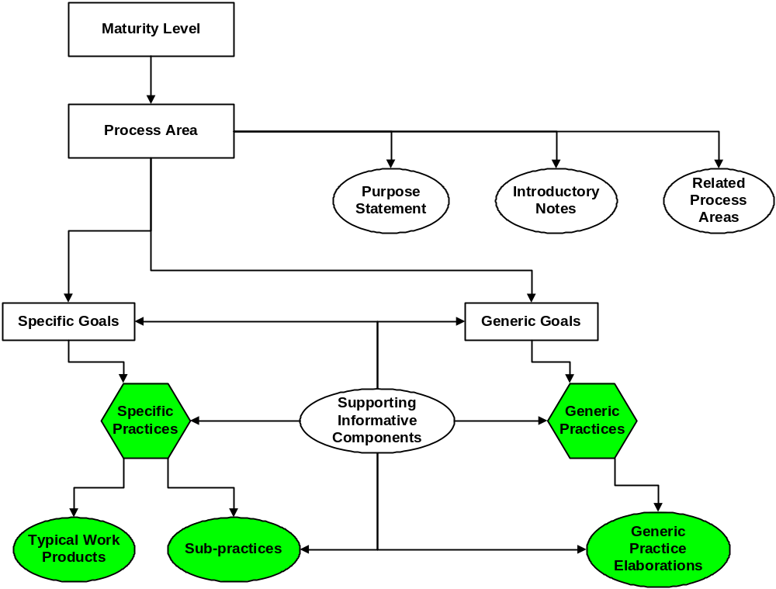
Model Components
Notes:
Practices are descriptions of actions need to enact key elements of a process and are the essence of the CMMI model, Practices are major building blocks in establishing the process maturity of an organization
Specific Practices map to specific goals
A specific practice is an activity that is considered important in achieving the associated specific goal.
Req. Mgmt.
Specific Goal 1 – Manage Requirements, Specific Practice (SP) 1.4 – Maintain Bi-directional Traceability of Requirements
Typical Work Products provide examples of outputs from a practice area
There are often other work products that could be used that are not listed
Specific Practice (SP) 1.4 – Maintain Bi-directional Traceability of Requirements
Requirements traceability matrix, Requirements tracking system
Sub-practices are related to practices
Suggest a course of action for the associated specific process
Specific Practice (SP) 1.4 - Maintain requirements traceability to ensure that the source of lower level (derived) requirements is documented (total of 4 listed)
Generic Practices map to Generic Goals
Are activities that ensure that the process associated with the process area will be effective, repeatable and lasting
Contribute to the achievement of the generic goal when applied to a particular process area
Organized by “Common Features”, Commitment to Perform (CO), Ability to Perform (AB) Directing Implementation (DI) Verification (VE)
Establishing organizational policies and leadership, Resources, organizational structures, and training, Insight into the performance of the process, Reviews and audits.

Slide 28
SW-CMM KPA’s
To
CMMI PA’s
Using Maturity Levels

Slide 29
Mapping CMM ML to CMMI ML
ML=MC²=PA*ln(GG³/SG)*(PR)*GPA^{exp(TWP)}
PA = q*[1-exp(-x*t)] / [1+exp(-x*t)]
GG = [-M / (2*k)]*ln([T - M*g - k*v^2] / [T - M*g])
SG = [+M / (2*k)]*ln([M*g + k*v^2] / [M*g])
PR = (M / k)*(1 / [2*q])*ln([q+v] / [q-v])
GPA = q*[1 - exp(-x*t)] / [1 + exp(-x*t)]
TWP = 1 - [ (m / {m+0.5*m}) / ln({m+m} / m) ]
Notes:
ML – Maturity Level
PA – Process Area
GG – Generic Goals
SG – Specific Goals
PR – Practices
GPA – Generic Practice Amplifications
TWP – Typical Work Products

Slide 30
Changes at Maturity Level 2 - Repeatable
SW-CMM
Requirements Management
Software Project Planning
Software Project Tracking and Oversight
Software Subcontract Management
Software Quality Assurance
Software Configuration Management
CMMI
Requirements Management
Project Planning
Project Monitoring and Control
Supplier Agreement Management
Product and Process QA
Configuration Management
Measurement and Analysis
Notes:
Measurement and Analysis is a new PA
Other process areas contain similar materials
Word “software” removed, CMMI covers both systems and software

Slide 31
Changes at Maturity Level 3 - Defined
CMMI
Organization Process Focus
Organization Process Definition
Organizational Training
Integrated Project Management
Integrated Supplier Mgmt
Organizational Environment for Innovation
Integrated Teaming
SW-CMM
Organization Process Focus
Organization Process Definition
Training Program
Inter-group Coordination
Integrated Software Mgmt
Notes:
Some KPA’s from Maturity Level 3 SW-CMM do not have a one-to-one correspondence to Maturity Level 3 in CMMI.
Practices from Inter-group Coordination now found in Requirements Management, Project Planning, Integrated Project Management, and other PA’s.
Practices from Integrated Software Management now found in Integrated Project Management and Risk Management
Integrated Supplier Management, Organizational Environment for Innovation, and Integrated Teaming have no comparable KPA in SW CMM

Slide 32
Changes at Maturity Level 3 - Defined
SW-CMM
Software Product Engineering
Peer Reviews ========➔
CMMI
Risk Management
Requirements Development
Technical Solutions
Product Integration
Verification
Validation
Decision Analysis and Resolution
Notes:
Software Product Engineering handled what is now distributed in the new Engineering Process Areas (Requirements Development, Technical Solutions, Product Integration, etc.) in CMMI
Peer Reviews incorporated into Verification Process Area
Decision Analysis and Resolution is new

Slide 33
Changes at Maturity Level 4 - Managed
SW-CMM
Quantitative Process Management
Software Quality Management
CMMI
Organization Process Performance
Quantitative Project Management
Notes:
KPA’s from Maturity Level 4 in SW-CMM do not have a one-to-one correspondence to Maturity Level 4 in CMMI.
Practices from Quantitative Process Management and Software Quality Management are found in Quantitative Project Management and Risk Management
Organizational Process Performance is new to CMMI

Slide 34
Changes at Maturity Level 5 - Optimizing
SW-CMM
Causal Analysis and Resolution
Technology Change Management =======➔
Process Change Management =======➔
CMMI
Causal Analysis and Resolution
Organizational Innovation & Deployment
Notes:
Some KPA’s from Maturity Level 5 in SW-CMM do not have a one-to-one correspondence to Maturity Level 5 in CMMI.
Ideas contained in Technology Change Management and Process Change Management are found in the Organizational Innovation and Deployment

Slide 35
THE PLAN
AKA – Git Er Don

Slide 36
The Basic’s
Use KPIIDS (Key Practice Implementation Indicator Descriptions)
  Select CMM ML2 Project(s) (3 Max)
  Create KPIID for the Project(s) mapping Objective Evidence (OE) AND Process Documents

Slide 37
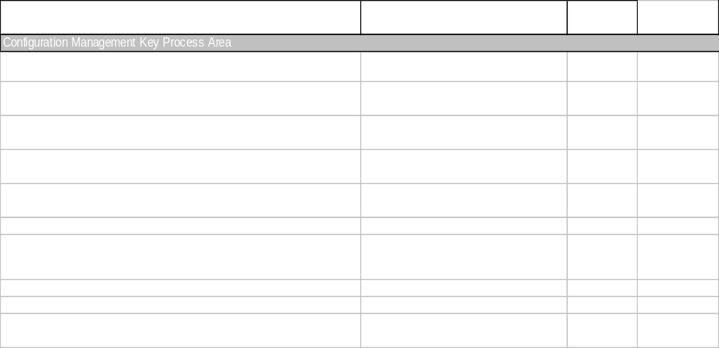
KPIID

Slide 38
The Basic’s
Map CMM Components to CMMI Components (done for you)

Slide 39
Mapping of SE-CMM V1.1 to CMMI-SE/SW/IPPD V 1.1 Stage - Requirements Management
Common Feature
Goals and Common Feature
CMMI PA/Activity Goal/Activity
Comment
Goals
Goal 1 – System requirements allocated to software are controlled to establish a baseline for software engineering
RM SG 1
Goal 2 – Software plans, products, and activities are kept consistent with the system requirements allocated to software
RM SG 1
Commitment to Perform
Commitment 1 – Project follows a written organizational policy for managing the system requirements allocated to software
RM GP 2.1
Ability to Perform
Ability 1 – For each project, responsibility is established for analyzing the system requirements and allocating them to hardware, software and other system components
RM GP 2.4
Ability 2 – The allocated requirements are documented
RD SP 2.2
Ability 3 – Adequate resources and funding are provided for managing the allocated requirements
RM GP 2.3
Ability 4 – Members of the software engineering group and other software-related groups are trained to perform their requirements management activities
OT SG 2
RM GP 2.5
Activities Performed
Activity 1 – The software engineering group reviews the allocated requirements before they are incorporated in the software project
RD GP 2.7
RM SP 1.2
Activity 2 – The software engineering group uses the allocated requirements as the basis for the software plans, work products, and activities
Not directly addressed
Activity 3 – Changes to the allocated requirements are reviewed and incorporated in the software project
RM SP 1.2, 1.3, & 1.5; RSKM SP 1.1
Measurement and Analysis
Measurement 1 – Measurements are made and used to determine the status of the activities for managing the allocated requirements
RM GP 2.8
CMMI not as specific
Verifying Implementation
Verification 1 – The activities for managing the allocated requirements are reviewed with senior management on a periodic basis
RM GP 2.10
Verification 2 – The activities for managing the allocated requirements are reviewed with the project manager on both a periodic and event-driven basis
RM GP 2.8
Not directly addressed
Verification 3 – The software quality assurance group reviews and/or audits the activities and work products for managing the allocated requirements and reports the results
RM GP 2.9
CMMI not as specific
Notes:
I only provided an overview of the mapping, but detailed one exists
This is a detailed map of SW-CMM to CMMI
Provide a reference to get the complete work later

Slide 40
The Basic’s
Add Project and Process Columns to CMM/CMMI Map
Map KPIID(s) OE and Process Doc’s to CMM/CMMI Map

Slide 41
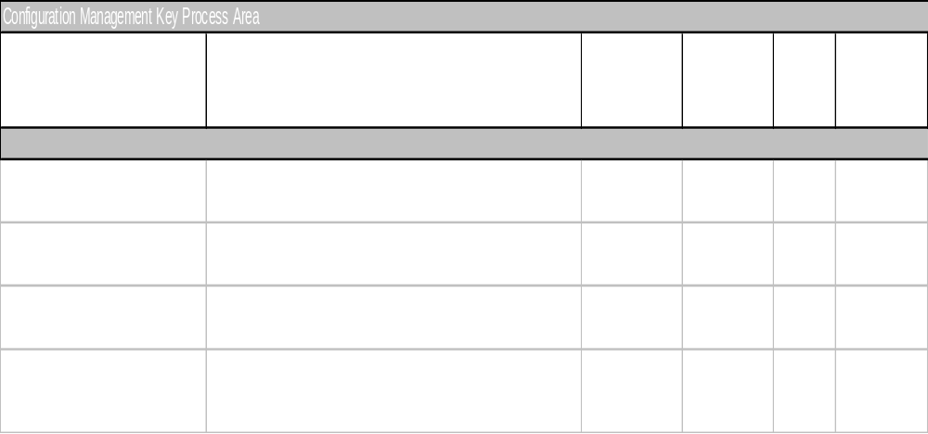
CMM/CMMI X-Ref

Slide 42
The Basic’s
Identify the Gaps and Restructuring
Extract The Measures
Treat It As A Development Project – Use Your Existing CMM Processes
  Gaps/Restructuring are requirements
  Developing documentation is a project deliverable
  Manage documentation versions
  QA Applies

Slide 43
Helpful Hints
Understand SCAMPI
  Standard CMMI Appraisal Method for Process Improvement
Use SCAMPI C and B as approach to monitoring overall progress (in alignment with QA)
Don’t forget to include pilot project for updated processes
Need to assess conversion requirements
Select target projects for first release early

Slide 44
Helpful Hints
Continuous model can be used to help plan at detailed level
  Practice level is more granular due to additional level of the model, i.e, level 1
  Equivalent staging

Slide 45
For Non CMM Organizations
Use the CMMI GP’s to Plan your effort
  GP 2.1 Establish an Organizational Policy
  GP 2.2 Plan the Process
  GP 2.3 Provide Resources
  GP 2.4 Assign Responsibilities
  GP 2.5 Train people
  GP 2.6 Manage configurations
  GP 2.7 Identify and involve relevant stake holders
  GP 2.8 Monitor and control the process
  GP 2.9 Objectively Evaluate Adherence
  GP 2.10 Review Status with Higher Level Management
Notes:
From a Presentation done by Richard Marks of Raytheon

Slide 46
For Non CMM Organizations
GP 2.1 Establish an Organizational Policy
  State clearly that the organization is going to follow CMMI and be successful
GP 2.2 Plan the Process
  Develop an approach and schedule for implementing each PA including estimates of time/resources needed
GP 2.3 Provide Resources
  Overhead, direct/indirect expenses, supplies, travel
  Facilities required
  Training for people, key players, etc.
Notes:
From a Presentation done by Richard Marks of Raytheon

Slide 47
Conclusion
The models map sufficiently well to allow for sane conversion
  You say Tomato, I say Toemato, You say Potato, I Say Pototo, you get the idea
Hard Work – Yes, Rocket Science – No

Slide 48
CMMI Future
Next version will contain minor revisions, e.g., clarifications
Moving to single training class for representations
Future versions will
  Drop common features
  Add additional process area, e.g., Acquisition
  Add a “service model”, ITIL/COBIT
Other changes
  Moving to certifying appraisers and instructors
Notes:
Authorized ➔ Certified
ITIL – IT Infrastructure Library is an authoritative source of descriptive IT best practices, notably in operations and service management
COBIT (Control Objectives for Information and related Technologies) was borne out of the efforts of dedicated experienced practitioners who recognized the need to have a series of controls to manage IT. In fact, numerous standards and practices were reviewed to identify the controls that it covers, and it is still evolving

Slide 49
Questions
?

Slide 50
Additional Information
Frequently Asked Questions (FAQs) - Mappings of CMMI to Other Standards
http://www.sei.cmu.edu/cmmi/faq/map-faq.html#MAP01

Slide 51
Contact Information
Paul H. Meyers, SAIC Project Manager
DSCMO Systems Integration Organization
301-763-3911
paul.h.meyers@census.gov

