Slide 1
eGovernment SecurePay Overview
Jim Hill
DAS IRMD
State of Oregon

Slide 2
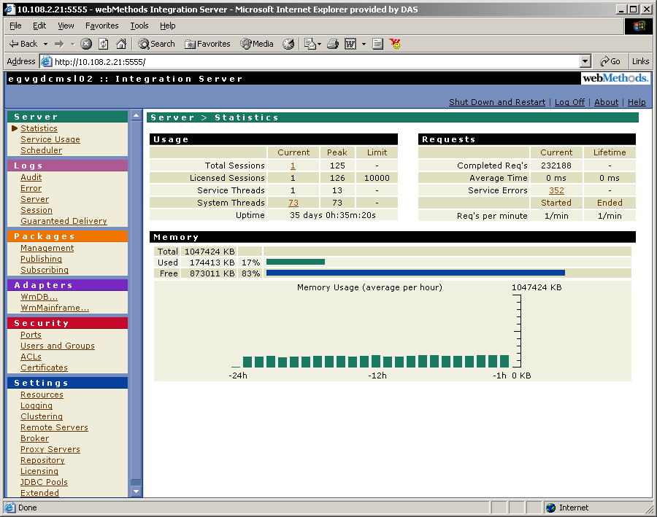
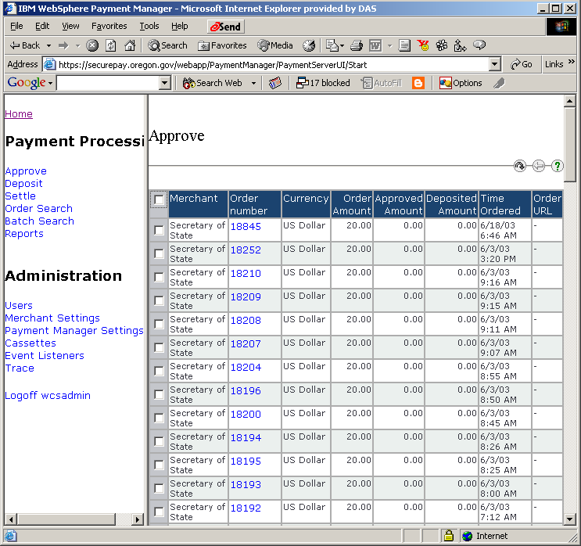
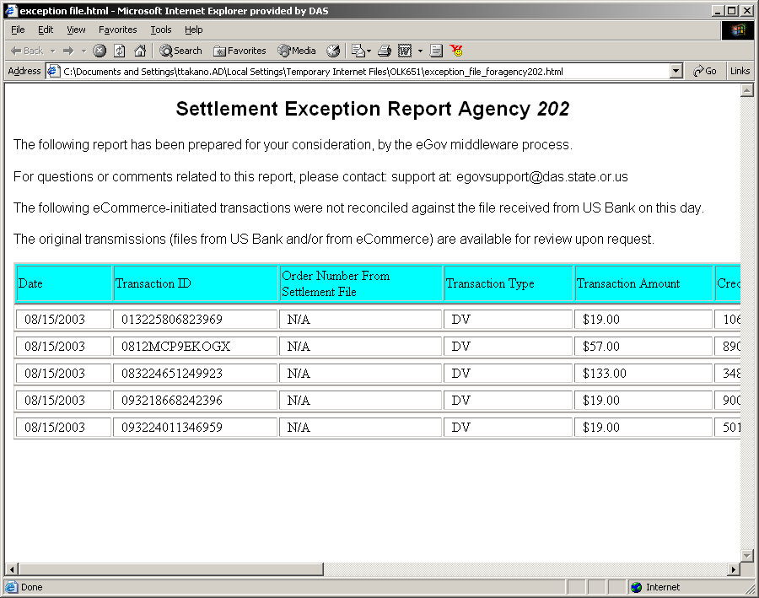
Enterprise Application Integration
webMethods to Websphere Commerce

Slide 3
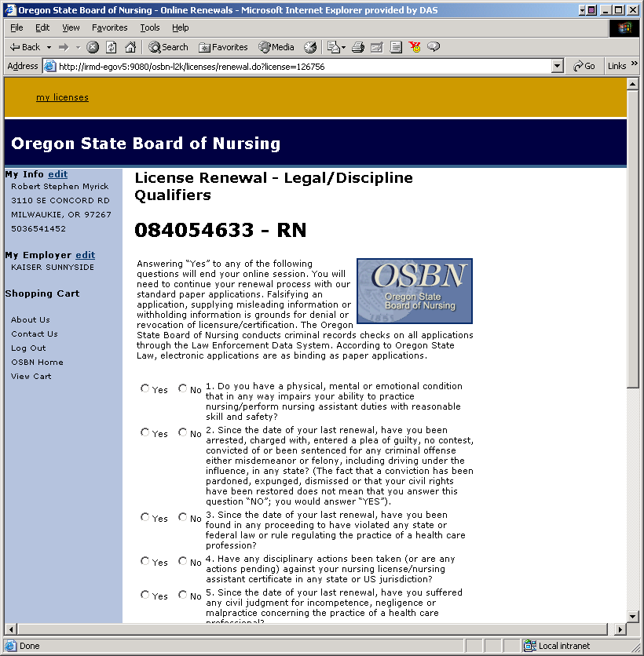
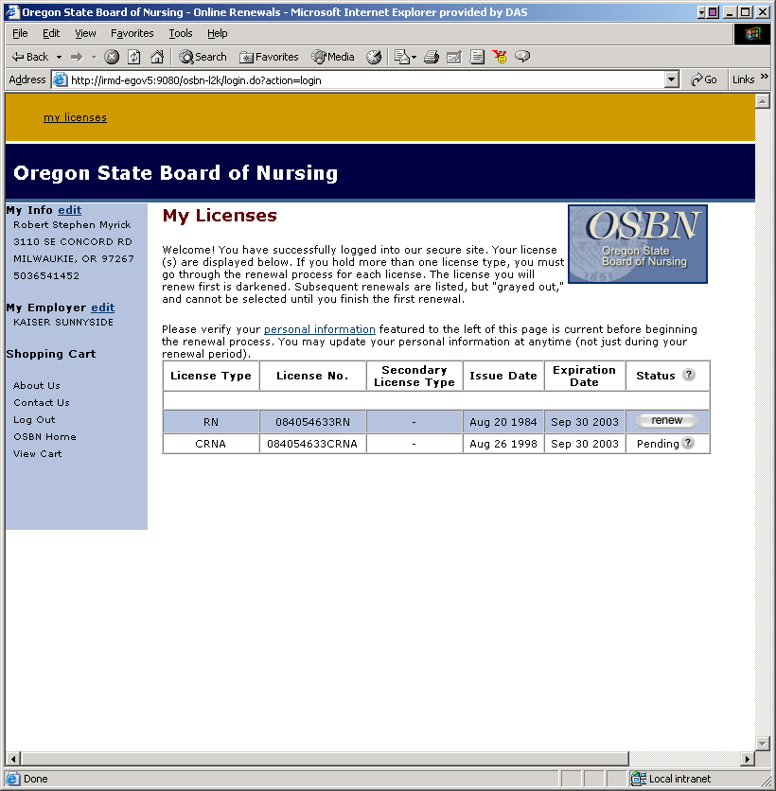
Webservices based Application Integration

Slide 4
What is eCommerce?
It is accepting credit cards on-line.
SecurePay is DAS’s central system for accepting and clearing credit cards.

Slide 5
What are my options?
There are several technical methods for connecting and clearing credit cards.
DAS IRMD eGovernment staff will assist you in making the best business decision you can.
API (Application Programming Interface)
Generic Store

Slide 6
Generic Store
The Generic Store is a concept. It is not a location. The “Generic Store” includes all the components necessary to integrate your application to SFMA.
eGovernment builds your initial store.
Integration into your existing business systems is customization.

Slide 7
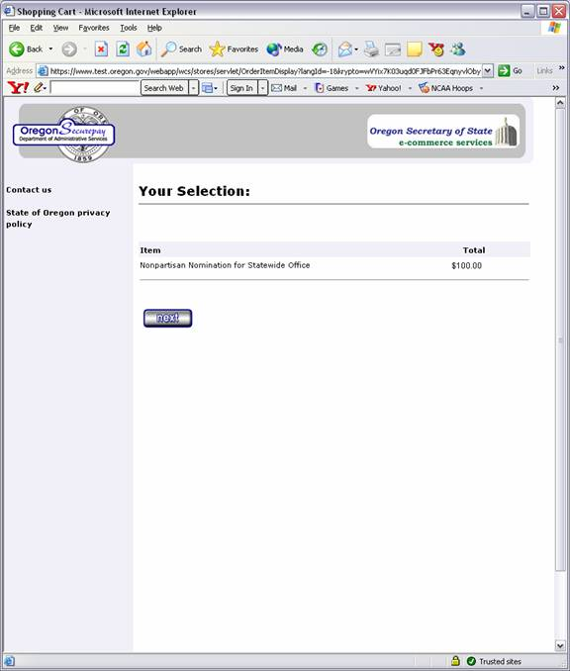

Slide 8
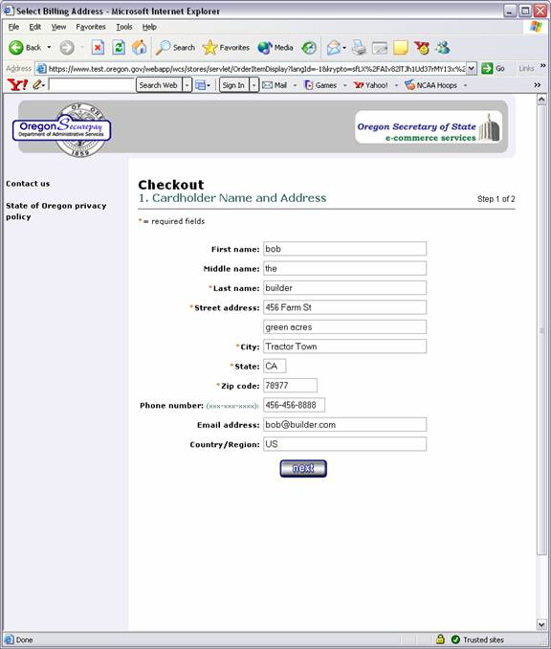

Slide 9
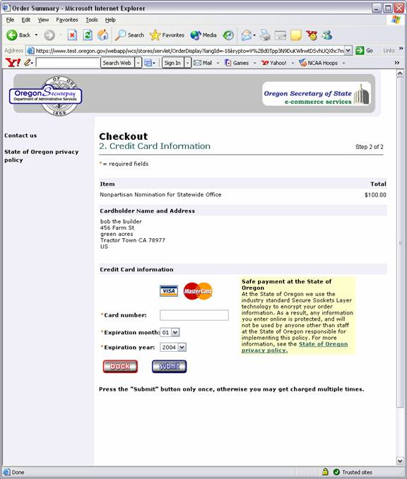

Slide 10
API
This is a methodology that is used to clear credit cards. An agency must receive an exception to use this model, as it requires an increased technical requirements to maintain the interface.

Slide 11
Services available for integration
Web content management
  Interwoven
Enterprise Directory Services
  Sun One Identity Server
Enterprise Application Integration
  webMethods
Enterprise Commerce
  Websphere Commerce 5.4/5.5

Slide 12
How do I get started?
Call me. Jim Hill 503-378-4705 or call the State Controller’s Office.
HTTP://EGOV.DAS.STATE.OR.US

Slide 13
Jim Hill
eGovernment Program Manager
DAS IRMD
1225 Ferry ST SE
Salem OR 97301
503.378.4705
jim.hill@state.or.us

