Slide 1

Finding Remedies for Medicaid
2nd Annual Legislative Summit
RSA Plaza, Montgomery, AL
September 22, 2004

Slide 2


Medicaid Basics

Slide 3
Medicaid “Rules”
Medicaid was established in 1965 by federal law to provide medical assistance to low income and resource individuals.
States may choose to have a Medicaid program, but must comply with all federal Medicaid requirements once a program has been implemented.
Funded through a federal and state partnership (generally 70/30 in Alabama)
Notes:
MEDICAID created by Title 19 of the Social Security Act (SSA) in 1965 to provide medical assistance for certain individuals and families with low income and resources.
MEDCAID is the largest program providing medical and health-related services to Alabama's poorest people
MEDICARE created by Title 18 of the Social Security Act in 1965 to provide for seniors 65+
MEDICARE provides hospital insurance also known as Part A coverage, and supplementary medical insurance (SMI), also known as Part B coverage
MEDICARE beneficiaries (65+) and who have low income and limited resources may receive help paying for their out-of-pocket medical expenses from Medicaid
“Dual eligibles” are entitled to Medicare and are eligible for some type of Medicaid benefit

Slide 4
“Rules” cont.
Federal law sets minimum eligibility and benefit levels.
With few exceptions, Alabama’s program is at the federal minimum level for eligibility.
Alabama has one of the most conservative benefit packages in the country.
Medicaid cannot make any more program cuts and still be in compliance with federal regulations.

Slide 5
Don’t be confused…
Medicaid is a federal and state program and provides medical assistance to low income and resource individuals.
Medicare is a federal program to provide medical insurance generally to individuals aged 65 and older.

Slide 6
Who Determines Eligibility
Three Alabama agencies certify individuals for Medicaid.
Agencies certify certain groups of individuals for Medicaid based on their circumstances.
These agencies are:
  The Social Security Administration
  The Department of Human Resources
  The Alabama Medicaid Agency

Slide 7

The Face of Medicaid

Slide 8
Demographics
Medicaid covers:
19.9% of Alabama’s total population (includes all eligibility categories)
46% of all deliveries in Alabama
37.1% of Alabama’s children (under 19)
21.2% of Alabama’s elderly (65 and above)
74% of nursing home residents in facilities with certified beds (65% of all beds in Alabama)

Slide 9
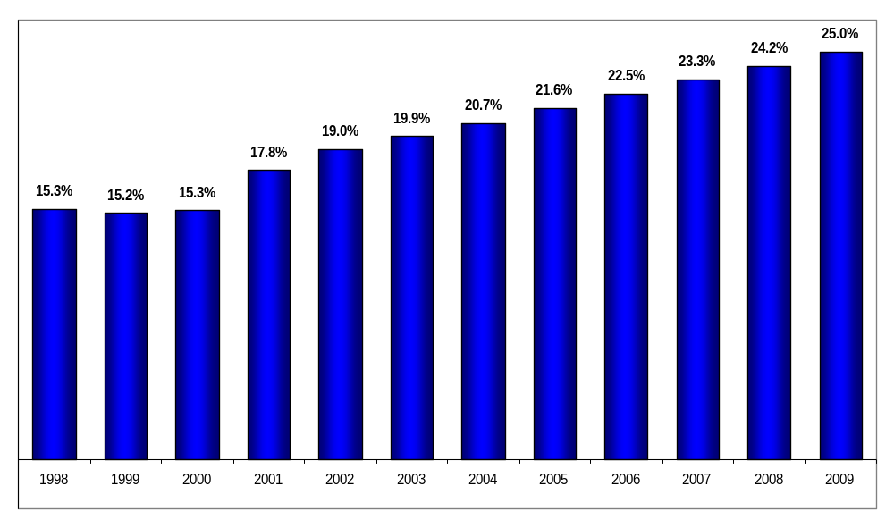
Total Medicaid Eligibles
As a Percentage of Alabama’s Population
Note: Includes individuals eligible for Plan 1st

Slide 10
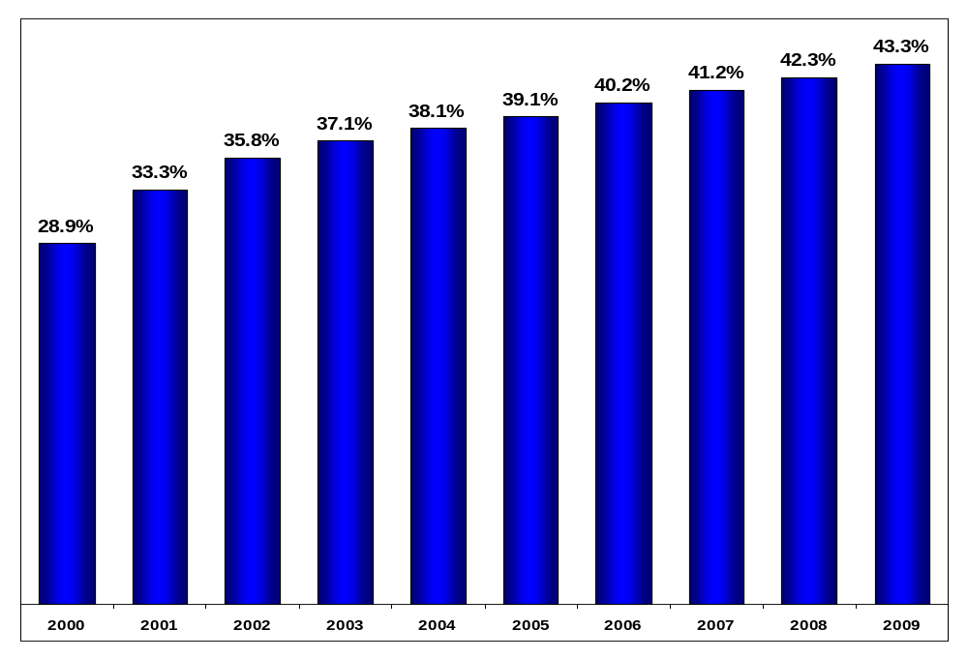
Medicaid Children
As a Percent of Alabama’s Child Population
(under 19 years of age)

Slide 11

Children in Working Families
As of January 2004
Source: Obtained for MLIF and SOBRA populations based on information from Medicaid applications as filed.

Slide 12
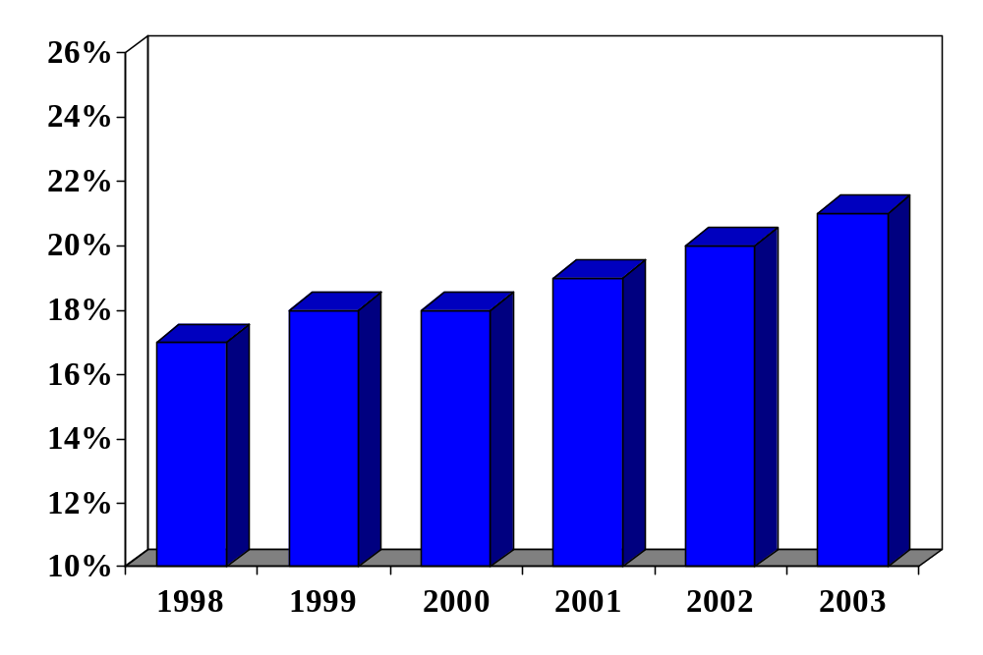
Medicaid Seniors
As a Percent of Alabama’s Population
Beneficiaries Age 65 and Over

Slide 13
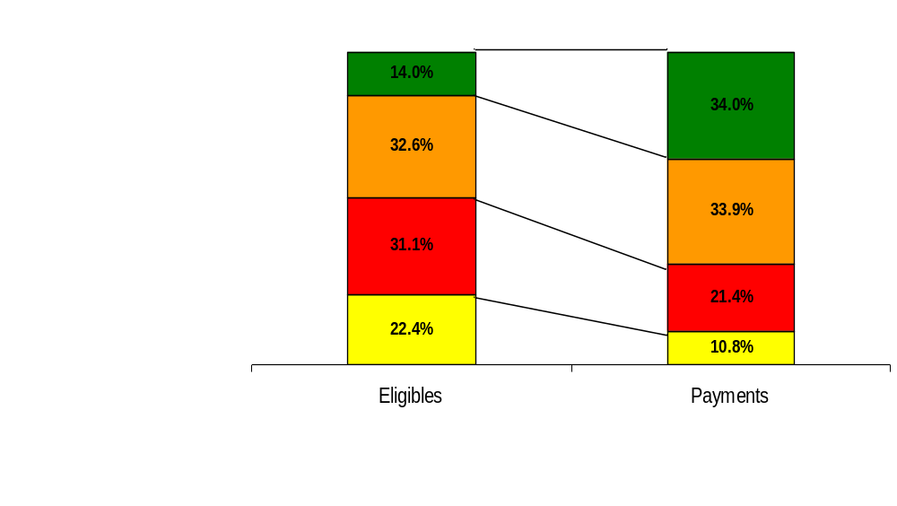
Eligible and Payment Distribution
By Age

Slide 14
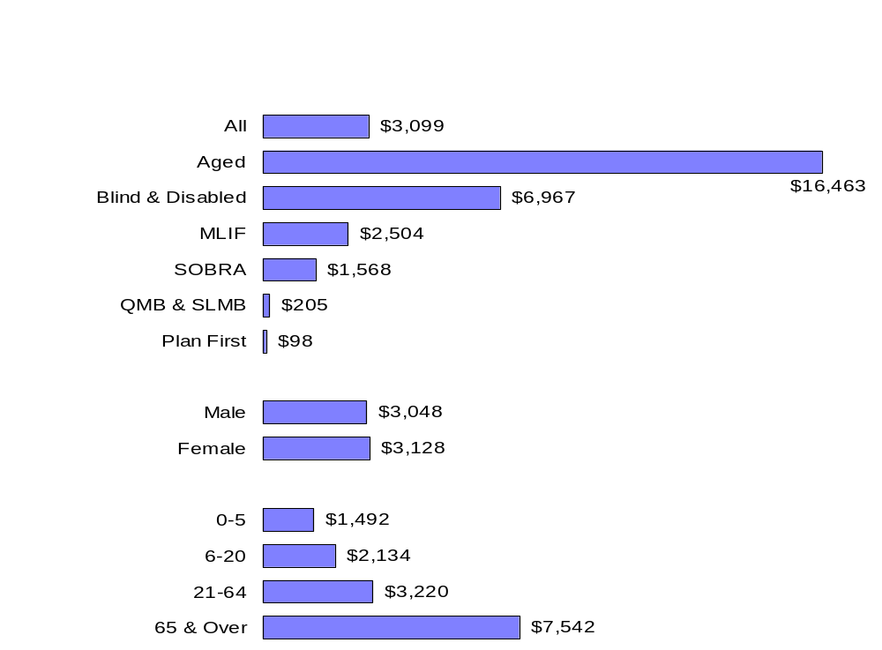
Cost Per Eligible
FY 2003

Slide 15
Programs Initiatives
Patient 1st Redesign
Coordination of Services
Disease Management and Patient Education
Pharmacy Program Management
PDL
Brand Prescription Limit
Program Integrity

Slide 16

October 1, 2004

Slide 17
Patient 1st Redesign
Four Month Implementation beginning 10/1/04
Opportunity to re-evaluate and revise based on Agency needs and CMS requirements - 1915(b) Waiver Authority
Create a medical home and provide physicians with effective patient management tools

Slide 18
Patient 1st Redesign
Program enhancements
Program accountability
Historically 1,500 PMPs and 425,000 enrollees

Slide 19

PMP Responsibilities
Patient Coordination and Management
  Provision and/or referral
24/7 Availability
  Directly or through arrangement
Participate in Agency utilization and quality programs

Slide 20
Program Structure
PMP paid case management fee
Services reimbursed fee-for-service
Quality assurance process
Provider report cards

Slide 21
Program Enhancements
Patient Intervention
  “Frequent fliers”
  Non compliant patients
  Interaction with disease management
  Direct referral from physician
  Referral from Medicaid
  DPH case managers work with patient to resolve issues identified

Slide 22
Program Enhancements
Disease Management
  Telemetry concept
  2. In-home patient monitoring
  3. Partnership with USA Hospital and the Alabama Dept. of Public Health

Slide 23
Program Enhancements
Disease Management (continued)
  4. Target chronic diseases
    Diabetes (initial phase)
    Monitor high risk patients for primary disease and co-morbidities
    Coordinate with Primary Physician
    Primary Physician sets alarm limits
  5. Encourage appropriate use of medical resources

Slide 24

Program Enhancements
InfoSolutions
  PDA tool for physicians
  Download patient prescription information each morning
  Patient specific Preferred Drug information
  Alternative treatment options
ePocrates

Slide 25
Case Management Fees
PMP Determines
Updated Quarterly
Reflective of Program Goals
Verified through QA
2nd Year
  Performance Based
  Potential shared savings
COMPONENTS:
EPSDT
Vaccines for Children
Medical Home Project
24/7 Arrangements
Hospital Admitting
Disease Management
InfoSolutions
Electronic Materials

Slide 26
Fee Restructuring
EPSDT Provider $0.45
VFC Participant $0.10
Medical Home CME $0.10
24/7 Coverage (up to) $0.85
Hospital Admitting Privileges $0.30
Disease Management Participant $0.10
InfoSolutions Participant $0.50
Electronic Notices $0.05
Electronic Educational Materials $0.15
PMPM $2.60

Slide 27

Measures of Success
PROGRAM IMPACT
Patient Costs
Emergency Room Usage
Pharmacy
  Prescribing Practices
    PDL Usage
  Generic vs. Brand
PATIENT OUTCOMES
Diabetic patients with A1C Tests
Asthma Emergency Room Visits
Referral Rates

Slide 28
Program Implementation
Four Month Phase In - 10/1/04 - 1/1/05
  Phase One - October 1, 2004
    Providers Notified: 6/10/04 - Contracted 7/26/04
    Recipients Assigned: 8/10/04 - Effective 10/1/04
    Baldwin, Choctaw, Clarke, Conecuh, Dallas, Escambia, Greene, Hale, Marengo, Mobile, Monroe, Perry, Sumter, Washington, Wilcox

Slide 29
Program Implementation
Four Month Phase In - 10/1/04 - 1/1/05
  Phase Two - November 1, 2004
    Providers Notified: 7/10/04 - Contracted 8/27/04
    Recipients Assigned: 9/12/04 - Effective 11/1/04
    Autauga, Barbour, Bullock, Butler, Chambers, Coffee, Covington, Crenshaw, Dale, Elmore, Geneva, Henry, Houston, Lee, Lowndes, Macon, Montgomery, Pike, Russell

Slide 30
Program Implementation
Four Month Phase In - 10/1/04 - 1/1/05
  Phase Three - December 1, 2004
    Providers Notified: 8/10/04 - Contracted 9/27/04
    Recipients Assigned: 10/12/04 - Effective 12/1/04
    Calhoun, Cherokee, Clay, Cleburne, Colbert, Coosa, DeKalb, Etowah, Franklin, Jackson, Lauderdale, Lawrence, Limestone, Madison, Marion, Marshall, Morgan, Randolph, Talladega, Tallapoosa

Slide 31
Program Implementation
Four Month Phase In - 10/1/04 - 1/1/05
  Phase Four - January 1, 2005
    Providers Notified: 9/10/04 - Contracted 10/25/04
    Recipients Assigned: 11/12/04 - Effective 01/1/05
    Bibb, Blount, Chilton, Cullman, Fayette, Jefferson, Lamar, Pickens, Shelby, St. Clair, Tuscaloosa, Walker, Winston

Slide 32
Cost Effectiveness
Base Year: July 1, 2001 – June 30, 2002
Seven MEGs
PHP and Inpatient Hospital services excluded
DSH excluded
Historical Data for Trends: 3 years (7/00-6/03)

Slide 33

Pharmacy Management

Slide 34
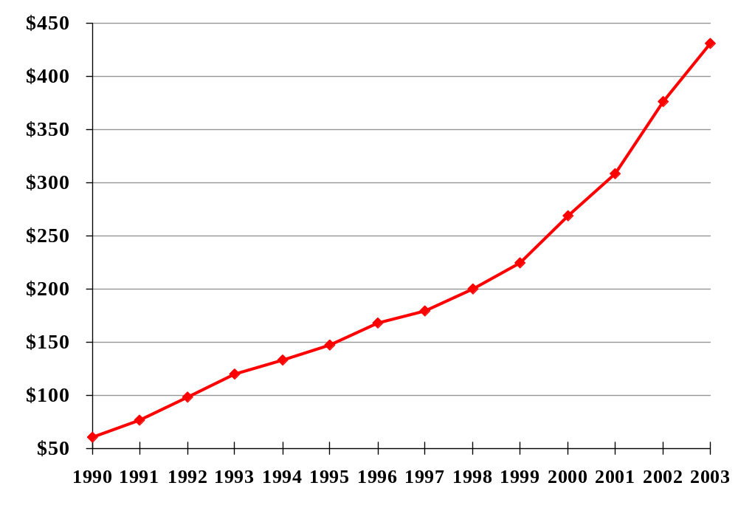
Pharmacy Growth
Millions
Net of Rebate from 1992, the first year for which we have Drug Rebate records.

Slide 35
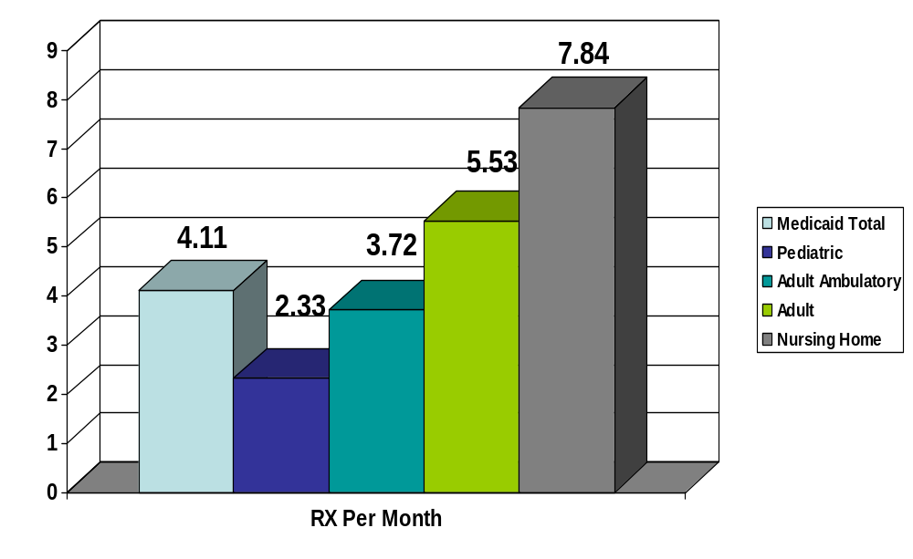
Prescription Utilization

Slide 36
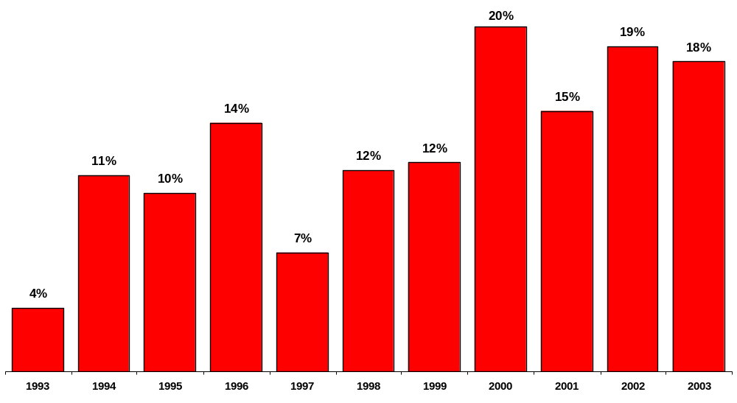
Pharmacy Expenditures
Percent Change from Previous Year
Net of Rebates

Slide 37
Program Initiatives
Preferred Drug List
Prior Authorization
Therapeutic Duplication Edits
Monthly Brand Prescription Limit

Slide 38
Preferred Drug Program
Preferred Drug Lists (PDL) offer an effective way to provide safe and effective therapy options in a cost efficient manner. 27 state Medicaid programs use a PDL and more are adding this component.
Most employment-related insurance today use a preferred drug list.
The new Medicare drug benefit is predicated on a system of formularies and preferred drug lists.
Medicaid uses a Pharmacy and Therapeutics (P&T) Committee to conduct in-depth clinical reviews to insure safe and effective drugs are placed on the PDL.

Slide 39
P&T Committee
6 physicians recommended by the Medical Association of the State of Alabama (MASA). Physicians represent the fields of family practice, pediatrics, psychiatry, and pain management.
3 pharmacists recommended by the Alabama Pharmacy Association (APA) on the P&T Committee. Pharmacists represent the fields of independent, retail and long-term care pharmacy.

Slide 40
Scope of the PDL
PDL currently covers 8 major groups of drugs; includes brand, generic and over-the-counter alternatives available without prior authorization.
There are over 88 brand name drugs on the PDL.
100% of the non-preferred brand drugs have clinical alternatives.
Physicians retain the ability to write for any medication believed medically necessary.

Slide 41
Safe, Effective Options
PDL considers whether a particular drug offers significant clinical advantages over brand and generic alternatives in general use.
PDL is based on clinical considerations of efficacy, safety, and side effect profiles.
Wide variety of preferred drugs available without prior authorization.

Slide 42
Safe, Effective Options
Simple and timely prior authorization process
72 hour emergency supply
Allowance for stable therapy in appropriate drug classes

Slide 43

PDL Offers Physicians Choices
PDL offers physicians choices without seeking prior authorization that include preferred brands, generics, and over-the-counter drugs.
If prior authorization is required, the process is simple and timely with minimal effort from providers.
  “Electronic PA” under development

Slide 44
Impact on Other Programs
The PDL has been designed to foster safe and cost-effective drug therapy.
Medicaid monitors the impact of the PDL and prior authorization.
Based on Medicaid studies there has been no increase in other Medicaid costs as a result of pharmacy initiatives.
Studies will continue to insure program costs in other areas are not adversely affected (ER, Hospital, Physicians).

Slide 45
Prior Authorization Program
Prior authorization is available by completing a simplified form or in many cases by requesting authorization over the telephone.
Average response time to PA requests is between 1-4 hours; average BCBS response time is 30 days.
Patients may receive a 72 hour supply in cases of emergency.

Slide 46
Electronic Prior Authorization
A system is under development to simplify the PA process and decrease paperwork.
Many prior authorizations may be granted by the system based on claims history.
  If appropriate diagnoses or drug utilization are found
    Prescription approved and is filled. No paperwork is necessary
  If appropriate diagnoses or drug utilization are not found
    Prior authorization required. Complete one page form
Implementation anticipated by December 2004

Slide 47
Monthly Prescription Limit
Effective July 1, 2004 patients may receive 4 brand prescriptions per month with unlimited generic and OTC prescriptions.
Children and nursing home patients are excluded.
Anti-psychotic and anti-retroviral drugs are allowed up to total of 10 brand prescriptions.
Switch over approval available for certain classes. Anticipated implementation November 2004.

Slide 48

Monthly Prescription Limit
Brand prescriptions account for 49.8% of Medicaid prescriptions, but 83.1% of the pharmacy ingredient costs.
Many brand drugs have clinically equivalent alternatives that are just as safe as the brand, yet cost approximately 73% less¹.
Medicaid could save $17 million annually if generic utilization was increased by 3%².
¹Calculation based on average generic price of $20.48 and
average brand price of $76.66 before federal rebates
² Review of Alabama Medicaid data by the Center for
Pharmacoeconomic Studies, University of Texas, March 2004

Slide 49
Fostering Generic Use
The standards of safety and quality are established by the FDA and are the same for brand and generic drugs.
Generic drugs offer a significant opportunity to provide high quality medication in a cost efficient manner.
Generic drugs are exact copies of the brand name drug approved by the FDA as having the same quality, safety, purity, strength and stability as the brand name drug.
There are over 140 preferred generic alternatives available on the PDL without prior authorization.

Slide 50
Facts About Generic Drugs
Fact
Generic drugs are just as safe as brand name drugs. FDA requires that all drugs be safe and effective and that their benefits outweigh their risks; generics have the same risk-benefit profile as their brand name counterpart.
Fact
Generic drugs are as strong as brand name drugs. FDA requires generics to have the same quality, strength and purity as the brand name drugs.
Fact
Generic drugs cause no more side effects than brands. FDA monitors reports of adverse drug reactions and has found no differences between brands and generics.

Slide 51
Fostering Therapeutic Equivalents
Therapeutic equivalency involves use of clinical alternatives to single source brands
Example
Lexapro - No exact generic is available, but therapeutic alternatives include fluoxetine, fluvoxamine, paroxetine, bupropion, nefazodone and mirtazapine.
If all physicians used therapeutic equivalents, including those with patients excluded from four brand limit, savings can be achieved without jeopardizing the quality or appropriateness of patient care.
Use of therapeutic equivalents requires a broader knowledge of medications in a given class.
Medicaid will work with physicians and pharmacists to define therapeutic equivalent alternatives within preferred drug classes.

Slide 52
Facts About Therapeutic Equivalents
Fact
  Patients receive appropriate treatment. Therapeutic equivalents provide effective drug therapy in a cost efficient manner.
Fact
  Use of therapeutic equivalents eliminates the need for PA. The Preferred Drug List provides a choice of therapeutic equivalents in every class.
Fact
  Use of therapeutic equivalents helps physicians and patients stay within the monthly four brand limit while fostering quality care.
Fact
  Use of therapeutic equivalents provides quality care and saves money for Medicaid, private pay patients and other insurers

Slide 53
Program Integrity
Medicaid will insure that payments are made to legitimate providers for legitimate services for legitimate recipients.
Medicaid has enhanced efforts to recover inappropriately paid funds, overpayments and address fraud, waste, and abuse.

Slide 54
Appropriate Payments
Medicaid is working with Health Watch Technologies (HWT) to further insure payment integrity.
HWT will provide a cross functional team to include professionals in medicine, law, public policy, hospital administration, nursing, mental health, and data analysis.

Slide 55
Review Algorithms
Examples of review algorithms
CPT and HCPC coding guidelines to insure appropriate billing of comprehensive codes, mutually exclusive codes, and modifier use
Regulation and policy based rules to include coverage limitations and non-covered services
3. Unbundling review of lab and ER services, surgical procedures and procedures

Slide 56
Review Algorithms
Examples continued:
Unreasonable volume to indicate excessive units of a service
5. Duplicate billings of the same claim or same service by multiple providers
6. Recipient utilization of narcotics, or other services that indicate potential drug seeking behavior

Slide 57
Benefits for Providers
Clarifies billing rules and policies that may be confusing
Reduces need to resubmit claims and additional documentation
Reduces the number of on-site audits

Slide 58
Provider Resources
Medicaid will provide further information as these initiatives are implemented.
Information available through quarterly Provider Insider, Medicaid website, HID newsletter, and association newsletters.

Slide 59
BREAK

Slide 60
Economic Impact
Hospital
Care
Pharmacy
MEDICAID
Primary
Care
Maternity
Care

Slide 61
High Medicaid Counties
These 13 counties have the highest concentration of Medicaid eligibles across the general population (30% or greater).
Bullock 33% Lowndes 34%
Butler 32% Macon 30%
Conecuh 30% Marengo 30%
Dallas 41% Perry 44%
Greene 40% Pickens 30%
Hale 33% Sumter 40%
Wilcox 48%

Slide 62
High Medicaid Counties
These 14 counties have the highest concentration of Medicaid eligibles across the children’s population (50% or greater).
Barbour 50% Greene 64%
Bullock 66% Hale 52%
Butler 56% Lowndes 56%
Conecuh 57% Perry 68 %
Crenshaw 51% Pike 52%
Dallas 66% Sumter 65%
Escambia 50% Wilcox 71%

Slide 63
Economic Impact
In FY 2004, Medicaid will pay approximately $3.7 billion to providers for various health care services rendered; $2.7 billion represents federal funds brought into the State.
In FY 2005, Medicaid will pay approximately $3.9 billion to providers for various health care services rendered; $2.8 billion represents federal funds brought into the State.
Medicaid expenditures supported more than 84,323 jobs in various industries within the state.¹
¹Economic Impact of the Alabama Medicaid Agency on the Economy of the State of Alabama and its Counties, Amy K. Yarbrough, MSHA, MBA, Administrative Fellow, University of Alabama at Birmingham

Slide 64
Financial Impact by County
5 counties receive Medicaid payments in excess of $100 million.
Jefferson $474 million
Mobile $275 million
Tuscaloosa $137 million
Madison $118 million
Montgomery $302 million
9 counties receive Medicaid payments in excess of $60 million.
16 counties receive Medicaid payments in excess of $40 million.
31 counties receive Medicaid payments in excess of $20 million.

Slide 65
Financial Impact by Hospital
Without Medicaid revenue, critical components of Alabama’s healthcare infrastructure could not continue to exist.
  52% of the patient days at Children’s Hospital are paid for by Medicaid.
  77% of the patient days at USA Women’s and Children’s Center are paid for by Medicaid.
  Source: Information obtained from Medicare Cost Reports as filed.

Slide 66




Program Funding

Slide 67
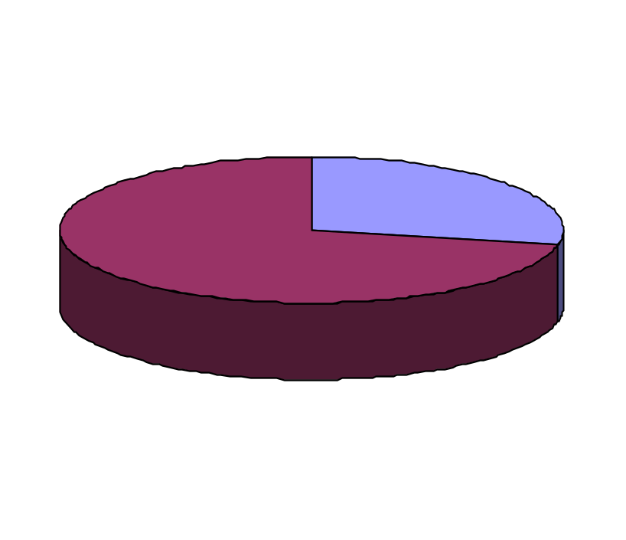
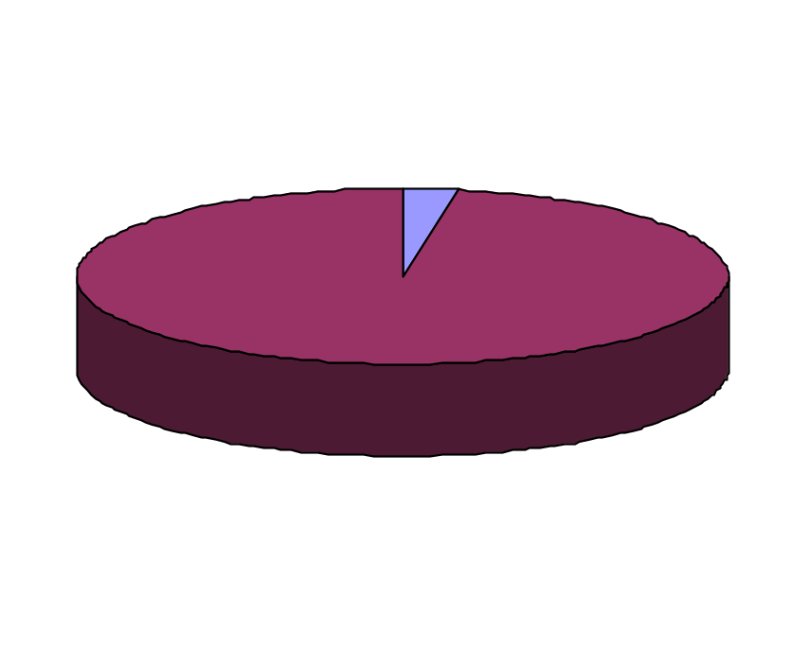
Where It Comes From, Where It Goes
Administrative Costs
3.48%
State Funds
27.93 %
Federal Funds
72.07%
Benefit Payments
96.52%
Federal Funds
72.07%
Benefit Payments
96.52%

Slide 68
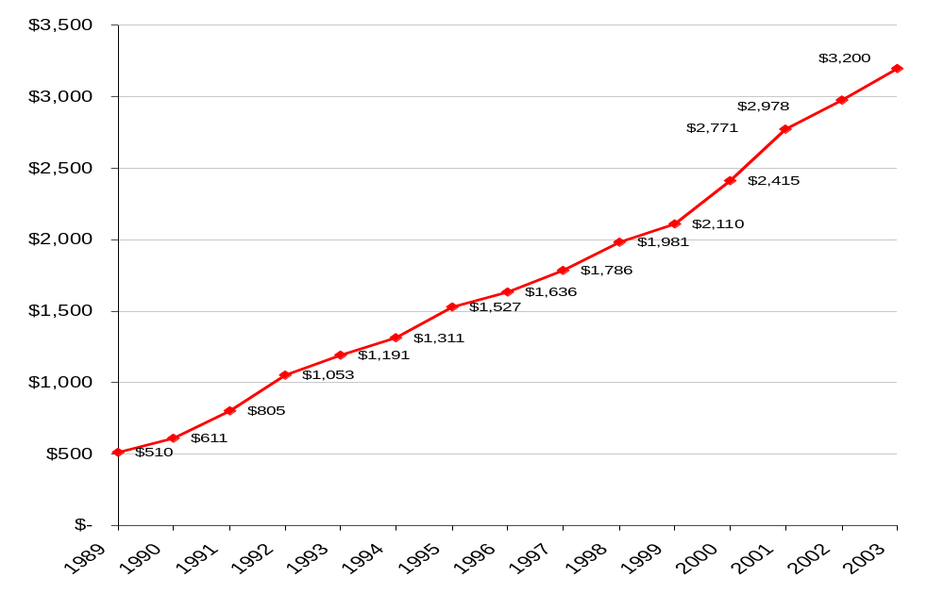
Medicaid Benefit Expenditures
Excluding Hospital Disproportionate Share Payments
Millions

Slide 69
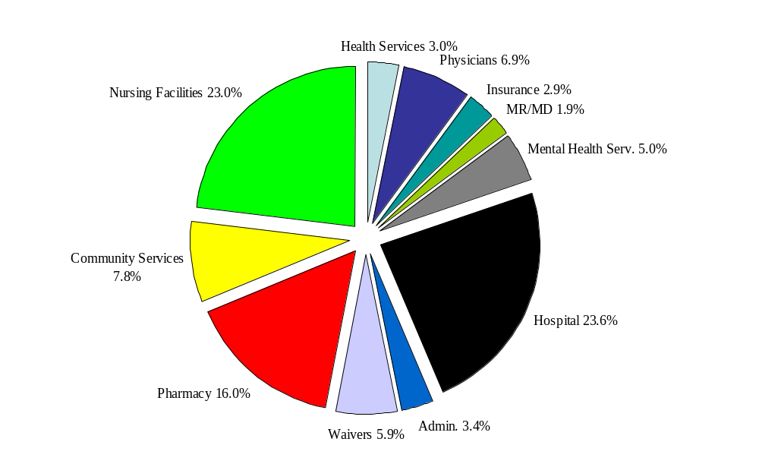
Distribution of Payments
(Excluding Hospital Disproportionate Share Payments)

Slide 70
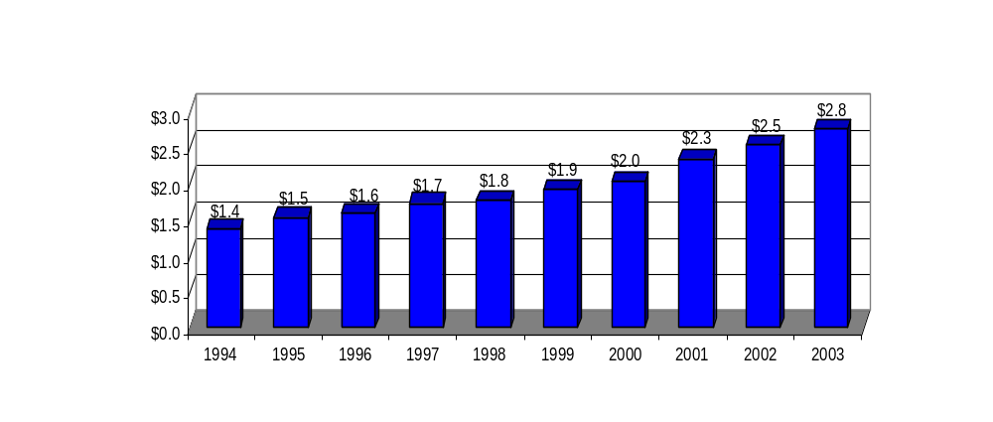
Medical Care Expenditures
1994-2003

Slide 71
History of Unfunded Mandates
Medicare Modernization Act, 2004
Health Insurance Portability and Accountability Act
(Currently implementing NPI)
Pryor Amendment, 1990 (Mandated open drug formulary)
OBRA 1989 (Mandated the EPSDT program)
CCA 1988 (Mandated coverage of QMB)

Slide 72
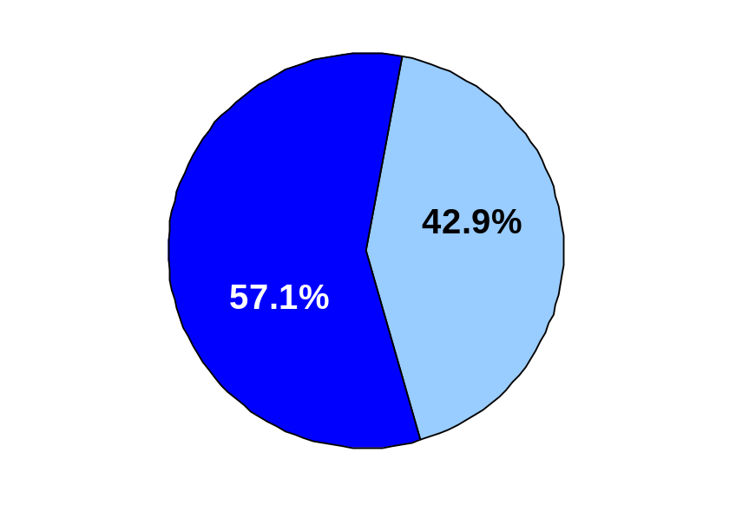
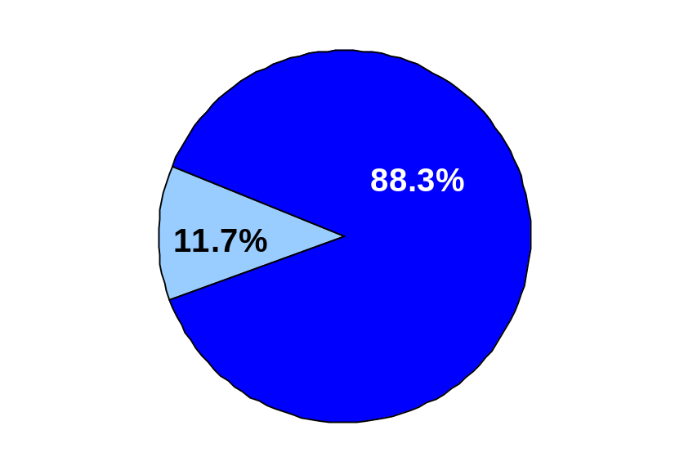
Dual Eligibles
Payments
Eligibles
Non-Dual
Eligibles
Non-Dual
Eligibles
Dual
Eligibles
Based on expenditure and eligibility information January-June 2004. Includes fee for service payments and crossover claims. Does not include buy-in premiums or HMO capitation payments.
Notes:
Dual eligibles
Non-duals
Total Eligibiles
Dual $
Non-dual $
Total $ (

Slide 73
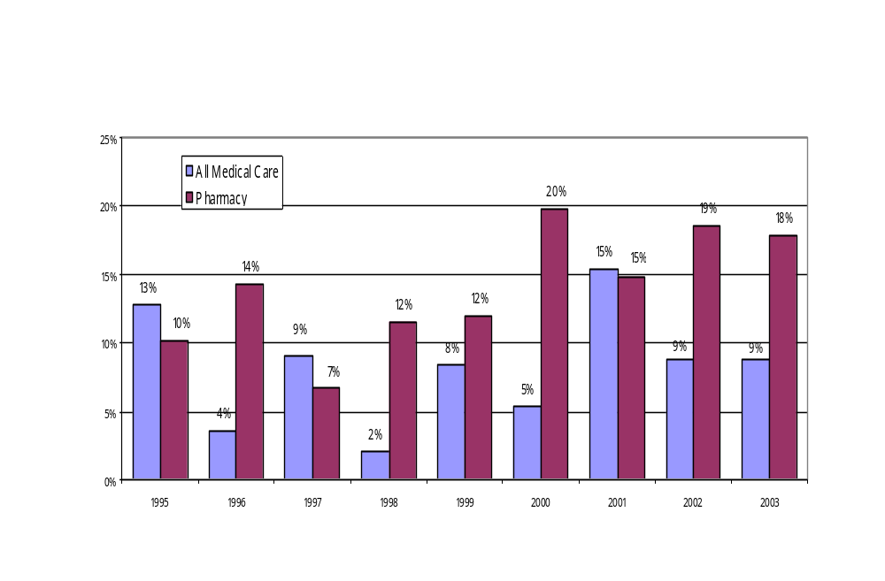
Growth in Medical Care and Pharmacy
Percent Change from Previous Year

Slide 74
Pharmacy Factor
Despite Alabama having one of the lowest annual growth rates in the country, Medicaid’s Pharmacy Program is the fastest growing area.
Without question, the driving force behind the unsustainable growth is the cost of medications.
The pharmaceutical industry enjoys astronomical rates of return on investment.

Slide 75
Pharmacy Factor
GlaxoSmithKline 60.30%
Merck 40.44%
Bristol-Myers Squibb 33.12%
Johnson & Johnson 29.03%
AstraZeneca 25.02%
Abbott 23.32%
2003 ROI information obtained from www.morningstar.com

Slide 76
Budget Outlook
Through the strong support of Governor Riley and the Alabama Legislature, Medicaid overcame a shortfall of $182 million state, $623.9 million total fund shortfall in FY 2005.
In addition to the General Fund appropriation, Medicaid has implemented program changes to balance the FY 2005 budget.

Slide 77
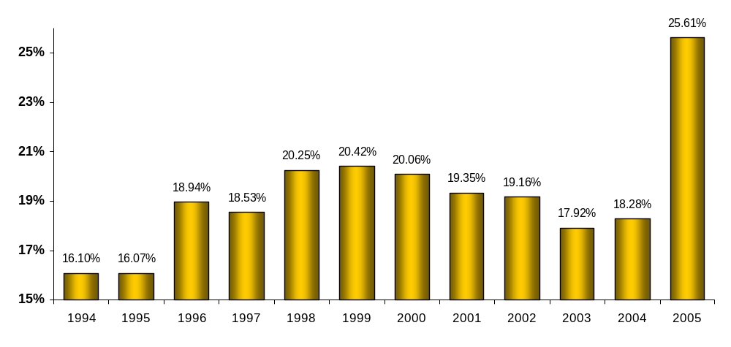
General Fund Contributions
Medicaid as a Percent of the GF

Slide 78
Addressing the Shortfall
FY 2004
  $39.8 million supplemental appropriation (HB298)
  2. Program changes
  a. Implement monthly prescription limit (7/1/04)
  20,692 patients received more than 4 brands per month
  Annual savings $25.2 m total, $7.3 m state
  b. Tighten nursing home transfer penalty rules (7/1/04)
  Annual savings $4 m total, $1.2 m state

Slide 79
Addressing the Shortfall
  c. Change hospital reimbursement (5/1/04)
  Annual savings $44.8 million total, 13.44 million state
  d. Nursing home participation fee (6/1/04)
  Annual State revenue of $13.2 million
  e. Enhanced program integrity initiatives
FY 2005
  Supplemental appropriation of $144 million
  Continue program changes implemented FY 2004

Slide 80
FY 2006
Need additional $153.3 million State funds
Loss of IGT for UPL payments $33.1 million
Inflation $46.8 million
Admin (National Identifier) $4.4 million
Change in FMAP (69.41% from 70.83%) $57.0 million
53 week provider payroll $12.0 million
Total $153.3 million
Assumptions: 3% inflation for all programs except Nursing Homes at 4% and Pharmacy at 15%

Slide 81
Being Part of the Solution
Be informed.
Encourage physicians in your districts to participate in Patient 1st and the Preferred Drug List.
Support the continued development and use of the Medicaid Preferred Drug List.
Support substitution of generics for more costly brands.

Slide 82
Being Part of the Solution
Access updated information on Medicaid programs at www.medicaid.state.al.us.
Continue to support accountability measures to insure limited state funds are spent appropriately.
Work together to provide adequate Medicaid funding.

Slide 83
Medicaid Website
For updated Medicaid information and provider alerts:
www.medicaid.state.al.us

Slide 84
Contact Information
Commissioner
Carol A. Herrmann, M.P.H.
334-242-5600
almedicaid@medicaid.state.al.us
Medical Directors
John Searcy, M.D. Mary G. McIntyre, M.D., M.P.H.
334-353-8473 334-353-8473
jsearcy@medicaid.state.al.us mmcintyre@medicaid.state.al.us

Slide 85
Contact Information
Policy and State Legislative Affairs
Mary Hayes Finch, J.D., M.B.A.
334-242-5610
mfinch@medicaid.state.al.us
Policy and Federal Legislative Affairs
Georgette Harvest, R.N.
334-353-4700
gharvest@medicaid.state.al.us

Slide 86
Contact Information
Deputy Commissioners
Programs Administration
Kathy Hall, M.P.A Lee Maddox
334-242-5007 334-242-5602
khall@medicaid.state.al.us lmaddox@medicaid.state.al.us
Beneficiary Services Chief Financial Officer
Lee Rawlinson Mike Lewis
334-242-5601 334-242-2290
lrawlinson@medicaid.state.al.us mlewis@medicaid.state.al.us

Slide 87
Contact Information
Pharmacy Medical Services
Louise Jones Kim Davis-Allen
334-242-5039 334-242-5011
lljones@medicaid.state.al.us kdavis@medicaid.state.al.us
Program Integrity Long Term Care
Jackie Thomas Marilyn Ferguson
334-242-5318 334-242-5009
jthomas@medicaid.state.al.us mferguson@medicaid.state.al.us

Slide 88
Every noble work
is at first impossible.
Thomas Carlyle

