Slide 1

CITY OF ASHEVILLE
OPEN ENROLLMENT
2008/09

Slide 2
What’s New and Exciting in
Our Medical Plan?
CoreSource (new administrator)
Adding a 3rd tier with new options
Crescent Physician Network
Enrollments will be made on-line or via telephone and must be completed by midnight, Sunday, August 10

Slide 3
Benefit Comparison - Medical
 | Standard Hi Deductible | High In-Network Only | Premium Preferred Provider
Deductible | $1200/$3600 | None | $300/$900
Physical | $25 co-pay to $350 | No co-pay | No co-pay
Office Visit/Urgent Care | 80/20 after $1200 co-pay | $15/$30 co-pay | $20/$40 co-pay
Hospital In-Patient | 80/20 after $1200 | $300 co-pay | 80/20 after $300
Out-Patient Surgery | 80/20 after $1200 | $150 co-pay | 80/20 after $300

Slide 4
2008 Health Insurance Premiums
Status | Coverage | STANDARD (Hi Deductible) | HIGH (In-Network Only) | PREMIUM (Preferred Provider)
Full-Time | Employee Only | $3.00 | $11.00 | $16.00
 | E + Child(ren) | $50.00 | $60.00 | $70.00
 | E + Spouse | $65.00 | $86.00 | $100.00
 | E + Family | $98.00 | $148.00 | $171.00
Part-time | Employee Only | $34.00 | $44.00 | $53.00
30-37 hrs/wk | E + Child(ren) | $95.00 | $108.00 | $125.00
 | E + Spouse | $122.00 | $145.00 | $168.00
 | E + Family | $187.00 | $237.00 | $273.00
These and other rates available on page 6 of your booklet

Slide 5
What’s So Great About the
Hi In-Network Tier?
Significant premium savings in most cases
Large network of local providers
Significant savings in co-pays
No co-insurance (no 80/20 plan)
No generic drug co-pay
Flat $150 co-pay for ER visits

Slide 6

Hi In-Network Scenario
Single Employee on
Hi-Option PPO June 2008
Single Employee on
Hi-Option In Network Sept. 2008
Bi –Weekly Premium | $13.66 | $11.00
Annual Premium | $355.16 | $286.00
1 Urgent Care Visit | $25.00 | $30.00
1 Specialist Visit | $45 + 20% ($78.00) | $30.00
1 Out Patient Surgery | $600.00 (20% of $3000) | $150.00
2 Prescriptions (Generic) | $10.00 | $0.00
Total Annual Cost | $1,113.16 | $497.00
Annual Savings of $616.16 A Total !!
Or
154 Gallons of Gasoline!!

Slide 7
Hi In-Network Scenario
Employee + 2 Children on
Hi-Option PPO June 2008
Employee + 2 Children on
Hi-Option In Network Sept.2008
Bi –Weekly Premium | $116.47 | $60.00
Annual Premium | $3,028.22 | $1,560.00
3 Family Dr. Visits | $75.00 | $45.00
1 ER Visit | $150.00 co-pay $300.00 (20%- $1500.00 Charge) | $150.00 co-pay
2 Specialist Visits | $45.00 + 20% (78.00) X 2 visits= $246.00 Total | $60.00
12 Prescriptions (Generic) | $60.00 | $0.00
Total Annual Cost | $3,859.22 | $1,815.00
Annual Savings of $2,044.22 !!
Or
511 Gallons of Gasoline!!

Slide 8
Hi In-Network Scenario
Employee + Family on
Hi-Option PPO June 2008
Employee + Family on
Hi-Option In Network Sept.2008
Bi –Weekly Premium | $144.31 | $148.00
Annual Premium | $3,752.06 | $3,848.00
5 Family Dr. Visits | $125.00 | $75.00
1 Hospital Admission | $300.00 co-pay $1,000 (20%-of $5000.00 Charge) | $300.00 co-pay
3 Urgent Care Visits | $75.00 | $90.00
25 Prescriptions (Generic) | $125.00 | $0.00
Total Annual Cost | $5,377.06 | $4,313.00
Annual Savings of $1,064.06 !!
Or
266 Gallons of Gasoline!!

Slide 9
Standard Vs. Hi In-Network Plan
Employee + One on
Standard Plan June 2008
Employee + Spouse on
Hi-Option In Network Sept.2008
Bi –Weekly Premium | $47.82 | $86.00
Annual Premium | $1,243.32 | $2,236.00
3 Family Dr. Visits | $225.00 | $45.00
2 Specialist Visits | $600.00 | $60.00
1 Out Patient Surgery | $675.00 (to meet Deductible) $465.00 (20% of $3000 Charge) | $150.00
24 Prescriptions (Generic) 12 Prescriptions (Formulary) | $120.00 (Generic) $360.00 (Formulary) | $0.00 $300.00
Total Annual Cost | $3,688.32 | $2,791.00
Annual Savings of $897.32 !!
Or
224 Gallons of Gasoline!!

Slide 10
What’s New and Exciting in the Pharmacy Plan?
CareMark (new administrator)
Adding 3rd tier
Annual maximum removed
The City continues to offer 16 free medications regardless of your plan
Asheville Project – Prescriptions remain free of charge

Slide 11
Benefit Comparison - Pharmacy
 | Standard Prescription | High Prescription | Premium Prescription
Generic | $5 co-pay | $0 co-pay | $5 co-pay
Formulary | $25 co-pay | $25 co-pay | $25 co-pay
Name Brand | $45 co-pay | $45 co-pay | $45 co-pay
Specialty | $100 co-pay | $100 co-pay | $100 co-pay
Maximum | No | No | No
Caremark Card | Yes | Yes | Yes

Slide 12
2008 Dental Premiums
Status | Coverage | STANDARD | HIGH | PREMIUM
Full-Time | Employee Only | $0.00 | $4.00 | $6.00
 | E + Child(ren) | $9.00 | $16.00 | $20.00
 | E + Spouse | $10.00 | $18.00 | $22.00
 | E + Family | $18.00 | $25.00 | $31.00
PT/30-37 hrs/wk | Employee Only | $5.00 | $7.00 | $9.00
 | E + Child(ren) | $14.00 | $23.00 | $29.00
 | E + Spouse | $15.00 | $25.00 | $31.00
 | E + Family | $23.00 | $32.00 | $40.00
Other dental rates available on page 12 of your booklet

Slide 13
On-Line Enrollment – You Control Your Benefit Selections
You will enroll and select your benefit options either on-line or by telephone
You will receive a benefits enrollment worksheet in 5-10 days that will explain how to access the enrollment system.

Slide 14
It Only Takes A Minute
Every employee will receive a confirmation that details the elected benefits
You will have the opportunity to change/revise your initial benefit elections – must be completed by midnight, Sunday, August 17th

Slide 15
It’s Easy
A final confirmation letter will be mailed to you with vital information regarding your election
New insurance cards will be distributed in early September

Slide 16
How to Enroll
Go to www.eelect.com
  Enter the Enrollment ID 17133 (on your form)
  Enter your Social Security Number
  Enter the 4 digit Pin that appears on your form
Call 1-866-203-3885

Slide 17
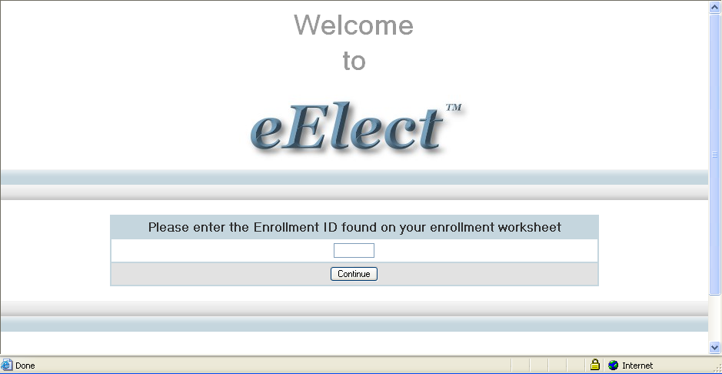
How Will It Look?

Slide 18
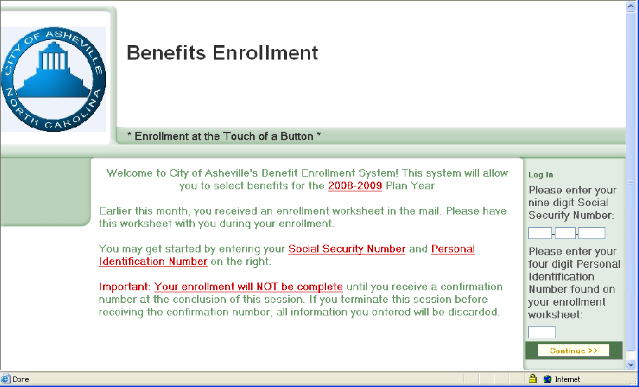
What’s Next….?

Slide 19
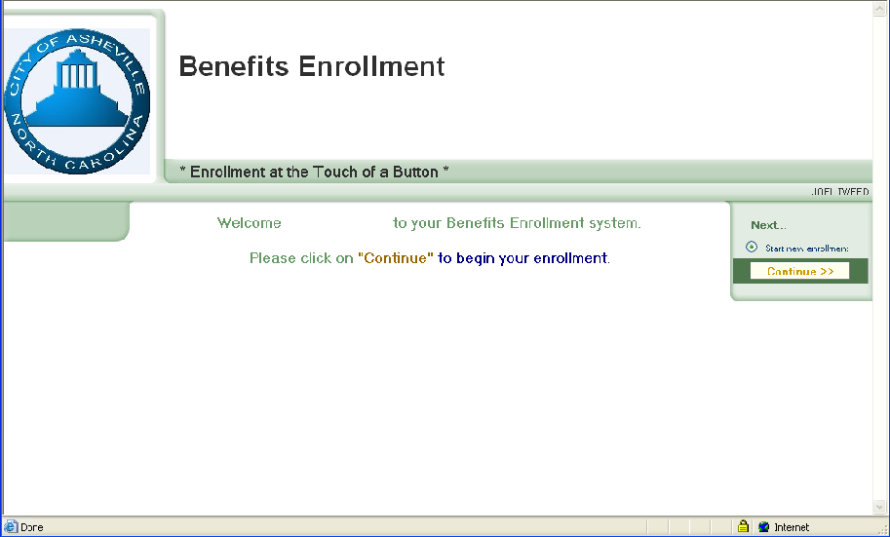
You’re Ready To Begin

Slide 20
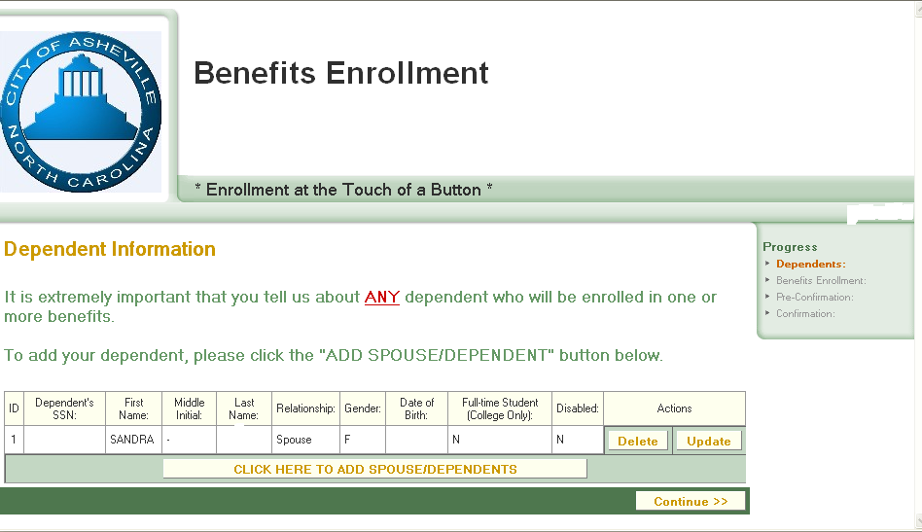
Add Dependent Information

Slide 21
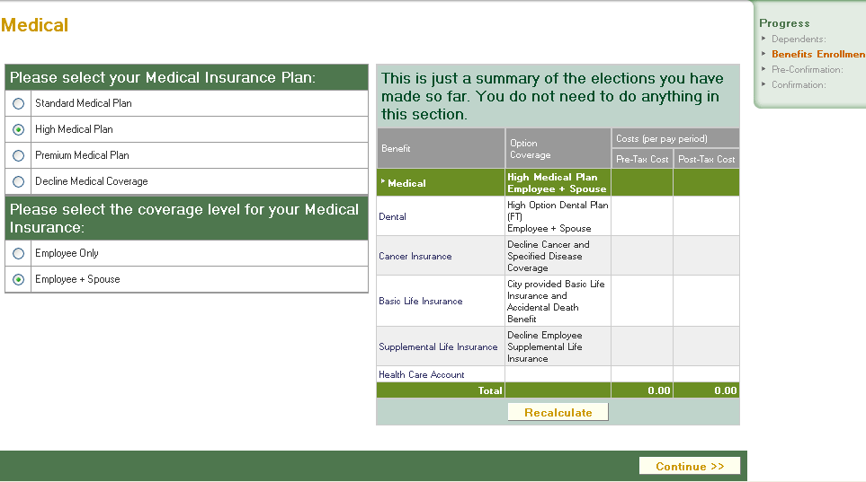
Make Your Elections

Slide 22
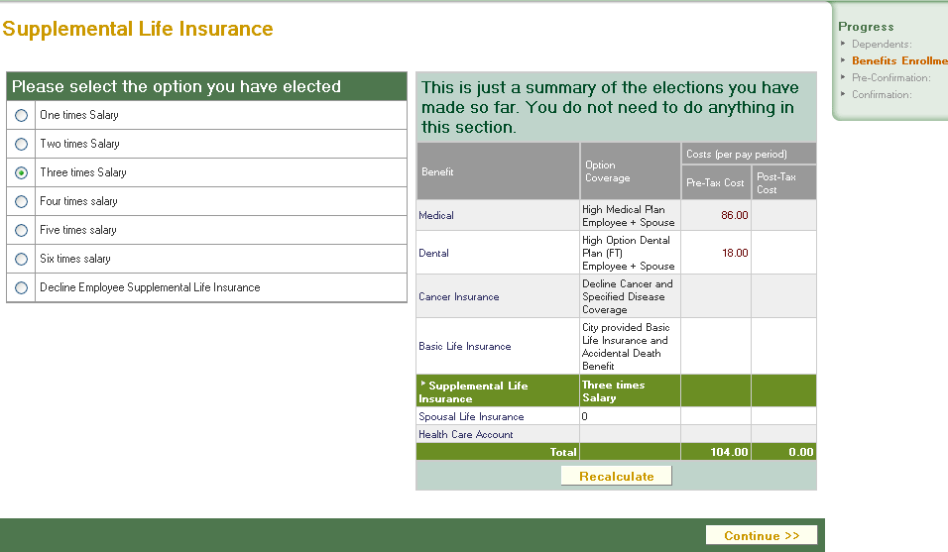
Don’t Forget Life Insurance

Slide 23
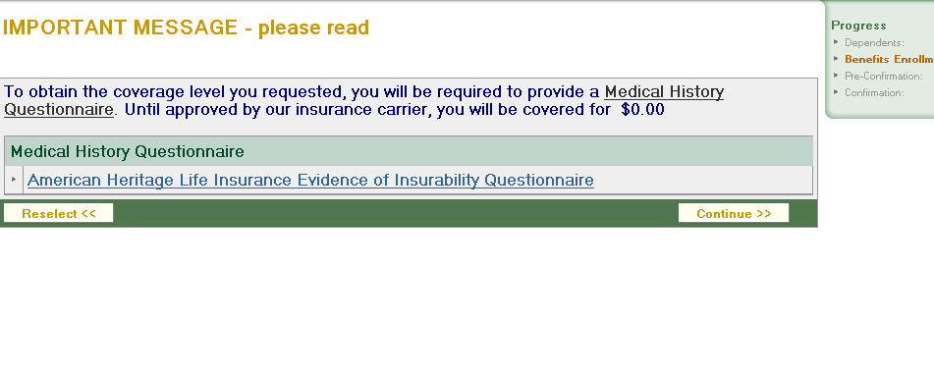
You’re Almost Finished

Slide 24
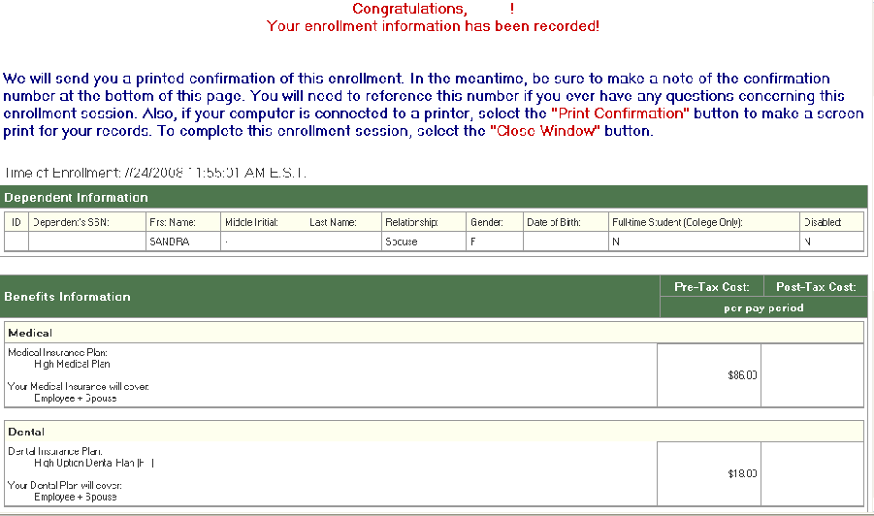
It’s Completed

Slide 25
Cancer & Specified Disease
This benefit provides coverage to employees and their dependents diagnosed w/cancer or any of the other 29 other specified diseases.
  Maximum 12 month pre-existing condition exclusion
  $100 payment each year for each covered person getting annual physical that includes cancer screening
  To add this coverage, you must complete the Evidence of Insurability & Enrollment Form

Slide 26
Life Insurance – The Standard
Rates remain the same
  Rates are based on salary & age on 1/1
  To increase your life insurance or your dependent life insurance requires additional paperwork and a physical

Slide 27
Flexible Spending Accounts
Because of the new plan, you may change the amount in your Flexible Spending Account.
This change affects 2008 only.

Slide 28
Flexible Spending Accounts
You should enter a “yearly” dollar amount when completing your on-line enrollment.
In December, all employees will have the opportunity to enroll for Calendar Year 2009.

Slide 29
Miscellaneous
Vision Benefit – Vision comes with the medical benefit and remains the same
Asheville Project
  Forms are available on the Intranet/Internet, and in Human Resources and Health Services
  Forms need to be returned to Human Resources/Destiny Mattsson
Beneficiary Changes
  Forms are available on the Intranet/Internet. Return to HR for final processing.
401(k) – ICMA 457
  To change your contributions you can go to the Intranet/Internet. Return to HR for final processing

Slide 30
Questions???

