Slide 1
Validation for Integrated Remote Sensing/Yield Modeling
Eric Warner
Research Associate
Office for Remote Sensing of Earth Resources
Penn State University
University Park, PA 16802

Slide 2
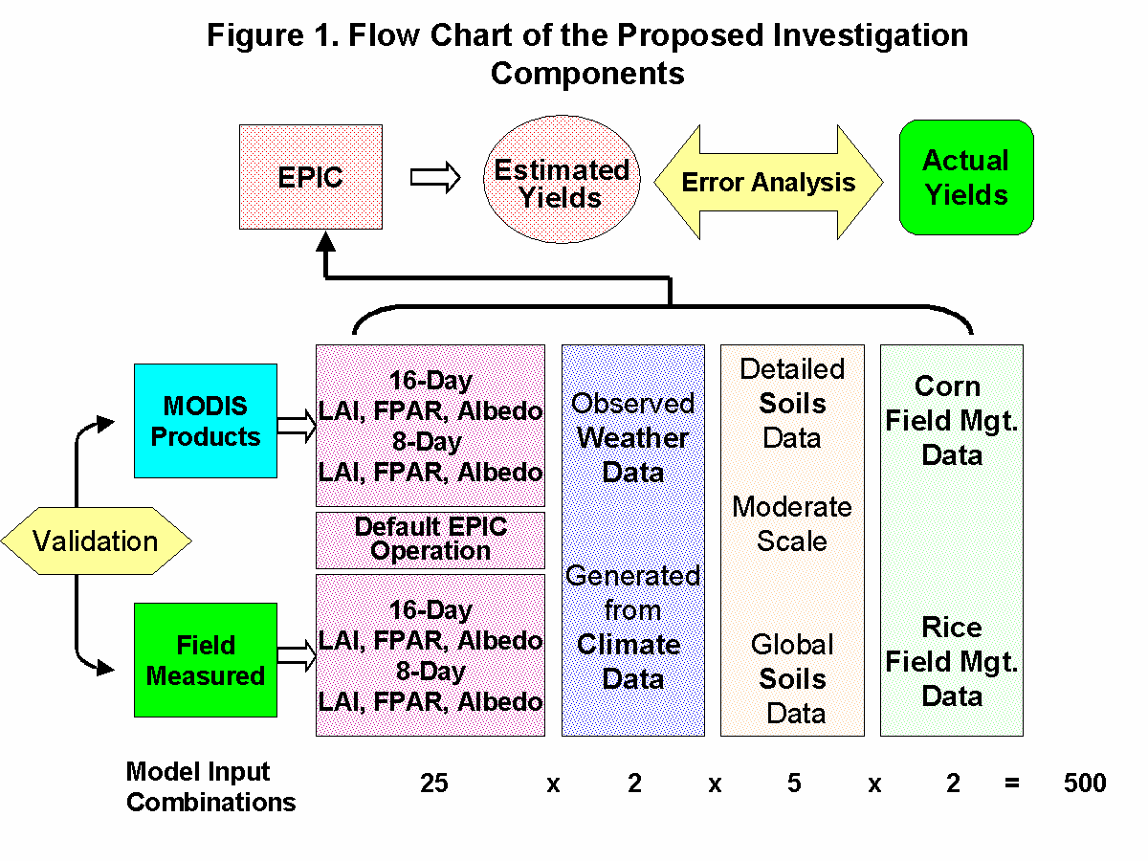

Slide 3
Validation Goals
Develop a field based method for generating LAI validation data sets
Conduct a comparison of LAI-2000 and Decagon ACCUPAR
Frequent, repeated LAI validation across three growing seasons and two crops
Illinois – Corn
China - Rice

Slide 4
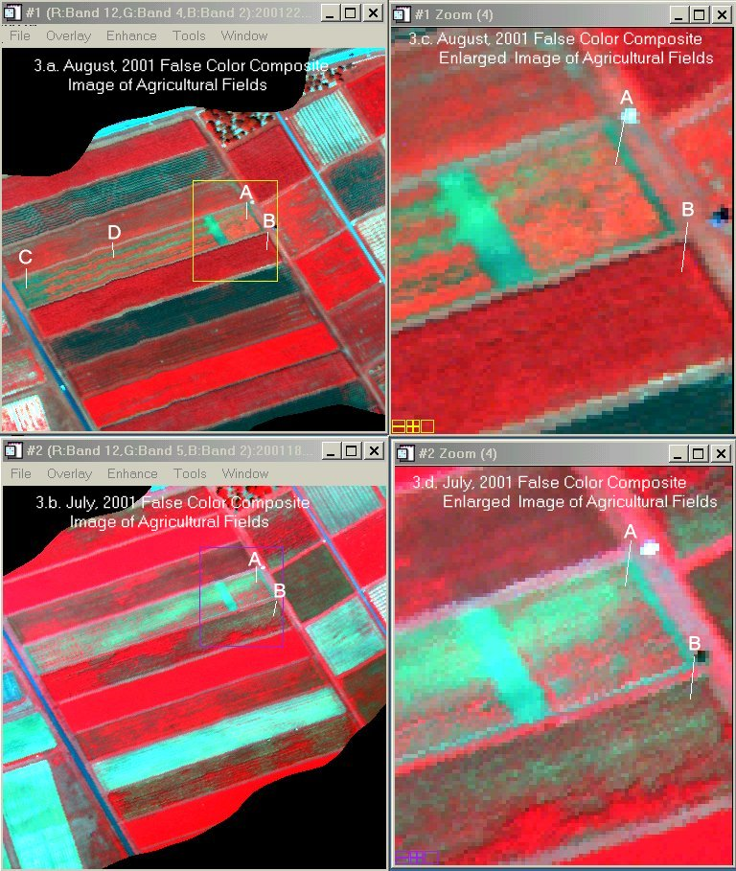

Slide 5
Directed Sampling Example
Single
Transect
Overlapping
Transect
Sampling
Location
Check
Sample
Soil Type 1
Soil Type 2

Slide 6
LAI Validation Flow Chart
Field
Sampling
Geostatistics ?
Area Weighted
LAI ?
MODIS LAI
Error
Assessment

Slide 7
Graphical Illustration of Validation

Slide 8
Thoughts/Issues
Feedback sought
Collaboration is welcomed
Data will be shared

