Slide 1
A Systems Approach to Improving
Efficiencies and Cost-Effectiveness in Correctional Health Care
Renee Kanan, M.D., MPH
December 2005
Notes:
Introduction

Slide 2
Discussion Outline
California System: Brief Overview
California System: Drivers and Responses
California Case Studies
Lessons Learned
Questions and Comments

Slide 3
Overview
10 major lawsuits related to health care since 1980s
Health Care Services Division established 1993
~ 167,000 inmates
33 Institutions, 4 hospitals, 13 licensed “infirmaries”
~7,000 health care staff
~ $1.1 billion expenditures
> 20 labor unions
Civil service employees except temp help & specialty care
Population demographics and epidemiology
  Gender
  Age
  Mental illness
  Chronic medical conditions
Notes:
92% men, 8% > 50, 18 % Mental illness, 33% chronic illness

Slide 4
Drivers of Change
Population growth
Increasing litigation related to quality problems in all clinical programs and physician practice
Increasing costs related to volume and type of inmate patient, contract/procurement rates, changing community standards and technology, sub-optimal workforce qualifications and UM and QM programs and decentralized care model for high needs & high risk patients

Slide 5
Drivers of Change
Insufficient data & information systems to understand patient populations needs & risks, or to develop priorities
Sub-optimal chronic care & case management
Insufficient standardization, esp. evidence-based
Insufficient quantity of the right types of workforce
Sub-optimal workforce quality

Slide 6
Major Responses to Drivers
Established quality & value as guiding principles
Value = Quality/Cost
Established a CDCR Strategic Plan based on a Managed Health Care Model
Established initial priorities, based on data, court mandates & other requirements
Established new Organizational Design
Notes:
Waste, Inefficiency and Cost-Savings and Cost-Effectiveness; Good care is not cheap

Slide 7
A Managed Health Care Model
Effective way to strategically organize business and apply scarce resources
Well-tested industry model to improve efficiency and cost-effectiveness of health care services
Defined patient populations and provider networks
Uses data to set priorities based upon the patient population needs and risks
Standardized approach to doing all business lines based upon best evidence
Integrates QM, UM, and RM components to improve quality and value
Notes:
Money where your mouth is and walk the talk
Value = Q/C waste, ineffciency,

Slide 8
Small proportion of patients drive majority of health care costs.
High Risk
Intermediate Risk
Low Risk
Notes:
Understand population needs and risks

Slide 9
Managed Care Model
Evidence-Based Standards
Mission
Vision
Resources
Performance Management System
Service Delivery System
Acute
Inpatient
Sub-Acute
Inpatient
Health Assessment
& Classification
Pre-Release
Planning
High-Risk Outpatient
Levels of Care
Prevention
Medium-Risk Outpatient
Low-Risk Outpatient
Strategic Management
Values

Slide 10
Four Major Components of Managed Care Model
Service Delivery System
Performance Management System
Resources
Evidence-Based Standards
Notes:
Across all programs

Slide 11
Five Major Clinical Programs
Medical
Dental
Mental Health
Specialty Care
Pharmacy and Medication Management

Slide 12
Service Delivery System
Health Care Assessment and Classification
  Standardized
  Across all core clinical programs
  Coordinated with custody classification

Slide 13
Service Delivery System
Levels of Care
  Low-risk outpatient
    Routine primary care
  Intermediate-risk outpatient
    Stable chronic condition
  High-risk outpatient
    Unstable chronic condition
  Sub-acute inpatient
    Skilled Nursing Facility, Intermediate Care Facility, CTC
  Acute inpatient
    General Acute Care Hospital

Slide 14
A small proportion of patients drive the majority of health care costs.
High Risk
Intermediate Risk
Low Risk

Slide 15
California Case Study:
Efficiencies of Scale
Consolidated Care Centers
  Special Populations
    High-risk mental health patients
    High-risk medical patients
    Long-term care patients
    Hemodialysis patients
  Criteria
    Near communities with large recruitment pool
    Near tertiary care centers
    Multiple levels of care available at institution
  Emphasis
    Most qualified providers
    Coordinated care
    Chronic Care and tertiary prevention
    Case management

Slide 16
California Case Study:
Efficiencies of Scale
Consolidated Care Centers
  Efficiencies
    Avoid transportation and guarding expenses
    Fewer unnecessary/avoidable hospitalizations because providers are able to manage complex cases and have the resources to provide coordinated chronic care and case management

Slide 17
California Case Study:
Efficiencies of Scale
Example: Consolidated Care Centers for High-Risk Mental Health
Proposed areas facilitate recruitment of qualified psychologists and psychiatrists
Achieving stabilization of mental illness means:
  More successful patient outcomes
  Fewer Mental Health Crisis Beds (sub-acute beds) occupied by these patients
  More sub-acute beds available for medical patients (step-down from community hospital)
  Fewer patients occupying DMH sub-acute and acute beds
  Reduced demand for transportation and guarding services
  Reduced pharmacy costs
  Reduced recidivism
Notes:
Medical and MH interactions

Slide 18
Service Delivery System
Prevention
  Patient education
  Immunizations
  Screening
  Chronic care
  Case management

Slide 19
Service Delivery System
Pre-Release Planning
  Continuity of care
  Strengthen community partnerships
  Reduce recidivism

Slide 20
Managed Care System
Evidence-Based Standards
Mission
Vision
Resources
Performance Management System
Service Delivery System
Acute
Inpatient
Sub-Acute
Inpatient
Health Assessment
& Classification
Pre-Release
Planning
High-Risk Outpatient
Levels of Care
Prevention
Medium-Risk Outpatient
Low-Risk Outpatient
Strategic Management
Values

Slide 21
Performance Management System
Governing Body
Professional
Practice Executive
Committee
Quality
Management
Committee
Operations
Committee
Subcommittees for Key
Professional Practice
Functions: Peer
Review, Credentialing
and Privileging, and
Health Care Review
Subcommittees for
Core Clinical
Programs: Medical,
Dental, Mental Health
Subcommittees for
Supplemental Clinical
Areas: Pharmacy/
Medication
Management and
Specialty Care
Subcommittees for
Key Resources:
Financial
Health Information
Human Resources, etc.

Slide 22
California Case Study:
Meet, Measure, Manage
Performance Management System
  Meet
    Subcommittees at headquarters and in the field in
      Core clinical areas (medical, dental, mental health)
      Supplemental clinical areas (pharmacy and specialty care)
      Resources
      Professional Practices
  Measure
    Performance Measures (Key Indicators)
    Aggregate Reporting
      Comparison and trending
  Manage
    Addressing problematic trends
    Quality Improvement Plans
    Developing best practices
Notes:
Mantra

Slide 23
California Case Study: Regionalization and Performance Management
Division Director
Deputy Director
Clinical Policy and
Programs Branch
Deputy Director
Clinical Operations
Branch
Deputy Director
Health Care Administrative
Operations Branch
Regional
Medical Directors
Regional
Administrators
Institution Medical
Directors (indirect)
Health Care
Managers
Quality Management
Assistance Team
Clinical
Quality Management
Assistance Team
Administrative
Utilization Management

Slide 24
California Case Study:
Efficiencies and Cost-Effectiveness
Example: 17% average increase in pharmacy expenditures from FY 2000-2001 through 2002-2003
Patient Population: High disease prevalence rates in HCV, HIV, mental illness; high volume transfers
Notes:
PMS

Slide 25
California Case Study:
Efficiencies and Cost-Effectiveness
Example: Pharmacy and Medication Management Program
Strategic plan and prioritization:
  Isolated the top 5 high-cost drug categories
  Implemented prescribing protocols & training
  Contract negotiations, consolidated purchasing
  Formulary development,
  Performance measures, management reports & Subcommittee
Notes:
Pareto principle

Slide 26
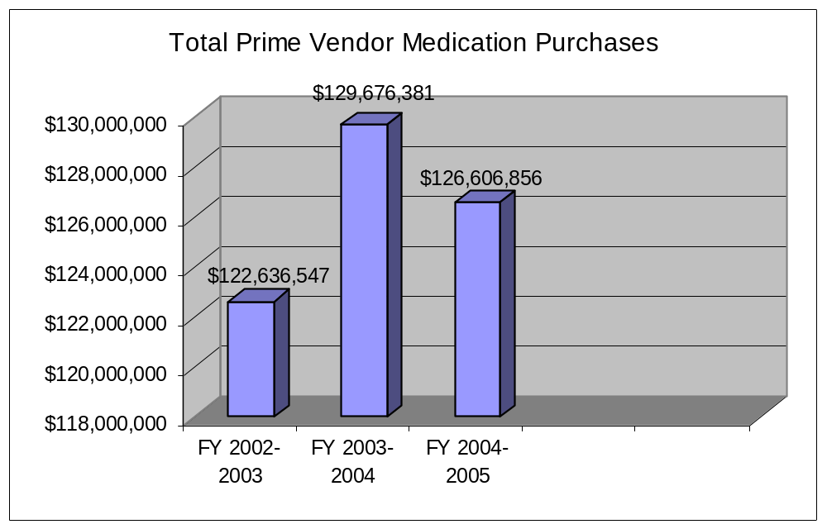
California Case Study: Pharmacy & Medication Management Program
2.1 decrease in total expenditures from FY 2003-2004 to FY 2004-2005.

Slide 27
Managed Care System
Evidence-Based Standards
Mission
Vision
Resources
Performance Management System
Service Delivery System
Acute
Inpatient
Sub-Acute
Inpatient
Health Assessment
& Classification
Pre-Release
Planning
High-Risk Outpatient
Levels of Care
Prevention
Medium-Risk Outpatient
Low-Risk Outpatient
Strategic Management
Values

Slide 28
Resources
Human Resources & Professional Practice
Health Information Systems
Equipment
Physical Space
Community Partnerships and Outsourcing

Slide 29
California Case Study:
Quality of Primary Care Workforce
Evaluation of competence in primary care
Rigorous credentialing
Change in primary care model to include mid-level providers and staffing standards
Enhanced compensation
Federal Loan Repayment Program
Staff development and peer review

Slide 30
California Case Study:
Cooperative and Collaborative Agreements
Preferred Providers
  Medical guarded units
University of California
  QICM Program
  Medical Consultation Network
  Telemedicine
  Tertiary care
  Disease management guidelines
Lumetra
  Long-term care needs assessment
  Long-Term Care Consolidated Care Center
Department of Mental Health
  Licensed inpatient care for mental health patients
Greeley Company
  Professional Practice Program standards
Department of General Services
  Group purchasing of pharmaceuticals
Department of Health Services
  Communicable disease control
  Licensing expertise
Notes:
CMS and community specialty providers, MaineCare

Slide 31
Managed Care System
Evidence-Based Standards
Mission
Vision
Resources
Performance Management System
Service Delivery System
Acute
Inpatient
Sub-Acute
Inpatient
Health Assessment
& Classification
Pre-Release
Planning
High-Risk Outpatient
Levels of Care
Prevention
Medium-Risk Outpatient
Low-Risk Outpatient
Strategic Management
Values

Slide 32
Evidence-Based Standards
Data-driven
Apply to Service Delivery System, Performance Management System, and Resources

Slide 33
California Case Study:
Standardization/Evidence-Based Standards
InterQual Criteria
Hepatitis C Virus Clinical Management Guidelines
Other Chronic Care Guidelines
Prescribing Guidelines – Atypical anti-psychotic, SSRI Statin, PPI, anti-seizure and hour of sleep medications,
Notes:
UCSD

Slide 34
Lessons Learned
Establish strategic plan and priorities based on organizing principles, a model/framework & data
Organizing principles emphasize quality & value
Managed care model with four major components
  SDS, PMS, Resources & Evidence-based standards
Components across all clinical programs
  Medical, MH, Dental, Specialty Care & Pharmacy
Establish quick win & longer term priorities based on data and mandates
Change management important
Leverage strategic partnerships
Notes:
Can’t manage want you don’t measure; pharmacy, protocols and criteria, can’t do it all

Slide 35
Questions and Comments

Slide 36
Comments and Notes

