Slide 1

e-Payroll Status
September 29, 2003

Slide 2

Overview
Project Status
Scope Decisions
Open Issues
Issues Summary
Next Steps
Backup

Slide 3
Project Status
MILESTONE | DATE
Steering Committee Established Signed DOI/NASA Letter of Intent Payroll and HR “As Is” Processes Defined Interface and Report Discovery Payroll and HR “To Be” Processes Defined Payroll and HR Preliminary Gap Assessment Technical Requirements Established - Core FPPS Data Crosswalk Completed Payroll and HR Final Gap Analysis Project Formulation Phase Ends | Dec 20,2002 March 07, 2003 May 13 – 16, 2003 May 30 – September 12, 2003 June 30, 2003 August 14, 2003 September 12, 2003 September 18, 2003 September 25, 2003 September 30, 2003
Implementation Begins Communication Plan Tester Training Parallel Testing Cut-over | October 1, 2003 November 15, 2003 March – April 2004 May 30, 2004 – July 11, 2004 August 8, 2004

Slide 4
Project Status (cont’d)
Communication Events Over the Past Three Weeks
  IPO presentation to Center CIOs on Technical Integration Principles (9/9)
  HR Long Term Strategy discussion (9/16)
  e-Payroll Steering Committee concurrence on Integration Principles (9/17)
  Process Owner Briefings (9/16 – 9/25)
    Code F (Policy Office)
      Presented recommendation for Agency-level policy changes to facilitate process standardization
      Established format for communicating policy changes to Centers
    Code F (Labor Relations)
      Communicated future process changes that will directly impact employees
      Established format for continuous status update to Centers’ local unions
    Code G (Legal Office)
      Communicated future process changes that impact Centers’ legal offices
      Established format for communicating process changes to Centers
    Financial and HR Steering Committee updates on project status

Slide 5
Project Status (cont’d)
White Papers
  Historical Data Conversation
    Supports requirement to convert all NPPS historical data to FPPS
    Revised and resubmitted for final project management review
  Award Systems Interface
    Awards interface automates transactional processing for monetary and time-off awards in NPPS
    Awards system performs tracking, budgetary management, and reporting functions not provided in NPPS
    Currently, five different systems deployed at five Centers with a common interface for processing data elements needed to automate award transactions in NPPS
    Integration scope accommodates current interface structure
    Gap between NPPS and FPPS for generating award transactions via an interface

Slide 6
Project Status (cont’d)
Payroll and HR Gap Analysis Completed
  Business Practice (10)
  Regulatory (12)
  Workarounds identified for gaps
  No commitment from DOI at this time as to gaps that will be resolved prior to parallel testing
    Prioritization of gaps will be accomplished after completion of NASA’s impact assessment package(detailed description, regulatory citing, etc.) (10/3/03)

Slide 7
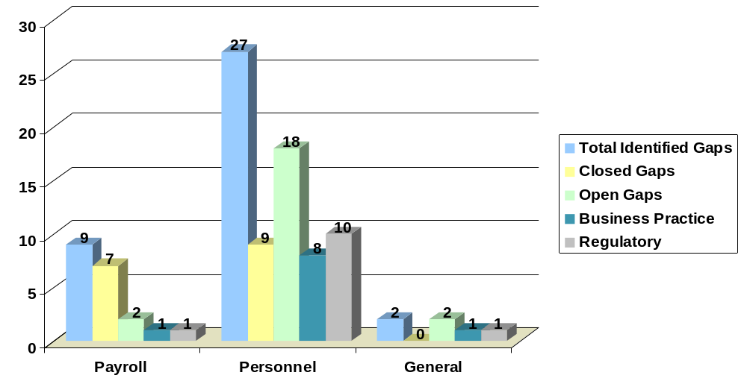
Project Status (cont’d)
Gap Analysis - Segmentation
Notes:
Reduces risk of inability to provide inter-agency collaboration where needed
environment challenge of finding resources that can support and upgrade the software products

Slide 8
Scope Decisions
Replace NPPS Functionality
  Payroll functions
  HR transactional processing
Utilize FPPS SF50/52 Automated Workflow Capability
  Provides capability to initiate an SF50 action from a manager’s desktop
  Makes the SF50/52 function a paperless process
Utilize FPPS Data Mart Reporting and Query Capabilities
Convert all NPPS Historical Data to FPPS Data Mart
Retire NPPS After FPPS Stabilization
  W-2 processing in year of cut-over
  Support financial statement audit for FY04
  Contingency Solution
Use Agreed Upon Principles for Technical Integration Approach
Notes:
Reduces risk of inability to provide inter-agency collaboration where needed
environment challenge of finding resources that can support and upgrade the software products

Slide 9
Open Issues
Labor Distribution Identified as an “Undecided Issue” in Formulation Plan; decision was to be made during formulation phase concerning the advisability of developing a standard system within the scope of e-Payroll, or developing interfaces with the existing unique Center systems
  Integration scope accommodates developing interfaces with existing labor legacy systems
  Standardization of a single Labor system determined to be “out of scope” for e-Payroll implementation
  Assessed FPPS functionality
    Supports labor cost processing
    Does not meet labor NASA’s distribution processing requirements
      Key functionalities needed for labor distribution processing (i.e., cost element assignment), not provided; must occur within Centers’ labor distribution systems
    Delivers labor cost associated with accounting codes within the pay calculation process
      Functionality has the potential eliminate the labor distribution reconciliation process
      Requires change to labor Centers’ legacy systems to utilize functionality
  Standardization of a single labor system may not be feasible during e-Payroll implementation due to time constraints
  Scope assessment to be documented as part of formulation close-out
Notes:
Reduces risk of inability to provide inter-agency collaboration where needed
environment challenge of finding resources that can support and upgrade the software products

Slide 10
Open Issues (cont’d)
Agency Awards System
  Selecting one of the five awards systems currently utilized at the Centers (KSC, MSFC, ARC, GRC, JSC) standardizing, and deploying Agency wide
  No impact to awards integration scope
    Interface rolls from common to agency model
    Reduce incoming data feeds
  Change management and training required for standardization
  Requires business case for standardization proposal
Integration and Reporting Scope
  Requires steering committee resolution for formulation closeout
Notes:
Reduces risk of inability to provide inter-agency collaboration where needed
environment challenge of finding resources that can support and upgrade the software products

Slide 11
Open Issues (cont’d)
Steering Committee Actions from August 28 Briefing (Follow-up)
  Assess Minimum Impact Solution for Regulatory Changes to NPPS
    Work Flexibility Act of 2003
      Preliminary analysis performed based on pending legislation
      Initial assessment determined modification can be made to NPPS to accommodate minimum requirements; results in low impact to e-Payroll schedule and resources
      Final impact assessment will be made when final requirements received (estimated 10/25/03)
    Change in Insurance Provider (NASA Employees Benefits Association)
      Initial assessment made with minimal changes to NPPS (table changes); determined low impact to schedule and resources
      Final assessment to be completed by 10/03/03
    Assessment as to whether or not DOI can commit to these changes will be made after NASA’s final requirements have been submitted (October)
Notes:
Reduces risk of inability to provide inter-agency collaboration where needed
environment challenge of finding resources that can support and upgrade the software products

Slide 12
Open Issues (cont’d)
  Assess impact of workarounds that may be imposed due to current DOI implementation schedule timeframe (see Backup)
    Total gaps reduced from 38 to 22
    Workarounds developed for all gaps
    Regulatory gaps receive priority and have a high probability of timely resolution (within schedule)
    Business practice gaps may suffer due to time frame allowed for resolution (May 2004)
    DOI commitment to gap resolutions to be completed after receiving NASA’s impact assessment package (10/3/03)
Notes:
Reduces risk of inability to provide inter-agency collaboration where needed
environment challenge of finding resources that can support and upgrade the software products

Slide 13
Open Issues (cont’d)
  Assess Impacts Due to Absence of DOI Technical Support Structure
    Requested FPPS development environment (FPPS sandbox) that provides sample FPPS data to facilitate interface and technical infrastructure assessment
    Project phase impacts due to absence of technical support structure needed to accomplish critical tasks have been identified (see Backup)
    DOI response due 10/6/03
  Assess Overall Implementation Schedule Impact Resulting From Above Issues and Advise e-Payroll Steering Committee of Findings
  Issue Schedule Impact
  Regulatory Changes to NPPS Low
  Gap Resolutions Medium
  Absence of DOI Tech Support Structure Unknown

Slide 14
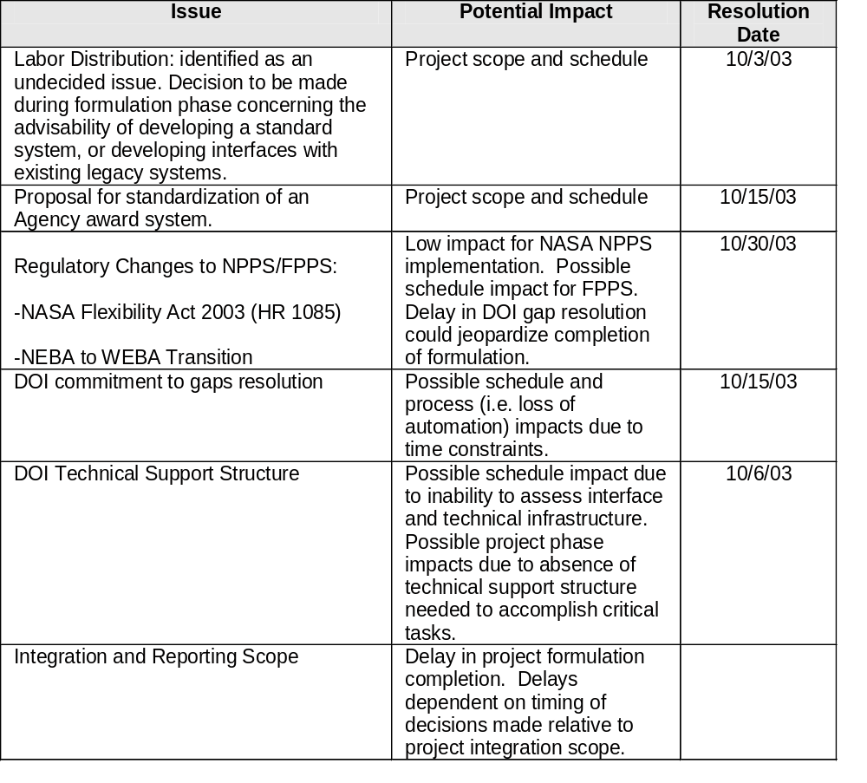
Issues Summary

Slide 15
Next Steps
Close Open Issues
Close Remaining Formulation Tasks
Assess Implementation Schedule Impact After Receiving DOI Response to Providing FPPS Development Environment

Slide 16
Backup

Slide 17
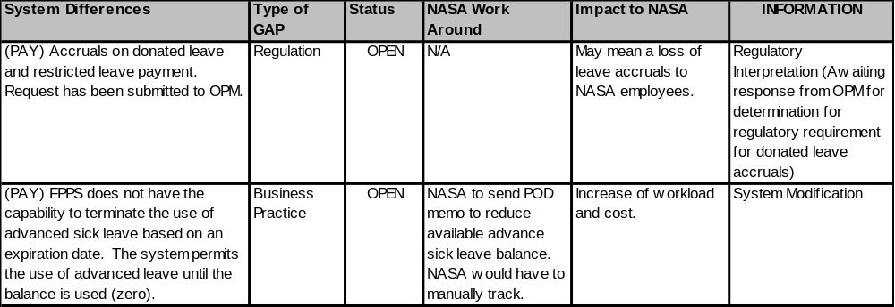
Gaps
Payroll (2)

Slide 18
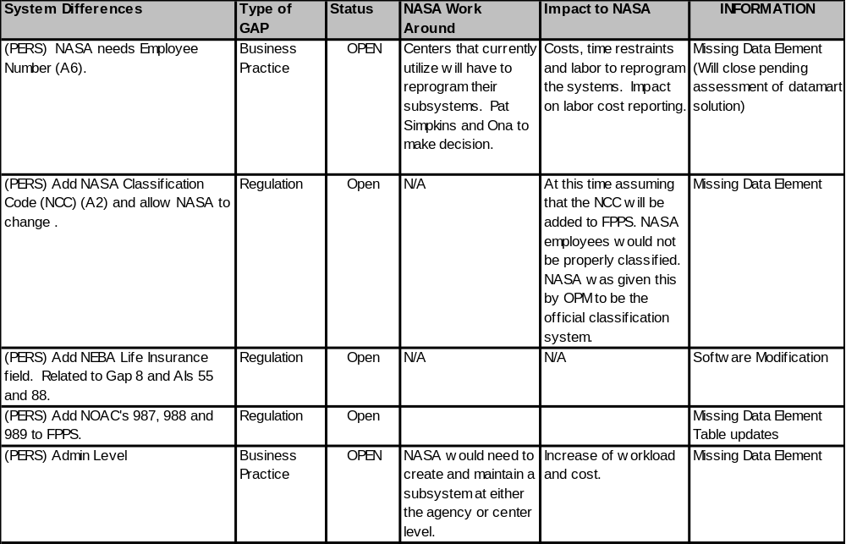
Gaps
Personnel (18)

Slide 19
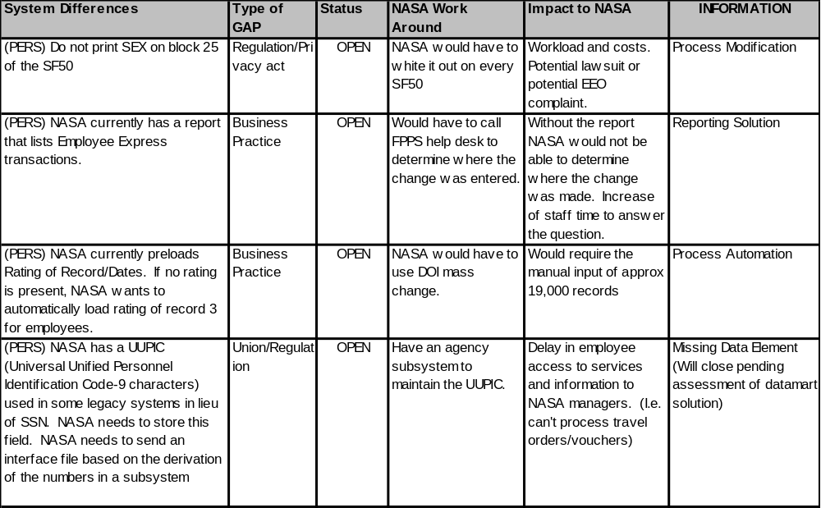
Gaps
Personnel (18)

Slide 20
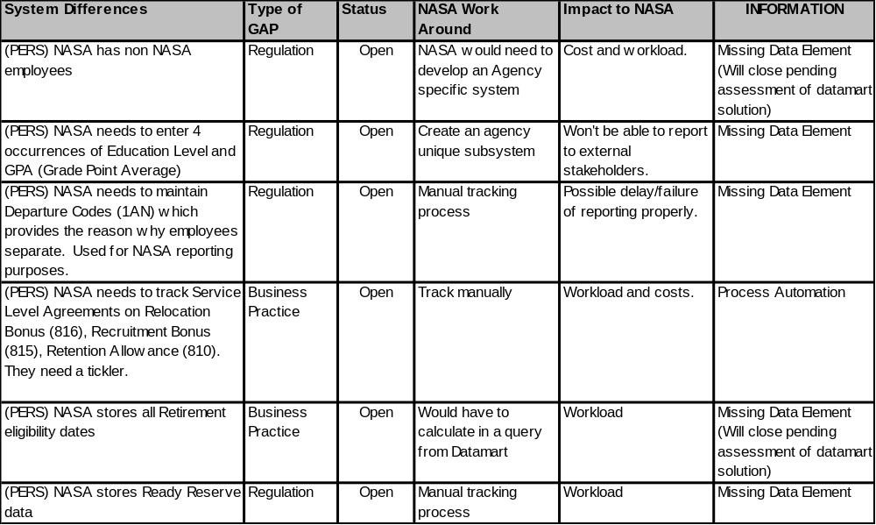
Gaps
Personnel (18)

Slide 21
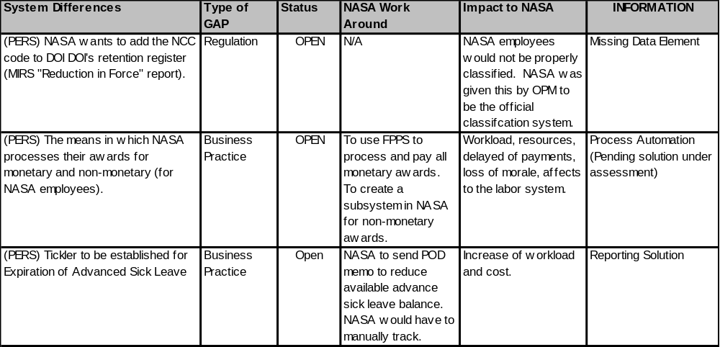
Gaps
Personnel (18)

Slide 22
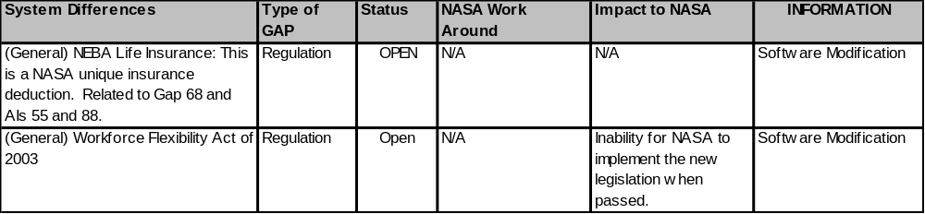
Gaps
General (2)

Slide 23
FPPS Sandbox Justification
FPPS sandbox refers to a sandbox / development environment that provides sample FPPS data and facilitates datamart access.

Slide 24
FPPS Sandbox Justification
Technical Infrastructure Integration Assessment
  The IFMP Integration Project requires access to DOI/NBC FPPS and its related components in order to assess requirements for integration with NASA Agency and Center technical infrastructures. It is key that a development environment of this nature is provided as soon as possible in order to meet proposed NASA FPPS schedules.
  The development environment will be used to understand 1) desktop, 2) printing, 3) network, and 4) security integration elements. Specifically:
    The Integration Project needs to be able to download and install all required desktop components for FPPS and its related components.
    The Integration Project requires a username and password to an FPPS environment that is representative of proposed NASA FPPS implementation.
    The Integration Project needs to be able to generate mainframe print jobs from this environment. We will need support from DOI/NBC mainframe/print services personnel in order to test routing this print through the consolidate NASA mainframe environment.
    The Integration Project will need support from DOI/NBC functional personnel to help emulate typical user interaction with the FPPS system.

Slide 25
FPPS Sandbox Justification
Project Phase Impacts
Without the availability of an FPPS sandbox, the following phase impacts have been identified:
  Formulation Phase Impact
    Unable to accurately depict the future state architecture model
    Unable to realistically estimate implementation option cost estimates for steering committee
    At risk of exceeding initiative timeline due to inaccurate source data assumptions
    At risk of exceeding budget due to complexity of integrations based upon source data assumptions

Slide 26
FPPS Sandbox Justification
  Requirements / Design Phase Impact
    Unable to identify qualifying Common Integration Model candidates based upon source data
    Options for the transmittal of reports cannot be fully evaluated
    Estimates for the creation of unavailable reports cannot be determined
    Unable to evaluate Agency and Center reports against available FPPS and Datamart reports
    Unable to evaluate Agency and Center reports against new reports modified or created in Brio
    Deliverable document rework associated with the assumption a single FPPS data source for unique integrations
    Deliverable document rework associated with the assumption a single FPPS data source for consolidated integrations

Slide 27
FPPS Sandbox Justification
  Development Phase Impact
    Code delivery rework associated with the assumption a single FPPS data source for unique integrations
    Code delivery rework associated with the assumption a single FPPS data source for consolidated integrations
    At risk of exceeding integration development estimates due to inaccurate requirement / design assumptions
    At risk of under or over staffing development resources due to inaccurate requirement / design assumptions
Testing Phase Impact
    Full testing of FPPS data conversion for legacy systems may be inadequately tested due to schedule compression
    Unable to validate all Agency and Center reports against available FPPS and Datamart reports due to schedule compression
    Unable to validate Agency and Center reports against new reports modified or created in Brio due to schedule compression

