Slide 1
PK-PD relationships for antiretroviral drugs
Richard M.W. Hoetelmans, PharmD, PhD
Slotervaart Hospital
Dept. of Pharmacy & Pharmacology
Amsterdam, The Netherlands

Slide 2
PK-PD relationships
An attempt to correlate pharmacokinetic parameters of a drug and its efficacy/toxicity.
Antiretroviral drugs: focus on the PIs and the NNRTIs.

Slide 3
PK-PD relationships
nucleoside analogues reverse transcriptase inhibitors
no clear relationships between plasma concentrations and the virological response (might be different for intracellular TP concentrations, but large datasets are lacking).
protease inhibitors
relationships between the pharmacological exposure and virological response/toxicity have been established (this presentation).
non-nucleoside reverse transcriptase inhibitors
some indications of relationships between the pharmacological exposure and virological response exist (this presentation).

Slide 4
Indinavir
Indinavir
Most studies on PK-PD relationships for antiretroviral drugs have been performed with indinavir in an 800 mg tid dosing regimen with 2 NRTIs.

Slide 5
Indinavir
Indinavir and virologic efficacy
pretreatment PK parameters PD parameters
Stein et al. NRTIs AUC, Cmin Δ HIV-1 RNA wk 24
Burger et al. mixed conc. ratio Δ HIV-1 RNA wk 24
Harris et al. NRTIs Cmin 1-NAUC (RNA) wk 24
Fletcher et al. NRTIs Cmin Δ HIV-1 RNA wk 24
Murphy et al. NRTIs/naïve AUC, Cmin, Cmax Δ HIV-1 RNA day 36
Acosta et al. naïve AUC, Cmin HIV-1 RNA < LOQ

Slide 6
Indinavir
Indinavir and virologic efficacy
Some (but not all) studies show, in retrospective, relationships between indinavir pharmacokinetics and HIV-1 RNA response.
These relationships have mainly been established in NRTI-pretreated patients.
Reported pharmacokinetic parameters are AUC, C_{min}, and C_{max} (all correlated).
No clear data on such relationships when indinavir is used in combination with (low dose) ritonavir.

Slide 7
Indinavir
Indinavir and (renal) toxicity
pretreatment PK parameters PD parameters
Dieleman et al. NRTIs conc. ratio urological complaints

Slide 8
Indinavir
Indinavir and renal toxicity
Anecdotal data show that high exposure to indinavir is associated with an increased risk for urological complaints (flank pain, haematuria, renal colic).
It has been hypothesized that C_{max} of indinavir is correlated with renal toxicity.
Recent (preliminary) data of the BEST trial suggest that renal toxicity is more often encountered when used in a RTV/IDV 100/800 mg bid regimen as compared to IDV 800 mg tid alone, suggesting that AUC or time > certain concentration rather than C_{max} might be the main determinant of renal toxicity¹.
¹Gatell, XIII IAC, Durban, 2000, abstract WeOrB484

Slide 9
Saquinavir
Saquinavir
Studies on PK-PD relationships for saquinavir have been performed during monotherapy or when combined with 2 NRTIs

Slide 10
Saquinavir
Saquinavir and virologic efficacy
pretreatment PK parameters PD parameters
Gieschke et al. naïve (monother) AUC Δ HIV-1 RNA wk 8
Hoetelmans et al. mixed conc. ratio Δ HIV-1 RNA wk 48
Hoetelmans et al. naïve (quadruple) conc. ratio initial HIV-1 RNA decline (wk 2)*
Heeswijk et al. naïve (triple) none Δ HIV-1 RNA wk 48
* Only in a univariate model

Slide 11
Saquinavir
Saquinavir and virologic efficacy
Some (but not all) studies show, in retrospective, relationships between saquinavir pharmacokinetics and HIV-1 RNA response.
These relationships have been established in naïve and NRTI-pretreated patients.
Reported pharmacokinetic parameters are AUC and C_{min} (all correlated).
No clear data on such relationships when saquinavir is used in combination with (low dose) ritonavir.

Slide 12
Saquinavir
Saquinavir and toxicity
pretreatment PK parameters PD parameters
Reijers et al. naive conc. ratio gastrointestinal complaints

Slide 13
Saquinavir
Saquinavir and toxicity
Higher saquinavir exposure has been linked with increased risk for gastrointestinal complaints.
It is unclear which PK parameters is best associated with the occurrence of these side effects.

Slide 14
Nelfinavir
Nelfinavir
Few studies have investigated PK-PD relationships for nelfinavir. The active metabolite (M8) has often not been taken into account.

Slide 15
Nelfinavir
Nelfinavir and virologic efficacy
pretreatment PK parameters PD parameters
Kerr et al. naïve (triple) 2h conc. HIV-1 RNA wk 24
Hoetelmans et al. naïve (quadruple) conc. ratio initial HIV-1 RNA decline (wk 2)

Slide 16
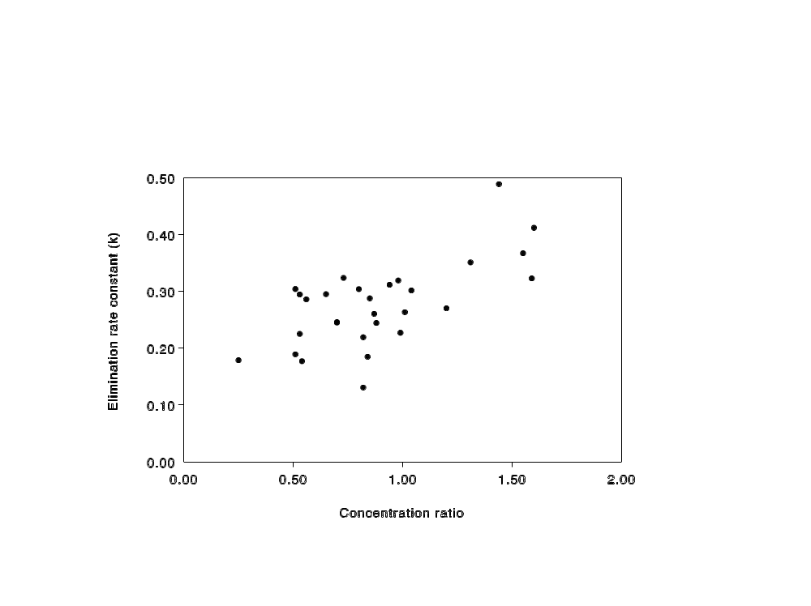
Nelfinavir and initial decline HIV-1 RNA

Slide 17
Nelfinavir
Nelfinavir and virologic efficacy
Some studies show, in retrospective, relationships between nelfinavir pharmacokinetics and (initial) HIV-1 RNA response.
These relationships have been established in naïve patients.

Slide 18
Nelfinavir
Nelfinavir and toxicity
pretreatment PK parameters PD parameters
Reijers et al. naive conc. ratio gastrointestinal complaints

Slide 19
Nelfinavir
Nelfinavir and toxicity
High nelfinavir exposure has been associated with increased risk for gastrointestinal complaints.
It is unclear which PK parameters is best associated with the occurrence of these side effects.

Slide 20
Ritonavir
Ritonavir and toxicity
pretreatment PK parameters PD parameters
Gatti et al. naive Cmax, Cmin gastrointestinal and neurological complaints

Slide 21
Ritonavir
Ritonavir and toxicity
High ritonavir exposure has been associated with increased risk for gastrointestinal and neurological complaints.
These associations have been reported for AUC, C_{max} and C_{min} (all correlated).

Slide 22
Nevirapine
Nevirapine and virologic efficacy
pretreatment PK parameters PD parameters
Veldkamp et al. naïve median conc. Δ HIV-1 RNA wk 52,
initial decline HIV RNA
duration of response

Slide 23
Nevirapine
Nevirapine and virologic efficacy
Limited data on retrospective relationships between nevirapine pharmacokinetics and HIV-1 RNA response (short and long term, durability).
These relationships have been established in naïve patients.
Reported pharmacokinetic parameter is the median concentration.

Slide 24
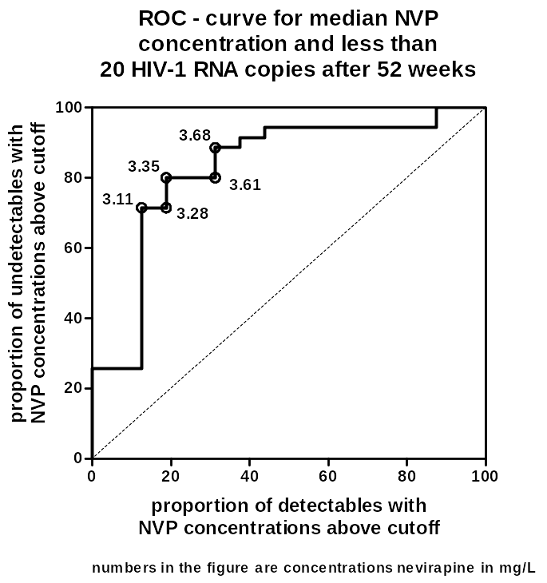
NVP PK-PD relationship

Slide 25
Efavirenz
Efavirenz and virologic efficacy
pretreatment PK parameters PD parameters
Joshi et al. mixed C_{min} treatment failure
¹Joshi, 39 ICAAC, San Francisco, 1999, abstract 1201

Slide 26
Treatment outcome by subset of efavirenz concentration windows in studies 266-003/004/005/021/024
Number of Patients (%)
C₂₄ <3.5 µM C₂₄ ≥3.5 µM Total
Failure 17 (63%) 20 (21%) 37 (30%)
Non-Failure 10 (37%) 77 (79%) 87 (70%)
Total 27 97 124
These data show that treatment failure was three times as frequent
(63% versus 21%) when EFV C₂₄ <3.5 µM
Joshi, 39 ICAAC, San Francisco, 1999, abstract 1201

Slide 27
Efavirenz
Efavirenz and virologic efficacy
Limited data on retrospective relationships between efavirenz pharmacokinetics and treatment failure are available.
Reported pharmacokinetic parameter is the C_{min}.

Slide 28
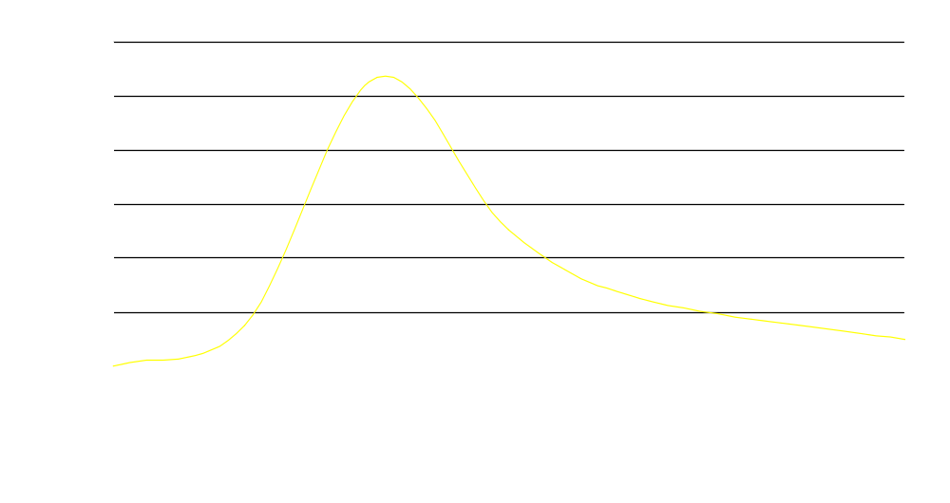
Variability of exposure
Example of variability of exposure
(AUC) after administration of the
same dose in a patient population.

Slide 29
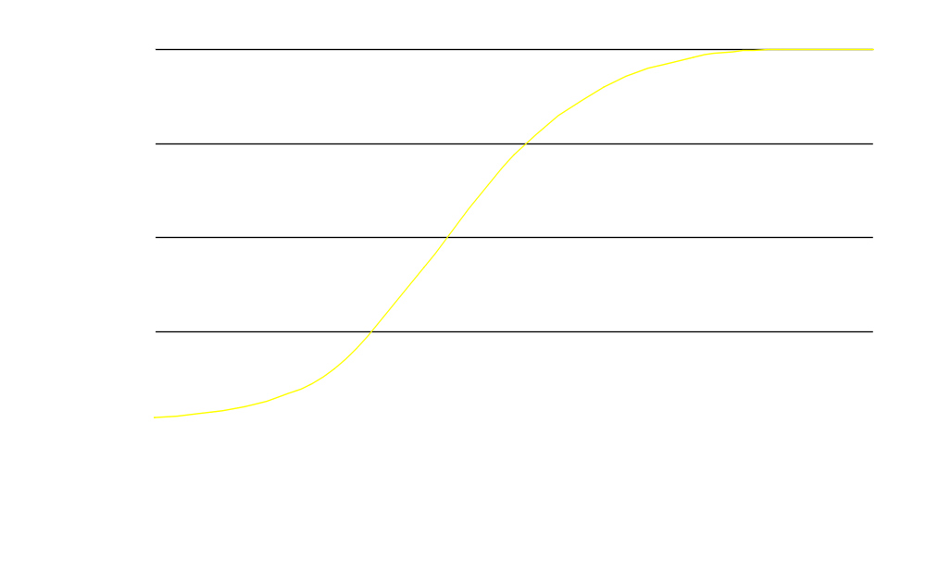
Relevance of exposure
Wild type

Slide 30
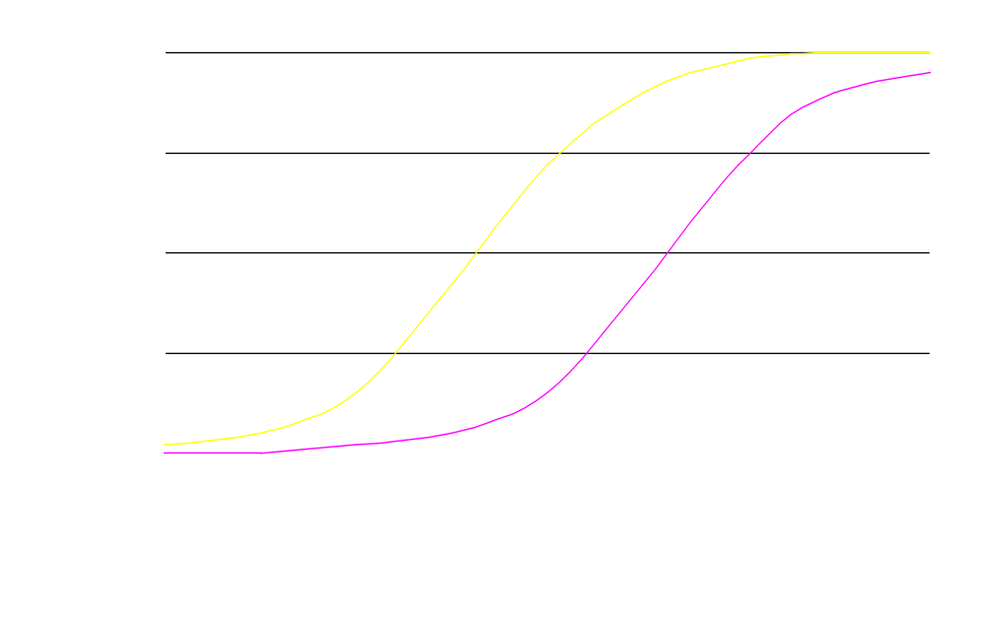
Relevance of exposure
Wild type
Decreased
sensitivity

Slide 31
Relevance of exposure
Wild type

Slide 32
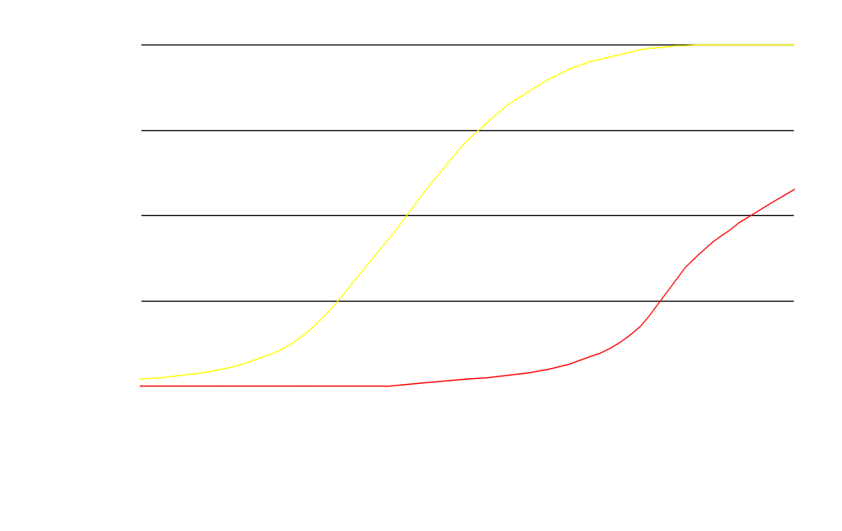
Relevance of exposure
Wild type
Resistant

Slide 33
C_{min}/IC₅₀ ratios
If used, the threshold values for C_{min}/IC₅₀ ratios should be established for each drug.
Correcting for protein binding is a step in the right direction, but is also insufficient.
Other factors such as penetration of compartments, intracellular accumulation, active metabolites, synergy/antagonism etc. should be taken into account.

Slide 34
C_{min}/IC₅₀ ratios
For the NNRTIs, the ratios that are required may well be > 500
For PIs, the required ratios may actually be smaller than 1 (intracellular accumulation)
C_{min}/IC₅₀ ratios can most likely not be used to compare the potency/durability of drugs

Slide 35
From in vitro to in vivo?
Accumulation
Synergy
Protein binding
Active metabolites
P-glycoprotein
Viral diversity
Sanctuaries
What else?

Slide 36
IC₅₀ versus EC₅₀
The IC₅₀ represents the concentration of a drug that is required for 50% inhibition of viral replication in vitro (can be corrected for protein binding etc).
The EC₅₀ represents the plasma concentration/AUC required for obtaining 50% of the maximum effect in vivo.

Slide 37
Conclusions (1)
For the protease inhibitors PK-PD relationships have been established (but not always).
It is unclear which PK parameter should be used for each PI.
Until now, PK-PD relationships have mainly been found for single PI-therapy (+/- 2 NRTIs).

Slide 38
Conclusions (2)
For the NNRTIs indications of PK-PD relationships have been reported.
It is unclear which PK parameter should be used.
These relationships might rather be explained by the presence of resistant mutants than the ratio between exposure/IC₅₀ for wild-type virus.

Slide 39
Remarks (1)
Models of PK-PD have largely not (yet) included sensitivity of the virus as a parameter.
When linking phenotypic data with pharmacokinetics: IC₅₀ values should (if at all) rather be used than IC₉₀ or IC₉₅ values.
EC values should rather be established than IC values.
It would be interesting to know if the boosted PI-strategy overcomes the PK-PD relationships found with the unboosted strategy.

Slide 40
Remarks (2)
Based on PK-PD relationships, pharmacokinetic data can and should be used as a background for new formulations/dosing regimens, but clinical data are still essential given the modest information available at this moment.

Slide 41
Acknowledgements
Slotervaart Hospital, Amsterdam
  Agnes Veldkamp
  Monique de Maat
  Rolf van Heeswijk
  Joke Schol
  Monique Profijt
  Rikkert van der Put
  Ingrid Bedeker
  Hanneke Paap
  Lilian van Belle
Slotervaart Hospital, Amsterdam
  Eric van Gorp
  Jan-Willem Mulder
  Pieter Meenhorst
  Jos Beijnen
NATEC, University of Amsterdam
  Gerrit-Jan Weverling
  Joep Lange

