Slide 1
INDUSTRIAL ENVIRONMENTAL PERFORMANCE
METRICS
Presented at the NIST Workshop on
Atmospheric Measures and Standards
Gaithersburg, Maryland
John Carberry
DuPont
6 September, 2001
Notes:
1

Slide 2

ENVIRONMENTAL METRICS
Have a management process, within the “territory”, for selecting issues and using the results
Involve a broad range of stakeholders
Pick issues, and develop metrics with care
Use for continuous improvement and strategic decisions

Slide 3
WELCOME TO
Pine View, Colorado
J.B.Carberry/DuPont
Notes:
What are the issues

Slide 4
WELCOME TO
Pine View, Colorado
Established
Population
Pets&Lvstk
Elevation
Weather
SmTwn QLI
J.B.Carberry/DuPont
Notes:
What are the issues

Slide 5

POTENTIAL ENVIRONMENTAL ISSUES AND METRICS
National Academy of Engineering
http://www.nap.edu/
“Industrial Environmental Performance Metrics”
  search on that one and “Related Titles”
US EPA
http://www.epa.gov/docs/futures/risk/history/unfinished/
AIChE/CWRT
http://www.aiche.org/cwrt/projects/sustain.htm
Notes:
3

Slide 6
WELCOME TO
Pine View, Colorado
Established 1872
Population 732
Pets&Lvstk 3478
Elevation 4755
Weather CBBTB
SmTwn QLI >75%
J.B.Carberry/DuPont
Notes:
How would you measure those issues. Important to recognize that some will be highly quantitative and others will be highly qualitative. For display purposes even the highly qualitative can be converted into a pseudo quantitative scale.

Slide 7
ENVIRONMENTAL INDICATORS
Few, easily understood and accepted
Preferably, built from existing data systems
Good for the environment, society and business
Drive continuous improvement, now
Compatible with the evolving definition of “sustainable”
Notes:
2

Slide 8
WELCOME TO
Pine View, Colorado
Established 1872.135
Population 731.752
Elevation 4755.004
*Audited by JGE (Formerly Jobs for Green Eye-shades)
J.B.Carberry/DuPont
Notes:
Decide on the level of accuracy needed. Be careful of the temptation to push that too far resulting in unacceptable expense and loss of sponsorship.

Slide 9
MEASURING
Within an issue
Such as acid rain or global warming
Accuracy sufficient to be credible
Cost effective accuracy a/o verification (strategic, engineering, accounting, etc.)
Identify and combine where appropriate
Express in equivalents (e.g. mass of CO2)
ICI has a superb example
Notes:
9

Slide 10
WELCOME TO
Pine View, Colorado
Established 1872
Population 732
Elevation 5755
TOTAL 8359**
**Verified by 3iDataCen (Formerly, the Center for irrelevant, immaterial and inconvenient Data)
J.B.Carberry/DuPont
Notes:
Decide to what extent you wish to combine metrics driving toward a single score or not.

Slide 11
MEASURING
Adding up across the issues
  Dow has a leading example
  No broadly accepted basis for issue selection, scoring of the issues, or relative weight of the issues
  Is a single score worth the effort?
  Identify the major contributors and continuously improve them
Notes:
9

Slide 12
WELCOME TO
Pine View, Colorado
Established 1872
Population 732
Elevation 4755
J.B.Carberry/DuPont
Notes:
Reduce those to the issues important to the business you are working with

Slide 13
AIChE/CWRT METRICS
Regional or local environmental burden issues critical but covered by existing regulations
Broader societal issues mostly not yet defined or in a form useable within manufacturing
----Elect to focus on----
Resource Demand
Energy, Material, Water and Land
Critical World-wide Environmental Burden
  Persistent Bioaccumulative Toxins (PBTs),
  Priority Heavy Metals
  Green House Gases (GHG)
  Ozone Depleting Substances (ODS)
Notes:
8

Slide 14
ENERGY AND MATERIALS BURDEN MATRIX
(Per Pound)
15.00
12.00
9.00
Energy Intensity (KBtu/Lb.)
6.00
3.00
0.00
0.80
1.00
1.20
1.40
1.60
1.80
Material Intensity (Lbs. In/Lbs. Sold)

Slide 15
MASS EFFECTIVENESS AND MASS BALANCE CLOSURE
Products Arranged in Order of Increasing Price left to right
Sold/Purch
110%
MassBal
RefLine
100%
90%
80%
Mass Sold per Mass Used (%) and Mass Balance closure (%)
70%
60%
50%
40%

Slide 16
TOXIC DISPERSION
Mass, Persistence, Bioaccumulation, & Exposure
Comparable with external systems
Used for continuous improvement and R&D planning
Broadly accepted toxicity scale lacking but there is considerable emerging work

Slide 17
P&B Assessments
High
Potential for Persistence
Moderate
Low
Low
Clear
Moderate
Mkt. Oppose?
High
Reg. Barriers
Potential for Bioaccumulation
Notes:
2

Slide 18
EPA TRI
80
5
27
Chlordane, Aldrin
Hexachlorobenzene
Pentachoroethane
High
Hexachloroethane
216
8
18
Potential for Persistence
Moderate
Mustard Gas
Phenothrin
203
1
Low
3
Low
Moderate
High
Potential for Bioaccumulation
Notes:
3

Slide 19
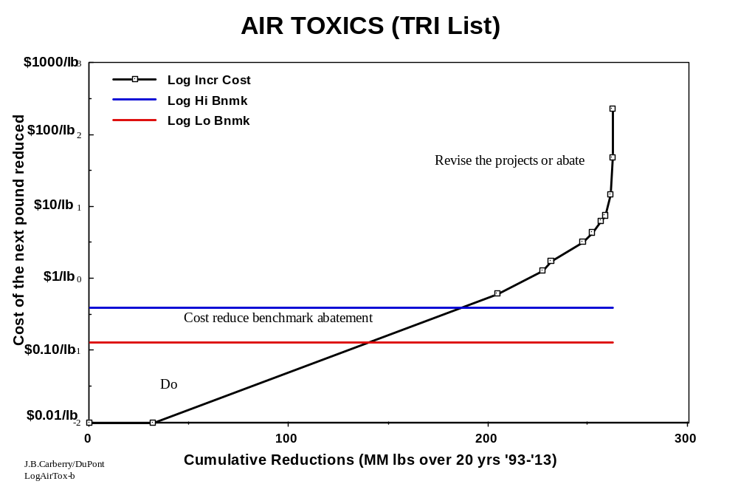

Slide 20
MIKE’s 17 QUESTIONS
Effective process for selection of issues and use of results, involving multiple stakeholders
Acceptance of the concern and the need for action
An assessment of the present situation, the trend, and all sources for a targeted pollutant
Valid, science based, peer reviewed, broadly accepted models
Quality data and sufficient experimental capability
Apply to NOx, ozone, PM fine, mercury, smog and a material not yet identified

Slide 21
MIKE’s 17 QUESTIONS
MY THREE FAVORITES
Is there a role for strategic partnerships between industry and government in atmospheric science?
Is there a need for industrial atmospheric performance metrics?
Are there environmental fates requirements for key chemicals, and if so, what are the leading candidates?

Slide 22
CHALLENGES AND
OPPORTUNITIES
Where does air quality fit within our Nation’s needs?
Are we looking at the right air quality issues?
Where are the grandchildren of the Ames test including persistence and bioaccumulation as well as multiple end-point toxicity?
What constitutes zero?

Slide 23
Thank you for your time !!!

