Slide 1
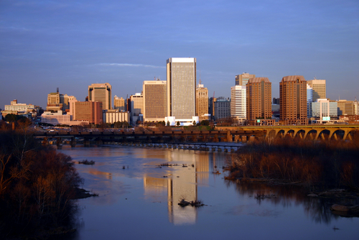
Turning Around Chronically Low-Performing Schools
Nelson Colbert, Science Instructional Specialist
Richmond Public Schools
Richmond, VA

Slide 2
Strong Leadership

Slide 3
Strong Leadership
Surveyed the needs of the schools to increase high expectations.
Developed a statement of positive change-“Moving from Good to Great”.
Invited the community, parents, businesses, colleges and universities to provide input in the instructional program.

Slide 4
Strong Leadership
Changed leadership in the administration in central office, schools, and classrooms.
Established a leadership academy/institute to train administrators.
Implemented “Charting the Course”, a process for visiting all schools in the system for monitoring instructional data.
Established leadership teams, consisting of department heads and lead teachers.

Slide 5
Strong Leadership Goals
Increased student achievement.
Provided strong leadership for effective and efficient operations.
Enhanced capacity building professional development.
Increased parent and community satisfaction.
Strengthened collaboration with stakeholders.
Provided safe and nurturing schools.

Slide 6
Improving Instruction

Slide 7
“Quick Wins” for Improving Instruction
Reviewed data for improved instruction.
Created an “Observations Checklist” for immediate feedback.
Created a “Look For” booklet for principals.
Established “Rapid Response” teams based on immediate needs.
Improved security plans for all schools.
Provided elementary teachers with a half-day for weekly planning.
Introduced a 90-minute instructional block in secondary schools.

Slide 8
Improving Instruction
Collected data to set instructional goals:
  Teacher and student attendance
  Content
  Professional development
  Benchmark and SOL assessments
Introduced A” Balanced Scorecard” that focused on goals and evaluations.
Revised and aligned the curriculum.
Introduced a system-wide Instructional Model along with Study and Test Taking Skills.

Slide 9
Building a Committed Staff
Staffed middle schools with core content teachers.
Established programs to train and recruit new teachers.
Met with teachers during planning time to assist with instructional planning.
Provided free content classes to elementary teachers.
Provided an incentive plan for new teachers.
Formed SPMT (School Planning-Management Teams) to give staff input .

Slide 10
The End

